Slide 1
MODELING ATMOSPHERIC PRESSURE PLASMA MULTI-JET DYNAMICS*
Amanda M. Lietzª Xavier Damany^{b}, Eric Robert^{b}, Jean-Michel Pouvesle^{b}, and Mark J. Kushner^{c}
^{a)}Dept. Nuclear Engineering and Radiological Sciences
University of Michigan, Ann Arbor, MI 48109, USA
^{b)} GREMI, UMR7344 CNRS Université d’Orléans, Orléans, France
^{C)}Dept. Electrical Engineering and Computer Science
University of Michigan, Ann Arbor, MI 48109, USA
lietz@umich.edu
MIPSE Symposium
14 November 2018
* Work was supported by the DOE Office of Fusion Energy Science and the National Science Foundation.

Slide 2
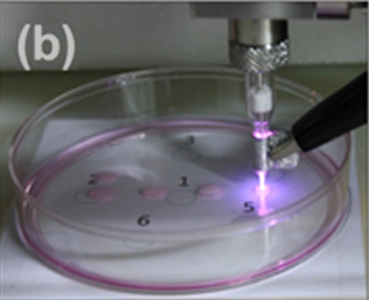
APPLICATIONS OF PLASMA JETS
Atmospheric pressure plasma jets (APPJs) in plasma medicine have been studied for:
Sanitizing wounds without tissue damage
Reducing size of cancerous tumors
Eradicating bacteria in biofilms
Rare gas with small amounts of O₂ to increase reactive oxygen and nitrogen species (RONS) production.
A single jet has a small treatment area.
• Joh, H. et al. Applied Phys. Letters, 5, 101 (2012)
• O’Connor, N. J. Applied Phys., 110, 013308 (2011)
University of Michigan
Institute for Plasma Science & Engr.
MIPSE_2018
Notes:
Application for atm discharges

Slide 3
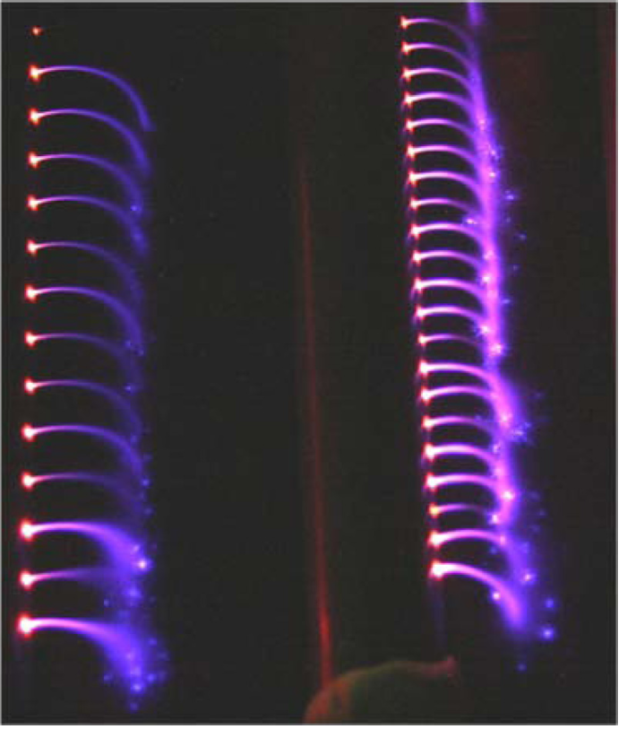
MULTI-JET
Arrays of jets are often desirable to treat larger areas.
Interactions between the jets makes array behavior more difficult to predict.
E. Robert et al. have developed a novel solution to this issue – a single tube having many holes.
Plasma jets are produced through each hole.
Objective: Computationally investigate the branching of an ionization wave (IW) in a plasma comb including effects of the system geometry.
Robert, E. et al. Physics of Plasmas, 22, 12207 (2015).
University of Michigan
Institute for Plasma Science & Engr.
MIPSE_2018
Notes:
Application for atm discharges

Slide 4
MODEL:
nonPDPSIM
Plasma Hydrodynamics
Poisson’s Equation
Gas Phase Plasma
Unstructured mesh.
Fully implicit plasma transport and gas dynamic transport.
Electron temperature equation for bulk electrons with Boltzmann derived transport coefficients.
Radiation transport and photoionization.
Time slicing algorithms between plasma and fluid timescales.
Bulk Electron Energy
Transport
Kinetic “Beam”
Electron Transport
Neutral Transport
Navier-Stokes
Neutral and Plasma
Chemistry
Radiation Transport
Surface Chemistry
and Charging
Ion Monte Carlo
Simulation
Circuit Model
University of Michigan
Institute for Plasma Science & Engr.
MIPSE_2018
Notes:
4
4

Slide 5
GEOMETRY
+28 kV pulse
5 ns rise time
800 µm holes
5 mm between holes
Quartz tube, inner diameter: 4 mm, outer diameter: 6 mm
Steady-state flow established before plasma initiated.
Upper ground plane is much further than lower ground plane.
He/H₂O = 99.9/0.1 + O₂/N₂ (2.4/4.7 ppm), 1 atm, 1 slm into humid air
Reaction mechanism: He/N₂/O₂/H₂O, 36 species, 447 reactions
MIN MAX
University of Michigan
Institute for Plasma Science & Engr.
MIPSE_2018
Linear scale

Slide 6
GAS FLOW and PHOTOIONIZATION
Air
3-D entrainment approximated by air nozzles.
3 slm air based on calibration with Schlieren imaging.
Positive polarity ionization waves can be sensitive to photoionization parameters
He₂* → He + He + hν
H₂O + hν → H₂O⁺ + e
N₂ + hν → N₂⁺ + e
O₂ + hν → O₂⁺ + e
0.1% H₂O in He helps propagation – reasonable without deliberate purification.
Air photoionization is needed for propagation outside of the tube.
N₂** → N₂ + hν
O₂ + hν → O₂⁺ + e
He
He
Schlieren
University of Michigan
Institute for Plasma Science & Engr.
MIPSE_2018
Notes:
From multijet ICCD 20161209, without plasma

Slide 7
BASE CASE: IONIZATION WAVE (IW)
+28 kV, 5 ns rise
800 µm holes, 5 mm apart
S_{e} – electron impact ionization source term.
n_{e} – electron density
Primary ionization wave (PIW) propagates within tube.
Secondary ionization waves (SIW) emerge from each hole.
SIWs interact electrostatically.
The interaction is overestimated in the model because of the 2-D assumption.
University of Michigan
Institute for Plasma Science & Engr.
MIPSE_2018
MIN MAX
Notes:
Frames 8-94

Slide 8
SINGLE HOLE: IW PROPAGATION
+28 kV, 0.2 slm He
PIW is slightly attenuated after propagation of SIW.
When SIW reaches the grounded target, the E-field within the tube increases.
When SIW reaches target, it spreads along the surface.
University of Michigan
Institute for Plasma Science & Engr.
MIPSE_2018
MIN MAX
Notes:
Frames 9-99

Slide 9
SINGLE HOLE: E-FIELD
Model
Experiment
+28 kV in model, +16 kV in experiment.^{[1]}
E_{x} peaks as IW passes each point.
E_{x} returns to ~0 kV/cm when the SIW reaches surface and restrike within the tube occurs.
E_{x} is larger in model due to 2-D sheet representation of charge.
University of Michigan
Institute for Plasma Science & Engr.
MIPSE_2018
[1] Z. Xiong, et al., J. Phys. D. Appl. Phys. 45, 275201 (2012).

Slide 10
SPACING BETWEEN HOLES
+28 kV
800 µm holes
Increasing the gap between holes allows SIWs to propagate out all of the holes.
Interaction is overestimate in the model due to the 2-dimensional assumption of Poisson’s equation.
10 mm gap – PIW slows each time an SIW reaches the target.
MIN MAX
Log scale
University of Michigan
Institute for Plasma Science & Engr.
MIPSE_2018
Notes:
Frame 20-102

Slide 11
SPACING BETWEEN HOLES
+28 kV
800 µm holes.
Maximum electron density at each node.
Increasing the gap between holes allows SIWs to propagate out all of the holes.
Interaction is overestimate in the model due to the 2-dimensional assumption of Poisson’s equation.
10 mm gap – PIW slows each time an SIW reaches the target.
MIN MAX
Log scale
University of Michigan
Institute for Plasma Science & Engr.
MIPSE_2018

Slide 12
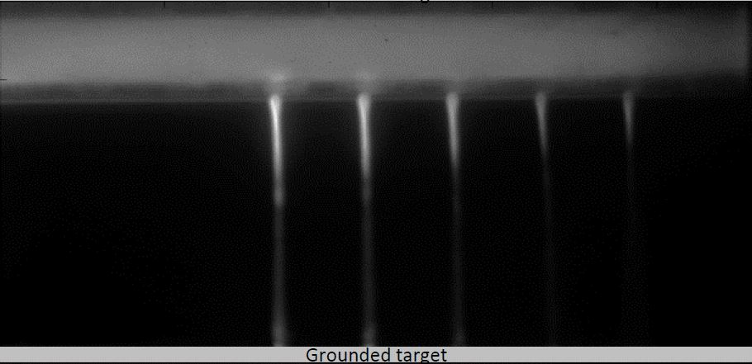
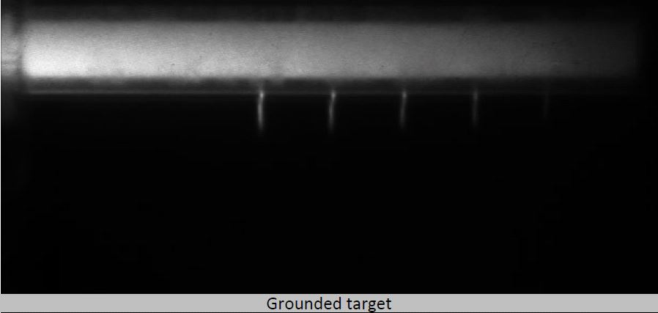
VOLTAGE POLARITY
Experimental ICCD
+16 kV
-16 kV
SIWs reach target for positive polarity.
Negative polarity, short SIWs develop on the right side of each hole.
Experimental images are time integrated over 100 pulses at 1 kHz.
MIN MAX
University of Michigan
Institute for Plasma Science & Engr.
MIPSE_2018
Log scale
Notes:
Frame 21-91

Slide 13
HE FLOW RATE
+28 kV
800 µm holes, 5 mm apart
3 slm air in all cases
Maximum n_{e} at each node.
SIWs do not reach target for 0.5 slm.
n_{e} in SIWs increases with flow rate.
MIN MAX
Log scale
University of Michigan
Institute for Plasma Science & Engr.
MIPSE_2018
Notes:
Frames 27-85 animated, 8frames/sec
Electron density at 340 ns

Slide 14
HE FLOW RATE
+28 kV
800 µm, first hole.
Higher He flow rate expels air from He channel.
With less air, fewer energy losses to vibrational modes, higher T_{e}.
Stronger SIW propagation for higher flow rate.
MIN MAX
University of Michigan
Institute for Plasma Science & Engr.
MIPSE_2018
Notes:
Increase size of He, Se, Te, Ne
Frames 30-48

Slide 15
HOLE DIAMETER – 10 mm gap
+28 kV
10 mm between holes
Larger holes provided a larger photoionization view angle.
Smaller holes result in a larger rate of diffusion of air into He plume.
Not all SIWs reach target for small holes.
IW propagate more quickly through larger holes.
MIN MAX
Log scale
University of Michigan
Institute for Plasma Science & Engr.
MIPSE_2018
Notes:
Frames 28-95
Debye length ~ 5um

Slide 16
HOLE DIAMETER – 10 mm gap
+28 kV, first hole
Larger photoionization view angle for larger holes.
IW propagate more quickly through larger holes.
Smaller holes have higher air concentration outside of tube.
Higher n_{e} in SIW
MIN MAX
University of Michigan
Institute for Plasma Science & Engr.
MIPSE_2018
Notes:
Frame 30-62
8fps

Slide 17
DISTANCE TO GROUND PLANE
+28 kV
800 µm, 5 mm apart
Decreasing distance to target increases PIW speed.
Closer grounded target causes much stronger restrike.
PIW weakens.
n_{e} decreases with each SIW.
Closer ground planes lead to less electrostatic interaction between SIW.
MIN MAX
University of Michigan
Institute for Plasma Science & Engr.
MIPSE_2018
Log scale
Notes:
Se – frame 21-88

Slide 18
CONCLUDING REMARKS
The properties of atmospheric pressure plasma multi-jets have been studied using nonPDPSIM and experimental observations.
Secondary ionization waves (SIWs) propagate out of the holes more effectively for positive polarity pulses because there is no potential drop at powered electrode.
SIWs propagate more rapidly through larger holes due to photoionization view angle.
Decreasing the distance to the grounded target is a tradeoff:
Interaction between the SIWs are less significant.
SIWs are more intense, restrikes attenuate the PIW.
University of Michigan
Institute for Plasma Science & Engr.
MIPSE_2018

Slide 19
VOLTAGE POLARITY
Positive polarity, plasma potential ≈ applied voltage.
Most of the voltage drop is at the IW front.
E/N is higher in the IW front.
SIWs propagate more easily.
Negative polarity, cathode fall like structure at electrode.
Approximately half of the voltage drop is in the IW front.
E/N is lower in the IW front.
SIWs do not propagate well.
University of Michigan
Institute for Plasma Science & Engr.
MIPSE_2018
MIN MAX
Notes:
Humidity:

Slide 20
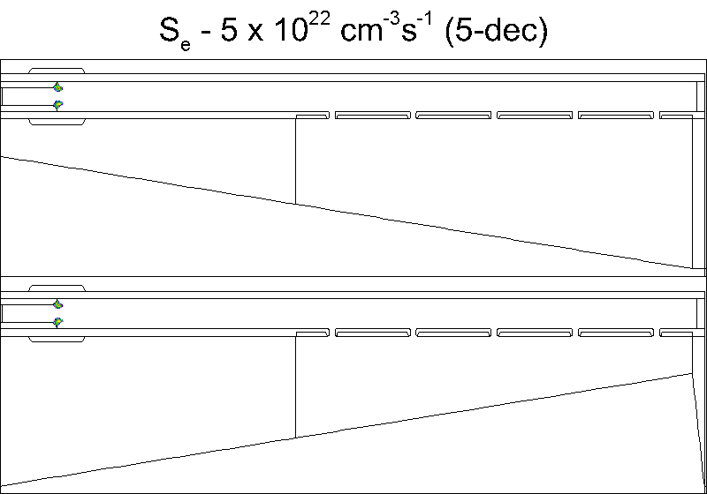
SLANTED GROUND
500 ns
+28 kV
800 µm holes, 10 mm apart
Angled ground plane
MIN MAX
Log scale
Animation Slide
University of Michigan
Institute for Plasma Science & Engr.
MIPSE_2018
Notes:
Frames 12-104

