Slide 1
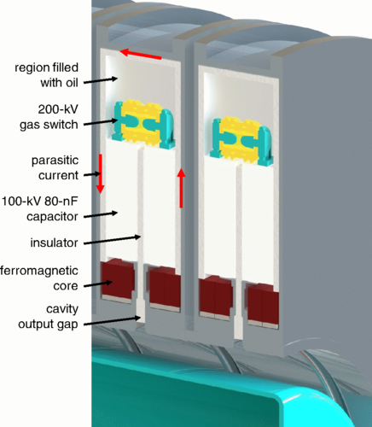
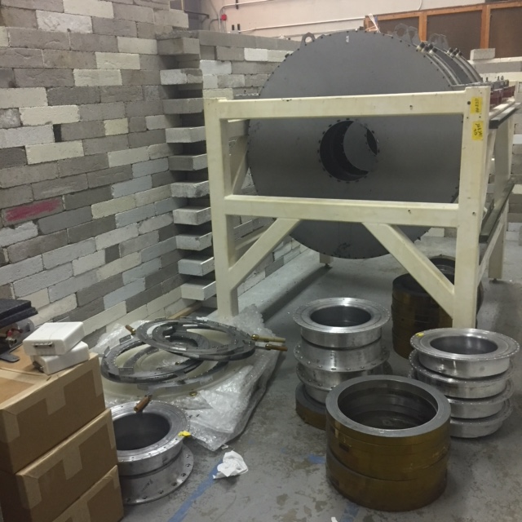
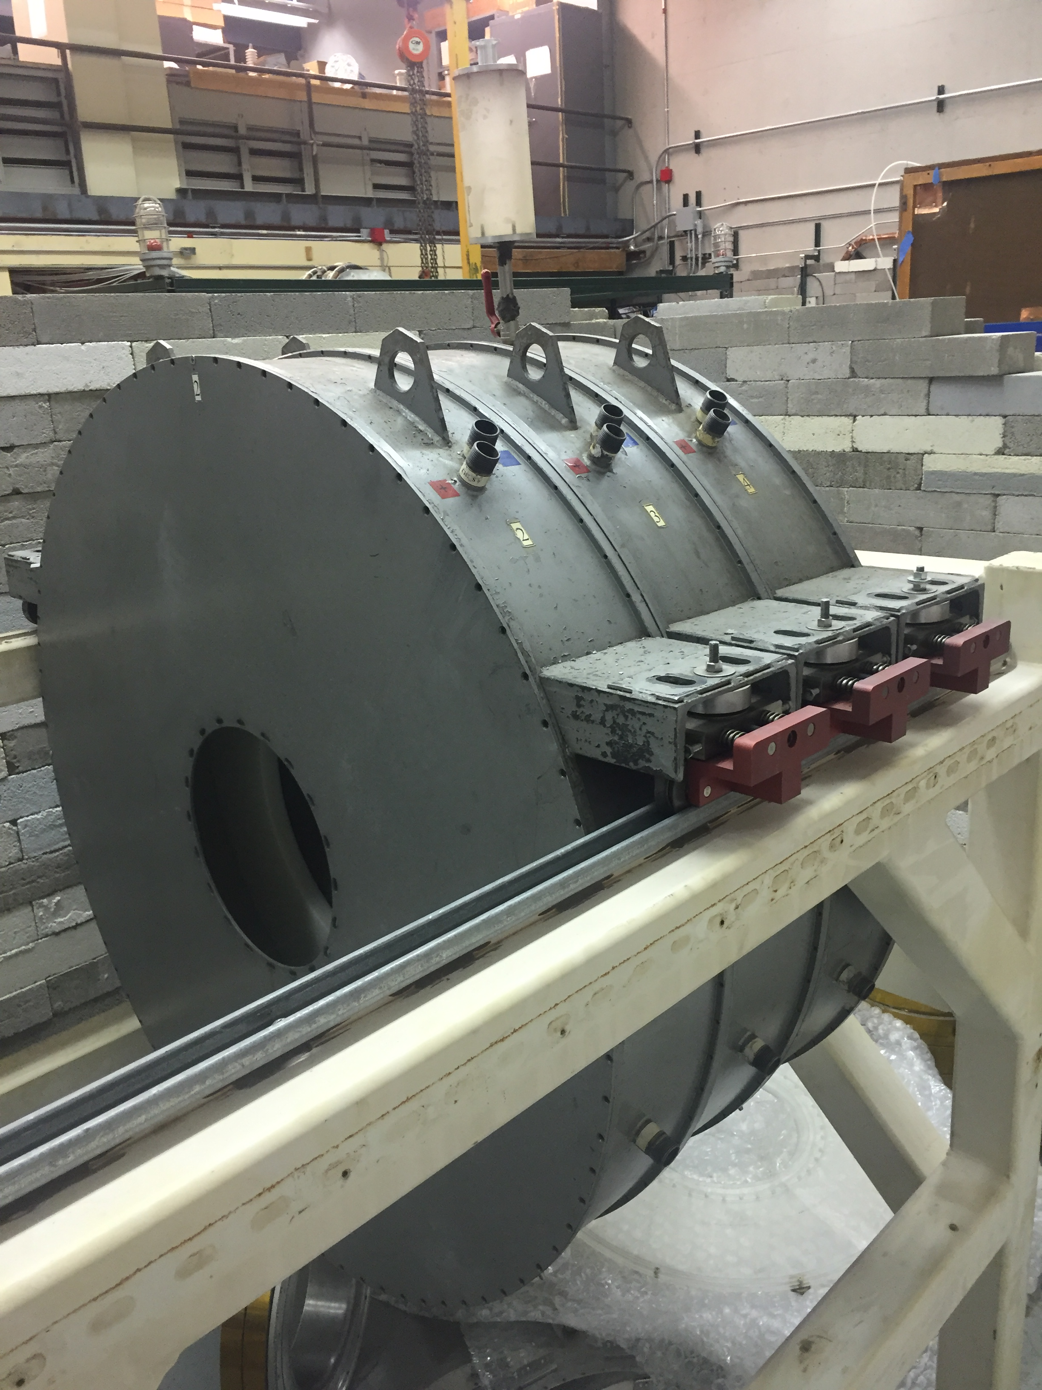
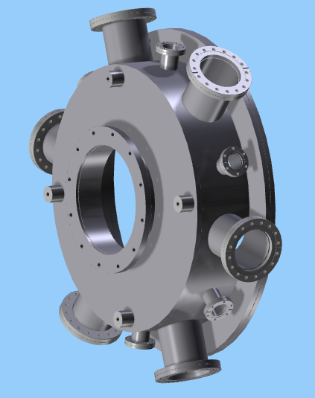
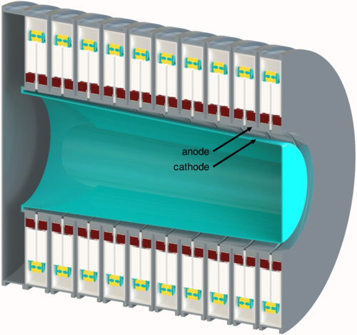
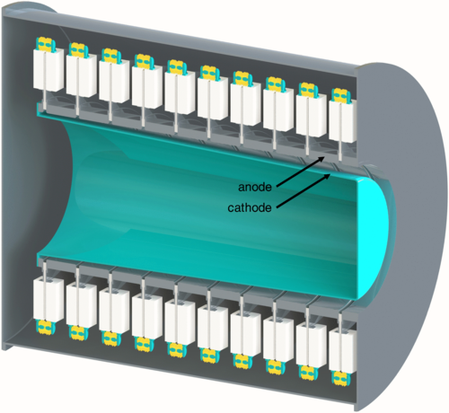
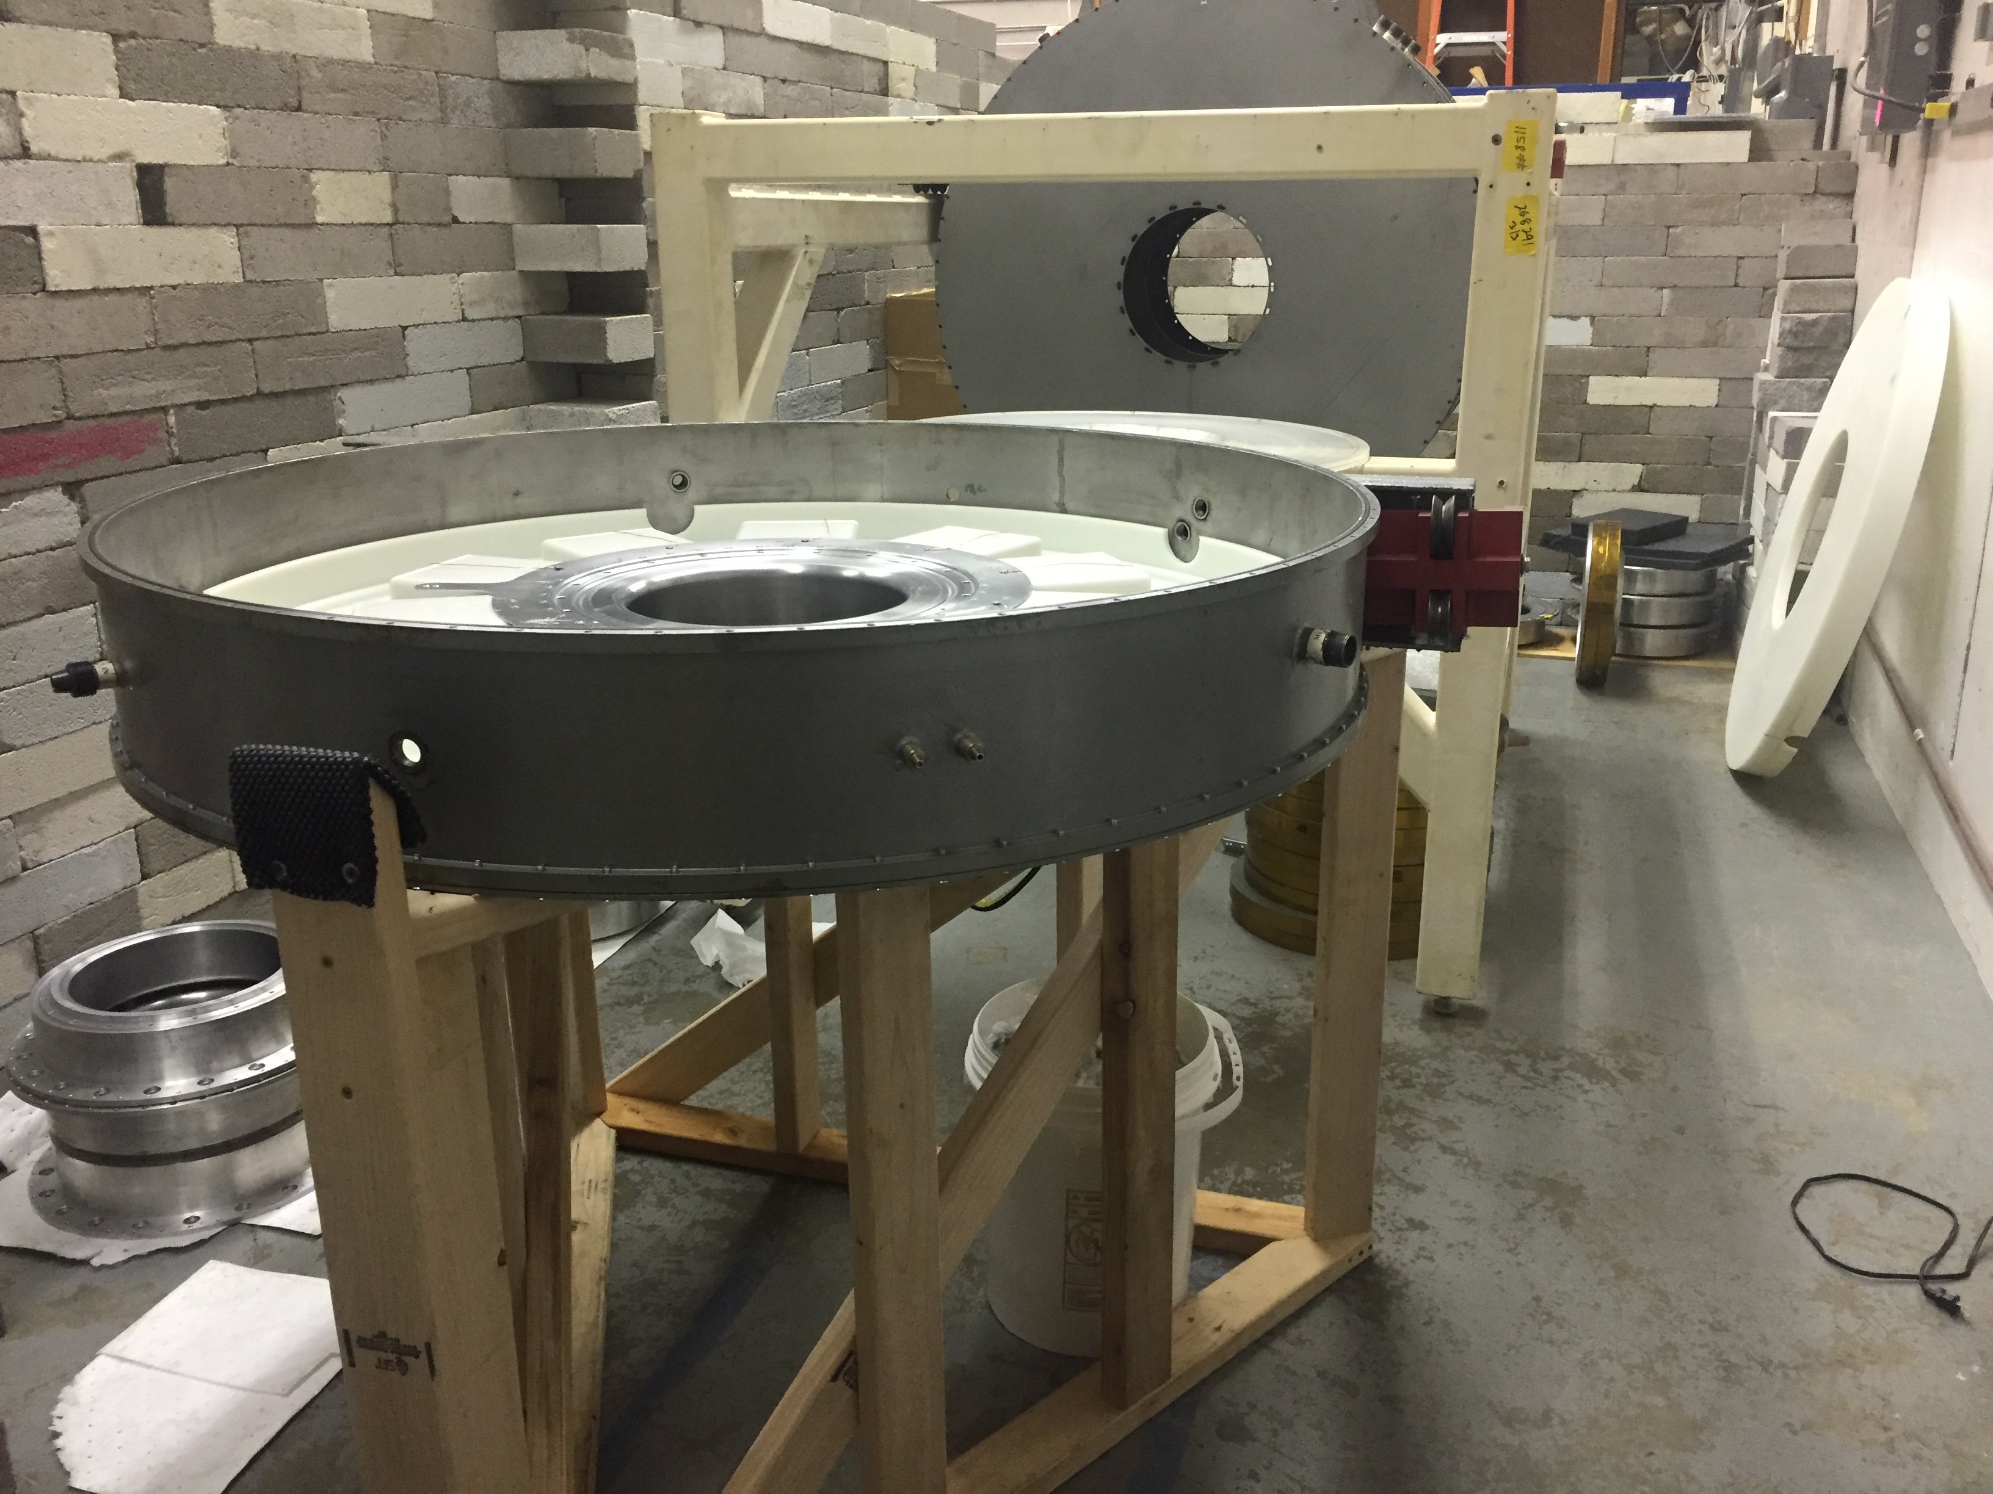
Construction of the BLUE Linear Transformer Driver System at the University of Michigan*
Brendan Sporer, Nicholas Jordan, Ryan McBride
University of Michigan
bsporer@umich.edu
Abstract:
Michigan has received four linear transformer driver (LTD) cavities, which were previously a part of the Ursa Minor experiment at Sandia National Labs. As such, the stack has been somewhat facetiously deemed the Bestowed LTD from the Ursa Minor Experiment, or BLUE. BLUE will be capable of delivering up to 8kJ of energy in a ~100ns, ~200kA pulse for high-power microwave and Z-pinch experiments.
Goals:
Our ambitious goal is to rep-rate the entire system as fast as 5-10Hz in microwave or gas puff experiments, though this may only prove possible with lower charge voltage and/or lower total capacitance. We are considering dual ambipolar 100kV, 12kW Spellman power supplies to minimize charging time. Based on our existing LTD system, MAIZE, we have also begun to consider triggering circuits. Pulse shaping on LTDs has been explored briefly at Sandia [1]; eventually BLUE may have this capability by staggering cavity triggers or mismatching capacitors within cavities.
Impedance-Matched Marx Generator:
We are considering transforming BLUE into a relatively new pulsed power architecture known as an impedance-matched Marx generator (IMG) [2]. IMG systems are nearly identical to LTDs, but do not require the ferrite cores, which can represent a large fraction of a cavity’s weight and cost. The transformation can be done by somehow removing the parasitic current path around the external case of the cavity (see Figure 3); in our case, by using polycarbonate rather than steel cavity lids. While BLUE will most likely be assembled first as an LTD, we are keeping in mind the requirements for an IMG and working closely with LTD experts at Sandia to understand the benefits and drawbacks of an IMG transformation.
Figure 1: Ursa Minor (BLUE) cavities in the Pulsed Power & Microwave Lab at the University of Michigan
Figure 3: Anatomy of a linear transformer driver (LTD)
Construction:
The components of the BLUE cavities currently reside within a newly-built bunker of concrete bricks. The wall is necessary to shield the neutrons and high-energy photons that will eventually be emitted during experiments. A sturdy wooden stand has been constructed to hold individual cavities during servicing. The several hundred pound cavities are lifted by a motorized crane out of their frame and laid horizontally on the stand (see Figure 2).
Figure 5: An LTD (left) vs. an IMG (right) [2]
References:
[1] Savage, M. E., et al. “Temporally Shaped Current Pulses on a Two-Cavity Linear Transformer Driver System.” 2011 IEEE Pulsed Power Conference, 2011, doi:10.1109/ppc.2011.6191525.
[2] Stygar, W. A., LeChien, K. R., Mazarakis, M. G., Savage, M. E., Stoltzfus, B. S., Austin, K. N., Breden, E. W., Cuneo, M. E., Hutsel, B. T., Lewis, S. A., McKee, G. R., Moore, J. K., Mulville, T. D., Muron, D. J., Reisman, D. B., Sceiford, M. E., and Wisher, M. L. Impedance-matched Marx generators. United States: N. p., 2017. Web.
Figure 4: CAD model of vacuum chamber likely to be used for Z-pinch experiments
Figure 2: First cavity being assembled on stand
*This work was supported in part by the U.S. Office of Naval Research through the Young Investigator Program under Grant N00014-18-1-2499 and in part by Sandia National Laboratories through the Stevenson-Wydler Gift Program.

