Slide 1
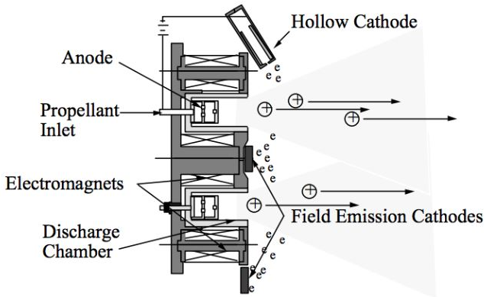
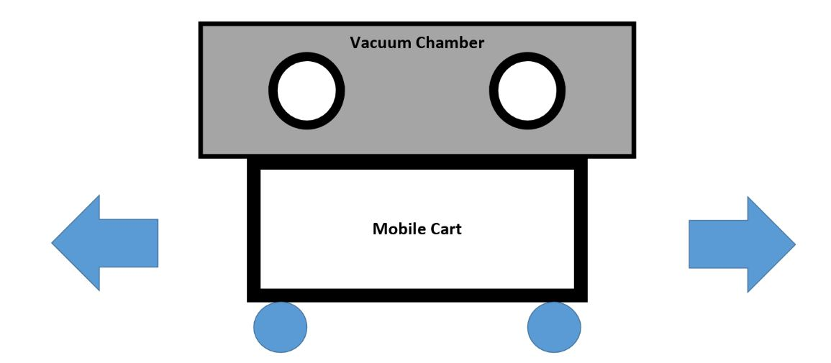
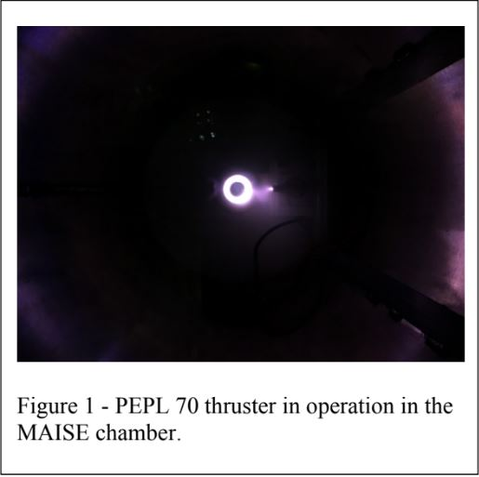
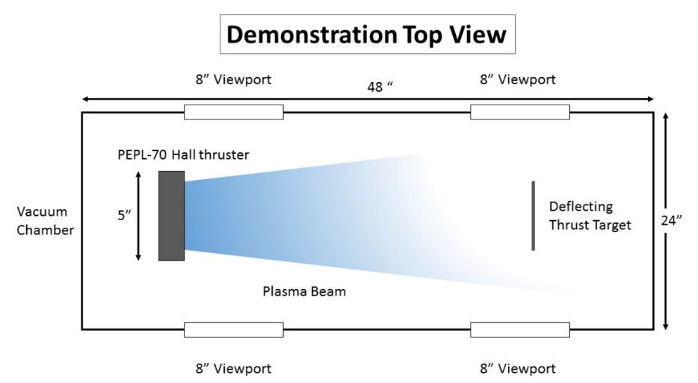
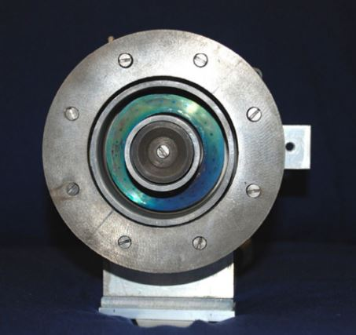
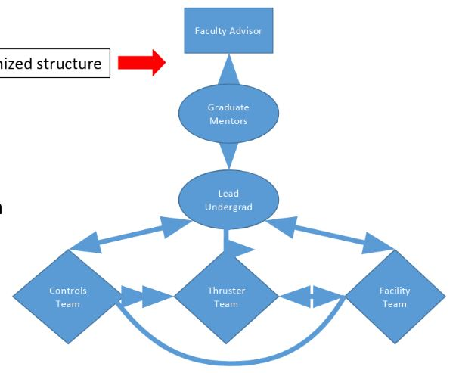
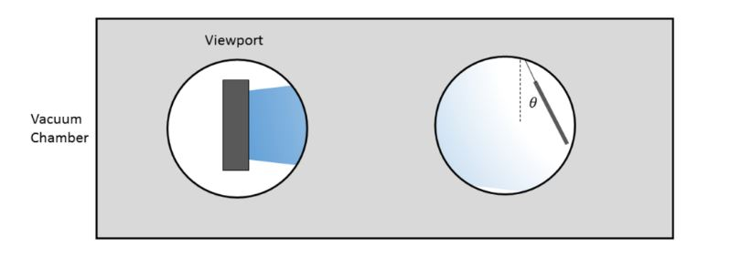
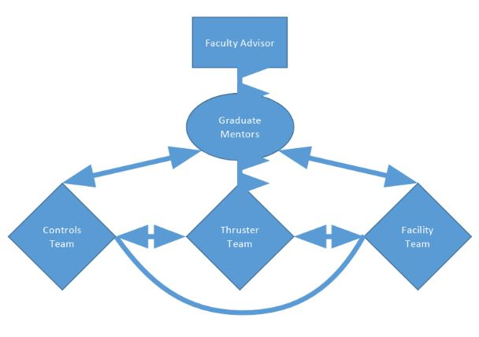
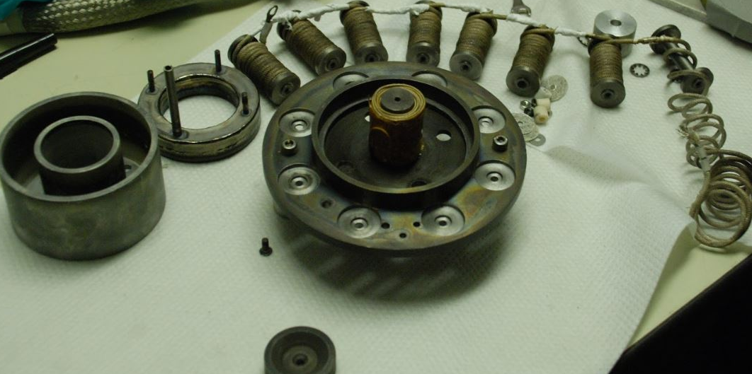
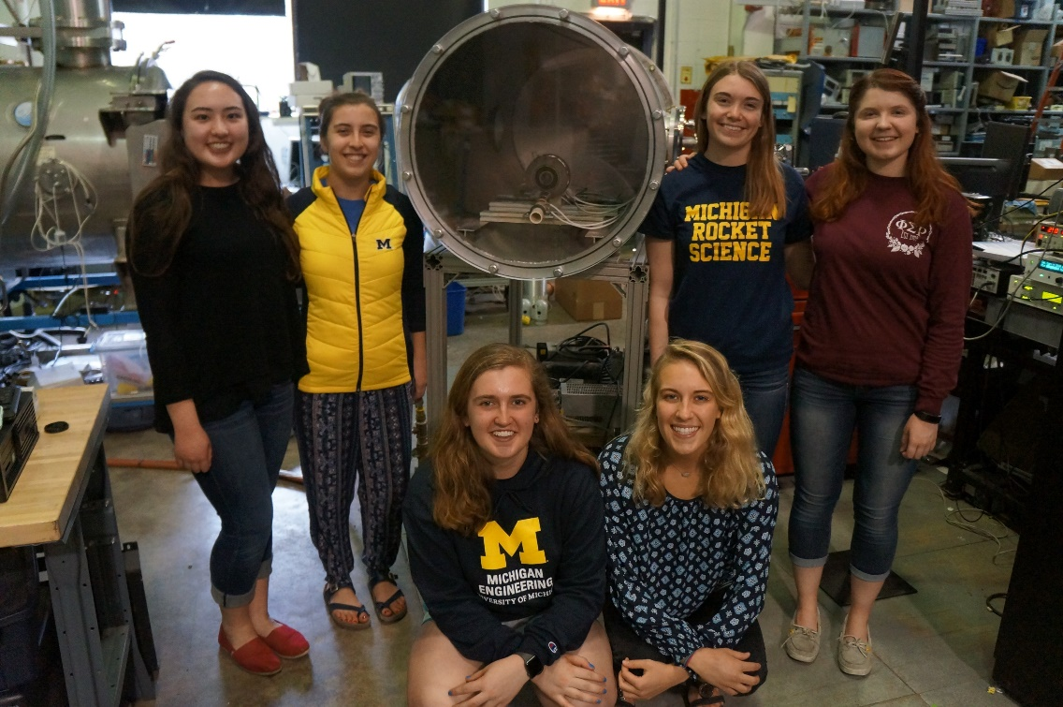
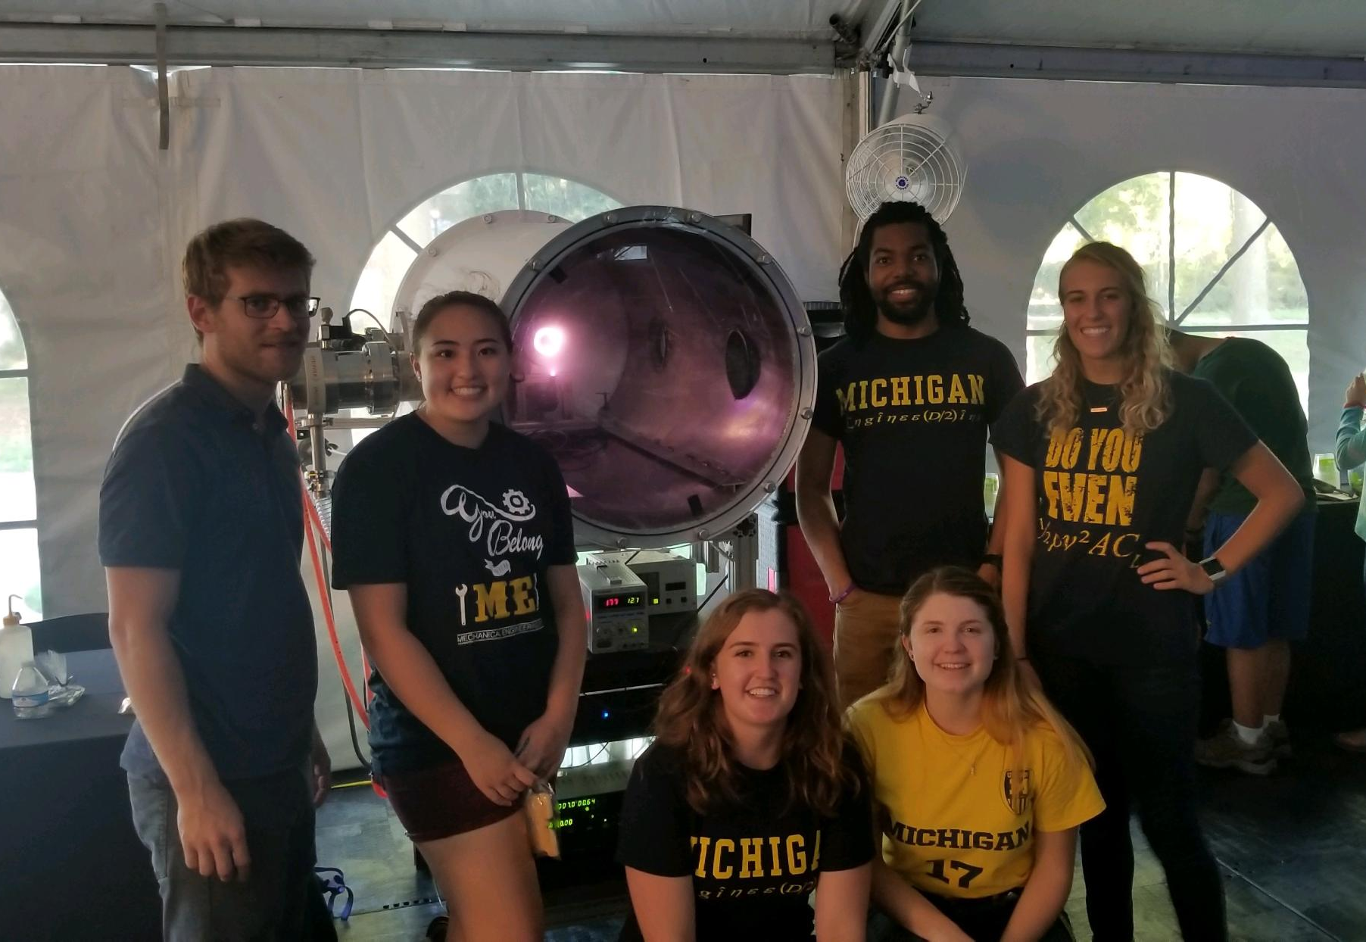
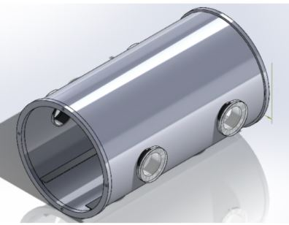
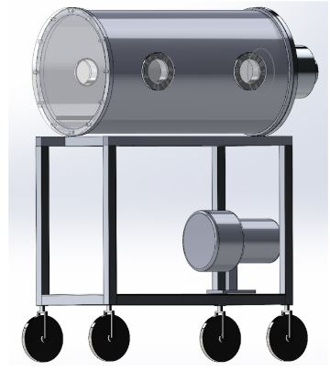
Development of a Mobile Electric Propulsion Demonstration for STEM Outreach Katherine Wolff, Nora Shapiro, Sarah E. Cusson, Marcel P. Georgin, Benjamin A. Jorns, and Alec D. Gallimore Department of Aerospace Engineering, University of Michigan, Ann Arbor, MI 48109
Abstract
Hall thrusters
Demonstration Concept and Future Work
Public outreach is critical to recruit the next generation of engineers and scientists as well as correct misconceptions about the engineering discipline. In particular, outreach for plasma sciences and engineering is challenging as the ideas and technologies are removed from everyday life. In response to this need, the Plasmadynamics and Electric Propulsion Laboratory (PEPL) at the University of Michigan is developing a mobile-demonstration platform to bring advanced propulsion technology into high school classrooms in the greater Ann Arbor area to build interest in plasma science and engineering. To design, build, and staff this outreach tool, undergraduates from the Women in Aeronautics and Astronautics were recruited. The implementation of the team and the design of the setup is discussed.
Hall Thrusters use a crossed electric and magnetic field to ionize and accelerate propellant
Electrical discharge consists of two main parts: an anode and a cathode
Cathode is the electron source
Electrons are emitted from the cathode and move towards the anode
A radial direction magnetic field is applied impeding the motion of the electrons towards the anode and electrons are trapped along the magnetic field lines
Krypton gas is injected through the anode and is ionized through electron-impact ionization.
The axial electric field accelerates the ions and the cathode also neutralizes the flow of ions
Challenges for STEM Fields
Children, educators, and the public hold misconceptions and limited understanding of the engineering profession [1]
No room for creativity
STEM fields are lonely
Must be a “straight A” student
Women aren’t as capable as men
Everyone in STEM becomes a scientist
Enrollment in engineering graduate programs is declining [2]
Graduate degrees are simply extensions of bachelor’s degrees with harder classes
Talent pool may start to deplete
Need undergraduate research opportunities
STEM outreach is most effective at the elementary and high school level.
To improve this project, we would implement a single undergraduate lead for the project for a single point of contact. The controls team also wants to modify the power supplies to return them to their remote control state, as the LabJack controllers were overloaded during testing. Data acquisition needs to be added to the LabVIEW interface based on the choice of probes and measurements desired. Lastly, in order to continue to enhance the effectiveness of the demonstration, we aim to implement two additional features:
Deflection Paddle
Would visibly show the audience the thrust that the thruster is producing, and a sensor could output to the LabVIEW interface showing numerical thrust measurements and variations
Auditory Demonstration
Hall thrusters are very oscillatory by nature
Could measure the oscillations and convert them to sound such that the students can “hear” the Hall thruster operating
The PEPL-70 thruster [right] shares design heritage with the Russian SPT-70 and SPT-100 thrusters. To refurbish the thruster, we confirmed the electrical and magnetic field configuration, selected a cathode, and implemented the system into the vacuum facility.
Project Structure and Team Responsibilities
PEPL Outreach Involvement
Controls Team:
-Created LabVIEW interface with buttons and dials to remotely control power supplies
-Determined the best possible computer and screen for our configuration
-Determined the current and voltage requirements for thruster components
-Created procedure to set up system and ignite thruster
Rocket Scientist for a Half-Day (RSHD) program
Elementary school students from Ann Arbor tour PEPL and receive an introduction to advanced propulsion
Lab tours
Communicate research to industry partners, government officials, and visiting students and programs
Summer College Engineering Exposure Program (SCEEP)
Hosted by U of M Center for Engineering Diversity (CEDO)
Guided tours and discussion of work with small scale demonstrations
The major missing component is a live demonstration of the technology in action.
[Right] Proposed improvement for team structure
[Below] Drawing of thrust deflection paddle
Thruster Team:
-Assessed electrical configuration of the PEPL-70 for proper isolation and connectivity
-Modeled magnetic field using MagNet v7.7 simulation software
-Determined cathode type most suitable for our application
-Implemented heat shield to lower required current for operation
Facility Team:
-Designed vacuum chamber, mobile cart, and viewing portholes for audience
-Tested facility to meet pressure and flow requirements
-Considered safety measures like Plexi-glass enclosure
-Implemented turbo pump and flow system with needle valve and regulator
Acknowledgements and References
MAISE Team
The authors would like to express their sincere thanks to the University of Michigan College of Engineering and the Michigan Institute for Plasma Science and Engineering for sponsoring this project.
[1] National Academy of Engineering, C. o. P. U. o. E. M., Changing the conversation: messages for improving public understanding of engineering, National Academies Press, 2008.
[2] Borrego, M., Knight, D. B., Gibbs Jr, K., and Crede, E., Pursuing Graduate Study: Factors Underlying Undergraduate Engineering Students' Decisions, Journal of Engineering Education, Vol. 107, No. 1, 2018, pp.140163.
[3] Department of Aerospace Engineering Statistics, https://www.petersons.com/graduate-schools/university-of-michigan-college-of-engineering-department-of-aerospace-engineering-000_10039578.aspx, 2018.
Goal - combine a presentation on electric propulsion and a demonstration of the PEPL-70 EP device in a vacuum chamber while encouraging diversity in engineering by recruiting undergraduate students from the Women in Aeronautics and Astronautics
Only about 15% of the aerospace engineering graduate students at the University of Michigan and 10% of the graduates from PEPL are women [3].
[Above] Disassembled PEPL-70 Hall thruster
[Below] SolidWorks drawings of the facility
Diagram of MAISE project structure with sub-teams

