Slide 1
OPTIMIZING POWER DELIVERY IN A PULSED INDUCTIVELY COUPLED PLASMA USING SET-POINT IMPEDANCE MATCH AND FREQUENCY TUNING*
Chenhui Qu, and Mark J. Kushner
University of Michigan, Ann Arbor, MI 48109-2122 USA
chenqu@umich.edu, mjkush@umich.edu
Joel Brandon, Carl Smith, and Steven C. Shannon
North Carolina State University, Raleigh, NC 27695-7909
scshannon@ncsu.edu
David Coumou
MKS Instruments, ENI Power Division, Rochester NY
David_coumou@mksinst.com
MIPSE Graduate Student Symposium, November 2019
* Work supported by Samsung Electronics, National Science Foundation and the DOE Office of Fusion Energy Science

Slide 2
AGENDA
Introduction to impedance matching
Description of the model
Base case setup and analysis
Scaling of operating conditions
Power
Power Ramp-time
Duty Cycle
Concluding Remarks
University of Michigan
Institute for Plasma Science & Engr.
Chenhui_MIPSE_2019

Slide 3
POWER INTO ICP: LOAD ON TRANSMISSION LINE
In inductively coupled plasmas (ICPs) reactor, power is delivered to the plasma through a transmission line (TL) – the plasma is the load at the end of the TL.
Power delivered to the plasma is
Γ is the “reflection coefficient”. Since Z₀ = 50 Ω (usually) and, for example, Z_{P} = 10 - i100 Ω, Γ can be close to 1 and little power gets into the plasma.
University of Michigan
Institute for Plasma Science & Engr.
Chenhui_MIPSE_2019
Notes:
pictures

Slide 4
POWER INTO PLASMA: MATCHING NETWORK
To trick the generator into thinking Z_{L} = Z₀ and Γ =0, an impedance matching circuit is used.
Reactive circuit components (this is a π-network) are used so that there is little power loss in the matching network.
With pulsed plasmas, Z_{P} changes during the pulse – difficult to match power into plasma during entire pulse.
University of Michigan
Institute for Plasma Science & Engr.
Chenhui_MIPSE_2019
Notes:
pictures

Slide 5
MATCHING TO PULSED ICPs
Load impedance is tightly coupled to plasma properties that significantly vary with pulsed power.
With the resulting change in load impedance, impedance mismatch occurs during the pulsed period.
It is difficult to tune the circuit components in the matchbox rapidly enough for real-time matching during the pulse.
With advanced function generators and amplifiers, the RF frequency can be rapidly changed.
Set point matching: Select matching network components to match the impedance at a specific time.
Frequency tuning matching: Adjust RF-frequency to obtain better impedance match.
In this work, we discuss results from computational investigation on set-point and frequency tuning matching in optimizing power delivery to pulsed ICPs.
University of Michigan
Institute for Plasma Science & Engr.
Chenhui_MIPSE_2019

Slide 6
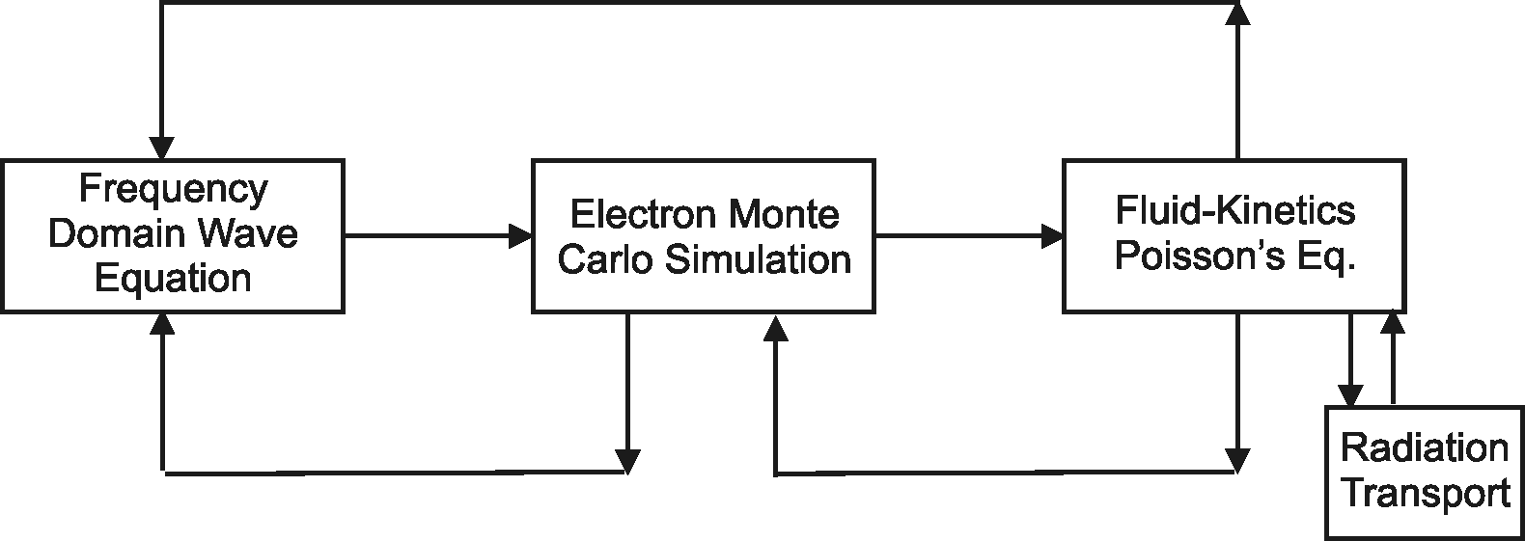
MODELING OF PULSED ICPs
The Hybrid Plasma Equipment Model (HPEM) is a modular simulator that combines fluid and kinetic approaches.
Variables are transferred between modules and updated in a time slicing manner.
Monte Carlo Ion/Neutral Transport
Surface
Chemistry
Module
Monte Carlo Radiation Transport
University of Michigan
Institute for Plasma Science & Engr.
Chenhui_MIPSE_2019

Slide 7
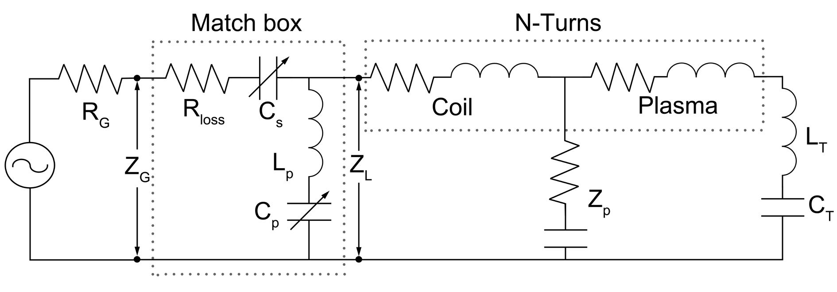
MODELING OF MATCHING NETWORK
Transformed Plasma
Matching network is between the power source and the coil.
Plasma impedance (Z_{p}) based on the HPEM plasma properties ([e], ν_{m}, and Fourier analysis of displacement current)
Termination components are constant, L_{T} = 0; C_{T} = 350 pF.
For a “perfect match”, values of capacitance (C_{s},C_{p}) in the matching network are analytically calculated on-the-fly for Γ = 0.
University of Michigan
Institute for Plasma Science & Engr.
Chenhui_MIPSE_2019

Slide 8
FREQUENCY TUNING
Nearly all contributions to load impedance are functions of frequency.
Minimizing reflection coefficient, Γ, can be achieved by varying frequency of the source.
During execution of Model:
Specify range of tuning: f_{range} = 11.56 – 15.56 MHz
Sample Z_{L} impedance every 0.3 μs.
Adjust source frequency to minimize Γ within permitted range.
University of Michigan
Institute for Plasma Science & Engr.
Chenhui_MIPSE_2019

Slide 9
FREQUENCY TUNING
Sporadic history of frequency tuning that is now resurging due to wide adoption of pulsed plasmas in HVM (high volume manufacturing).
Commercial power supply systems available for tuning many MHz per few microseconds.
University of Michigan
Institute for Plasma Science & Engr.
Chenhui_MIPSE_2019

Slide 10
GEOMETRY
Ar (10 sccm), 15 mTorr
Pulsed power:
50 W
Pulse repetition frequency (PRF): 5 kHz.
Duty cycle (DC): 50%
Base frequency: 13.56 MHz
Capacitive coupling not included in Ar plasma modeling.
Top coil: power source
Bottom coil: grounded
University of Michigan
Institute for Plasma Science & Engr.
Chenhui_MIPSE_2019

Slide 11
[e] AND POWER DURING POWER-ON
Perfect match during pulse.
Peak electron density, temperature: 1.4 x 10¹¹ cm⁻³, 4.5 eV
Low [e] at the beginning of the pulse creates small spike in T_{e}.
50 W; Ar (10 sccm); 15 mTorr; RF = 13.56 MHz; PRF = 5 kHz; DC = 50%
University of Michigan
Institute for Plasma Science & Engr.
Chenhui_MIPSE_2019

Slide 12
STEP 1: ANALYTICAL SOLUTION FOR PERFECT MATCH CONDITION
Values of match network components C_{P} and C_{S} are solved analytically for perfect match.
Transients in C_{P} and C_{S} during power ramp up/down due to rapid change in Z_{L}.
C_{P} and C_{S} approach constant values near end of pulse.
50 W; Ar (10 sccm); 15 mTorr; RF = 13.56 MHz; PRF = 5 kHz; DC = 50%
University of Michigan
Institute for Plasma Science & Engr.
Chenhui_MIPSE_2019

Slide 13
STEP 2: FIX C_{P} AND C_{S}, SET-POINT MATCHING
C_{P} and C_{S} are selected from Step 1 to match at early or late times during pulse.
Early match produces mismatch late in pulse; late match produces mismatch in early pulse.
The impedance of the plasma is not terribly sensitive to match components.
University of Michigan
Institute for Plasma Science & Engr.
Chenhui_MIPSE_2019

Slide 14
STEP 3: FREQUENCY TUNING WITH SET-POINT MATCH
Frequency tuning (FT) augments set-point matching (13.56 ± 2 MHz)
Essentially “perfect” match can be achieved.
At match points, nominally f = 13.56 MHz
Matching achieved with:
Lower frequencies before set-point.
Higher frequencies after set point.
Mismatch results from off range of frequency tune.
University of Michigan
Institute for Plasma Science & Engr.
Chenhui_MIPSE_2019

Slide 15
FREQUENCY TUNING vs POWER
Power Efficiency
τ: Pulse period
P_{dep}: Deposited power
P_{forward}: Forward power
Peak forward power: 30 to 80 W.
C_{P} and C_{S} are chosen from late-pulse perfect match for P = 50 W
Significant decrease of η as power decreases: different steady states, distinguishable plasma impedances.
50 W; Ar (10 sccm); 15 mTorr; RF = 13.56±2 MHz; PRF = 5 kHz; DC = 50%; C_{P} = 64 pF; C_{S} = 0.26 nF
University of Michigan
Institute for Plasma Science & Engr.
Chenhui_MIPSE_2019

Slide 16
POWER SCALING
Low Power:
Without frequency tuning, late match conditions prevent early power delivery, and so plasma does not develop.
FT restores early match, and enables plasma development.
High Power
Plasma density at start of pulse is high enough to enable coupling of power.
FT is less impactful, but still recoups early plasma development.
50 W; Ar (10 sccm); 15 mTorr; RF = 13.56±2 MHz; PRF = 5 kHz; DC = 50%; C_{P} = 64 pF; C_{S} = 0.26 nF
University of Michigan
Institute for Plasma Science & Engr.
Chenhui_MIPSE_2019

Slide 17
POWER SCALING
Peak power: 30 W
[e] at the end of pulse with and without frequency tuning.
Similar plasma distribution.
Without FT – Slowly increasing plasma density slowly improves the match.
With FT – Match is good throughout he pulse, and plasma achieves steady state.
30 W; Ar (10 sccm); 15 mTorr; RF = 13.56±2 MHz; PRF = 5 kHz; DC = 50%; C_{P} = 64 pF; C_{S} = 0.26 nF
University of Michigan
Institute for Plasma Science & Engr.
Chenhui_MIPSE_2019

Slide 18
POWER RAMP TIME
Power ramp time: 4 to 80 µs.
Short Ramp Time
Enables “overshoot” of electron density and early plasma formation.
Less need for FT
Long Ramp Time
Plasma density is generally lower at start of pulse producing a mismatch.
FT required to deliver early power.
FT likely most impactful for sawtooth waveform.
50 W; Ar (10 sccm); 15 mTorr; RF = 13.56±2 MHz; PRF = 5 kHz; DC = 50%; C_{P} = 64 pF; C_{S} = 0.26 nF
University of Michigan
Institute for Plasma Science & Engr.
Chenhui_MIPSE_2019

Slide 19
DUTY CYCLE
Duty cycle: 40 – 60%
Small duty cycle
Lower average power, longer inter-pulse period, lower initial electron density.
FT required to match early, though effects are small.
Large duty cycle
Plasma reaches quasi-steady state with larger initial [e].
Starting conditions resemble match point, needing less FT.
Expect more need for FT as duty cycle shortens.
50 W; Ar (10 sccm); 15 mTorr; RF = 13.56±2 MHz; PRF = 5 kHz; C_{P} = 64 pF; C_{S} = 0.26 nF
University of Michigan
Institute for Plasma Science & Engr.
Chenhui_MIPSE_2019

Slide 20
CONCLUDING REMARKS
Power delivery to pulsed ICP plasmas was investigated using set-point and frequency tuning impedance matching.
Mismatch occurs at some point during when only set-point matching is used.
Choose set-point to optimize matching efficiency.
Choose set-point to optimize desired portion of waveform.
Further matching can be achieved through frequency tuning (FT).
Begin with best-case set-point matching values.
Ability to match by frequency tuning is based on frequency range and values of C_{P}, C_{S}.
Two-Stage matching strategy suggested.
Stage 1 (Coarse): Set-point match to set C_{p}, C_{s}
Stage 2 (Fine): Intra-pulse Frequency Tuning
University of Michigan
Institute for Plasma Science & Engr.
Chenhui_MIPSE_2019

