Slide 1

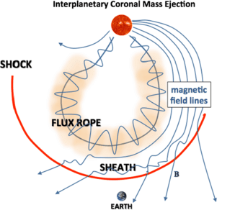
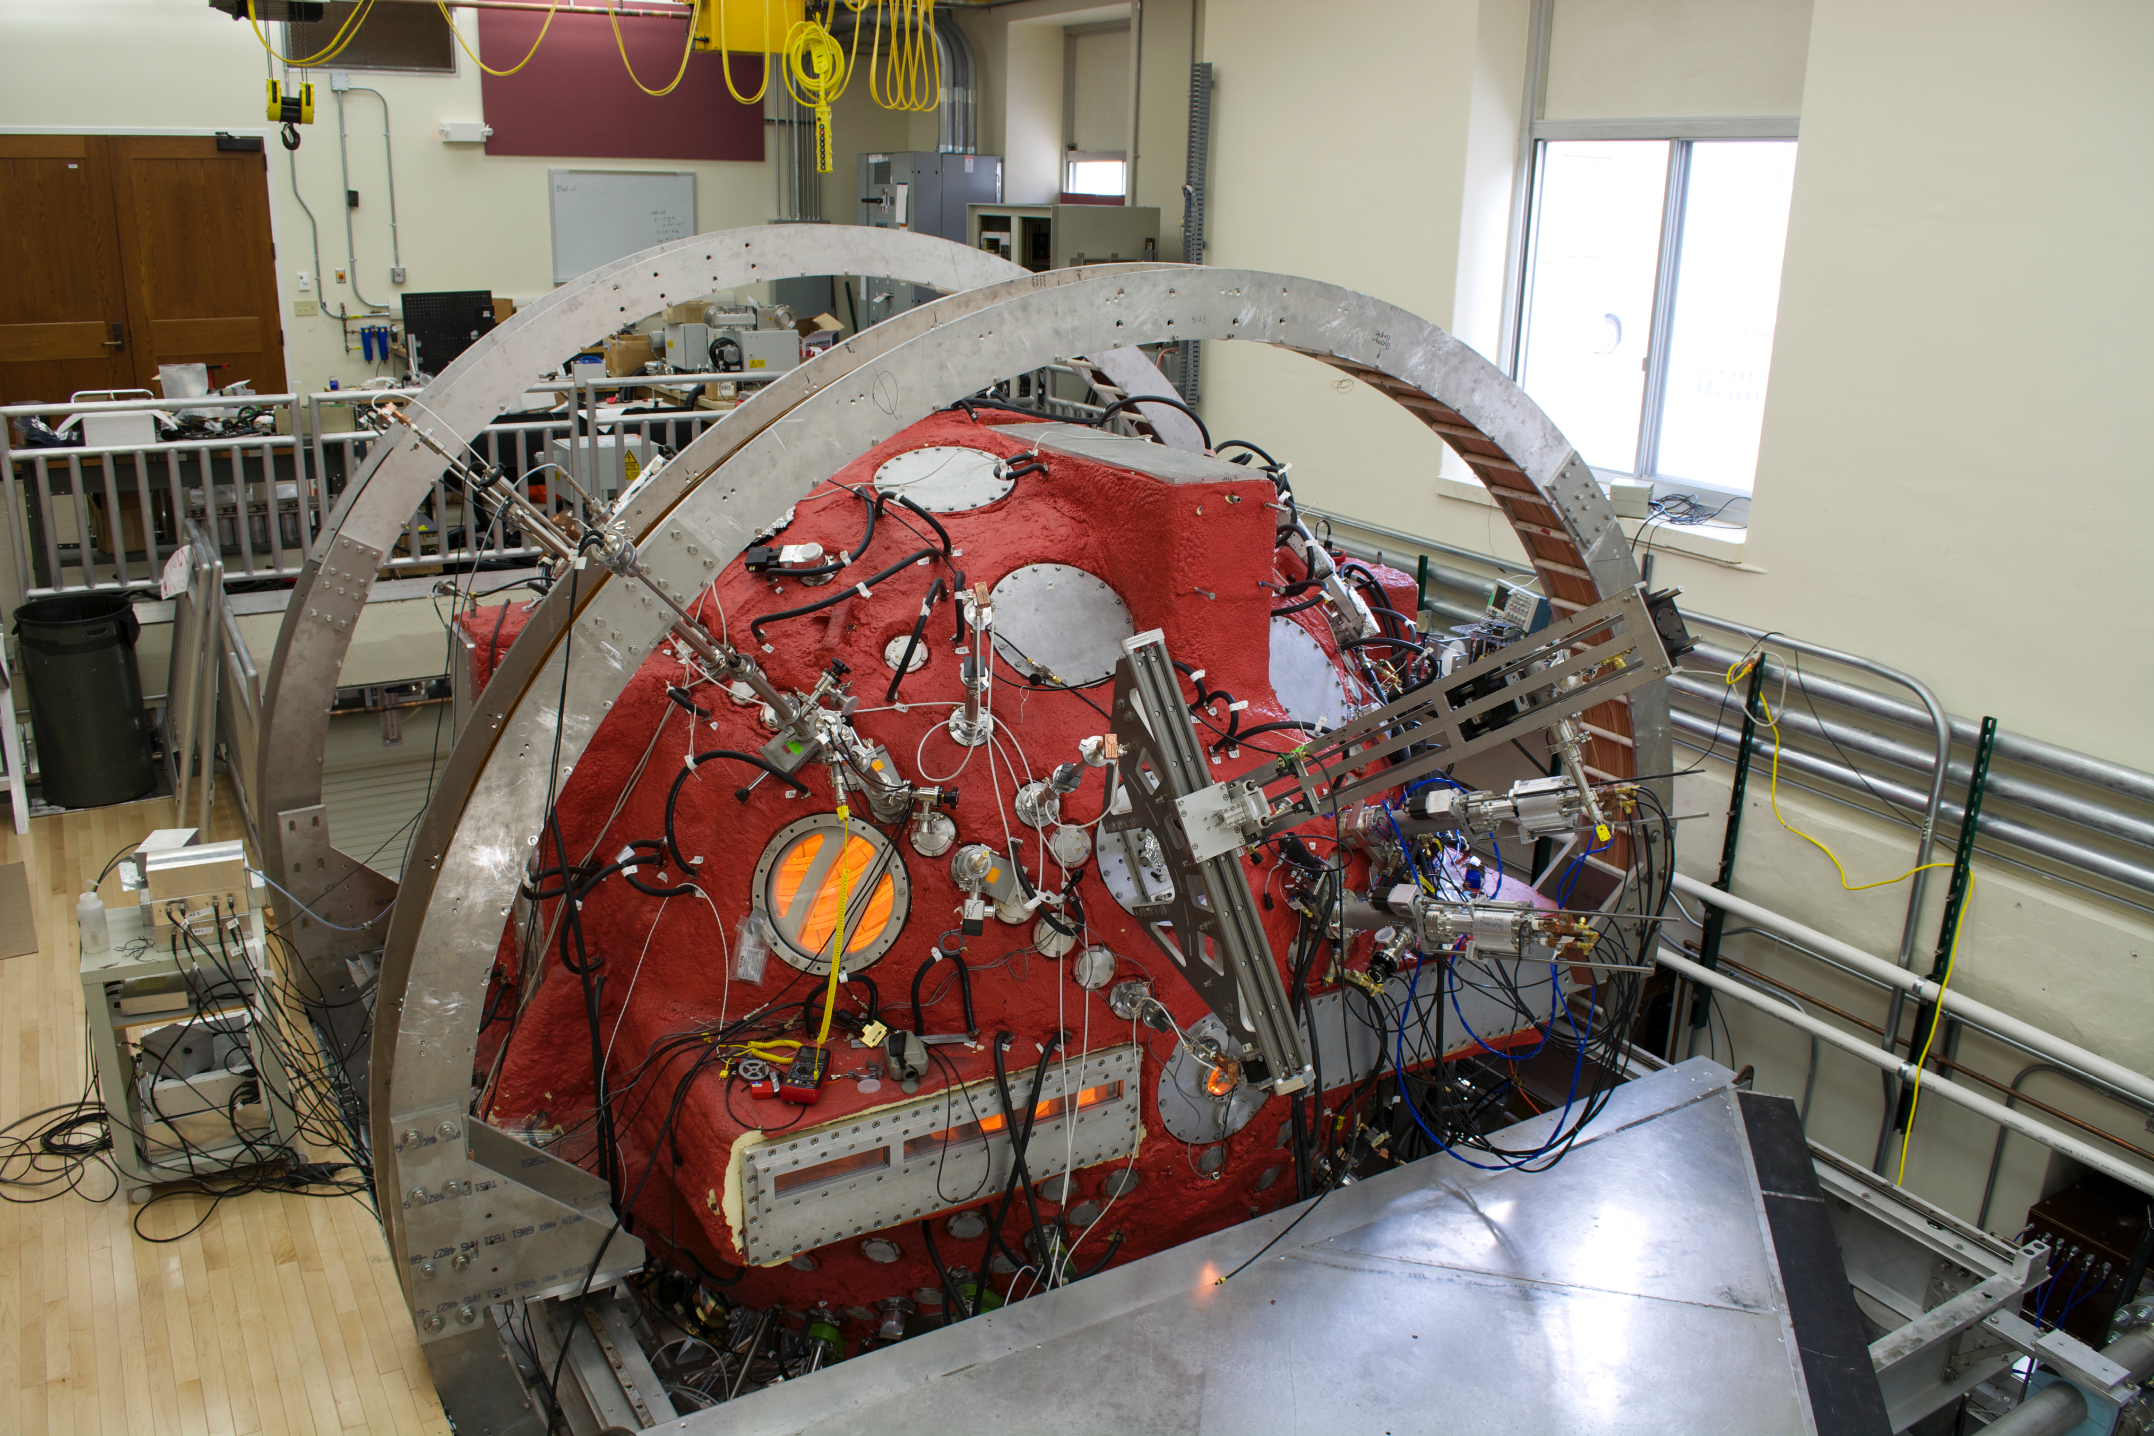
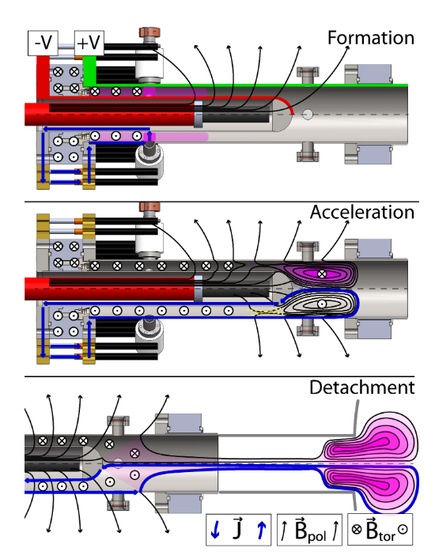
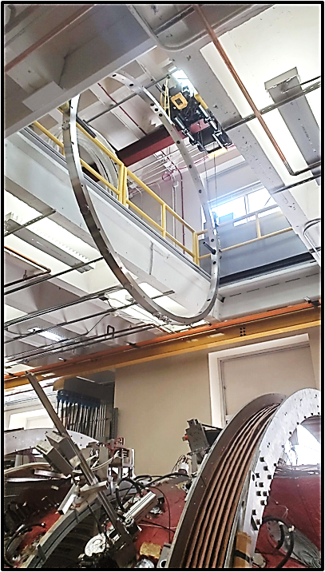
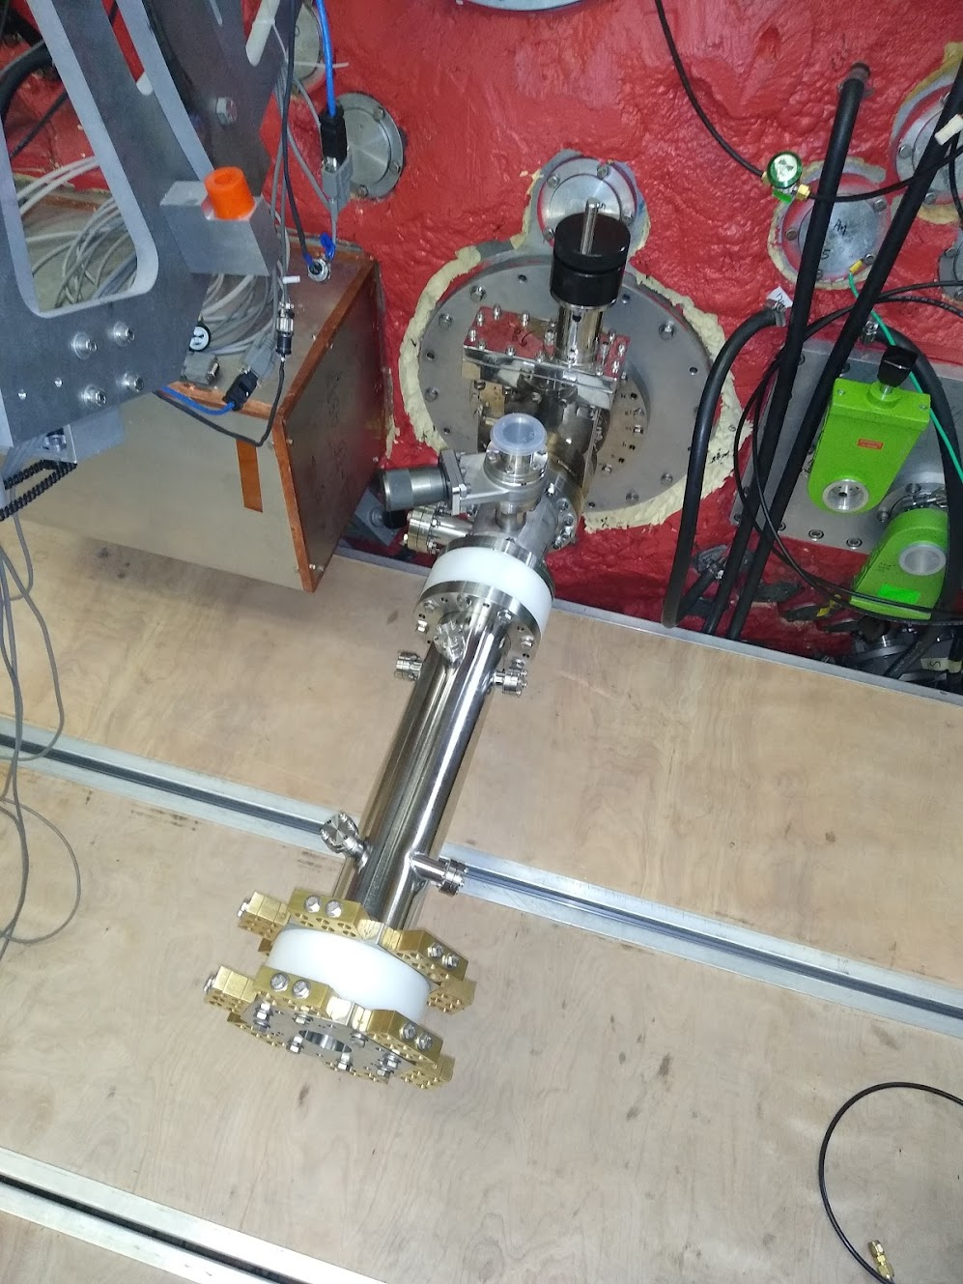
Future Experiment for the Wisconsin Plasma Physics Laboratory (WIPPL)
K. Bryant¹, C.C. Kuranz¹, J. R. Olson², C. Forest²
¹University of Michigan, Ann Arbor. ²University of Wisconsin, Madison.
How can we learn about Interplanetary Coronal Mass Ejections (ICMEs) in a laboratory environment?
What is an ICME and why are they important?
We’ve designed a scaled experiment to be conducted on the Big Red Ball
ICMEs are the source of geomagnetic storms
Often accompanied by a shock, pushes a sheath of plasma to high energies
Geomagnetic storms caused by the sun can damage human electrical systems
A Compact Torus (CT) of plasma will be sent through a perpendicularly magnetized plasma
We control the background plasma parameters to scale the experiment appropriately
The Big Red Ball
The CT is generated and shot using a CT Injector (CTI)
We’re installing a ring to mount the CTI at the best location
Helmholtz coils
Current flows through the outer conductor, arcs through the plasma and to the center electrode
Magnetic pressure forces plasma down the tube
Towards the end, the magnetic field reconnects, and the plasma is sent into the vessel
Ideally, we want to mount the CTI perpendicular to the Helmholtz field
A ring will be inserted between the hemispheres of the vessel with ports to mount the CTI
~1m
Image by Doug Endrizzi
*This work is funded by the U.S. Department of Energy, Fusion Energy Sciences under award DE-SC0021288

