Slide 1
Characterizing the growth of current filamentation instability using laser wakefield accelerated beams
Jason Cardarelli
APS Division of Plasma Physics 2021
Y. Ma, P.T. Campbell, A.F. Antoine, M. Berboucha, R. Fitzgarrald, R. Hollinger, B. Kettle, K. Krushelnick, S.P.D. Mangles, J. Morrison, R. Nedbailo, Q. Qian, J.J.Rocca, G. Sarri, D. Seipt, H. Song, M.J.V. Streeter, S. Wang, L. Willingale, A.G.R. Thomas
Acknowledgement to the NSF (grant # 1804463) and DOE Fusion Energy Sciences Lasernet US (grant # DE-SC0021246)
Notes:
Try to include a few bullet points per slide
Try to include no more than 3 slides of introduction

Slide 2
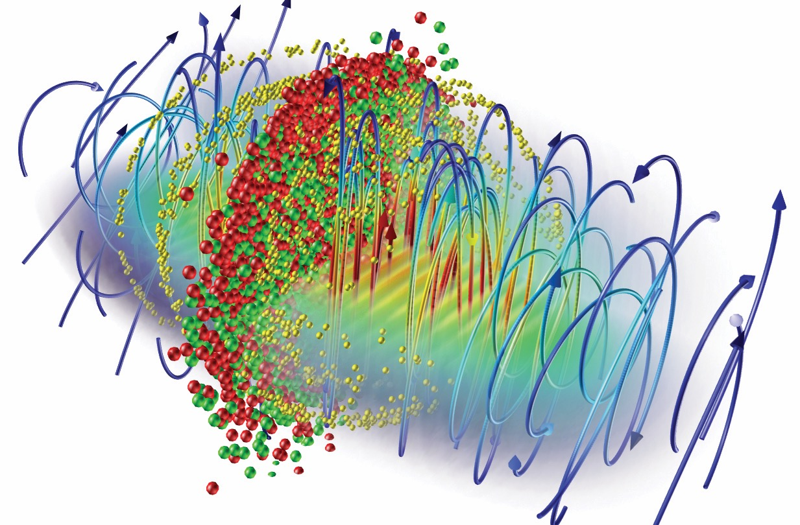
Committed to open science
Open-access model
40+ research groups worldwide are using OSIRIS
300+ publications in leading scientific journals
Large developer and user community
Detailed documentation and sample inputs files available
Using OSIRIS 4.0
The code can be used freely by research institutions after signing an MoU
Find out more at:
OSIRIS framework
Massively Parallel, Fully Relativistic Particle-in-Cell Code
Parallel scalability to 2 M cores
Explicit SSE / AVX / QPX / Xeon Phi / CUDA support
Extended physics/simulation models
http://epp.tecnico.ulisboa.pt/osiris
Ricardo Fonseca: ricardo.fonseca@tecnico.ulisboa.pt

Slide 3
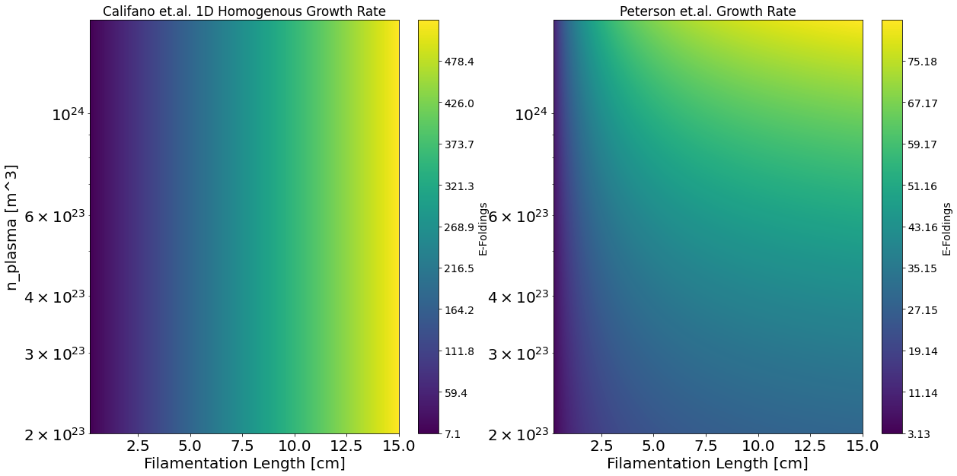
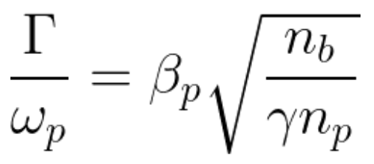
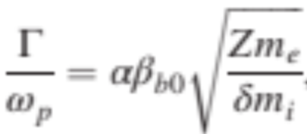
Relativistic Current Filamentation Instability
Peterson, J. et al. "Magnetic field amplification by a nonlinear electron streaming instability." Physical Review Letters (2021)
Califano, et al. "Nonlinear filamentation instability driven by an inhomogeneous current in a collisionless plasma." Physical Review E (1998)
Notes:
REDO THE WEIBLE CARTOON

Slide 4
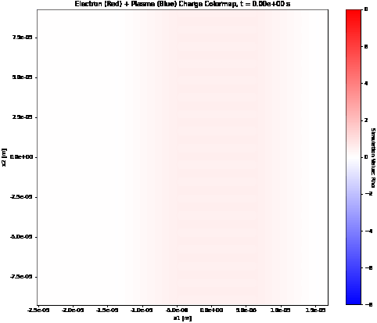
PIC Modelling of Current Filamentation Instability

Slide 5
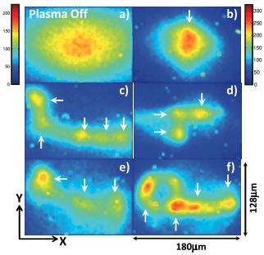
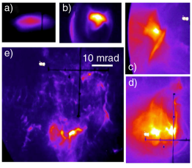
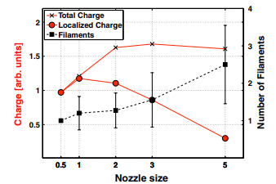
Current Filamentation Instability - Previous Works
Proof-of-concept LWFA experiment has been done by our group in the past (Huntington et al.)
Previous experiments demonstrate early growth of instability, but do not explore a large parameter space.
Huntington, et al. "Current filamentation instability in laser wakefield accelerators." Physical review letters (2011)
Allen, Brian, et al. "Experimental study of current filamentation instability." Physical Review Letters (2012)

Slide 6
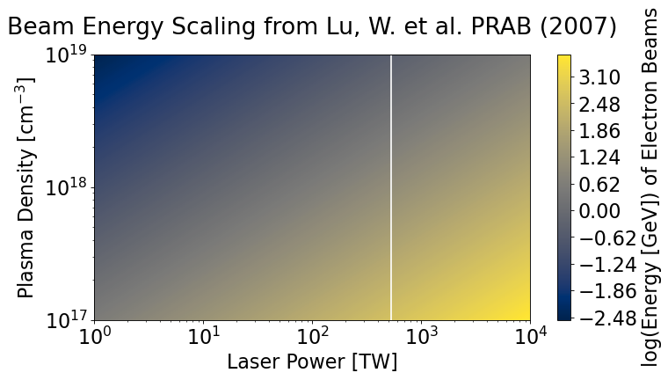
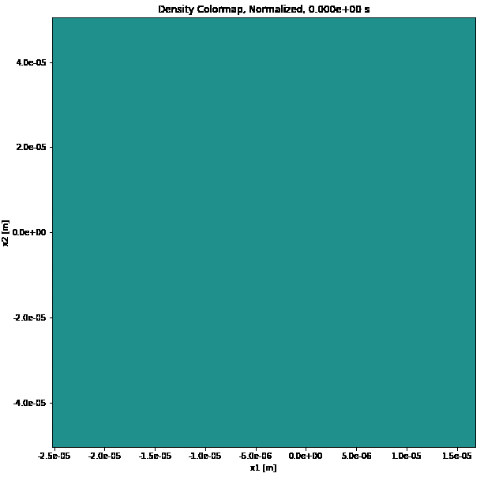
Laser Wakefield Acceleration (LWFA) of Electron Beams
LWFA produces ultrashort (fs time scale), high current density, low-divergence, relativistic electron beams.
Beam parameters (high current density, GeV-class energy, tunability) make LWFA an attractive source of particle beams to study current filamentation instability in spatial scales suitable to a lab setting.
Notes:
Maybe the W. Lu scaling graph isn’t the best plot to include here. Ideas of a good alternative?

Slide 7
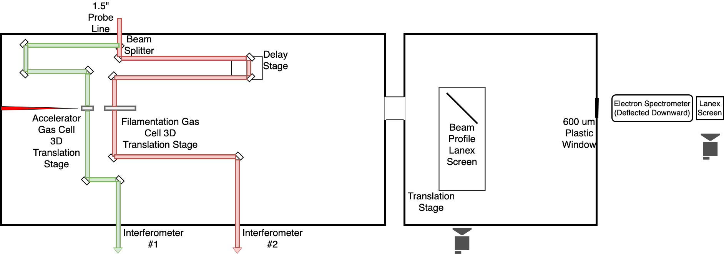
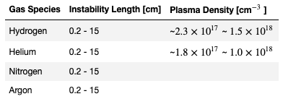
Experiment at CSU: Scan Length, Plasma Density, and Filamentation Gas Species to Characterize Instability
a₀=2.163
a₀=2.16
Similar Range
Notes:
Fill in the remainder of the experimental parameters table

Slide 8
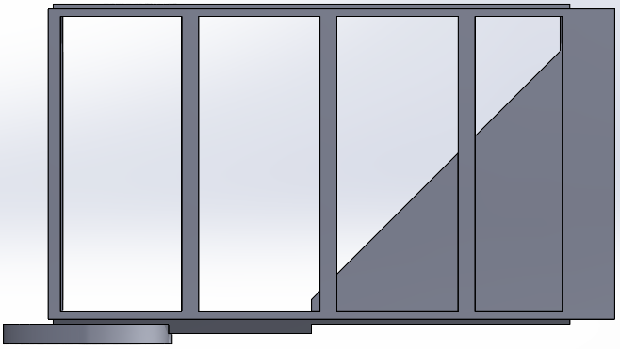
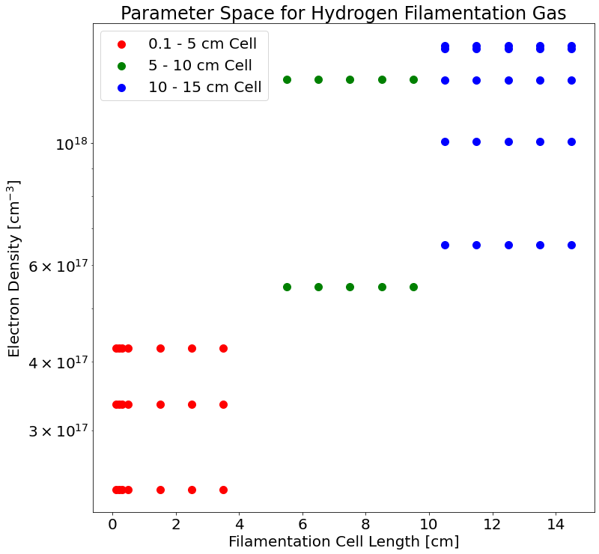
Surveyed Length & Plasma Density in Filamentation Cell
Gas Valve
Electron Beam (Fixed Height)
Adjustable Gas Bottle
Motorized Stage
(Variable Height)
Notes:
Say the laser ionized the plasma ahead of the electron beam

Slide 9
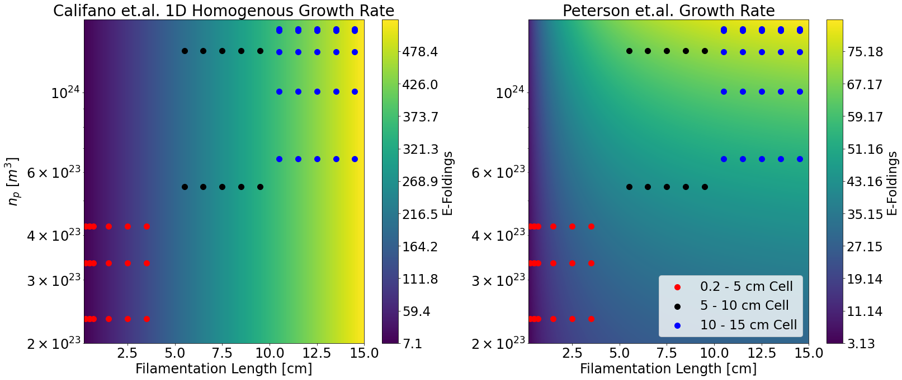
Example of Parameter Space Measured
Notes:
Say the laser ionized the plasma ahead of the electron beam

Slide 10
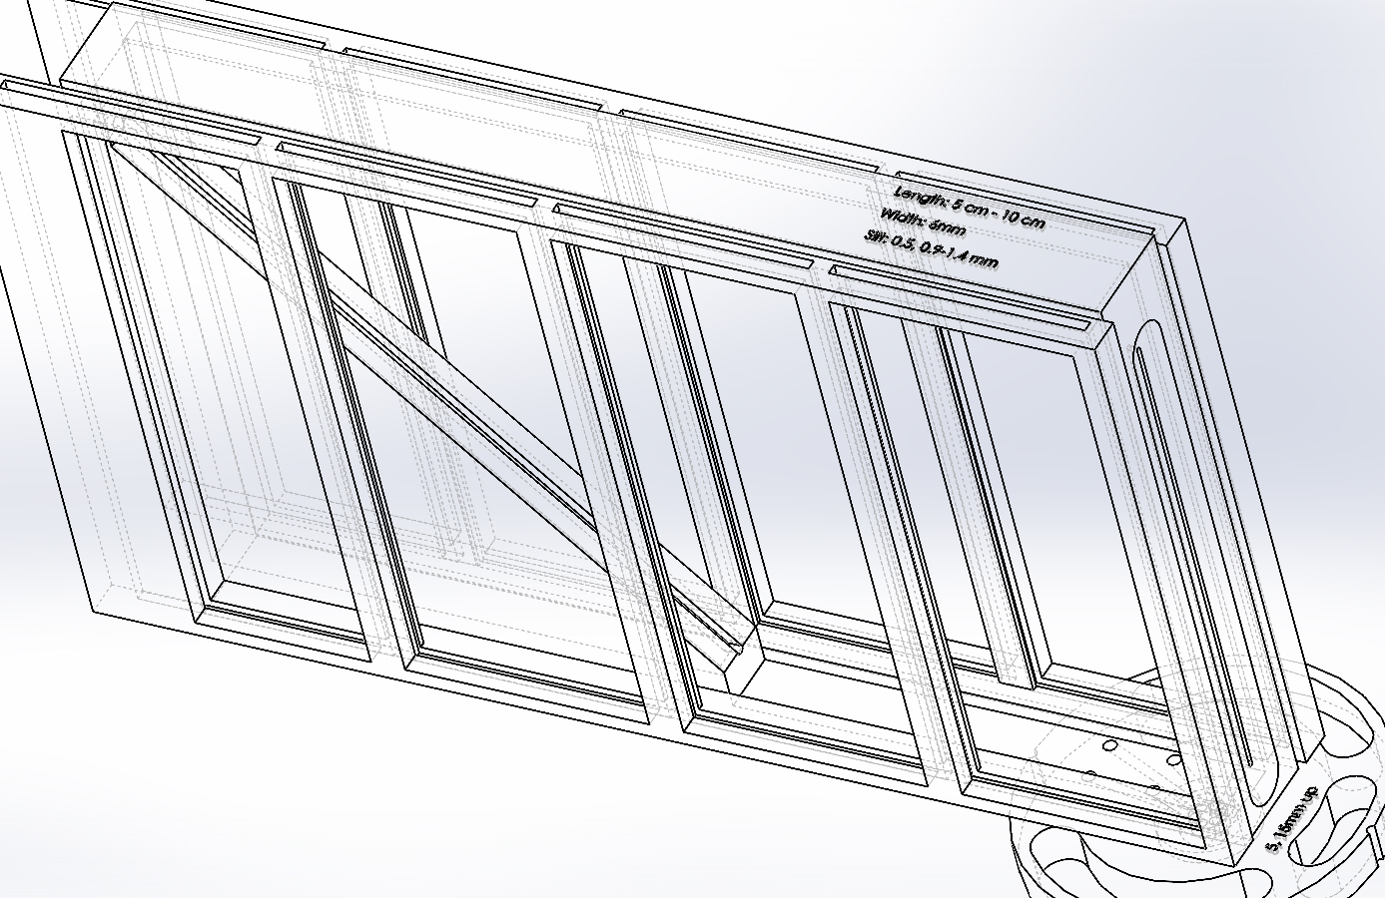
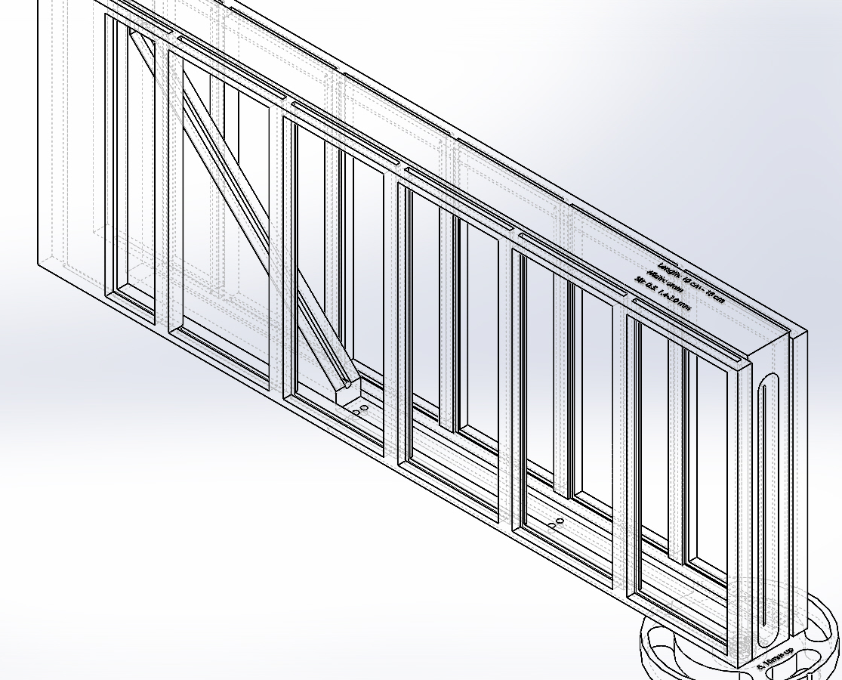
Filamentation Stage: Variable-Length Cell Designs
0.2 - 5 cm
5 - 10 cm
10 - 15 cm
Notes:
Optional???

Slide 11
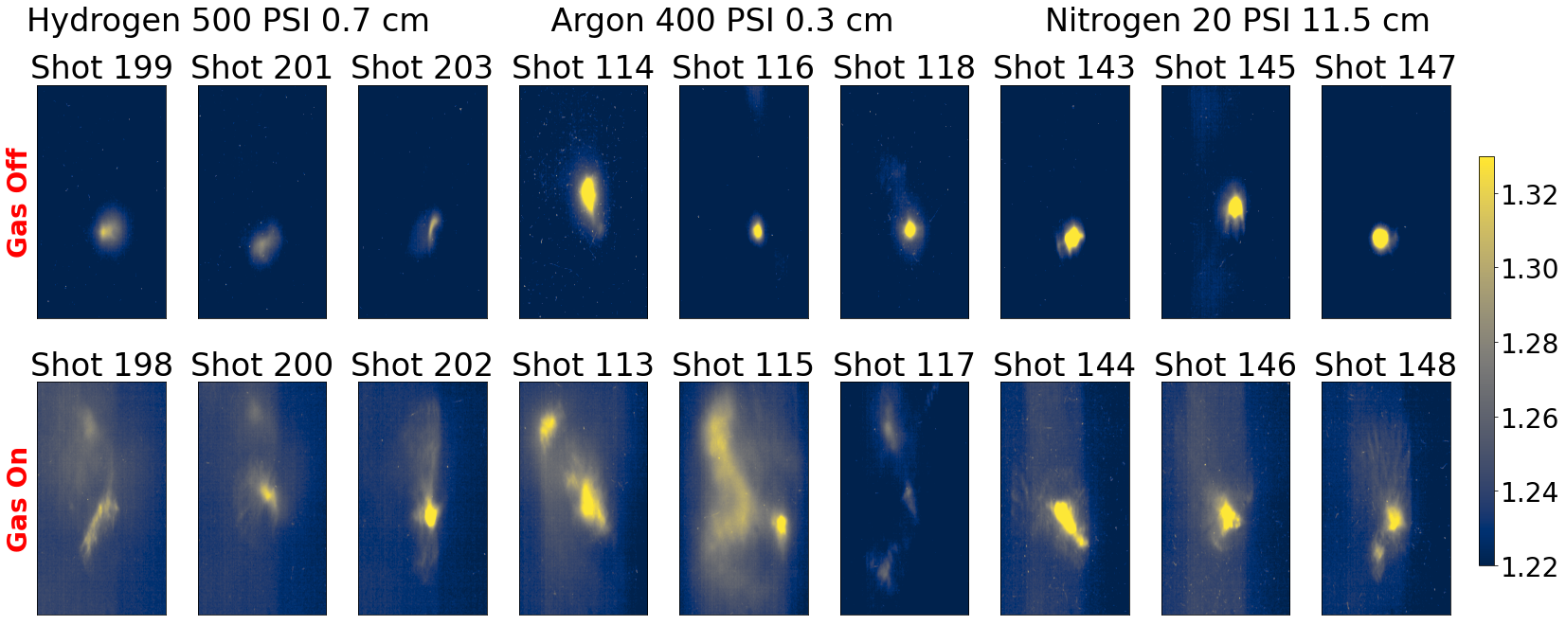
Sequential Off / On Test of Filamentation Gas Cell

Slide 12
Scanning Length of Instability for Similar Gas Densities
Longer

Slide 13
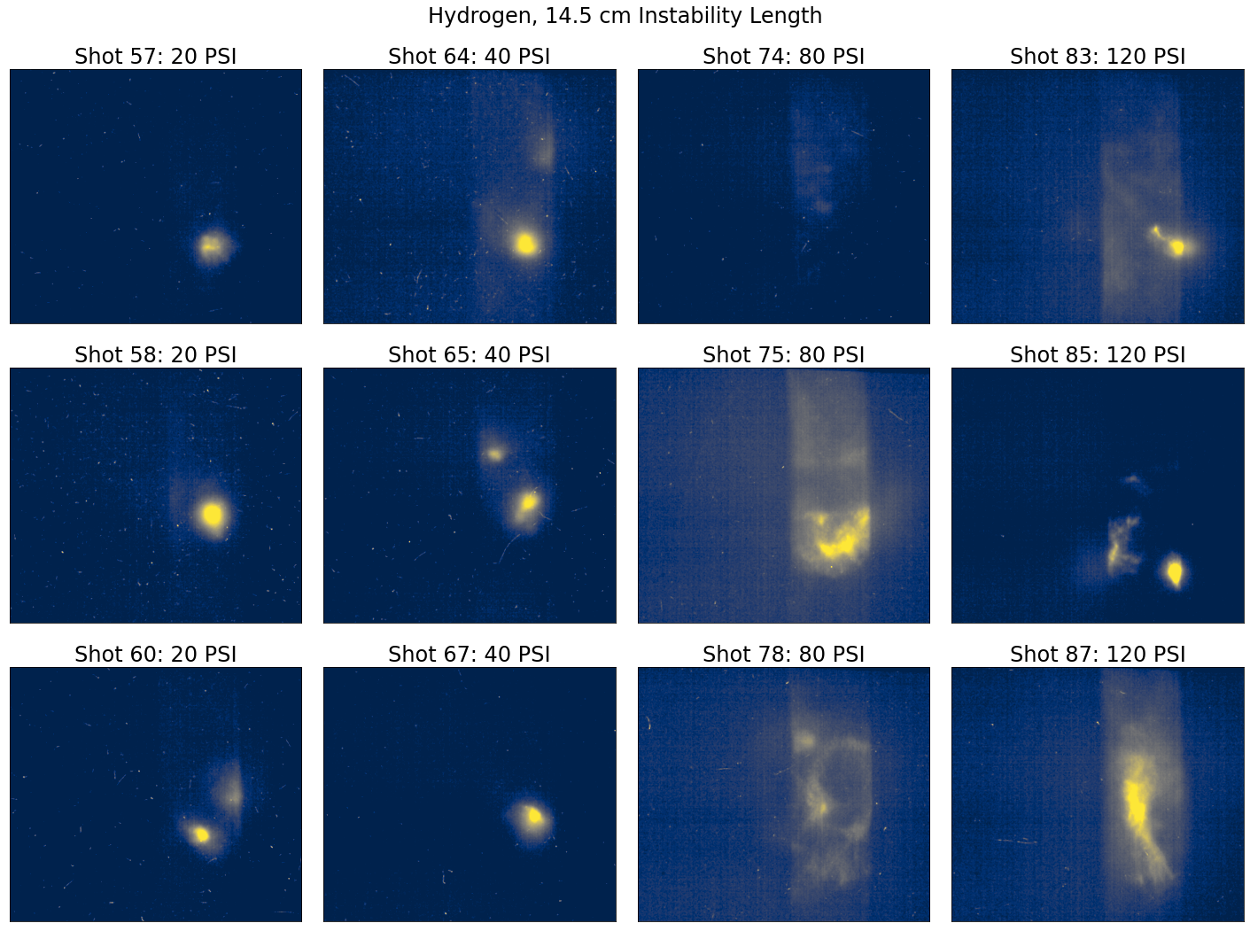
Scanning Plasma Density: Clear Dependence

Slide 14
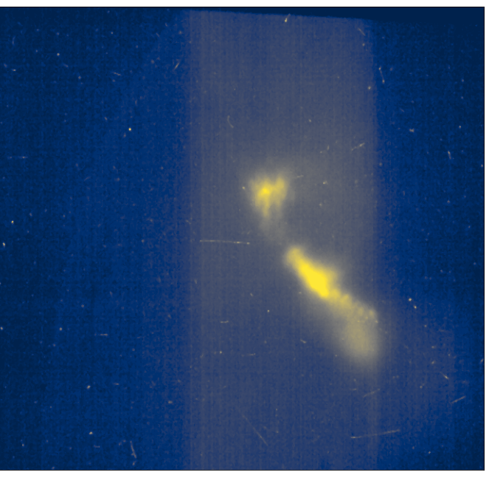
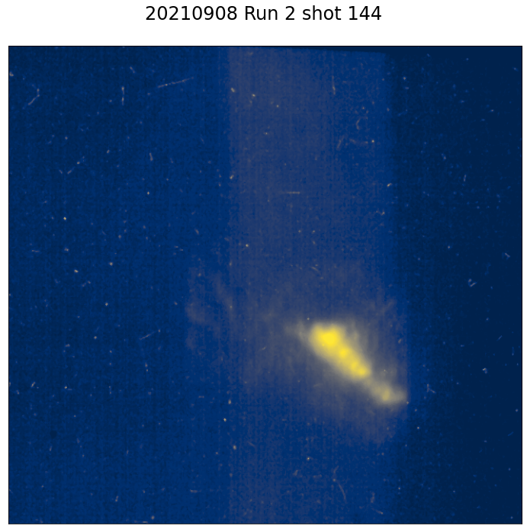
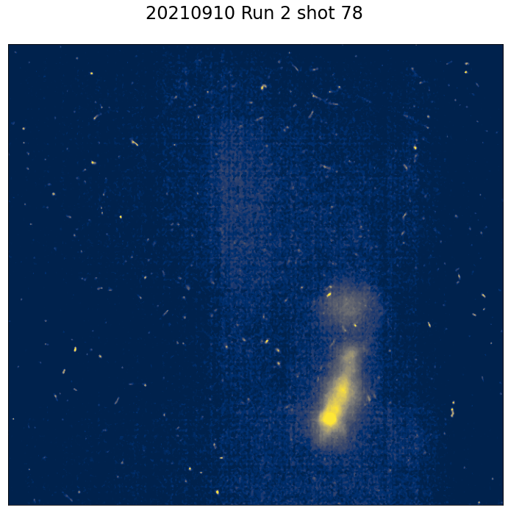
Conclusion / Ongoing Analysis
Filamentation was observed over a wide range of instability parameters.
Work is ongoing to quantify the growth rate as a function of the experiment’s parameter space.

Slide 15
Thank you! Questions?
Email: jcardar@umich.edu
Advanced Beam Laboratory!

Slide 16
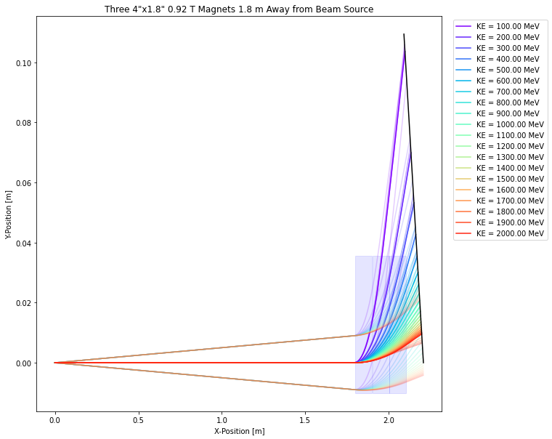
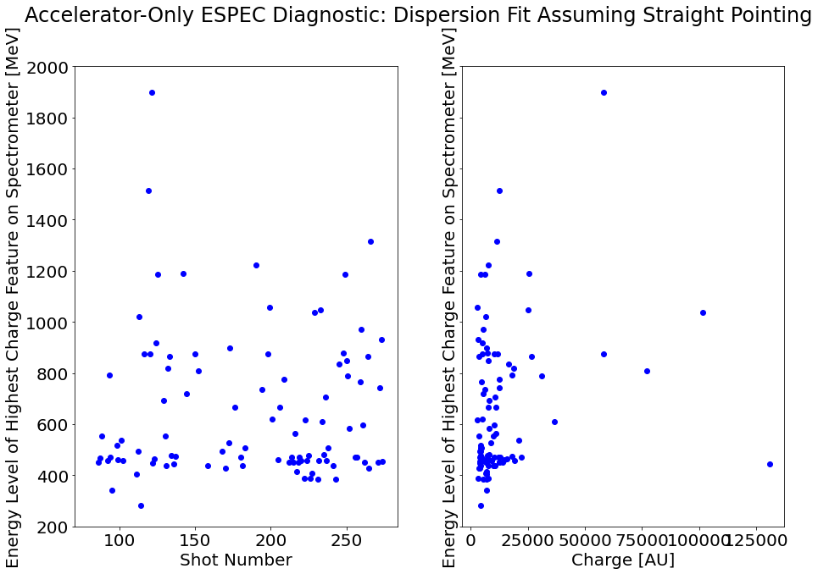
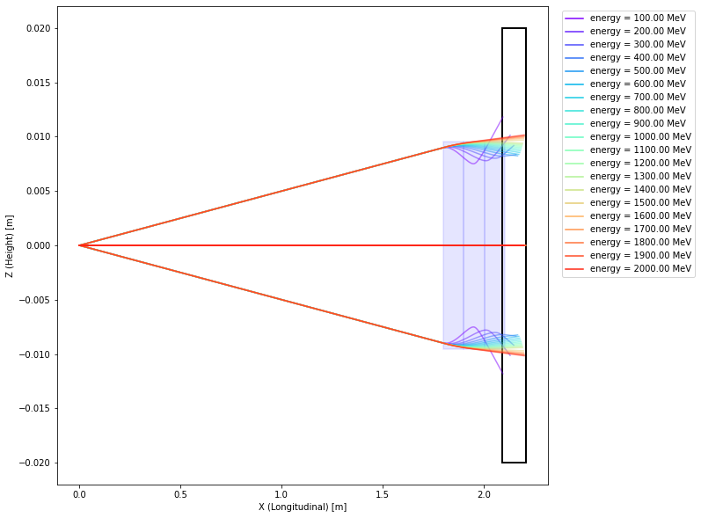
Extra: Spectrometer Measurements From CSU Setup
Notes:
Work on this slide more! Maybe include waterfall plots instead of spectrometer modelling?

Slide 17
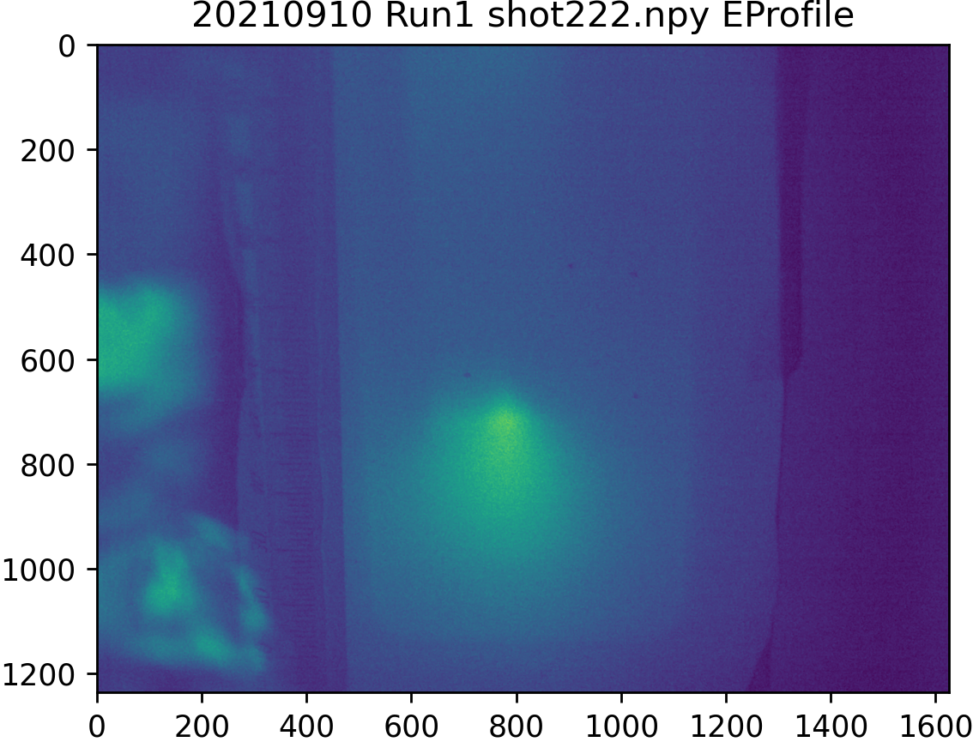
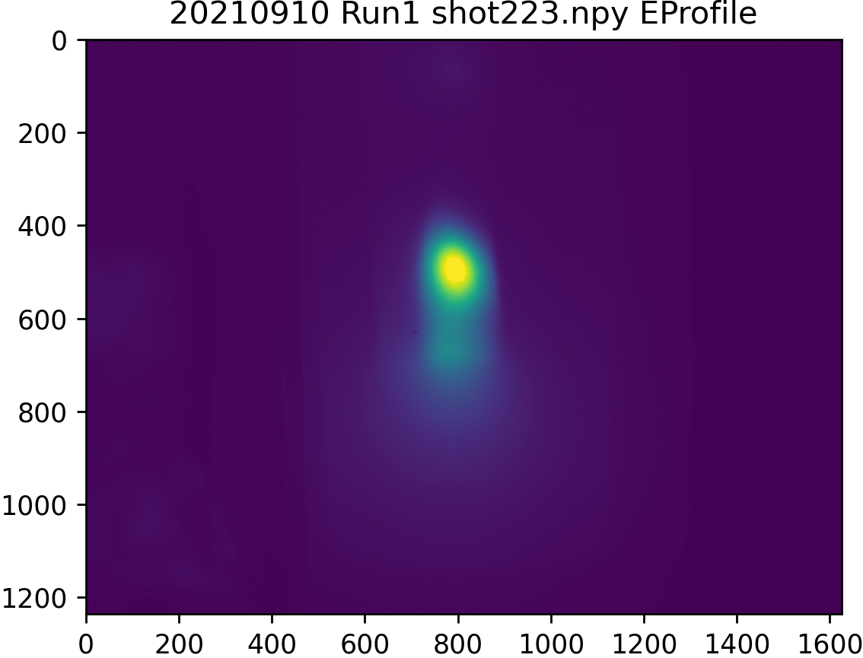
Extra: ESPEC On/Off test ~3 mm long, 500 PSI

Slide 18
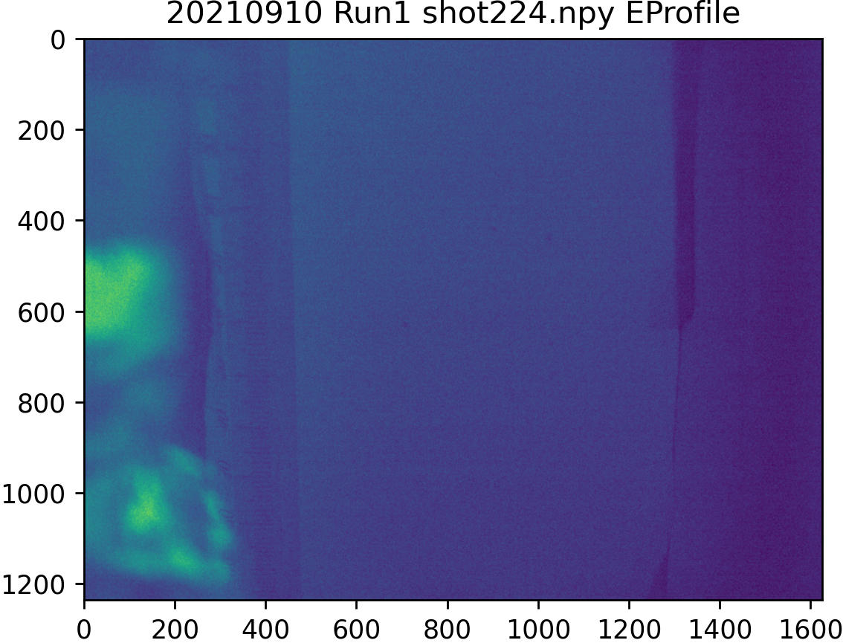
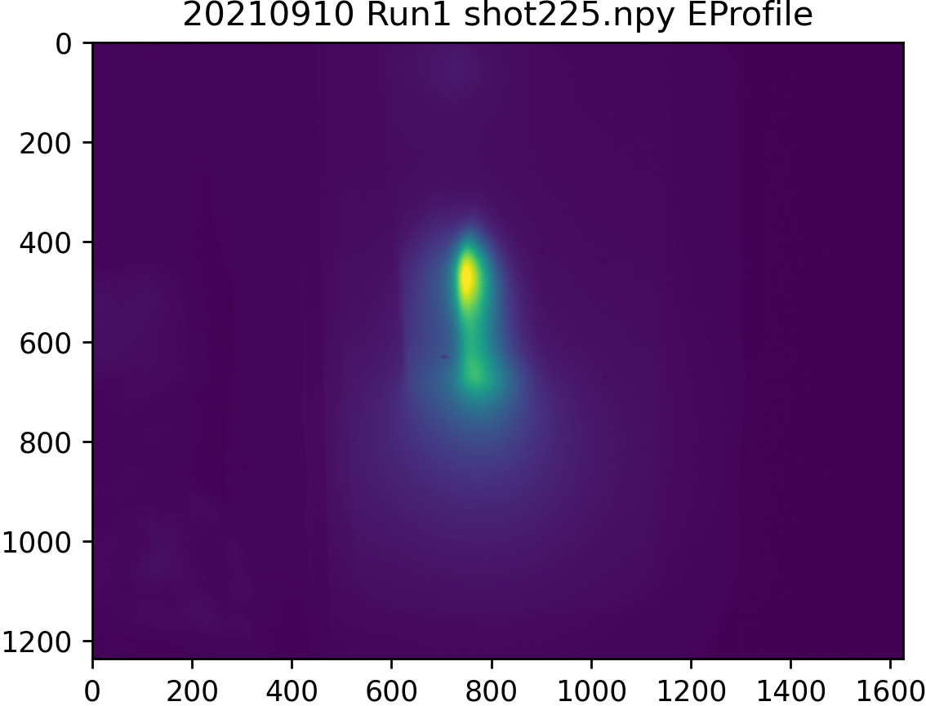
Continued...

Slide 19
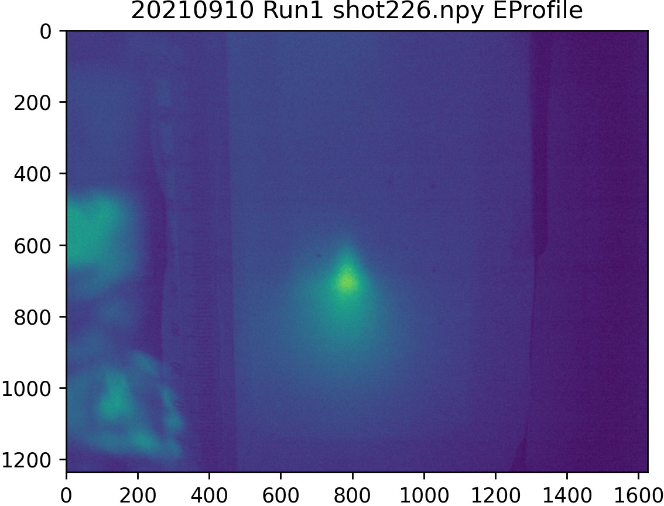
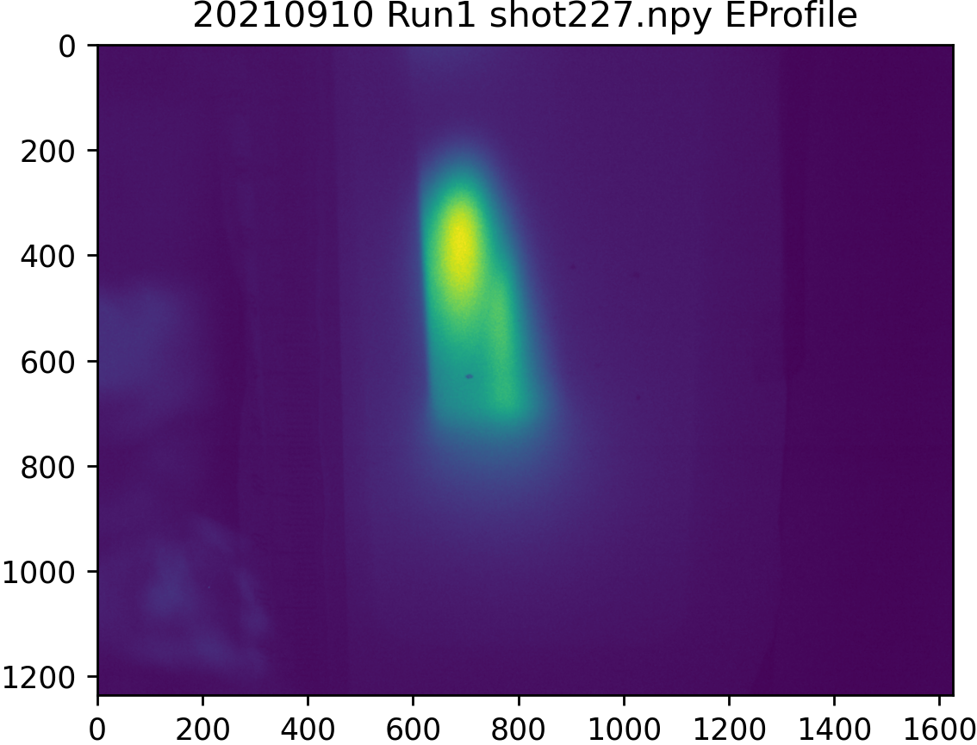
Continued...

