Slide 1
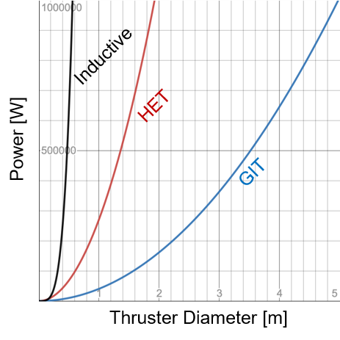
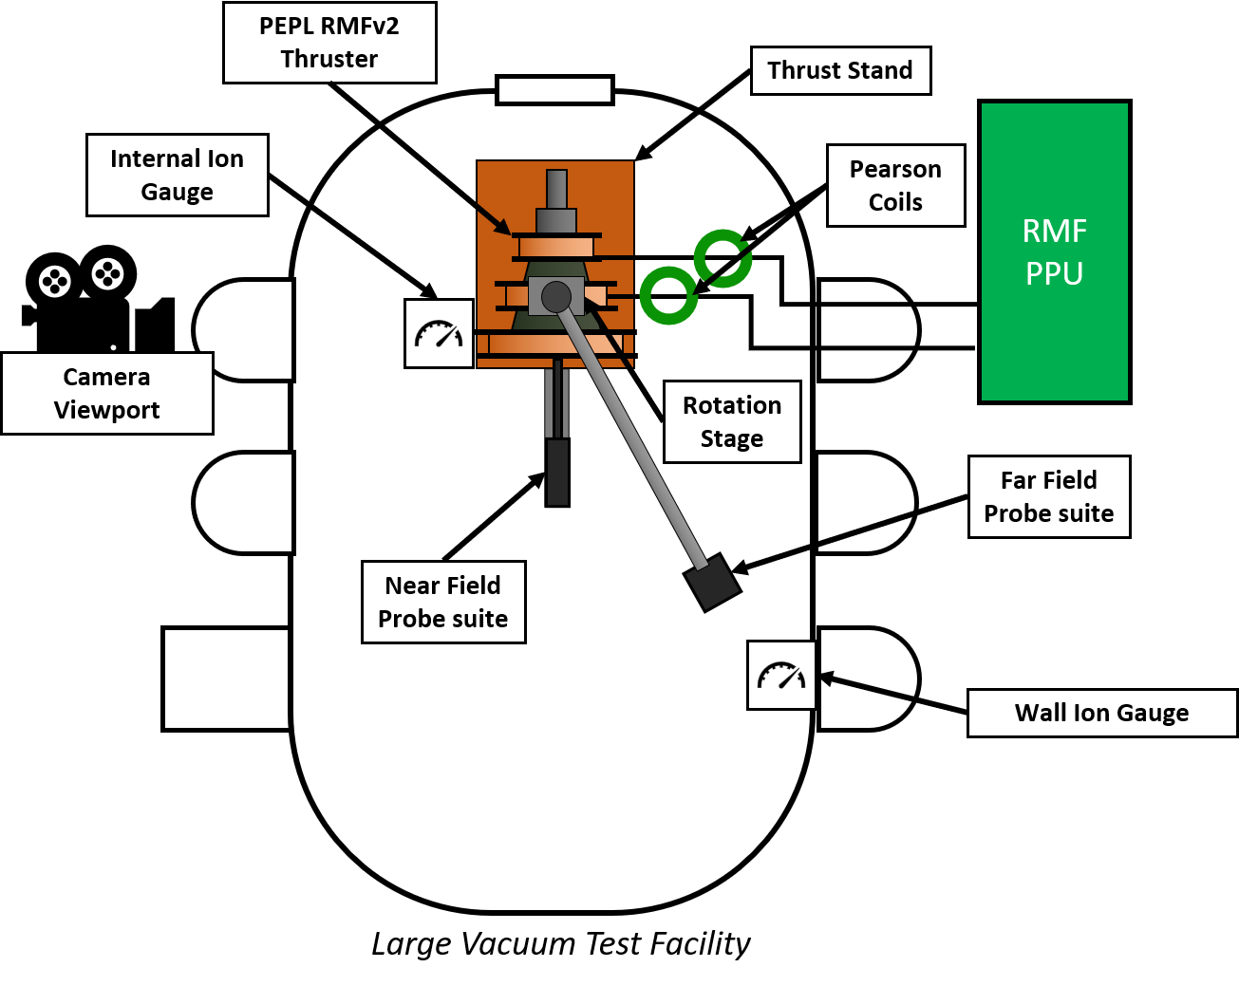
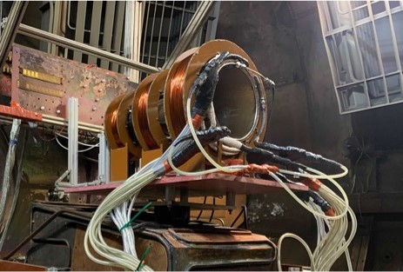
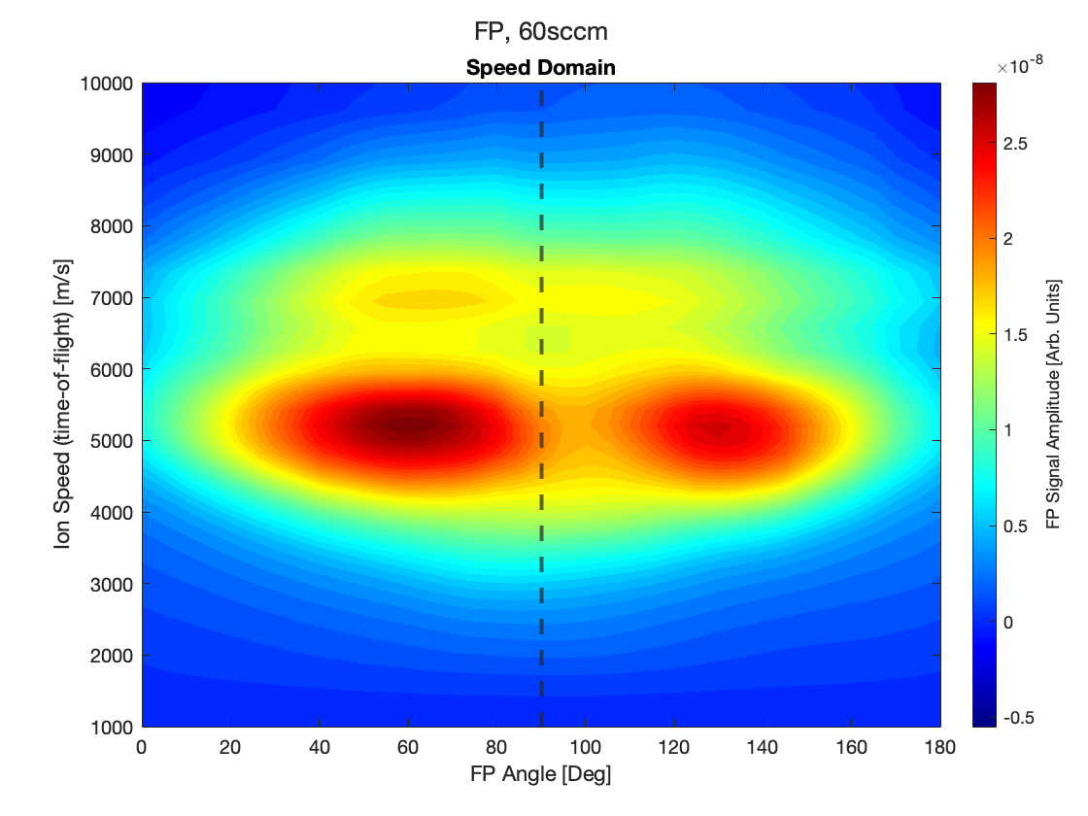
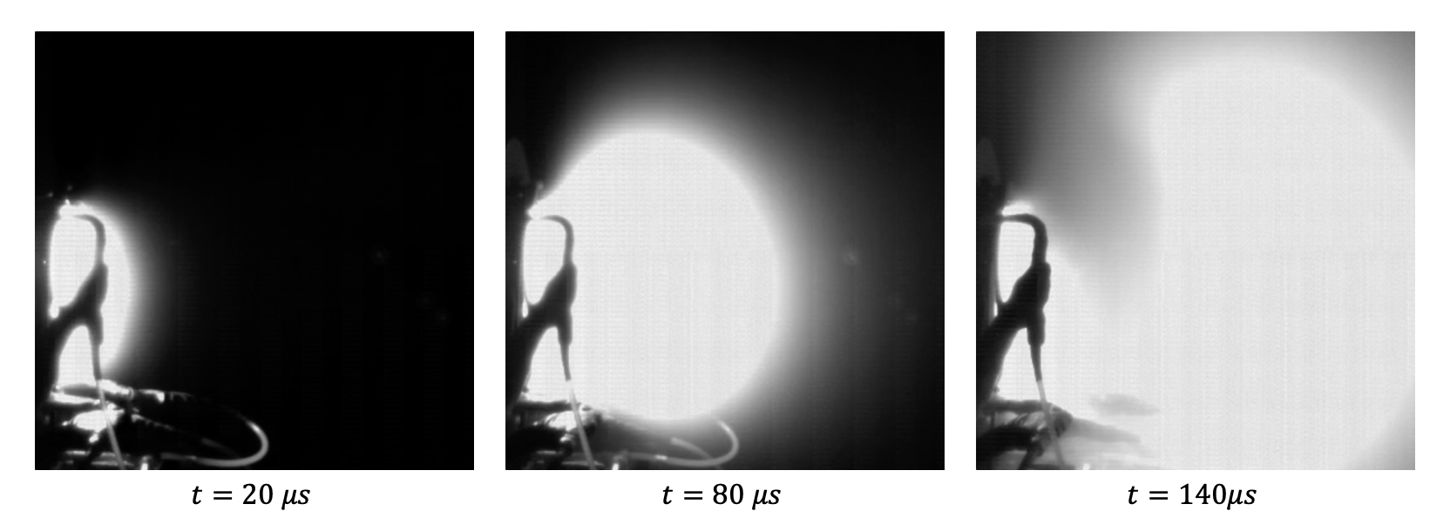
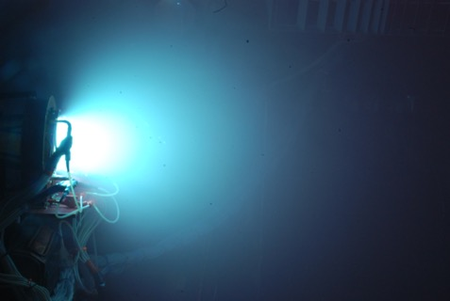
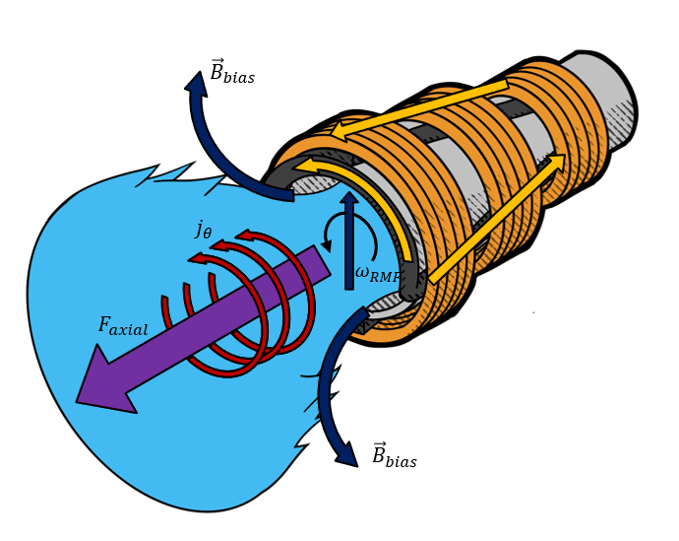
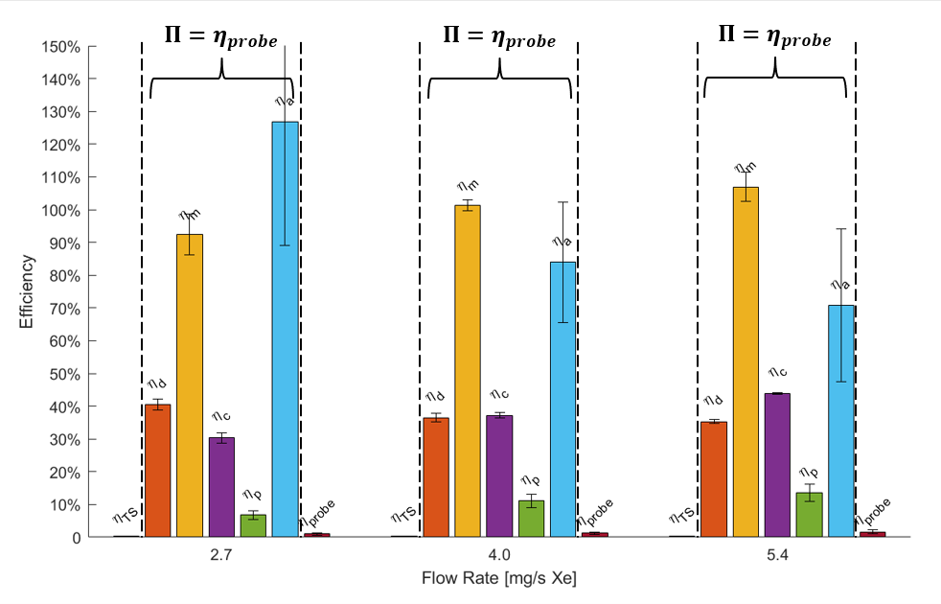
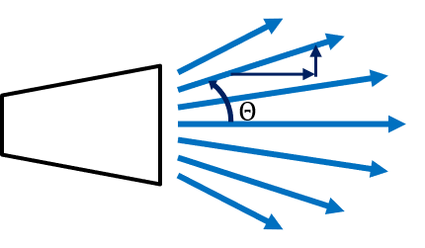
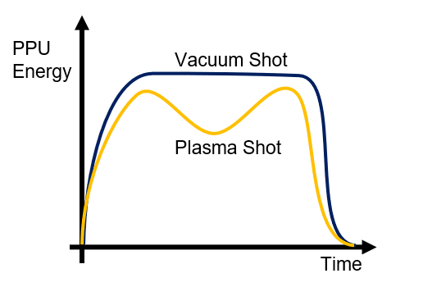
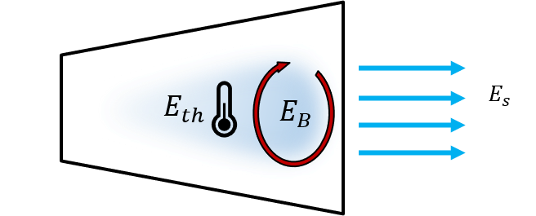
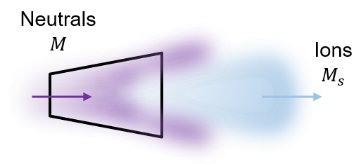
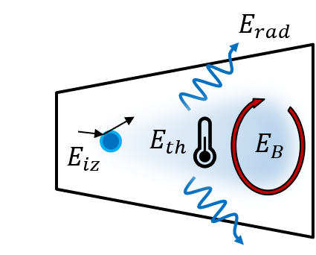
Far-Field Measurements of a Rotating Magnetic Field Thruster
Tate Gill, Christopher Sercel, Joshua Woods, and Benjamin Jorns
University of Michigan, Department of Aerospace Engineering, Ann Arbor, MI 48109
Introduction
Experimental Setup
Discussion
The rotating magnetic field (RMF) drive is an inductive pulsed plasma thruster (IPPT) architecture that promises favorable scaling above 100 kW [1]
IPPTs have demonstrated efficiencies of over 50% and have been the focus of several experimental efforts [2, 3]
Performance measurements of RMF thrusters remain below theoretical predictions with < 10% efficiency [4, 5]
Mass Utilization
Mass utilization efficiencies on the order of 100% contradict previous hypothesis from numerical work [6]
Neutral mass lost because of low duty cycle (1%) not accounted for mass utilization
Toroidal shape of FP measurement is evidence for magnetic field reversal
Two ion populations may be present
Fast inductively driven
Slower charge exchange from downstream neutral collisions
Inductive B-dot probes
Langmuir probe
Faraday probe
Retarding Potential Analyzer
Pearson coils
Objectives
Develop a phenomenological efficiency model to describe the loss mech-anisms in an RMF thruster system.
Establish the role of these different efficiency losses in our RMF test article using plasma diagnostic techniques.
$$E_{p}=E_{b}+E_{th}+E_{iz}+E_{rad}+…$$
Results
$$E_{rad}=\int{n^{2}<σ_{ex}>\overline{v_{e}}ε_{ex}V dt}$$
Plasma Efficiency
Thermal and magnetic energy in plasma is a lower bound estimate
${(η}_{p}η_{a})$ is physically representative measure
Ionization energy is a relatively small cost < 0.15% absorbed ($E_{p}$)
Radiation losses from excitation collisions are significant factor (4e18 m⁻³ measured)
Phenomenological Efficiency Model
Thruster Operation
Antennas fire in sequence to spin up RMF ($ω_{RMF}≫Ω_{i}$)
RMF induces axial electron plasma currents and fully ionizes gas
Axial currents couple to radial fields which drives azimuthal electron current
Azimuthal current pushes off radial bias field and accelerates plasma via the Lorentz force ($F=j_{θ}×B_{r}$)
$$E_{rad}$$
Near unity mass utilization and acceleration efficiencies
RMF is sufficiently ionizing and accelerating propellant
Low plasma efficiency ~10%
90% of energy coupled into plasma is lost
Flow [mg/s] | $E_{p}$ [J] | $E_{ke}$ [J] | $E_{iz}$ [J] | $E_{rad}$ [J]
2.7 | 11.8 ± 0.5 | 1.0 ± 0.2 | 0.15 | 0.8 ± 0.2
4.0 | 15.6 ± 0.2 | 1.5 ± 0.2 | 0.23 | 1.6 ± 0.4
5.4 | 21.3 ± 0.1 | 2.1 ± 0.5 | 0.31 | 3.2 ± 0.7
Phenomenological Efficiency Model
Conclusions & Future Work
$$η= \frac{I^{2}}{2ME_{in}}=η_{d}η_{m}η_{c}η_{p}η_{a}$$
$η$ = total jet efficiency
$I$ = impulse
$M$ = input neutral mass
$E$ = energy input from RMF
The performance and energy flow in our RMF test article has been experimentally characterized. Mass utilization efficiency was measured above 90% for all measured flowrates and plasma efficiency was measured on the order of 10% indicating vast majority of RMF energy lost though other channels.
Divergence
Coupling
Acceleration
Future Work
Further characterize energy loss in the near-field
Additional measurements of radiative, wall, and anomalous wave losses
Visualization of ion/neutral dynamics
Mass Utilization
Plasma
References
[1] K. A. Polzin, et al., Aerospace 7(8), 105 (2020).
[2] P. G. Mikellides and C. Neilly, J. Prop. Power 23(1), 51-58 (2007).
[3] K.A. Polzin, J. Prop. Power 27(3), 512-531 (2011).
[4] T. E. Webber, U. of Washington Thesis. (2010)
[5] C. L. Sercel, et al., AIAA Prop. and Energy 2021 Forum. (2021).
[6] J. Brackbill, et al., J. Prop. Power 30, 1450–1458 (2014)
Contact Tate Gill
tategill@umich.edu
Work supported by NASA NSTGRO grant number 80NSSC20K1168 and NASA NSTRF grant number 80NSSC18K1190

