Slide 1
Controlling Charged Particle Dynamics and Nanometer Scale SiO2 Etching in Ar/CF4/O2 Plasmas
via Voltage Waveform Tailoring
Florian Krüger¹, Seungbo Shim², Hyunjae Lee²,
Sang-Ki Nam² and Mark J. Kushner¹
¹Department of Electrical Engineering and Computer Science
University of Michigan, Ann Arbor, MI 48109-2122 USA
²Samsung Electronics Ltd., Suwon-si, Gyeonggi-do 443-742, South Korea
fkrueger@umich.edu, mjkush@umich.edu,
http://uigelz.eecs.umich.edu
12th Annual MIPSE Graduate Student Symposium, 2021
* Work supported by the National Science Foundation, Samsung Electronics Co. Ltd. and Tokyo Electron Ltd.

Slide 2
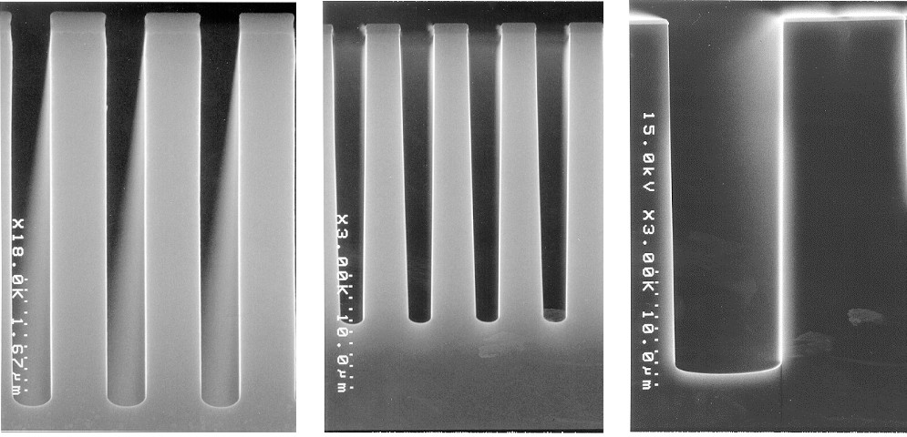
PLASMA ETCHING
Modern semiconductor fabrication relies on plasma based dry etch processes to generate nanometer scale features
Capacitively coupled plasmas are a very common tool used in these processes
Key requirements in these processes are straight sidewalls and consistent etch rates
Most of these processes require perpendicular incident ions
This is especially relevant with high aspect ratio (HAR) features
University of Michigan
Institute for Plasma Science & Engr.
Wu et al, Journal of Applied Physics 108, 051101 (2010)

Slide 3
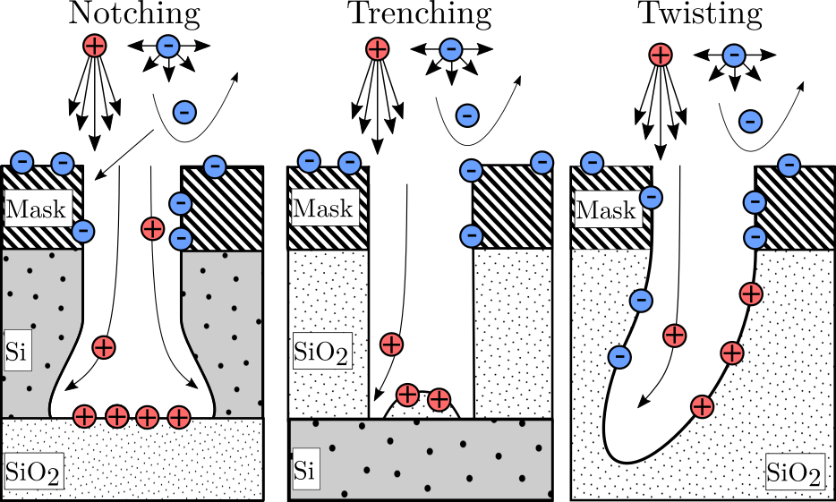
ETCH DEFECTS
The dynamics of charging of HAR features is largely governed by
Ions: narrow angular distributions and high energy
Electrons: Broad angular distribution and low energy
This can result in negative charging of the top of the feature and positive charging of lower parts.
The resulting electric field can deflect incoming ions and cause unwanted feature deformation such as notching, trenching and twisting
Previous work has shown that the charged particle EADs onto wafers in rare gas CCPs can be controlled by voltage waveform tailoring (VWT).
This work aims to show a direct causal link between the applied voltage waveform and quality of the etched feature.
University of Michigan
Institute for Plasma Science & Engr.

Slide 4
ELECTRIC FIELD REVERSAL
Positive and negative fluxes to the wafer must balance over time
$$\overline{Γ_{i}}=\overline{Γ_{e}}$$
In a radio frequency (RF) excited discharge, electron flux to the wafer only occurs during sheath collapse
If diffusive electron transport is insufficient to balance the ion flux, electrons must be accelerated toward the surface by electric field reversal in the sheath region.
Increase electric field reversal by limiting electron transport
Short sheath collapse
Steep flanks
University of Michigan
Institute for Plasma Science & Engr.

Slide 5
ELECTRIC ASYMMETRY EFFECT
Even in geometrically symmetric CCP-systems a DC self-bias can be generated through the well documented electrical asymmetry effect (EAE)
This effect is a function of the absolute extrema of the applied voltage:
It has been shown to be controlled by the even harmonics of constructed waveforms.
University of Michigan
Institute for Plasma Science & Engr.

Slide 6
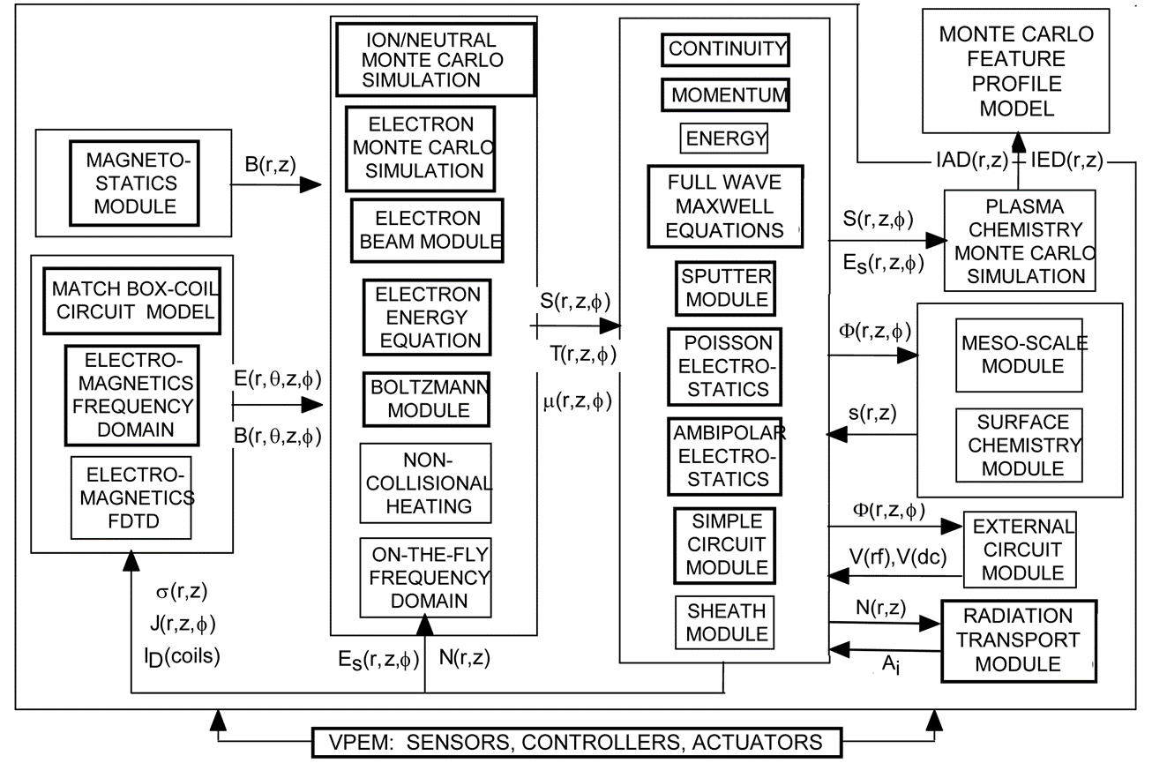
HYBRID PLASMA EQUIPMENT MODEL (HPEM)
University of Michigan
Institute for Plasma Science & Engr.

Slide 7
2-FREQUENCY CCP WITH VWT
Ar/CF₄/O₂ (75:15:10)
Flow Rate: 500 sccm
Pressure: 40 mTorr
Top Electrode:
Sinusoidal,
500 W,
80 MHz
Bottom Electrode:
Tailored Waveform,
1MHz,
1 kW / 2 kW
University of Michigan
Institute for Plasma Science & Engr.

Slide 8
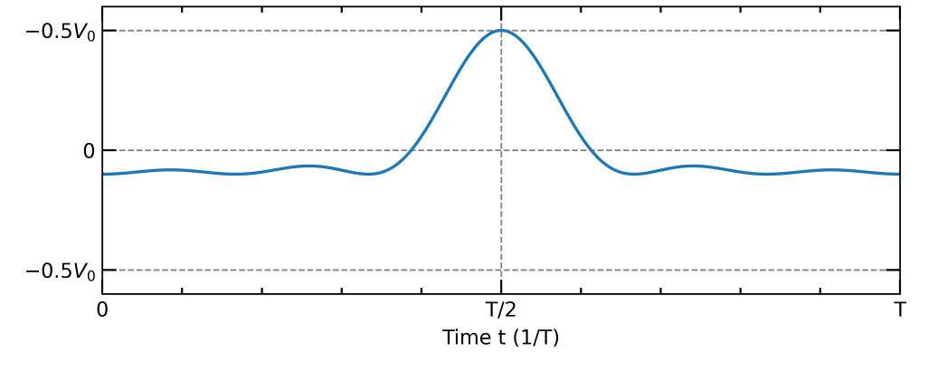
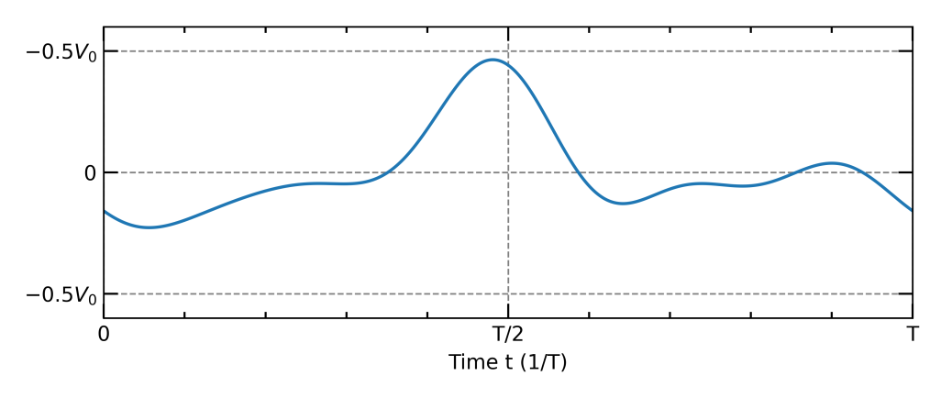
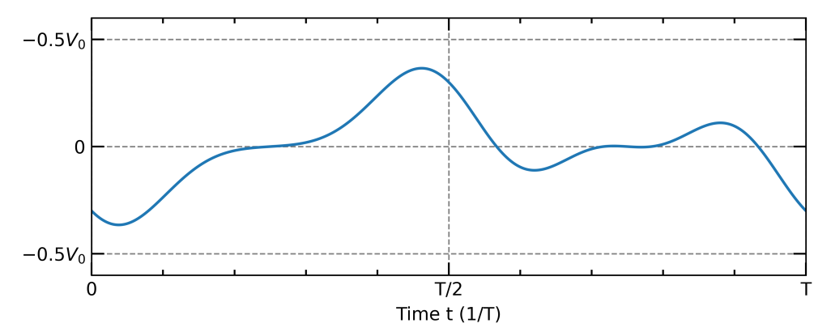
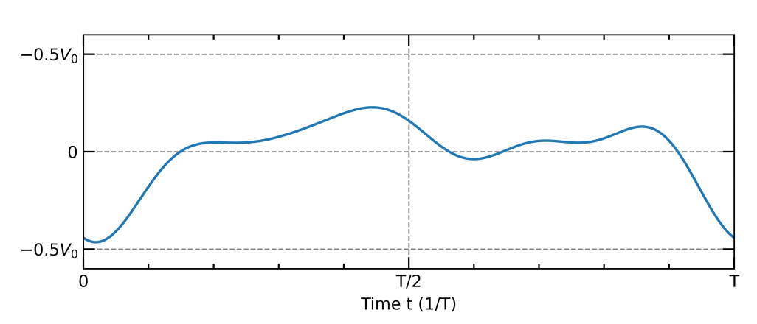
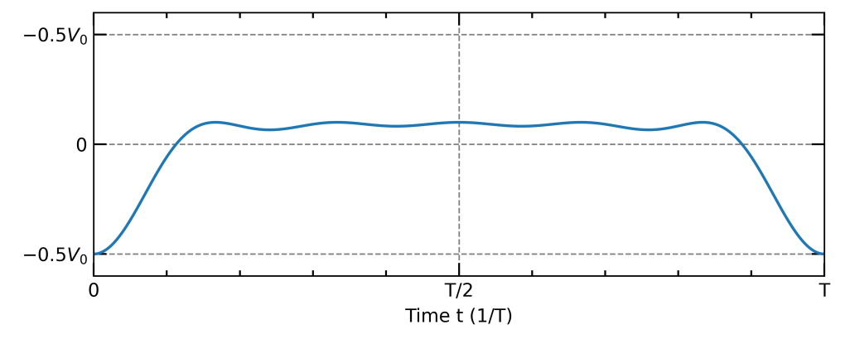
VWT Ar/CF₄/O₂ WAVEFORMS
0° (peak)
45°
90°
135°
180°(valley)
The phase angle controls the fractional time span during which the applied voltage is high (sheath collapsed) or low (sheath expanded)
The expected sheath collapse is shortest for 0°(peak) and longest for 180 °(valley)
University of Michigan
Institute for Plasma Science & Engr.

Slide 9
VWT IEADs TO WAFER – 500 W, 1000 W
0° 45° 90° 135° 180°
The ion distributions onto the wafer reflect the trend of the DC self-bias.
The mean and peak ion energies decrease with phase angle.
Due to the low fundamental frequency, ions might be responsive to sheath dynamics, producing the wide energy spread and multi peak structures.
Energy (eV)
Angle ( °)
2 decade log scale
University of Michigan
Institute for Plasma Science & Engr.
min max

Slide 10
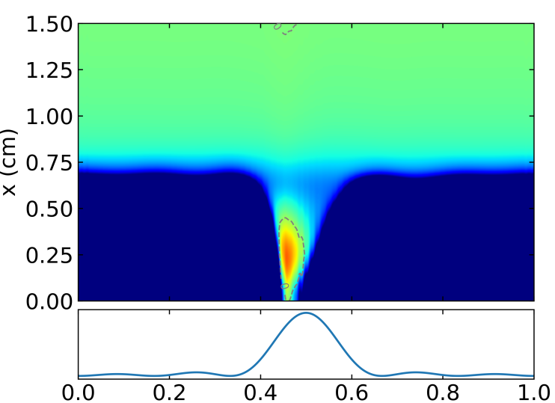
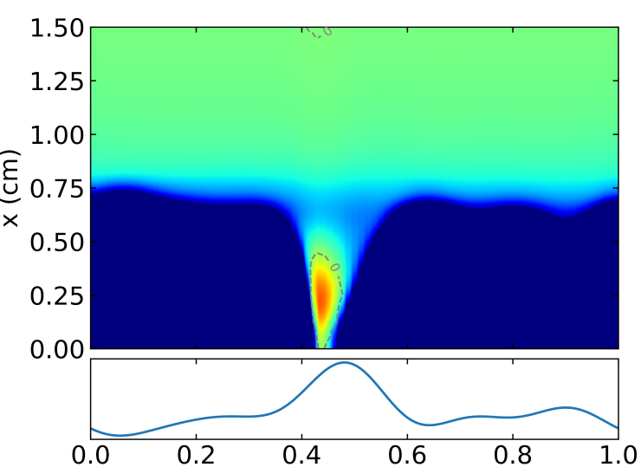
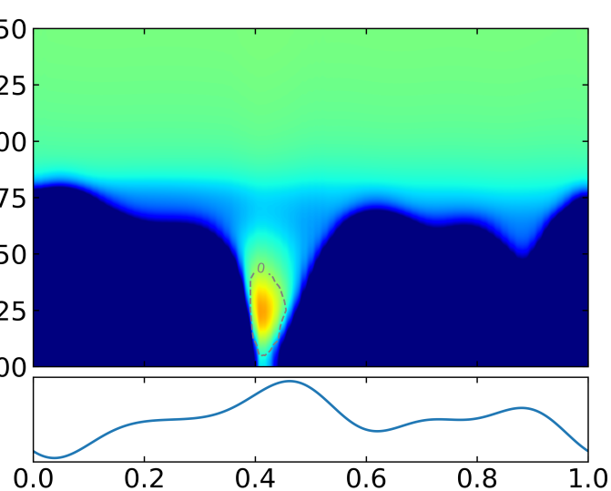
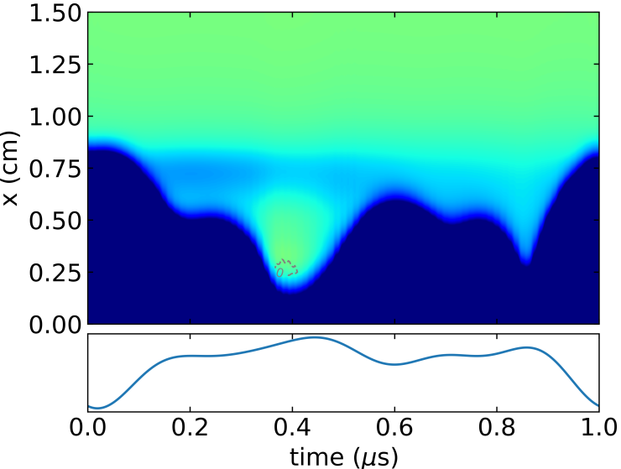
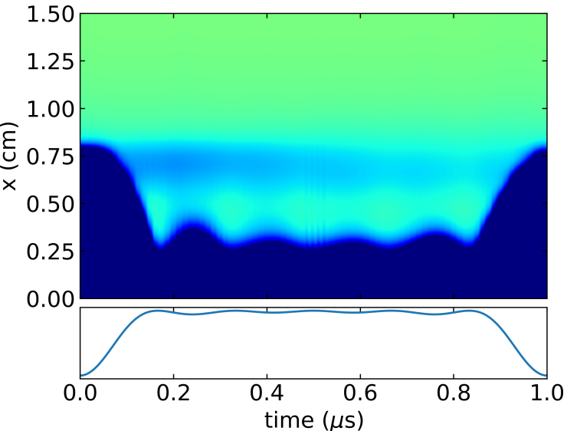
ELECTRIC FIELD REVERSAL – 500 W, 1000 W
0° 45° 90°
135° 180°
Electric Field (V/cm)
-100 -50 0 50 100
500 W Top
1000 W Bottom
Magnitude of EFR is a strong function of the phase shift – minimal at 180º and increases with decreasing phase angle.
University of Michigan
Institute for Plasma Science & Engr.

Slide 11
VWT EEADs TO WAFER – 500 W, 1000 W
0° 45° 90° 135° 180°
The electron distributions onto the wafer correspond to the electric field reversal generated by the tailored voltage waveforms.
At low phase shifts, when the sheath collapse is particularly short and rapid, high energy directional electrons are generated.
Energy (eV)
Angle ( °)
2 decade log scale
University of Michigan
Institute for Plasma Science & Engr.
min max

Slide 12
VWT IEADs TO WAFER– 500 W, 2000 W
0° 45° 90° 135° 180°
At higher electrode power, the peak and mean ion energies increase
The major trends present before are still present in the 2 kW case
Energy (eV)
500 W Top
2000 W Bottom
Angle ( °)
2 decade log scale
University of Michigan
Institute for Plasma Science & Engr.
min max

Slide 13
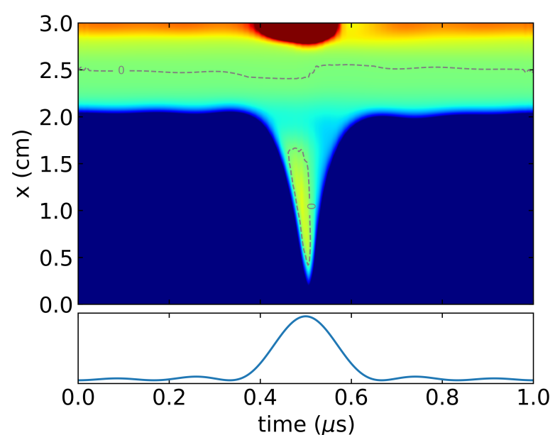
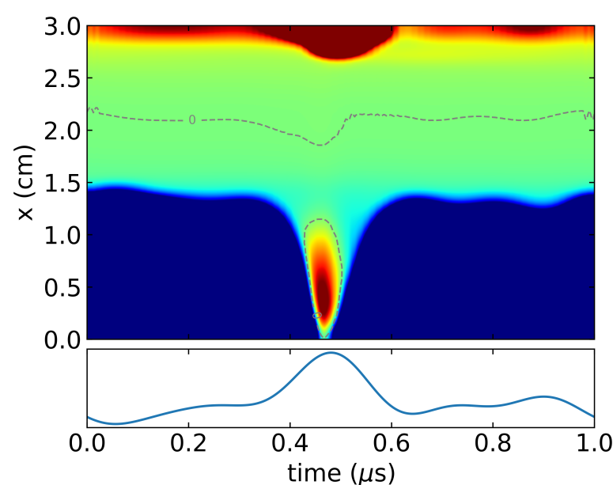
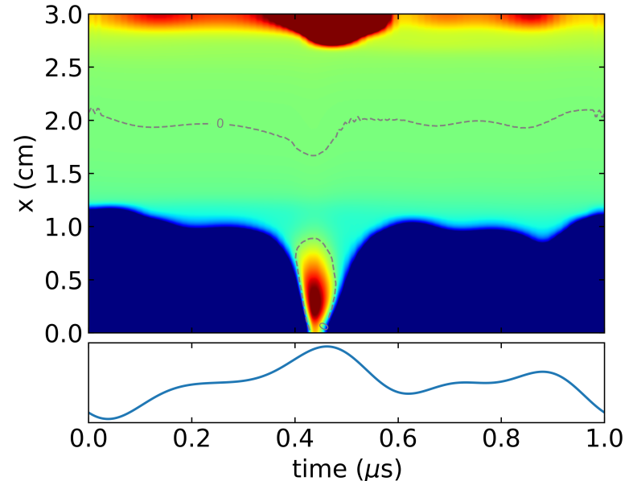
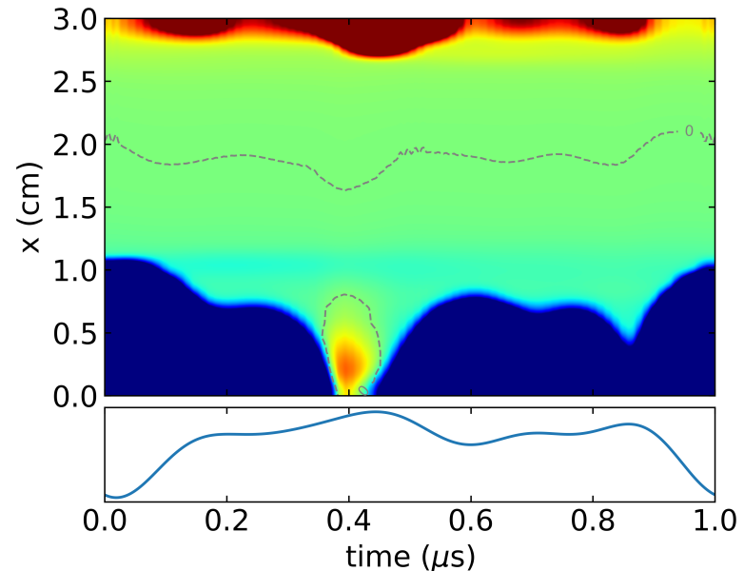
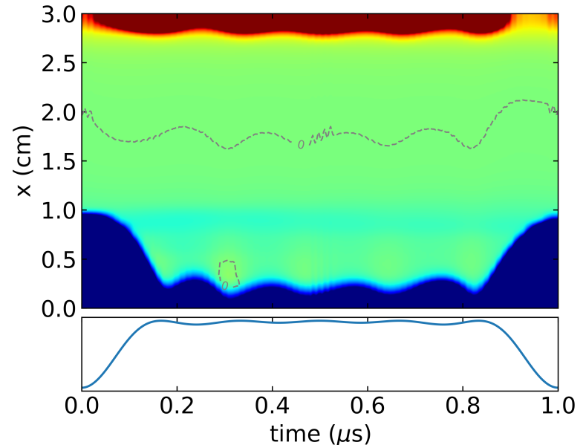
ELECTRIC FIELD REVERSAL – 500 W, 2000 W
0° 45° 90°
Electric Field (V/cm)
135° 180°
-100 -50 0 50 100
500 W Top
2000 W Bottom
Higher electric field reversal
University of Michigan
Institute for Plasma Science & Engr.

Slide 14
VWT EEADs TO WAFER – 500 W, 2000 W
0° 45° 90° 135° 180°
At higher power, the trends in electron distributions are analogous to those of the previous case
A notable exception is the 0°(peak waveform) case
Due to secondary geometrical geometry effects its field reversal is severely dampened
Energy (eV)
500 W Top
2000 W Bottom
Angle ( °)
2 decade log scale
University of Michigan
Institute for Plasma Science & Engr.
min max

Slide 15
SiO₂ ETCH SETUP
100 nm
A SiO₂ feature etch was simulated using the Monte Carlo Feature Profile Model (MCFPM)
MCFPM is a kinetic voxel based feature scale simulation tool used to simulate the etching of nanometer scale semiconductors
Particles are launched according to the fluxes and distributions sampled from the HPEM gas phase simulations
Surface reactions are determined by a statistical Monte Carlo approach
Mask opening = 100 nm
Etch time 15 min
700 nm
3000 nm
SiO₂
PR
University of Michigan
Institute for Plasma Science & Engr.

Slide 16
SiO₂ ETCH MECHANISM
100 nm
The mechanism includes:
Polymer deposition by CF_{x}
Polymer removal by
Oxidation
Physical sputtering
SiO₂ removal via
Chemical etching
Sputtering of generated surface Si_{x}O_{y}F_{z} complexes
Physical sputtering
Physical sputtering of photoresist
700 nm
3000 nm
SiO₂
PR
University of Michigan
Institute for Plasma Science & Engr.

Slide 17
VWT FEATURE ETCH - 500 W 2000 W
0° 45° 90° 135° 180°
The differences in charged particle distributions translates to differences in etched feature profiles and rates.
Higher ion energy allows for more effective polymer removal, direct as well as chemically assisted sputtering.
Given equal ratios of polymerizing and ion fluxes, the observed differences are most likely due to ion energy dependence of polymer removal and sputter rates.
500 W Top
2000 W Bottom
University of Michigan
Institute for Plasma Science & Engr.

Slide 18
VWT FEATURE ETCH - 500 W 2000 W
0° 90° 180°
VWT - thermal
VWT - thermal
VWT - thermal
Comparing etch with self-consistently determined electron distribution with artificially generated 3 eV thermal distribution
The directional high energy electrons enable higher etch rates
The difference is largest where the incident electron energy is highest (90°case)
However, ultimately the highest etch rate is determined by the highest ion energy (0°case)
University of Michigan
Institute for Plasma Science & Engr.

Slide 19
VWT FEATURE ETCH – 500 W, 1000 W
VWT thermal
To investigate the influence of the EEAD, etching was simulated using the actual EEAD with a thermal electron distribution.
The thermal electron distribution produces a reduced etch rate and more bowing in the feature.
The electric potential in the feature using the EEAD of the VWT case is significantly lower.
The lower potential indicates superior surface charge neutralization by the highly directional and energetic electrons.
Potential
-100 V 500 V
500 W Top
1000 W Bottom
University of Michigan
Institute for Plasma Science & Engr.

Slide 20
CONCLUSION
We computationally investigated the use of non-sinusoidal voltage waveforms on the charged particle dynamics in an Ar/CF₄/O₂ CCP
By changing the phase of the even harmonics significant control of electron and ion distributions can be achieved, as a result of
the electrical asymmetry effect and
the generation of electric field reversal in the sheath
Maximum energy and directionality of surface incident electrons as well as ions was observed for low phase angles, however, the EEADs are sensitive to secondary geometrical effects.
The direct ion energy dependence allows for control of the etch rate
Customizing the EEAD enabled better control of the sidewall slope during SiO₂ etching and increased etch rate – both attributed to reduction of in-feature charging.
University of Michigan
Institute for Plasma Science & Engr.

