Slide 1
PLASMA-PRODUCED REACTIVE SPECIES REACTIONS WITH LIQUID WATER DROPLETS*
Mackenzie Meyer¹, Gaurav Nayak², Peter Bruggeman², and Mark J. Kushner¹
¹University of Michigan, Ann Arbor, MI 48109-2122 USA ²University of Minnesota, Minneapolis, MN 55455 USA
maemeyer@umich.edu, mjkush@umich.edu
12th Annual MIPSE Graduate Student Symposium
17 November 2021
* Work supported by the National Science Foundation (PHY-1902878) and the Department of Energy Fusion Energy Sciences (DE-SC0020232).

Slide 2
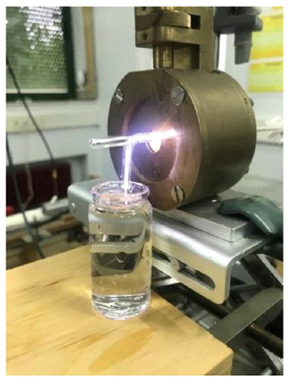
PLASMA-LIQUID INTERACTIONS
Plasma-liquid interactions play a pivotal role in plasma medicine and water treatment.
Reactive oxygen and nitrogen species can oxidize complex organic molecules and produce biologically active compounds.
Chemical activation of the liquid is limited by transport.
High surface to volume ratio of liquid enables rapid activation.
Producing reactive species near surface of liquid also enables rapid activation.
Argon plasma jet interacting with liquid water (E. Casado et al, Plasma Process Polym. E2000030 (2020)).
University of Michigan
Institute for Plasma Science & Engr.
MIPSE_2021

Slide 3
PLASMA-LIQUID INTERACTIONS
Interactions at the surface of the liquid are not well understood.
Sheath dynamics
Concentrated water vapor near the surface due to evaporation
Short-lived species dynamics
Reactions of short-lived species and water droplet are investigated by global chemistry modeling and 2D modeling.
Global modeling provides long timescale results, while 2D modeling shows spatial dependence.
Processes occurring in the plasma, interface, and bulk liquid.
University of Michigan
Institute for Plasma Science & Engr.
MIPSE_2021

Slide 4
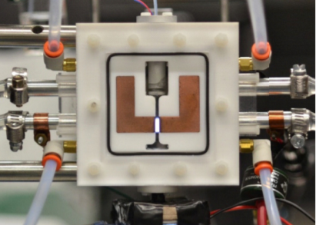
PLASMA-DROPLET APPARATUS
Experimental reactor is an atmospheric pressure radio frequency (RF) glow discharge.
Power: 5 – 15 W
Electrode separation: 2 mm
Varying gas mixtures (He, Ar, admixtures of molecular gases)
Water droplets (10s of microns in diameter) are entrained in the gas flow.
Formate (HCOO⁻_{aq}) dissolved in water reacts with OH as measure of OH transport into droplet.
Experimental plasma reactor (G. Oinuma et al, Plasma Sources Sci. Technol. 29 095002 (2020)).
University of Michigan
Institute for Plasma Science & Engr.
MIPSE_2021

Slide 5
GLOBAL CHEMISTRY MODELING
GlobalKin is a global plasma chemistry model solving for electron temperature, species densities, and gas temperature over time.
Diffusion losses are accounted for by specifying the area of materials in contact with the plasma and diffusion length.
GlobalKin includes a liquid module.
Interactions between the gas and liquid are diffusion and Henry’s law equilibrium.
Transport to droplet is specified by local diffusion length.
A separate reaction mechanism is used for the liquid.
Evaporation of water is considered by flux of water into the gas phase.
University of Michigan
Institute for Plasma Science & Engr.
MIPSE_2021

Slide 6
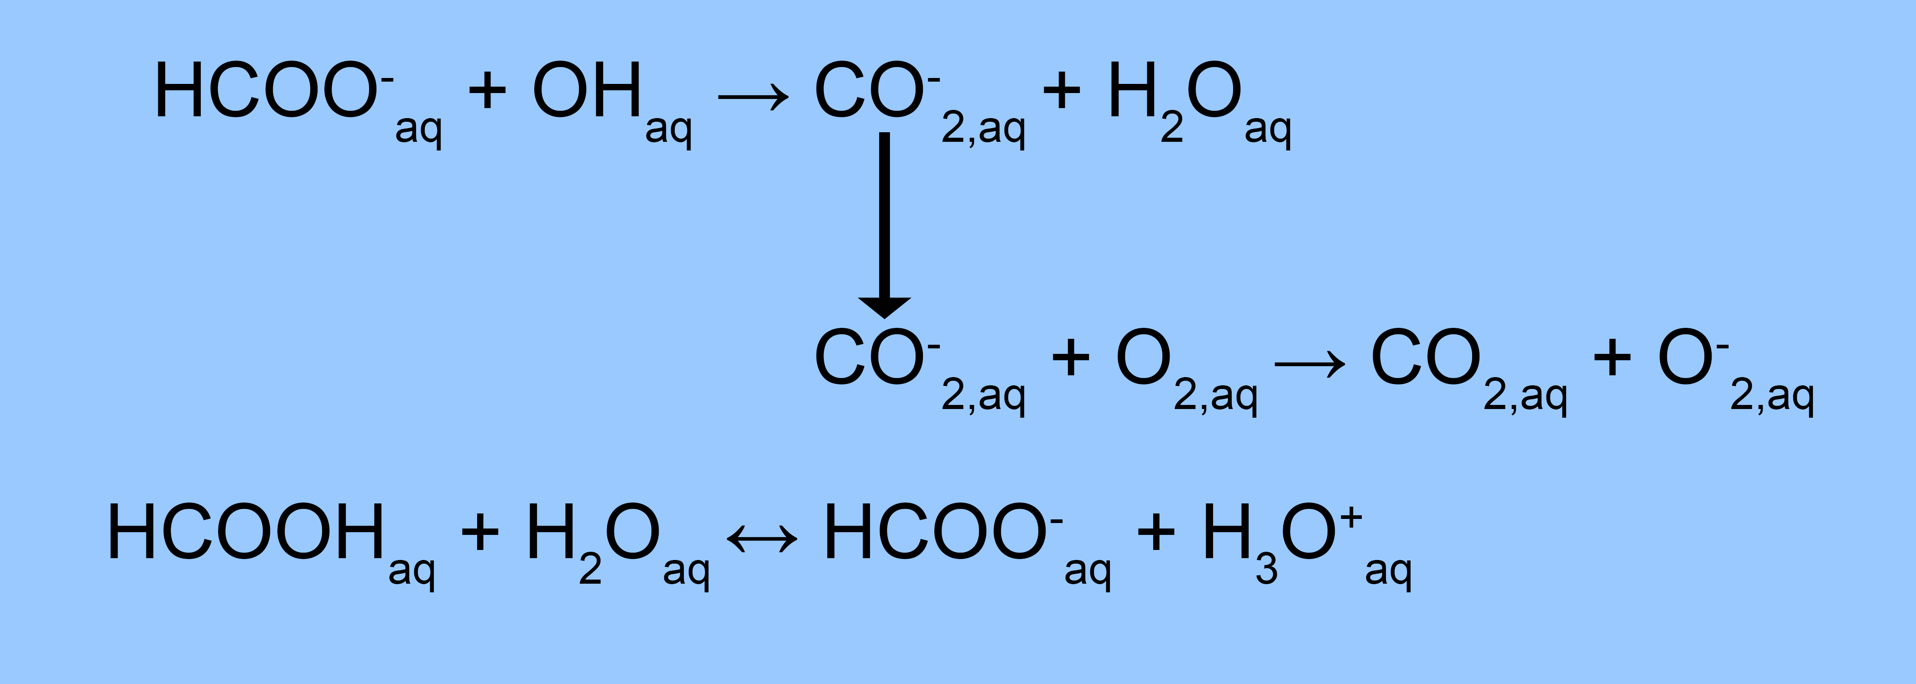
GLOBAL MODELING CONDITIONS, REACTION MECHANISM
Reactions involving formate in the liquid.
13.6 W for 10 ms, 100 ms total
Flow rate: 1 slm
He with air impurities (6 ppm N₂, 2.3 ppm H₂O, 1.5 ppm O₂)
56 µm diameter water droplet with 2 mM formate (HCOO⁻_{aq})
Volume between electrodes is analyzed (0.2 cm × 0.95 cm × 1.91 cm).
Formate reactions include equilibrium reactions with formic acid, reaction with OH.
University of Michigan
Institute for Plasma Science & Engr.
MIPSE_2021

Slide 7
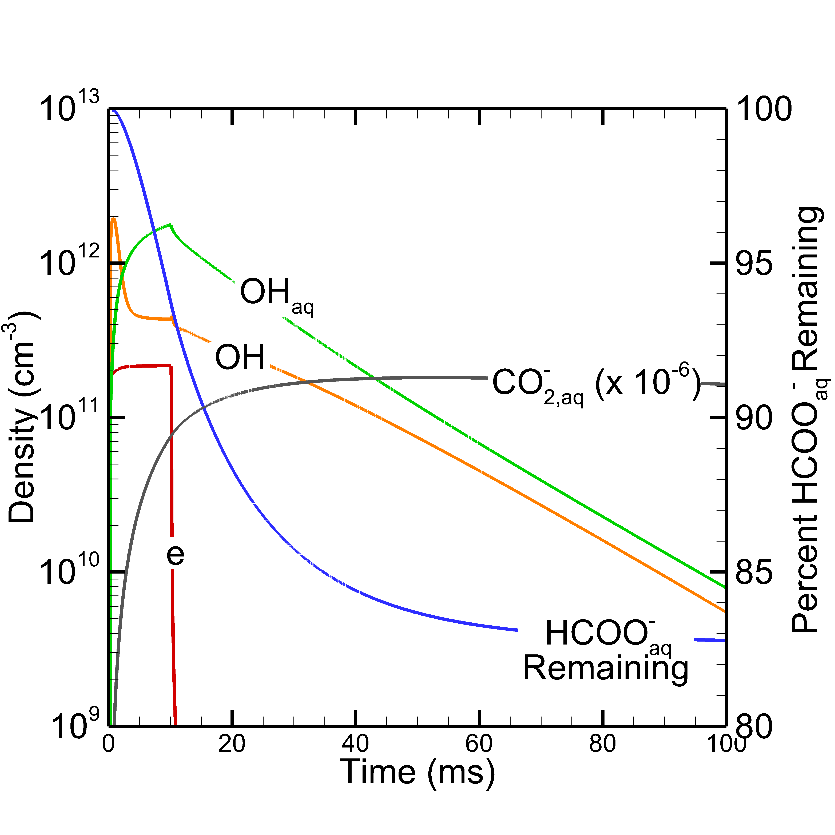
FORMATE DEGRADATION
Electron density is constant during residence time (power on period), rapidly decreases afterwards.
OH density decreases after initial spike and then slightly increases near residence time.
OH_{aq} density increases during residence time.
Both gas phase and aqueous OH densities decrease after the residence time.
CO⁻_{2,aq} density increases during residence time, reaches constant value after residence time.
Percent of HCOO⁻_{aq} remaining decreases during residence time, is 83% at 100 ms.
Species densities and formate degradation over 100 ms. Left axis is logarithmic.
University of Michigan
Institute for Plasma Science & Engr.
MIPSE_2021

Slide 8
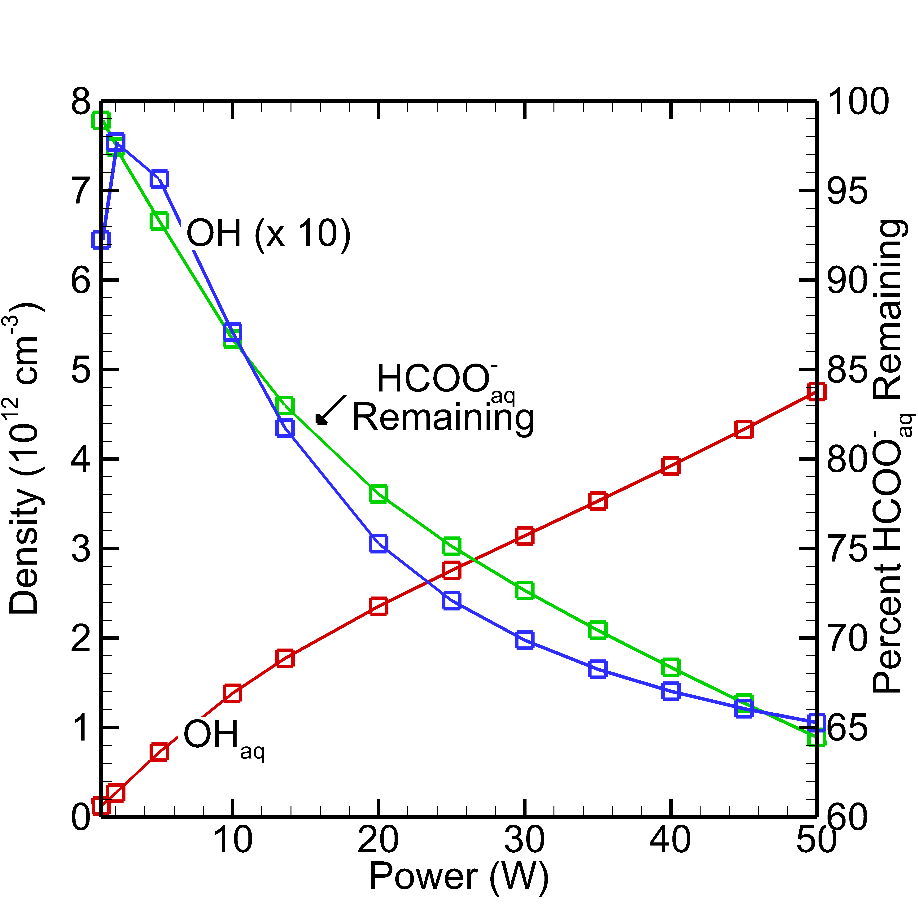
FORMATE DEGRADATION WITH VARYING POWER
Power value is changed.
As power increases beyond 2 W, OH density decreases.
OH_{aq} density increases as power increases.
Since OH_{aq} density increases, more reactions with HCOO⁻_{aq} occur.
Percent of HCOO⁻_{aq} remaining at 100 ms decreases because OH_{aq} density increases.
OH density and OH_{aq} density at residence time, and formate degradation at 100 ms.
University of Michigan
Institute for Plasma Science & Engr.
MIPSE_2021

Slide 9
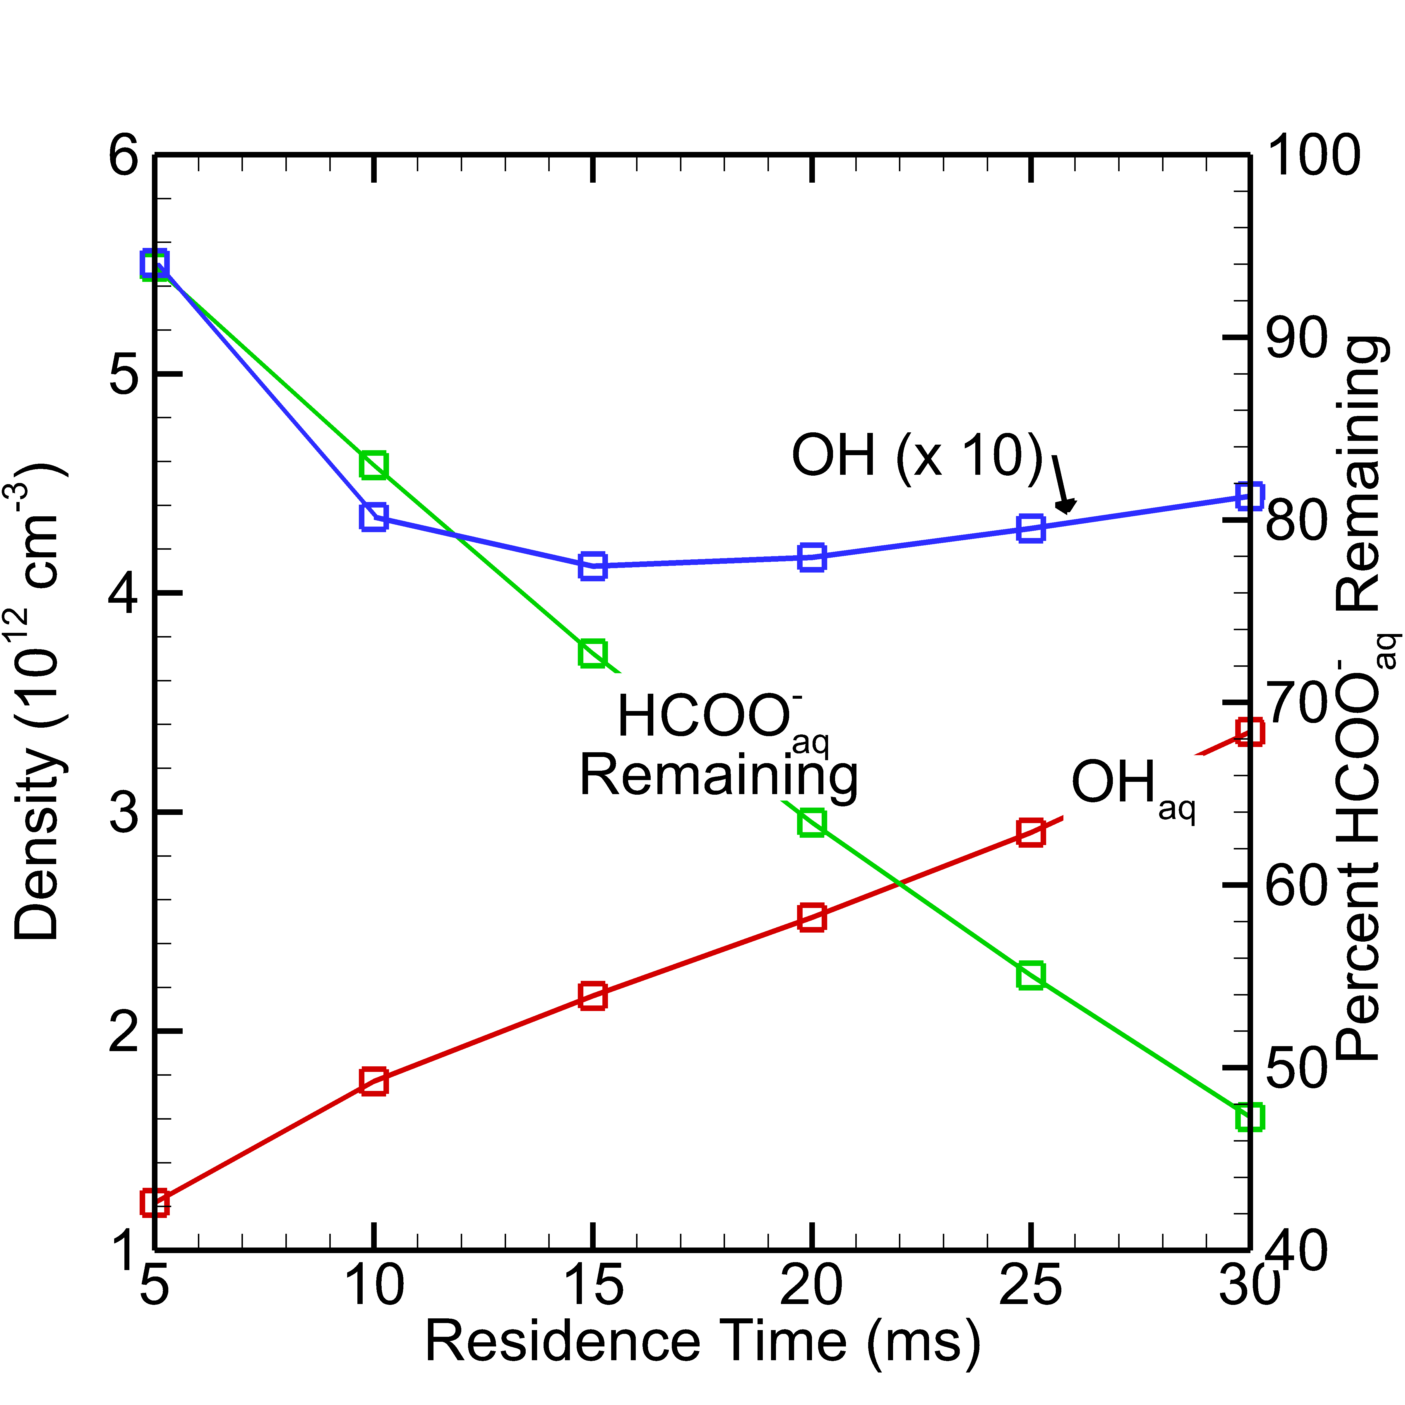
FORMATE DEGRADATION WITH VARYING RESIDENCE TIME
Residence time (power on time) is changed, and flow rate is adjusted.
OH density decreases for short residence times as H₂O is being depleted.
OH density increases at long residence times due to replenishment of H₂O by evaporation.
Lengthening residence time increases OH_{aq} density.
Percent of HCOO⁻_{aq} remaining at 100 ms decreases because OH_{aq} density increases.
OH density and OH_{aq} density at residence time, and formate degradation at 100 ms.
University of Michigan
Institute for Plasma Science & Engr.
MIPSE_2021

Slide 10
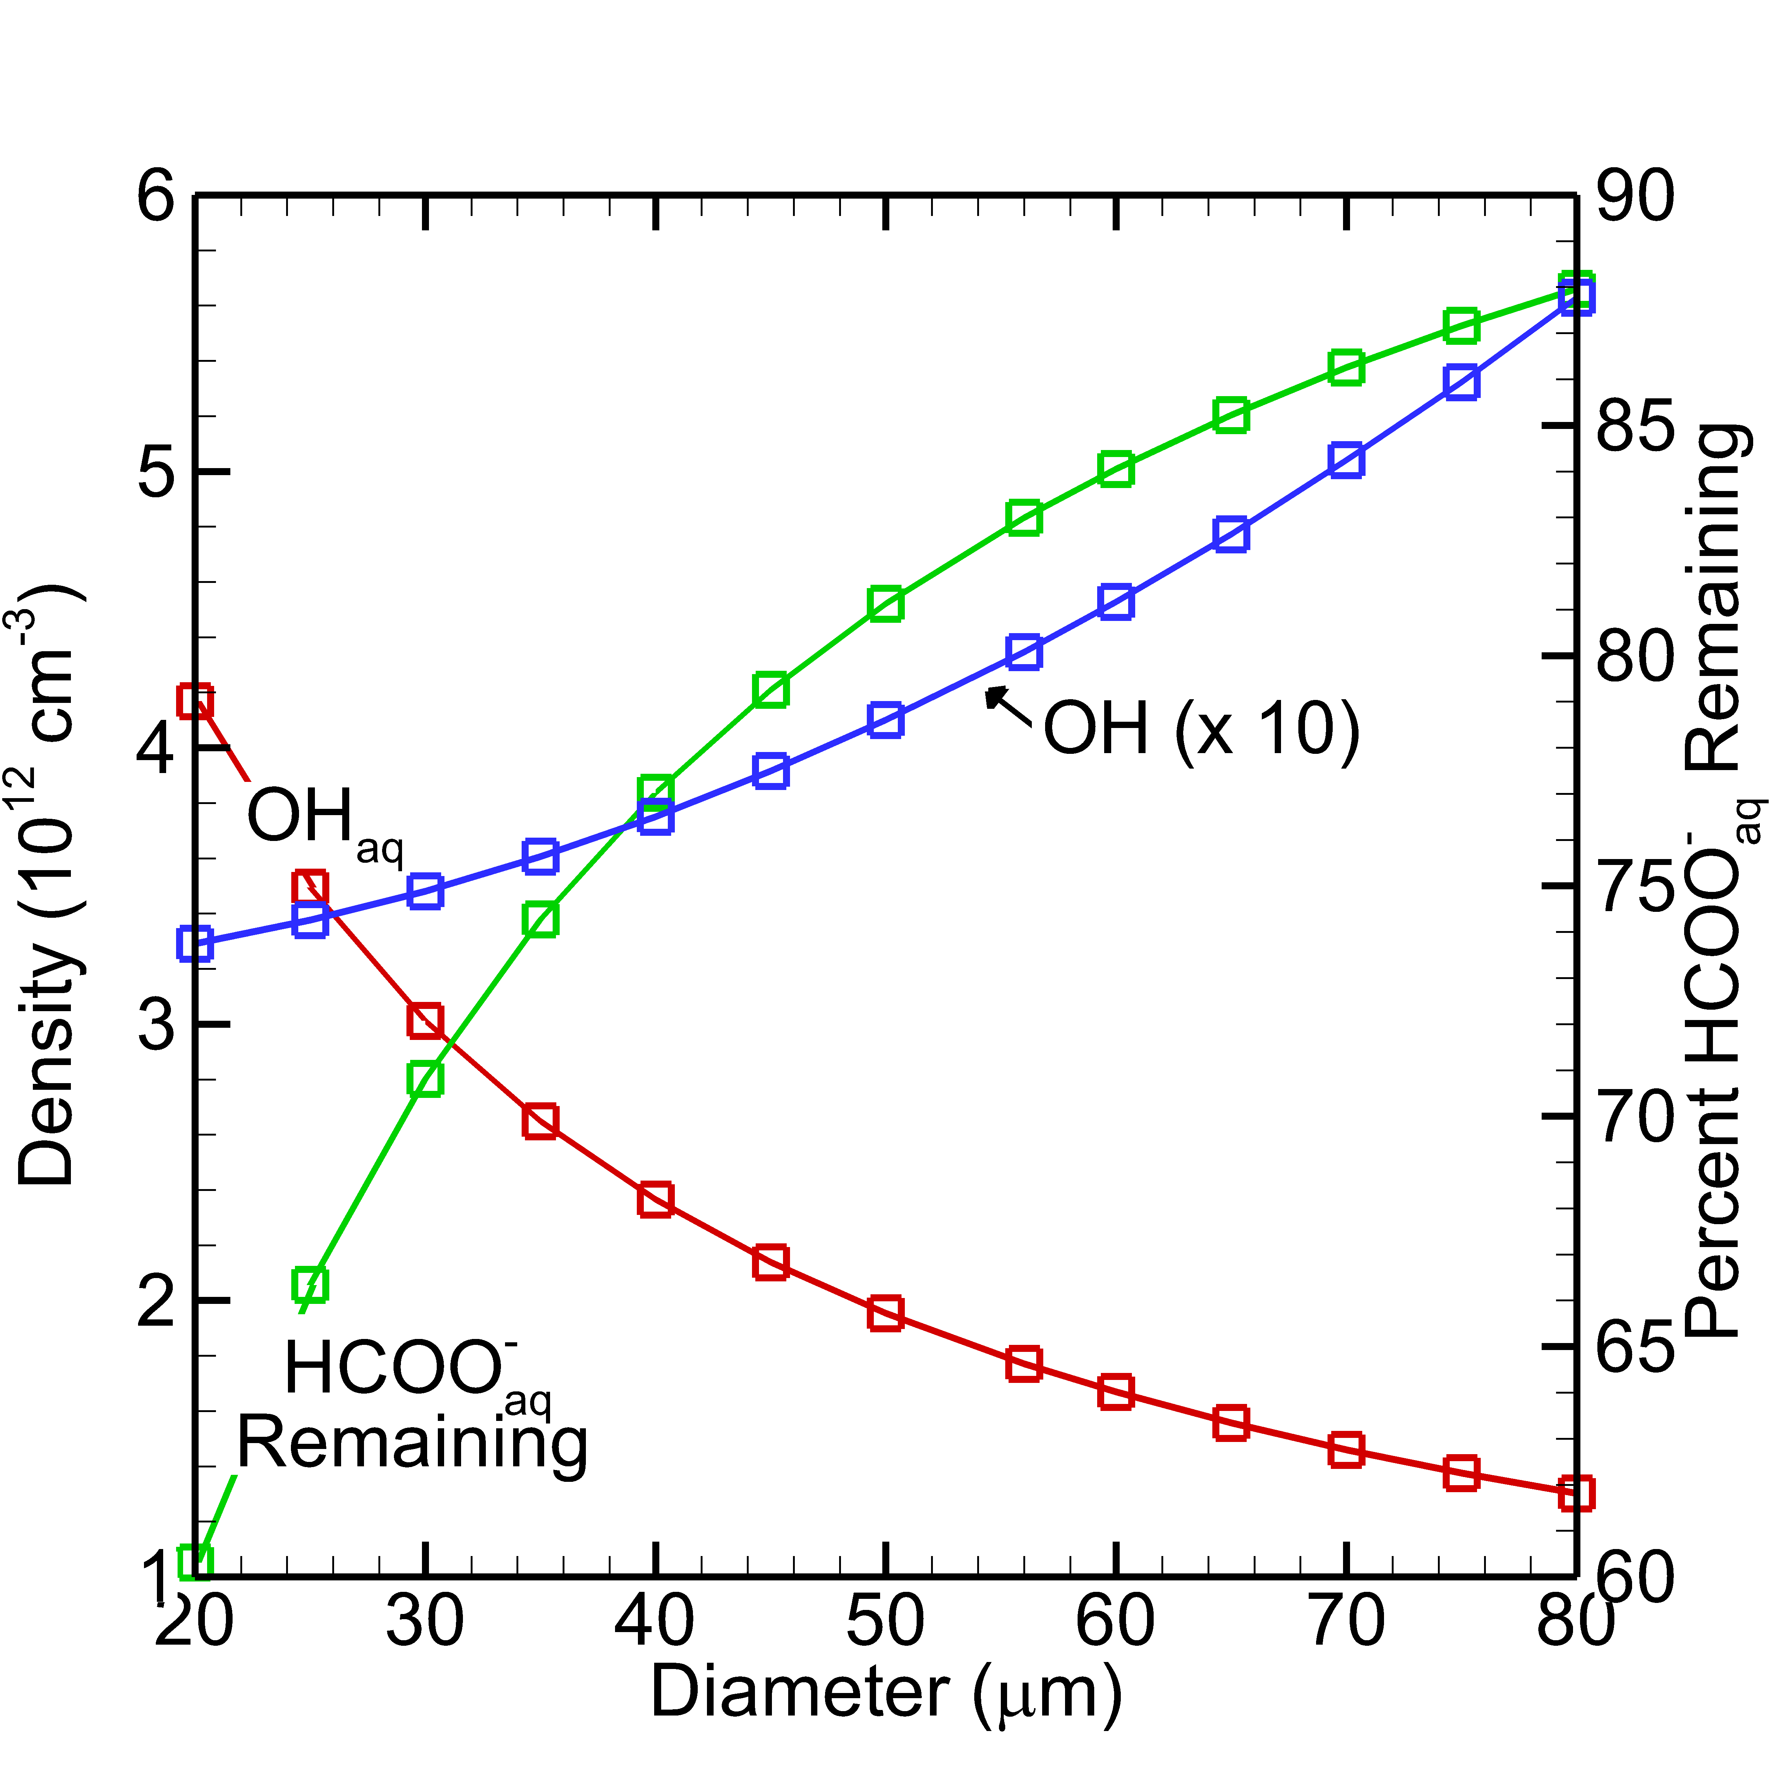
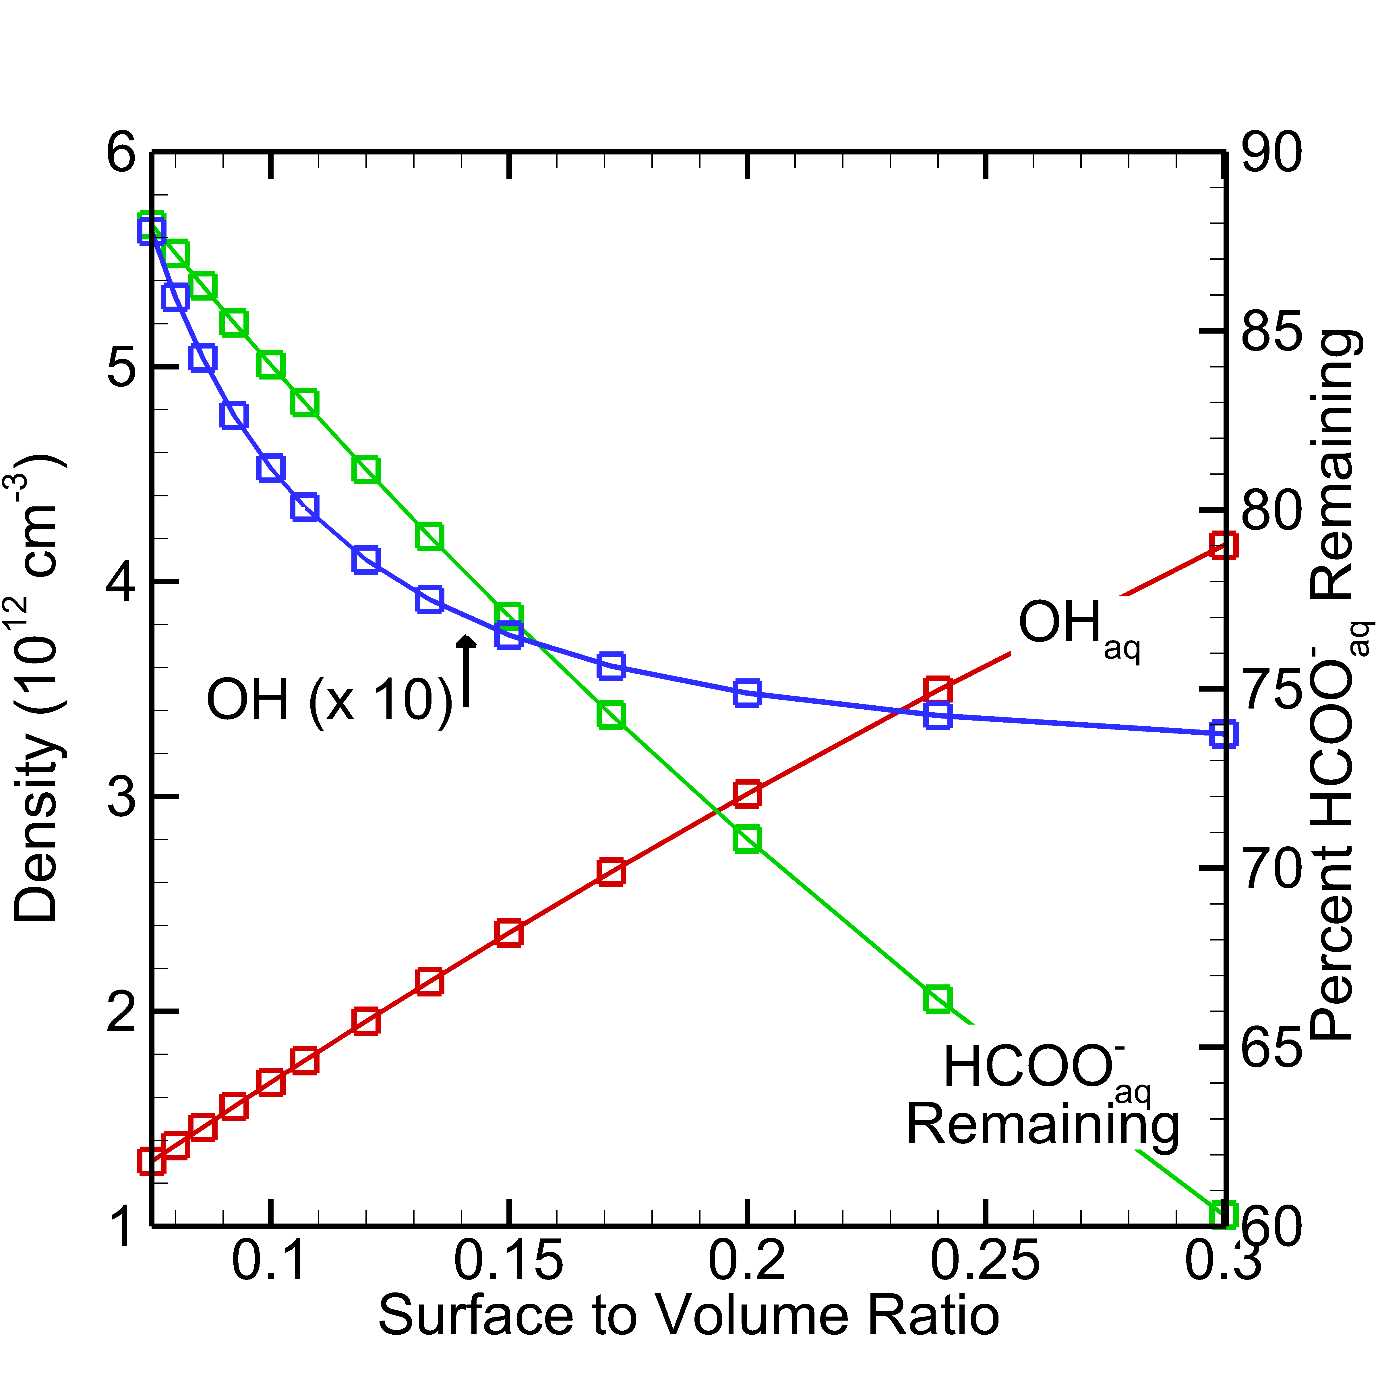
FORMATE DEGRADATION WITH VARYING DROPLET DIAMETER
OH density and OH_{aq} density at residence time, and formate degradation at 100 ms.
OH density increases as diameter increases and surface to volume ratio (SVR) decreases because H₂O evaporation to gas increases.
OH_{aq} increases as SVR increases and diameter decreases.
Remaining HCOO⁻_{aq} percentage decreases as SVR increases and diameter decreases.
University of Michigan
Institute for Plasma Science & Engr.
MIPSE_2021

Slide 11
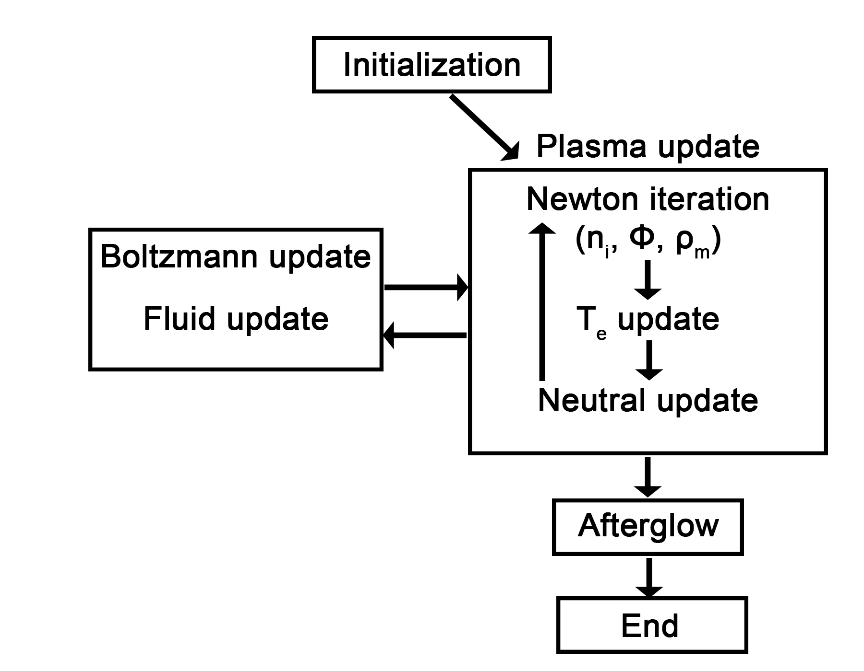
PLASMA HYDRODYNAMICS MODELING
nonPDPSIM is a 2D modeling platform that addresses plasma transport on an unstructured mesh.
Charged particle transport solved simultaneously with Poisson’s equation by a Newton-Raphson method.
Electron temperature and continuity equations for neutrals implicitly solved after charged particle update.
Electron-impact rate coefficients obtained from stationary solutions of Boltzmann’s equation.
Liquid treated similarly to gas with separate reaction mechanism.
Evaporation by saturated vapor pressure of water on droplet surface.
University of Michigan
Institute for Plasma Science & Engr.
MIPSE_2021

Slide 12
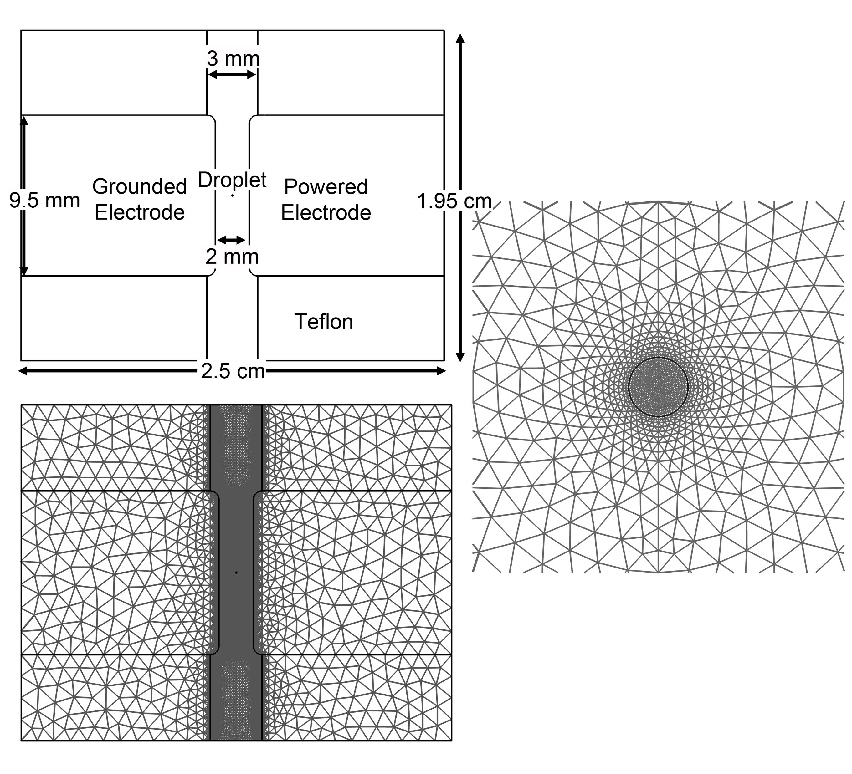
GEOMETRY, CONDITIONS
Liquid water droplet immersed in He RF glow discharge.
He with air impurities (6 ppm N₂, 1.5 ppm O₂, 2.3 ppm H₂O)
Droplet diameter: 80 µm
Pressure: 1 atm
RF frequency: 13.56 MHz
Simulated time: 52 µs (70 RF cycles)
15 W of power deposited in plasma over RF cycle.
Geometry and mesh for nonPDPSIM.
University of Michigan
Institute for Plasma Science & Engr.
MIPSE_2021

Slide 13
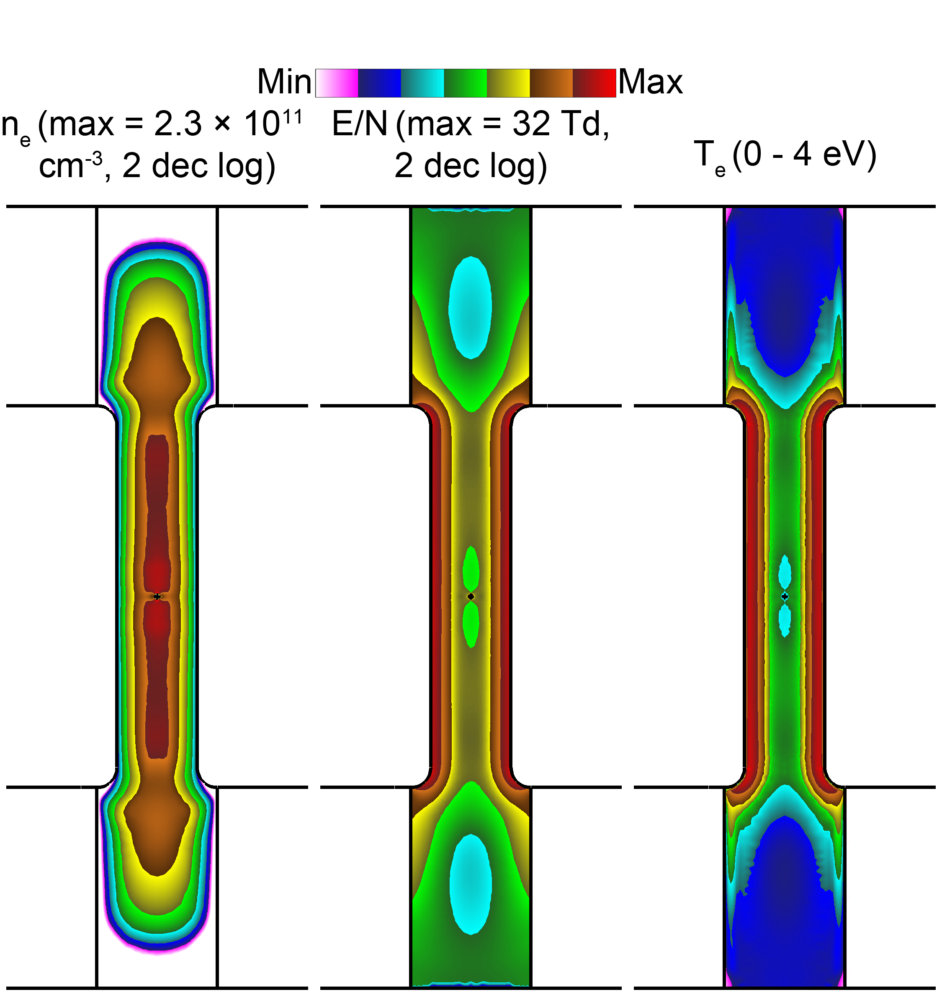
BULK PLASMA PROPERTIES
Electron density oscillates over RF cycle, away from more negative electrode.
Droplet produces “cut” through plasma – caused by shadowing by droplet in 2D simulation.
E/N, T_{e} are maximized in the sheaths near the electrodes.
E/N, T_{e} are minimized in bulk plasma.
Bulk plasma properties time averaged over 70th RF cycle.
University of Michigan
Institute for Plasma Science & Engr.
MIPSE_2021

Slide 14
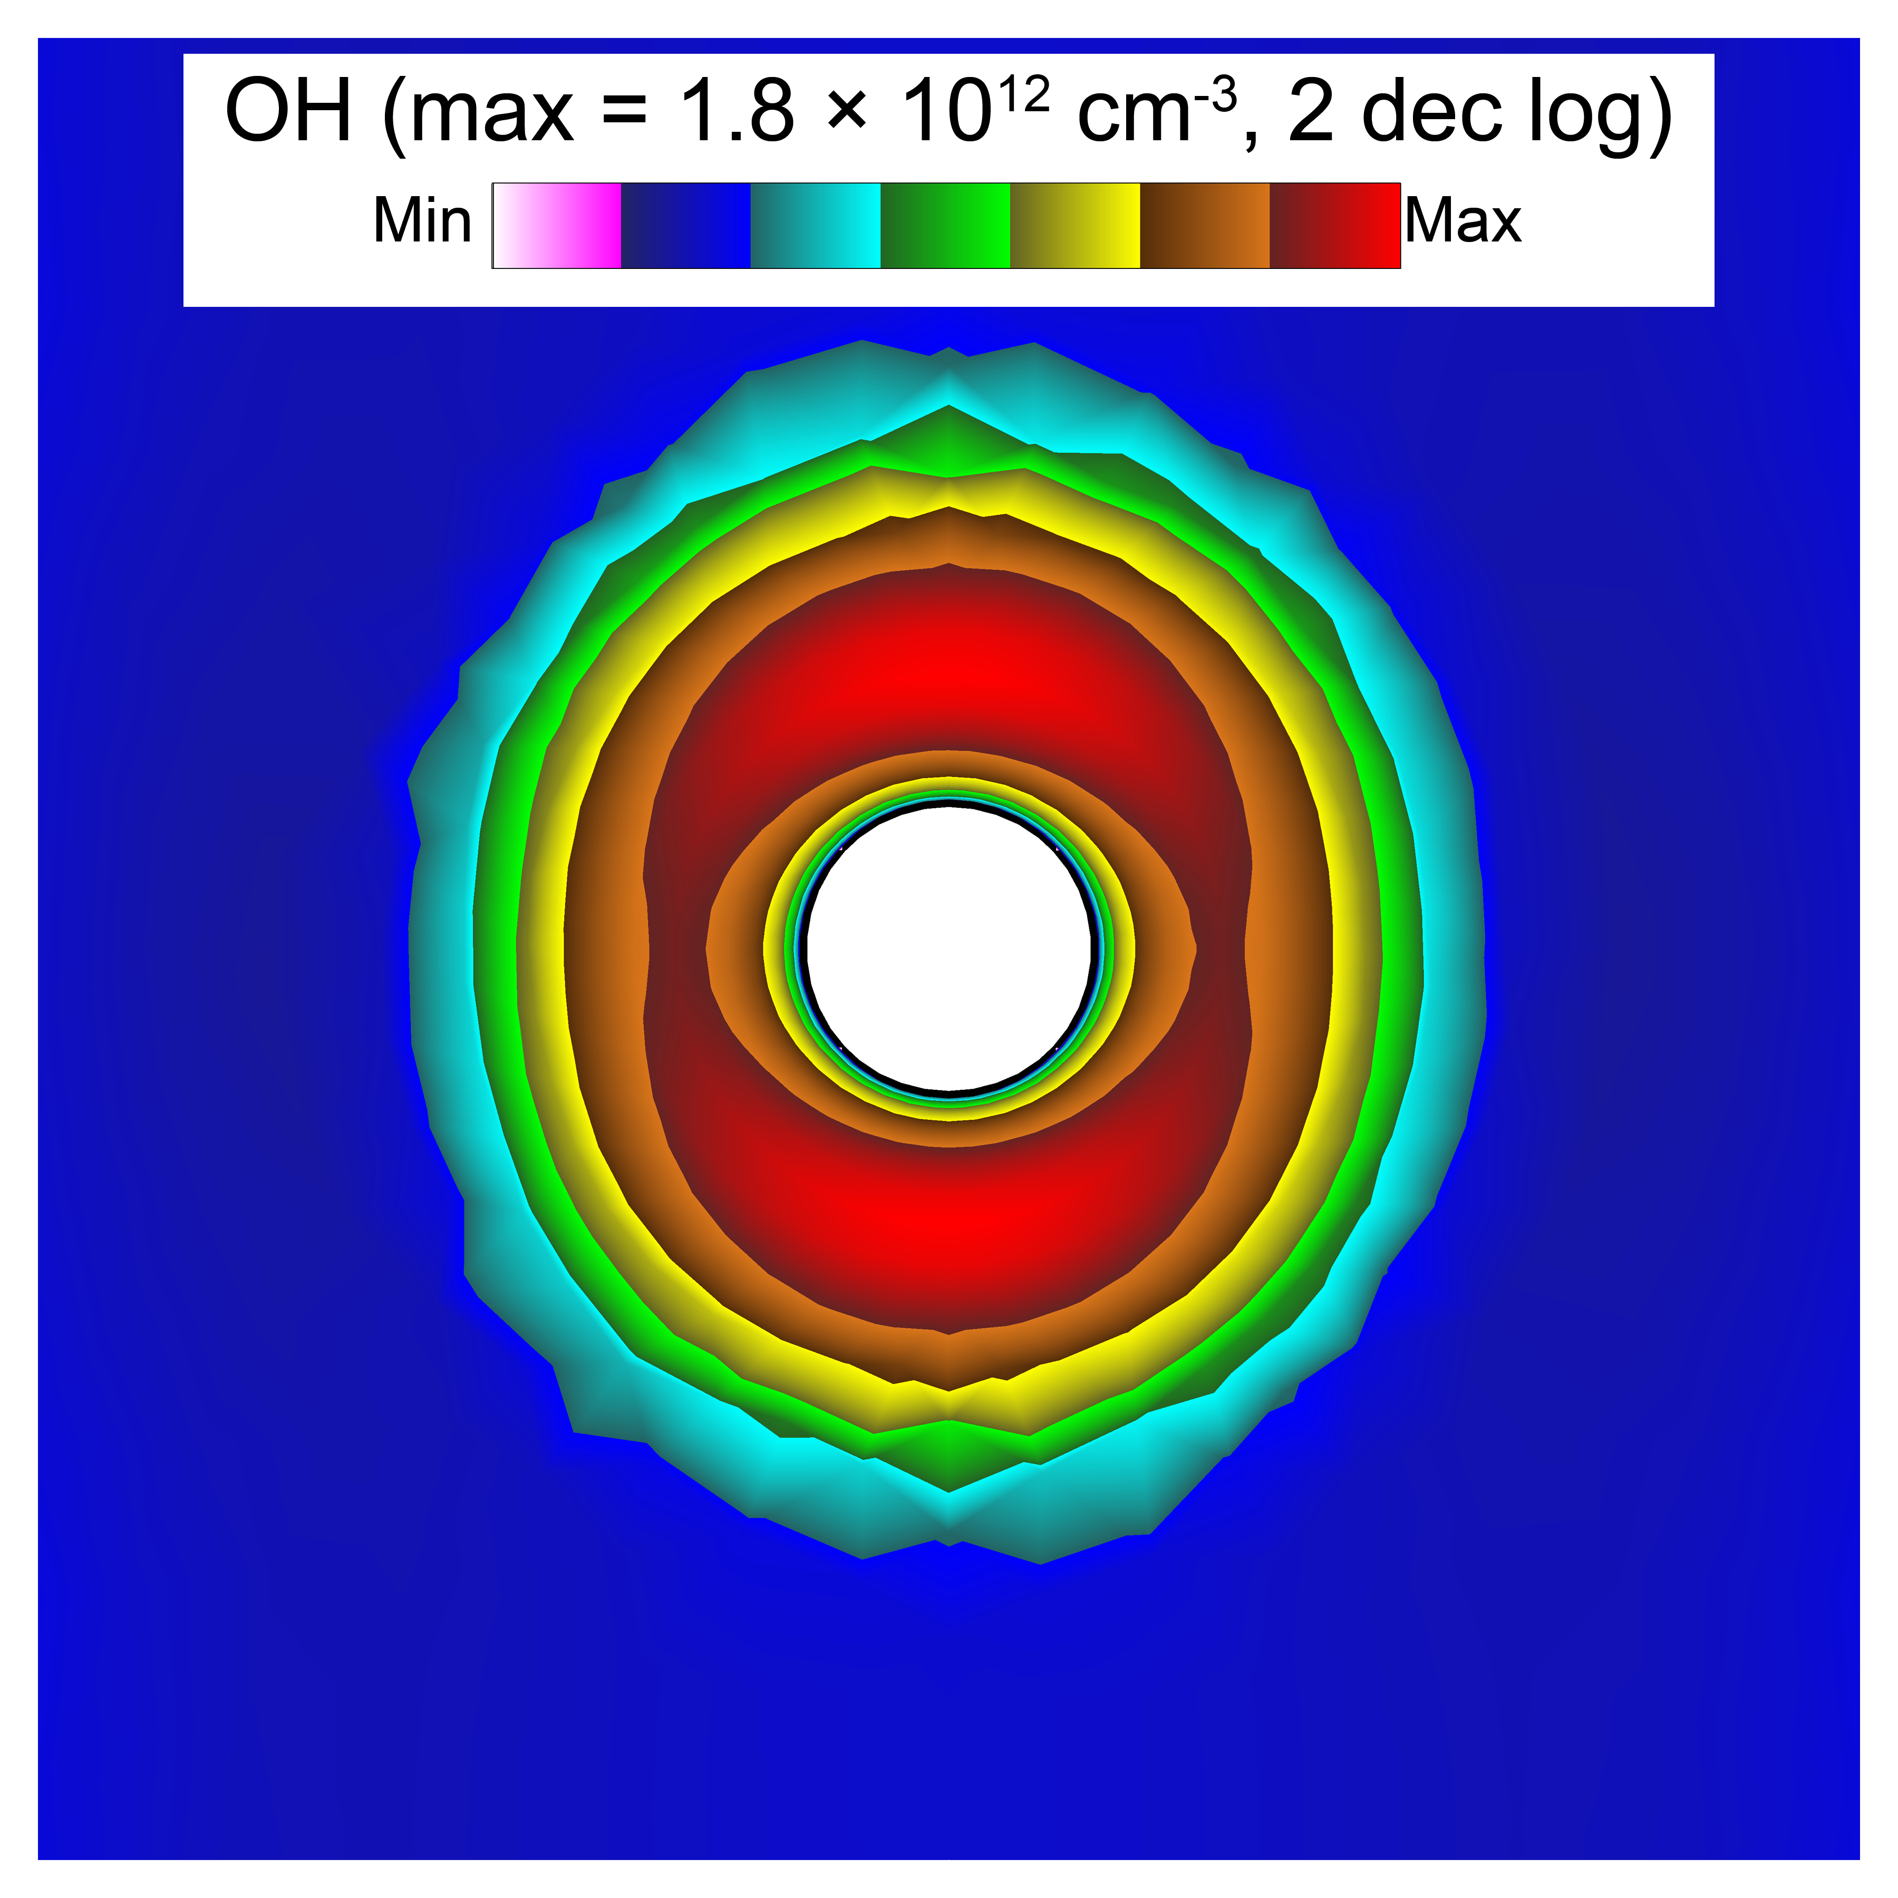
GAS PHASE OH DENSITY
OH density at beginning of 70th RF cycle.
OH produced primarily near droplet due to evaporation of droplet.
OH density maximized at poles of droplet.
Maximum occurs at poles of droplet because time-averaged power deposited per electron is maximized at poles.
University of Michigan
Institute for Plasma Science & Engr.
MIPSE_2021

Slide 15
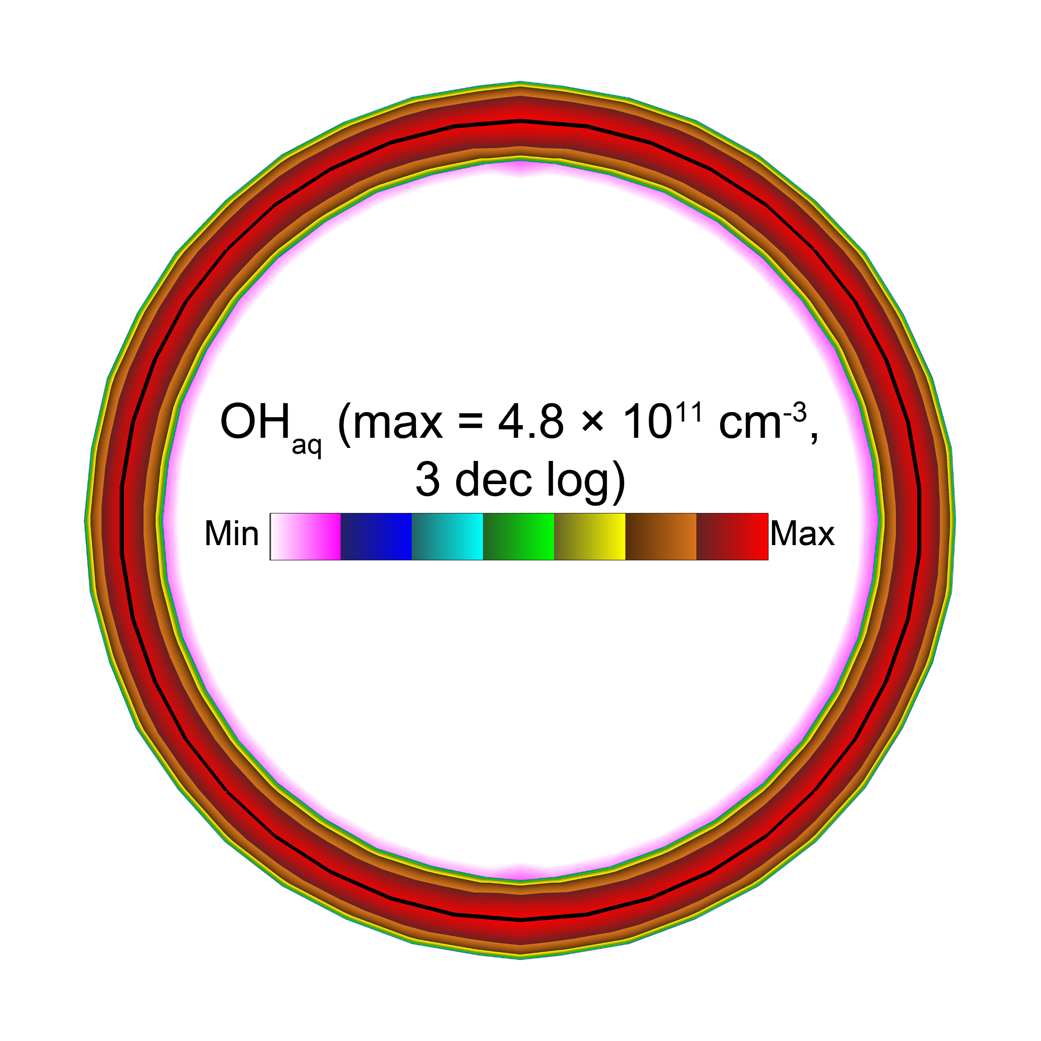
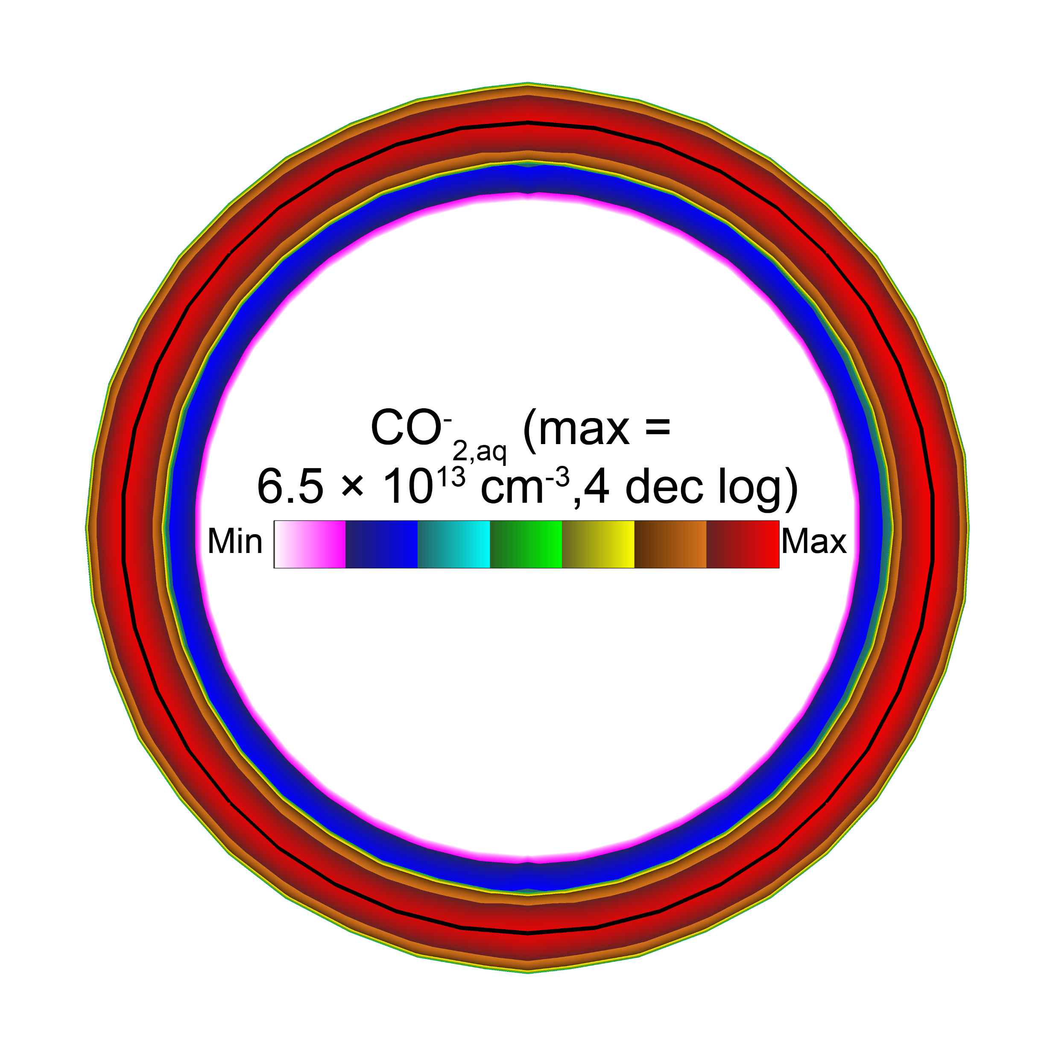
AQUEOUS DENSITIES
OH_{aq} and CO⁻_{2,aq} densities at beginning of 70th RF cycle.
OH_{aq} density uniform over droplet surface.
OH_{aq} less than 4.8 × 10⁸ cm⁻³ at 6 µm from droplet surface.
OH_{aq} reacts with HCOO⁻_{aq} to produce CO⁻_{2,aq}.
CO⁻_{2,aq} density less than 6.5 × 10⁹ cm⁻³ at 8 µm from droplet surface.
University of Michigan
Institute for Plasma Science & Engr.
MIPSE_2021

Slide 16
CONCLUDING REMARKS
Interaction between OH_{aq} and HCOO⁻_{aq} dissolved in a water droplet immersed in a He plasma are investigated by global chemistry modeling and 2D modeling.
OH_{aq} increases during residence time, decreases after power is turned off.
Percentage of HCOO⁻_{aq} remaining after 10 ms residence time and 90 ms afterglow is 83%.
As power, residence time, and SVR are increased, OH_{aq} at power off increases and HCOO⁻_{aq} at 100 ms decreases.
2D modeling shows CO⁻_{2,aq} produced within 8 µm of droplet surface.
University of Michigan
Institute for Plasma Science & Engr.
MIPSE_2021

