Slide 1


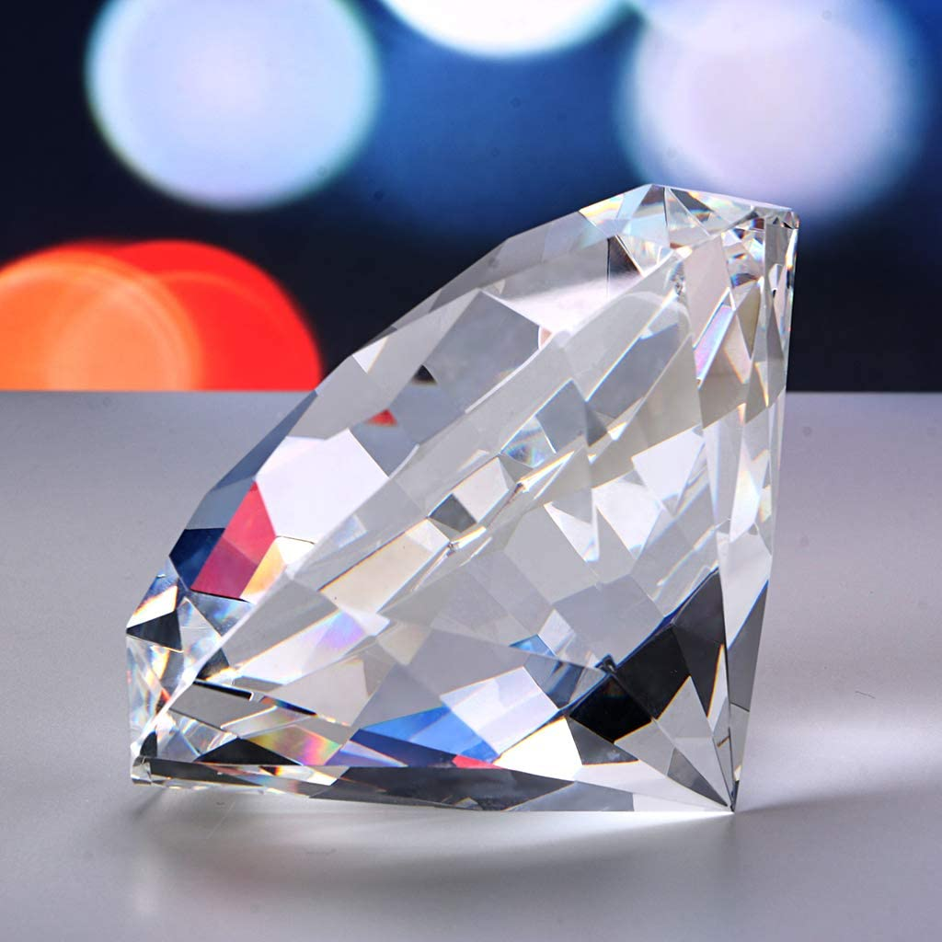
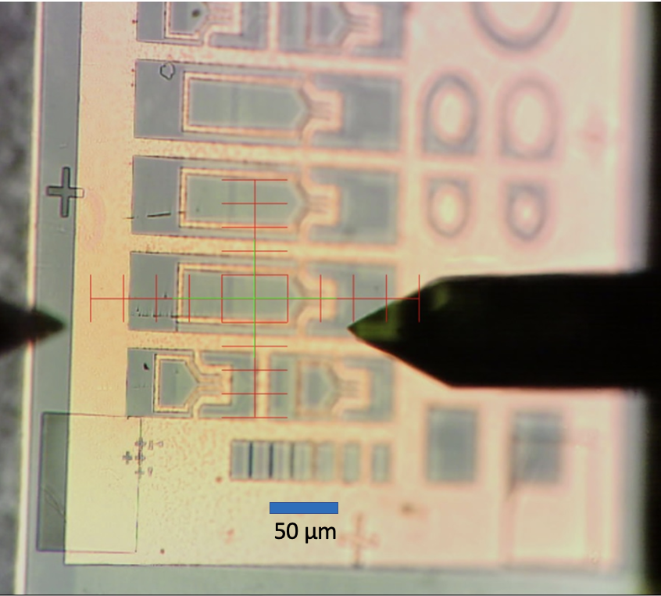
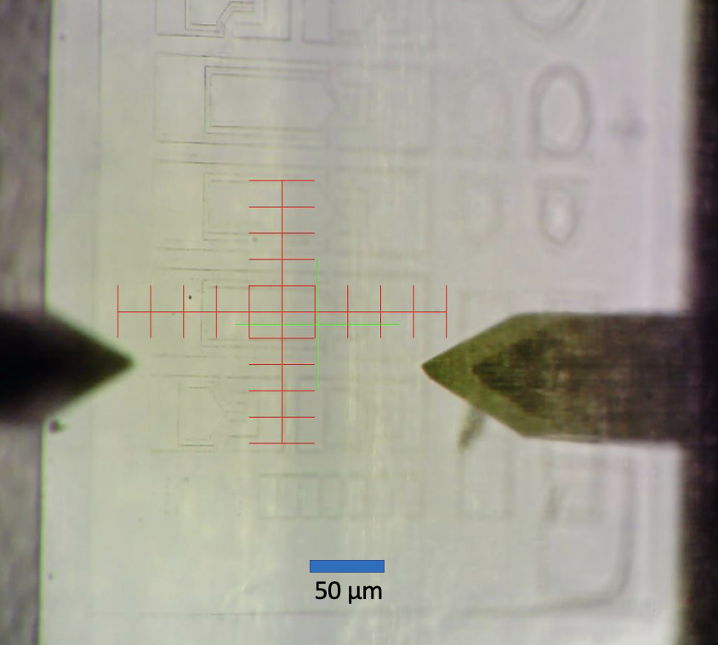
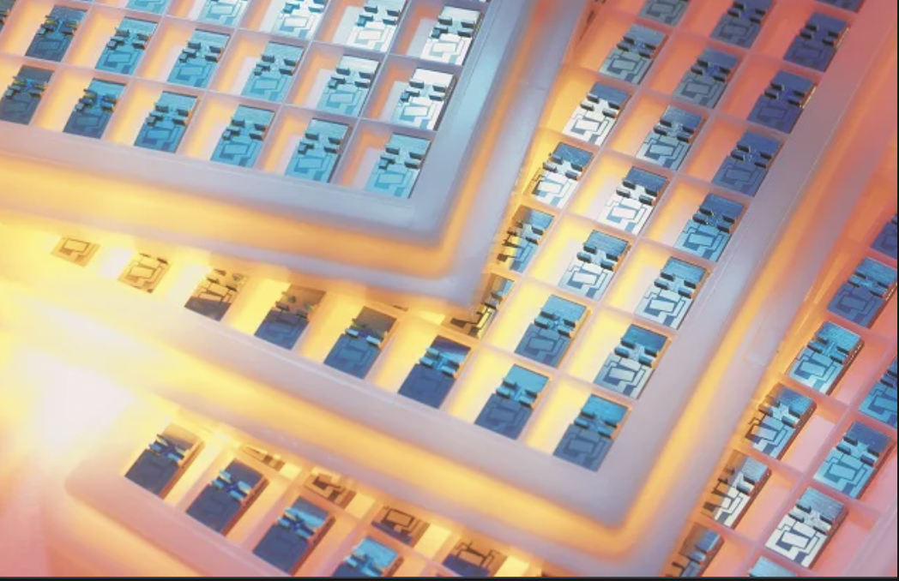

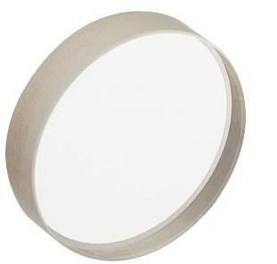
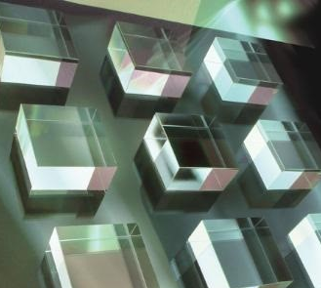
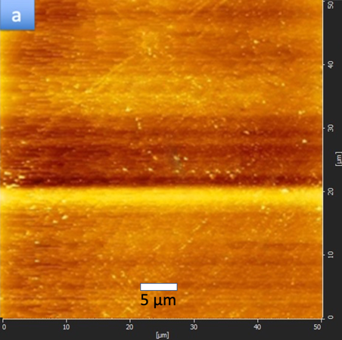
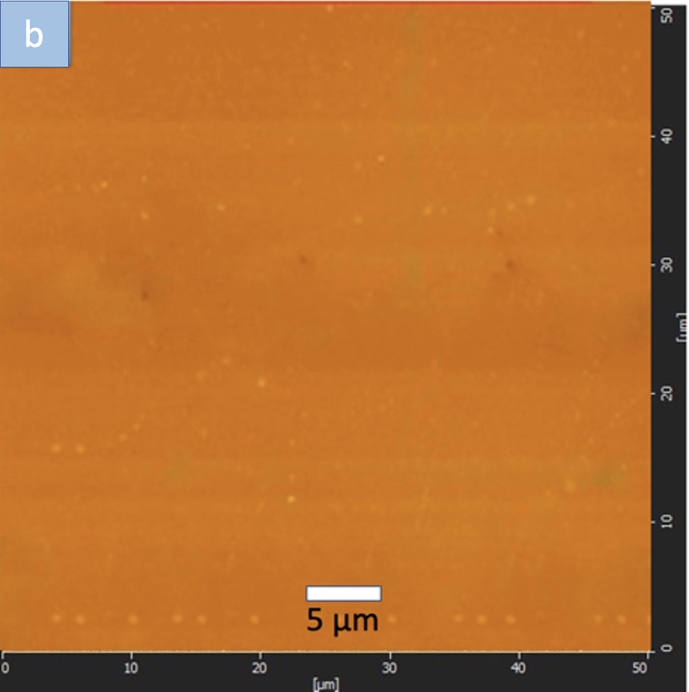
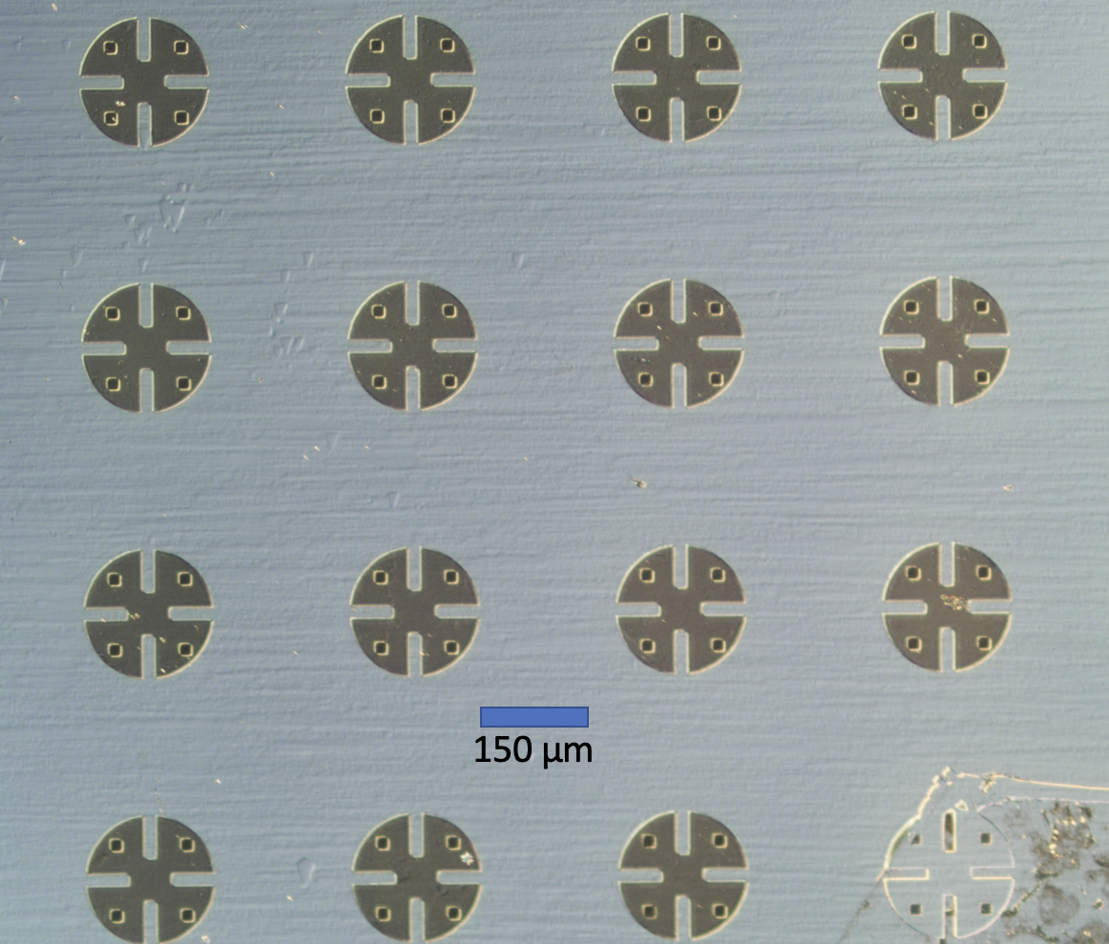
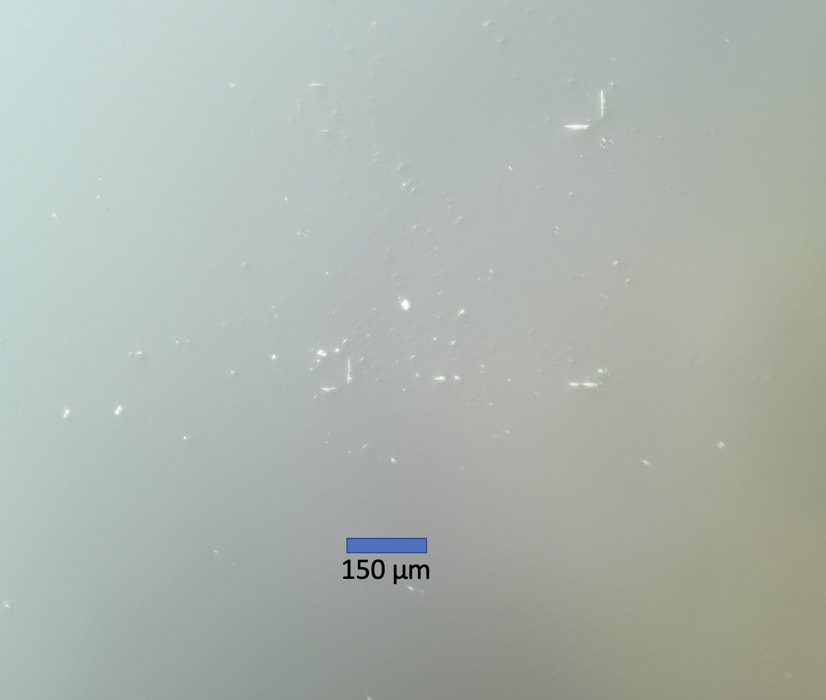
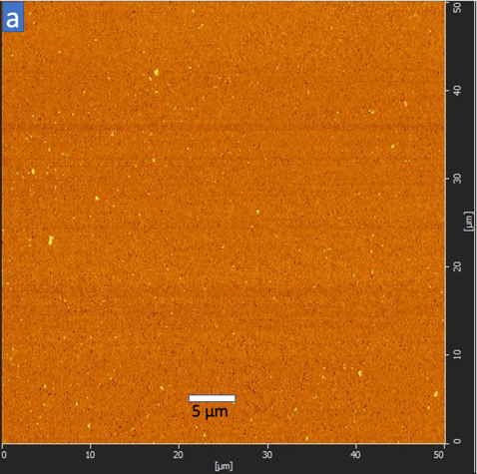
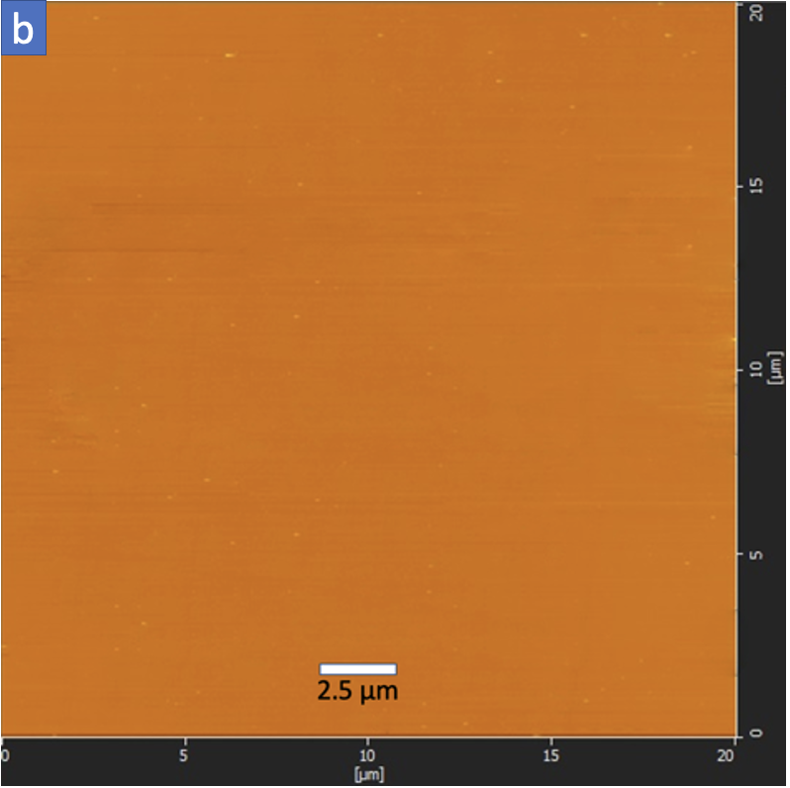
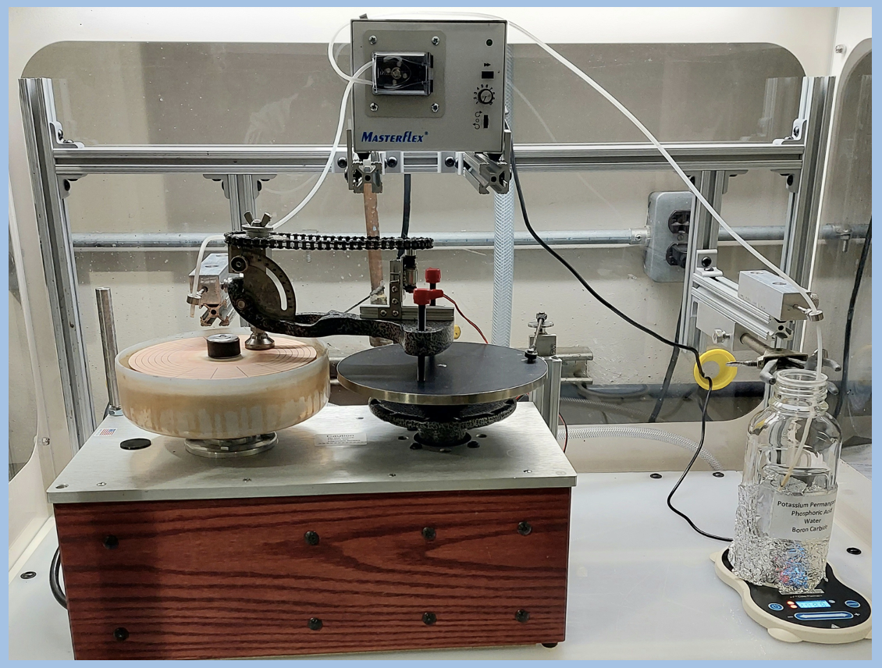
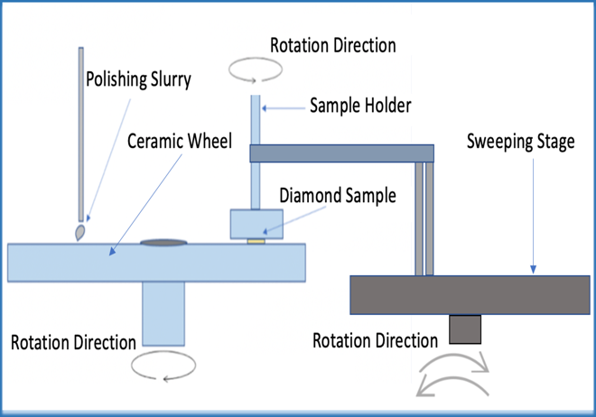
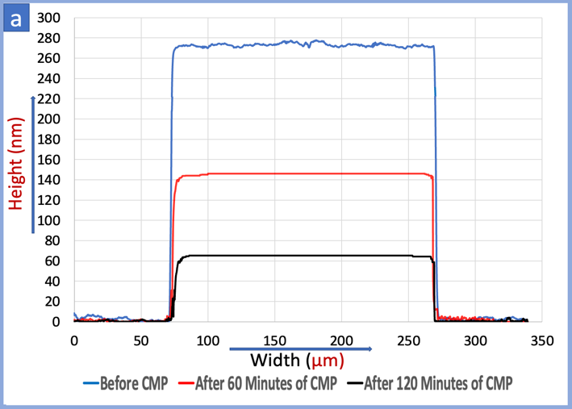
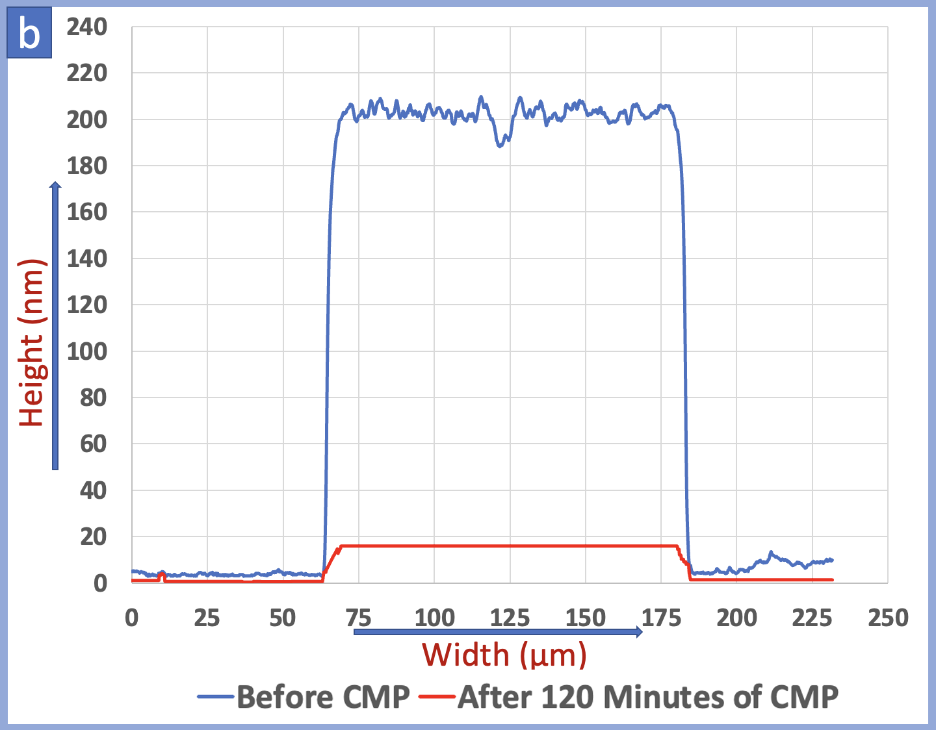
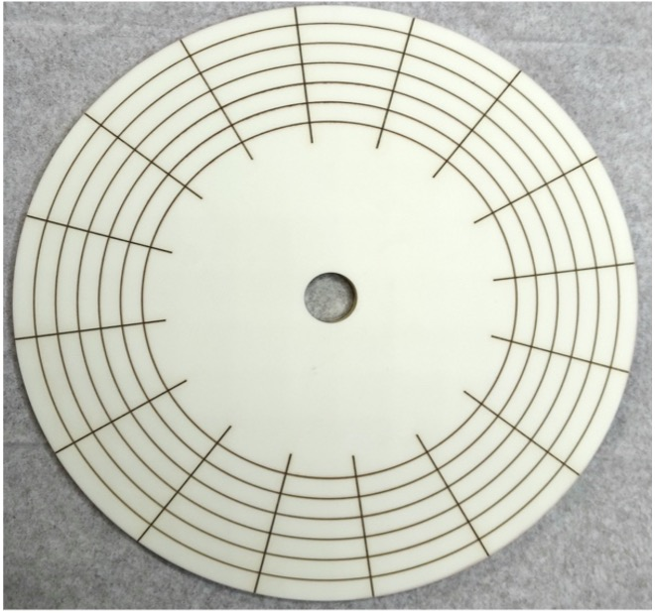
Chemical Mechanical Polishing Rate and Surface Roughness for Single-Crystalline Diamond Substrates
S M Asaduzzaman and Dr. Timothy Grotjohn
Department of Electrical and Computer Engineering, Michigan State University, East Lansing, MI-48824, USA
Diamond Material Polishing
Microscopic Analysis
AFM Scanning
Single crystalline diamond (SCD) has many applications in electronics, quantum information processing systems, quantum sensors, optical windows, and diamond bonding to other semiconductors. These applications require precisely polished and smooth-surfaced diamonds. Chemical and mechanical polishing (CMP) can reduce diamond surface roughness and improve surface quality. Standard polishing with diamond powder damages the surface too much. Therefore, CMP is done with a soft powder.
Sample-01 Dimension: 3.7 x 3.7 mm²
Sample-01 Thickness: 0.4 mm
The Sample-01 was etched with oxygen, sulfur hexafluoride, and argon plasma to form a pattern.
Diamond Sample-01:
Topography Surface Roughness Area: (50x50 µm²)
Before CMP, the sample has a roughness above Ra 1.0 nm
After 60 minutes of the CMP run, the roughness Ra was reduced to less than 0.8 nm.
After 120 minutes of the CMP process, the roughness Ra was reduced to less than 0.4 nm.
a
b
DISCUSSION
Electronics
Quantum Processor
Optical Window
Semiconductor Bonding
Sample-01: Before CMP
Sample-01: After 120 minutes of CMP
Experimental Objectives and Methodology
Sample-02 Dimension: 5.0 x 5.0 mm²
Sample-02 Thickness: 0.2 mm
The sample had a layer of nitride-based features on its top surface
It was characterized by numerous pad-shaped features
Objectives: Determine the polishing rate and surface roughness of the Chemical Mechanical (CMP) Polishing Process for Single-Crystalline Chemical Vapor Deposition (CVD) Diamond.
Methodology:
  Etching patterns into the diamond surface and performing CMP to study the diamond material polishing rates.
  Preparing proportionate CMP slurries with a robust oxidizing chemical mixture consisting of potassium permanganate and boron carbide particles (1-3 µm) with phosphoric acid and DI water to polish the diamonds.
  Performing CMP for 60-minute intervals and calculating the diamond material removal rate and surface smoothness utilizing the profilometer step scan and atomic force microscope (AFM) scan.
Sample -01: Before CMP
AFM Scan (Topography View)
Sample -01: After 120 Minutes of CMP
AFM Scan (Topography View)
Diamond Sample-02:
a
b
Topography Surface Roughness Area: (50x50 µm²)
Before CMP, the sample has a roughness above Ra 1.0 nm
After 60 minutes of the CMP run, the roughness Ra was reduced to less than 0.8 nm.
After 120 minutes of the CMP process, the roughness Ra was reduced to less than 0.4 nm.
Experimental Setup: Chemical Mechanical Polishing
Sample-02: Before CMP
Sample-02: After 120 minutes of CMP
Profilometer Step Scanning
The CMP polishing equipment rotates the polishing wheel and sweeps/rotates the sample while using a self-leveling sample holder to maintain contact between the SCD surface and the grooved ceramic polishing wheel. The self-leveling approach helps achieve repeatable, uniform, and proportionate material removal.
Profilometer Step Scanning
Diamond Sample-01:
Before CMP, the etched pattern has a 270 nm thickness layer
After 60 minutes of CMP, the pattern height was reduced to 145 nm
After 120 minutes of CMP, the thickness was reduced to 65 nm
The polishing rate for 120 minutes of CMP is around 102 nm/hour
Sample -02: Before CMP
AFM Scan (Topography View)
Sample -02: After 120 Minutes of CMP
AFM Scan (Topography View)
Summary
In this study, we have analyzed the performance of Chemical Mechanical Polishing using an oxidative chemical slurry for single-crystal Chemical Vapor Deposition diamonds. This experiment was performed at fixed time intervals to quantify the CMP polishing rate and the uniformity of the polishing across the diamond substrate. The approximate materials removal rates were 100-110 nm/hr.
Chemical Mechanical Polishing setup
Schematic diagram of the CMP Process
In order to speed up the process of removing diamond material, the slurry is poured onto the ceramic groove plate and spread over the entire surface. Once the diamond sample is polished, it is cleaned to remove the polishing slurry.
This study investigated samples ranging in size from 3.7 x 3.7 mm² to 5 x 5 mm² to calculate material removal rate and surface smoothness.
References
Profilometer step scanning of sample-01
Profilometer step scanning of sample-02
1. T. Schuelke, T.A. Grotjohn, Diam. Relat. Mater. 32 (2013).
H. Luo, K.M. Ajmal, W. Liu, K. Yamamura, Int. J. Extrem. Manuf. 3 (2021).
3. Z. Yuan, Z. Jin, Y. Zhang, Q. Wen, J. Manuf. Sci. Eng. Trans. ASME. 135 (2013).
Diamond Sample-02:
Before CMP, the etched pattern has a 220 nm thickness layer
After 120 minutes of CMP, the thickness was reduced to 20 nm
The polishing rate for 120 minutes of CMP is around 100 nm/hour
Acknowledgments
The grooved ceramic wheel
This Project is supported by The Michigan Translational Research and Commercialization (MTRAC) and Fraunhofer USA, Inc., Center Midwest.

