Slide 1
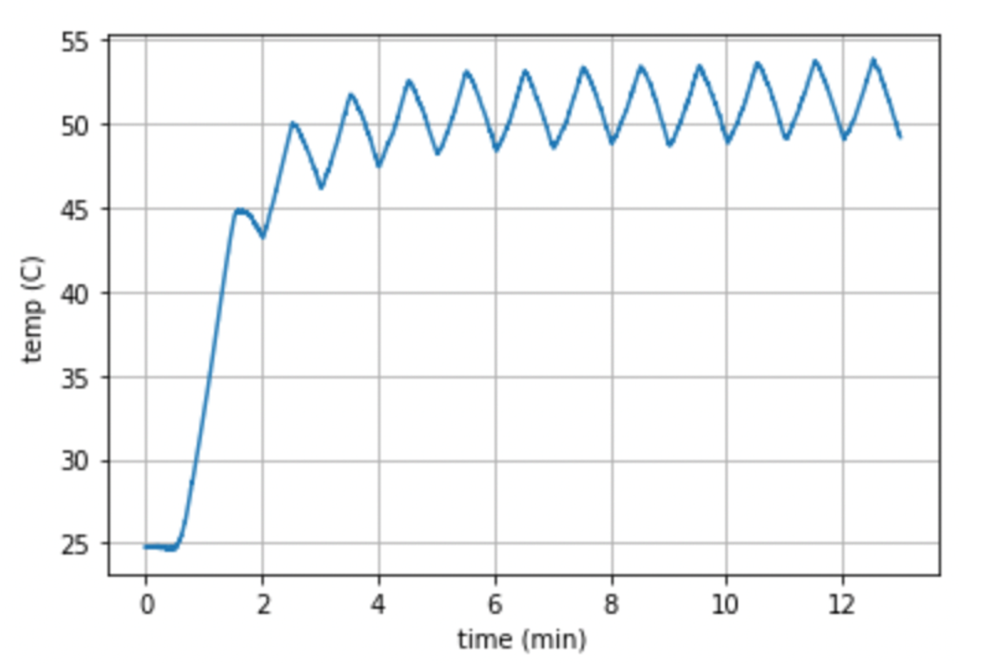
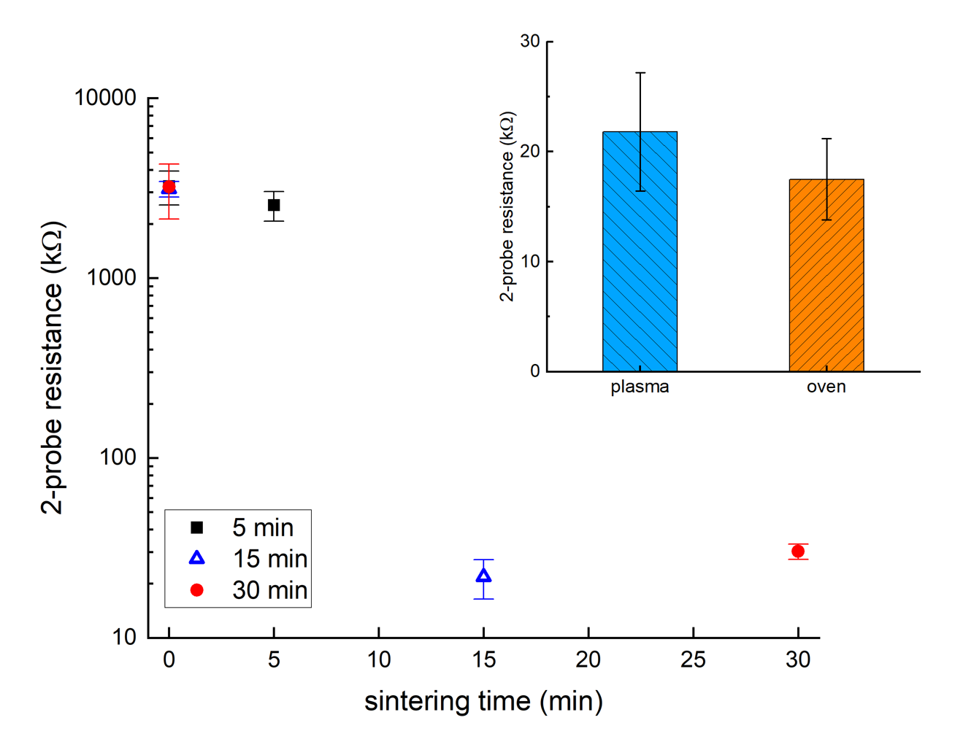
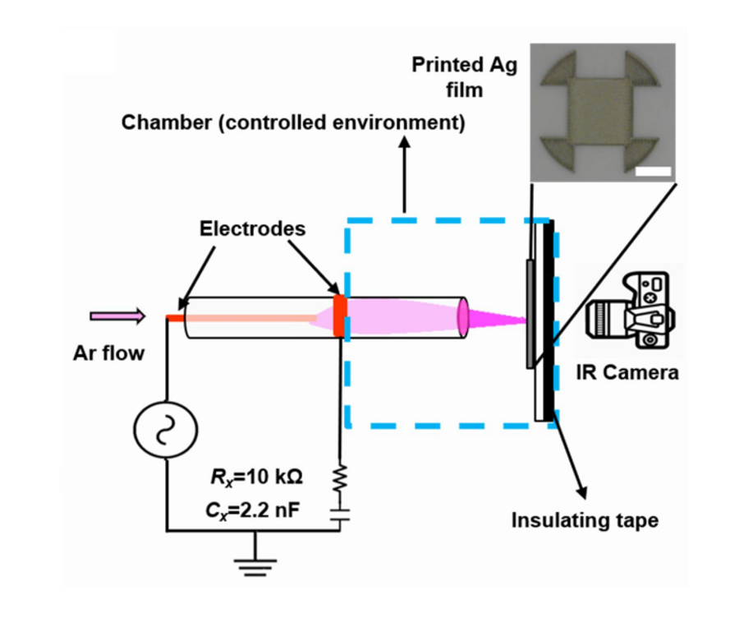
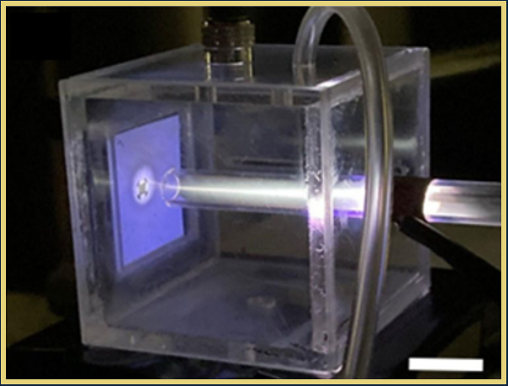
Non-Thermal Plasma Jet Sintering of Non-Metallic Printed Thin Films
Zhongyu Cheng, Ali Newaz Mohammad Tanvir, Jinyu Yang, Yanliang Zhang, David B. Go
University of Notre Dame
Motivation
Experimental Method
Results and Conclusions
Rapid processing of emerging nanomaterials on flexible and sensitive surfaces for applications in wearable electronics and in situ sensors
Non-thermal plasma jets enable simple, low-cost, and low-temperature sintering of printed thin films on delicate substrates^{1,2}
Expanding plasma jet sintering to non-metallic films including oxides, semi-conductors, and ceramics, opens opportunities for wide variety of applications
Blade coated indium tin oxide (ITO) thin film (~10-100 μm) used as model non-metallic system
Dielectric barrier discharge (DBD) plasma jet impinges on sample substrate with in situ infrared temperature monitoring
Controllable variables include gas, flow rate, voltage, power, gap distance, and exposure time
Substrate temperature can be controlled under 55 °C during sintering process.
Resistance of ITO films decreased most dramatically after 15 minutes of plasma jet exposure.
Compared with oven sintering, plasma jet sintering saves hours of processing time.
Fig. 1. Schematic illustration
of the argon plasma jet sintering setup.²
Fig. 2. Plasma jet sintering Ag thin film
on PEL paper.²
Figure 3. Substrate temperature variation vs. plasma jet sintering time of ITO thin film.
Figure 4. 2-probe resistance vs. plasma jet sintering time of ITO thin films, and comparison between plasma jet sintering and oven thermal sintering (inset).
References:
Turan, N., Saeidi‐Javash, M., Zhang, Y., & Go, D. B. (2022). Does plasma jet sintering follow an arrhenius‐type expression? Plasma Processes and Polymers, 19(8), 2200011.
Turan, N., Saeidi-Javash, M., Chen, J., Zeng, M., Zhang, Y., & Go, D. B. (2021). Atmospheric pressure and ambient temperature plasma jet sintering of aerosol jet printed silver nanoparticles. ACS Applied Materials & Interfaces, 13(39), 47244–47251.
Acknowledgements:
This work was supported by the Department of Energy under Award Number DE-EE0009103.

