Slide 1


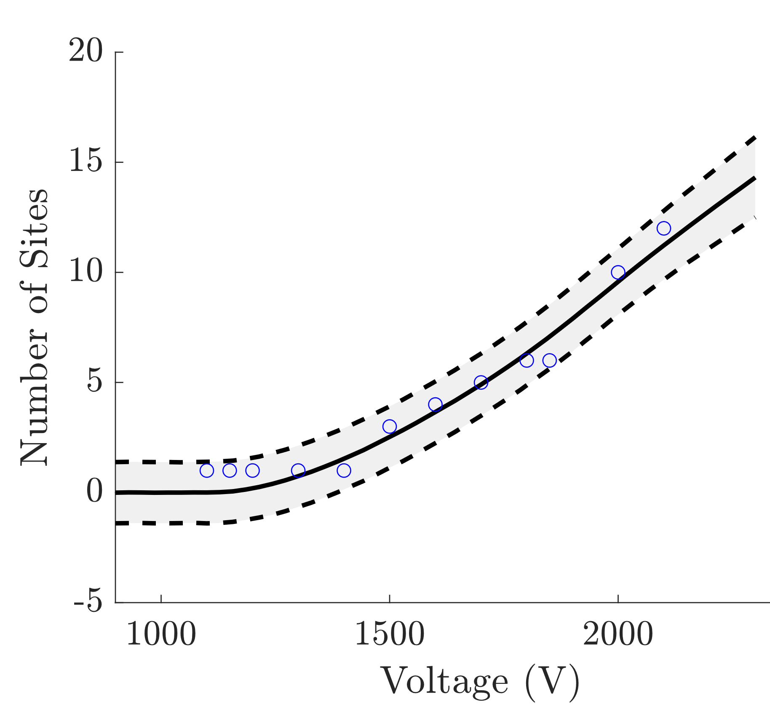
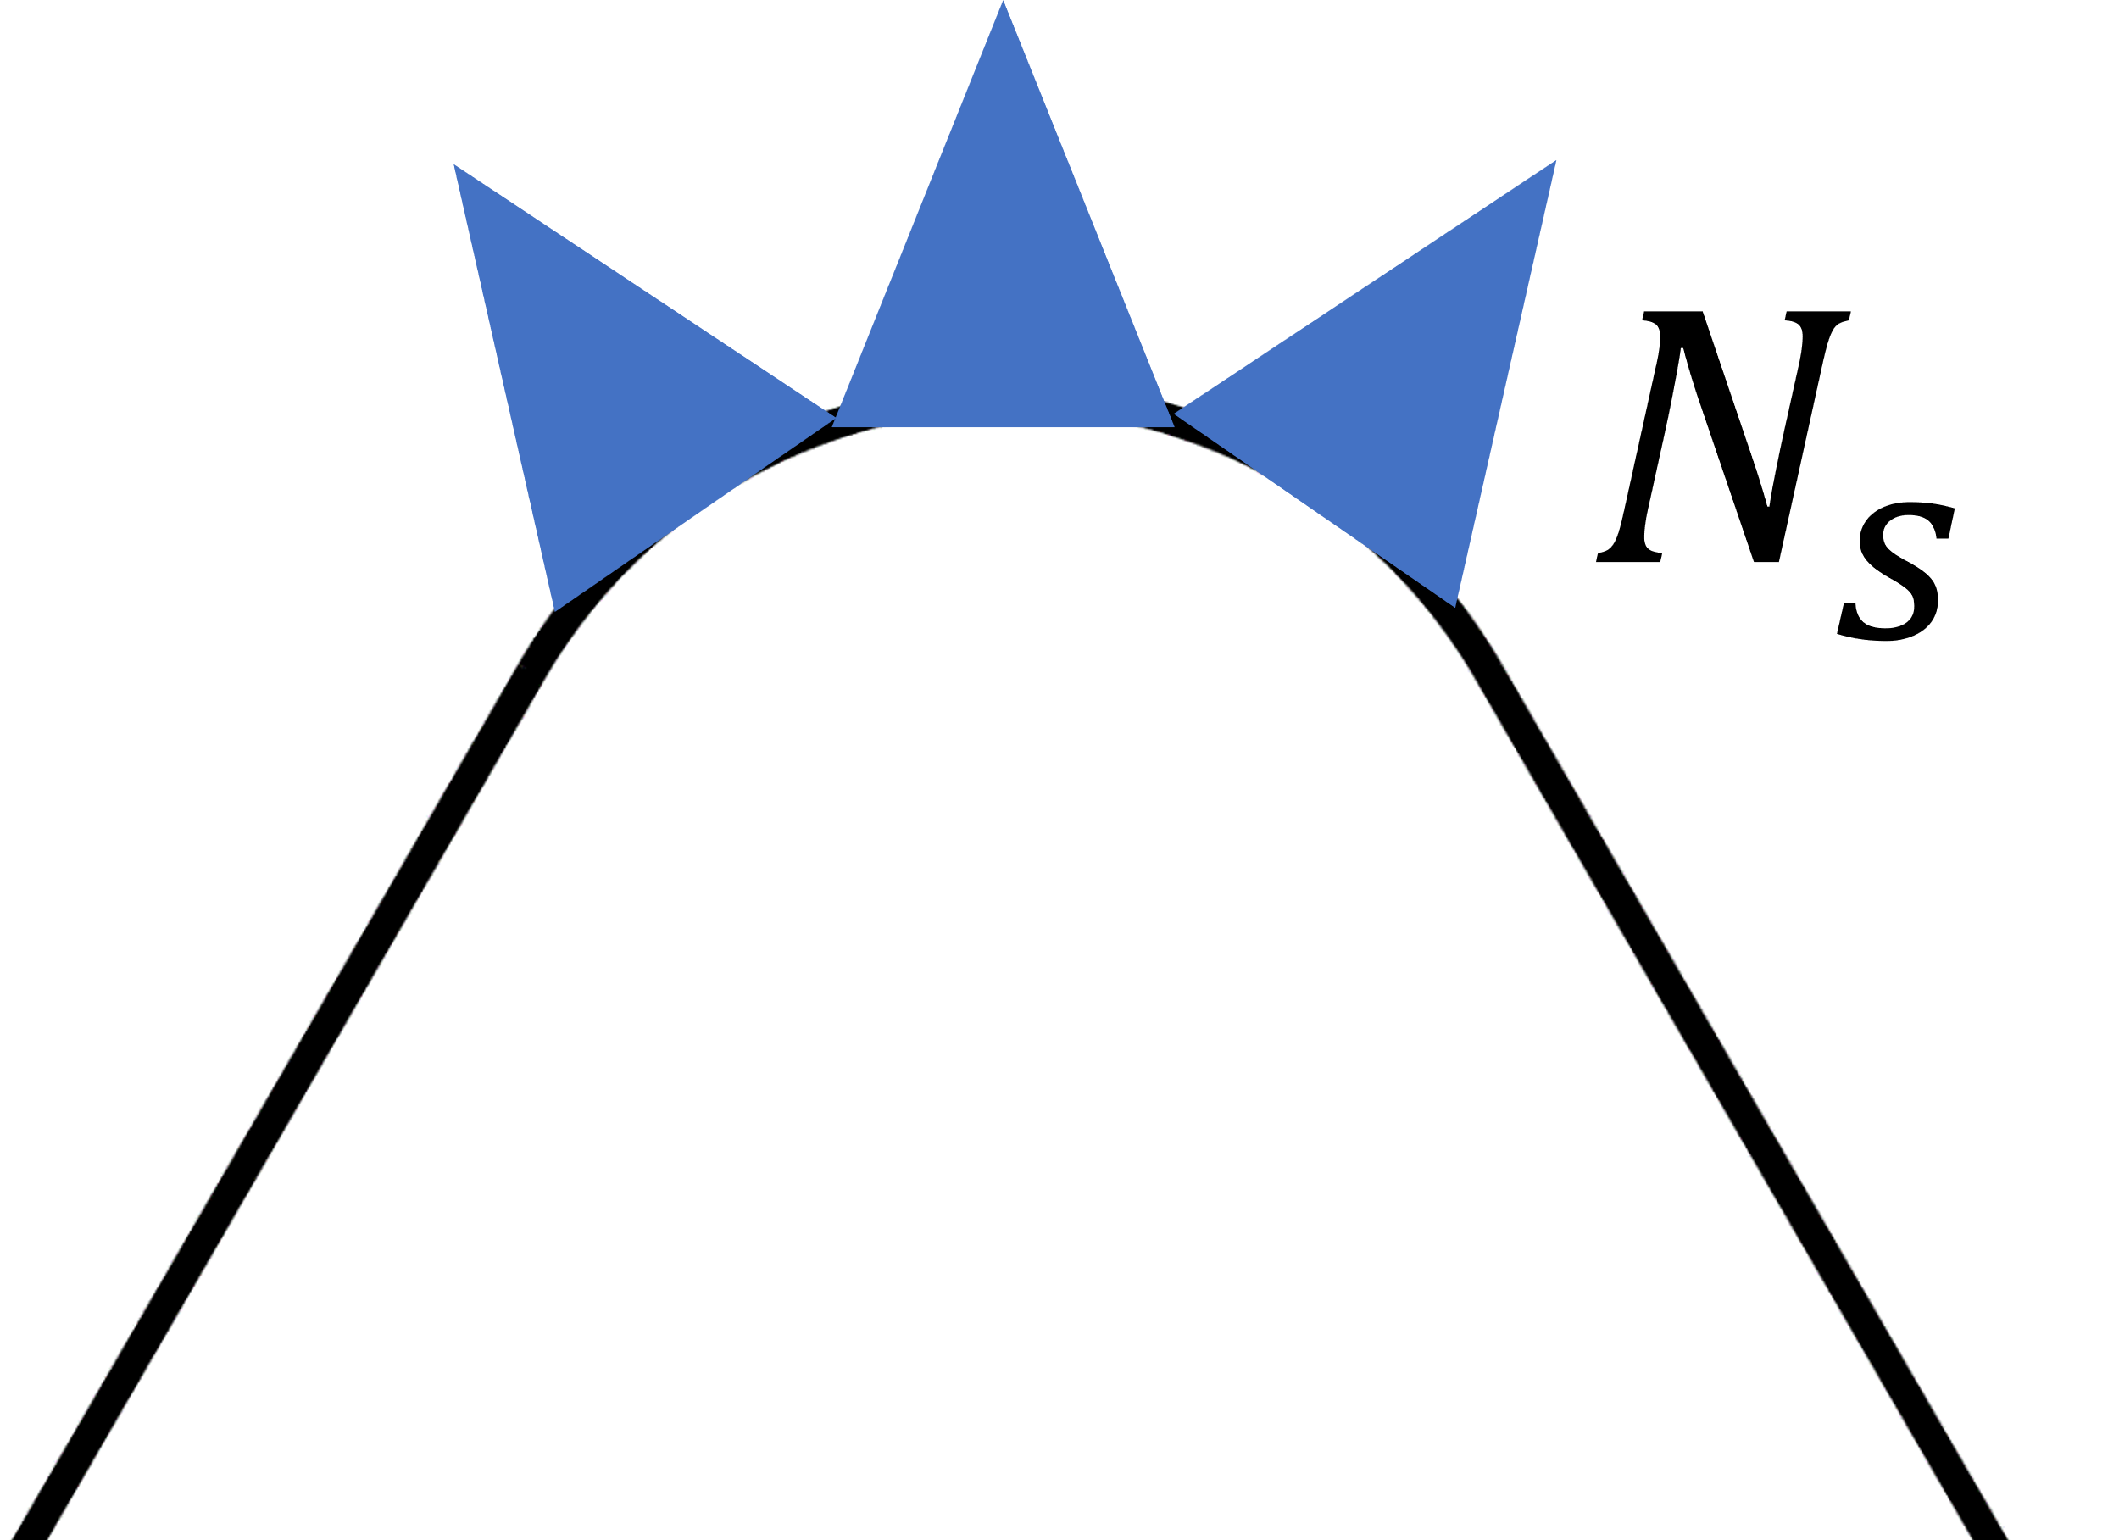
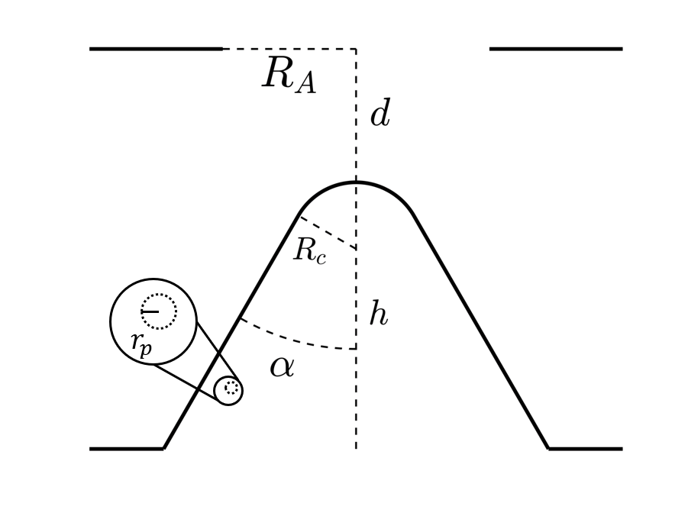
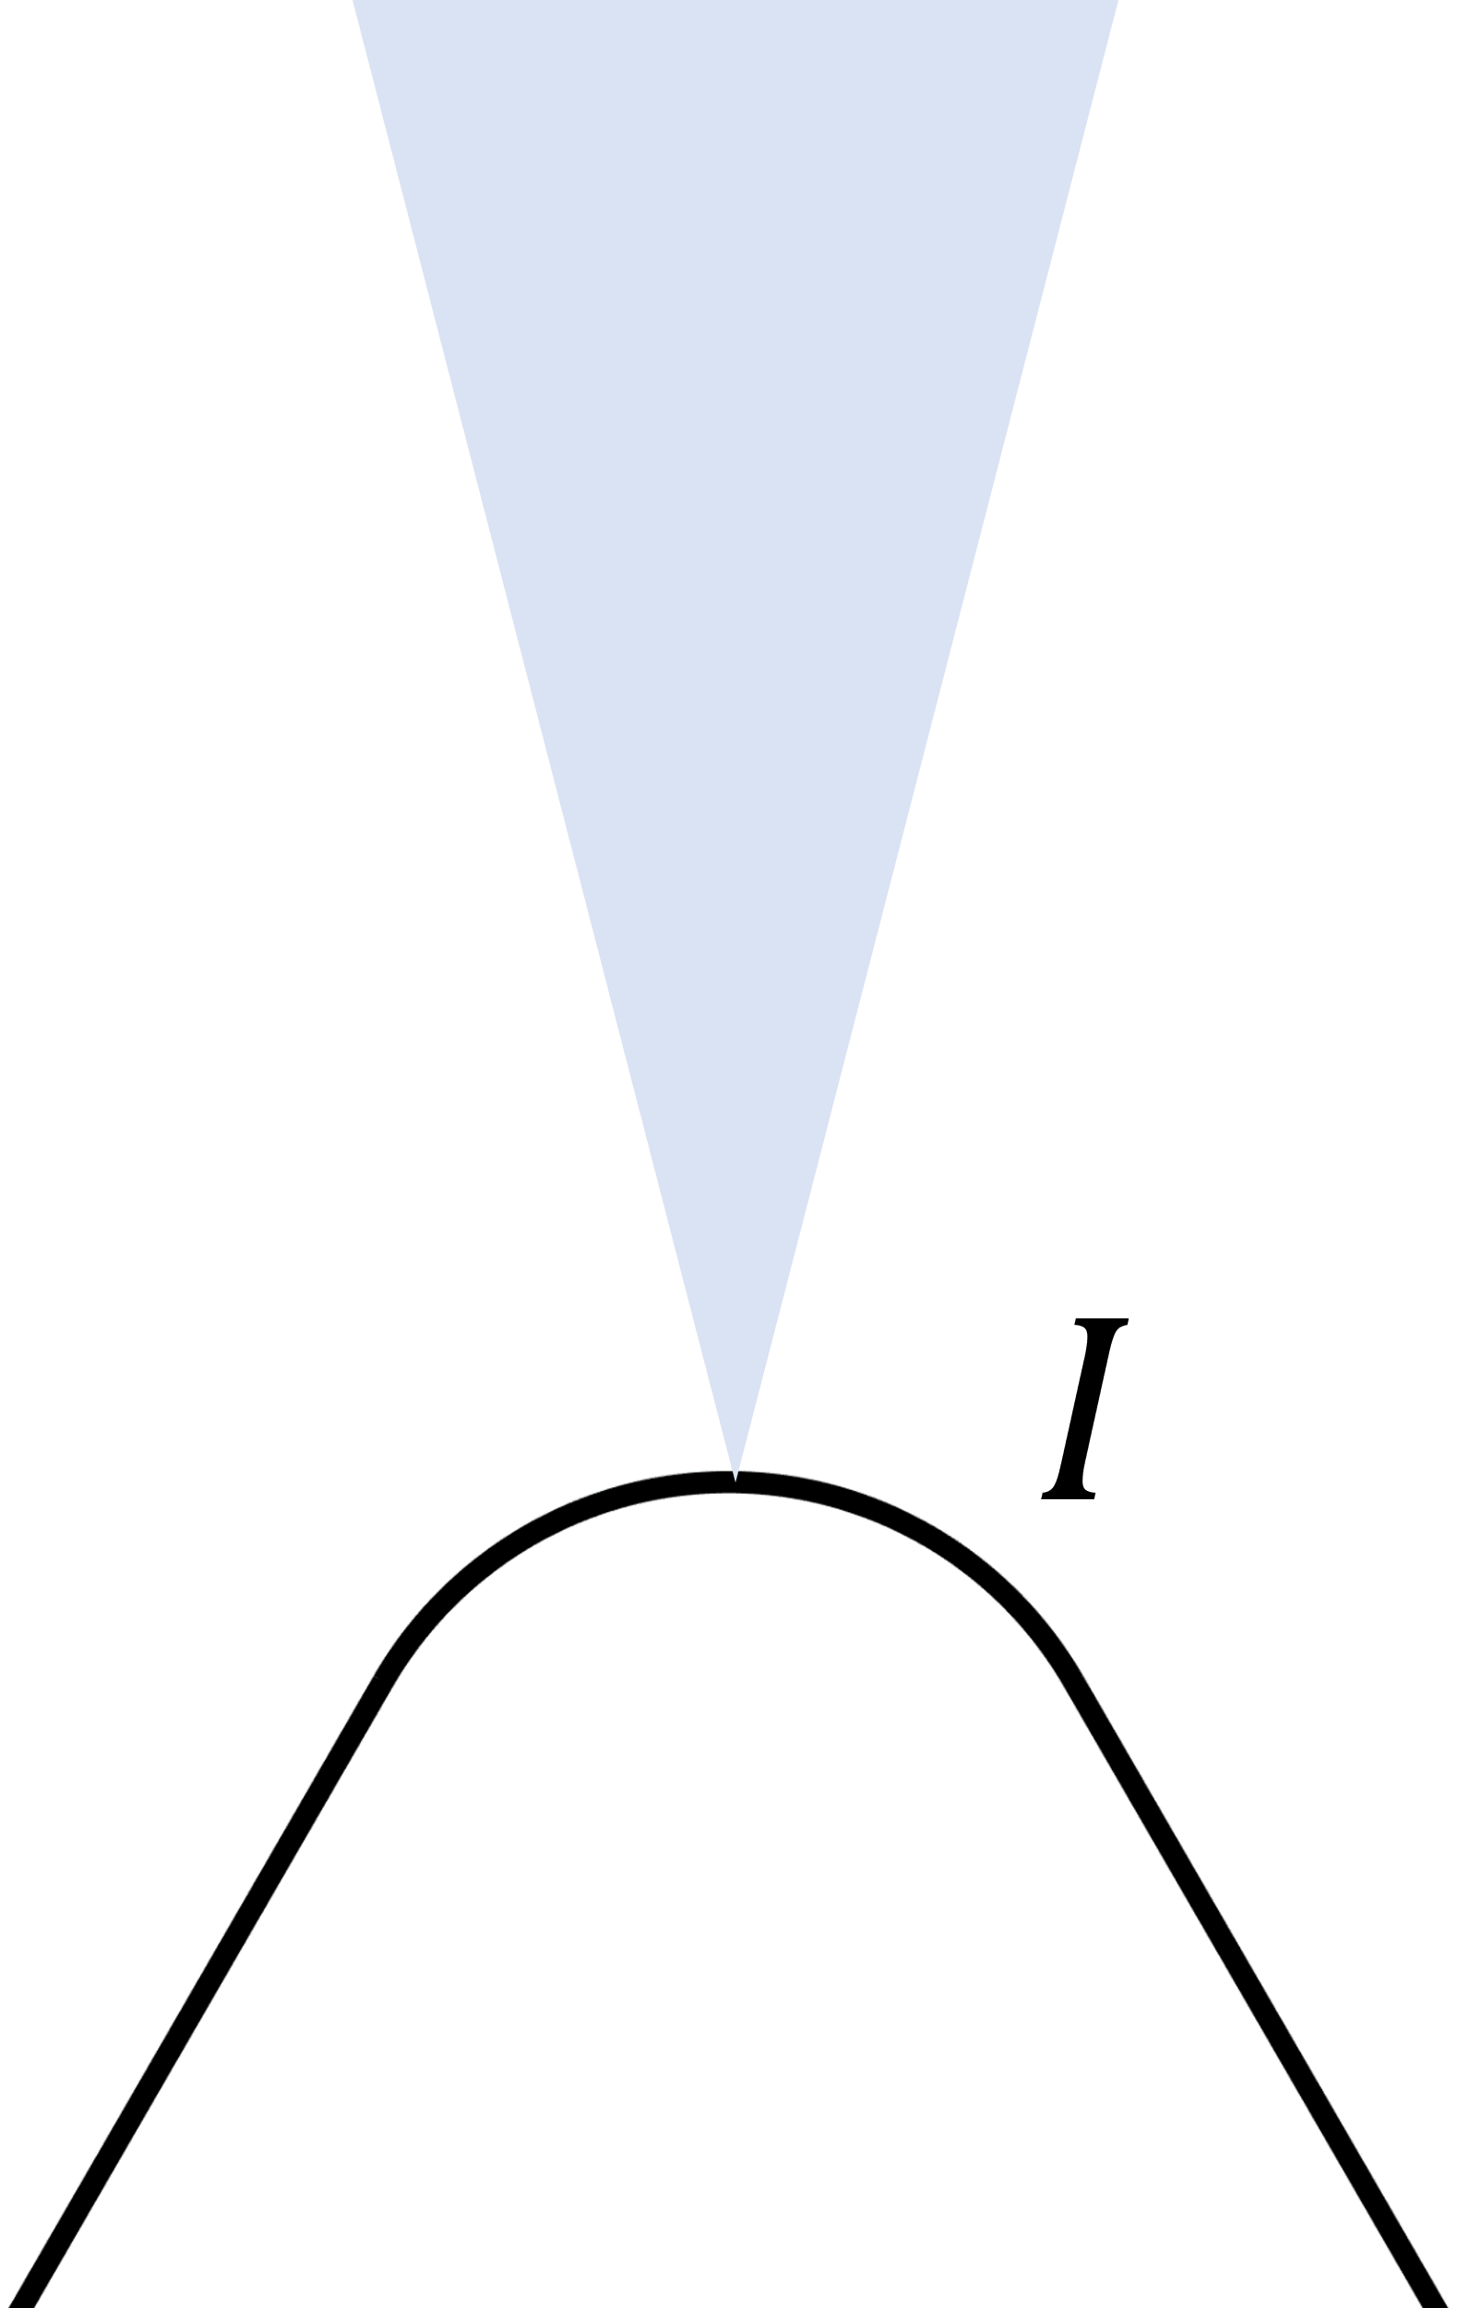
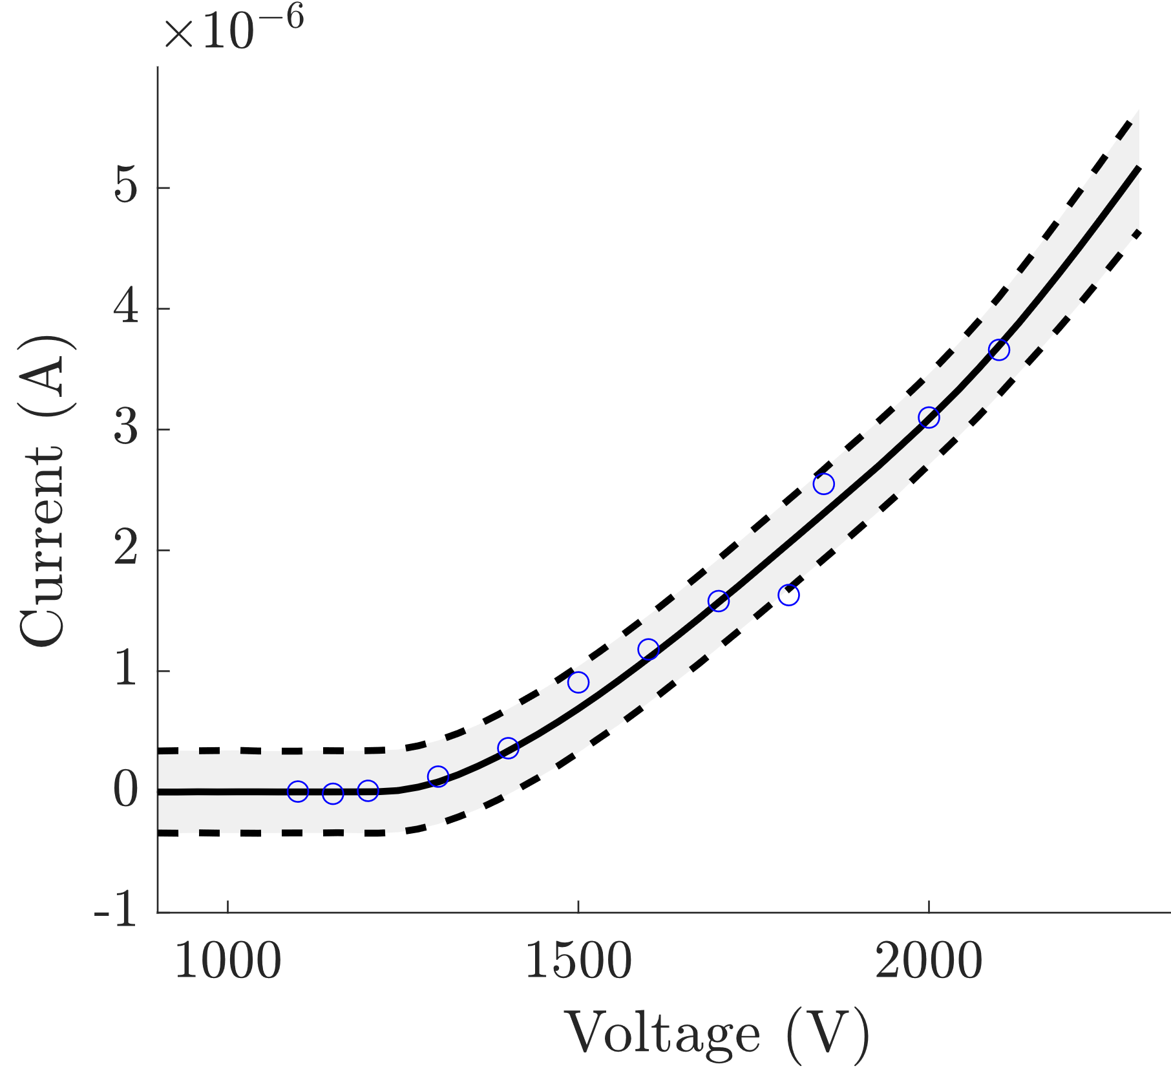
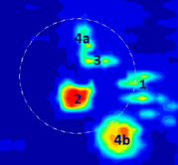
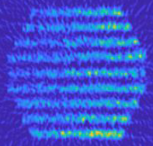
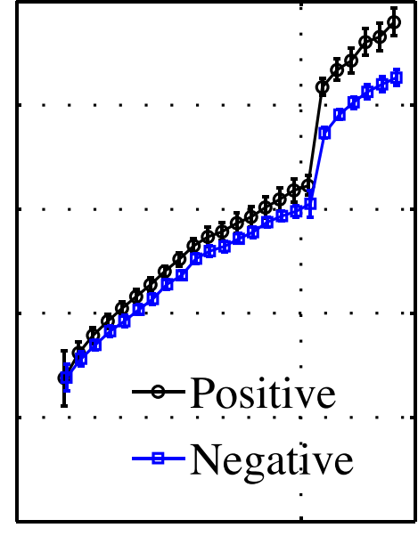
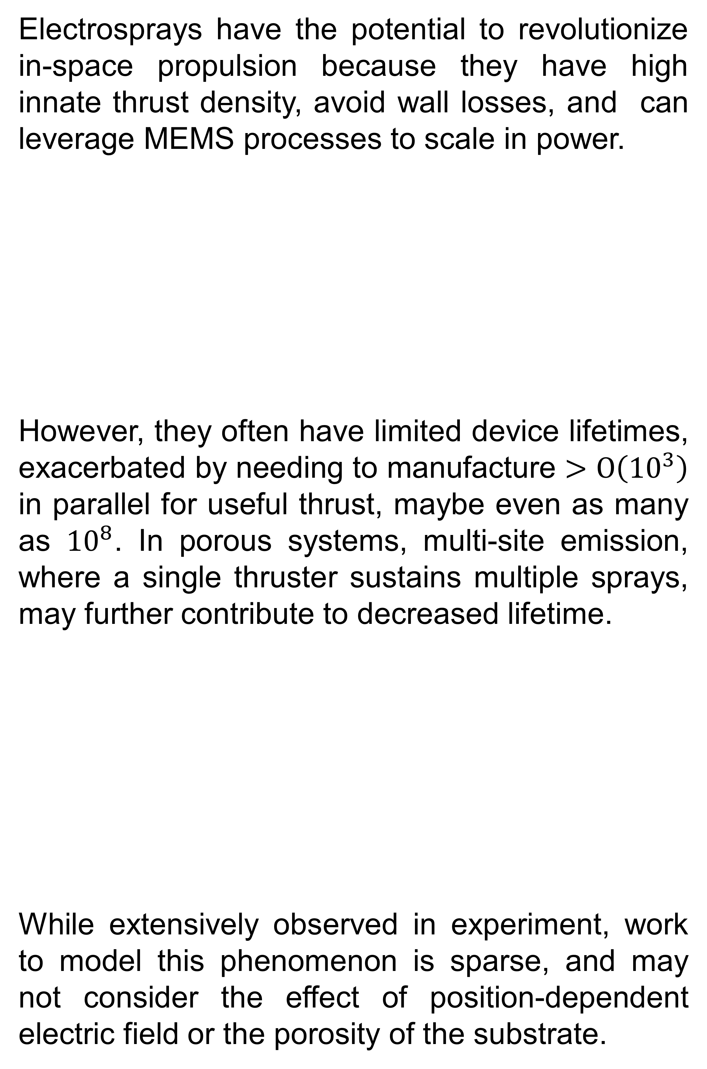
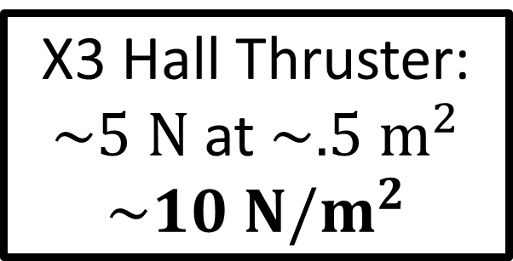

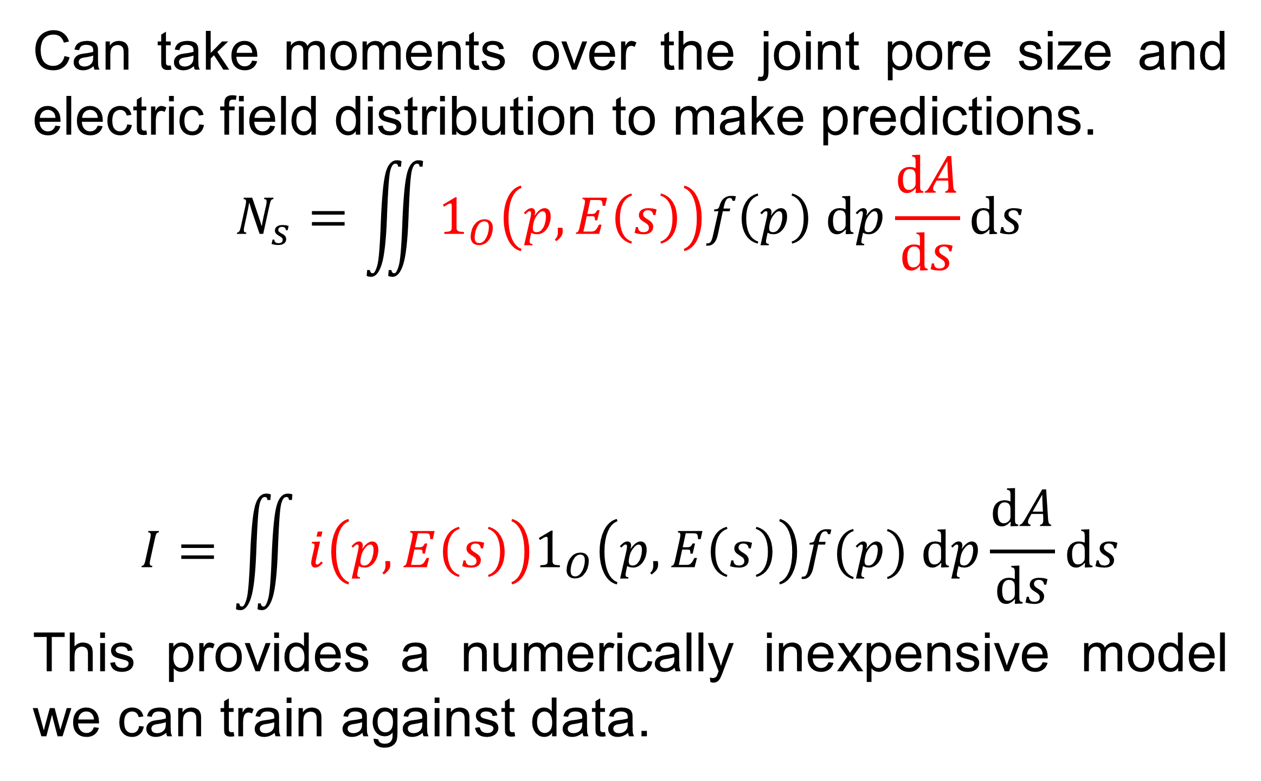


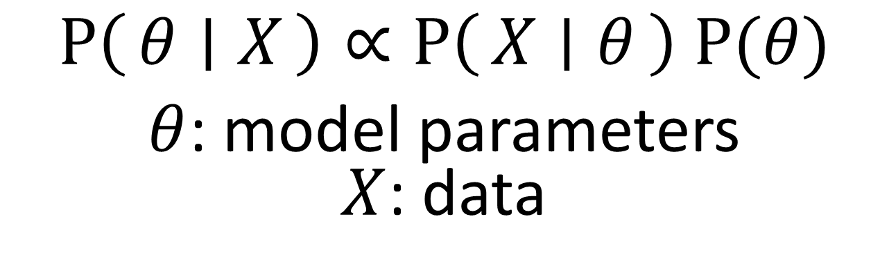
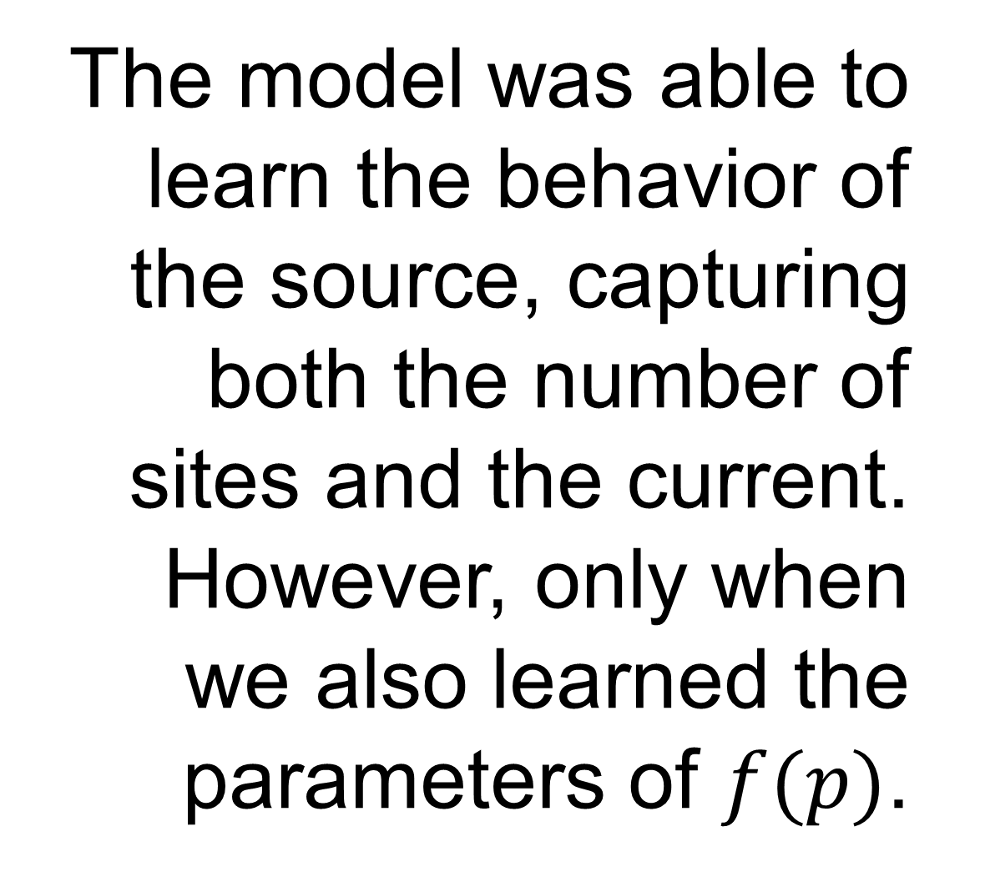

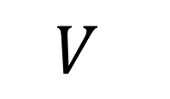
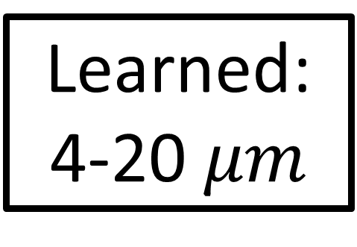
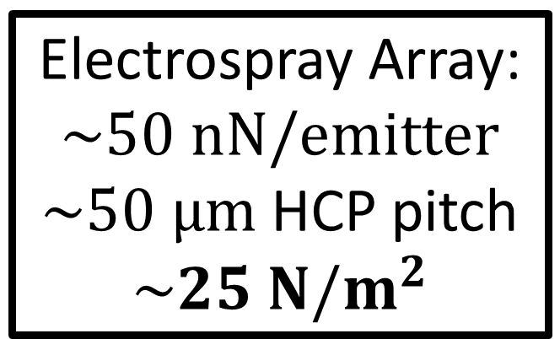
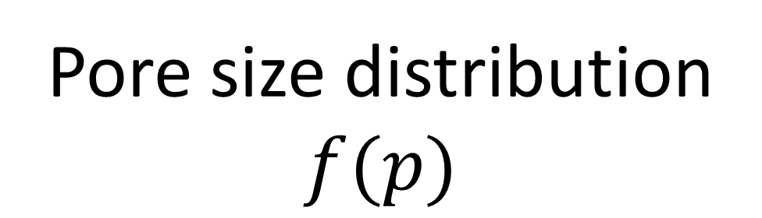
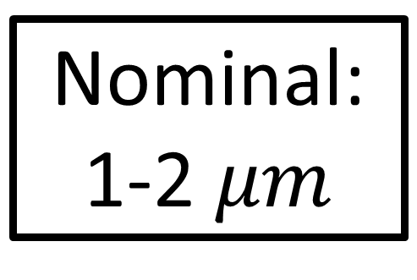
A Multi-Site Emission Modeling Framework for Porous Electrosprays
Collin B. Whittaker and Benjamin A. Jorns
University of Michigan, Department of Aerospace Engineering, Ann Arbor, MI 48109
Motivation
Model
Results
Electrosprays have the potential to revolutionize in-space propulsion because they have high innate thrust density, avoid wall losses, and can leverage MEMS processes to scale in power.
However, they often have limited device lifetimes, exacerbated by needing to manufacture $>O\left({10}^{3}\right)$ in parallel for useful thrust, maybe even as many as ${10}^{8}$. In porous systems, multi-site emission, where a single thruster sustains multiple sprays, may further contribute to decreased lifetime.
While extensively observed in experiment, work to model this phenomenon is sparse, and may not consider the effect of position-dependent electric field or the porosity of the substrate.
Two key mechanisms:
The model was able to learn the behavior of the source, capturing both the number of sites and the current. However, only when we also learned the parameters of $f(p)$.
Experiment [1]
Pore size distribution
$$f(p)$$
X3 Hall Thruster:
$\sim 5 N$ at $\sim .5 m^{2}$
$$\sim 10 N/m^{2}$$
90% CI
Electrospray Array:
$\sim 50 nN/emitter$ $\sim 50 μm$ HCP pitch
$$\sim 25 N/m^{2}$$
Median
Increasing $V$
Experiment [1]
That is, we could not reproduce the data assuming the nominal substrate pore sizing. The learned pore sizes were up to 10x larger:
Electric field distribution
$$E(s)$$
90% CI
Can take moments over the joint pore size and electric field distribution to make predictions.
$$N_{s}=\iint{1_{O}\left(p,E\left(s\right)\right)f\left(p\right) dp\frac{dA}{ds}ds}$$
$$I=\iint{i\left(p,E\left(s\right)\right)1_{O}\left(p,E\left(s\right)\right)f(p) dp\frac{dA}{ds}ds}$$
This provides a numerically inexpensive model we can train against data.
Median
Nominal:
1-2 $μm$
Learned:
4-20 $μm$
[1]
multiple beams
discrete jumps
[3]
This indicates that the surface wetting differs substantially from the internal wetting, which may result from fluid pooling or device fabrication.
$$I$$
current emission
onset
geometry
[2]
Conclusions
$$V$$
Formulated a reduced-fidelity physical model of multi-site emission for porous electrosprays
When calibrated, the model could reproduce experimentally-observed emitter behavior
Learned parameters suggest propellant pooling or surface modification from manufacturing
Parameter Inference
Objectives
We applied Bayesian inference to train the model on measurements of number of sites and emitter current taken on a single-emitter system as a function of voltage [1].
Derive a model predicting the onset of multiple beams and their total current, accounting for these mechanisms
Train the model on experimental data as a validation test case
References & Acknowledgements
$$P\left(θ ∣ X\right)∝P\left(X ∣ θ\right) P(θ)$$
$θ$: model parameters
$X$: data
$$X=\left\{V^{\left(k\right)};N_{s}^{\left(k\right)},I^{\left(k\right)}\right\}$$
[1] B. St. Peter et al., Aerospace. 7, 91 (2020).
[2] Fedkiw et al. AIAA P&E 2021 Forum, 3389, (2021).
[3] Perez-Martinez et al. App. Phys. Lett. 107, 043501, (2015).
[4] Whittaker et al. 37th IEPC, 205, (2022).
This work was supported by a NASA Space Technology Graduate Research Opportunity.
13th Annual MIPSE Graduate Student Symposium

