Slide 1
ONSET OF SILICON NANOPARTICLE CRYSTALLINITY IN NONTHERMAL PLASMAS
Yifan Gui¹, Jordyn Polito² and Mark J Kushner³
¹Department of Nuclear Engineering and Radiological Sciences
²Department of Chemical Engineering
³Department of Electrical Engineering and Computer Science
University of Michigan, Ann Arbor, MI 48109 USA
evangyf@umich.edu, jopolito@umich.edu, mjkush@umich.edu
http://uigelz.eecs.umich.edu
MIPSE Symposium 2024
* Work supported by Army Research Office MURI Grant W911NF-18-1-0240, the National Science Foundation (PHY-2009219), and the Department of Energy Office of Fusion Energy Science (No.DE-SC0020232).
Notes:
1

Slide 2
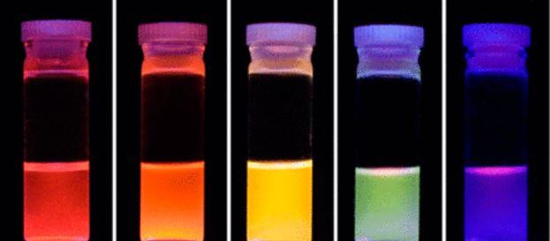
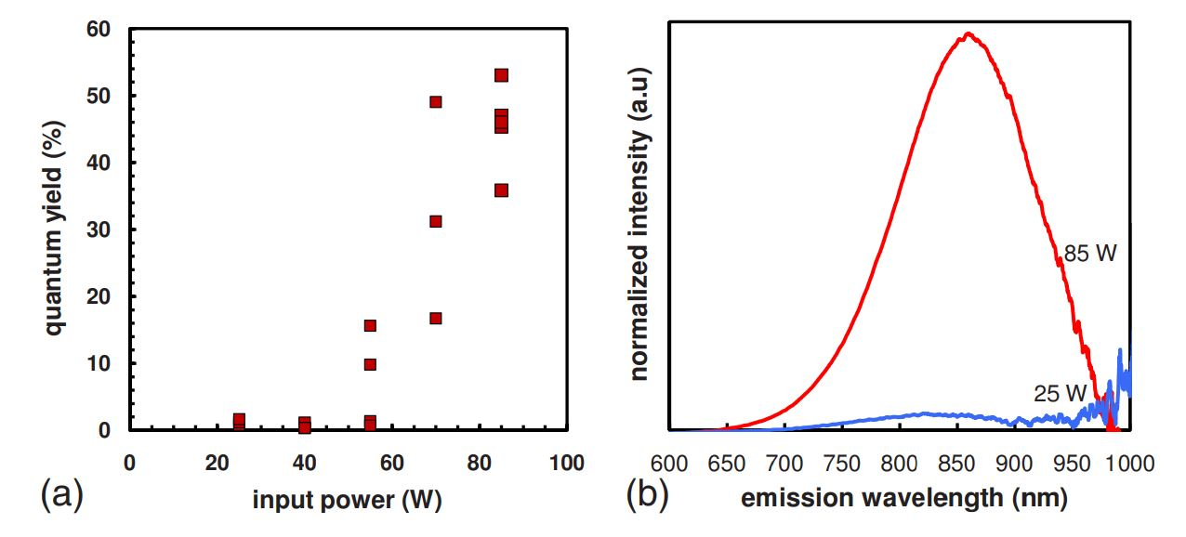
CRYSTALLINE NANOPARTICLES
Controlling size uniformity, purity and crystallinity of NPs is crucial.
Photoluminescence quantum yield (PLQY) increases from 2 to 40% as Si NP crystallizes. [1]
Crystalline NPs can be produced through high temperature annealing.
Capacitively coupled plasmas (CCPs) vs. inductively coupled plasmas (ICPs).
X. D. Pi et al. Nanotechnology 19, 245603 (2008).
R. Anthony et al. Phy. Review B 80, 115407 (2009).
University of Michigan
Institute for Plasma Science & Engr.
[1] R. Anthony et al. Phys. Review B 80, 115407 (2009).
Notes:
2

Slide 3
MODELING PLATFORMS
Modular HPEM to address physical processes in low-temperature plasmas using fluid and kinetic approaches.
DTS workflow:
  Temperature, densities, neutral/ion momenta, and electric fields from HPEM
  Initialize NPs; Compute growth, charging, temperature and the forces acting on the NPs
  Generates a 3-D trajectory for each NP
  Feed NP density and charge back to HPEM
University of Michigan
Institute for Plasma Science & Engr.
Notes:
3
Forces on NPs:
Electrostatic
Gravitational
Thermophoretic
Ion drag
Fluid drag
Interparticle Coulombic interactions

Slide 4
REACTOR GEOMETRIES
CCP
ICP
Inlet
Cylindrical CCP and ICP reactors to create NP growth zone.
2 cm radius, 10 cm height.
Ar/SiH₄ = 98/2, 50 sccm
1 Torr
10 W, 10 MHz
Glass
CCP electrodes
ICP antennae
Plasma Zone
Reactor Height (cm)
Plasma Zone
Outlet
Radius (cm)
Radius (cm)
University of Michigan
Institute for Plasma Science & Engr.
Notes:
4

Slide 5
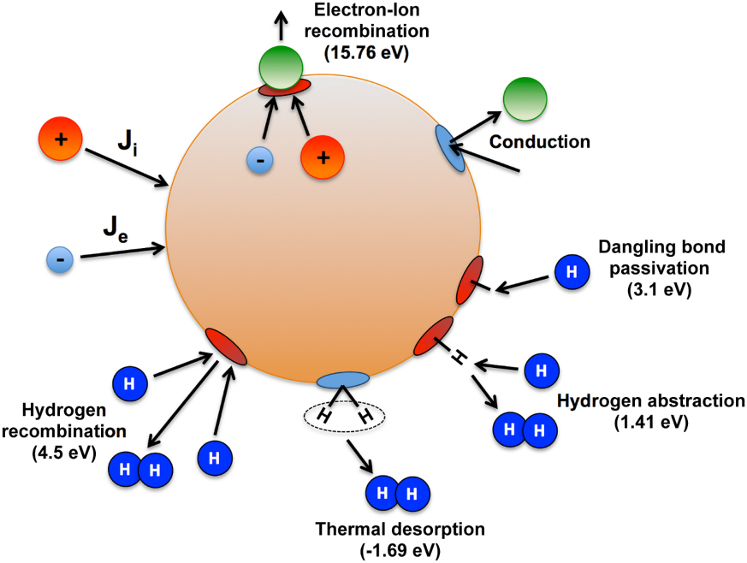
NP HEATING
  NP temperature computed based on approach of Kramer et al. [3].
  Cooling
    Heat conduction to gas, continuously computed
    Radiative loss
  Gain
    Ion recombination (freq. from OML theory)
    Hydrogen atom and radical growth reactions.
[3] N. J. Kramer et al J. Phys. D: Appl. Phys. 47, 075202 (2014)
University of Michigan
Institute for Plasma Science & Engr.
Notes:
5

Slide 6
NP GROWTH
SiH₄
7.8×10¹⁴
S_{c}=0
SiH₃
7.7×10¹¹
S_{c}=0.125
SiH₂
8.45×10¹¹
S_{c}=0.66
SiH
9.6×10¹⁰
S_{c}=0.945
2 dec., [cm⁻³]
10
    SiH₄ breaks into radicals by electron impact dissociation.
    These radicals stick to NPs.
    Sticking coefficients (S_{c}) of radicals from molecular dynamics simulations [2].
    Although unlikely, NPs can coagulate.
8
6
Height (cm)
4
2
ICP, 1 Torr, 10 W, 50 sccm, Ar/SiH₄ 98/2
0
[2] X. Shi et al, J. Phys. D: Appl. Phys. 54, 365203 (2021)
0
1
0
1
0
1
0
1
2
University of Michigan
Institute for Plasma Science & Engr.
Radius (cm)
Notes:
6
Need to change this slide

Slide 7
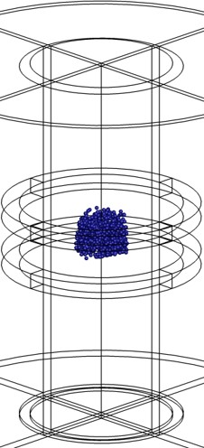
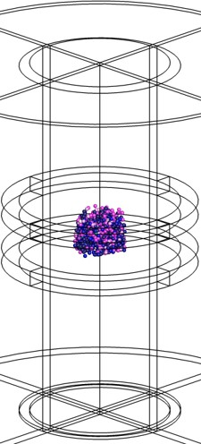
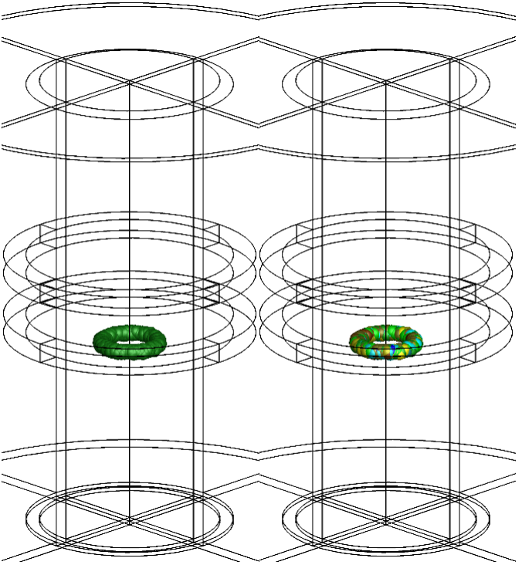
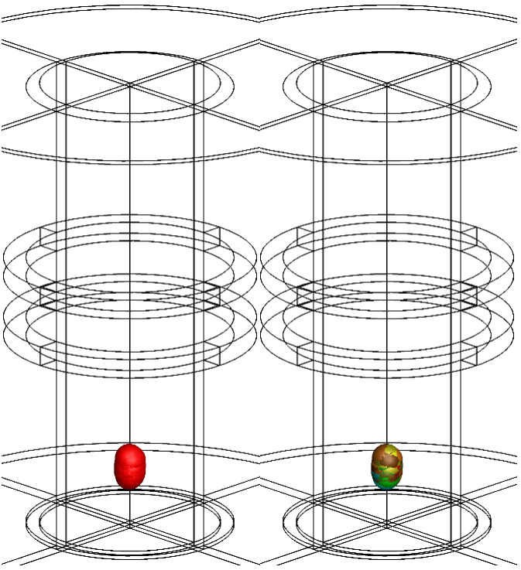
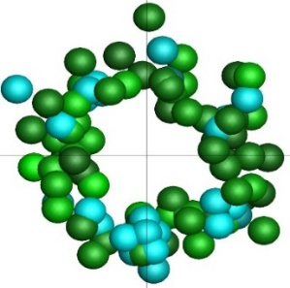
NP TRANSPORT
NP Diameter
NP Charge
t = 0 – 0.85 s
2 nm
11 nm
-1 q
-20 q
NPs initialization at nucleation sites
NPs trap in ring formation
NPs de-trap
Top down view
CCP, 1 Torr, 10 W, 50 sccm, Ar/SiH₄ 98/2
Animation
University of Michigan
Institute for Plasma Science & Engr.
Notes:
7
Si NPs were initialized as “seeds” with 1 nm radius between electrodes.
NPs are charged negatively due to the higher mobility of electrons.
Electrostatic forces traps the NPs near regions of maximum potential.
Thermophoresis and ion drag force pushes NPs radially outward to form ring-like structures.
NPs grow to critical size when fluid drag dominates and flow out of the reactor.

Slide 8
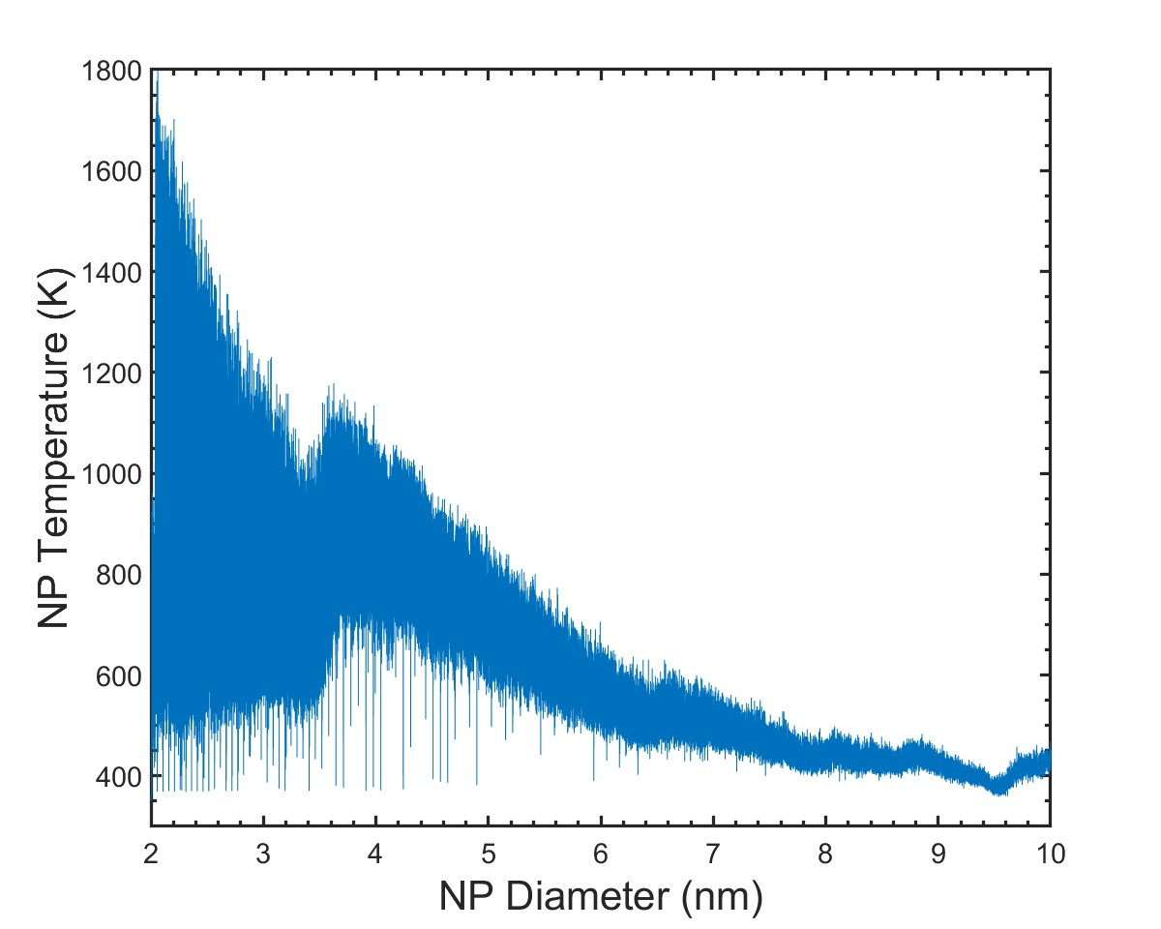
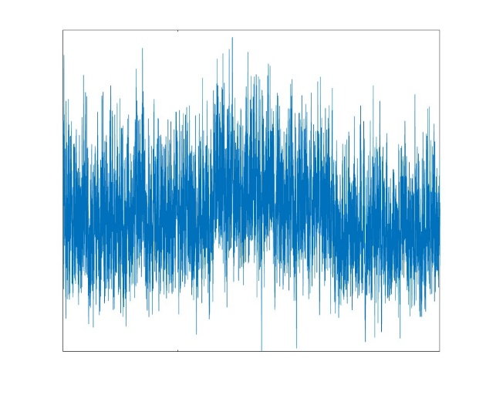
NP TEMPERATURE
  Stochastic ion and neutral reactions produce impulsive energy gain in NPs.
  Reactions occurring at high frequency enables T_{NP} build-up, followed by rapid conductive cooling.
  T_{NP} decreases with increasing NP size.
ICP, 1 Torr, 10 W, 50 sccm, Ar/SiH₄ 98/2
University of Michigan
Institute for Plasma Science & Engr.
Notes:
8

Slide 9
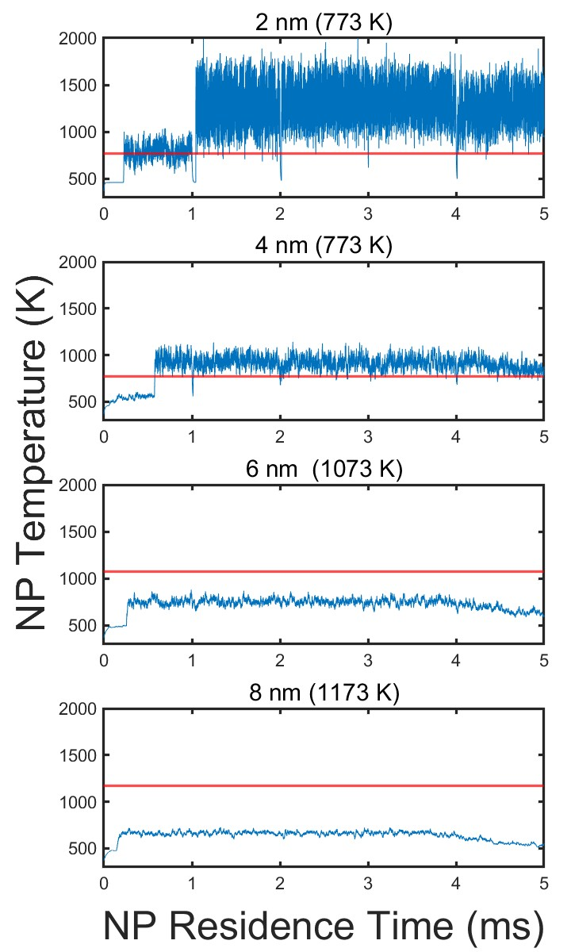
NP CRYSTALLIZATION vs. NP SIZE
  Hirasawa et al investigated NP crystallization temperature T_{c} vs NP size [4].
  4 nm: 773 K
  6 nm: 1073 K
  8 nm: 1173 K
  10 nm: 1273 K (Red lines)
  Only smaller NPs have T_{NP} above T_{c}.
  Large NCs are synthesized in plasma reactors [5].
  Hypothesis: Large NCs grow epitaxially on thermally produced smaller crystalline cores.
ICP, 1 Torr, 10 W, 50 sccm, Ar/SiH₄ 98/2
[4] M. Hirasawa et al. Appl. Phys. Lett. 88, 093119 (2006)
[5] U. R. Kortshagen et al, Chem. Rev. 116, 11061 (2016).
University of Michigan
Institute for Plasma Science & Engr.
Notes:
9

Slide 10
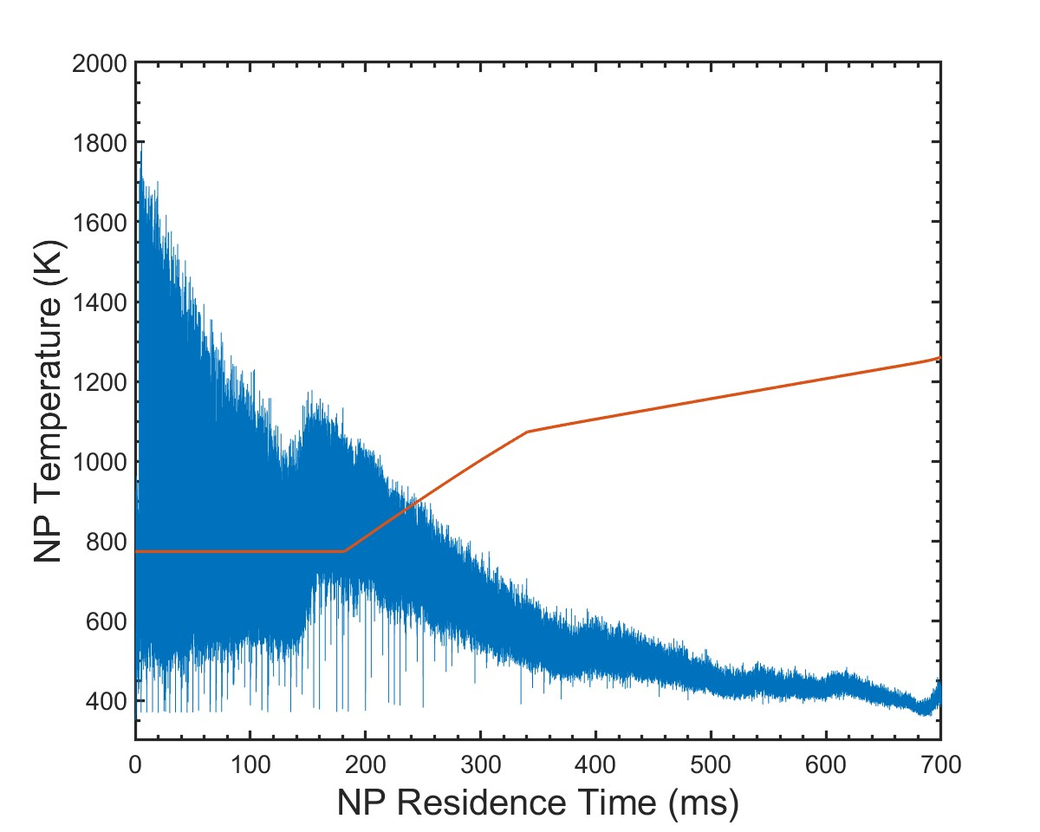
MODELING NANOCRYSTAL FORMATION
DTS tracks the NP “exposure time”, defined as the length of time T_{NP} > T_{c} (in red).
Maximum exposure time, t_{max}, determines the performance of CCP and ICP for NP crystallization.
t_{max} is the maximum time NP spends in the reactor with T_{NP} > T_{c}.
Larger the t_{max}, more optimal the reactor configuration is for NC production.
T_{NP}
T_{c}
t_{max}
ICP, 1 Torr, 10 W, 50 sccm, Ar/SiH₄ 98/2
University of Michigan
Institute for Plasma Science & Engr.
[6] C. Sun and D. Xue, Curr. Opin. Chem. Eng. 1, 108 (2012).
15
Notes:
10
50 sccm:
σ = 0.08 nm,
Ge/Si core/shell radius = 7.6/0.1 nm

Slide 11
CCP vs. ICP FOR NP CRYSTALLIZATION
Notes:
11

Slide 12
CCP vs. ICP PLASMA PROPERTIES
CCP CW
ICP CW
[e], 1.15×10¹⁰ cm⁻³, 2 dec.
[e], 3.72×10¹¹ cm⁻³, 2 dec.
2
2
1
1
0
0
T_{e}, 1 – 12 eV
T_{e}, 0.5 – 3.4 eV
1
1
Radius (cm)
Radius (cm)
0
0
Plasma potential, -100 – 130 V
Plasma potential, 0 – 23 V
1
1
0
0
10
8
6
4
2
0
10
8
6
4
2
0
Height (cm)
Height (cm)
ICPs have higher plasma density than CCPs.
CCPs are characterized by their plasma uniformity and higher electron temperature T_{e}.
ICP plasma potential tends to be more localized and quiescent compared to CCPs (stronger electrostatic NP traps).
1 Torr, 10 W, 50 sccm, Ar/SiH₄ 98/2
University of Michigan
Institute for Plasma Science & Engr.
Notes:
12

Slide 13
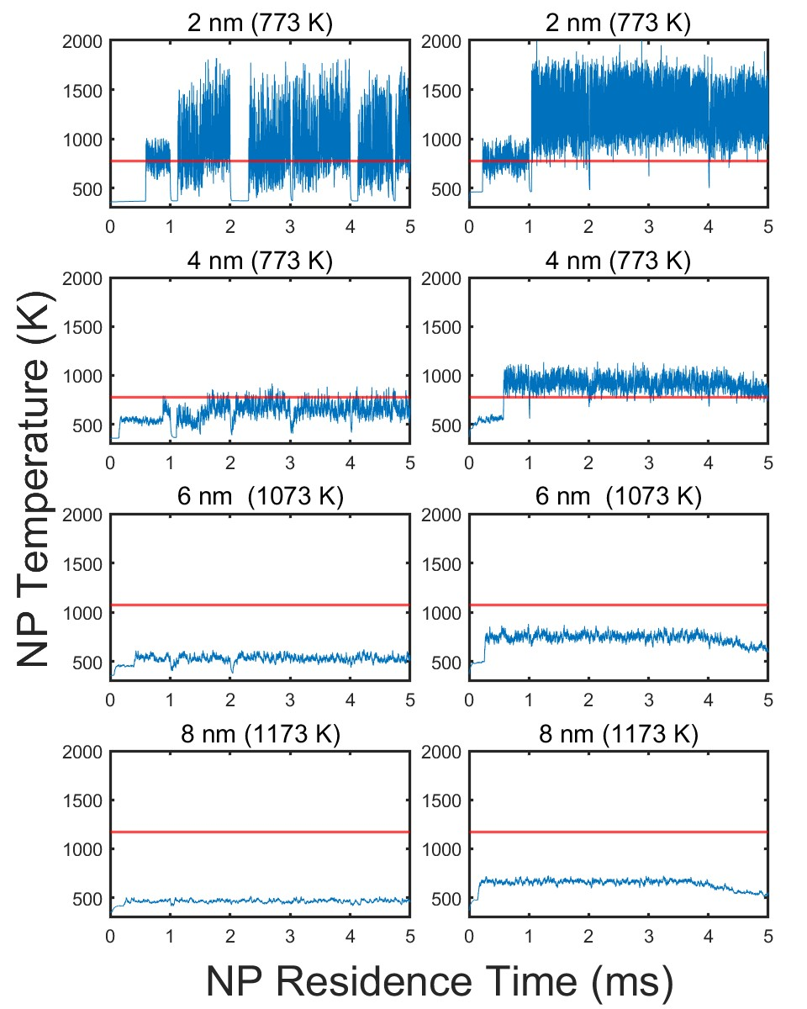
NP CRYSTALLIZATION: CCP vs. ICP
CCP
ICP
T_{NP} is higher for ICP than CCP due to the larger plasma density. (3.72×10¹¹ vs. 1.15×10¹⁰ cm⁻³ )
T_{NP} > T_{c} up to 4 nm NPs in ICP.
1 Torr, 10 W, 50 sccm, Ar/SiH₄ 98/2
University of Michigan
Institute for Plasma Science & Engr.
Notes:
13

Slide 14
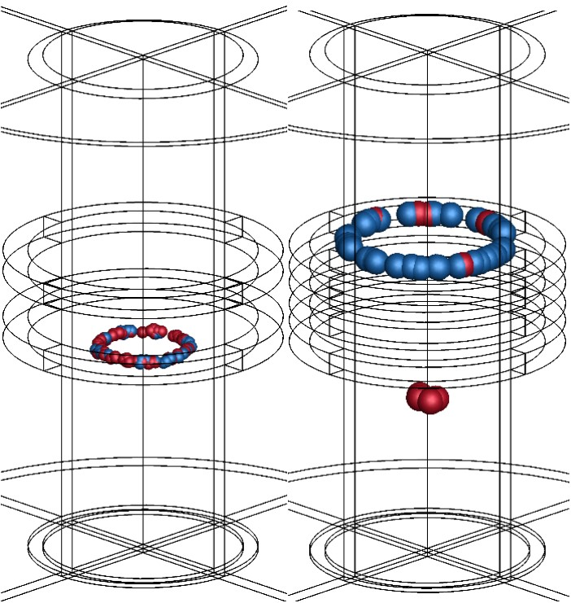
NP CRYSTALLIZATION: CCP vs. ICP
CCP
ICP
t_{max} = 0.15 s
t_{max} = 0.035 s
1 Torr, 10 W, 50 sccm, Ar/SiH₄ 98/2
ICP achieving t_{max} occurs sooner.
NPs are in crystallization process for shorter time in ICP.
t_{max} is 4 times higher for CCP than ICP.
t = 0 – 0.25 s
Animation Slide
Not crystalline
t_{max} achieved
University of Michigan
Institute for Plasma Science & Engr.
Notes:
14

Slide 15
NP CRYSTALLIZATION: CCP vs. ICP
CCP
ICP
[Si_{x}H_{y} ]
8.5×10¹¹, 2 dec.
[Si_{x}H_{y} ]
2.5×10¹², 2 dec.
[cm⁻³]
1 Torr, 10 W, 50 sccm, Ar/SiH₄ 98/2
10
10
Growth species density in ICP is 4 times larger, faster growth rate.
NPs spend less time being “small” → less time with T_{NP}>T_{c}.
Higher plasma density does not equate to more crystalline particles!
8
8
6
6
Height (cm)
4
4
2
2
0
0
0
1
2
0
1
2
University of Michigan
Institute for Plasma Science & Engr.
Radius (cm)
Notes:
15

Slide 16
CONTINUOUS WAVE (CW) vs. PULSED ICP FOR NP CRYSTALLIZATION
Notes:
16

Slide 17
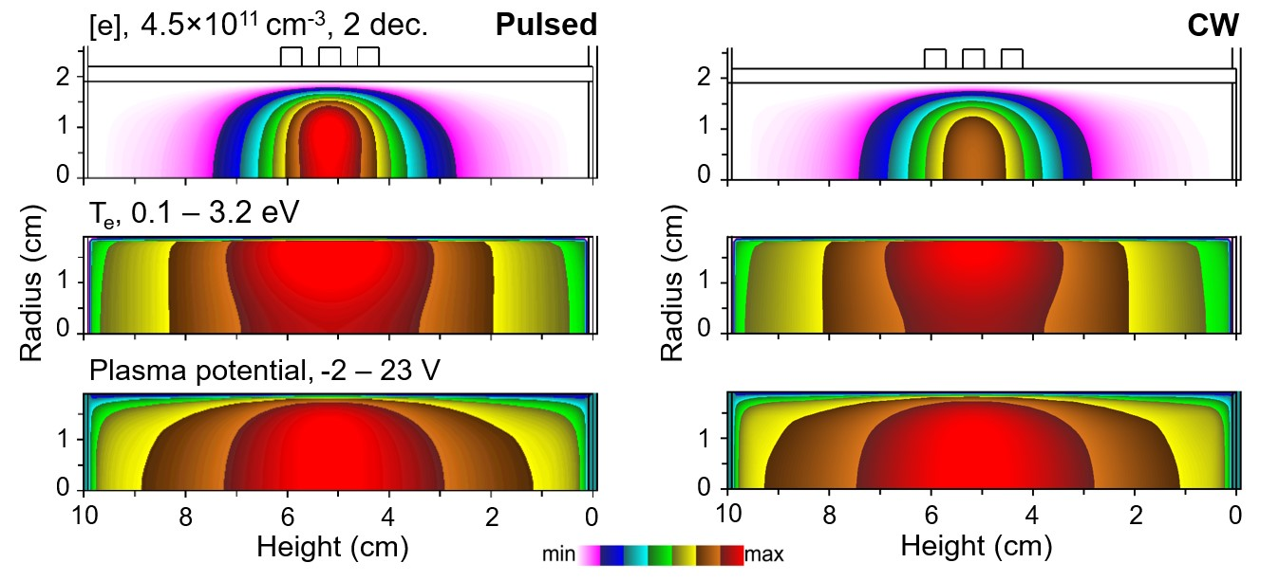
CW vs. PULSED ICP PLASMA PROPERTIES
Plasma density, temperature and potential of pulsed plasmas are higher at the onset of the pulse compared to cw.
During power-off period, n_{e} decreases as dissociative recombination, diffusion and thermal attachment reactions begin to dominate.
1 Torr, 10 W (1ms, 0.5 DC), 50 sccm, Ar/SiH₄ 98/2
Animation
University of Michigan
Institute for Plasma Science & Engr.
Notes:
17

Slide 18
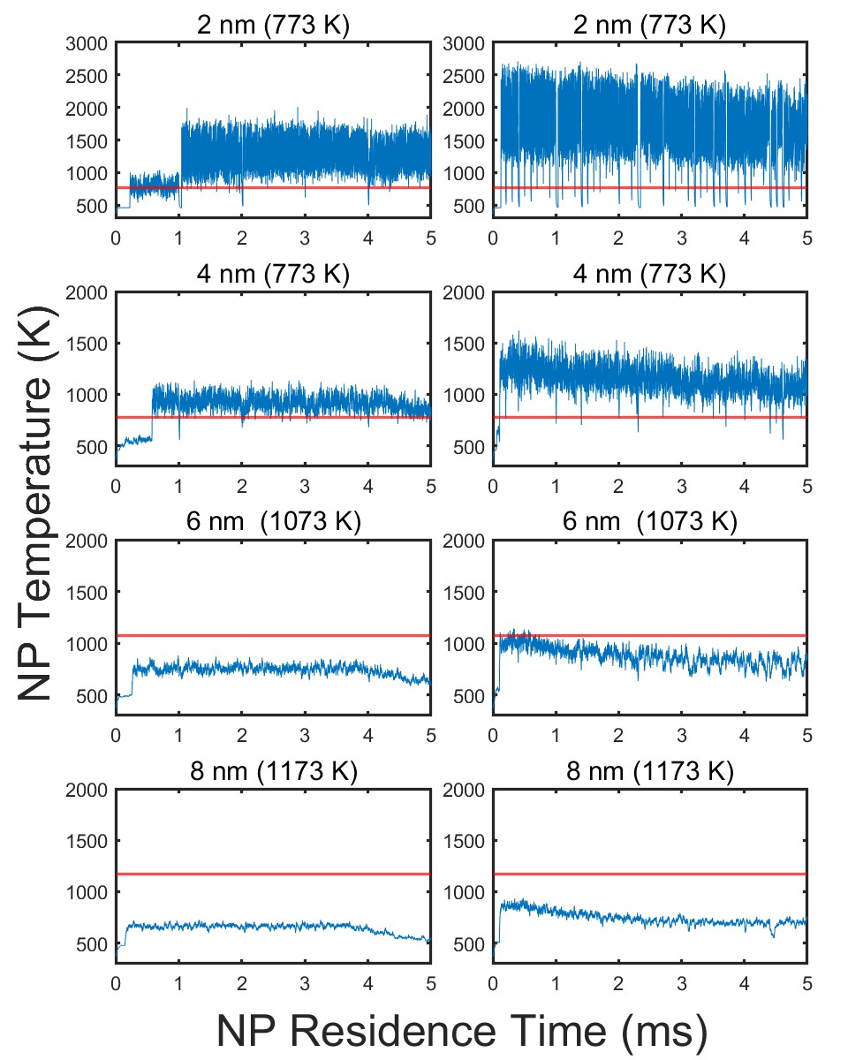
NP CRYSTALLIZATION: CW vs. PULSED ICP
CW
PULSED
10 W, 1 ms, 0.3 – 0.7 duty cycle (DC).
T_{NP} is higher for pulsed ICP due to the larger plasma density at onset of pulse.
Pulsed ICP pushes the crystallization limit to 6 nm.
University of Michigan
Institute for Plasma Science & Engr.
Notes:
18

Slide 19
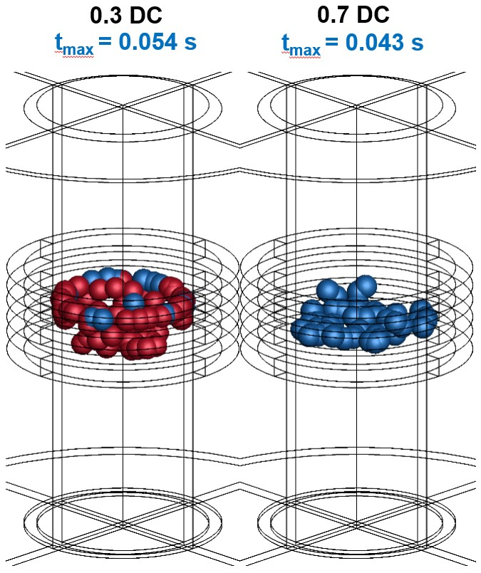
NP CRYSTALLIZATION: CW vs. PULSED ICP
t_{max} increases by 30% from cw to 0.5 DC pulsed (0.035 to 0.045 s).
Shorter DC extends crystallization limit.
t_{max} for DC of 0.3, 0.5, and 0.7 are 54, 45 and 43 ms.
For shorter DC, stronger NP heating during power-on outweighs the lowered heating during power-off.
t = 0.1 – 0.12 s
Animation
Crystallizing
Achieved t_{max}
University of Michigan
Institute for Plasma Science & Engr.
Notes:
19

Slide 20
CONCLUDING REMARKS
  Compared to CCPs, ICPs can crystallize larger NPs but t_{max} is short due to the higher growth rate.
  Pulsed ICP extends the crystallization size limit, resulting in more efficient NC production.
  Lower DC for pulsed ICP improves NC production.
  Optimization of plasma reactors for NC production requires consideration of not only plasma density, but other factors such as NP growth rate, charge and trapping locations as well.
  Mixing operating conditions (cw + pulsed) may be beneficial to NC synthesis.
University of Michigan
Institute for Plasma Science & Engr.
Notes:
20

