Slide 1

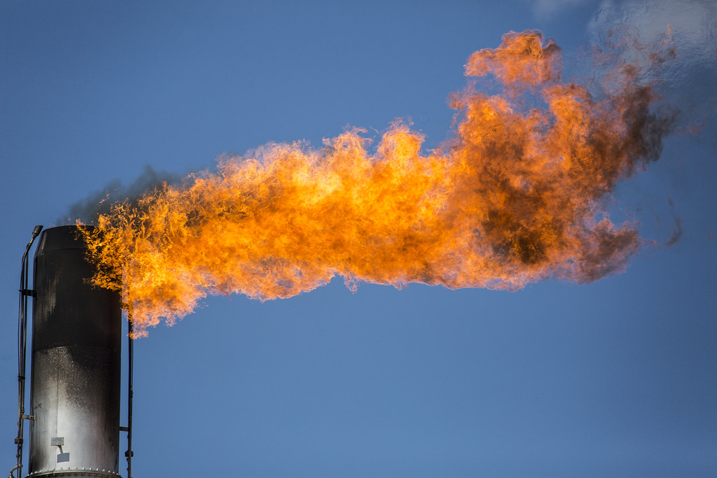
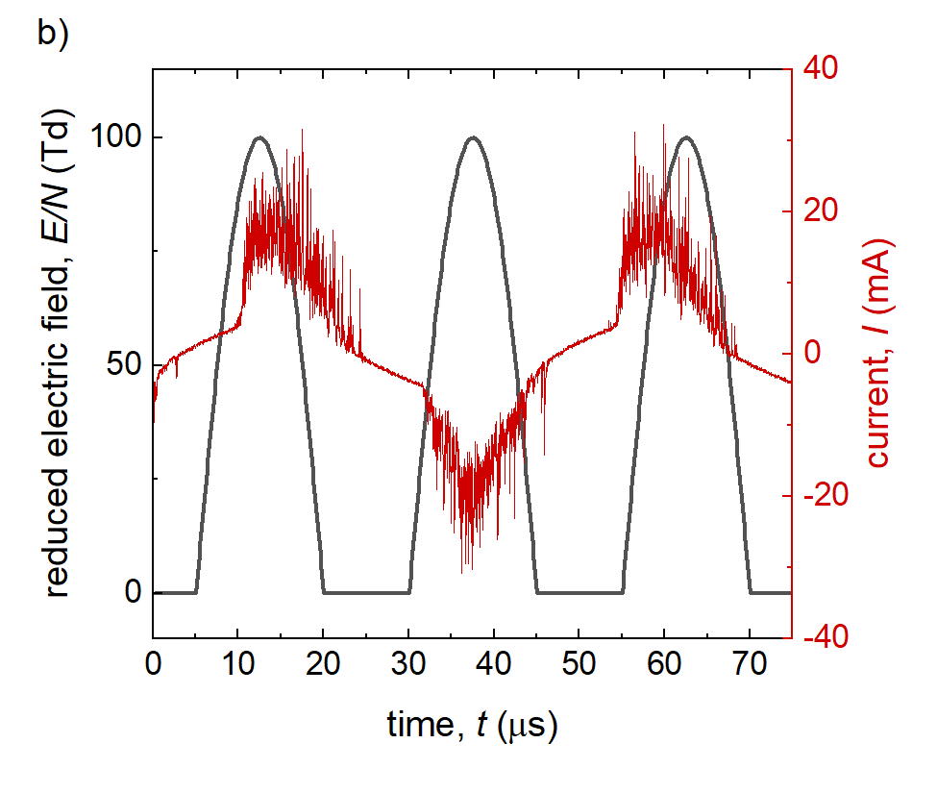
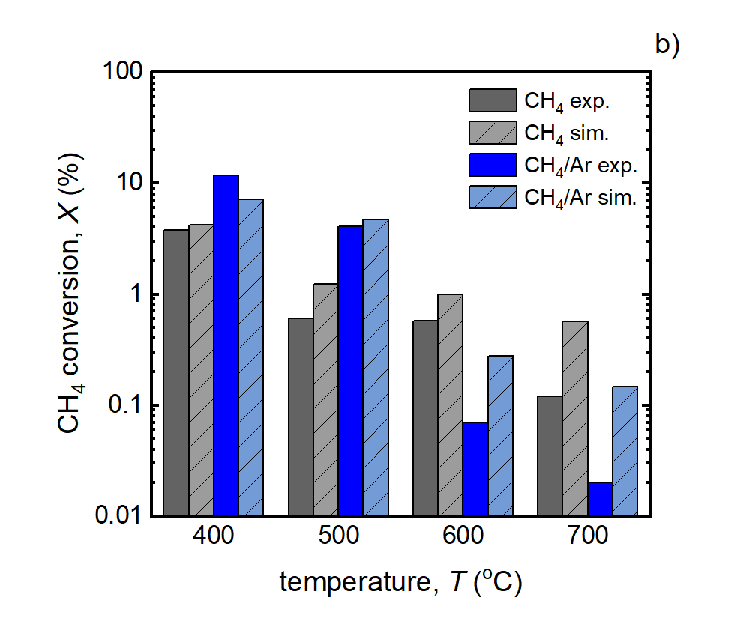
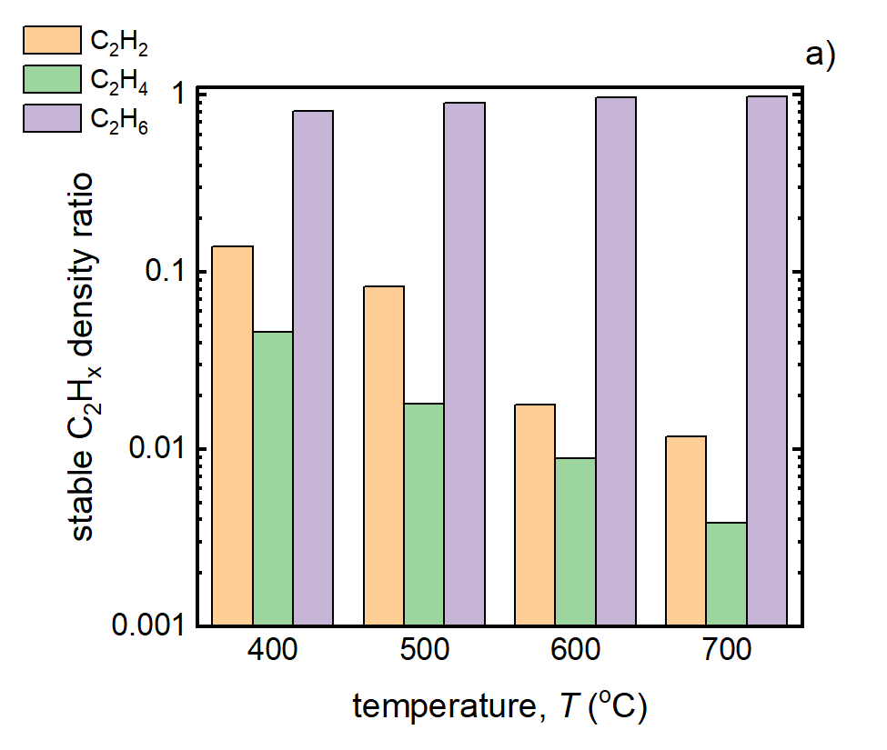



Homogeneous vs. Plasma Chemistry in High Temperature Methane DBDs:
A Global Kinetic and Graph Theory Analysis
Ibukunoluwa Akintola¹, Jinyu Yang¹, Mikhail Vasilev¹, David B. Go^{1,2}
¹ Department of Aerospace and Mechanical Engineering, University of Notre Dame, Indiana 46556 USA
² Department of Chemical and Biomolecular Engineering, University of Notre Dame, Indiana 46556 USA
¹
Results
Motivation
Simulation Approach
8
Penetration depth (H20) ~ 2.5 n
Carbon-efficient upgrading of natural gas into higher-order species
Non-thermal plasmas offer opportunity to create key intermediates from light hydrocarbons at ambient conditions
ZDPlasKin 0-D plasma kinetic solver used to determine time evolution of key reaction species¹
Simulated reduced electric field E/N of 100 Td estimated from experimental reactor geometry and electron density N_{e} of 5 × 10¹³ cm⁻³ estimated from total current per half cycle electrical measurements
400 ℃
700 ℃
www.texasstandard.org
Pulsed E/N and N_{e} every 25 𝜇s for total simulation time of 1 ms to model experimental frequency (~ 20 kHz) and filamentary behavior
Reaction model for pure CH₄ consists of 29 species, 61 electron-driven reactions and 125 homogeneous reactions
NetworkX used to graph reaction network²
Goal:
Understand competition between temperature-dependent plasma-driven and homogeneous reaction chemistry at high temperatures
3-Body CH₄ production reactions:
Experimental Approach
Cylindrical flow-through reactor with an integrated dielectric barrier discharge (DBD)
Reactions run at 1 atm pressure with bulk temperature controlled from 400 to 700 ℃, held at constant power
Reaction products characterized using gas chromatography (GC)
Simulated E/N to model frequency of plasma current activity
Results
Full and reduced networks for pure CH₄ plasma at 400 and 700 ℃
Reduced network shows reactions that create CH₄ become more important at 700 ℃
C₄H₁₀, C₃H₈, and C₂H₄ are key intermediates in the CH₄ conversion reaction mechanism
Increased temperature inhibits CH₄ conversion for DBD plasma-driven reactions³
Simulations closely match experimental results and show CH₄ conversion inhibition
Temperature-dependent change in distribution of C₂ products from triple carbon-carbon bonding to single carbon-carbon bonding
Reduction in graphical network by importance of edge betweenness centrality provides insight into key reaction pathways and mechanisms
Conclusions
Increase in temperature leads to inhibition of CH₄ conversion in DBD reactor
Temperature-dependent change in product selectivity and coupling of carbon
Homogeneous reaction chemistry, not plasma-driven reactions, is responsible for change to reaction mechanism at high temperatures
Schematic of the reactor setup for electrical characterization of the plasma and product formation analysis
Reaction of interest:
CH₄ + Gas → C₂ Products
References
Acknowledgements
¹Pancheshnyi, S., Eismann, B., Hagelaar, G., & Pitchford, L. (2008). ZDPlasKin: a new tool for plasmachemical simulations. Bulletin of the American Physical Society, 53.
²Hagberg, A., Swart, P.J. and Schult, D.A. (2008). Exploring network structure, dynamics, and function using NetworkX (No. LA-UR-08-05495; LA-UR-08-5495). Los Alamos National Laboratory (LANL), Los Alamos, NM (United States)
³Akintola, I., Rivera-Castro, G., Yang, J., Secrist, J., Hicks, J. C., Veloso, F., & Go, D. B. (2023). Temperature inhibition of plasma-driven methane conversion in DBD systems. Plasma Chemistry and Plasma Processing, 43(6), 1999-2016.
This work was supported by the U.S. Department of Energy by National Energy Technology Laboratory under Award Number DE-FE0031862 and the Office of Naval Research under Award Numbers N00014-23-1-2445 and N00014-25-1-2226.

