Slide 1
CHARGING DYNAMICS DURING PULSED PLASMA ETCHING OF HIGH ASPECT RATIO FEATURES IN DIELECTRIC MATERIALS
Chenyao Huang¹, Yeon Geun Yook¹, Yifan Gui¹, Steven C. Shannon², and Mark J. Kushner¹
¹University of Michigan, Ann Arbor, MI 48109-2122 USA
²North Carolina State University, Raleigh, NC, USA
chenyaoh@umich.edu, ygyook@umich.edu, evangyf@umich.edu, scshanno@ncsu.edu, mjkush@umich.edu
MIPSE Symposium
* Work supported by the Department of Energy Office of Fusion Energy Science (DE‐SC0024545).

Slide 2
AGENDA
Charging processes in High Aspect Ratio (HAR) plasma etching.
Description of HPEM and MCFPM
Charging dynamics of
Pre-etched feature
Fluorocarbon ONO stack etch
Concluding Remarks
University of Michigan
Institute for Plasma Science & Engr.
MIPSE_2025

Slide 3
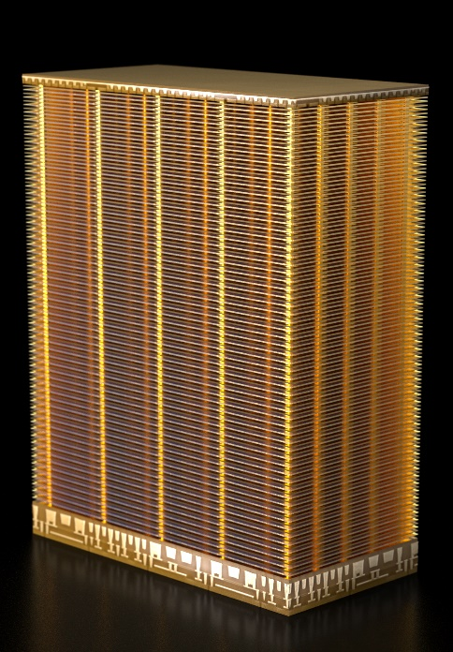
HIGH ASPECT RATIO PLASMA ETCHING
Fabrication challenges following the shift from “shrinking” cells to “stacking” require plasma etching extremely high aspect ratio (HAR) features exceeding aspect ratio (AR) > 100.
Oxide–nitride–oxide (ONO) stacks, which are composed of alternating SiO₂ and Si₃N₄ dielectric layers, are important structures for 3D-NAND memory.
Etching is performed in multi-frequency capacitively coupled plasmas (CCPs) whose substrate bias is typically pulsed.
Micron 3D-NAND 232 Layers
YMTC 3D-NAND 232 Layers
https://investors.micron.com/news-releases/news-release-details/micron-ships-worlds-first-232-layer-nand-extends-technology
https://www.techinsights.com/blog/ymtc-leading-pioneer-3d-nand
University of Michigan
Institute for Plasma Science & Engr.
MIPSE_2025

Slide 4
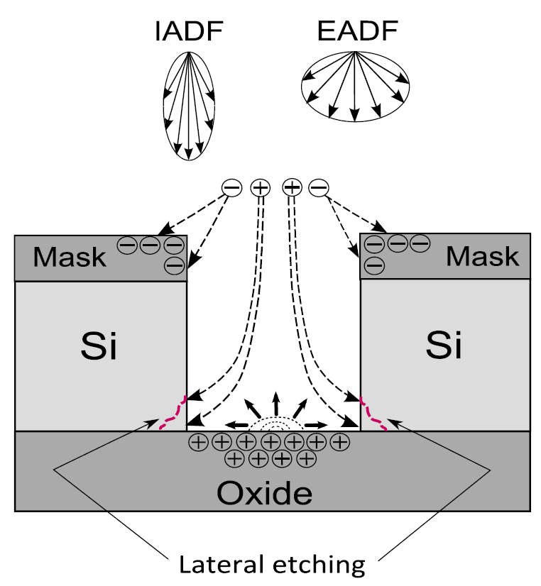
PLASMA ETCHING AND CHARGING PROCESS
During etching of dielectrics, ions with high energy and narrow angular distribution preferentially charge the bottom of features, while electrons with low energy and broad angular distribution preferentially charge the top.
The resulting intra-feature electric fields can deflect ion trajectories and produce feature distortion such as twisting.
Pulsing the bias is employed, in part, to remediate this charging though the dynamics have not been quantified.
In this presentation, the dynamics of feature charging during pulsing have been computationally investigated.
Pre-etched features
Etching of HAR ONO stacks.
Ishchuk et al. J. Appl. Phys. 112, 084308 (2012).
University of Michigan
Institute for Plasma Science & Engr.
MIPSE_2025
Notes:
make on-time consistent

Slide 5
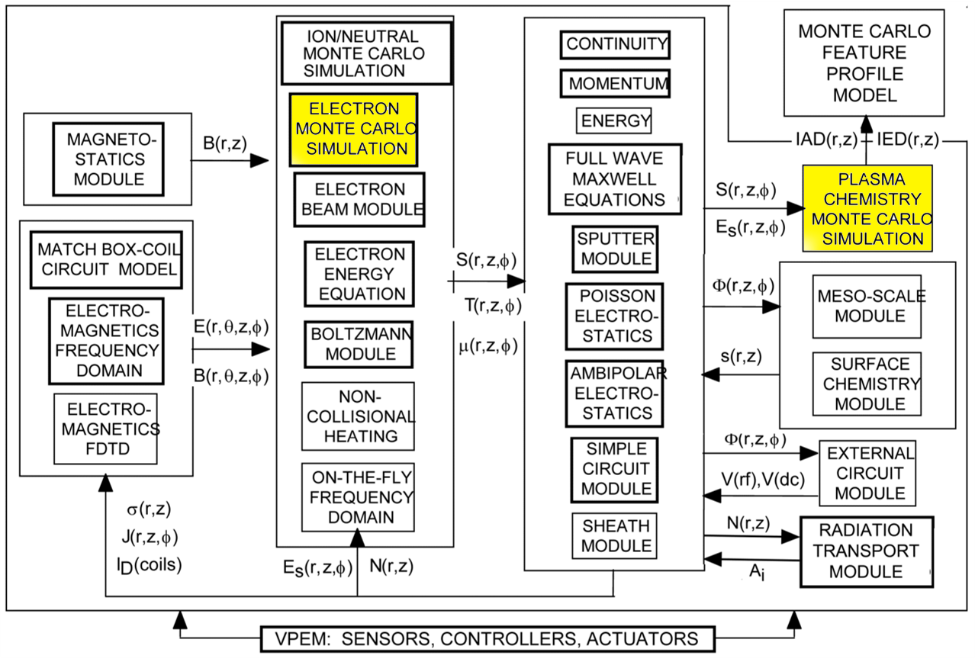
HYBRID PLASMA EQUIPMENT MODEL
Multi-scale model for low pressure, low-temperature plasma dynamics.
Heavy particles (ions/neutrals) and electrons are addressed by combined fluid and kinetic algorithms to produce energy/angular distributions to surfaces.
Modules producing particle energy and angular distributions to surfaces as input to MCFPM
MIPSE_2025
Notes:
delete

Slide 6

MONTE CARLO FEATURE PROFILE MODEL
3-dimensional voxel-based feature scale model that simulates etching and material properties of the evolving profile.
Pseudoparticles are launched from the top of the domain and are tracked until they react with material mesh.
Ion and electron energy and angular distributions from HPEM are input into MCFPM for launching pseudoparticles.
Electric potential produced from solution of Poisson’s equation:
Electric
potential
Etching
$$−∇⋅ε∇Φ=ρ$$
University of Michigan
Institute for Plasma Science & Engr.
MIPSE_2025
Notes:
charge deposition, use the same case for animation

Slide 7
REACTOR SETUP
Dual frequency CCP, Ar/CF₄/O₂=75/15/10
40 mTorr, 500 sccm
Top electrode: 500 W, 40 MHz
Bottom electrode: 2000 W, 5 MHz
Base case when pulsing the bottom electrode:
Duty cycle: 50%
Pulse repetition frequency (PRF): 1000 Hz (pre-defined features), 1 Hz (etching)
MIPSE_2025
Notes:
7
put in plasma properties

Slide 8
ENERGY ANGULAR DISTRIBUTIONS
EADs incident onto the wafer
Bias on:
Maximum ion energies > 2 keV with most ions having energies between 1 keV and 2 keV.
For electrons, a strong electric field reversal produces a energies up to 90 eV.
Bias off:
IEADs have energies up to 60 eV due to high frequency source power.
Electron energies are largely thermal due to lack of electric field reversal.
MIPSE_2025
Notes:
8

Slide 9
CHARGING DYNAMICS DURING PULSING FOR
PRE-ETCHED FEATURES
MIPSE_2025
Notes:
9

Slide 10
100 Hz
(animated)
CHARGING DYNAMICS
DURING PULSING
Pre-etched feature (100 nm CD, 60 AR)
Charging CW vs pulsing (100 Hz PRF, 50% duty cycle)
Maximum potential near trench bottom.
Pulsing reduces maximum potential (1247 V to 704 V).
At quasi-steady state, the electric potential oscillates synchronously with the pulsing waveform.
Animation Slide
University of Michigan
Institute for Plasma Science & Engr.
MIPSE_2025
Notes:
10

Slide 11
PRE-ETCHED FEATURE: DC
Duty Cycle (DC): 20%, 50% and 80% PRF = 1000 Hz.
Maximum positive potential in feature decreases with decreasing DC
Bias on:
Potential in feature results from high energy ions charging surfaces producing positive “floating potential”.
Electrons are accelerated into feature to neutralize charge.
Bias off:
Low energy ions are repelled by positive potential.
Electrons continue to be accelerated into feature reducing positive potential.
University of Michigan
Institute for Plasma Science & Engr.
Notes:
11

Slide 12
PRE-ETCHED FEATURE: DC
Conceptual trends (pulsed-averaged)
Ion and electron fluxes at bottom of feature and the ions reflected out of feature
Net positive charging during bias-on with energetic incoming ion flux not fully balanced by electron flux.
Net neutralization during bias-off with low energy ions reflected from the feature while electrons are accelerated into feature.
Decreasing DC lowers average ion energy and flux into feature, producing lower potential while reflecting large fraction of ions during bias-off.
University of Michigan
Institute for Plasma Science & Engr.
MIPSE_2025
Notes:
12

Slide 13
PRE-ETCHED FEATURE: DC
MCFPM Results (real-time)
Ion and electron fluxes at bottom of feature and the ions reflected out of feature
Net positive charging during bias-on with energetic incoming ion flux not fully balanced by electron flux.
Net neutralization during bias-off with low energy ions reflected from the feature while electrons are accelerated into feature.
Decreasing DC lowers average ion energy and flux into feature, producing lower potential while reflecting large fraction of ions during bias-off.
University of Michigan
Institute for Plasma Science & Engr.
MIPSE_2025
Notes:
13

Slide 14
PRE-ETCHED FEATURE: PRF
Pulse Repetition Frequency (PRF) = 50, 100, 1000 Hz; DC = 50 %.
Potential oscillates during pulsed cycle – mid‑cycle potential shown here.
Mid-cycle potential is weakly dependent on PRF for constant DC.
Oscillation in potential increases with longer pulse period because longer pulse period (lower PRF) lengthens both the charging (on) phase and the neutralization (off) phase.
University of Michigan
Institute for Plasma Science & Engr.
MIPSE_2025

Slide 15
ENERGIES TO BOTTOM
OF FEATURE: PRF
Oscillation in potential affects ion and e energy at the trench bottom.
Charged particle energy syncs with the potential.
e energy increases with positive potential while ion energy decreases.
Variation of particle energy with in one pulse is amplified with larger oscillation amplitude of potential.
Low PRF (longer cycle) with larger oscillation amplitude results in greater variation in particle energy.
High PRF (short cycle) results in more statistical variation.
University of Michigan
Institute for Plasma Science & Engr.
MIPSE_2025
Notes:
15

Slide 16
ETCHING & CHARGING OF HAR ONO WITH PULSING
MIPSE_2025
Notes:
16

Slide 17
HAR FEATURE
80 nm
800 nm
Initial feature width: 0.08 μm
90 layers of SiO₂, 90 layers of Si₃N₄
Thickness of each layer: 20 nm
Si at the bottom artificially made a hard stop-layer.
All cases are etched to the stop layer and to the same over-etch (extra 20% etching time).
AR (with photoresist): 60
AR (without photoresist): 50
4000 nm
Photoresist
SiO₂
Si₃N₄
200 nm
Si (stop layer)
University of Michigan
Institute for Plasma Science & Engr.
MIPSE_2025
320 nm
Notes:
17

Slide 18
ONO ETCHING: DC
(max power constant)
On-bias power 2000 W
CW etching produces bowed profile, which is remediated at lower DC.
In-feature potential decreases with decreasing DC.
Improvement in CD due to: (1) lowering of in-feature potential (2) more favorable passivation/ion flux ratio.
Lower duty cycle produces lower average etch rate.
MIPSE_2025
Notes:
18

Slide 19
ONO ETCHING: DC
(ave power constant)
On-bias average power 2000 W – lower duty cycle higher voltage and larger ion fluxes.
Etch rates remain comparable while potential moderately decreases with lower DC.
Bowing is not remediated at lower DC.
Higher ion energies and fluxes at lower DC require higher passivation fluxes to retain CD.
MIPSE_2025
Notes:
19

Slide 20
ONO ETCHING: DC
(with, without charge)
Etching with charging (w/) compared to without charging (w/o) vs duty cycle DC.
Charging resulted in lower etch rate due to slowing of ions by positive potential.
However, turning off charging does not result in a significant difference.
Improvement in sidewalls in these cases is dominated by favorable neutral/ion flux ratio.
University of Michigan
Institute for Plasma Science & Engr.
MIPSE_2025
Notes:
20

Slide 21
CONCLUDING REMARKS
Charging dynamics during pulsing of pre-etched features and ONO stack etching were investigated during bias pulsing.
Quasi-steady state in-feature potentials result from balance of energetic positive ion flux and electrons which are accelerated by that potential into the feature.
During pulsing, bias‑on produces net positive charging.
During bias-off, low energy ions are repelled, electrons attracted to produce net neutralization .
Electric potential scales linearly with DC and with a weak dependence on PRF.
Longer pulsed periods increase potential oscillations, and variation in energy of particles impacting the trench bottom.
During ONO stack etching, these relationships generally hold, with ion‑to‑neutral flux ratio yielding improved CD.
University of Michigan
Institute for Plasma Science & Engr.
MIPSE_2025

