Slide 1



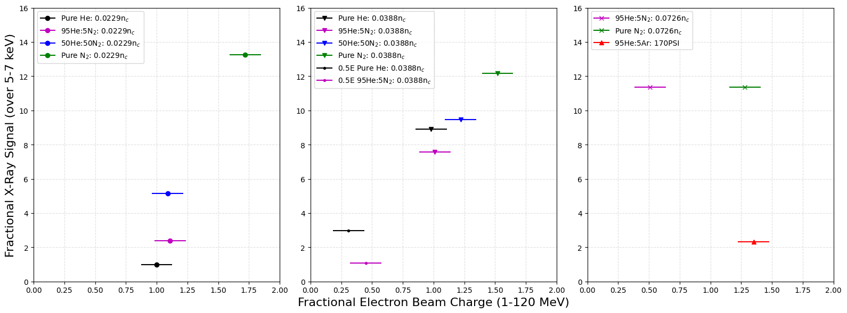
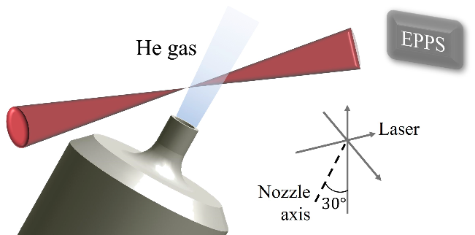
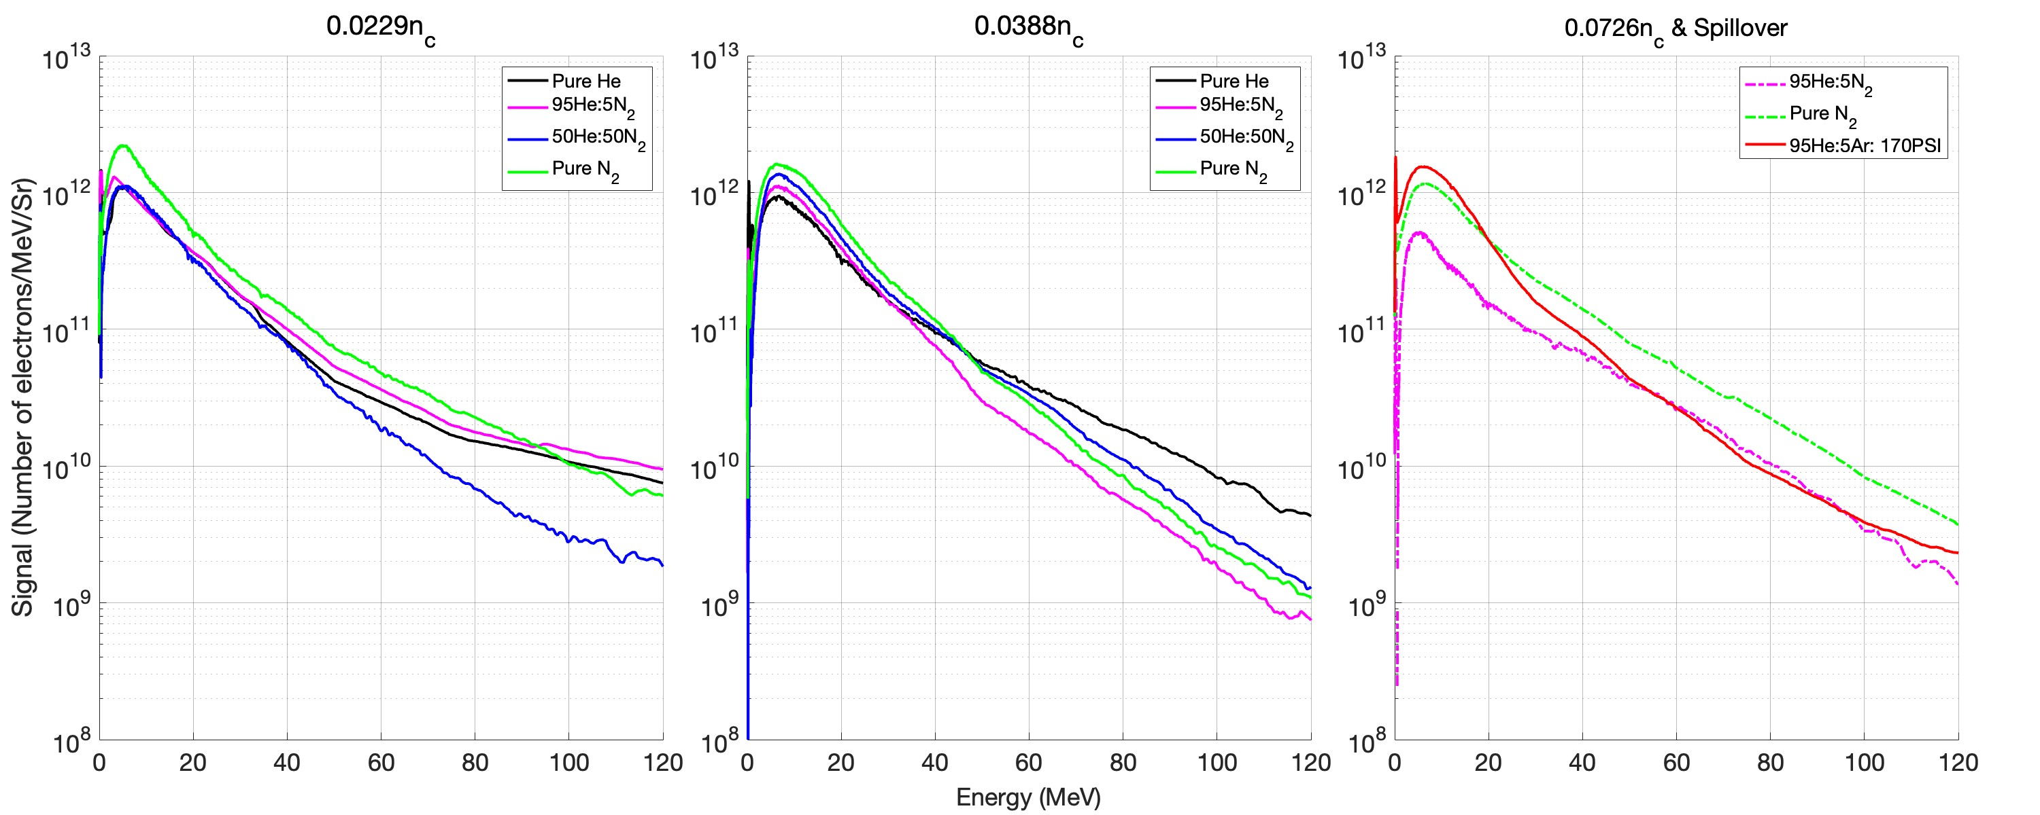
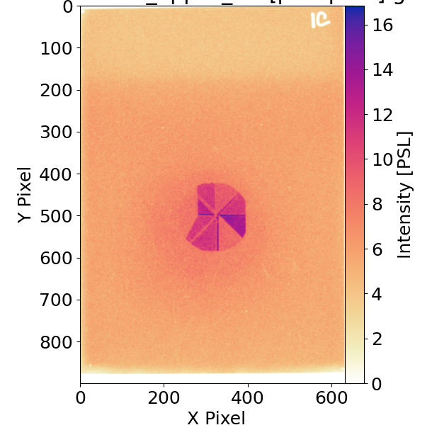
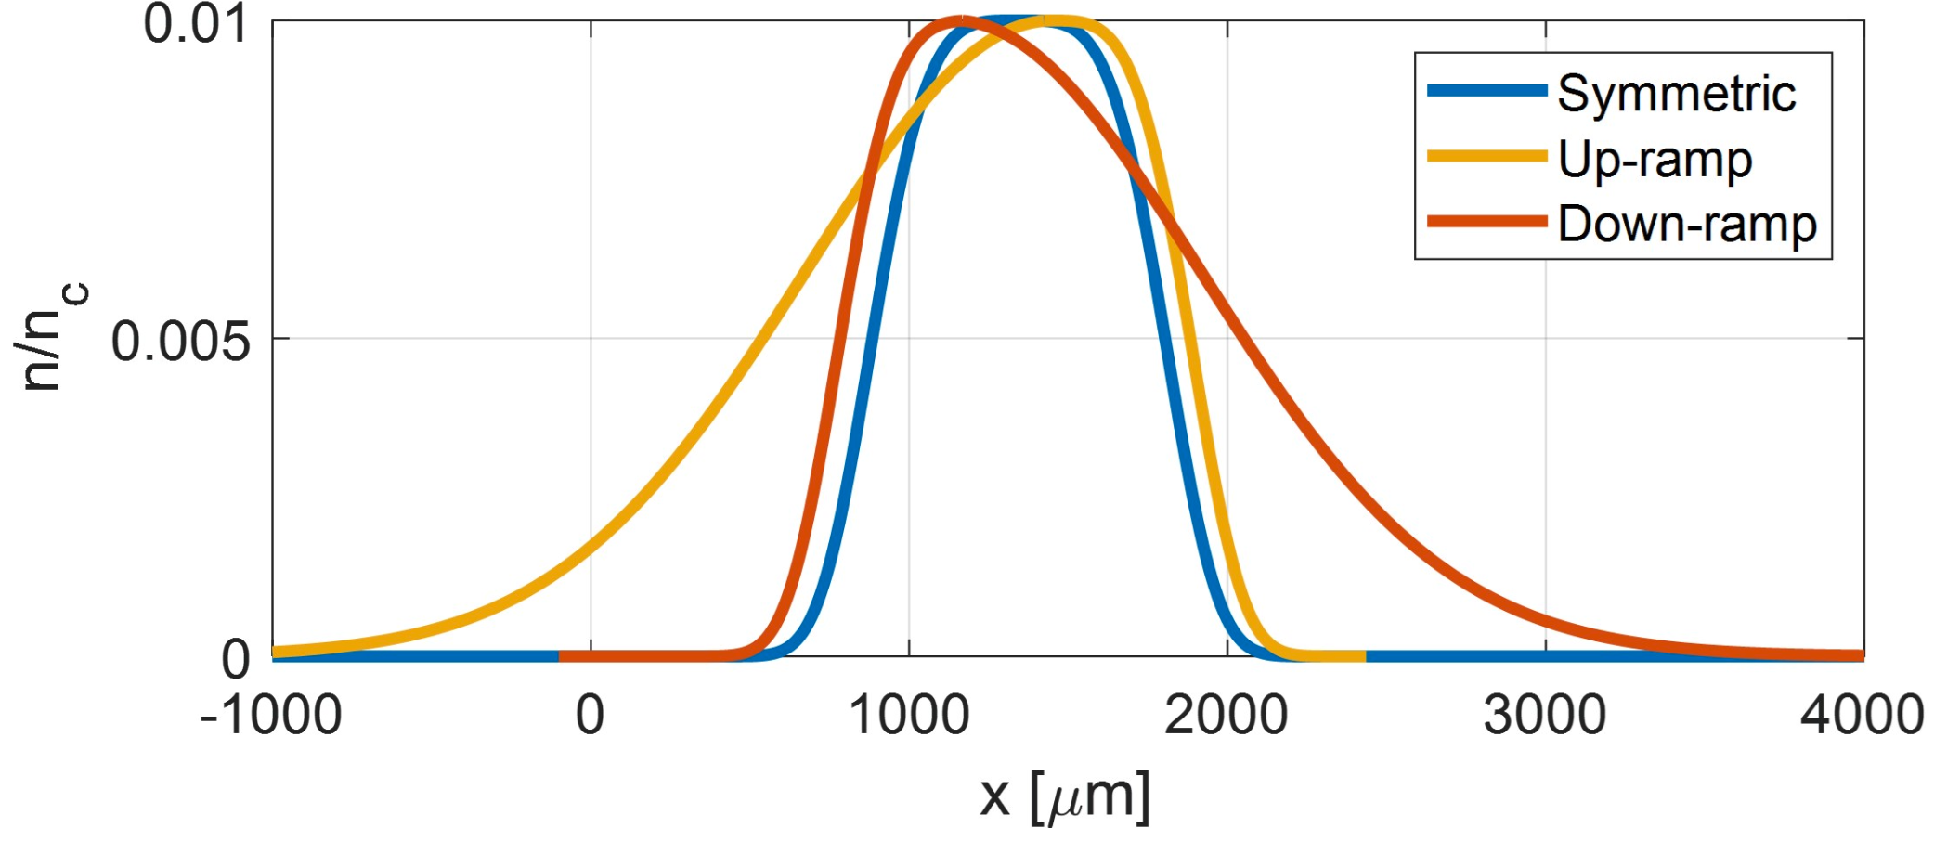
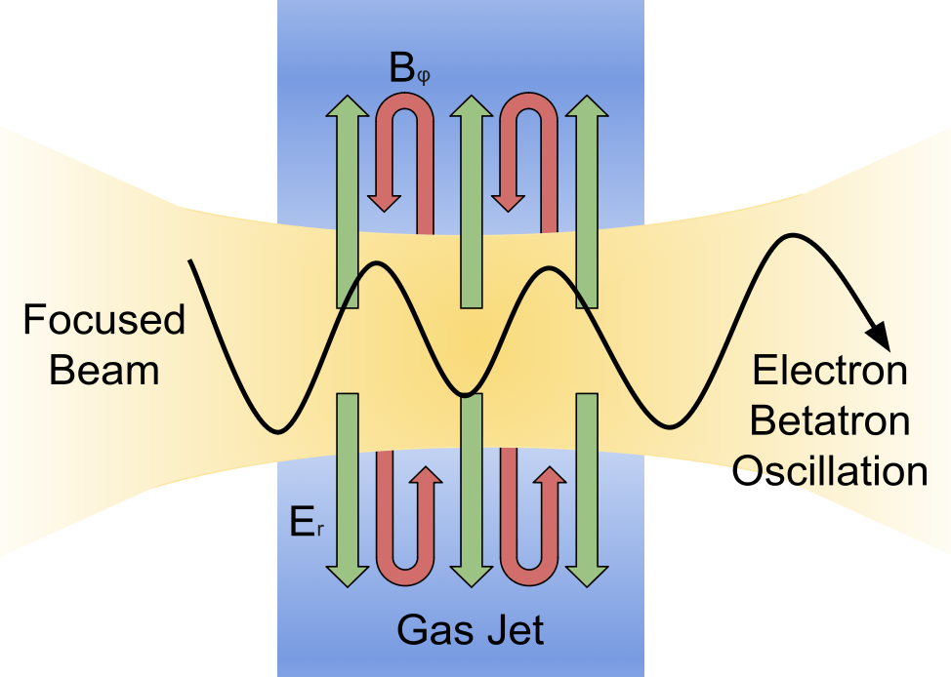
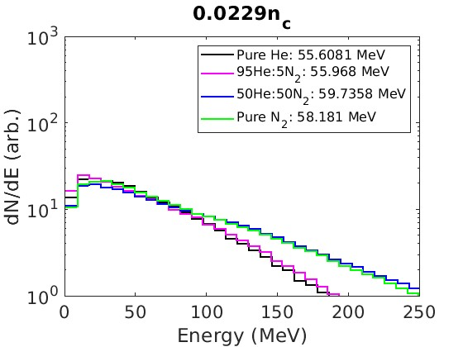
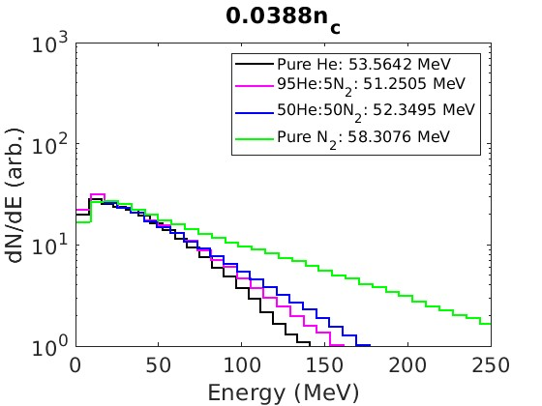

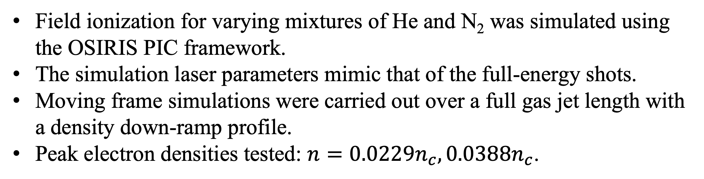
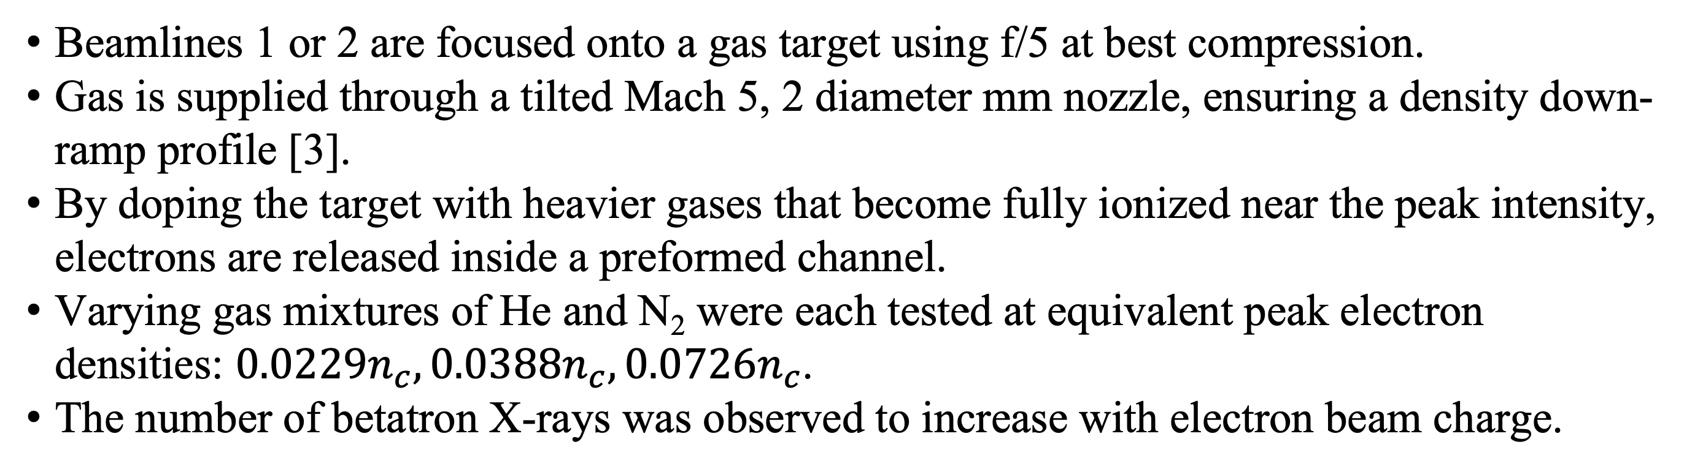
Harnessing Ionization Effects for Direct Laser Acceleration of Electrons
Nicolas M. Kalem¹, Veronica Contreras¹, Alexey V. Arefiev², Robert Babjak³, Marija Vranic³, Jessica Shaw⁴, Hui Chen⁵, Félicie Albert⁵, Louise Willingale¹
¹University of Michigan, Ann Arbor, MI , ²University of California, San Diego, CA, ³GoLP/IPFN, Instituto Superior Técnico, University of Lisbon, Portugal, ⁴Laboratory for Laser Energetics, Rochester, NY , ⁵Lawrence Livermore National Laboratory, CA
Overview
Ionization Shots
Conclusions & Future Work
Direct laser acceleration (DLA) offers a means of generating high-charge broadband MeV to GeV electron beams.
Prior experiments at OMEGA EP demonstrate that the efficacy of DLA is highly sensitive to laser geometry and channel formation.
Experiments typically use helium as the target gas due to its relatively low ionization threshold.
We investigate the incorporation of ionization effects into a DLA experiment to enhance beam charge [1, 2].
    Particle-in-cell simulations are used to further investigate schemes that utilize ionization effects to improve DLA performance.
We find that by doping the target with heavier gases, a higher charge and X-ray yield may be obtained.
Beamlines 1 or 2 are focused onto a gas target using f/5 at best compression.
Gas is supplied through a tilted Mach 5, 2 diameter mm nozzle, ensuring a density down-ramp profile [3].
By doping the target with heavier gases that become fully ionized near the peak intensity, electrons are released inside a preformed channel.
      Varying gas mixtures of He and N₂ were each tested at equivalent peak electron densities: $0.0229n_{c}, 0.0388n_{c}, 0.0726n_{c}$.
      The number of betatron X-rays was observed to increase with electron beam charge.
Ultimately, we find that by incorporating ionization effects into a DLA experiment in an underdense plasma, a greater electron beam charge may be obtained. By increasing the fraction of N₂ to He in our target, we observe as much as a 70% increase in charge, corresponding to approximately 450 nC of 1-120 MeV electrons. Ross filter analysis of the low-energy betatron X-rays shows that there is also an order of magnitude increase in flux. Preliminary simulations of a comparable DLA setup reaffirm the observation that progressively increasing the ratio of N₂ to He in the target increases the overall electron beam charge. However, simulations also predict an increase in average energy with progressive doping. Investigating this discrepancy with experimental findings is ongoing.
f(E_{avg}) | 0.0229n_{c} | 0.0388n_{c} | 0.0726n_{c}
Pure He | 1 | 1.03
95% He + 5% N₂ | 1.04 | 0.87 | 1.05
50% He + 50% N₂ | 0.91 | 0.93
Pure N₂ | 1 | 0.87 | 1.01
Direct Laser Acceleration
DLA may occur when focusing a short-pulse laser to high intensities onto an underdense gas target.
The ponderomotive force expels electrons to form a channel.
Inside the channel, transverse electric and azimuthal magnetic fields are generated.
              Slow ion expansion provides stability of the channel over the picosecond timescale.
Channel fields induce betatron motion of electrons, leading to energy gain when resonance with the laser field is achieved.
[3]
This table indicates the average energy of 20-120 MeV electrons as a ratio with respect to the references shot of pure He at 0.0229 n_{c}. The chosen range is from the approximate ponderomotive energy of electrons to resolution limit of the detector. The average electron energy for the reference is 39.04 MeV.
41 𝜇m Mo
64 𝜇m Ti
[4]
32 𝜇m Zr
19 𝜇m Fe
16 𝜇m Zr
42 𝜇m Fe
74 𝜇m Zn
28 𝜇m Zn
An EPPS measures X-rays along the straight-through beam path. The tile above illustrates the Ross filter wheel used for radiometry. The right figure shows the image plate scan immediately following the filter wheel that captures highest signal shot: pure N₂ at 0.0229n_{c}.
Preliminary Ionization Simulations
Acknowledgements
The experiment was conducted at the Omega Laser Facility with the beam time through the National Laser Users’ Facility user program. This material is based upon work supported by the Department of Energy [National Nuclear Security Administration] University of Rochester “National Inertial Confinement Fusion Program” under Award Number(s) DE-NA0004144. This material is based upon work supported by the Department of Energy National Nuclear Security Administration under Award Number DE-NA0004203. The authors would like to acknowledge the OSIRIS Consortium, consisting of UCLA and IST (Lisbon, Portugal) for providing access to the OSIRIS
4.0 framework. Work supported by NSF ACI-1339893. This material is based upon work supported by the Department of Energy [National Nuclear Security Administration] University of Rochester “National Inertial Confinement Fusion Program” under Award Number(s) DE-NA0004144 and the U. S. Department of Energy under Award DE-SC00215057.
Field ionization for varying mixtures of He and N₂ was simulated using the OSIRIS PIC framework.
The simulation laser parameters mimic that of the full-energy shots.
Moving frame simulations were carried out over a full gas jet length with a density down-ramp profile.
Peak electron densities tested: $n=0.0229n_{c},0.0388n_{c}$.
References
McGuffey, C., et al. "Ionization induced trapping in a laser wakefield accelerator." Physical review letters 104.2 (2010): 025004.
Shaw, J. L., et al. "Role of direct laser acceleration of electrons in a laser wakefield accelerator with ionization injection." Physical review letters 118.6 (2017): 064801.
Tang, H., et al. "The influence of laser focusing conditions on the direct laser acceleration of electrons." New Journal of Physics 26.5 (2024): 053010.
Tang, Hongmei. The Measurement and Optimization of Direct Laser Acceleration. Diss. University of Michigan, 2023.
a₀ | 𝜏 | 𝜆 | n_{c}
8.5 | 700 fs | 1053 nm | 10²¹ cm⁻³
The electron spectra after the laser has exited the plasma profile are shown above for all tested species mixtures and densities. The average 10-120 MeV electron energy is also listed for each simulation.

Slide 2
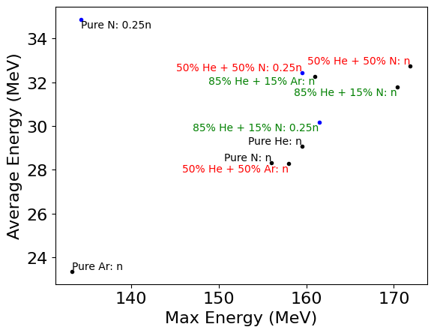
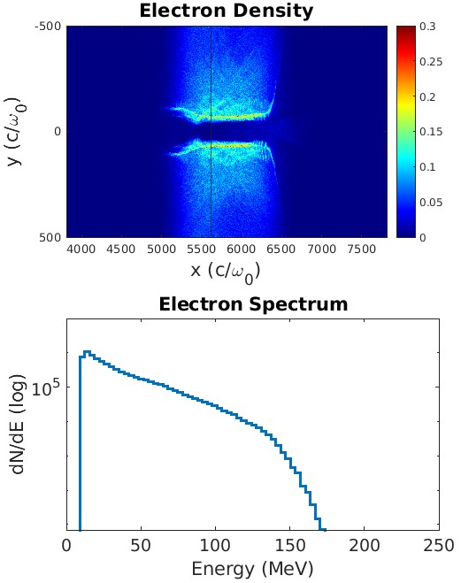
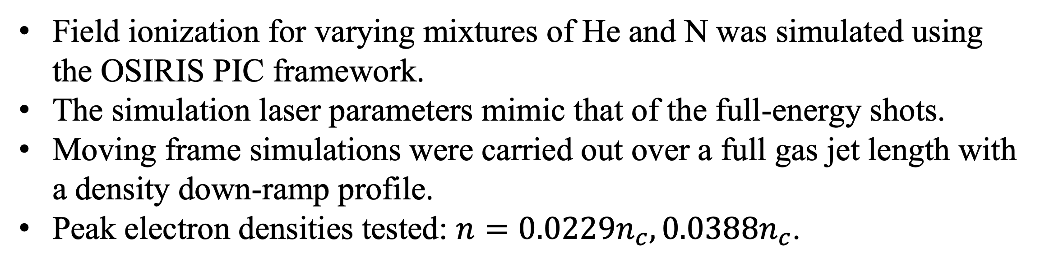
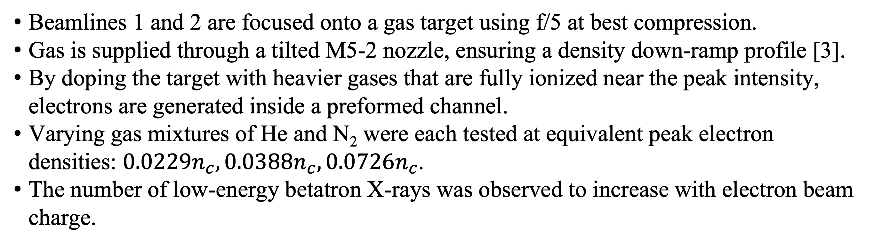
Harnessing Ionization Effects for Direct Laser Acceleration of Electrons
Nicolas M. Kalem¹, Veronica Contreras¹, Alexey V. Arefiev², Robert Babjak³, Marija Vranic³, Jessica Shaw⁴, Hui Chen⁵, Félicie Albert⁵, Louise Willingale¹
¹University of Michigan, Ann Arbor, MI , ²University of California, San Diego, CA, ³GoLP/IPFN, Instituto Superior Técnico, University of Lisbon, PT, ⁴Laboratory for Laser Energetics, Rochester, NY , ⁵Lawrence Livermore National Laboratory, CA
Overview
Ionization Shots
Conclusions & Future Work
Direct laser acceleration (DLA) offers a means of generating high-charge MeV to GeV electron beams.
Prior experiments at OMEGA EP demonstrate that the efficacy of DLA is highly sensitive to laser geometry and channel formation.
Experiments typically use helium gas targets due to its relatively low ionization threshold.
We investigate the incorporation of ionization effects into a DLA experiment to enhance beam charge [1, 2].
    Particle-in-cell simulations are used to further investigate schemes that utilize ionization effects to improve DLA performance.
We find that by doping the target with heavier gases, a higher signal and more energetic yield of electrons may be obtained.
Beamlines 1 and 2 are focused onto a gas target using f/5 at best compression.
Gas is supplied through a tilted M5-2 nozzle, ensuring a density down-ramp profile [3].
By doping the target with heavier gases that are fully ionized near the peak intensity, electrons are generated inside a preformed channel.
      Varying gas mixtures of He and N₂ were each tested at equivalent peak electron densities: $0.0229n_{c}, 0.0388n_{c}, 0.0726n_{c}$.
      The number of low-energy betatron X-rays was observed to increase with electron beam charge.
Ultimately, we find that by incorporating ionization effects into a DLA experiment in an underdense plasma, a greater electron beam charge may be obtained. By further doping the conventionally He target with N₂, we observe as much as a 70% increase in charge, corresponding to approximately 450 nC of 1-120 MeV electrons. Additionally, there is a strong rise in X-ray signal in accordance with increasing electron beam charge. Preliminary simulations of a comparable experimental setup reaffirm the observation that DLA using higher-Z gas targets will yield higher. However…
f(E_{avg}) | 0.0229n_{c} | 0.0388n_{c} | 0.0726n_{c}
Pure He | 1 | 1.06
95% He + 5% N₂ | 1 | 0.86 | 1.14
50% He + 50% N₂ | 0.85 | 0.93
Pure N₂ | 0.9 | 0.86 | 1.07
Direct Laser Acceleration
DLA may occur when focusing a short-pulse laser to high intensities onto an underdense gas target.
The ponderomotive force expels electrons to form a channel, thereby self-generating transverse electric and azimuthal magnetic fields.
              Slow ion expansion provides stability of the channel over the picosecond timescale.
Channel fields induce betatron motion of electrons, leading to energy gain when resonance with the laser field is achieved.
[3]
This table indicates the average energy of 1-120 MeV electrons as a ratio with respect to the references shot of pure He at 0.0229 n_{c}. The average electron energy for the reference is 19.8 MeV.
41 𝜇m Mo
64 𝜇m Ti
[4]
32 𝜇m Zr
19 𝜇m Fe
16 𝜇m Zr
42 𝜇m Fe
74 𝜇m Zn
28 𝜇m Zn
An EPPS measures X-rays along the straight-through beam path. The tile above illustrates the Ross filter wheel used for radiometry. The right figure shows the image plate scan immediately following the filter wheel that captures highest signal shot: pure N₂ at 0.0229n_{c}.
Ionization Simulations
Acknowledgements
50% He + 50% N: n
The experiment was conducted at the Omega Laser Facility with the beam time through the National Laser Users’ Facility user program. This material is based upon work supported by the Department of Energy [National Nuclear Security Administration] University of Rochester “National Inertial Confinement Fusion Program” under Award Number(s) DE-NA0004144. This material is based upon work supported by the Department of Energy National Nuclear Security Administration under Award Number DE-NA0004203. The authors would like to acknowledge the OSIRIS Consortium, consisting of UCLA and IST (Lisbon, Portugal) for providing access to the OSIRIS
4.0 framework. Work supported by NSF ACI-1339893. This material is based upon work supported by the Department of Energy [National Nuclear Security Administration] University of Rochester “National Inertial Confinement Fusion Program” under Award Number(s) DE-NA0004144 and the U. S. Department of Energy under Award DE-SC00215057.
Field ionization for varying mixtures of He and N was simulated using the OSIRIS PIC framework.
The simulation laser parameters mimic that of the full-energy shots.
Moving frame simulations were carried out over a full gas jet length with a density down-ramp profile.
Peak electron densities tested: $n=0.0229n_{c},0.0388n_{c}$.
References
McGuffey, C., et al. "Ionization induced trapping in a laser wakefield accelerator." Physical review letters 104.2 (2010): 025004.
Shaw, J. L., et al. "Role of direct laser acceleration of electrons in a laser wakefield accelerator with ionization injection." Physical review letters 118.6 (2017): 064801.
Tang, H., et al. "The influence of laser focusing conditions on the direct laser acceleration of electrons." New Journal of Physics 26.5 (2024): 053010.
Tang, Hongmei. The Measurement and Optimization of Direct Laser Acceleration. Diss. University of Michigan, 2023.
a₀ | 𝜏 | 𝜆 | n_{c}
8.5 | 700 fs | 1053 nm | 10²¹ cm⁻³

Slide 3
Harnessing Ionization Effects for Direct Laser Acceleration of Electrons
Nicolas M. Kalem¹, Veronica Contreras¹, Alexey V. Arefiev², Robert Babjak³, Marija Vranic³, Jessica Shaw⁴, Hui Chen⁵, Félicie Albert⁵, Louise Willingale¹
¹University of Michigan, Ann Arbor, MI , ²University of California, San Diego, CA, ³GoLP/IPFN, Instituto Superior Técnico, University of Lisbon, PT, ⁴Laboratory for Laser Energetics, Rochester, NY , ⁵Lawrence Livermore National Laboratory, CA
Overview
Ionization Shots
Conclusions & Future Work
Direct laser acceleration (DLA) offers a means of generating high-charge MeV to GeV electron beams.
Prior experiments at OMEGA EP demonstrate that the efficacy of DLA is highly sensitive to laser geometry and channel formation.
Experiments typically use helium gas targets due to its relatively low ionization threshold.
We investigate the incorporation of ionization effects into a DLA experiment to enhance beam charge [1, 2].
    Particle-in-cell simulations are used to further investigate schemes that utilize ionization effects to improve DLA performance.
We find that by doping the target with heavier gases, a higher signal and more energetic yield of electrons may be obtained.
Beamlines 1 and 2 are focused onto a gas target using f/5 at best compression.
Gas is supplied through a tilted M5-2 nozzle, ensuring a density down-ramp profile [3].
By doping the target with heavier gases that are fully ionized near the peak intensity, electrons are generated inside a preformed channel.
      Varying gas mixtures of He and N₂ were each tested at equivalent peak electron densities: $0.0229n_{c}, 0.0388n_{c}, 0.0726n_{c}$.
      The number of low-energy betatron X-rays was observed to increase with electron beam charge.
Ultimately, we find that by incorporating ionization effects into a DLA experiment in an underdense plasma, a greater electron beam charge may be obtained. By further doping the conventionally He target with N₂, we observe as much as a 70% increase in charge, corresponding to approximately 450 nC of 1-120 MeV electrons. Additionally, there is a strong rise in X-ray signal in accordance with increasing electron beam charge. Preliminary simulations of a comparable experimental setup reaffirm the observation that DLA using higher-Z gas targets will yield higher. However…
 | Laser Energy (J) | E_{avg} (MeV)
Pure He: 0.0229n_{c} | 61.5 | 27.0
95% He + 5% N₂: 0.0229n_{c} | 61.5 | 28.1
50% He + 50% N₂: 0.0229n_{c} | 63.5
Pure N₂: 0.0229n_{c} | 62
Pure He: 0.0388n_{c} | 64.1
95% He + 5% N₂: 0.0388n_{c} | 62
50% He + 50% N₂: 0.0388n_{c} | 61.7
Pure N₂: 0.0388n_{c} | 60.6
95% He + 5% N₂: 0.0726n_{c} | 63.1
Pure N₂: 0.0726n_{c} | 60.6 | 28.1
95% He + 5% Ar | 60.2 | 23.1
Direct Laser Acceleration
DLA may occur when focusing a short-pulse laser to high intensities onto an underdense gas target.
The ponderomotive force expels electrons to form a channel, thereby self-generating transverse electric and azimuthal magnetic fields.
              Slow ion expansion provides stability of the channel over the picosecond timescale.
Channel fields induce betatron motion of electrons, leading to energy gain when resonance with the laser field is achieved.
[3]
41 𝜇m Mo
64 𝜇m Ti
[4]
32 𝜇m Zr
19 𝜇m Fe
16 𝜇m Zr
42 𝜇m Fe
74 𝜇m Zn
28 𝜇m Zn
An EPPS measures X-rays along the straight-through beam path. The tile above illustrates the Ross filter wheel used for radiometry. The right figure shows the image plate scan immediately following the filter wheel that captures highest signal shot: pure N₂ at 0.0229n_{c}.
Ionization Simulations
Acknowledgements
50% He + 50% N: n
The experiment was conducted at the Omega Laser Facility with the beam time through the National Laser Users’ Facility user program. This material is based upon work supported by the Department of Energy [National Nuclear Security Administration] University of Rochester “National Inertial Confinement Fusion Program” under Award Number(s) DE-NA0004144. This material is based upon work supported by the Department of Energy National Nuclear Security Administration under Award Number DE-NA0004203. The authors would like to acknowledge the OSIRIS Consortium, consisting of UCLA and IST (Lisbon, Portugal) for providing access to the OSIRIS
4.0 framework. Work supported by NSF ACI-1339893. This material is based upon work supported by the Department of Energy [National Nuclear Security Administration] University of Rochester “National Inertial Confinement Fusion Program” under Award Number(s) DE-NA0004144 and the U. S. Department of Energy under Award DE-SC00215057.
Field ionization for varying mixtures of He and N was simulated using the OSIRIS PIC framework.
The simulation laser parameters mimic that of the full-energy shots.
Moving frame simulations were carried out over a full gas jet length with a density down-ramp profile.
Peak electron densities tested: $n=0.0229n_{c},0.0388n_{c}$.
References
McGuffey, C., et al. "Ionization induced trapping in a laser wakefield accelerator." Physical review letters 104.2 (2010): 025004.
Shaw, J. L., et al. "Role of direct laser acceleration of electrons in a laser wakefield accelerator with ionization injection." Physical review letters 118.6 (2017): 064801.
Tang, H., et al. "The influence of laser focusing conditions on the direct laser acceleration of electrons." New Journal of Physics 26.5 (2024): 053010.
Tang, Hongmei. The Measurement and Optimization of Direct Laser Acceleration. Diss. University of Michigan, 2023.
a₀ | 𝜏 | 𝜆 | n_{c}
8.5 | 700 fs | 1053 nm | 10²¹ cm⁻³

Slide 4
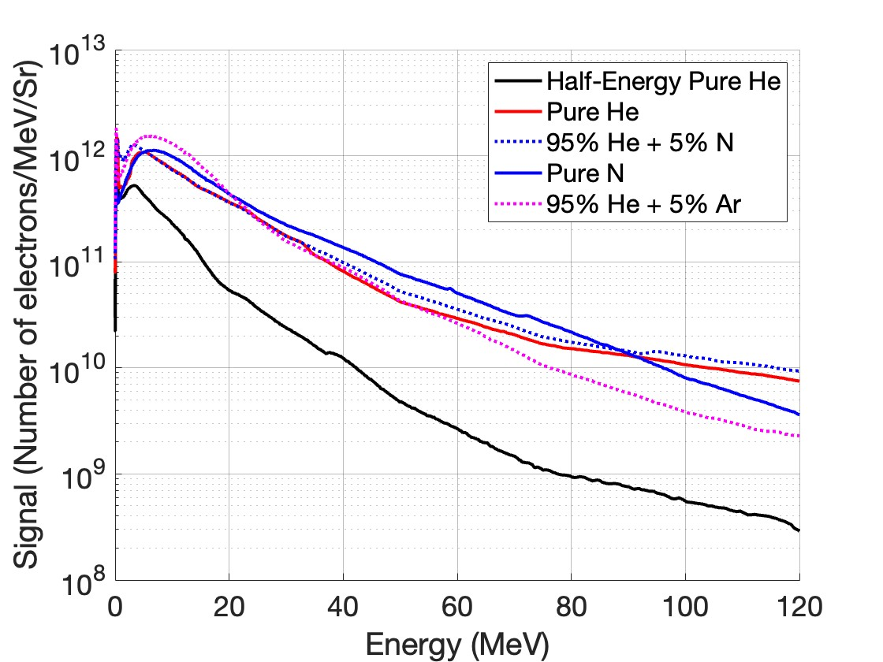
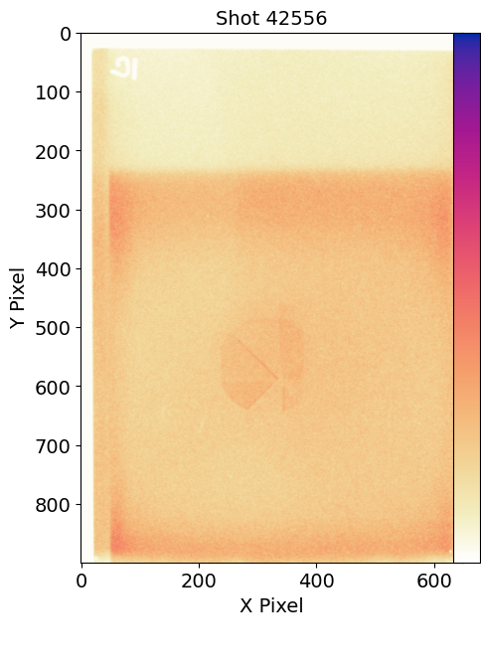
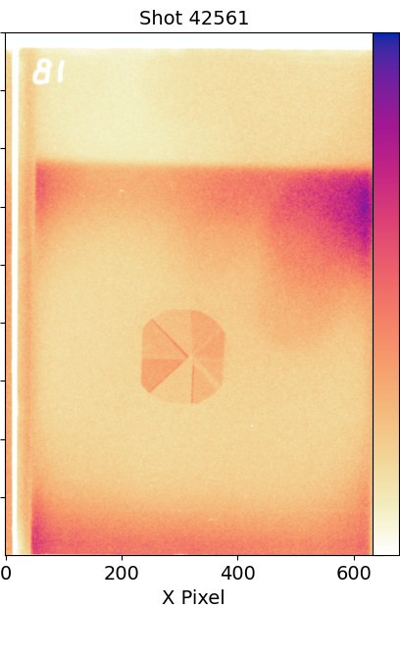
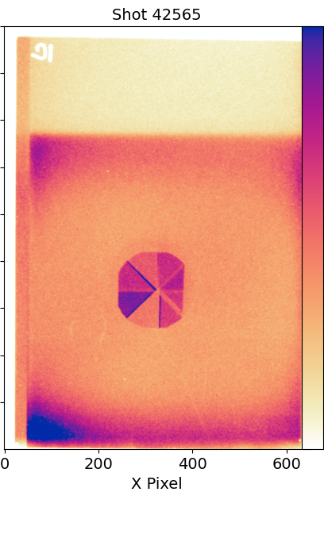
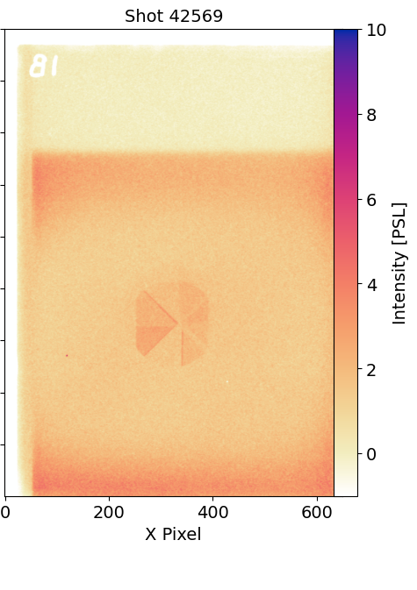
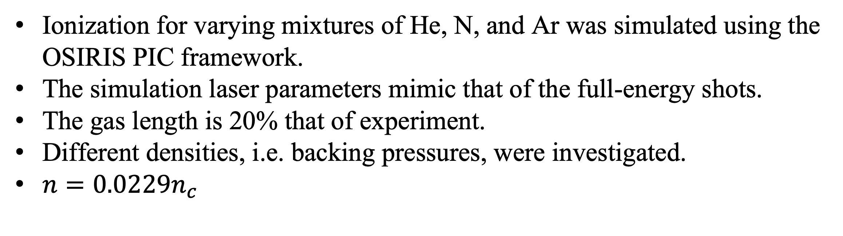
Harnessing Ionization Injection for Direct Laser Acceleration of Electrons
Nicolas M. Kalem¹, Veronica Contreras¹, Félicie Albert², Alexey V. Arefiev³, Hui Chen², Jessica Shaw⁴, Hongmei Tang¹, Louise Willingale¹
¹University of Michigan, Ann Arbor, MI, ²Lawrence Livermore National Laboratory, CA, ³University of California, San Diego, CA, Laboratory for Laser Energetics, Rochester, NY
Overview
Ionization Injection Shots
Conclusions & Future Work
Direct laser acceleration (DLA) offers a means of generating high-charge MeV to GeV electron beams.
Prior experiments at OMEGA EP demonstrate that the efficacy of DLA is highly sensitive to laser geometry and channel formation.
Experiments typically use helium gas targets due to its relatively low ionization threshold.
We investigate the incorporation of ionization injection into a DLA experiment to enhance beam charge [1, 2].
    Particle-in-cell simulations are used to further investigate schemes that utilize ionization injection to improve DLA performance.
We find that by doping the target with heavier gases, a higher signal and more energetic yield of electrons may be obtained.
Beamline 1 is focused onto a gas target using f/5 at best compression.
The gas is supplied at 170 PSI through a tilted M5-2 nozzle to ensure a density down-ramp profile [3].
The adjusted He density is 0.0229n_{c}.
By doping the target with heavier gases that are fully ionized near the peak intensity, electrons are generated inside a preformed channel.
      An increased electron beam charge may be achieved.
      The average electron energy remains consistent.
      The number of low-energy betatron X-rays was also observed to increase through ionization injection.
      Channel filamentation, delayed ionization, and relative density of heavy gases may limit the efficacy of DLA.
Ultimately, we find that by incorporating ionization injection into a DLA experiment, a greater yield of low energy electrons may be obtained. Shots using varying gas target mixtures demonstrate a relationship between the percentage and weight of the dopant gas and the electron signal at different regions of the spectra. Preliminary simulations of a similar experimental setup reaffirm the expectation that higher Z gas targets induce greater electron densities, thereby leading to filamentation of the channel. Further experiments accounting for the relative electron densities of gases in a mixture need to be performed.
 | Laser Energy (J) | a₀ | E_{avg} (MeV) | f(Q_{beam}(He)) | f(E_{beam}(He))
Pure He | 31 | 7.4 | 22.1 | 0.2 | 0.1
Pure He | 61.5 | 9.3 | 27.0 | 1 | 1
95% He + 5% N | 61.5 | 9.3 | 28.1 | 1.1 | 1.1
Pure N | 60.6 | 9.5 | 28.1 | 1.3 | 1.4
95% He + 5% Ar | 60.2 | 7.6 | 23.1 | 1.2 | 1.1
Direct Laser Acceleration
DLA may occur when focusing a short-pulse laser to high intensities onto an underdense gas target.
The ponderomotive force expels electrons to form a channel, thereby self-generating transverse electric and azimuthal magnetic fields.
              Slow ion expansion provides stability of the channel over the picosecond timescale.
Channel fields induce betatron motion of electrons, leading to energy gain when resonance with the laser field is achieved.
[3]
Assuming a 10° beam of 10-100 MeV electrons, with identical radial distributions as measured by the spectrometer, the Q_{beam} and E_{beam} of the pure helium shot would be approximately 161.5 nC and 4.4 J respectively.
Pure He
95% He + 5% N
Pure N
95% He + 5% Ar
41 𝜇m Mo
64 𝜇m Ti
[4]
32 𝜇m Zr
19 𝜇m Fe
16 𝜇m Zr
42 𝜇m Fe
74 𝜇m Zn
28 𝜇m Zn
Tiles show image plate scans of a Ross filter wheel for the tested gas mixtures. An EPPS measures X-rays along the straight-through beam path.
Ionization Simulations
Acknowledgements
50% He + 50% N: n
The experiment was conducted at the Omega Laser Facility with the beam time through the National Laser Users’ Facility user program. This material is based upon work supported by the Department of Energy [National Nuclear Security Administration] University of Rochester “National Inertial Confinement Fusion Program” under Award Number(s) DE-NA0004144. This material is based upon work supported by the Department of Energy National Nuclear Security Administration under Award
Number DE-NA0004203. The authors would like to acknowledge the OSIRIS Consortium, consisting of UCLA and IST (Lisbon, Portugal) for providing access to the OSIRIS 4.0 framework. Work supported by NSF ACI-1339893.
Ionization for varying mixtures of He, N, and Ar was simulated using the OSIRIS PIC framework.
The simulation laser parameters mimic that of the full-energy shots.
The gas length is 20% that of experiment.
Different densities, i.e. backing pressures, were investigated.
$n=0.0229n_{c}$
References
McGuffey, C., et al. "Ionization induced trapping in a laser wakefield accelerator." Physical review letters 104.2 (2010): 025004.
Shaw, J. L., et al. "Role of direct laser acceleration of electrons in a laser wakefield accelerator with ionization injection." Physical review letters 118.6 (2017): 064801.
Tang, H., et al. "The influence of laser focusing conditions on the direct laser acceleration of electrons." New Journal of Physics 26.5 (2024): 053010.
Tang, Hongmei. The Measurement and Optimization of Direct Laser Acceleration. Diss. University of Michigan, 2023.
a₀ | 𝜏 | 𝜆 | n_{c}
9 | 700 fs | 1053 nm | 10²¹ cm⁻³

