Slide 1

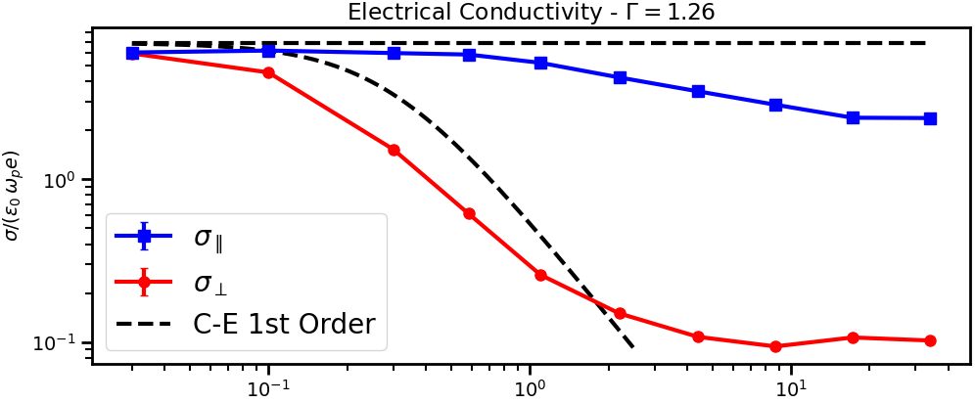
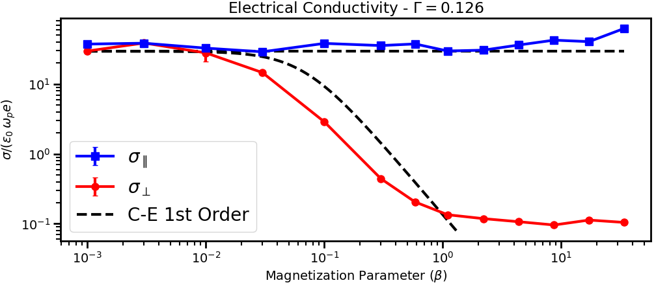
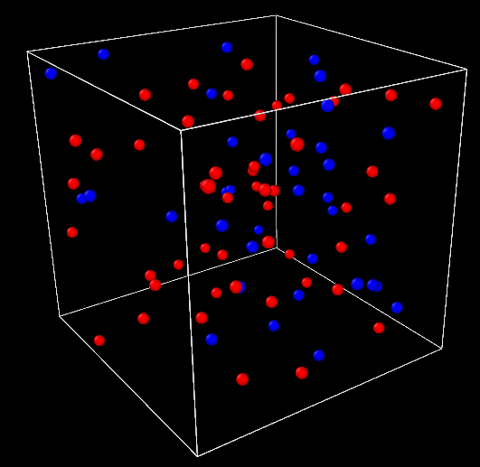
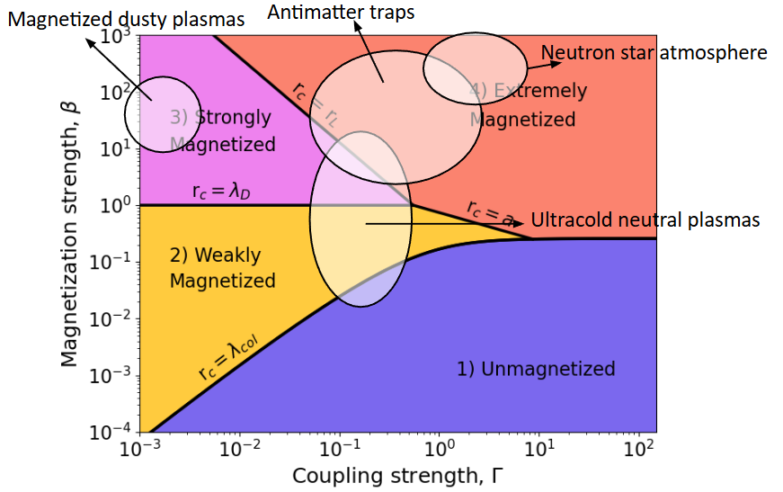
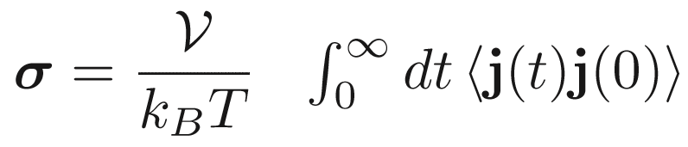
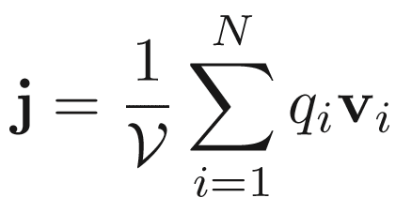
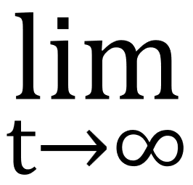
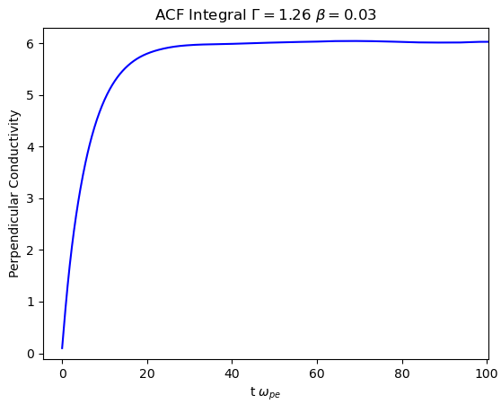
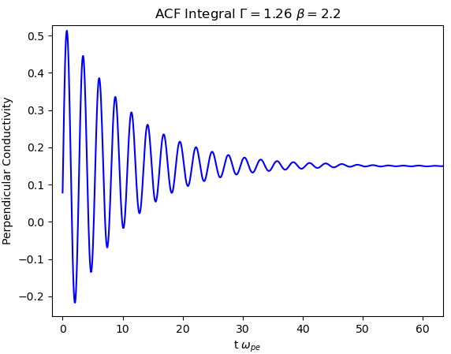
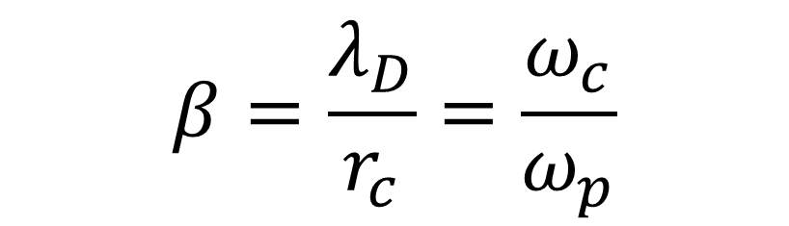

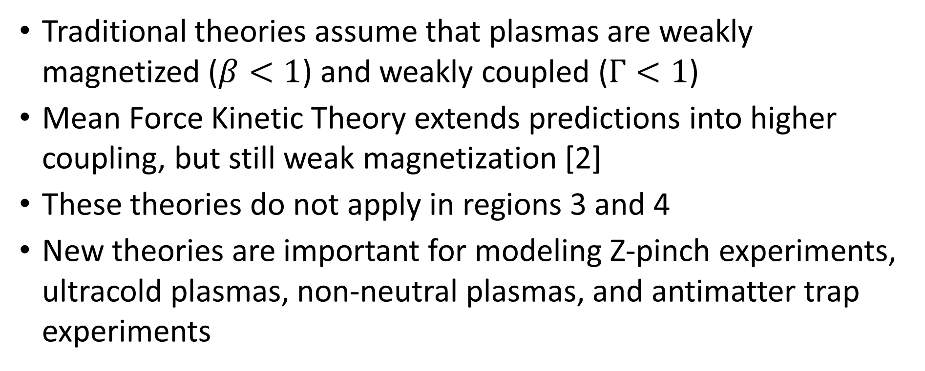
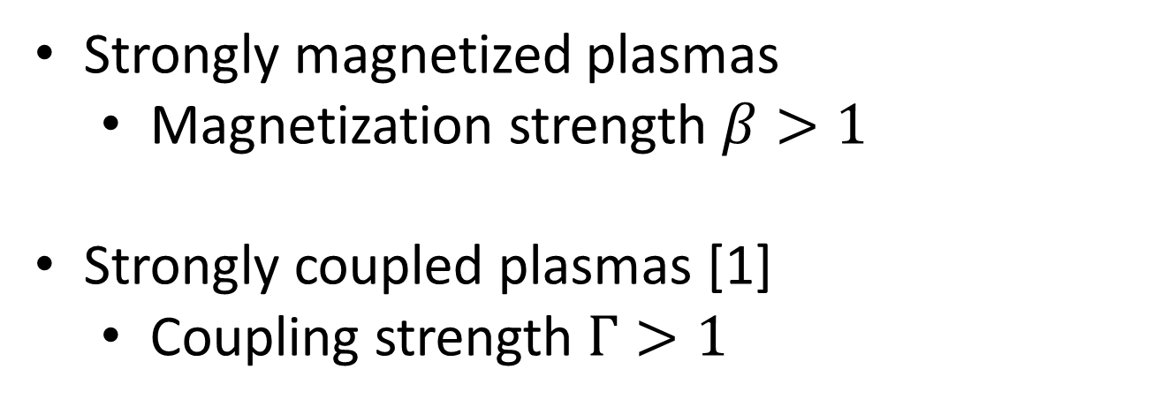

Molecular Dynamics Simulations of Electrical Conductivity in Strongly Magnetized Plasmas
Kyle Kemmerer, Louis Jose, Scott D. Baalrud
University of Michigan, Ann Arbor
Research Summary
Two-Component Molecular Dynamics Simulations of Conductivity
Simulation Results
Used molecular dynamics (MD) to obtain conductivity data to benchmark future theories in the strongly magnetized regime
Examples of strongly magnetized plasmas include Z-pinch experiments, ultracold neutral plasmas, and trapped antimatter experiments like the ALPHA project at CERN
Perpendicular conductivity becomes independent of magnetic field strength at strong magnetization, deviating from current theories
Molecular Dynamics simulations can provide first-principles data for new regimes
This provides a benchmark for future theories
Ran two-component repulsive (positrons + protons) simulations, with 10000 particles using LAMMPS
Periodic boundary conditions to simulate an infinite plasma
Equilibrated simulation using Nosé–Hoover thermostat
Then main NVE (microcanonical ensemble) outputs velocity data
Plasmas are Strongly Magnetized when the Gyroradius is Smaller than the Debye Length
$$β=\frac{λ_{D}}{r_{c}}=\frac{ω_{c}}{ω_{p}}$$
Strongly magnetized plasmas
  Magnetization strength $β>1$
Strongly coupled plasmas [1]
  Coupling strength $Γ>1$
$$Γ=\frac{e^{2}/a}{k_{B}T}$$
Conclusions
Parallel and perpendicular conductivities are equal at low magnetization
  Expected since with no magnetic field there is no distinction between perpendicular and parallel
At Γ = 1.26, the parallel conductivity begins to decrease around β_{e} = 1 until it plateaus around β_{e} = 34.0
  Traditional theories instead predict parallel conductivity stays constant
  One theory currently being developed predicts what we observe [4]
  The Γ = 0.126 parallel data is unfortunately harder to resolve
Perpendicular conductivity decreases as plasma becomes weakly magnetized
Perpendicular conductivity plateaus as plasma becomes strongly magnetized
  This plateau is not predicted by any current theory
Electrical Conductivity Obtained from MD using Green-Kubo Relations
MD Data
Green-Kubo relations obtain the electrical conductivity from equilibrium MD velocity data [3]
The conductivity coefficient can be found by approximating as the plateau in the autocorrelation function integrals
References
No Traditional Theories Describe Strongly Magnetized Plasmas
[1] Baalrud, Scott D., and Jérôme Daligault. “Transport Regimes Spanning Magnetization-Coupling Phase Space.” Physical Review E, vol. 96, no. 4, 2017.
[2] Baalrud, Scott D., and Jérôme Daligault. “Extending Plasma Transport Theory to Strong Coupling through the Concept of an Effective Interaction Potential.” Physics of Plasmas, vol. 21, no. 5, 2014.
[3] LeVan, Jarett, and Scott D. Baalrud. “Foundations of Magnetohydrodynamics.” Physics of Plasmas, vol. 32, no. 7, 2025.
[4] Jose, Louis, and Scott D. Baalrud. “A Generalized Boltzmann Kinetic Theory for Strongly Magnetized Plasmas with Application to Friction.” Physics of Plasmas, vol. 27, no. 11, 2020, 112101.
Traditional theories assume that plasmas are weakly magnetized ($β<1$) and weakly coupled ($Γ<1$)
Mean Force Kinetic Theory extends predictions into higher coupling, but still weak magnetization [2]
These theories do not apply in regions 3 and 4
New theories are important for modeling Z-pinch experiments, ultracold plasmas, non-neutral plasmas, and antimatter trap experiments
Funding Acknowledgement
This material is based upon work supported by the U.S. National Science Foundation under Grant No. PHY-2512424.

