Slide 1

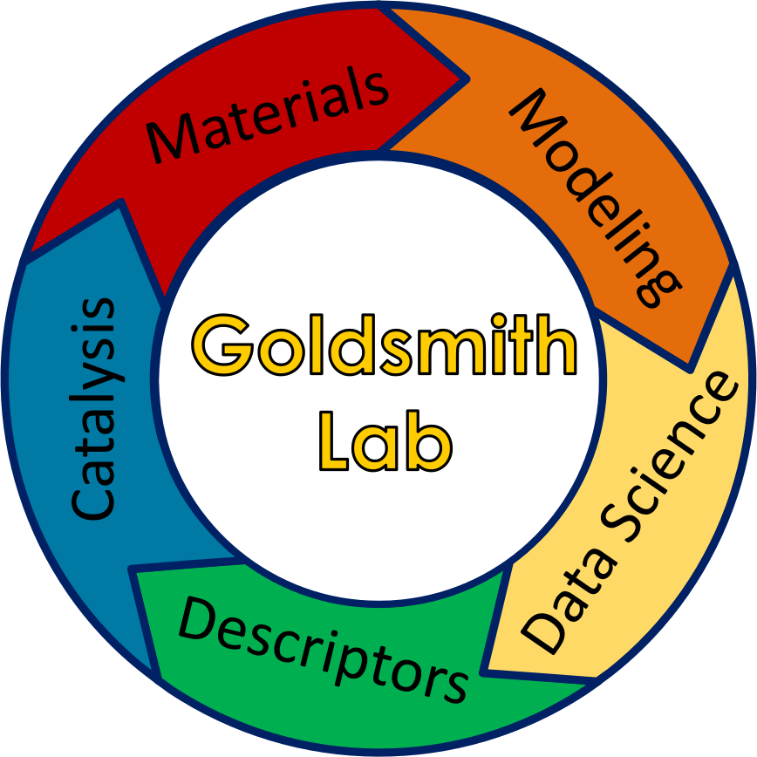
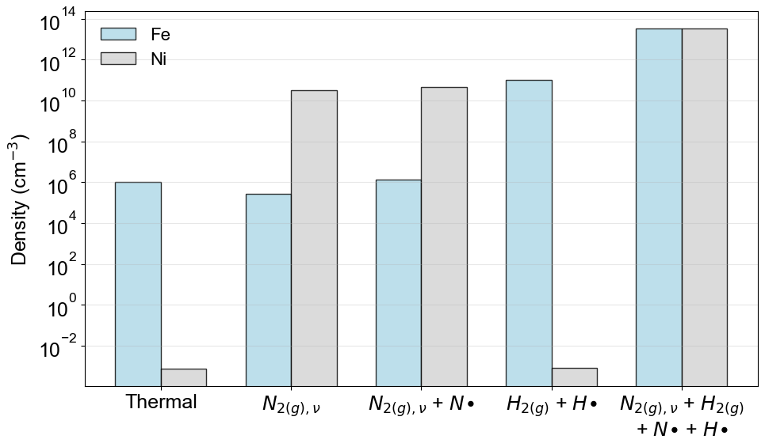
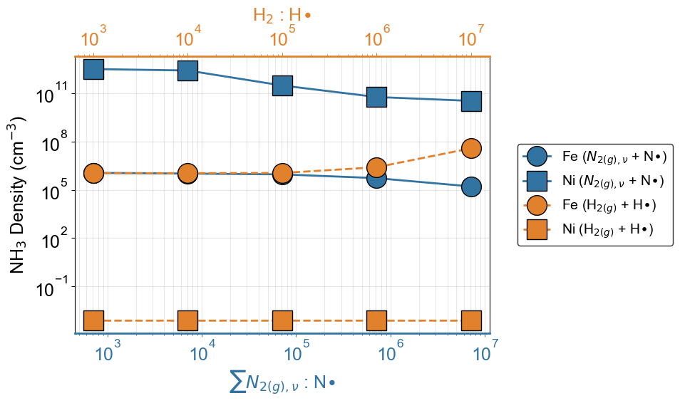
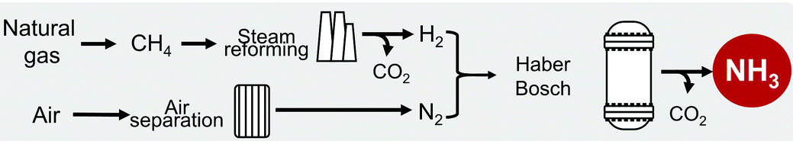
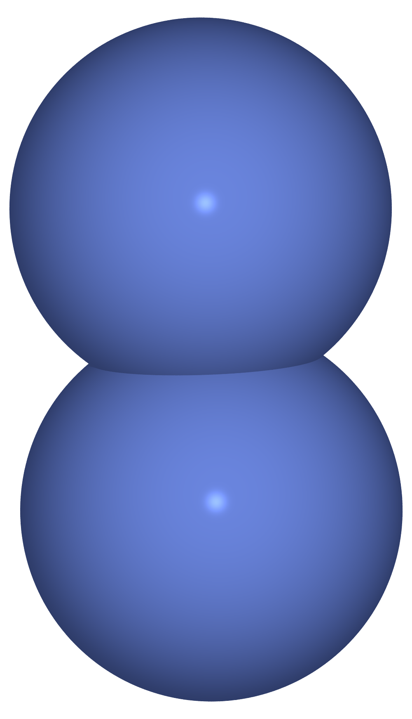








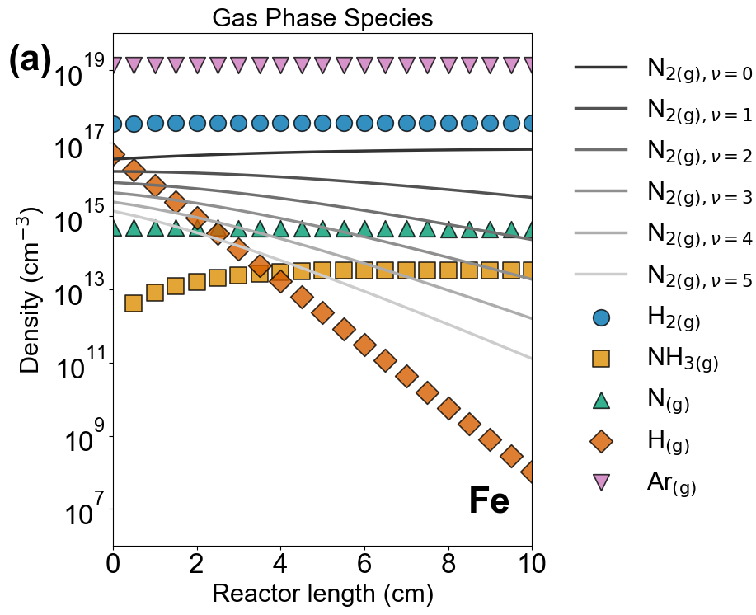
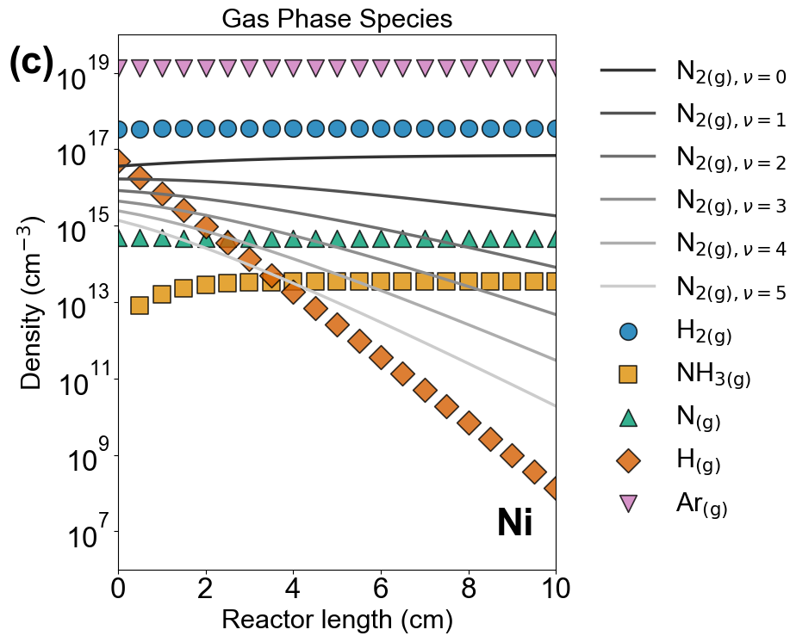
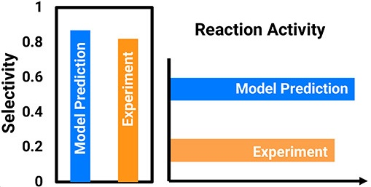
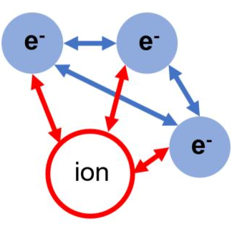
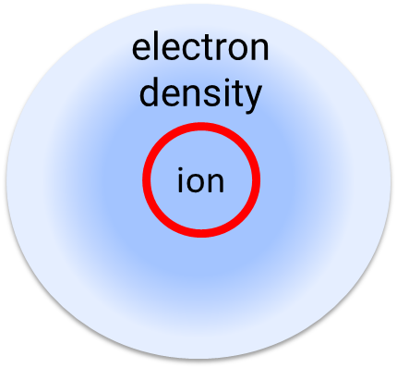

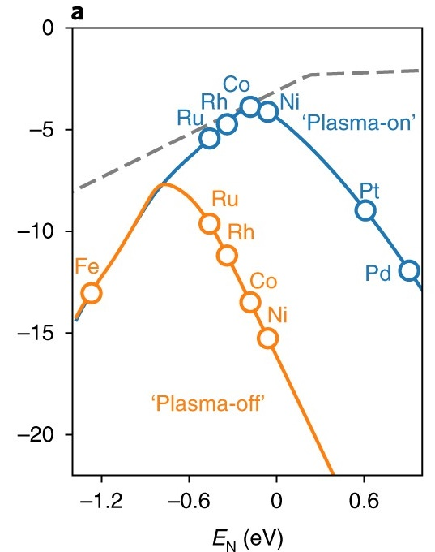
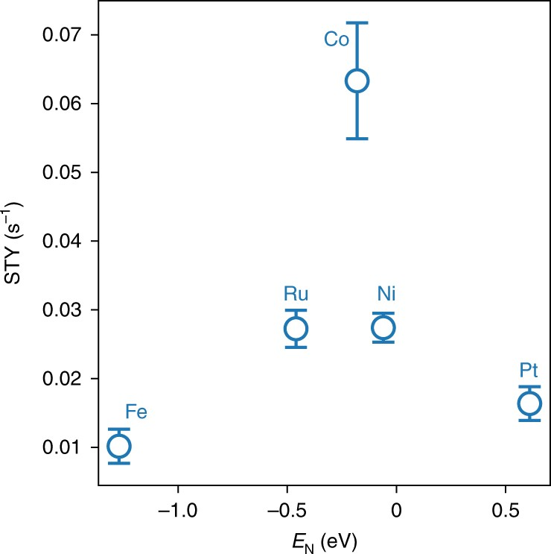
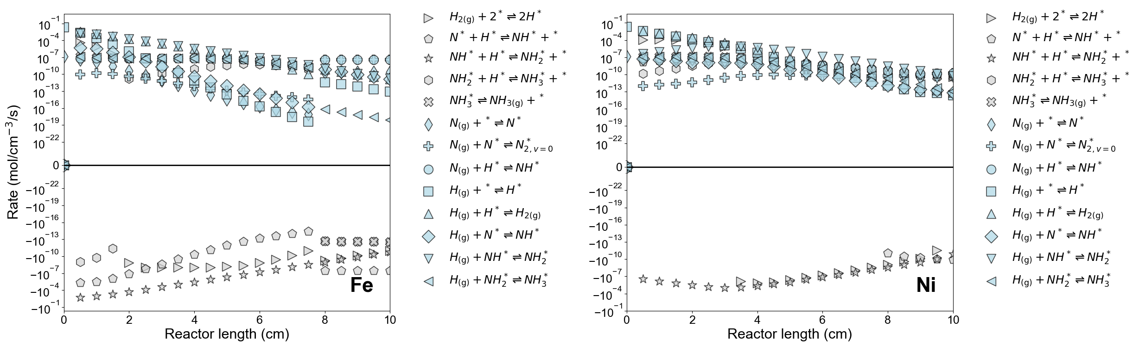

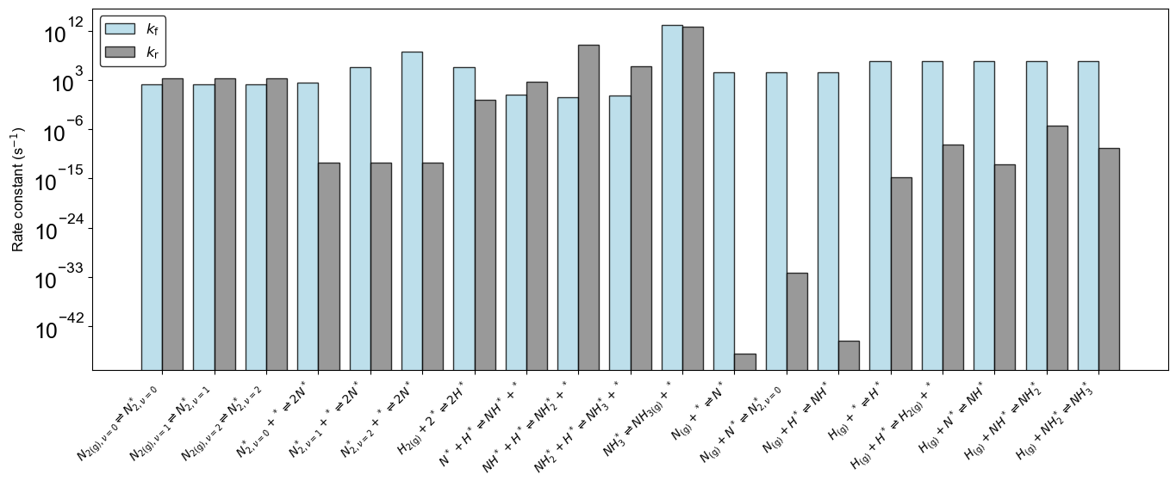

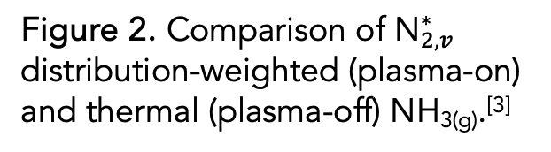
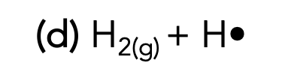
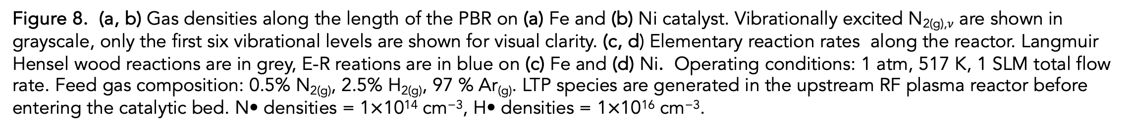
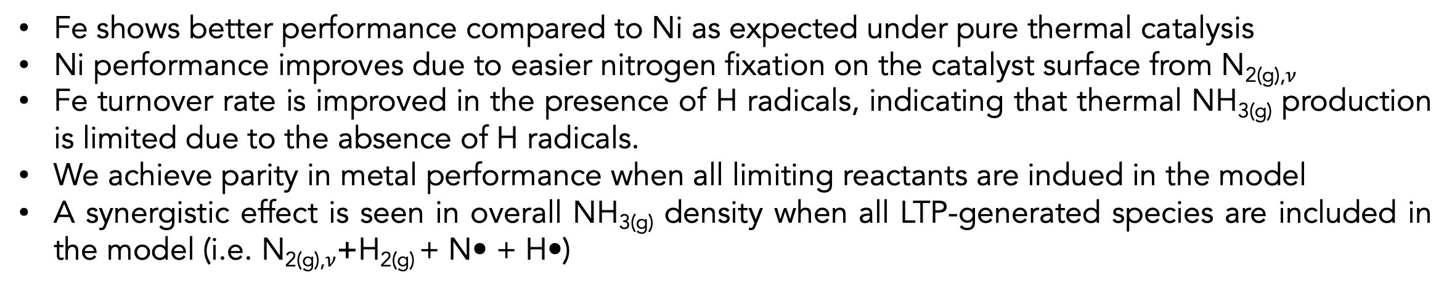
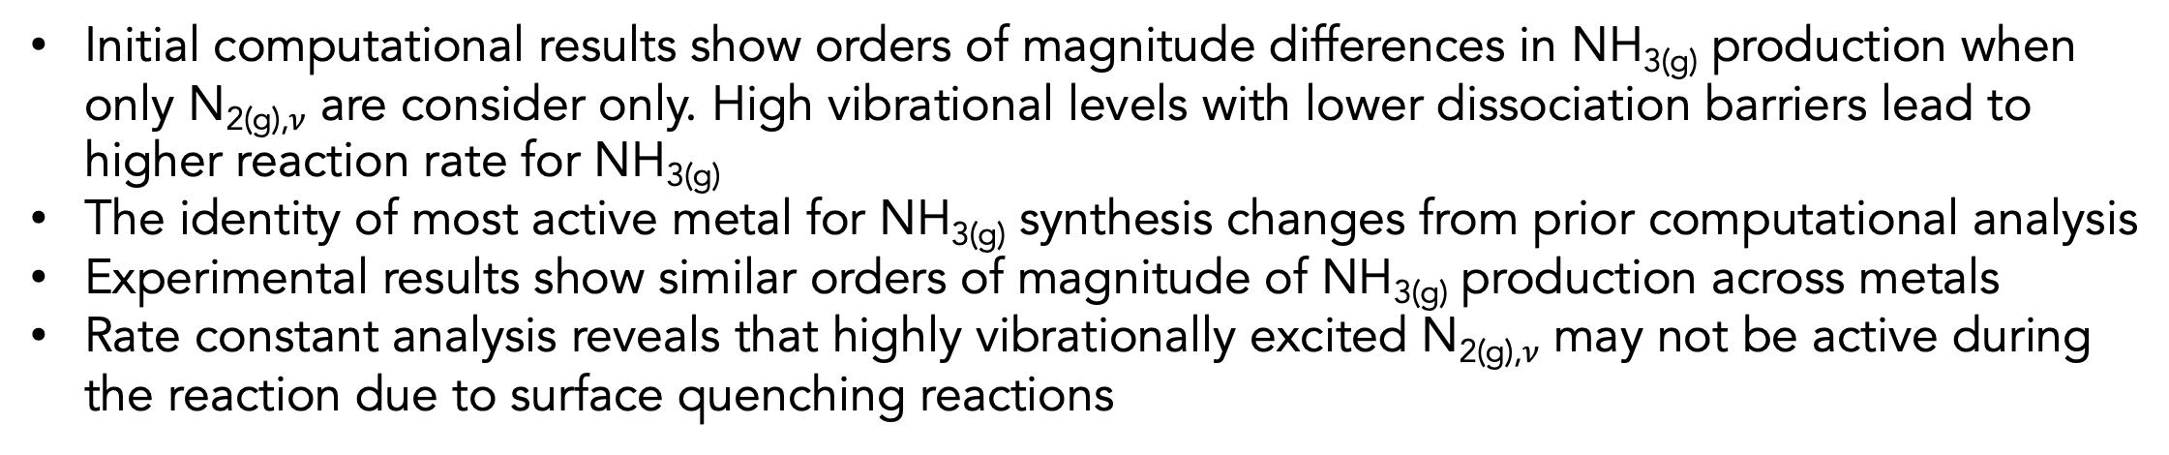


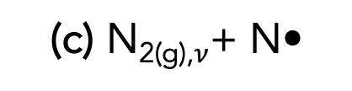
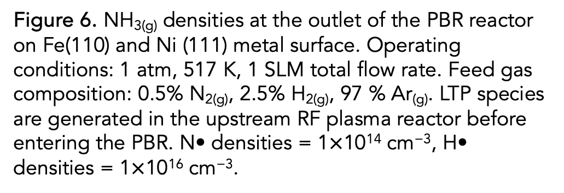
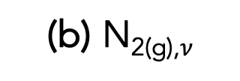

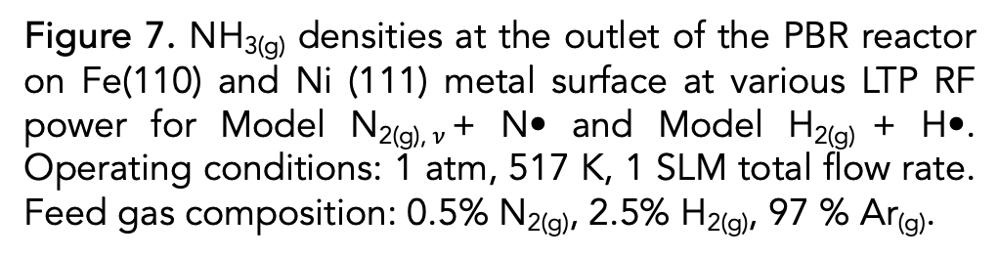
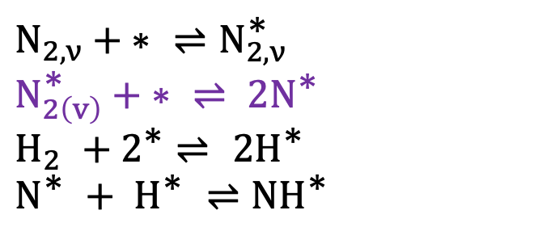
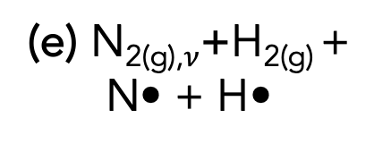
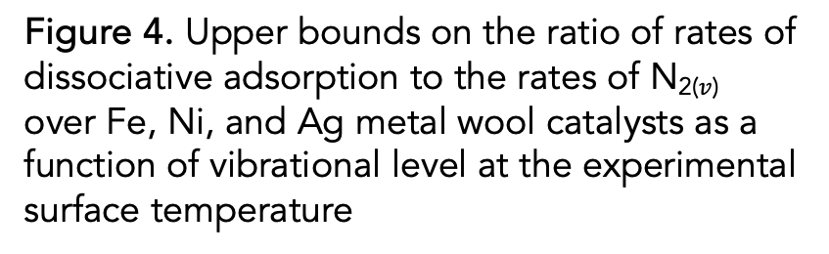
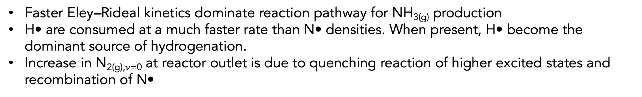
Multiscale Modeling of Radical and Vibrational Pathways in Plasma-Assisted Ammonia Synthesis on Fe(110) and Ni(111)
Oluwatosin A. Ohiro*, Samuel A. Ogunwale, Bryan R. Goldsmith
Department of Chemical Engineering, University of Michigan, Ann Arbor, MI, 48104, USA
Background and Motivation
Modeling Methodology
Reaction Mechanism Elucidation Results
The Haber–Bosch process for ammonia (NH_{3(g)}) synthesis is responsible for 1–2% of global energy consumption^{[1]}
We study plasma species generated in RF reactor interactions in a packed bed reactor (PBR)
We compare 5 microkinetic models increasing complexity to elucidate how different species affect the rate of NH₃ formation and examine which model rationalizes our experiments on Fe and Ni catalysts
(a) Thermal
(b) N_{2(g),}$ν$
(c) N_{2(g),}$ν$+ N•
(d) H_{2(g)} + H•
(e) N_{2(g),}$ν$+H_{2(g)} + N• + H•
N_{2(g)}
H_{2(g)}
Ar_{(g)}
N_{2(g)}
Ar_{(g)}
N_{2(g)}
Ar_{(g)}
N_{(g)}
H_{2(g)}
Ar_{(g)}
H_{2(g)}
N_{2(g)}
H_{2(g)}
Ar_{(g)}
H_{(g)}
H_{2(g)}
New catalytic technology is needed for sustainable ammonia synthesis
N_{2(g),} $υ$
H_{(g)}
N_{2(g),} $υ$
Figure 6. NH_{3(g)} densities at the outlet of the PBR reactor on Fe(110) and Ni (111) metal surface. Operating conditions: 1 atm, 517 K, 1 SLM total flow rate. Feed gas composition: 0.5% N_{2(g)}, 2.5% H_{2(g)}, 97 % Ar_{(g)}. LTP species are generated in the upstream RF plasma reactor before entering the PBR. N• densities = 1$×$10¹⁴ cm⁻³, H• densities = 1$×$10¹⁶ cm⁻³.
Figure 7. NH_{3(g)} densities at the outlet of the PBR reactor on Fe(110) and Ni (111) metal surface at various LTP RF power for Model N_{2(g),}$ν$+ N• and Model H_{2(g)} + H•. Operating conditions: 1 atm, 517 K, 1 SLM total flow rate. Feed gas composition: 0.5% N_{2(g)}, 2.5% H_{2(g)}, 97 % Ar_{(g)}.
Low temperature plasma (LTP) assisted catalysis is a potential complement to traditional thermocatalytic chemical conversion processes, such as NH_{3(g)} synthesis.^{[2]}
Activate difficult molecules (e.g., N₂) and enhance reactivity at low temperature
H_{2(g)}
N_{2(g),} $υ$
H_{2(g)}
N_{(g)}
N_{2(g)}
N_{(g)}
10 mm
Catalyst
Catalyst
Catalyst
Catalyst
Catalyst
Fe shows better performance compared to Ni as expected under pure thermal catalysis
Ni performance improves due to easier nitrogen fixation on the catalyst surface from N_{2(g),}$ν$
Fe turnover rate is improved in the presence of H radicals, indicating that thermal NH_{3(g)} production is limited due to the absence of H radicals.
We achieve parity in metal performance when all limiting reactants are indued in the model
A synergistic effect is seen in overall NH_{3(g)} density when all LTP-generated species are included in the model (i.e. N_{2(g),}$ν$+H_{2(g)} + N• + H•)
molecule
vibrationally excited
species X(𝑣)
MBMS
MBMS
MBMS
MBMS
MBMS
radicals
Gas phase reactions
Model parameters are computed via density functional theory (DFT) and mean-field microkinetic models are constructed to compare to experiments results.
ions
electron
Eley–Rideal reaction
Plasma–catalyst Interactions
Langmuir–Hinshelwood
reaction
DFT
Microkinetic modelling
Model Comparison with Experiment
(a)
(b)
Electric Field
Enhancements
Z
X
Many-body
problem
Electronic energy
Free Energy
Y*
X*
X*
X*
X*
Y*
Z*
Experiment
Reaction
Conditions
(T,P)
Micro-discharge
Active Site/Vacancies
Complex interactions affect elucidation of the mechanism for LTP-assisted NH_{3(g)} synthesis^{[1]}
Understanding interactions in LTP system allows for optimization of reaction conditions, catalyst type, and energy/environmental considerations
1
Reactions
3
Forward rate constants
4
Backward rate constants
Uncertainty in Species Activity for NH_{3(g)} Synthesis
$$N_{2,ν}+\text{∗ }⇌N_{2, ν}^{\text{∗}}$$
$$N_{2\left(v\right)}^{\text{∗}}+\text{∗ }⇌ {2N}^{\text{∗}}$$
$$H_{2} +2^{\text{∗}}⇌ {2H}^{\text{∗}}$$
$$N^{\text{∗}} + H^{\text{∗}} ⇌{NH}^{\text{∗}}$$
Langmuir Hinshelwood reactions
… for N_{2(g),} $v$ dissociation
5
Reaction Rate
(c)
(d)
2
From thermodynamics
Equilibrium rate constant are obtained from each chemical reaction
6
Transient flow behavior in a PBR
Eley-Rideal Reactions
Langmuir–Hinshelwood Reactions
Eley–Rideal Reactions
Figure 8. (a, b) Gas densities along the length of the PBR on (a) Fe and (b) Ni catalyst. Vibrationally excited N_{2(g),}$ν$ are shown in grayscale, only the first six vibrational levels are shown for visual clarity. (c, d) Elementary reaction rates along the reactor. Langmuir Hensel wood reactions are in grey, E-R reations are in blue on (c) Fe and (d) Ni. Operating conditions: 1 atm, 517 K, 1 SLM total flow rate. Feed gas composition: 0.5% N_{2(g)}, 2.5% H_{2(g)}, 97 % Ar_{(g)}. LTP species are generated in the upstream RF plasma reactor before entering the catalytic bed. N• densities = 1$×$10¹⁴ cm⁻³, H• densities = 1$×$10¹⁶ cm⁻³.
Figure 2. Comparison of ${\text{N}}_{2,v}^{∗}$ distribution-weighted (plasma-on) and thermal (plasma-off) NH_{3(g)}.^{[3]}
Figure 3. Measured NH_{3(g)} STYs in the DBD reactor on metal/Al₂O₃ catalysts as a function of the DFT-calculated nitrogen adsorption energy. T = 438 K.^{[3]}
Figure 4. Upper bounds on the ratio of rates of dissociative adsorption to the rates of N₂₍$v$₎ over Fe, Ni, and Ag metal wool catalysts as a function of vibrational level at the experimental surface temperature
Faster Eley–Rideal kinetics dominate reaction pathway for NH_{3(g)} production
H• are consumed at a much faster rate than N• densities. When present, H• become the dominant source of hydrogenation.
Increase in N_{2(g),}$ν$₌₀ at reactor outlet is due to quenching reaction of higher excited states and recombination of N•
Initial computational results show orders of magnitude differences in NH_{3(g)} production when only N_{2(g),}$ν$ are consider only. High vibrational levels with lower dissociation barriers lead to higher reaction rate for NH_{3(g)}
The identity of most active metal for NH_{3(g)} synthesis changes from prior computational analysis
Experimental results show similar orders of magnitude of NH_{3(g)} production across metals
Rate constant analysis reveals that highly vibrationally excited N_{2(g),}$ν$ may not be active during the reaction due to surface quenching reactions
Conclusions
References
Increasing model complexity to include Eley-Rideal reactions reconciles the discrepancy between experimental and computational results for Fe and Ni catalysts.
Similar analyses should be conducted across other transition metals to determine whether these trends persist more generally.
[1] Sun, J.; Alam, D.; Daiyan, R.; Masood, H.; Zhang, T.; Zhou, R.; J. Cullen, P.; C. Lovell, E.; Ali Jalili; Amal, R. Energy Environ. Sci. 2021
[2] Bogaerts, A.; Tu, X.; Whitehead, J. C.; Centi, G.; Lefferts, L.; Guaitella, O.; Azzolina-Jury, F.; Kim, H.-H.; Murphy, A. B.; Schneider, W. F.; Nozaki, T.; Hicks, J. C.; Rousseau, A.; Thevenet, F.; Khacef, A.; Carreon, M. J. Phys. Appl. Phys. 2020.
[3] Mehta, P.; Barboun, P. M.; Engelmann, Y.; Go, D. B.; Bogaerts, A.; Schneider, W. F.; Hicks, J. C. ACS Catal. 2020
[4] Bayer, B. N.; Raskar, S.; Adamovich, I. V.; Bruggeman, P. J.; Bhan, A. Plasma Sources Sci. Technol. 2023
Goal: Elucidate how various LTP-generated species yield
similar NH₃ rates across different metal catalyst
Figure 5. Reaction rate kinetics involving LTP generated species interaction with surface metal catalyst on Fe (110) at 517 K and 1 bar. Blue bars represents the forward rate constants, while the gray bars represents the reverse reaction rates.
Notes:
Fe and Ni catalyst are sensitive to the nature of the LTP species.
Fe turnover rate is improved in the presence of H radicals Figure X. indicating that thermal NH3 production on it is limited due to the abbsece of H radicals.
Ni improves die to easier nitrogen fixation on the catalyst surface
We achieve parairty in metal perfomacne when all LTP generated species are included in the model (i.e. N_{2(g),}$ν$+H_{2(g)} + N• + H•)
Synegistic effect is seen in overall NH3 density in the when both radical species are present

