Slide 1

High Energy Density Plasmas & Fluids at LANL
LA-UR-16-28942
David D. Meyerhofer
Physics Division Leader
November 30, 2016
Operated by Los Alamos National Security, LLC for the U.S. Department of Energy's NNSA

Slide 2
LANL has a diverse program of High Energy Density Physics and Fluids (HEDP&F) research
High energy density (HED) conditions occur at pressures above approximately 1 million atmospheres (> 1 Mbar)
Fluids research is focused on hydrodynamic instabilities, turbulence, and turbulent transport and mix
  It spans classical through high energy density regimes
LANL’s Inertial Confinement Fusion (ICF) focuses on
  Alternative paths to high yield (and possibly ignition) and platforms that can be perturbed from 1-D performance
  Understanding the role of kinetic effects in plasmas
  Developing transformative diagnostics
Other physics interests include radiation flow and opacity

Slide 3
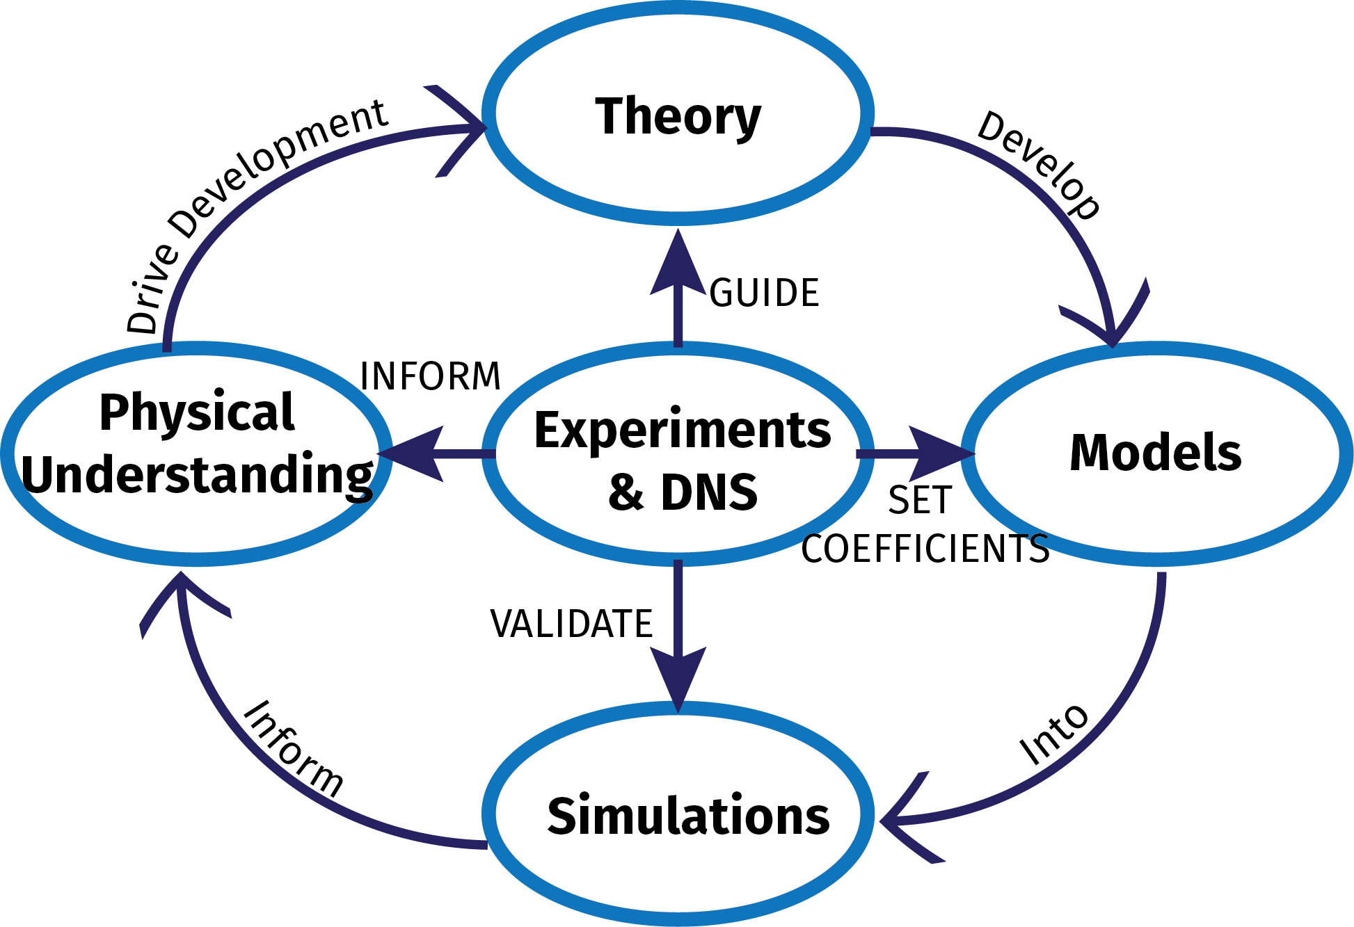
LANL’s HEDP&F Capability integrates theory, simulation, and experiment for maximal impact
DNS=Direct Numerical Simulations

Slide 4
Los Alamos fluids teams work together to prioritize the physics issues that are most impactful to our programs
Mission-related fluids problems are characterized by “extreme” regimes
  Multiple instabilities (RT, RM, KH)
  Multiphase flows with particles changing size, shape, 4-way coupling, etc.
  Unsteady turbulence that remembers its initial conditions
  Extension into the HED regime
  All of the above, with shocks!
Three fluids and turbulence facilities:
  Vertical Shock Tube (VST): Richtmyer-Meshkov mixing
  Turbulent Mixing Tunnel (TMT): Variable-density mixing (subsonic)
  Horizontal Shock Tube (HST): Shocked multiphase flow

Slide 5
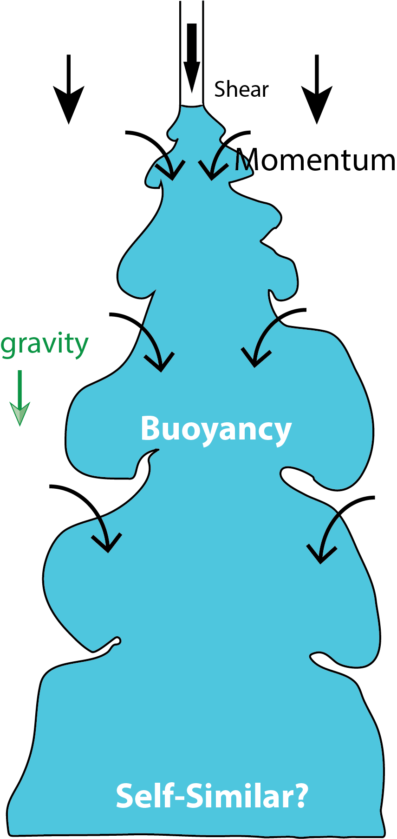
Buoyant jets in a co-flow are used to test models and search for new physical insights
x₂
Spatially evolving
Anisotropic (direction matters)
Inhomogeneous (both in motion and composition)
How does the resulting turbulence evolve in this flow, and how does it differ from classic Kolmogorov homogeneous isotropic turbulence?
How do the current models perform, and can we use them to match the experiment?
g, x₁
Notes:
Most descriptions of jets use self-similar conditions (in the far field), but there are differences in experimental results that are likely due to starting conditions, but are not yet explained.

Slide 6
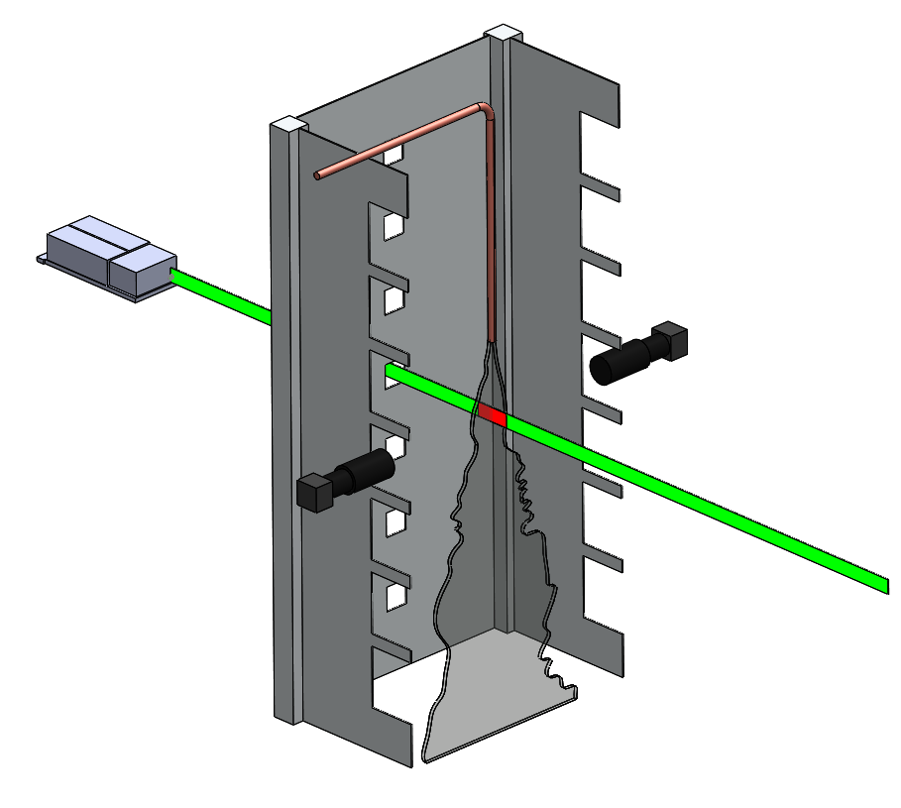
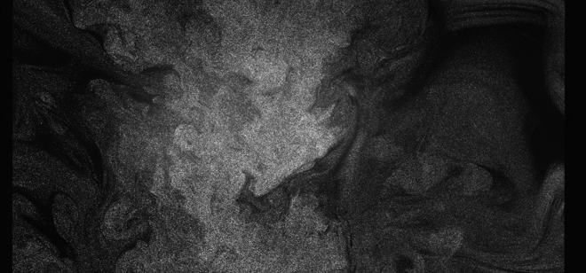
The Turbulent Mixing Tunnel and diagnostics let us capture the evolution of the inhomogeneities of buoyant jet flows
dual wavelength laser
10,000 velocity/density fields of the flow per case
Re = 19,000
At = 0.1, 0.6
Resolution ~250 um
0.524 m
PLIF camera
(density)
PLIF
PIV
5 m
Measurements at:
  x₁ /d₀ = ½ - 3 : shear
  x₁ /d₀ = 15 - 18 : buoyancy
  x₁ /d₀ = 29 - 31 : fully developed?
negatively buoyant jet
PIV camera
(velocity)

Slide 7
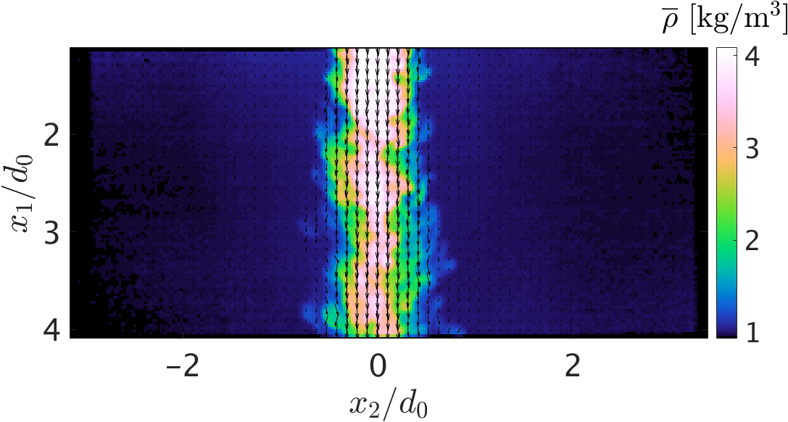
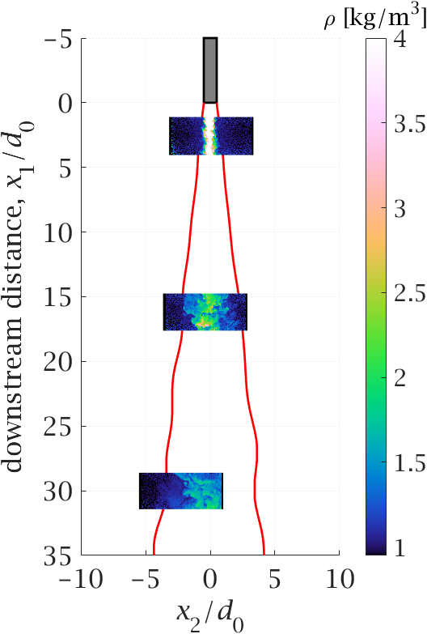
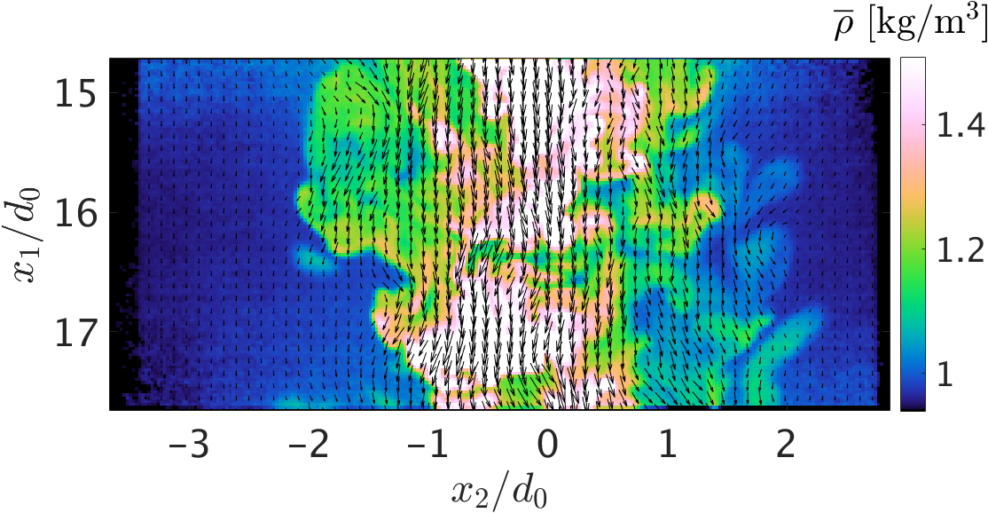
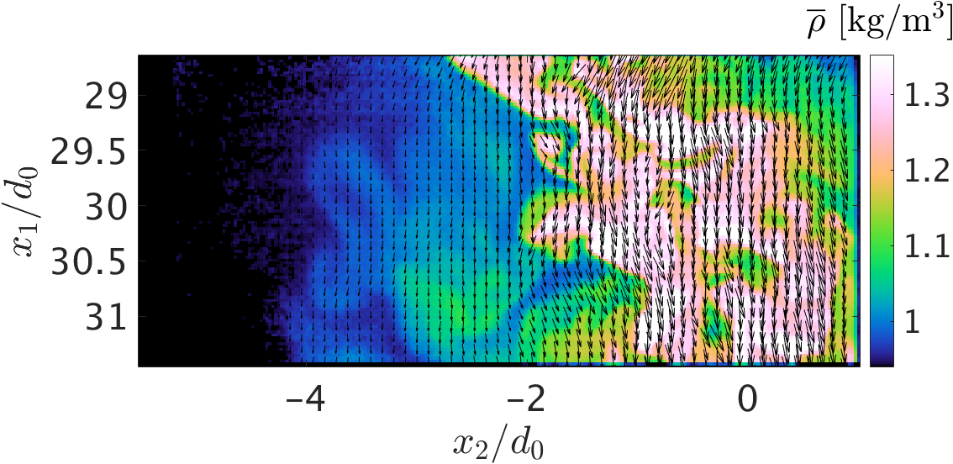
Three locations were selected to highlight the spatial evolution of the physics
Charonko and Vlachos, Meas. Sci. Technol., 24 (6), p. 065301, 2013

Slide 8
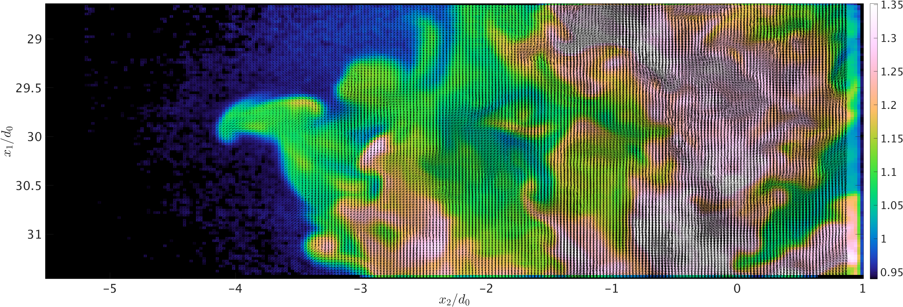
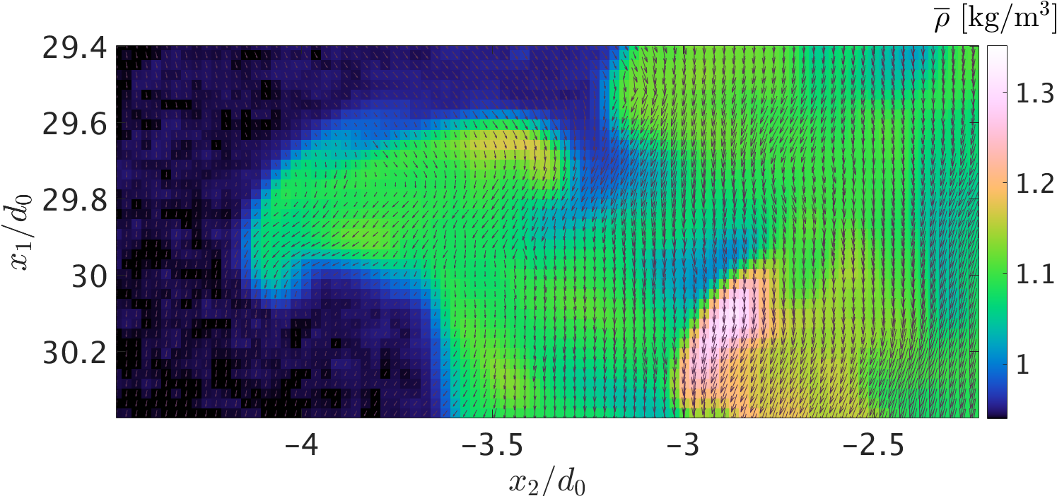
At full resolution (~41,000 data sites), the fine detail of the interaction between the density and velocity are clear allowing determination of transport coefficients through correlations

Slide 9
Variable density effects cause the production of turbulent fluctuations (Reynolds stress) and additional mass flux
Reynolds Stress, R_{ik}
Turbulent Mass Flux,
Density-Specific Volume covariance,
  Schwarzkopf, Livescu, Gore, Rauenzahn, Ristorcelli, “Application of a 2nd-moment closure model…,” J. of Turbulence, 12(29), 2011.

Slide 10
Even with simplified models, agreement with some turbulence quantities is good
3d₀
U₁
U₂
16d₀
velocity
30d₀
R₁₁
R₁₂
Reynolds
stresses
x₂
g, x₁

Slide 11
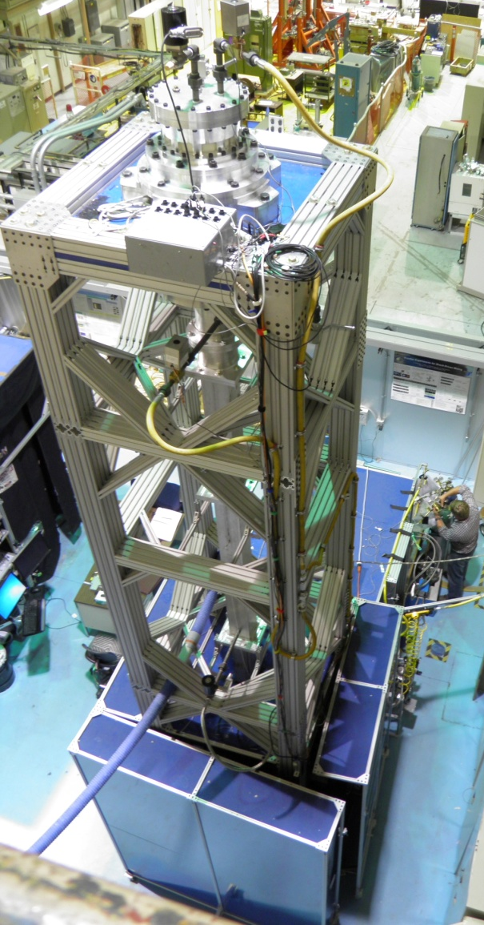
The Vertical Shock-Tube (VST) is LANL’s premier facility for studying the effect of Mach Number and Initial Conditions on RMI
Initial Conditions
Mach Numbers
Single Interface | Light (air) to heavy (SF6)
Atwood Number | 0.6
Daily Shot Rate | 50-100
Velocity Resolution | 388 um/vector
Density Resolution | 178 um/pixel
Taylor Microscale | ~2-5 mm
Turbulence Diagnostics | 2-D: Reynolds Stresses, K, a, b, PDFs of fluctuations and gradients

Slide 12


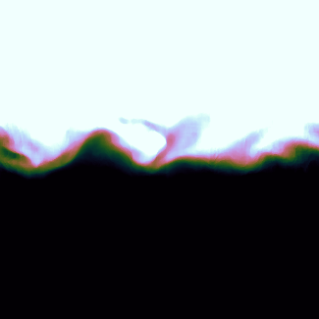
The current setup provides three-distinct regimes of quantifiable and reproducible initial conditions (ICs) that can be used directly for modeling and simulation
Density Contours
Density Contours
Initial Condition 1
Horizontal plate
Weak shear layer
Result:
2D interface with few modes
Initial Condition 2
Plate inclined 7°
No flapping
Stronger shear layer
Result:
Multimode in x-y plane, single mode in z-plane
Initial Condition 3
Trimodal flapping profile centered at 7°
Result:
Multimode 3D interface

Slide 13
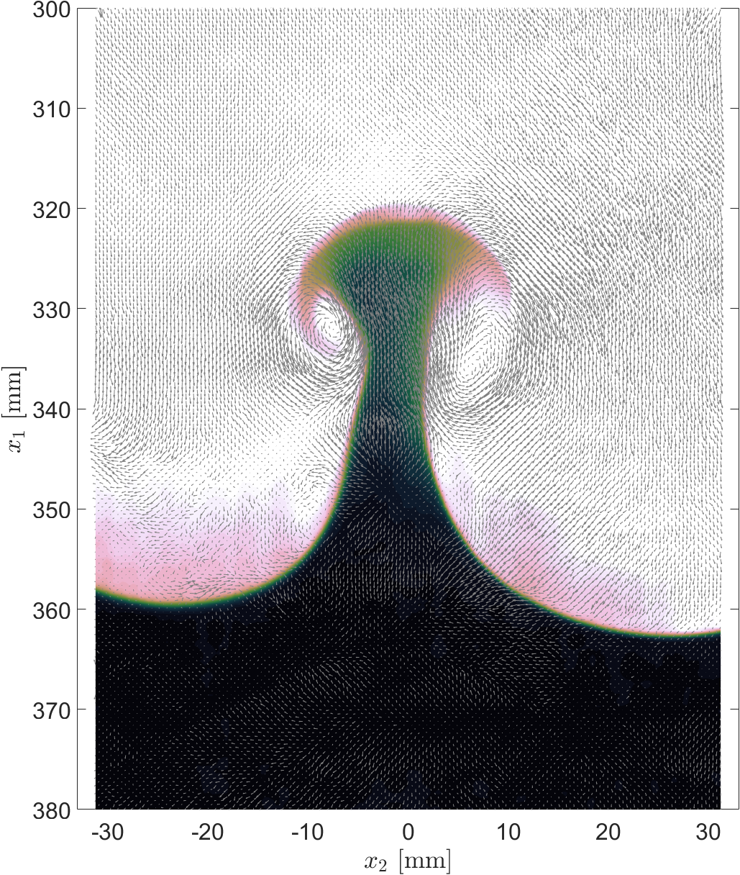
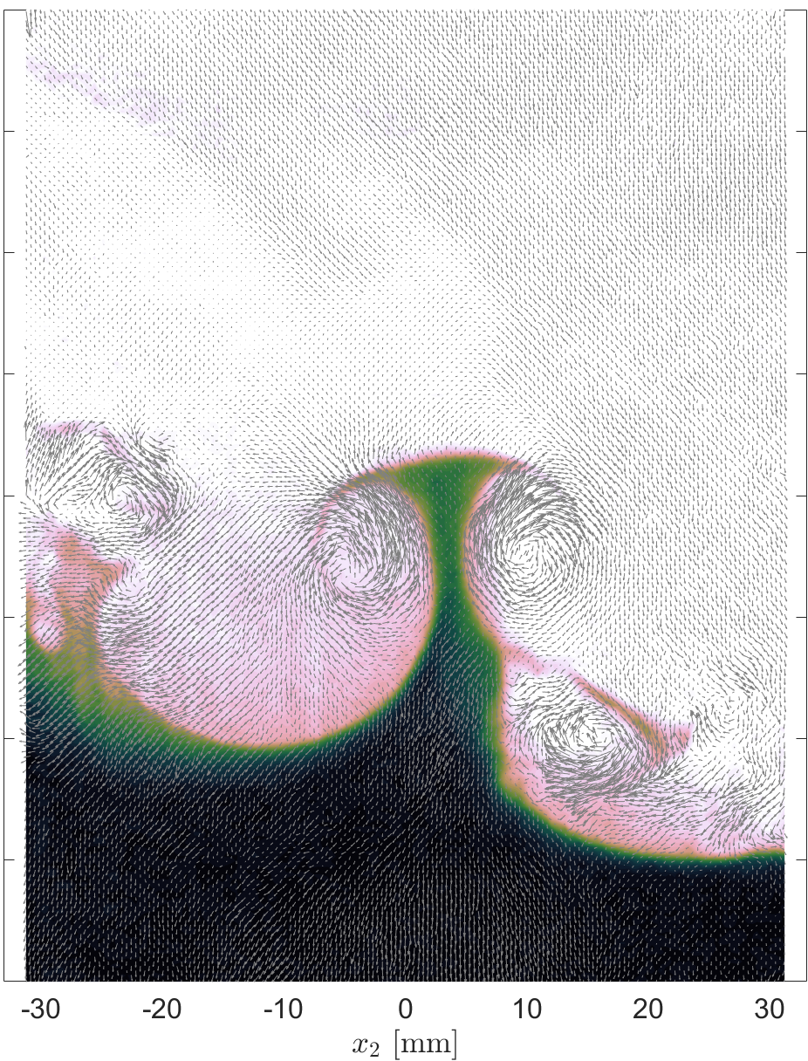
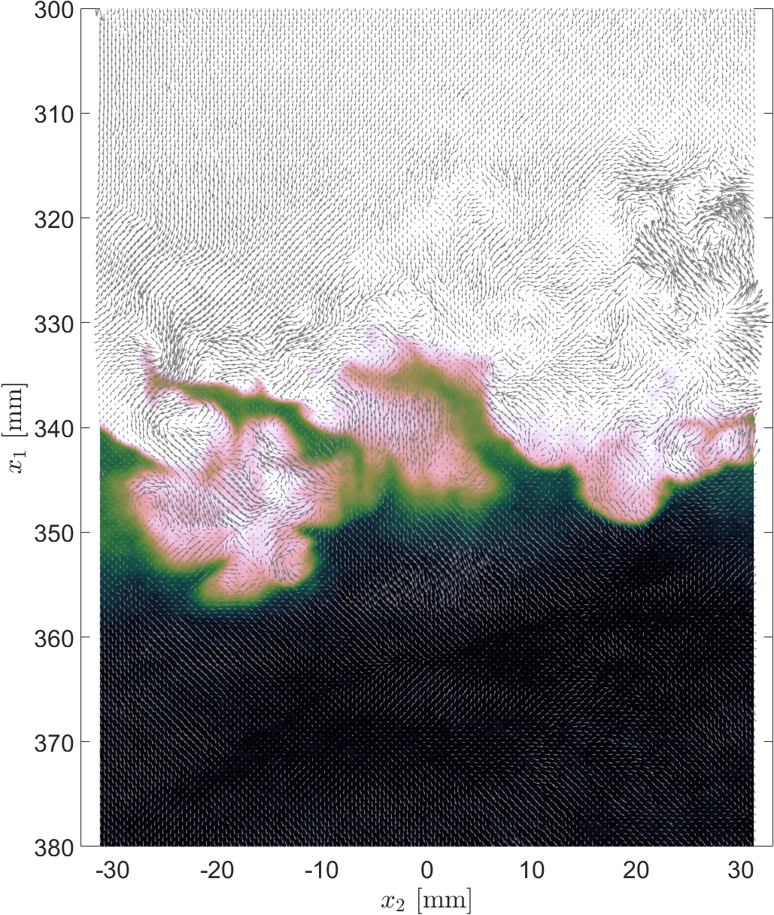
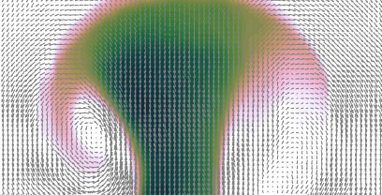
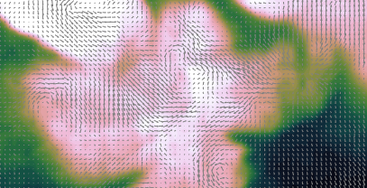
The initial condition are amplified by the RMI in density and velocity fluctuations. The VST has the spatial resolution to calculate turbulent statistics as well.
IC1
IC2
IC3
t = 3.4 ms

Slide 14
Richtmyer-Meshkov instability research highlights the connections between theory, modeling, computation and experiment.
Non-Linear
Perturbation
Theory
Understanding
for Applications
Vertical
Shock Tube
“Modal Model”
of interface
instabilities
2D/3D ASC
Calculations
We want to know when/if a flow of interest will become turbulent.

Slide 15
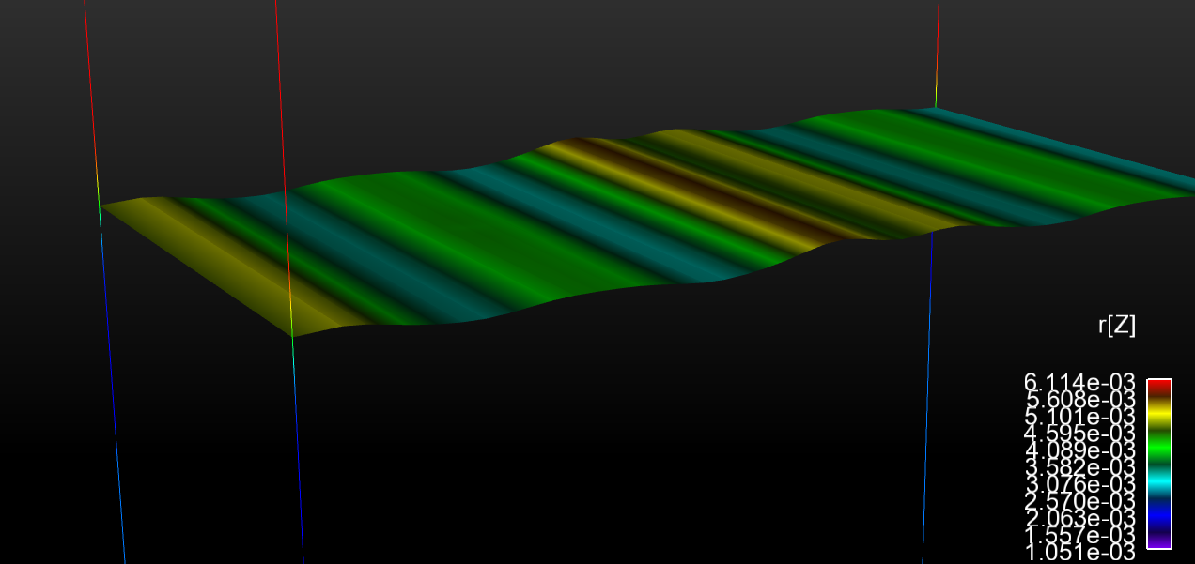
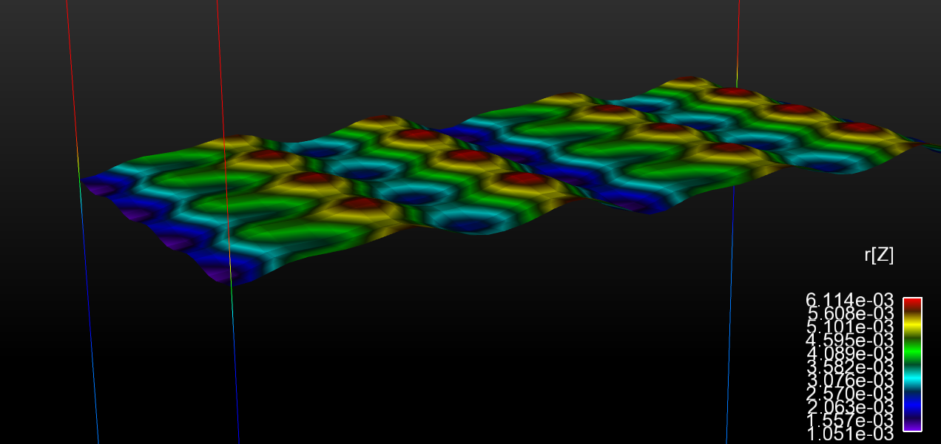


The LANL/ASC Code FLAG is being used to do scale-resolving (LES) calculations of the VST. FLAG enables the user to easily initialize many types of perturbations.
Interface conditions were specified as a Fourier Series with up to 38 coefficients in “x₂” and a combination of Heaviside/ Exponential functions in “x₁” to describe the diffusion layer.
The period/amplitude of the flapper was added to the “x₃” direction for IC2
These functions were added directly to the FLAG input file, which also supports randomized Fourier Series and spherical harmonic expansions for 3D geometries.
IC1
$$x_{1}$$
IC2
$$x_{2}$$

Slide 16
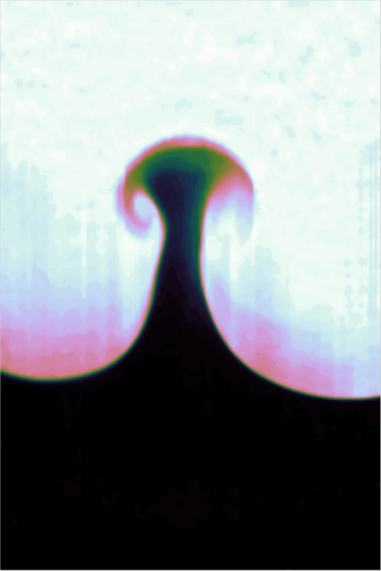

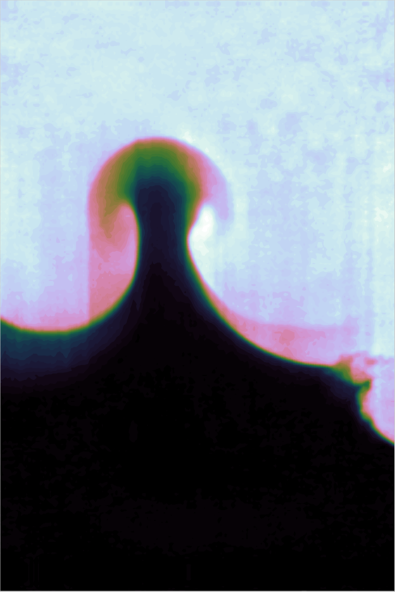
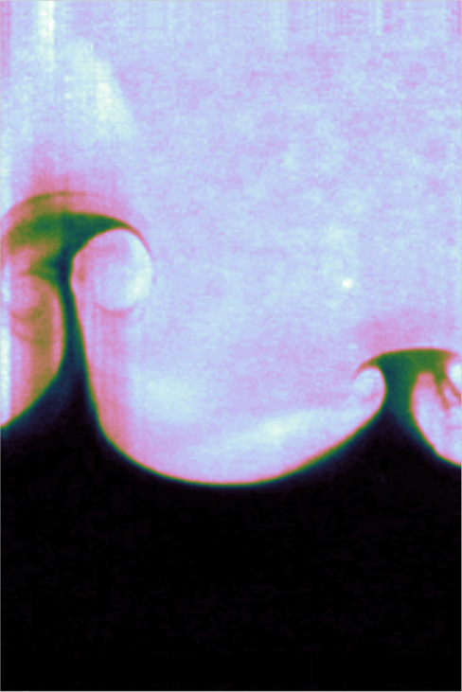

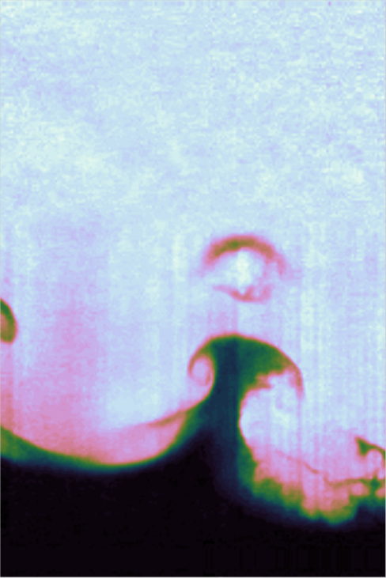
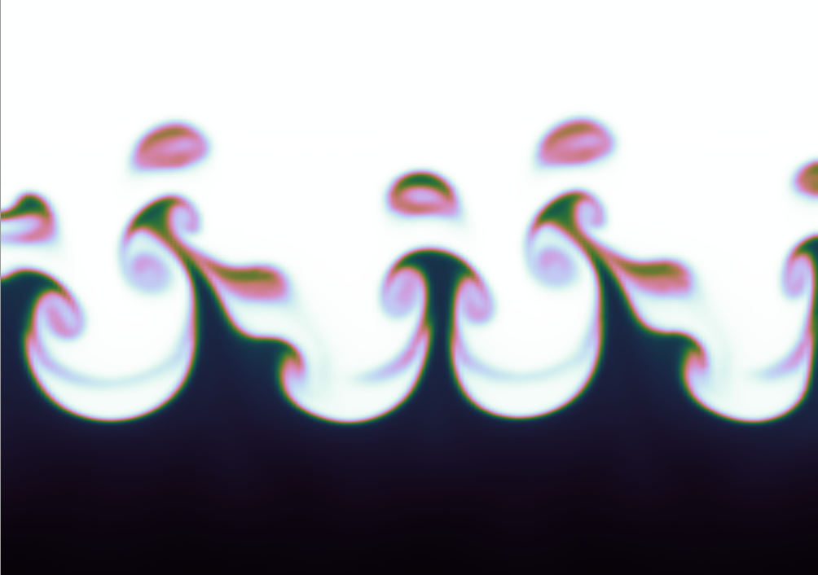
FLAG simulations reproduce the qualitative features of the VST initial conditions. 3D calculations on CIELO helped us understand some experimental observations
IC1
IC2
3D FLAG Centerline
3D FLAG Off-Center

Slide 17
High energy density (HED) conditions are found throughout the universe*
HED conditions can be defined in various ways
  Solids become compressible when the pressure is sufficiently large
    Typical bulk moduli < 1 million atmospheres (Mbar)
    HED > ~ 1 Mbar
    1 Mbar – 10⁵ J/cm³
The dissociation energy density of a hydrogen molecule is ~ 1 Mbar
HED systems typically show
  Collective effects
  Full or partial degeneracy
  Dynamic effects that often lead to turbulence

Slide 18
Ablation is used to create HED conditions – the “rocket” effect is driven by conservation of momentum

Slide 19
Laser ablation applies pressure to the targets through the “rocket” effect

Slide 20
The presence of a plasma modifies the dispersion relationship of electromagnetic waves

Slide 21
Intense lasers or x-rays interacting with the target produce shock waves through ablation

Slide 22
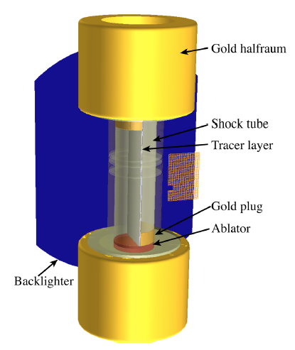
The counter-propagating (CP) shear campaign is extending shear instability and turbulence experiments into the high-energy-density (HED) regime
Experiments are in the HED plasma regime where fluid dynamics approximations may break down
Relevant to mix in ICF capsules and astrophysics
Used to benchmark hydrodynamics and turbulence models
  Low-energy-density/fluid regime experiments such as shock tubes do not include HED effects
Shock/shear “mini shock tube” experiments have made the first observations of emergent mixing layer features (Kelvin-Helmholtz) in plasma flows
“The Shock/Shear platform for planar radiation-hydrodynamics experiments on the National Ignition Facility,” Doss et al. 2015, Phys. Plasmas

Slide 23
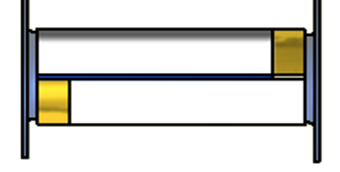


The experiment geometry reduces the model complexity using pressure-balanced, semi-to-fully supported, anti-symmetric flows
Gold plug
Tracer foil
60 mg/cc foam
After shock crossing
Shocks
Ablator cap
60 mg/cc foam
small
drive
small
OMEGA 1.6 mm / NIF 5.2 mm
drive
OMEGA
u_{s} ~110 km/s
u_{f} ~ 70 km/s
NIF
u_{s} ~130 km/s
u_{f} ~110 km/s

Slide 24
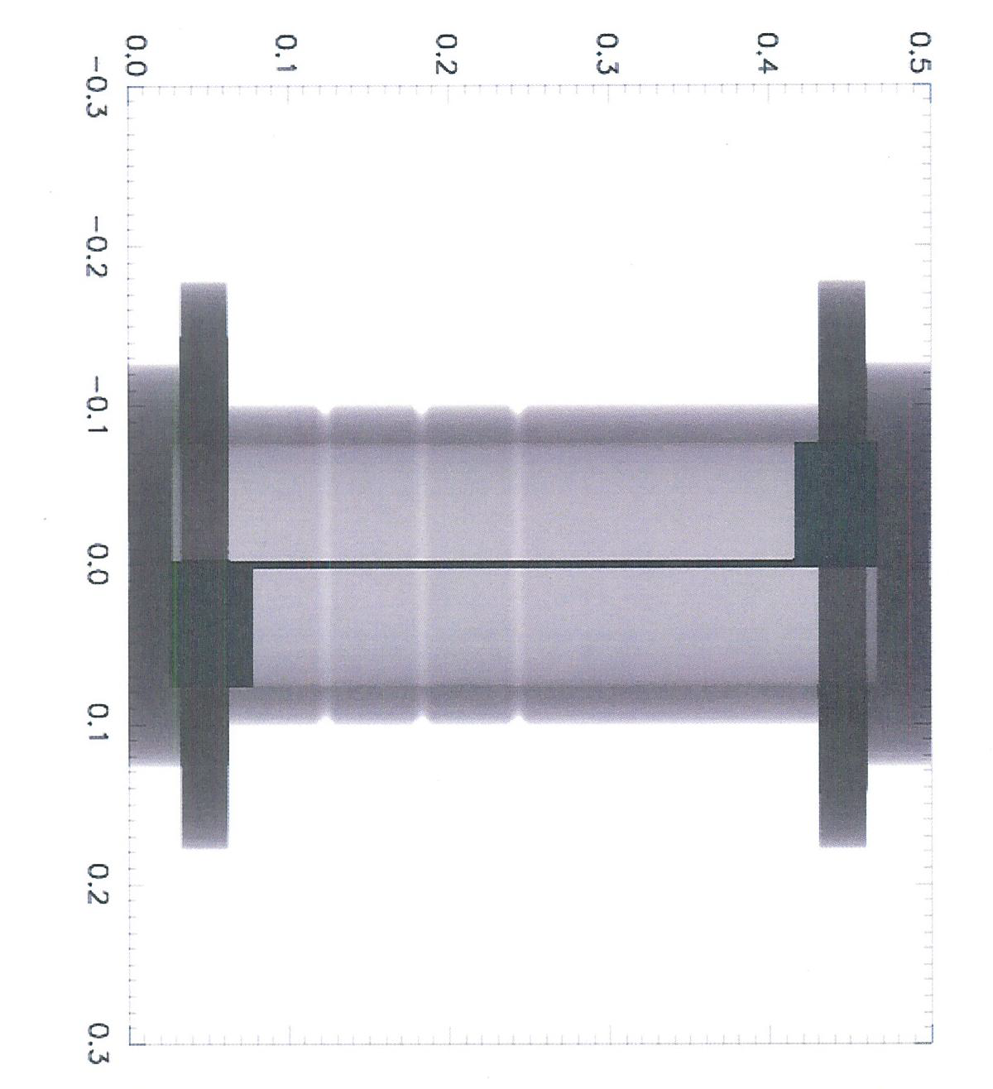
The experiment geometry reduces the model complexity using pressure-balanced, semi-to-fully supported, anti-symmetric flows
NIF platform simulation
(30 ns interval)
After shock crossing
small
small

Slide 25
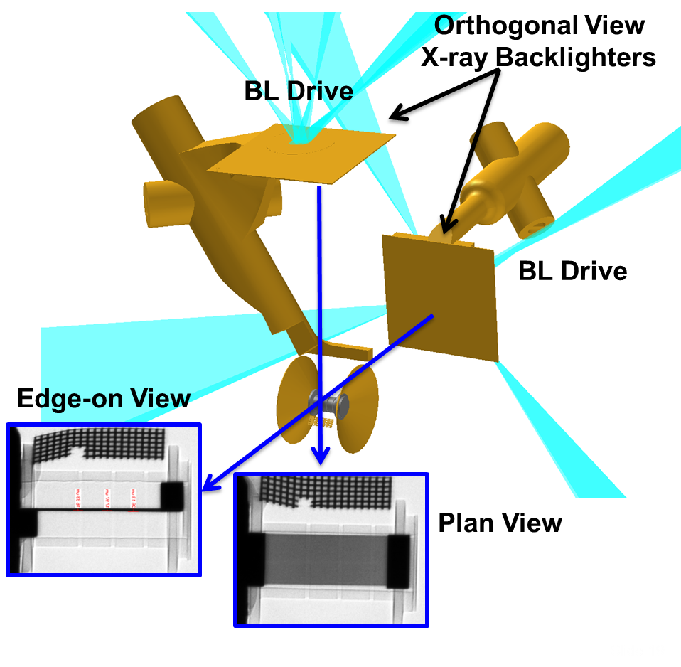
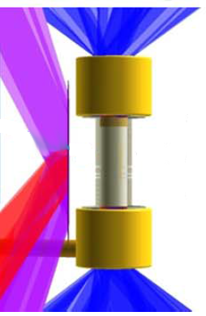
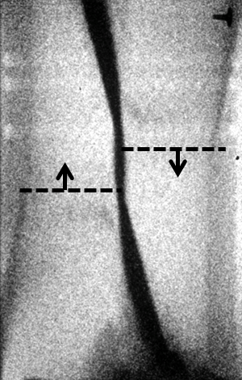
The experiment is diagnosed with radiography in geometry similar to that used in many canonical fluid shear experiments
*Flippo et al., RSI 85 093501 (2014)
Flippo et al., accepted to JPCS (IFSA 2015)
Shock front
BABL*
N131115
OMEGA: One image per shot in two orthogonal views
NIF: Multiple images per shot in one of two views**
Merritt and Doss, submitted to RSI (2015)
**Doss et al., accepted to JPCS (IFSA 2015)

Slide 26
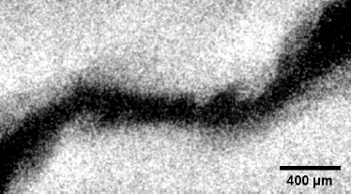
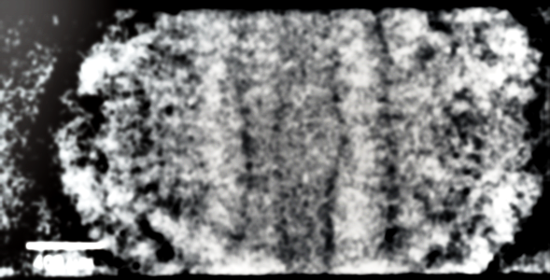
NIF Shear experiments produced the first observations of emergent coherent rollers associated with KH mixing in the HED regime
Edge View: N141016, 34.5 ns
Plan View: N150527, 30.5 ns
Al foil
Al foil
400 um

Slide 27
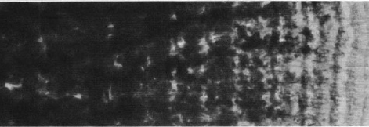
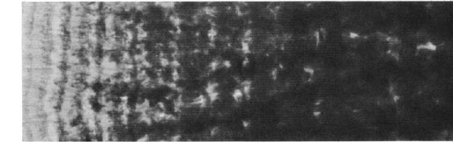
NIF Shear experiments produced the first observations of emergent coherent rollers associated with KH mixing in the HED regime
Edge View: N141016, 34.5 ns
Plan View: N150527, 30.5 ns
Al foil
Al foil
400 um
Breidentahal J. Fluid Mech. 109 1 (1981)
Counter-shear
NIF experiments establish preservation of hydrodynamic scaling across over eight orders of magnitude in time and velocity and we can analyze the results in context of the large body of work on planar mixing layer phenomenology

Slide 28
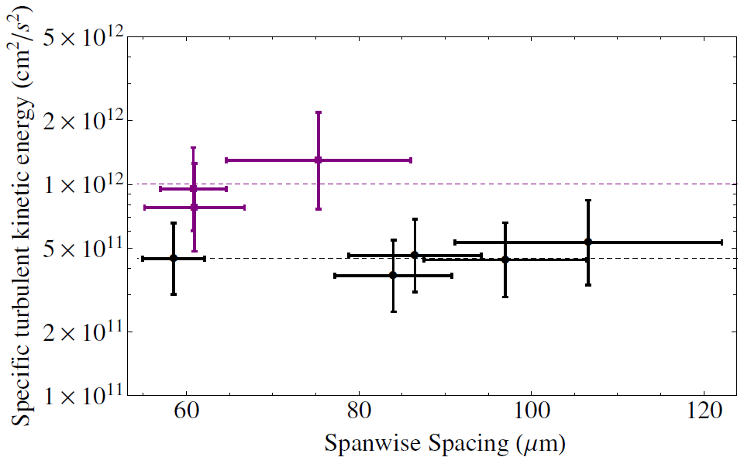
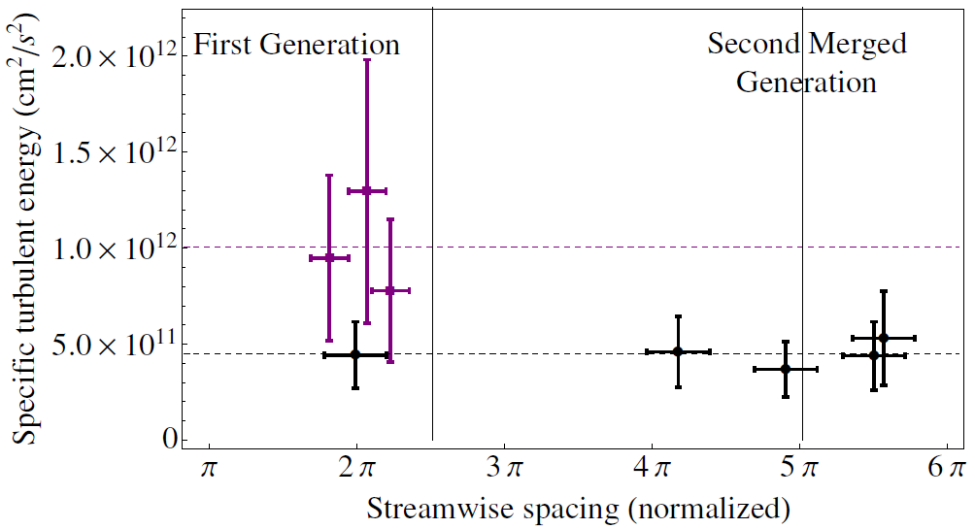

The periodicity of thestreamwise and spanwise structures provide estimates of fluctuating velocity data otherwise unobtainable in the HED environment
Al
Ti
1st sub-harmonic Rayleigh solution
This analysis indicates shear-induced turbulent energies in the NIF experiments are 10⁶ -10⁷ times higher than the nearest conventional experiment
Doss et al,. Submitted to PRE (2016)

Slide 29
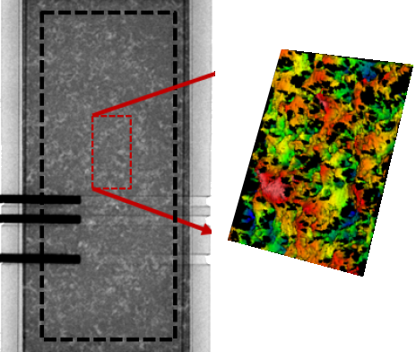
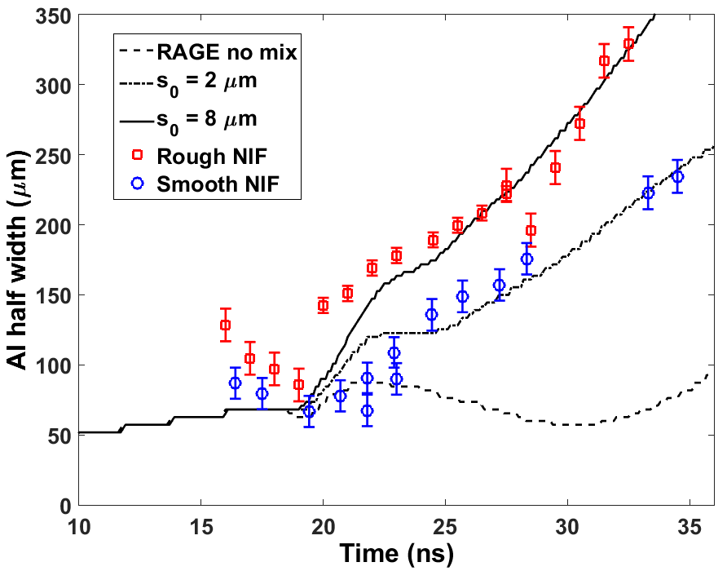
An advantage of initially solid targets is the capability to engineer a variety of complicated boundary profiles to test experiment sensitivity to initial conditions
BHR input conditions
Merritt et al., Phys. Plasmas 22, 062306 (2015)
Flippo et al., submitted to PRL (2016)
Experiments with roughened foils have shown increased mixing rates suggestive of an increase in the model initial conditions, which is a potential avenue for connecting model parameters and various experimental scales

Slide 30
LANL Inertial Confinement Fusion Uses 3 Threads to Support Stewardship
Burning Plasma Platforms
  Create a burning plasma platform, or
  Understand why not
  Use innovative platforms and approaches
HED Physics
  Hydrodynamics
  Mixing & models
Diagnostics
  Gamma-ray measurements
  Neutron Imaging
  25% of the Transformative Diagnostics
Infrastructure important to executing program
  Target fabrication and operations

Slide 31
LANL RAGE Code Now Used Routinely After Long Investment by ICF and Science
Laser Ray-Trace package added in collaboration with U. Rochester
  Working well for direct drive, hohlraum capability imminent
First Omega experiment completely designed & analyzed using RAGE
Indirect drive capsule implosions now routine (need link from HYDRA)
Provides a second look at ignition since code architecture and models very different

Slide 32
LANL’s Ignition Science Goal Is To Achieve “1D Performance” Using 3 Platforms
Hypothesis:
  Codes are not complete and not predictive
  Move to regimes where 1D codes are predictive, i.e. “1D Performance”
    Example: Predict Radius(t), Tion, density, shape, hot-spot pressure, ….
  Intentional perturbations will identify incomplete models
LANL is addressing two issues identified in indirect-drive reviews
  Symmetry (& capsule support)
  Convergence Ratio (R_{i}/R_{f})
We are using three platforms
  High case to capsule ratio experiments (Be capsules, in particular)
  Wetted Foam capsules
  Double shell capsules

Slide 33
The National Indirect Drive Program Will Span Parameter Space
LANL will test changes in convergence ratio and go to the extreme of case to capsule ratio

Slide 34
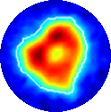
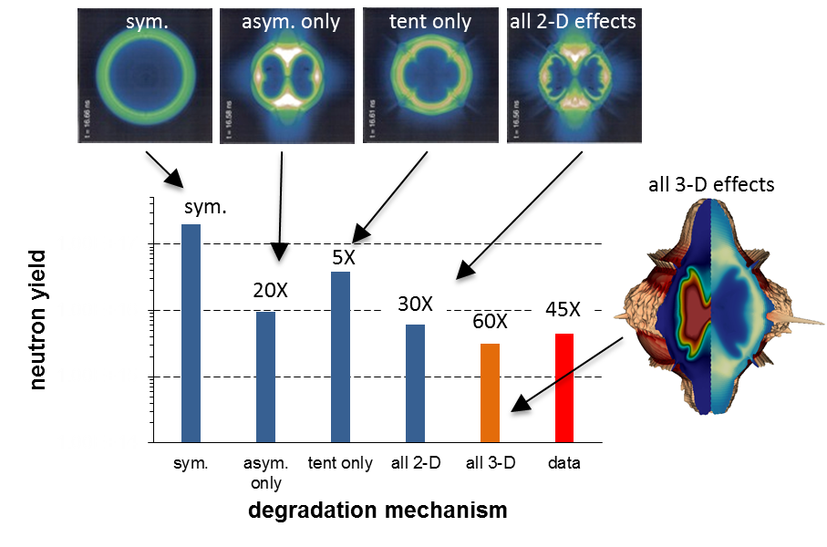
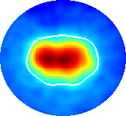
Implosion symmetry has been identified as an important degradation mechanism for NIF ICF implosions
High Res sims show tent, low mode symmetry, and native roughness lead to most performance degradation
Low mode symmetry
Clark et al., PoP (2016)

Slide 35
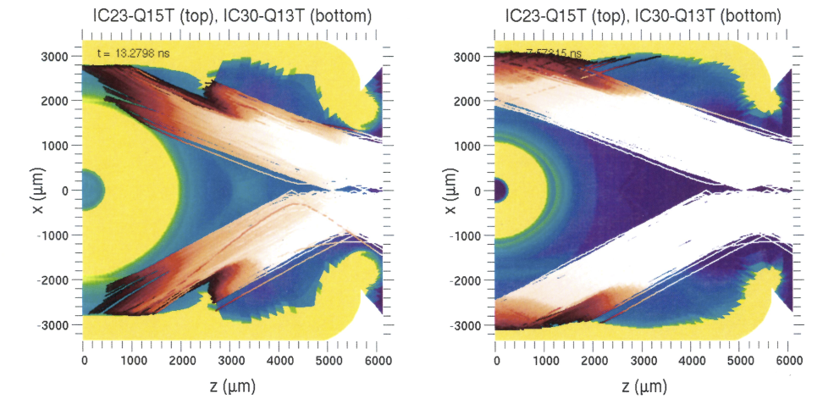
A high case-to-capsule ratio increases the physical separation between hohlraum wall and capsule blow-off plasmas, allowing for better inner cone propagation
End of pulse, 1.1 mm O.R. capsule
End of pulse, 0.6 mm O.R. capsule
Flux variation as function of case-to-capsule ratio
23 deg cone
23 deg cone
Lindl, PoP (1995)
30 deg cone
30 deg cone
30 deg cone
Range
Symmetry control requires understanding of the coupling between the capsule and hohlraum
We will start with a case having good symmetry and increase the capsule size to systematically find the largest capsule having a round implosion in a 672 hohlraum

Slide 36
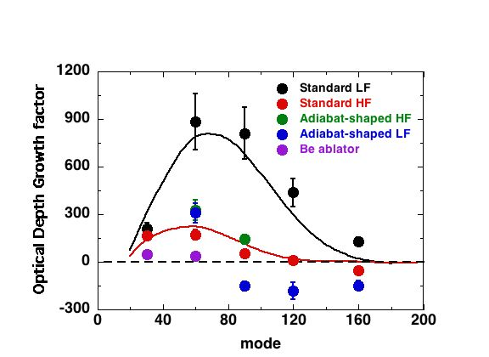
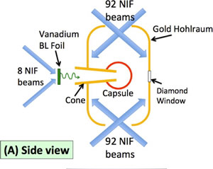
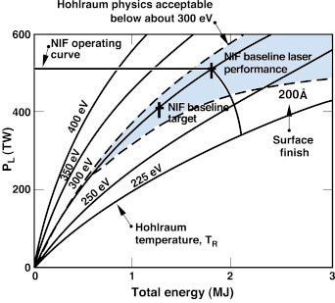
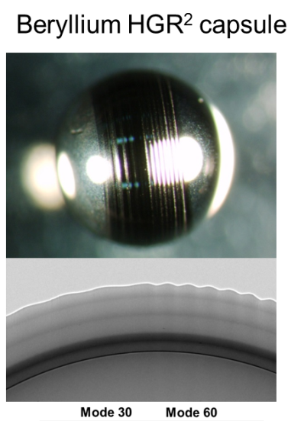
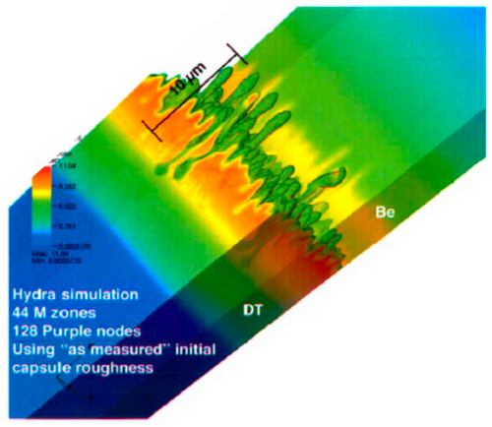
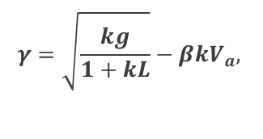
Hydro-growth radiography (HGR) data demonstrate the advantage of Be ablators for controlling ablation front hydrodynamic instability growth
Experimental setup
Comparison of measured growth vs mode number for different ablators
ICF target design space
$$γ=\sqrt{\frac{kg}{1+kL}}−βkV_{a},$$
V_{a} ~ T_{rad}
Lindl 2004
The stability properties of Beryllium capsules allow lower radiation temperature designs by increasing the case-to-capsule ratio to improve symmetry

Slide 37
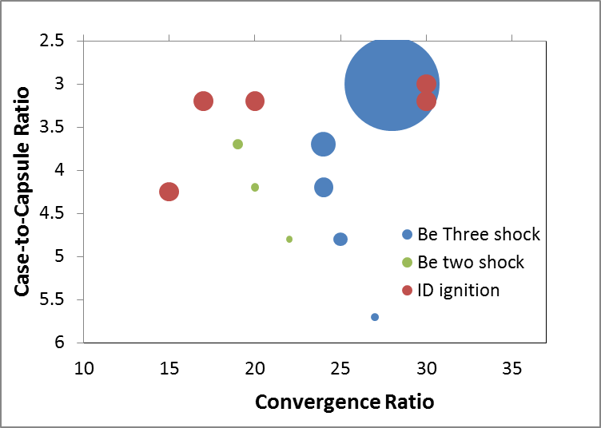
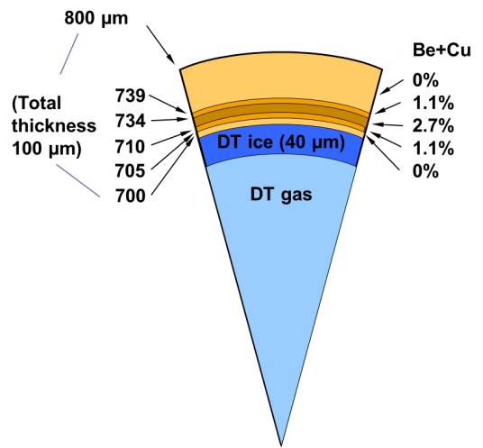
We have designed a series of hydro-scaled capsules to scan case-to-capsule ratios and determine where symmetry control breaks down
Yield vs CCR and CR for beryllium designs with respect to other ignition base camps
Hydro-scaling (~r²) is used to compare different performance at different CCRs
Big Foot
Wetted Foam
HDC
CH
Start
r²
Two Shock
Two shock experiments demonstrated round implosions with convergence ratio of 15 – 20
Our current designs focus on round implosions with high YOC, not ignition

Slide 38






Experiments at a case-to-capsule ratio of 4.2 show good agreement with simulations
Preshot
GXD self-emission
Postshot
N160717, 29% CF
Detector signal close to saturation
N160728, 19% CF
Notes:
Postshot simulations still do not use frequency multipliers and are only tuned to match bangtime, indicating weak sensitivity of shape to drive coupling only dial multiplier to match bak time as in key dtat coupling to peak power matter
Discrepancu to p0 is due to sat diah=g, time integrated show better and smaller p0

Slide 39


For the next campaign, we will move from a CCR = 4.2 to 3.7, by increasing capsule radius from 800 to 900 um in a 672 hohlraum
P2 versus CF at peak power
CCR 4.2
800 um capsule
CCR 3.7
900 um capsule
Simulations predict a round implosion at ~1/3 cone fraction at CCR = 3.7, with inner cone propagation not much worse
Notes:
Hohlraum maps at 3.7 appear not too degraded and experiments will test whether we lose predictability

Slide 40



Wetted Foam Experiments Test Convergence Effects and Hot-Spot Formation
Advantages:
Easily controlled convergence ratio
Better hot-spot formation
Goal:
Establish 1D-like implosion performance at low CR
Determine where 1D-like behavior breaks down
Wetted foam targets create many options for future experiments
N160421 GXD images
90-78 HGXD image:
Equatorial
Polar
90-78 HGXD image:
Status:
First two wetted foam implosions successfully shot on NIF using a liquid D₂ or DT layers, with CR ~ 14.
We will change convergence via vapor density
Critical target fab support from LLNL

Slide 41
A liquid DT layer (wetted CH foam) allows for a higher vapor density compared to a DT ice layer. This provides flexibility in hot spot CR.
Ablator
1100 μm
Ablator
1100 μm
DT liquid layer
(in CH foam)
910 μm
DT ice layer
910 μm
840 μm
840 μm
DT vapor
for 21<T<26 ºK
1.0 < ρ_{v} < 4.0 mg/cm³
DT vapor
for T<19 ºK
ρ_{v} < 0.4 mg/cm³
70 μm
28 μm
28 μm
20 μm
12 < CR < 30
30 < CR < 40
A detailed comparison of the performance of DT liquid layer and DT ice layer capsules in
R. E. Olson and R. J. Leeper, Phys. Plasmas 20, 092705 (2013).

Slide 42

In a 1D world, TN yield increases as CR increases.
The predicted 1D yield for a DT ice layer is 18 MJ – we are looking for where performance starts to deviate from 1-D
National Ignition Campaign (NIC)
ignition DT ice layer design
1D simulation TN yield = 18 MJ
hot spot CR = 35
TN yield predicted
in 1D simulations
of full power NIF implosions
TN yield (MJ)
DT liquid DT ice
hot spot CR
vapor density (mg/cm³)
fielding temperature (ºK)
4.0 3.0 2.0 1.0 0.6 0.4 0.3
26 25 24 23 22 21 20 19 18

Slide 43
The LLNL code Hydra¹ and the LANL code Rage² are being used to simulate and understand the wetted foam experiments. The April 21 experiment performed reasonably close to expectations.
N160421 Hydra 1D Rage (clean) 1D Rage (mix)*
DT neutrons (10¹⁴) 4.5 + 0.1 6.4 6.1 5.8
bang time (ns) 8.72 + 0.08 8.6 8.5 8.5
T_{ion}, burn avg (keV) 3.2 + 0.1 3.3 3.3 3.3
DT burn width (ps) 313 + 30 287 234 243
hot spot radius (μm) 64.8 + 4.8 61.8 65.4 65.4
inferred Pr_{hs} (Gbar) 16.5 + 2.6 18.5 17.3 17.3
¹M. M. Marinak et al., Phys. Plasmas 3 2070 (1996).
²M. Gittings et al., Computational Science & Discovery 1, 015005 (2008).

Slide 44
In the DT, CR=12 shot, material from the 30 μm dia. fill tube is simulated to enter the hot spot

Slide 45


LANL is Building 2 of 8 Transformative Diagnostics To Understanding of Stagnation & Burn
Bringing GCD-3 from OMEGA to NIF
3D Neutron Imaging
Polar, primary image only
installed in Q2FY17
New Carrier Support Assembly (CSA)
NIF
Chamber
Existing
GCD-3
Existing
3.9m Well
Goal: Enhanced Gamma-Ray Sensitivity, Temporal & Spectral Response relative to GRH-6m
Three views give tomographic imaging
Significant changes to present NIS to meet
constraints

Slide 46
LANL has a diverse program of High Energy Density Physics and Fluids (HEDP&F) research
High energy density (HED) conditions occur at pressures above approximately 1 million atmospheres (> 1 Mbar)
Fluids research is focused on hydrodynamic instabilities, turbulence, and turbulent transport and mix
  It spans classical through high energy density regimes
LANL’s Inertial Confinement Fusion (ICF) focuses on
  Alternative paths to high yield (and possibly ignition) and platforms that can be perturbed from 1-D performance
  Understanding the role of kinetic effects in plasmas
  Developing transformative diagnostics
Other physics interests include radiation flow and opacity

Slide 47
Backup

Slide 48





The first experiment Showed That Be Capsules Work and the Hohlraum Is the Problem
The only difference between in hohlraum fielding is the LEH diameter: 3461 μm for Be vs 3101 μm for CH
Beryllium
CH
1130 μm
993 μm
983 μm
949 μm
942 μm
937 μm
Ice: 69 um 886 μm
CH
Be
First Beryllium DT layered target

Slide 49








Poor shape control is evident in images of x ray self-emission for small case-to-capsule ratios
N150617 Be
DT implosion
575 hohlraum
1.6 mg/cc gas fill
CCR 2.7
672 hohlraum
0.15 mg/cc gas fill
CCR 3.2
N160831 Be
symcap
Equator
Equator
Pole
Neutron
Imaging
System
This is consistent with work implosions with other ablator materials

Slide 50


The NIF Shear phenomenology also includes spanwise periodic ‘ribs’ associated with secondary shear instabilities
N150604
34.5 ns
Ti Foil

Slide 51

The Turbulent Mixing Tunnel is designed to study subsonic, variable-density mixing in many flow conditions
Tunnel Test Section
Turbulence Lab

Slide 52





We are comparing this data to simulations in the LANL hydrocode RAGE
Simulations published in Phys. Plasmas 20, 012707 (2013)
6 ns
8 ns
10 ns
12 ns
14 ns
RAGE is a LANL Eulerian radiation-hydrodynamics code, running here with the BHR
(k-ε-a-b) mix model.

Slide 53
Double shell targets provide a different path to ignition than single shell ones – volume ignition
Double shells have different physics issues that will be addressed
High pressure DT gas

Slide 54




Double Shell Capsules Reduce Convergence, Change Hot-Spot Formation
First shot demonstrated
symmetric implosion
• 4.5-ns reverse ramp
° 1 MJ energy
• 97 – 98.5% coupling
• Be(Cu) outer shell
• symmetry tuning
tested
FY17 experiments will examine:
Mid-Z inner shell behavior
Collision elasticity
Shell instability

