Slide 1
Low-Temperature Plasma Surface Interactions: Nanoscale Graphitic Film Formation, Atomic Layer Etching And Atmospheric Pressure Plasma Jet Modification Of Biomolecules*
Gottlieb S. Oehrlein
Materials Science and Engineering
Institute for Research in Electronics and Applied Physics
University of Maryland, College Park, MD 207422115

Slide 2
Acknowledgements
Nanoscale graphitic film
D. Metzler, F. Weilnboeck, N. Fox-Lyon, Prof. L. Salamanca-Riba (UMD)
R. Bruce, S. Engelmann (IBM Research)
Atomic Layer Etching
D. Metzler, C. Li (UMD)
S. Engelmann, R. Bruce, E. Joseph (IBM Research)
Deactivation of harmful biomolecules using atmospheric pressure plasma
E. Bartis, A. Knoll, P. Luan, C. Hart, N. Fox-Lyon, Prof. J. Seog (UMD)
T.-Y. Chung, H.-W. Chang, Prof. D.B. Graves (UC Berkeley)
Profs. I.V. Adamovich and W.R. Lempert (OSU), E. Raitses (PPPL)
Funding
Semiconductor Research Corporation, NSF (DMR-0705953)
National Science Foundation (CBET-1134273; PHY-1004256)
US Department of Energy Office of Fusion Energy Sciences (DE-SC0005105; DE-SC0001939)
Notes:
2

Slide 3
Outline
Nanoscale graphitic film formation
Atomic layer etching using low pressure plasma
Use cyclic deposition of fluorocarbon layer to control etching depth of SiO₂ at atomistic (Angstrom) level
Atmospheric pressure plasma: Deactivation of biomolecules using N₂/O₂/Ar atmospheric pressure plasma jet
Role of interactions with environment in deactivation/etching of biomolecules
Conclusions
Notes:
3

Slide 4
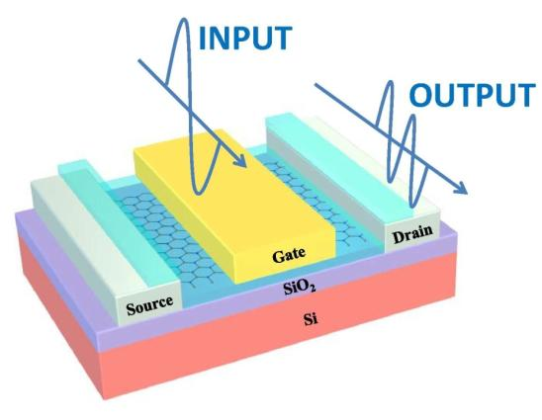
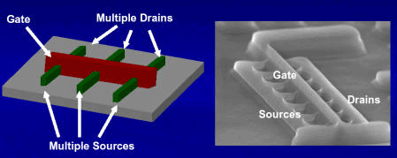
Need For Atomic Precision In Etching
Ultra-small features, ultra-thin layers and films – need for atomistic level of dimensional control during plasma etching
mask
gate
gate
graphene
High (infinite)
selectivity
substrate
<5nm
Fin/wire
Intel
Wang et al, 2010
Notes:
4

Slide 5
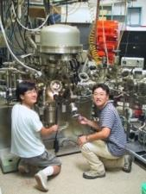
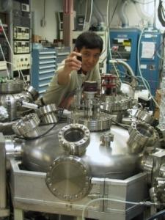
Cluster System for Plasma Processing of Materials
Inductively Coupled Plasma
Atomic Layer Etching
Multi-Technique
Surface Analysis
Chamber
Numerous Plasma and Surface
Diagnostic Techniques Shared Between All Systems
(XPS, AES, ...)
Load
APPJ
Lock II
Load
Lock I
Inductively
Coupled
Plasma
Reactor
Evaporator
Evaporator
Capacitively Coupled Plasma
(CCP) Reactor

Slide 6
Cluster System for Plasma Processing of Materials

Slide 7
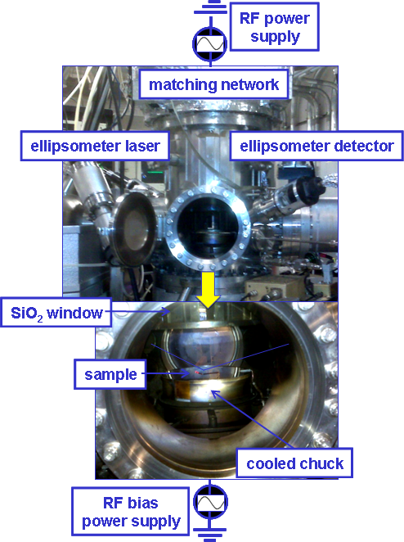
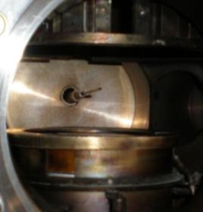
Plasma And Materials Characterization
Plasma characterization:
Langmuir probe measurements: electron energy distribution functions, electron temperature, plasma density
Ion energy/composition measurements: ion mass, ion energy distribution functions
Optical emission spectroscopy
Materials characterization:
Ellipsometry: surface modification and optical properties
XPS: surface composition and bonding
AFM: surface morphology and roughness
HIDEN EQP
Ion sampling

Slide 8
Formation of ~ 1nm Thick Carbon Films

Slide 9
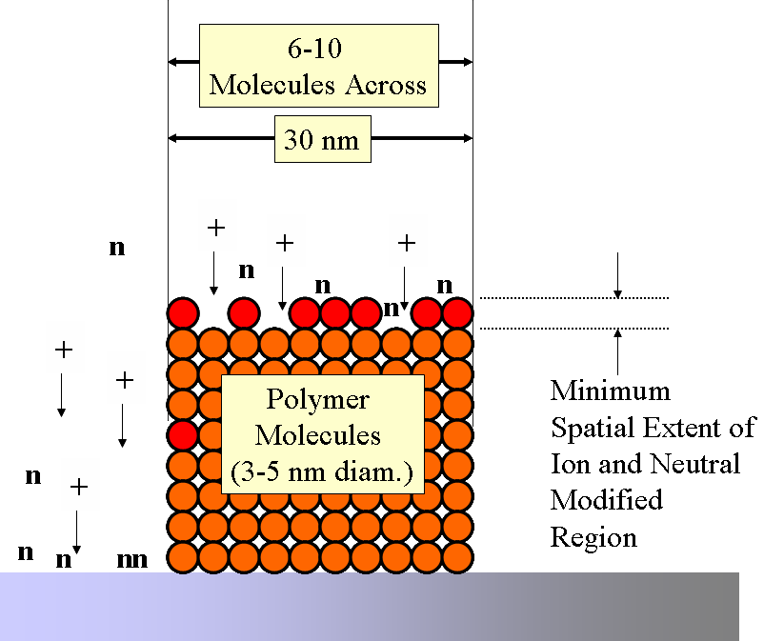
Challenge of Plasma-Polymer Interactions For Nanoscale Patterning Of Materials
Ion and Neutral-Modified
Region
e⁻
Photon (UV)-Modified Region
Polymer
Molecules
(3-5 nm diam.)
30 nm wide line is defined by 6-10 polymer molecules (~ 3-5 nm diameter)
Current resists do not satisfy LER requirement for 22 nm lines and beyond

Slide 10
Mechanism of Synergistic Roughness Formation
Wrinkling by interaction of dense ion induced surface layer and weakened UV modified photoresist
➔Limitations in pattern fidelity
UV modification, material dependent¹
Ion bombardment, material independent¹
➔Formation of compressive stress σ
UV
Ions
pristine
After PE
h = 1.8 nm
30 nm
E_{F} ≈ 100 GPa
h ≤ 200 nm
E_{s} ≈ 20-60 MPa
R. L. Bruce, et al., (2010);

Slide 11
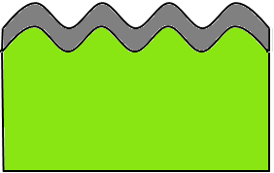
Mechanism of Synergistic Roughness Formation
Wrinkling by interaction of dense ion induced surface layer and weakened UV modified photoresist
➔Limitations in pattern fidelity
UV modification, material dependent¹
Ion bombardment, material independent¹
➔Formation of compressive stress σ
UV
Ions
pristine
After PE
h = 1.8 nm
30 nm
E_{F} ≈ 100 GPa
h ≤ 200 nm
wrinkling
E_{s} ≈ 20-60 MPa
buckling
instability
stiff film
stiff film
250 nm
stress
soft underlayer
stress
soft underlayer
R. L. Bruce, et al., (2010);

Slide 12
Plasma Pretreatment (PPT)
Plasma pretreatment
UV plasma radiation reduces plane strain modulus E_{s} (chain-scissioning) and densifies material without stress before actual PE
Increased plasma etch durability
Helium PPT:
Helium, 100 mTorr pressure, 800 W source power, no bias (E_{ion} ≤ 25 eV)
Little ion crust
More photons at low wavelengths (58.4 nm) than for Ar using high source power
He
Ar
Plasma etch (PE):
Argon, 20 mTorr pressure, 200 W source power, -100 V bias (E_{ion} ≤ 125 eV)
➔Similar to typical fluorocarbon/Ar pattern transfers

Slide 13
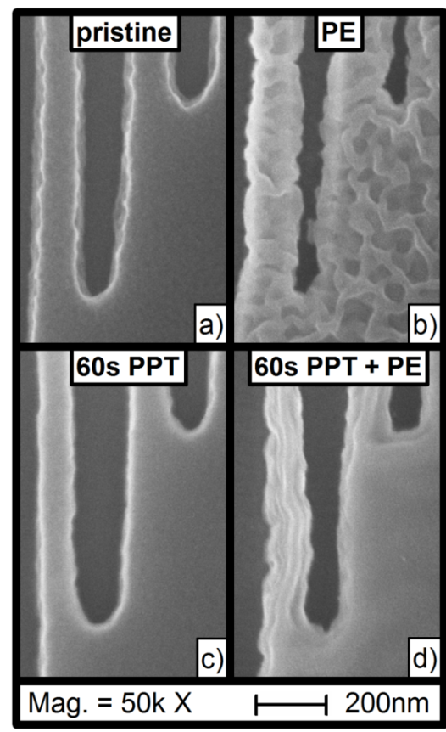
Improvement of Trench Patterns
While PE introduces significant roughness, PPT is not affecting surface morphology
For combined process, features and pattern free areas show strong reduction of surface roughness
FTIR shows significant change when applying the PPT before the PE :
Bulk modification saturation similar to after PE
Reduced oxygen content leads to increased etch resistivity
Total changes of thickness comparable for short to medium PPT
F. Weilnboeck et al,
Appl Phys Lett 99 (26), 261501 (2011).

Slide 14
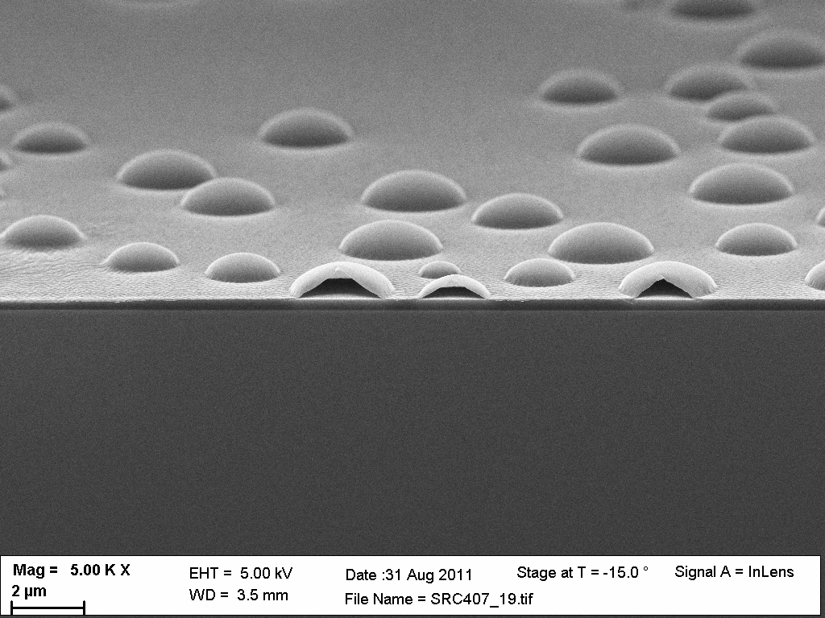
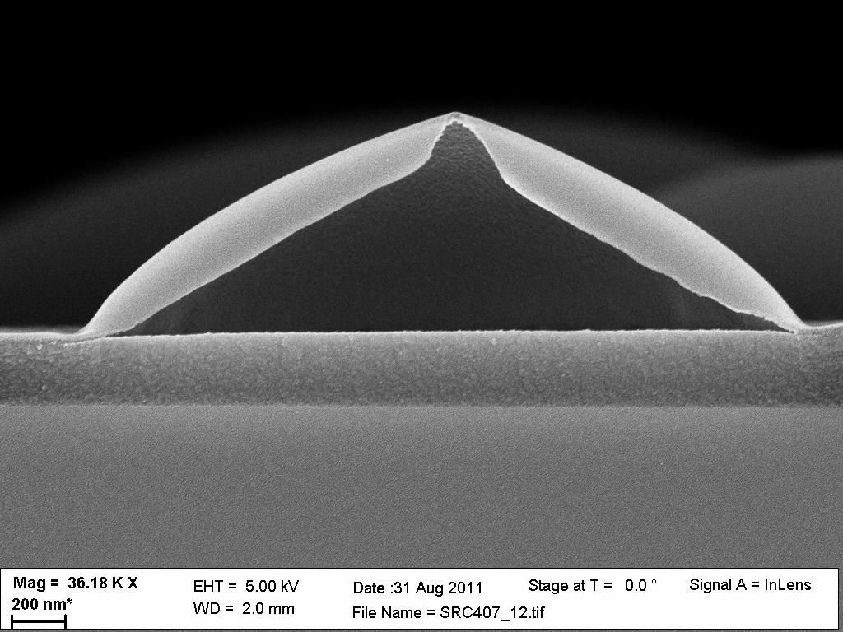
Blister Formation
2-step process:
Extended He PPT (VUV-induced scission of polymer to ~150 nm)
Ar plasma – ion induced formation of dense surface layer
SEM shows that the blisters are hollow and the delaminated layer is the ion crust
The underlying mechanism leading to blisters is buckle delamination
Cross-section SEM:

Slide 15
Formation of ~ 1nm Thick Carbon Films
Surface under the blister appears to be completely smooth
Notes:
Breaking down inherent synergies
of plasma processes,
can unlock new possibilities.

Slide 16
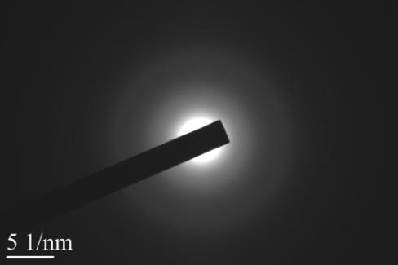
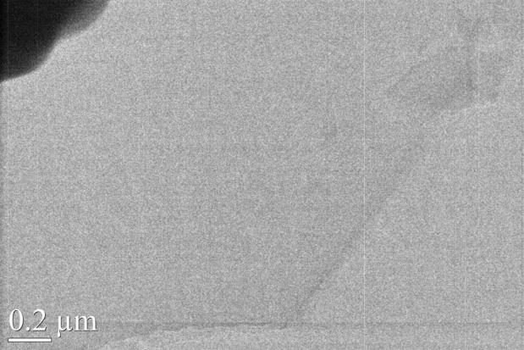
TEM Analysis
Diffraction patterns characteristic of amorphous C with weak rings.
Image from a very thin layer
Image showing several layers

Slide 17
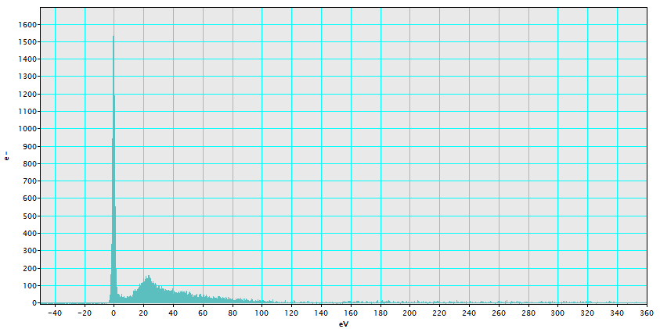
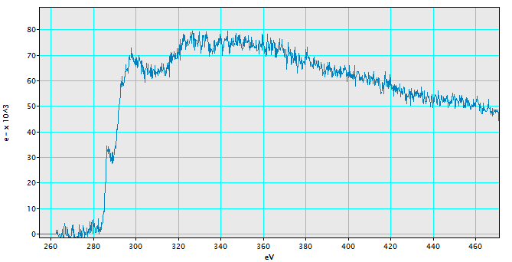
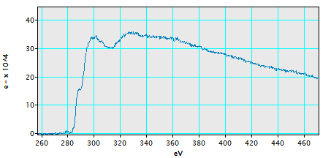
Electron Energy Loss Spectra
Low energy Loss spectrum
C-plasma energy
C-K edge area 1
C-K edge area 2
Pre-peak at 284 eV in C-K edge spectra characteristic of C with sp2 bonding

Slide 18
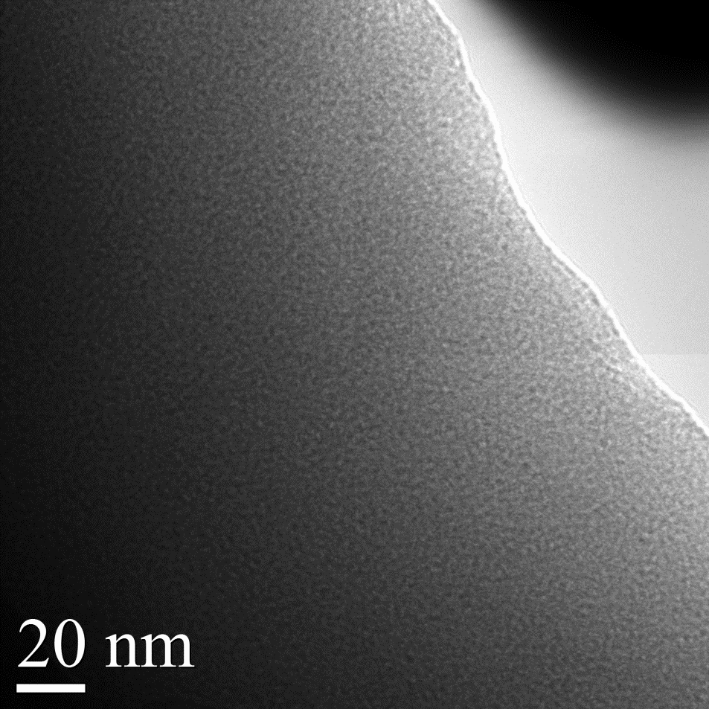
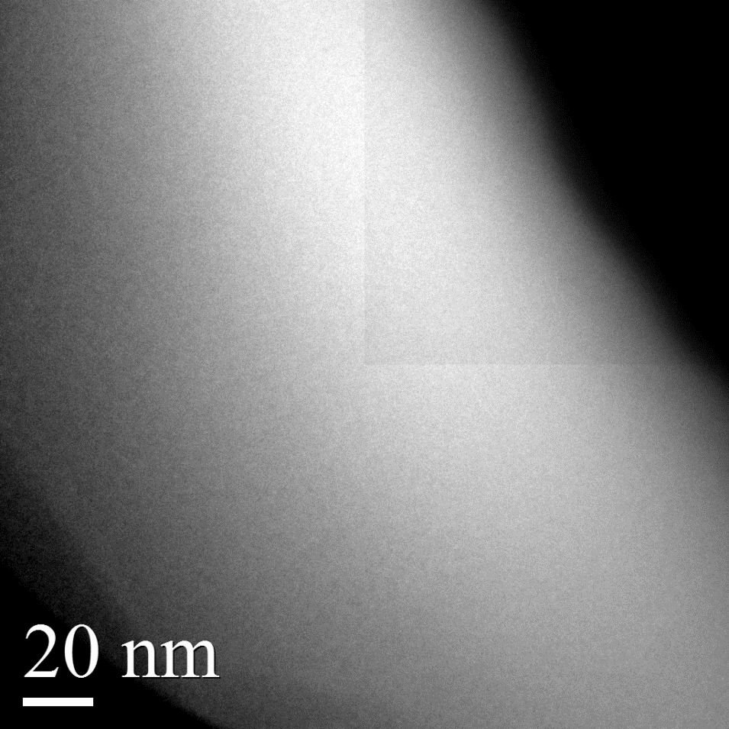
Energy Filtered TEM Images (EFTEM)
ZLP image
C-K edge map
The C-K edge map shows the regions of the ZLP image with high C content, uniform in this image

Slide 19
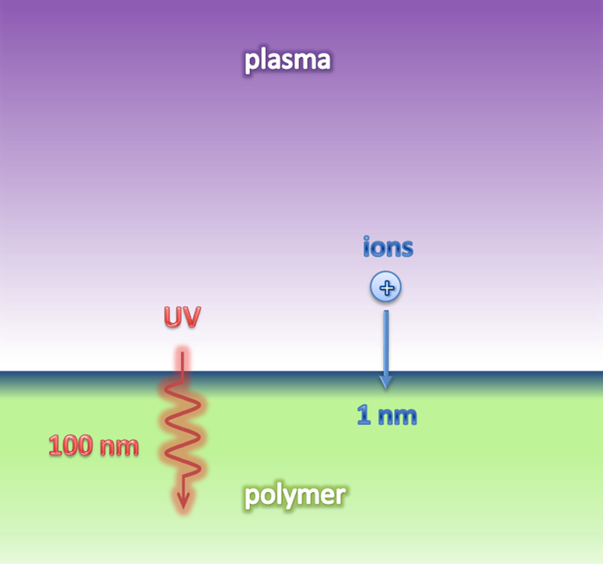
Mechanistic Considerations
PPT provides large photon flux that causes scission deep in specific polymer materials
Products can escape close to the surface (substrate at 10 C here)
At large depths, scission products are produced for long PPT times that cannot escape
During the 2nd ion dominated plasma process step they are trapped by the ion crust layer and can produce buckling instability
Conventional plasma process provides a too small UV/ion flux ratio to observe this phenomenon

Slide 20
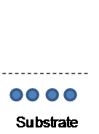
Atomic Layer Etching
Ar
+
+
+
Adsorbed Layer
Substrate
Substrate
Surface modification step (adsorption, short deposition, etc)
Low energy Ar ion bombardment for selective removal of reacted region
Overall etch depth is controlled by number of ALE cycles
Self-limitation requires:
Insignificant physical sputtering
Negligible spontaneous chemical etching

Slide 21
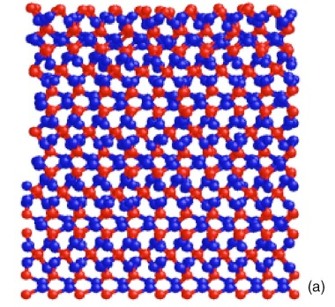
A Molecular Dynamics Investigation of Fluorocarbon Based Layer-by-Layer Etching of Silicon and SiO₂
Crystalline SiO₂
Notes:
Mixed and damaged layer after bombardment
Subsequently bombarded with 20 to 50 eV Ar+ ions

Slide 22
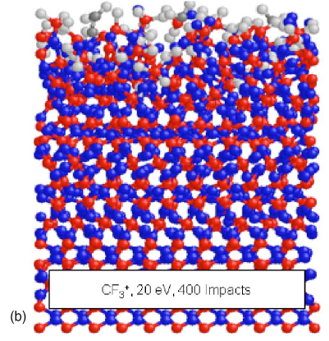
A Molecular Dynamics Investigation of Fluorocarbon Based Layer-by-Layer Etching of Silicon and SiO₂
≈ 5 Å
Crystalline SiO₂
SiO₂ sample after CF3⁺ ion bombardment
Notes:
Mixed and damaged layer after bombardment
Subsequently bombarded with 20 to 50 eV Ar+ ions

Slide 23
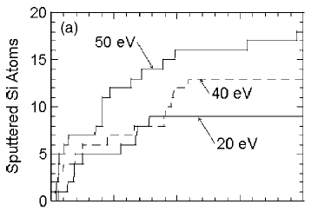
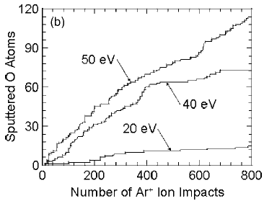
A Molecular Dynamics Investigation of Fluorocarbon Based Layer-by-Layer Etching of Silicon and SiO₂
For low ion energies:
Self-limited Si removal
For 50 eV:
Sputter rates decrease

Slide 24
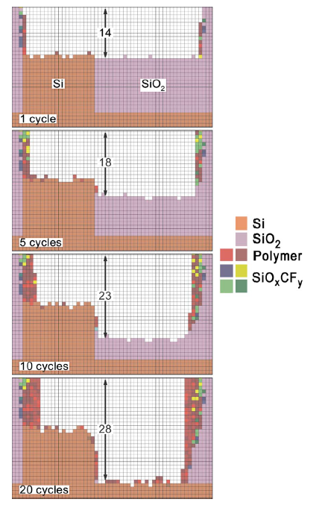
Etch profiles for Ar/c-C4F8 and Ar ALE etching of a SiO2-over-Si self-aligned contact.
The etch begins with 20 ML of Si aligned with 20 ML of SiO2. A highly selective etch of the contact is achieved in 20 cycles of ALE.

Slide 25
Process Description
Continuous inductively coupled plasma (Ar), periodic precursor injection, bias
A full cycle consists of:
Deposition Step ➔Short precursor pulse
Etch Step ➔Removal of modified surface layer
In-situ ellipsometry allows real-time monitoring of thickness changes
1.5 s
C₄F₈
Bias Power
10 V
35 s
10 s
Ar
10 mTorr pressure, 50 sccm, 200 W source power
A
B
A
B
A
B

Slide 26
Controlled FC Deposition
Controlled deposition of fluorocarbon films on the order of Ångstrom by varying precursor flow and/or pulse time

Slide 27
Time-Dependent Etch Rates
1.5 s C₄F₈ Pulse
10 s No Bias
35 s Bias
Stepwise etching at Angstrom level of SiO₂
Notes:
Sequential approach
Low energy Ar ion bombardment
Control over total etch thickness

Slide 28
Time-Dependent Etch Rates
1.5 s C₄F₈ Pulse
FC Etching
1.1 Å/s
10 s No Bias
0.6 Å/s
35 s Bias
SiO₂ Etching
FC Etching
1.3 Å/s
SiO₂ Etching
0.3 Å/s
0.7 Å/s
0.2 Å/s
3 s C₄F₈ Pulse
t_{f}
(a)
t₀
(b)
Strong impact of FC layer
Time dependent etch rates due to FC depletion
Notes:
Mixing of F into top layer
Unmodified material cannot be etched
Residual FC etch
ER expected to cease for thick film if bias time is extended
esidua

Slide 29
Time-Dependent Etch Rates
1.5 s C₄F₈ Pulse
FC Etching
1.1 Å/s
10 s No Bias
0.6 Å/s
35 s Bias
SiO₂ Etching
FC Etching
1.3 Å/s
SiO₂ Etching
0.3 Å/s
0.7 Å/s
0.2 Å/s
3 s C₄F₈ Pulse
t_{f}
(a)
t₀
(b)
t₀
t_{f}
Strong impact of FC layer
Time dependent etch rates due to FC depletion
Notes:
Bias step too short
ER expected to cease for thick film if bias time is extended
esidua

Slide 30
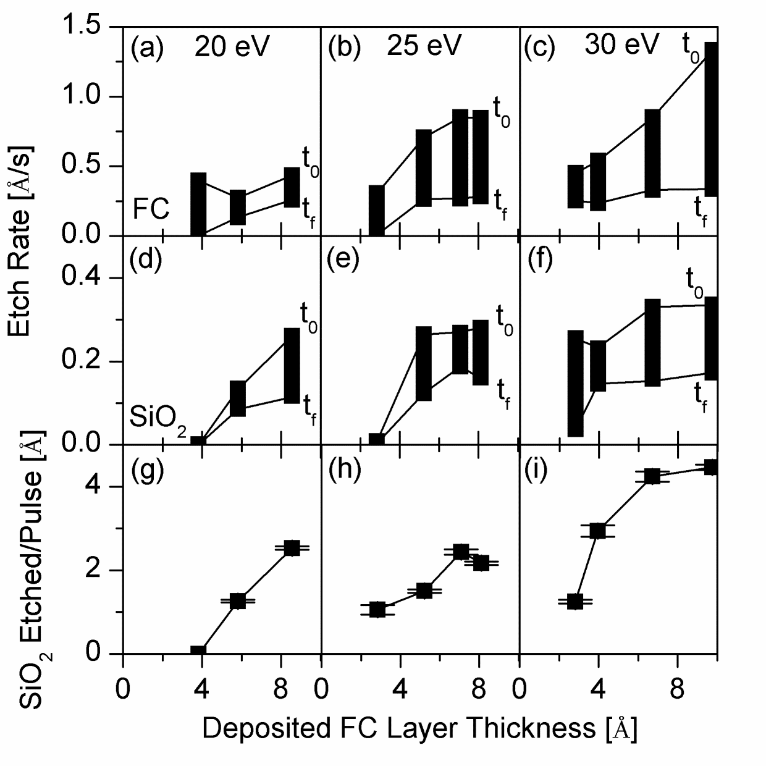
FC And Ion Energy Impact
Etch rates depend on:
FC film thickness
Ion energy
➔Chemically enhanced etching
Saturation effect when reaching critical FC film thickness
➔No additional mixing into SiO₂
Notes:
Key point: Chem. Enhanced etch
Reactant starved and energy starved regime

Slide 31
Surface Chemistry
Mixing of F into SiO₂
Notes:
Removal of FC during etch for both films
F content similar for thin film, basically unchanged
Slight shift of Si2p and O1s towards higher BE
➔Mixing of F into SiO2

Slide 32
Plasma Properties During a Single Cycle
EEPFs show a small impact and fast recovery after short precursor pulses
Typical values during the etch step are:
Plasma Potential, V_{p}: 13.8 V
Electron Density, N_{e}: 6.3 x 10¹⁰ cm⁻³
Electron Temperature, T_{e}: 3.13 eV
I
II
III
1.5 s
C₄F₈
Bias Power
10 V
80 s
10 s
Ar
10 mTorr pressure, 50 sccm, 200 W source power
A
B
A
B
A
B

Slide 33
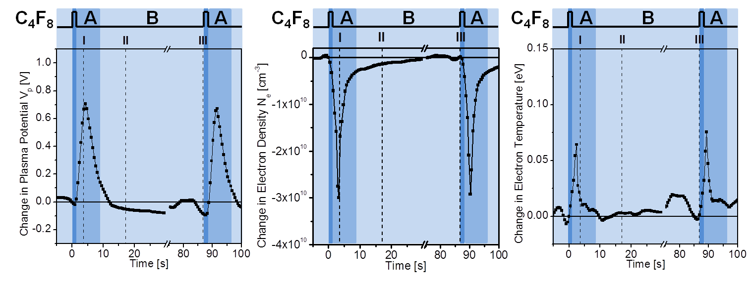
Plasma Properties During a Single Cycle
V_{p} and T_{e} spike during the pulse, while N_{e} drops
The change in T_{e} is very small
A recovery to initial values occurs within 20 s

Slide 34
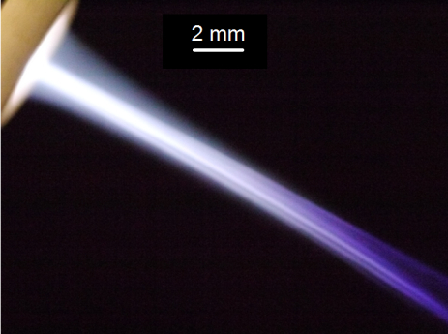
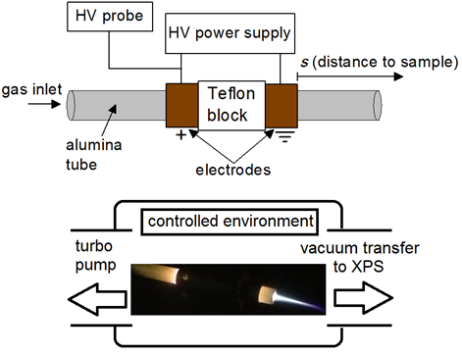
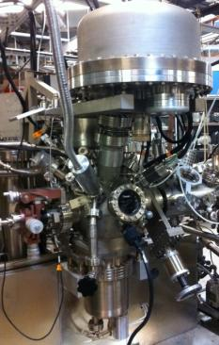
Atmospheric Pressure Plasma Effects On Model Polymers and Pyrogenic Molecules
Atmospheric Pressure Plasma Jet (APPJ): Ar carrier gas
Up to 1% O₂/N₂ admixtures
kHz-driven at 4-8 kV
Questions:
What species are created in the APPJ?
What is the role of plasma-environment interactions in modifying surfaces?
How does gas chemistry impact biological activity of harmful biomolecules?
How do model polymers respond?
Notes:
34

Slide 35
Real-time Surface Modifications By Atmospheric Pressure Plasma
Plasma characterization:
Electrical characterization: current and voltage waveforms and power dissipation
High speed photography: discharge characteristics
Materials characterization:
Ellipsometry: surface modification and optical properties in real-time
XPS: surface composition and bonding
Operating parameters:
Remote treatment: S = 15.8 cm, 8 mm gap between tube and sample
Coupled treatment: S = varied, 4 mm gap distance
feed gas
HV
power supply
variable
source
position
C_{m}
S (distance
to sample)
ambient
or controlled
environment
ellipsometer
shield
sample
Notes:
35

Slide 36
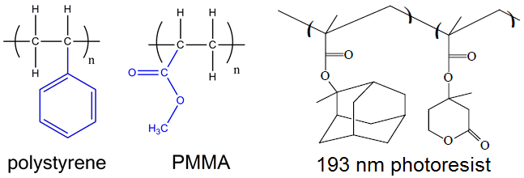
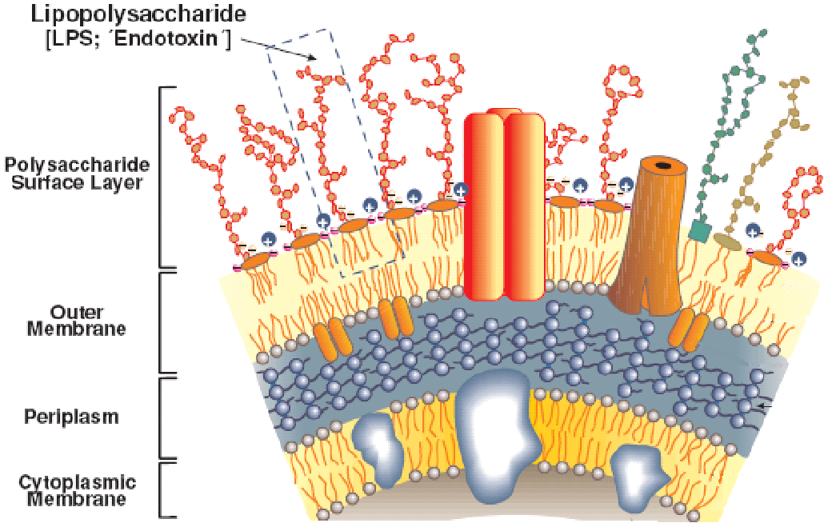
Model Polymers and Lipopolysaccharide
Model polymers were studied to simplify the complex structure of biomolecules and to isolate specific functional groups
Lipopolysaccharide (LPS) is a pyrogen found in Gram-negative bacterial membranes
Enzyme-linked Immunosorbent Assay (ELISA) – biological activity
Adapted from B. Beutler and E.T Rietschel, Nat. Rev. Immunol., 3, 169 (2003)
Notes:
36

Slide 37
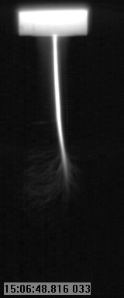
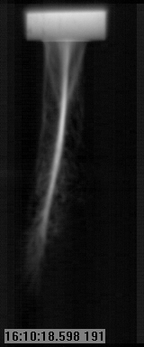
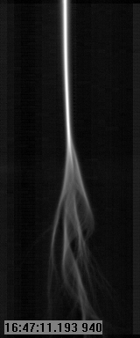
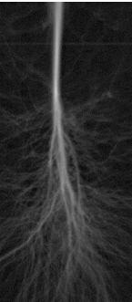
High Speed Photography Of APPJ Plume In Controlled Environments
High speed photography of the APPJ was conducted in open air (top row) and a controlled environment matching the feed gas chemistry (bottom row).
Ar plume is generally confined to single filament which extends farther in a controlled environment.
1% N₂ in Ar shows a more diffuse plasma than Ar that spreads out similar to a Lichtenberg figure in a controlled environment.
1% O₂ in Ar shows greatly reduced plasma density regardless of environment, which is due to the formation of negative ions when O₂ is ionized.
5 mm
5 mm
Ar
1% N₂ in Ar
1% O₂ in Ar
Notes:
37

Slide 38
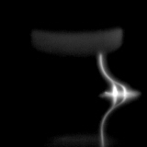
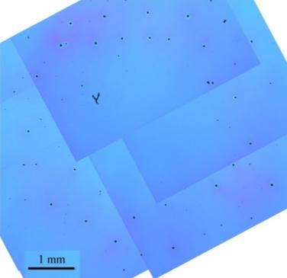
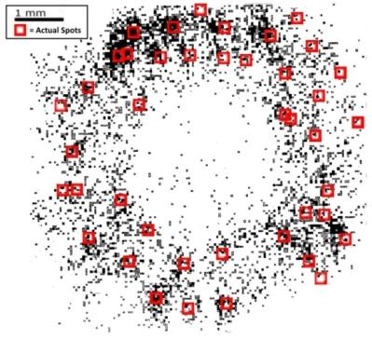
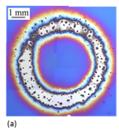
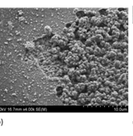
Electrically Coupled Interaction Mode with Surfaces
When brought close to the sample, APPJ discharge can couple to the sample, causing visible damage
Arcs to surface cause damaged spots, which can be correlated with the position of arc strikes to the surface using high speed photography.
Scanning electron microscopy of one of these spots highlights the damage caused by the electrical arcing, showing multiple deep trenches within the spot.
Notes:
38

Slide 39
Remote Interaction Mode with Surfaces:
Feed Gas Chemistry Effects - Ellipsometry
APP/surface interactions by remote plasma (no electrical coupling) are impacted by feed gas chemistry & tube temp.
N₂/Ar etch rates increase compared to Ar due to increased coupling of plasma down the tube.
Etch rates for O₂/Ar are reduced due to decreased plasma density despite stronger surface modifications by O₂/Ar measured by XPS.
Ar etching increases however from adding air to a controlled argon environment.
Notes:
39

Slide 40
Remote Interaction Mode with Surfaces:
Feed Gas Chemistry Effects – XPS
Strongest surface modifications seen for O₂/Ar as measured by XPS, whereas etching rates are the lowest
Notes:
40

Slide 41
Deactivation By Argon APPJ With Small O₂/N₂ Admixtures
Biodeactivation strongly correlates with oxygen content in the plasma.
N₂/Ar plasma without O₂ minimally deactivates.
Keeping the O₂ admixture constant, low N₂ admixtures decrease biodeactivation.
Thinner films are deactivated more efficiently

Slide 42
APPJ Characterization: Optical Emission Spectroscopy And UV Absorption
O and O₃ Destruction by Nitrogen Species
O + NO₂ → NO + O₂
O + NO₃ → NO₂ + O₂
N + O₃ → NO + O₂
NO + O₃ → NO₂ + O₂
NO₂ + O₃ → NO₃ + O₂
Key reactive species created are atomic O and excited N₂ (SPS).
O₂/N₂ ions not detected
O₃, NO₂, and long-lived species are not detected by OES
UV absorption spectroscopy was used to measure ozone concentrations as high as 10¹⁵ cm⁻³
Small admixtures of N₂ effectively reduce O₃ levels by 2-3 orders of magnitude

Slide 43
APPJ Treatment In Controlled Environments: Approach
Case 1: Exposed geometry
Plume extends into the environment. Source is 2 mm from nozzle.
The plasma does not arc to or electrically contact the sample.
Case 2: Confined geometry
Plume is confined in the alumina tube, minimizing plasma-environment interactions. Source is 9 cm from nozzle.
For both geometries, the nozzle-sample distance is 4 cm.
20%, 60%, and 100% N₂ in Ar
controlled environment
Exposed geometry
Confined geometry

Slide 44
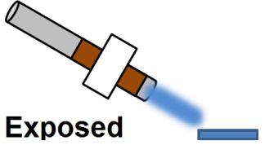
APPJ Treatment In Controlled Environment: Surface Analysis
When the plume is exposed to the environment, decreasing ambient N₂ concentrations increase surface modifications
Loss of C-C bonding, NO₃ formation, and oxygen uptake.
Plasma-environment interactions control the flux of reactive oxygen species (ROS) to the surface.

Slide 45
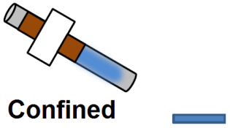
APPJ Treatment In Controlled Environment: Surface Analysis
When the plume is confined, the plasma itself is farther from the sample than in the exposed condition.
Consistent with previously reported work, for identical environments and feed gas, the surface modifications are stronger than the exposed geometry.
By minimizing plasma-environment interactions, ambient N₂ is minimally excited and cannot quench ROS as effectively.

Slide 46
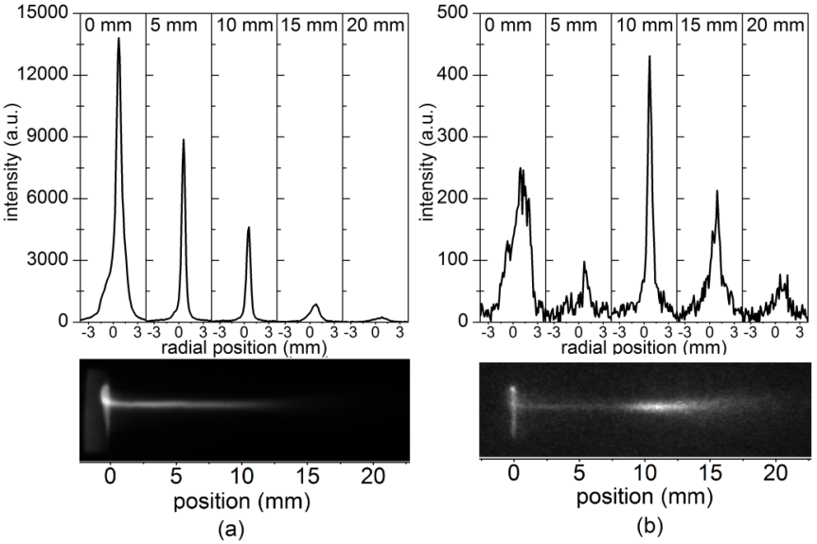
Optical Emission By Argon APPJ Interacting With Air
Spatially-resolved optical emission of the Ar APPJ shows emission extending as far as 20 mm from the nozzle in a narrow plume.
Isolating N₂* emission (second positive system) demonstrates clear formation downstream due to the plasma interacting with the environment.

Slide 47
APPJ Treatment Of Model Polymers: Surface Analysis
NO₃ and oxygen uptake occur on a variety of films independent of film chemistry.
PR193, PR248, and PMMA do not contain nitrogen
PS contains neither nitrogen nor oxygen
NO₃ formation is not due reaction with O₃ but occurs due to
ROS species interacting with ambient N₂
RNS species interacting with ambient O₂

Slide 48
Conclusions
Low pressure:
Understanding/controlling inherent synergies in plasma-surface interactions leads to unexpected phenomena, including novel paths of forming new 2-D materials
Designed pulsed plasma process sequences can enable atomic level etching/surface modifications of materials, e.g. SiO₂
Atmospheric pressure:
Plasma plume interactions with the environment can play a key role in plasma-surface interactions at atmospheric pressure and their control is a prerequisite for management of surface chemical modifications of materials
Notes:
48

Slide 50
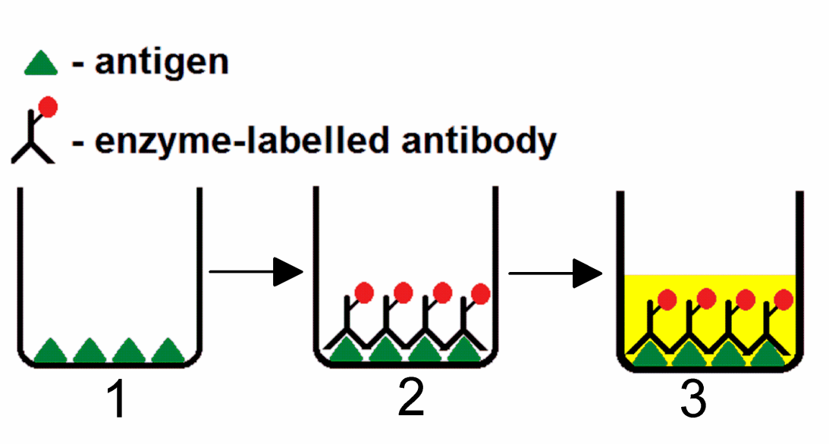
Enzyme-linked Immunosorbent Assay (ELISA)
Optical density directly relates to presence of antigen
Notes:
this assay measures the interaction between biotinylated-LPS and steptavidin to indirectly provide information on the chemical structural changes of LPS.
optical density at 450 nm

Slide 51
Electrical Characterization Of APPJ
Current vs applied voltage plots for various gas chemistries show multiple discrete current spikes per half cycle and differences between positive and negative applied voltage
O₂ addition to Ar in particular shows numerous, inconsistent current spikes
The Lissajous method shows that molecular gas addition to Ar and higher applied voltages increase the power dissipated between the electrodes
Notes:
51

