Slide 1
Solving (Stellar) Flows:
Methods, Software, and Results
Jeff Oishi (Bates/MIT)

Slide 2
Some motivating problems

Slide 3
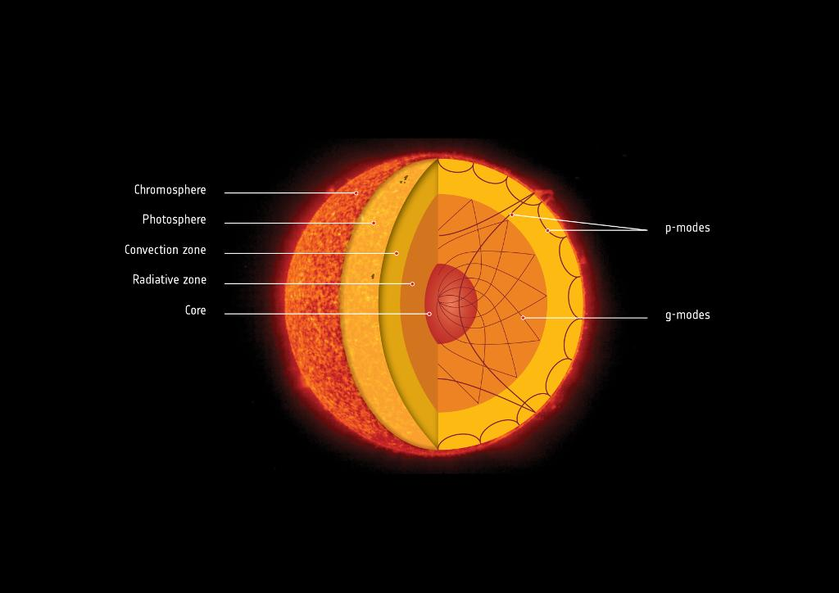
The Sun

Slide 4
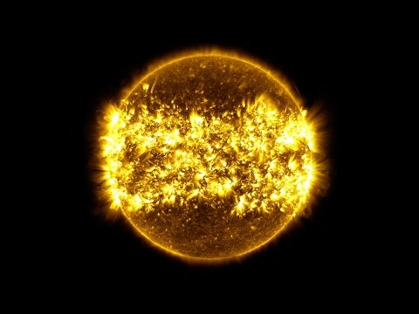
The Sun
NASA SDO

Slide 5
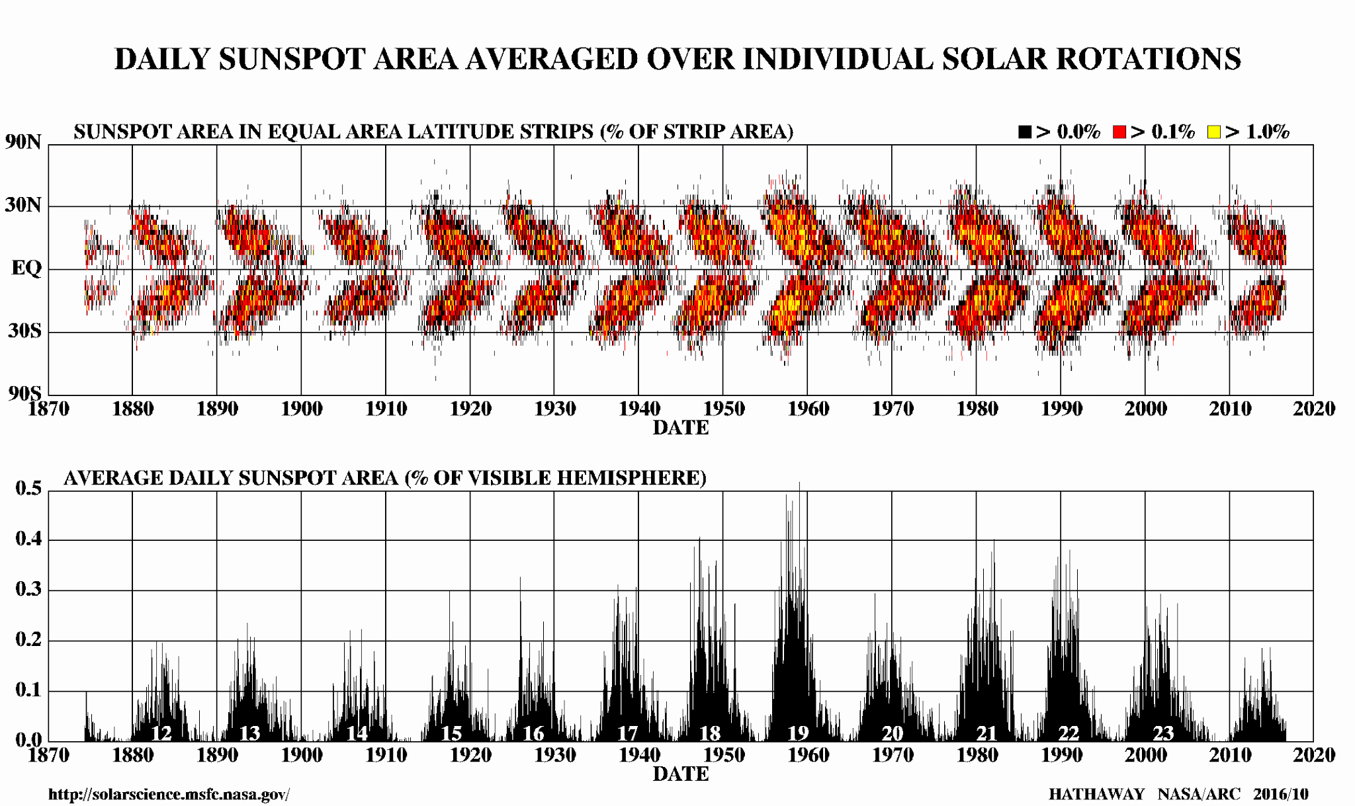
The Solar Cycle: 11 year pattern driven by Magnetic Field

Slide 6
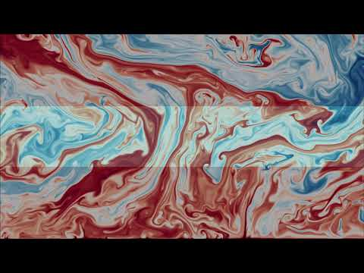
Convection

Slide 7
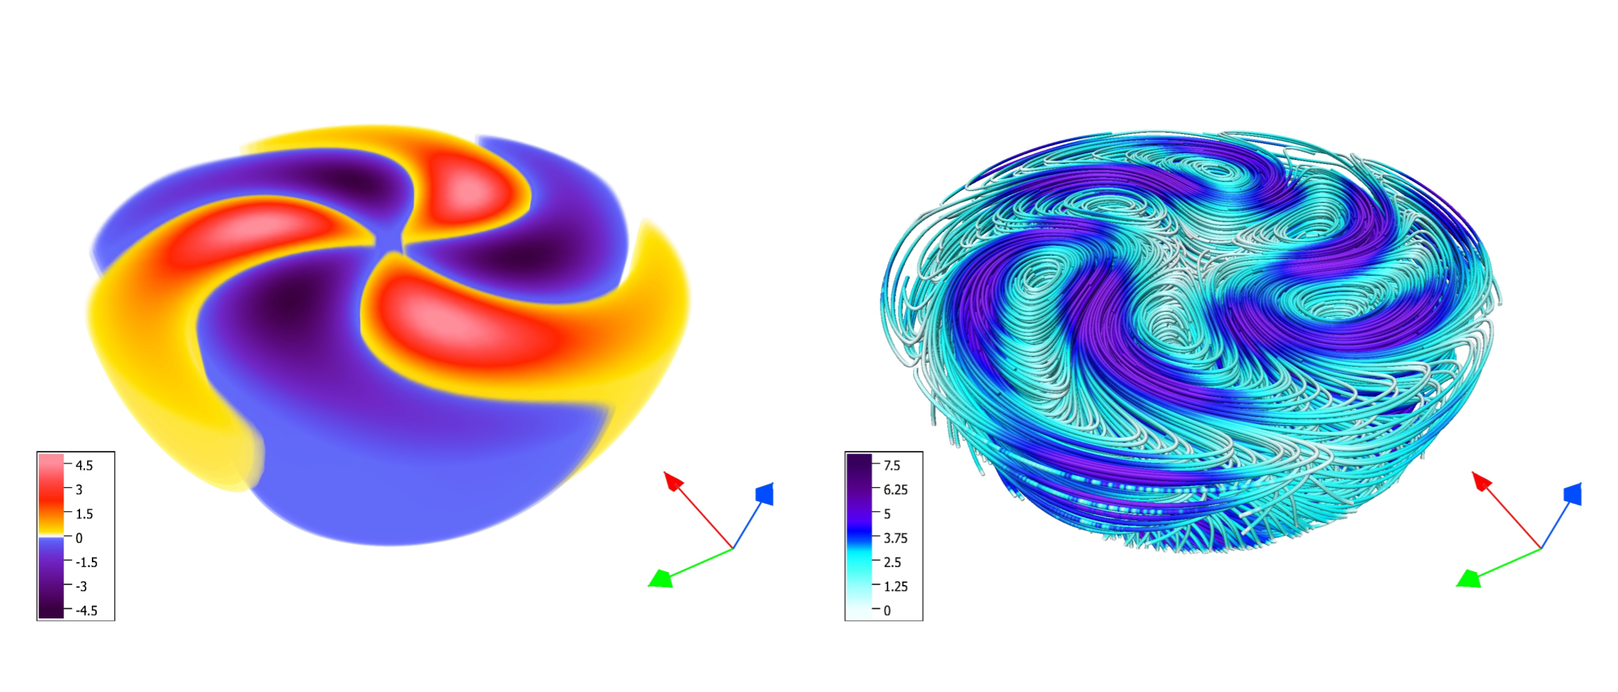
Stars (and planets) have Dynamically Generated Magnetic Fields
Radial velocity u_{r}
Magnetic Fields
(color indicates magnitude)

Slide 8
Stars (and planets) have Dynamically Generated Magnetic Fields
Radial velocity u_{r}
All the way to center!
Magnetic Fields
(color indicates magnitude)

Slide 9
Methods: The Dedalus Project

Slide 10
dedalus-project.org
Not an “MHD” code Arbitrary smooth PDE solution with spectral accuracy
Completely open source GPL licensed, developed on bitbucket, friendly community

Slide 11
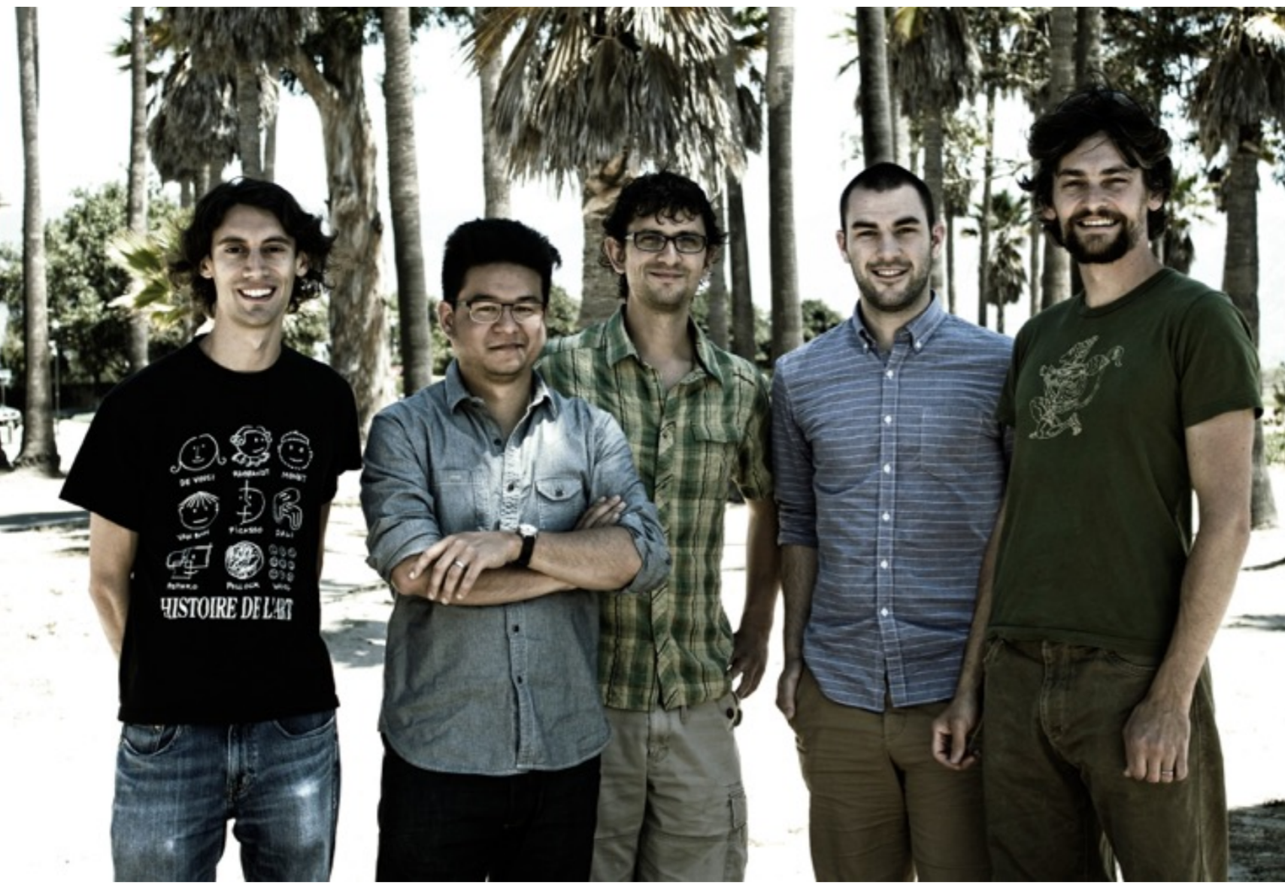
The Dedalus Project
Daniel Lecoanet
(Princeton)
Ben Brown
(Colorado)
Geoff Vasil (Sydney)
Keaton Burns (Flatiron)

Slide 12
Chebyshev Bases → Sparse Matrices
y
x

Slide 13
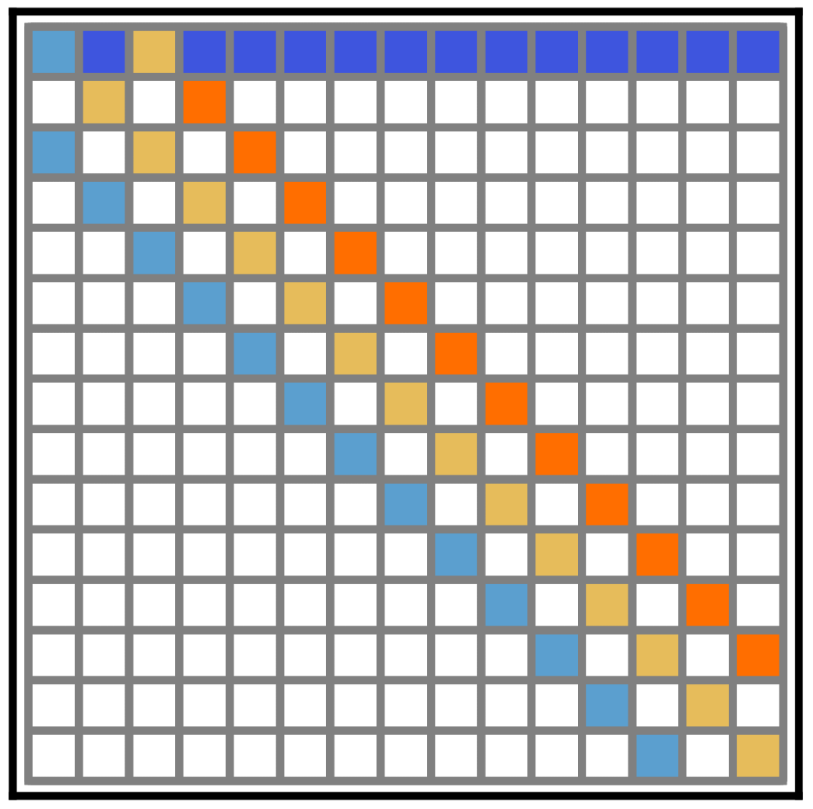
Chebyshev Bases → Sparse Matrices

Slide 14
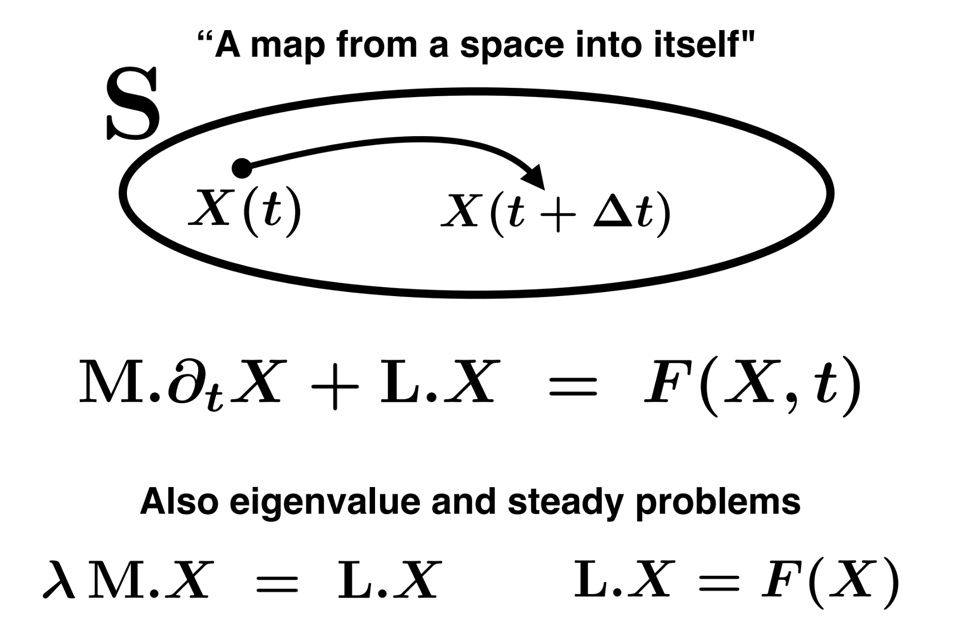
Dedalus Approach

Slide 15
Dedalus Approach
Sparse Matrices

Slide 16
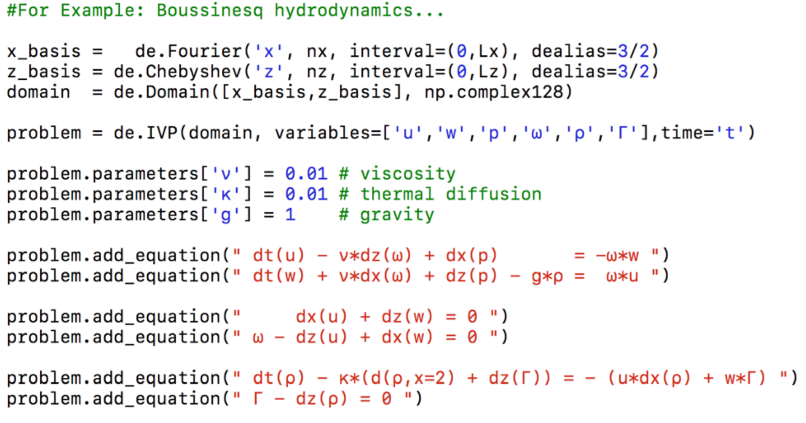
Equations entered as plain text

Slide 17
Stars transport angular momentum
Ω(r)
Ω₂
Ω₁

Slide 18
Stars transport angular momentum
Ω(r)
Ω₂
As Ω₁ decreases, Ω₂ increases → approaching solid body rotation
Ω₁

Slide 19
Stars transport angular momentum
Ω(r)
Ω₂
As Ω₁ decreases, Ω₂ increases → approaching solid body rotation
But how?
Ω₁

Slide 20
Magnetorotational instability
Ω(r)
B
Ω(r)∝r^{-m}

Slide 21
Magnetorotational instability
Ω(r)
B
Ω(r)∝r^{-m}

Slide 22
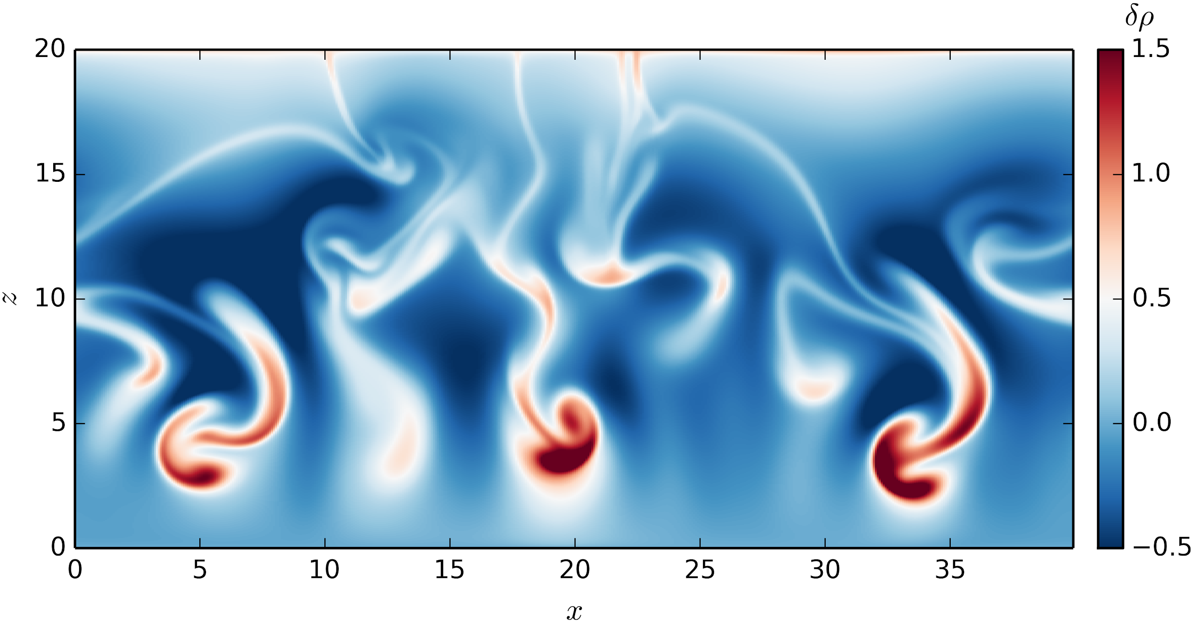
One angular momentum transport mechanism: local transport
By analogy with convection...
Cold, dense gas falls
Hot, rarefied gas rises
Simulation: D. Lecoanet

Slide 23
One accretion mechanism: local transport
By analogy with convection...
Cold, dense gas falls
Net effect: heat transfered upwards
Hot, rarefied gas rises
Simulation: D. Lecoanet
Local heat transport mediated by turbulence

Slide 24
So how does the MRI work?

Slide 25
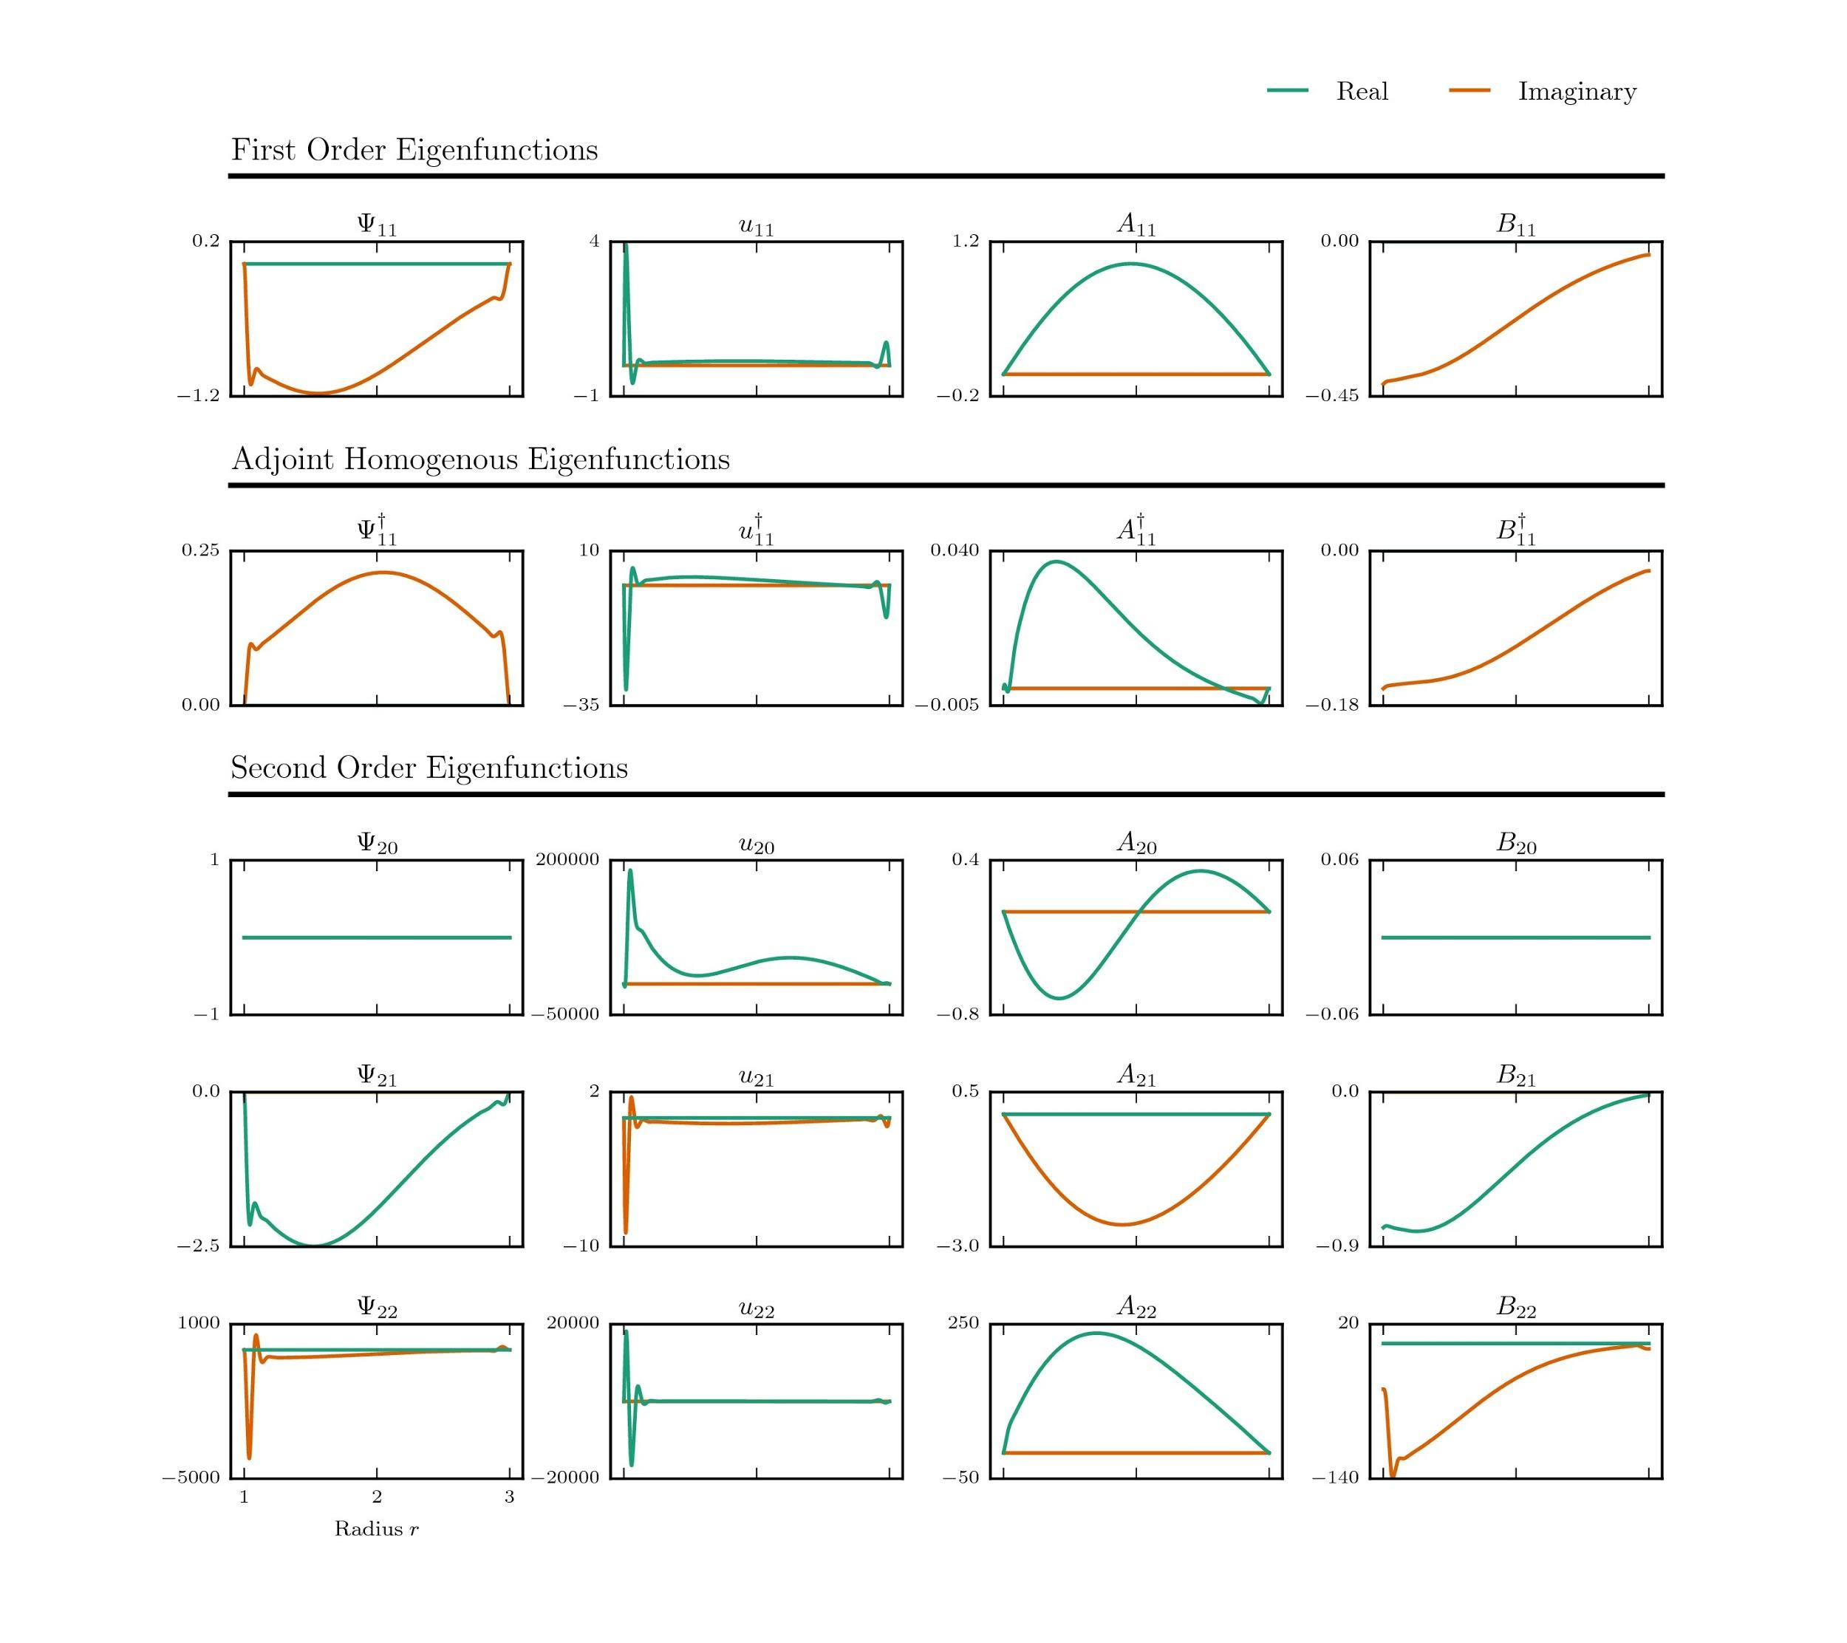
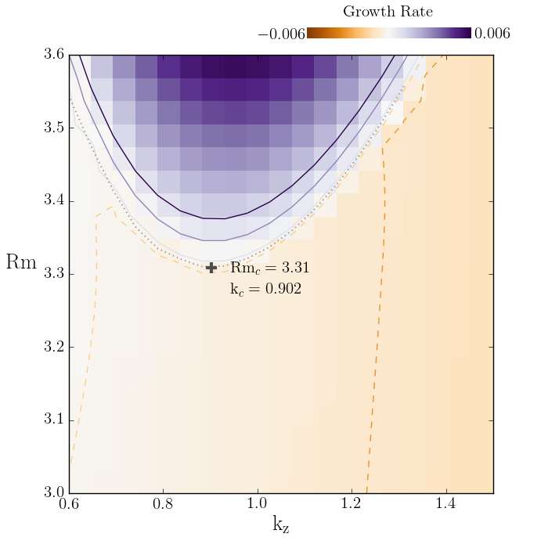
Traditional Investigation: Linear analysis
Provides eigenmodes and growth rates
Shortcoming: which pattern is selected? At what amplitude does it saturate?

Slide 26
Traditional Investigation: Numerical Simulation
Shortcoming: limited by computing power to unphysical parameters
Re = UL/ν ∼ 100-1000 (simulation)
Re ∼ 10¹² (disk)
Pm = Rm/Re = ν/η ∼ 10⁻⁸ - 0.1 (disks)
Oishi & Mac Low (2009)

Slide 27
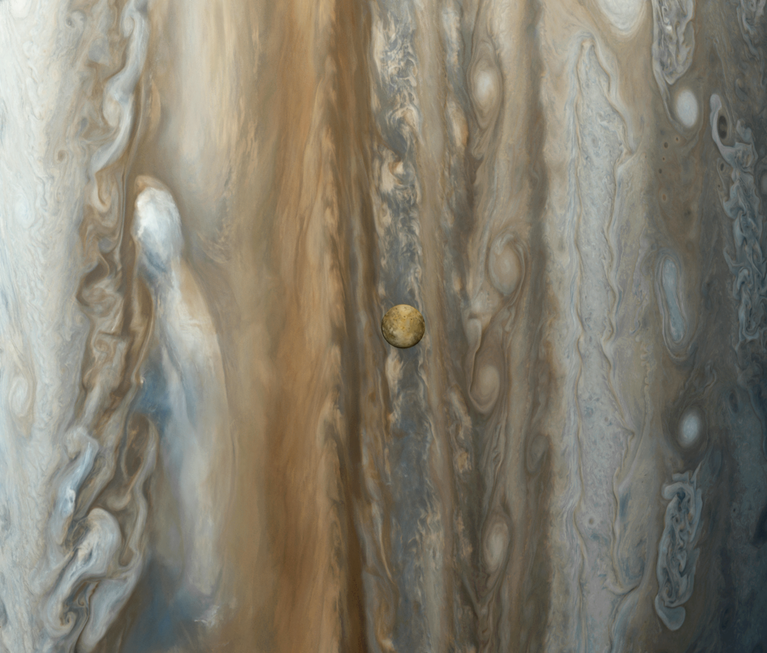
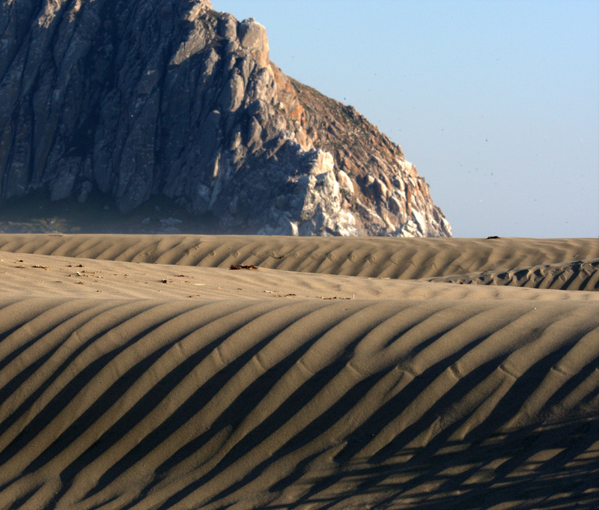
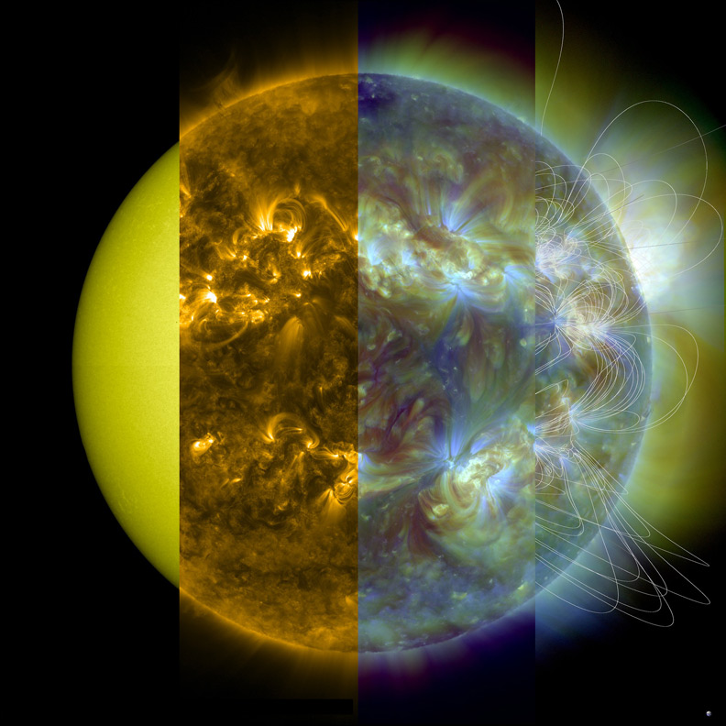
Pattern Formation Approach
Image: NASA
Image: M. Baird
Image: NASA

Slide 28
Pattern Formation
Goal: Derive an Amplitude equation to describe leading-order nonlinearities

Slide 29
Multiple Scales Analysis
Take state vector V to be of the form
Slow spatial scale
Fast spatial scale
Amplitude

Slide 30
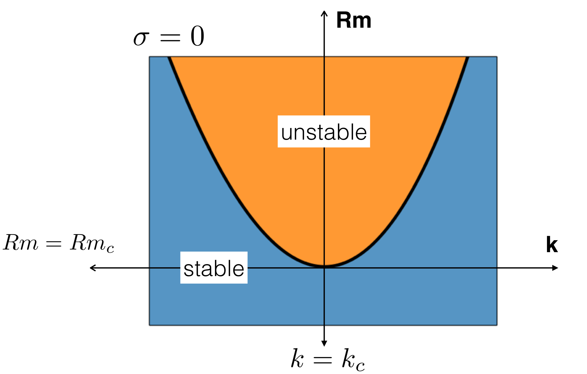
∝e^{σt}, σ = γ + iω
Stability diagram

Slide 31
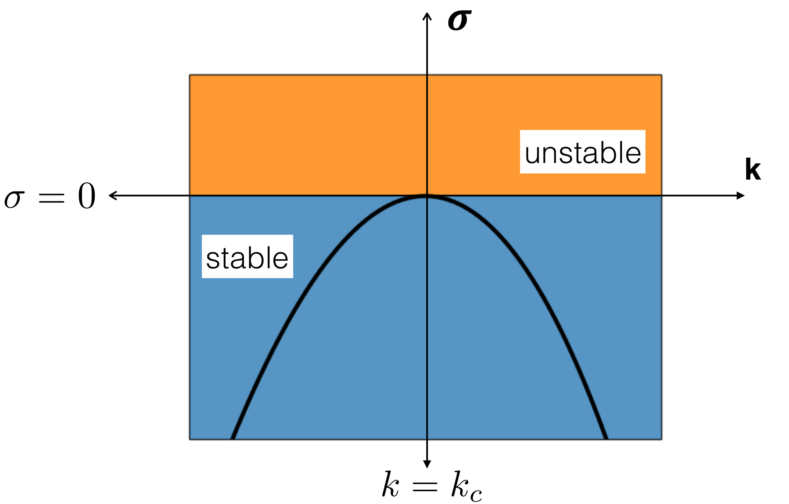
Pick a Rm, and then tune the system from stable...

Slide 32
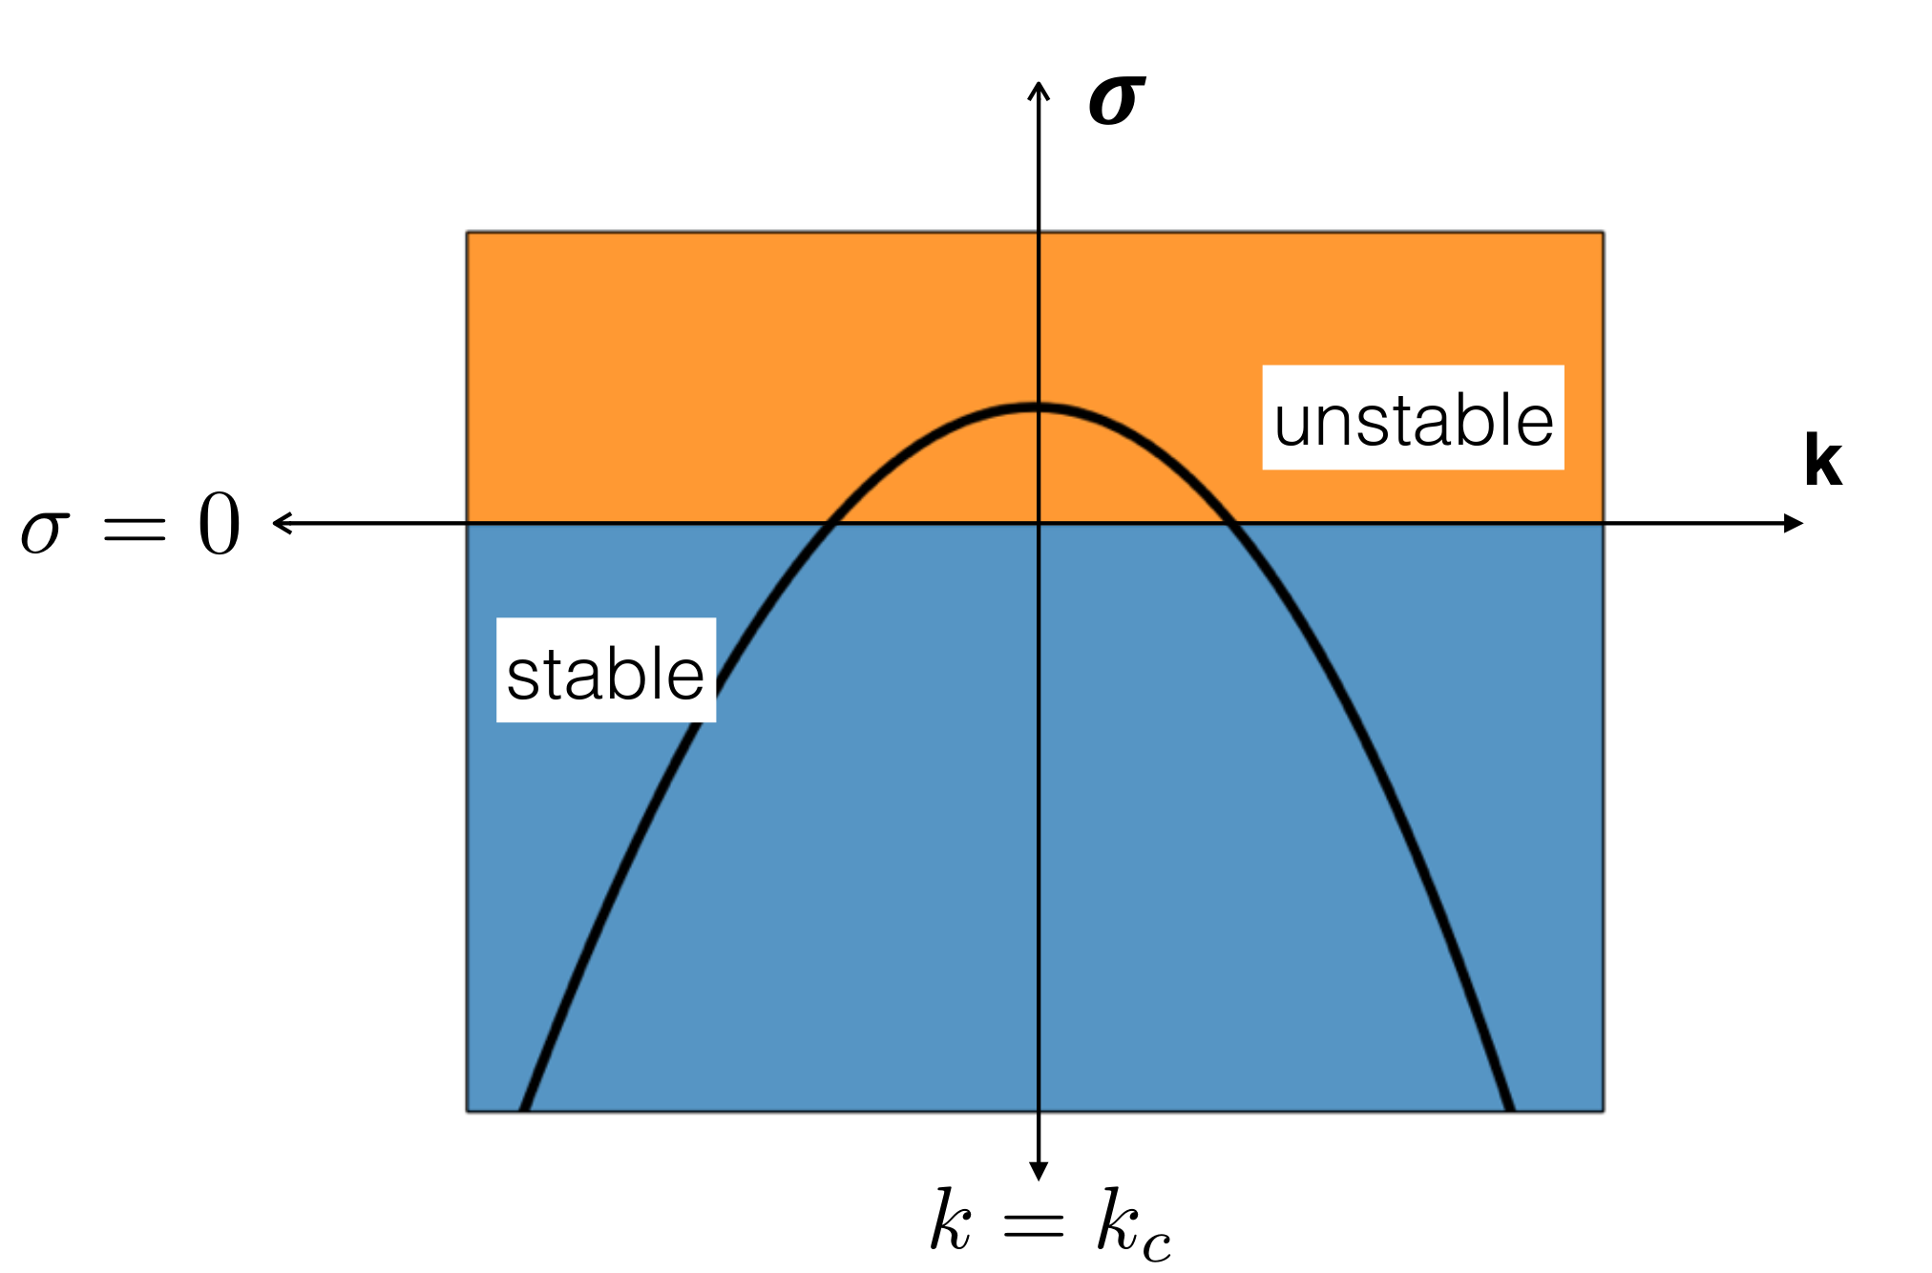
Pick a Rm, and then tune the system from stable...to unstable

Slide 33
O(ε) band of unstable modes
Not just a single wave!
Pick a Rm, and then tune the system from stable...to unstable

Slide 34
Calculate nonlinear interaction of all modes in band
O(ε) band of unstable modes
Not just a single wave!
Pick a Rm, and then tune the system from stable...to unstable

Slide 35
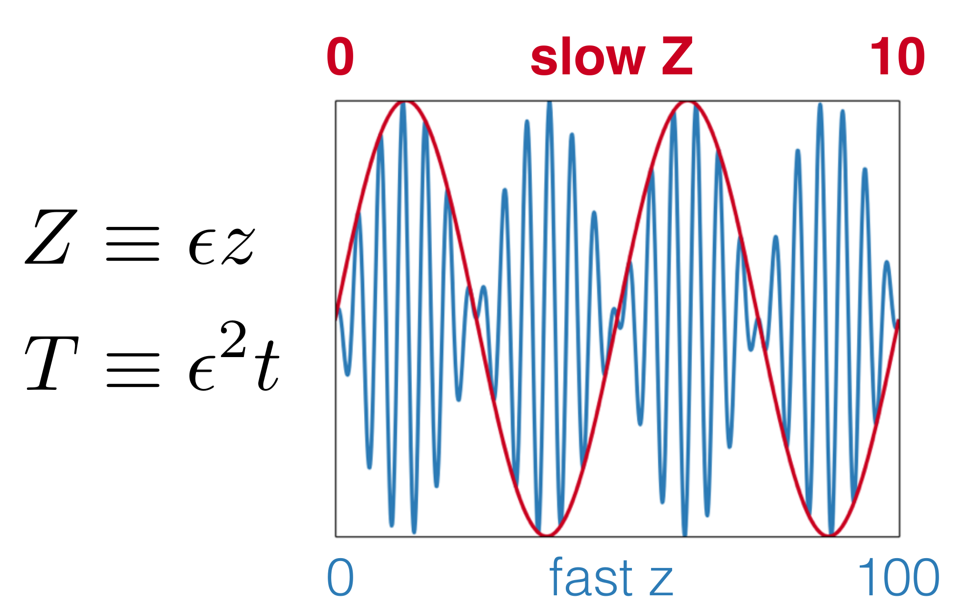
Multiple scales

Slide 36
Multiple scales

Slide 37
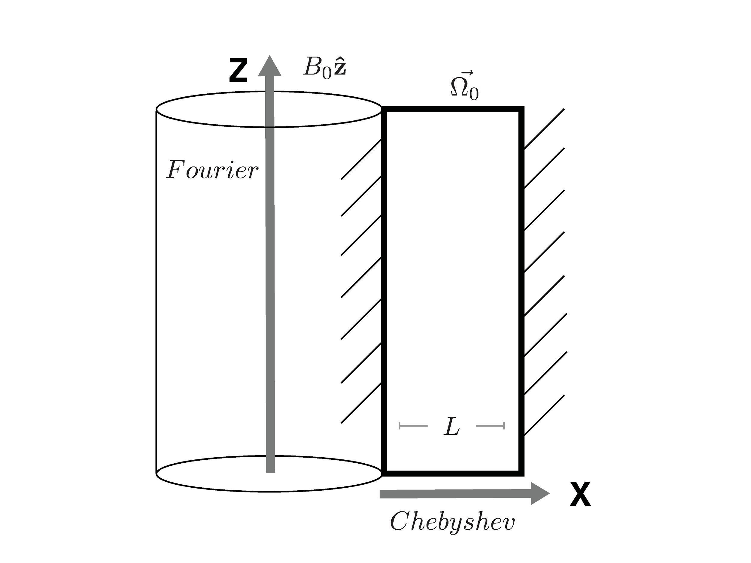
L/R << 1→R_{i} ~ R_{o}
Narrow Gap Geometry

Slide 38
L/R << 1→R_{i} ~ R_{o}
Formally identical to shearing box, except with walls
Narrow Gap Geometry

Slide 39
L/R_{i} > 1
Retains curvature terms
But must be quasi-Keplerian
R
Wide Gap Geometry

Slide 40
Equations: Streamfunction & Vector Potential form

Slide 41
Equations: Streamfunction & Vector Potential form
Viscous dissipation
Non-linear
Shear
Resistive dissipation

Slide 42
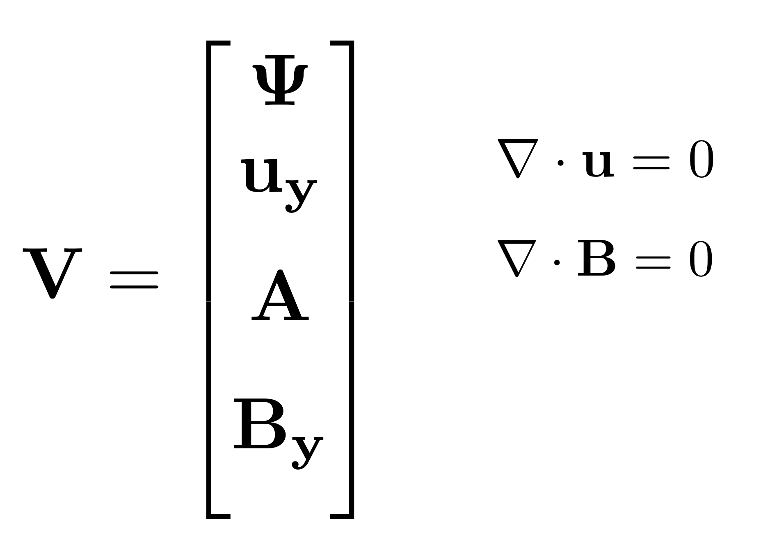
Expand Solution Vector in perturbation series

Slide 43
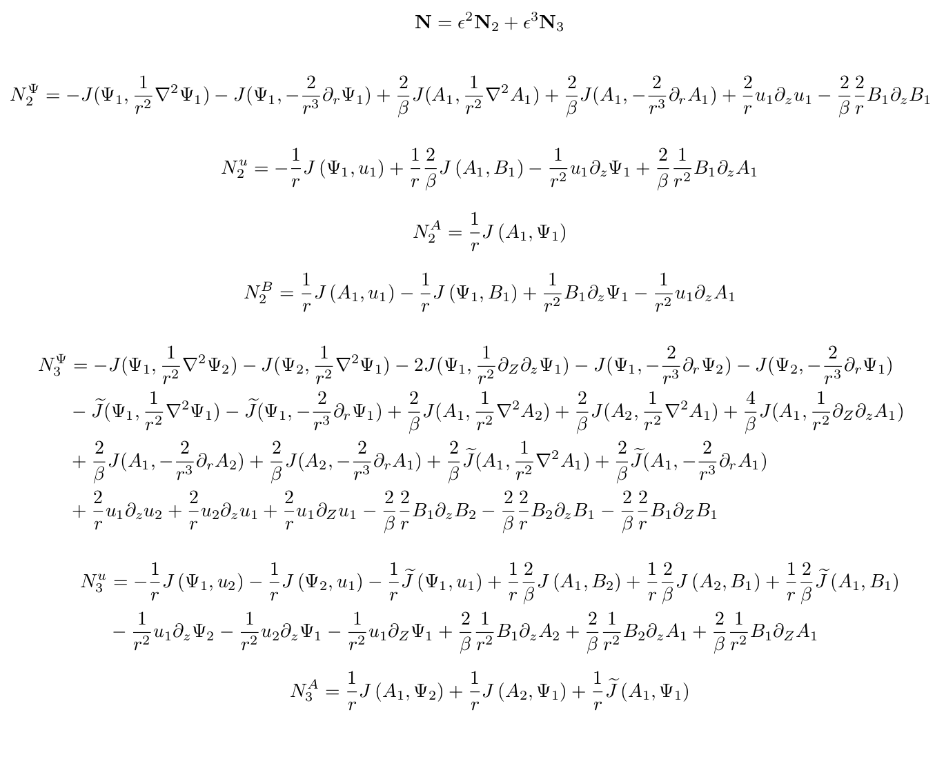
Do a bit of math...

Slide 44
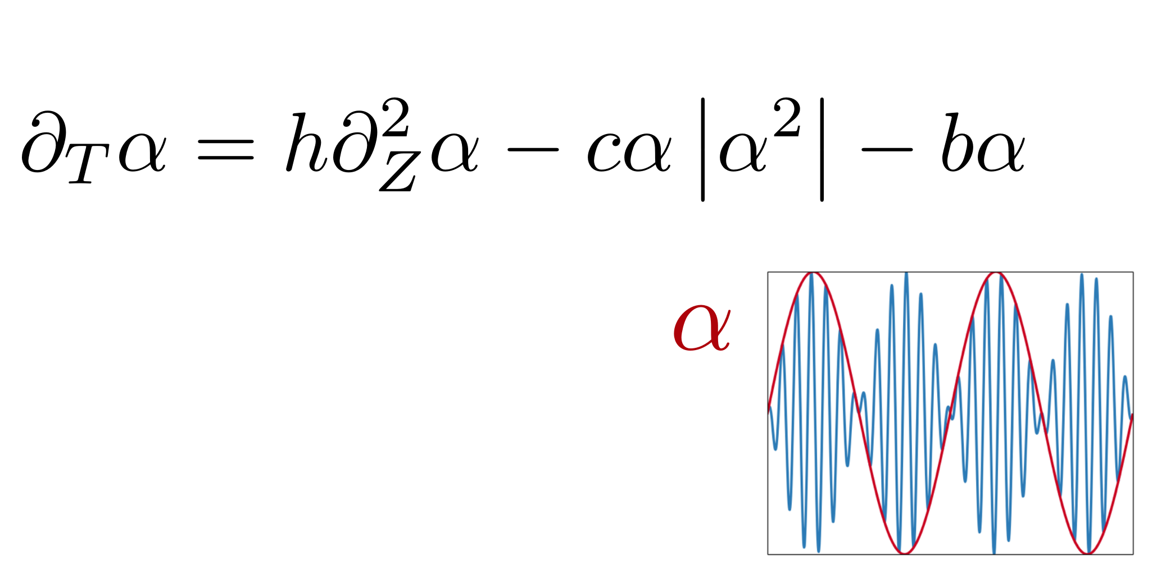
...and derive Amplitude equation
This is the famous Ginzburg-Landau equation!
Multiple scales gives us h, c, b coefficients.

Slide 45
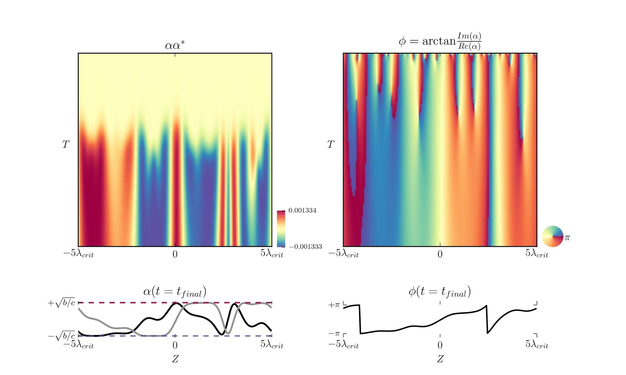
time
Plug GL into Dedalus...MRI is Eckhaus unstable!

Slide 46
Saturation Mechanism

Slide 47
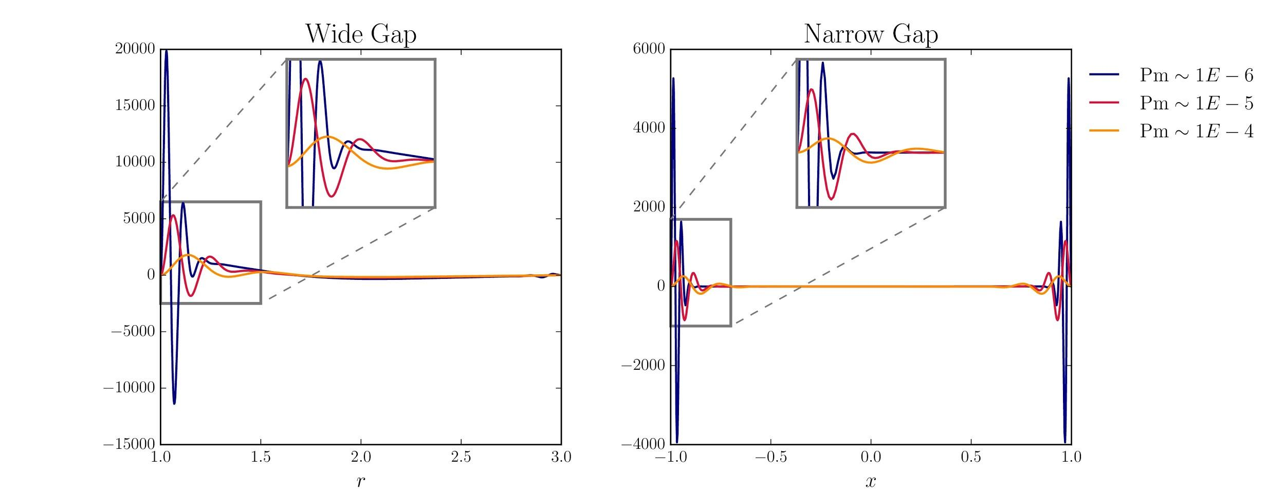
Leading-order Nonlinear term is very similar

Slide 48
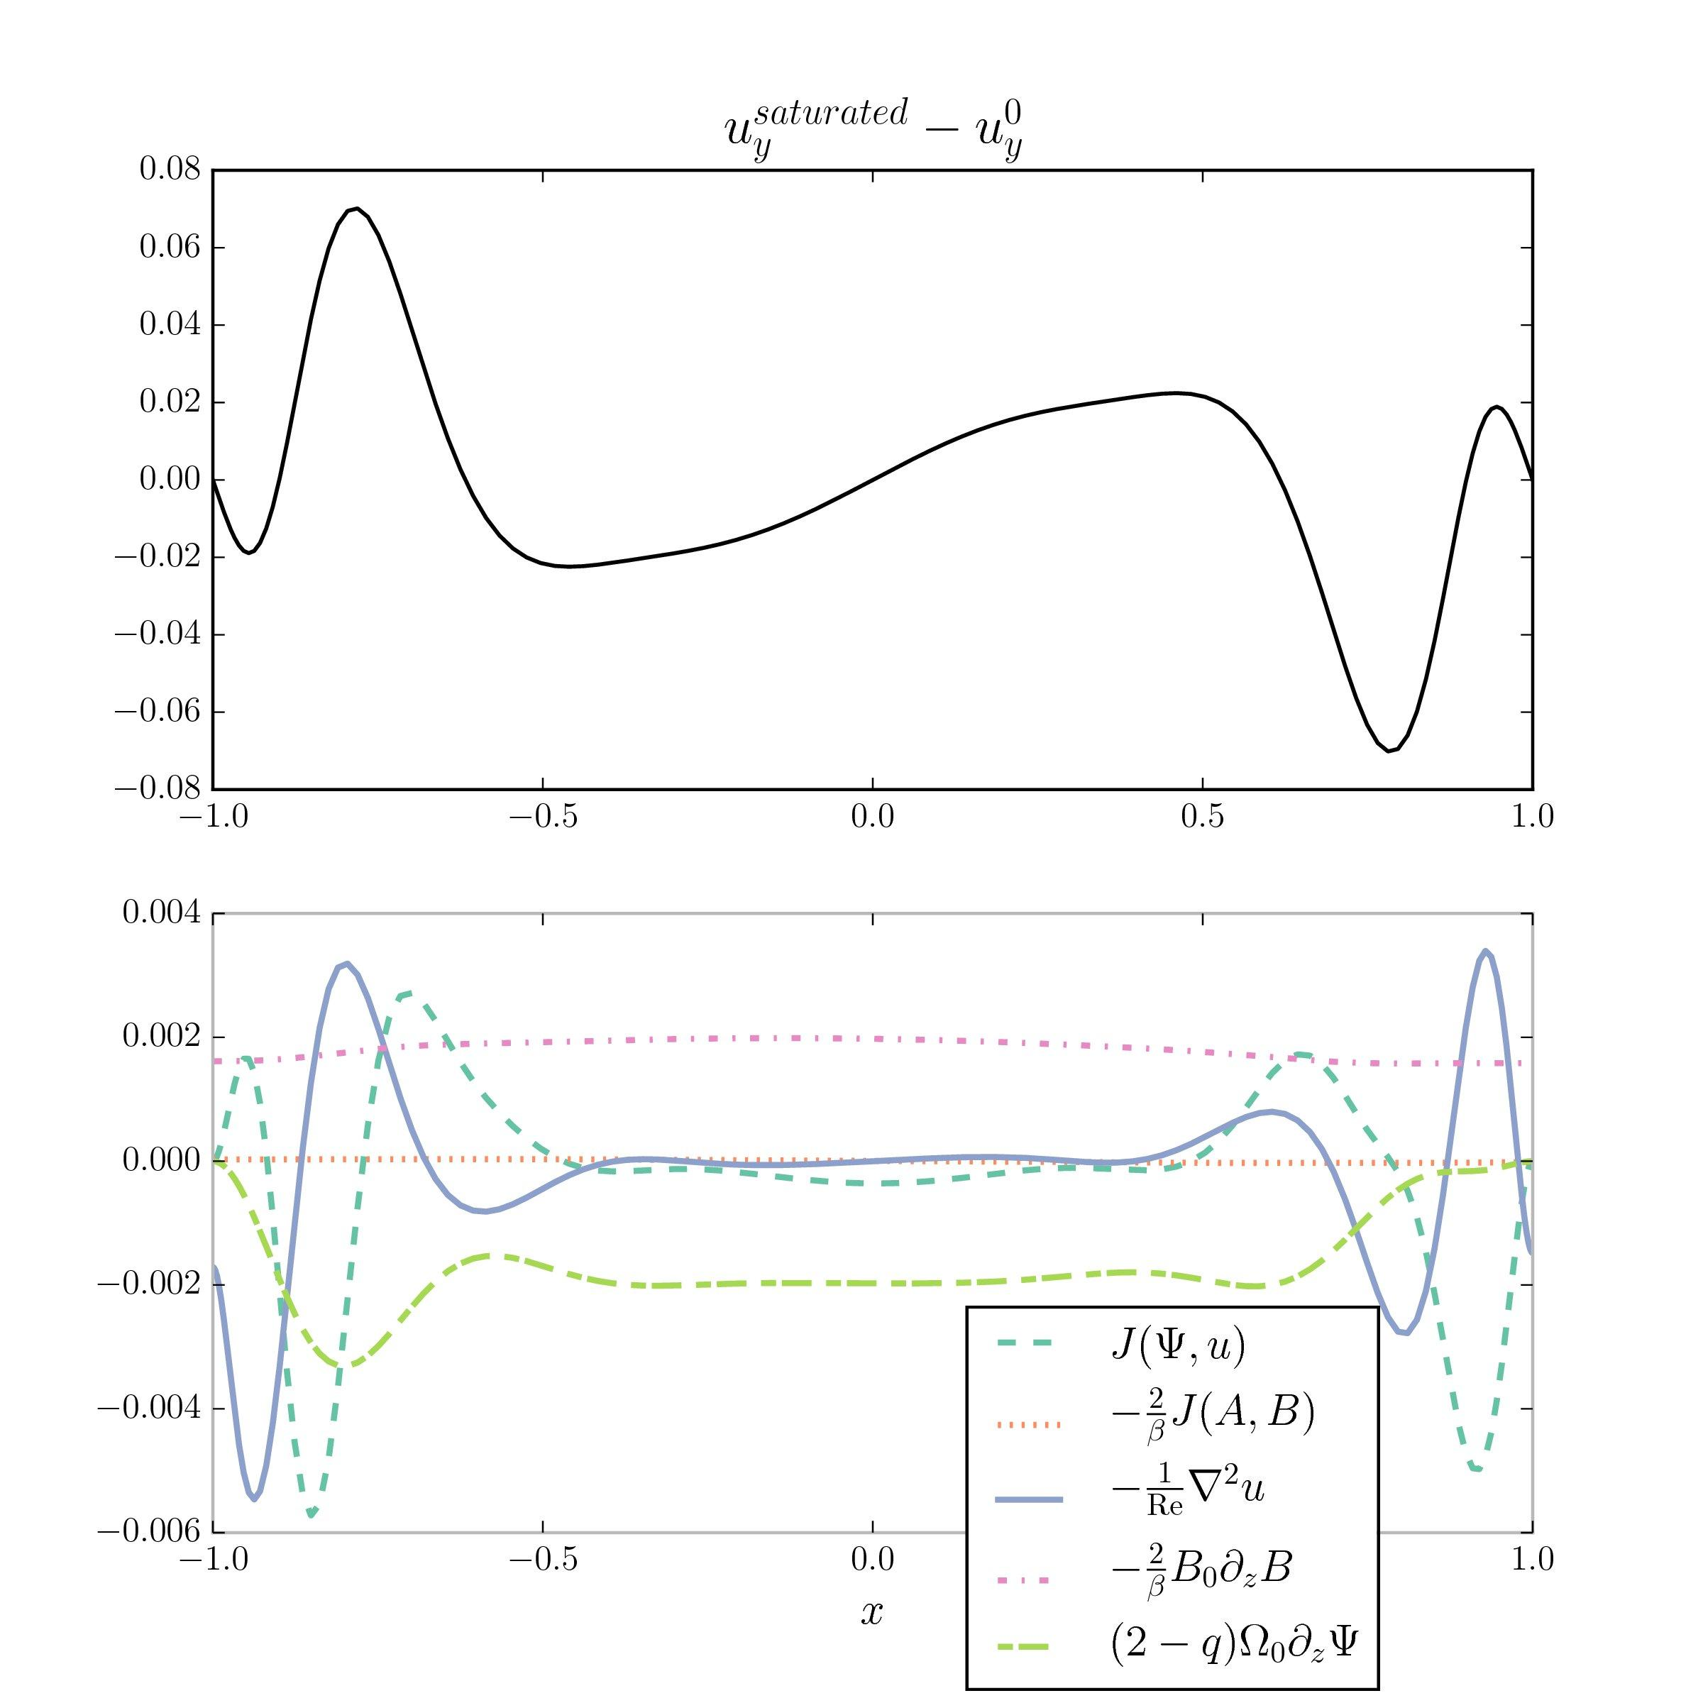
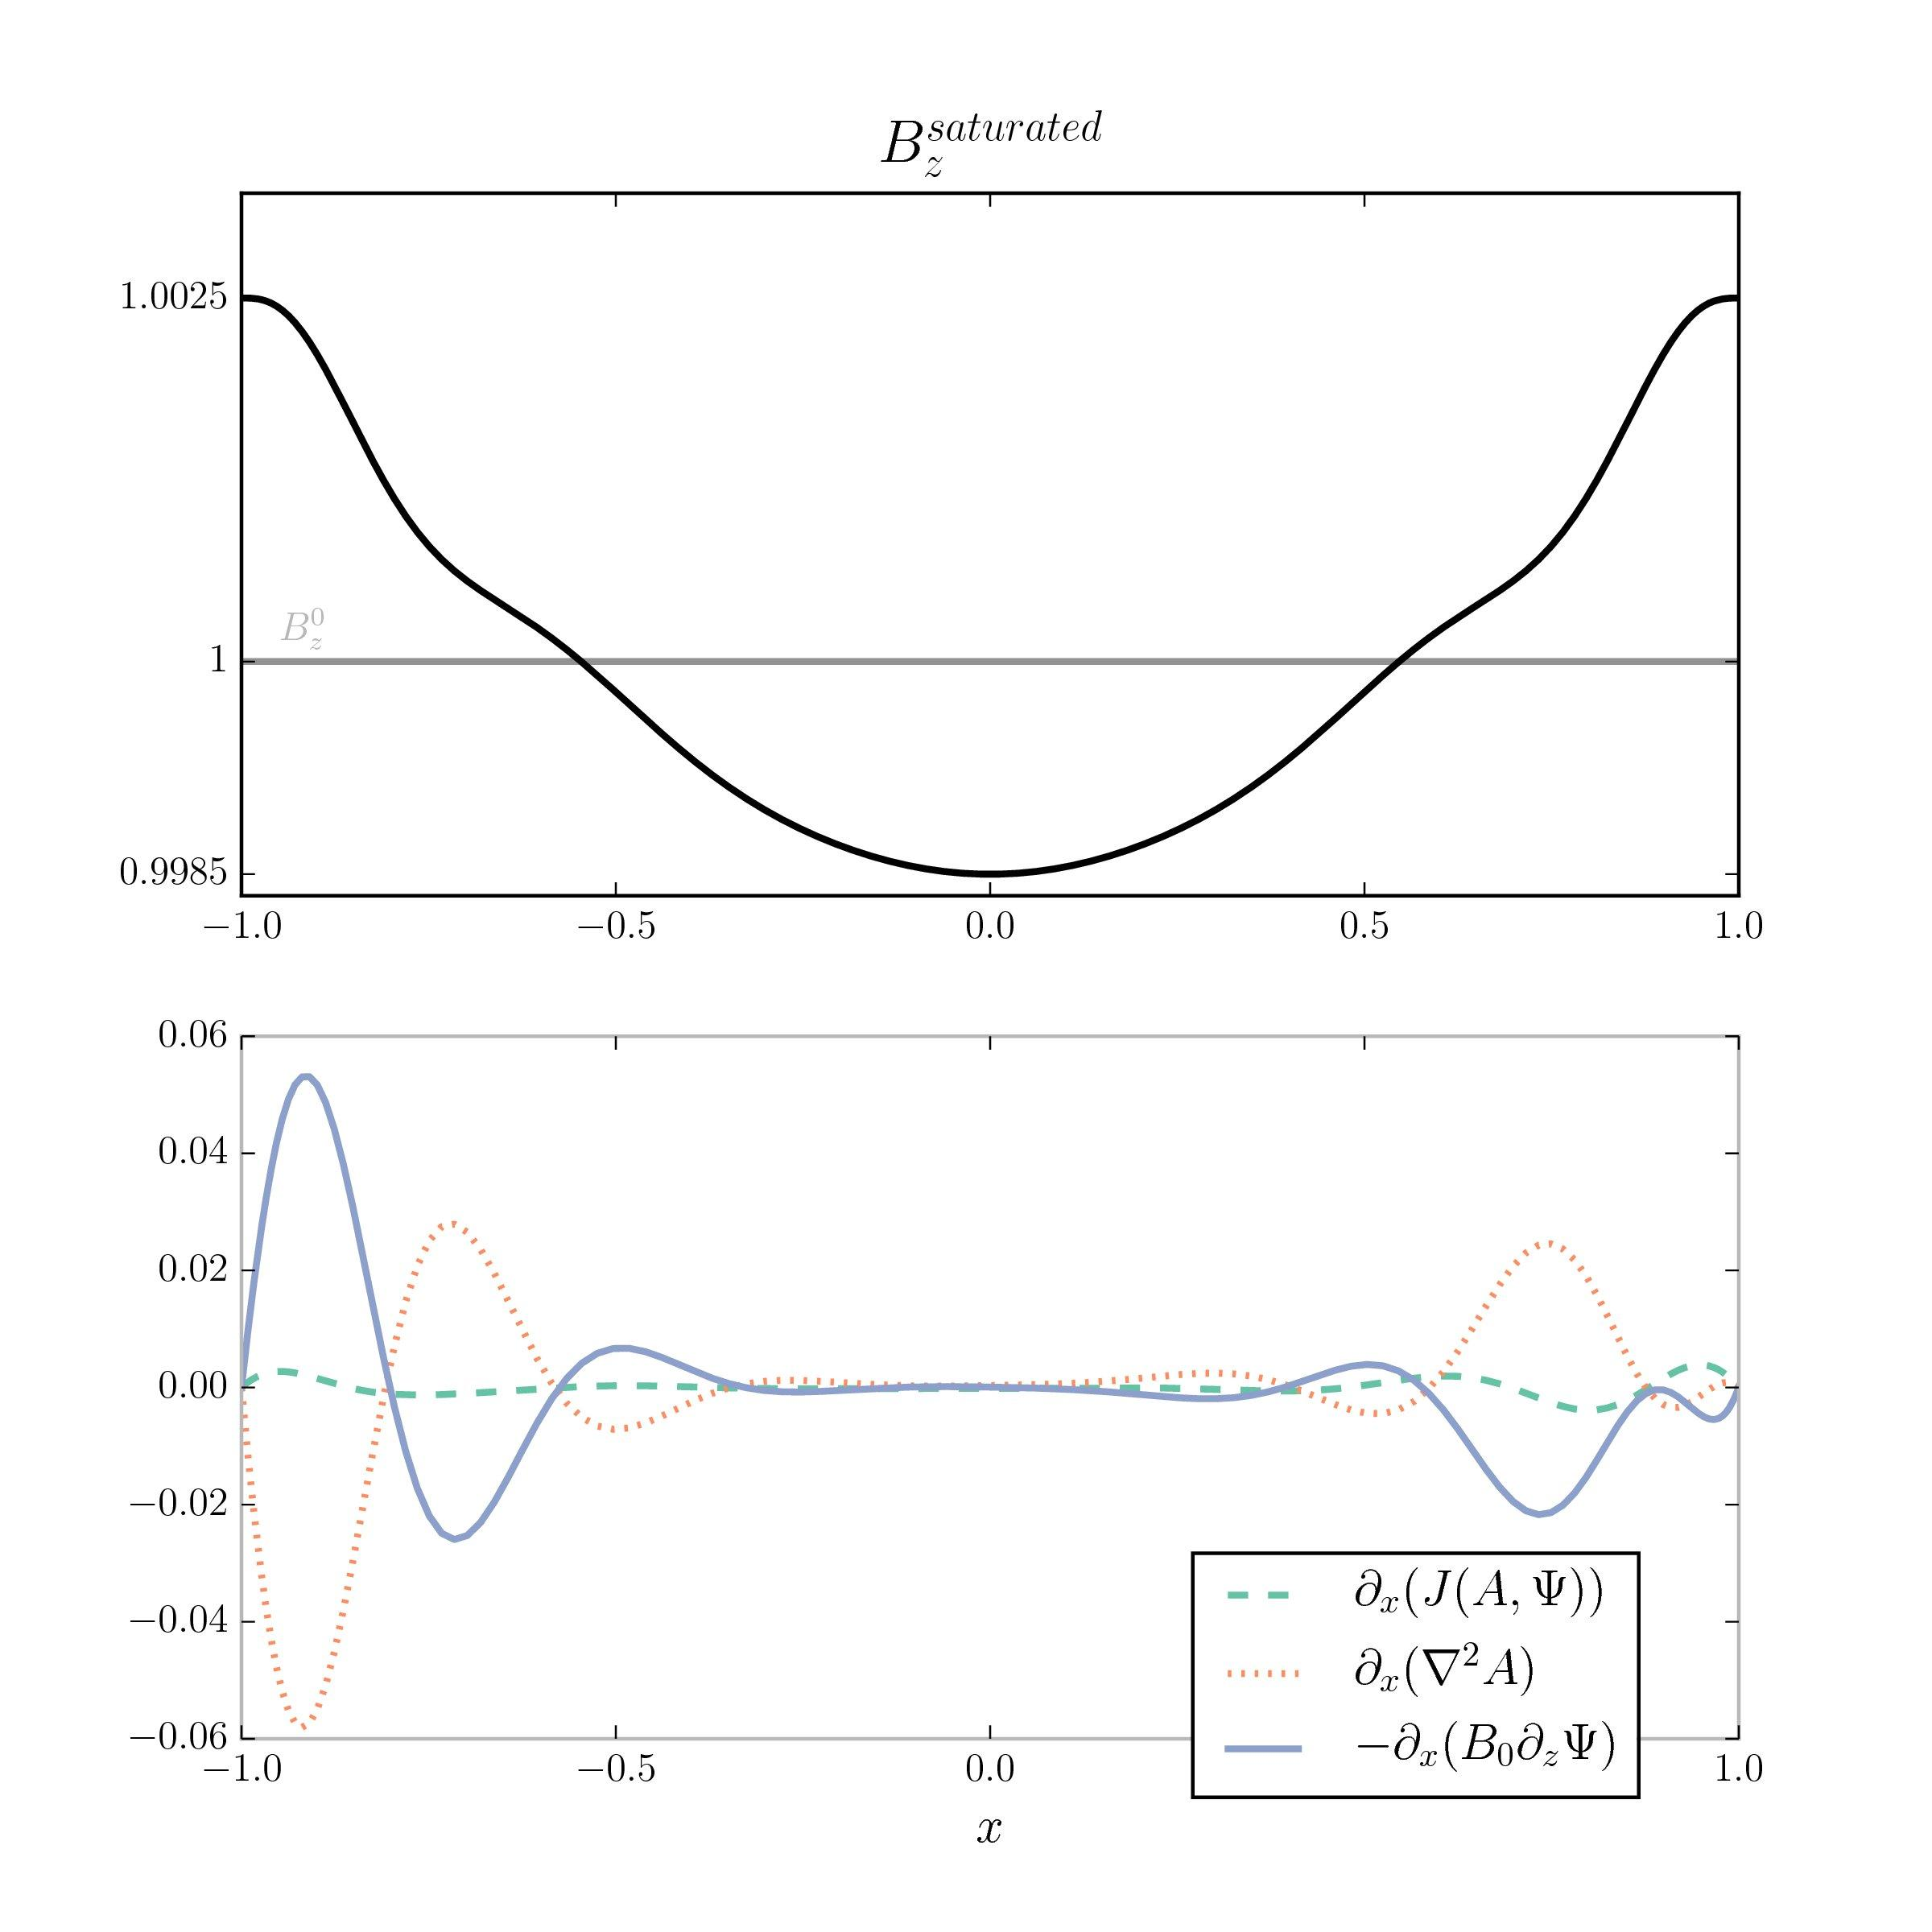
Saturation in thin gap

Slide 49
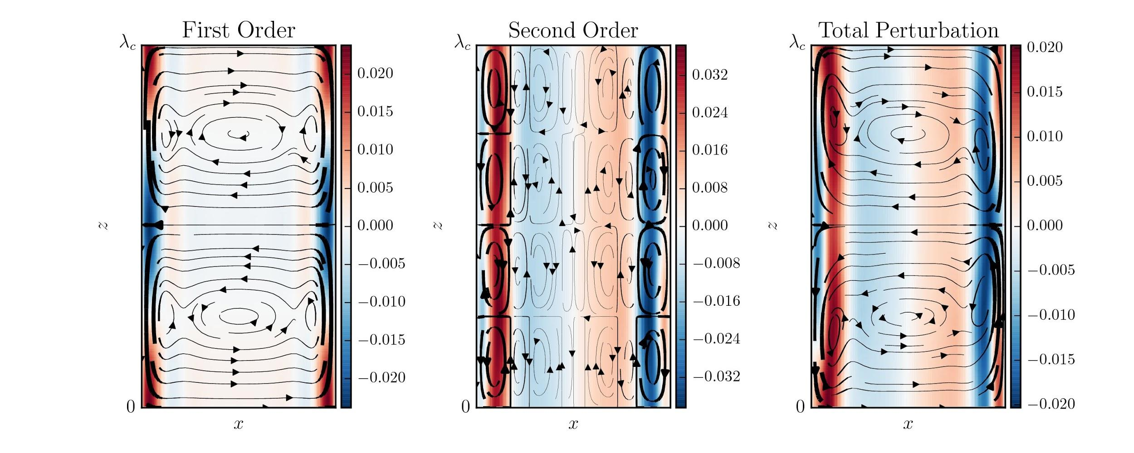
Narrow gap multiple scales velocity fields

Slide 50
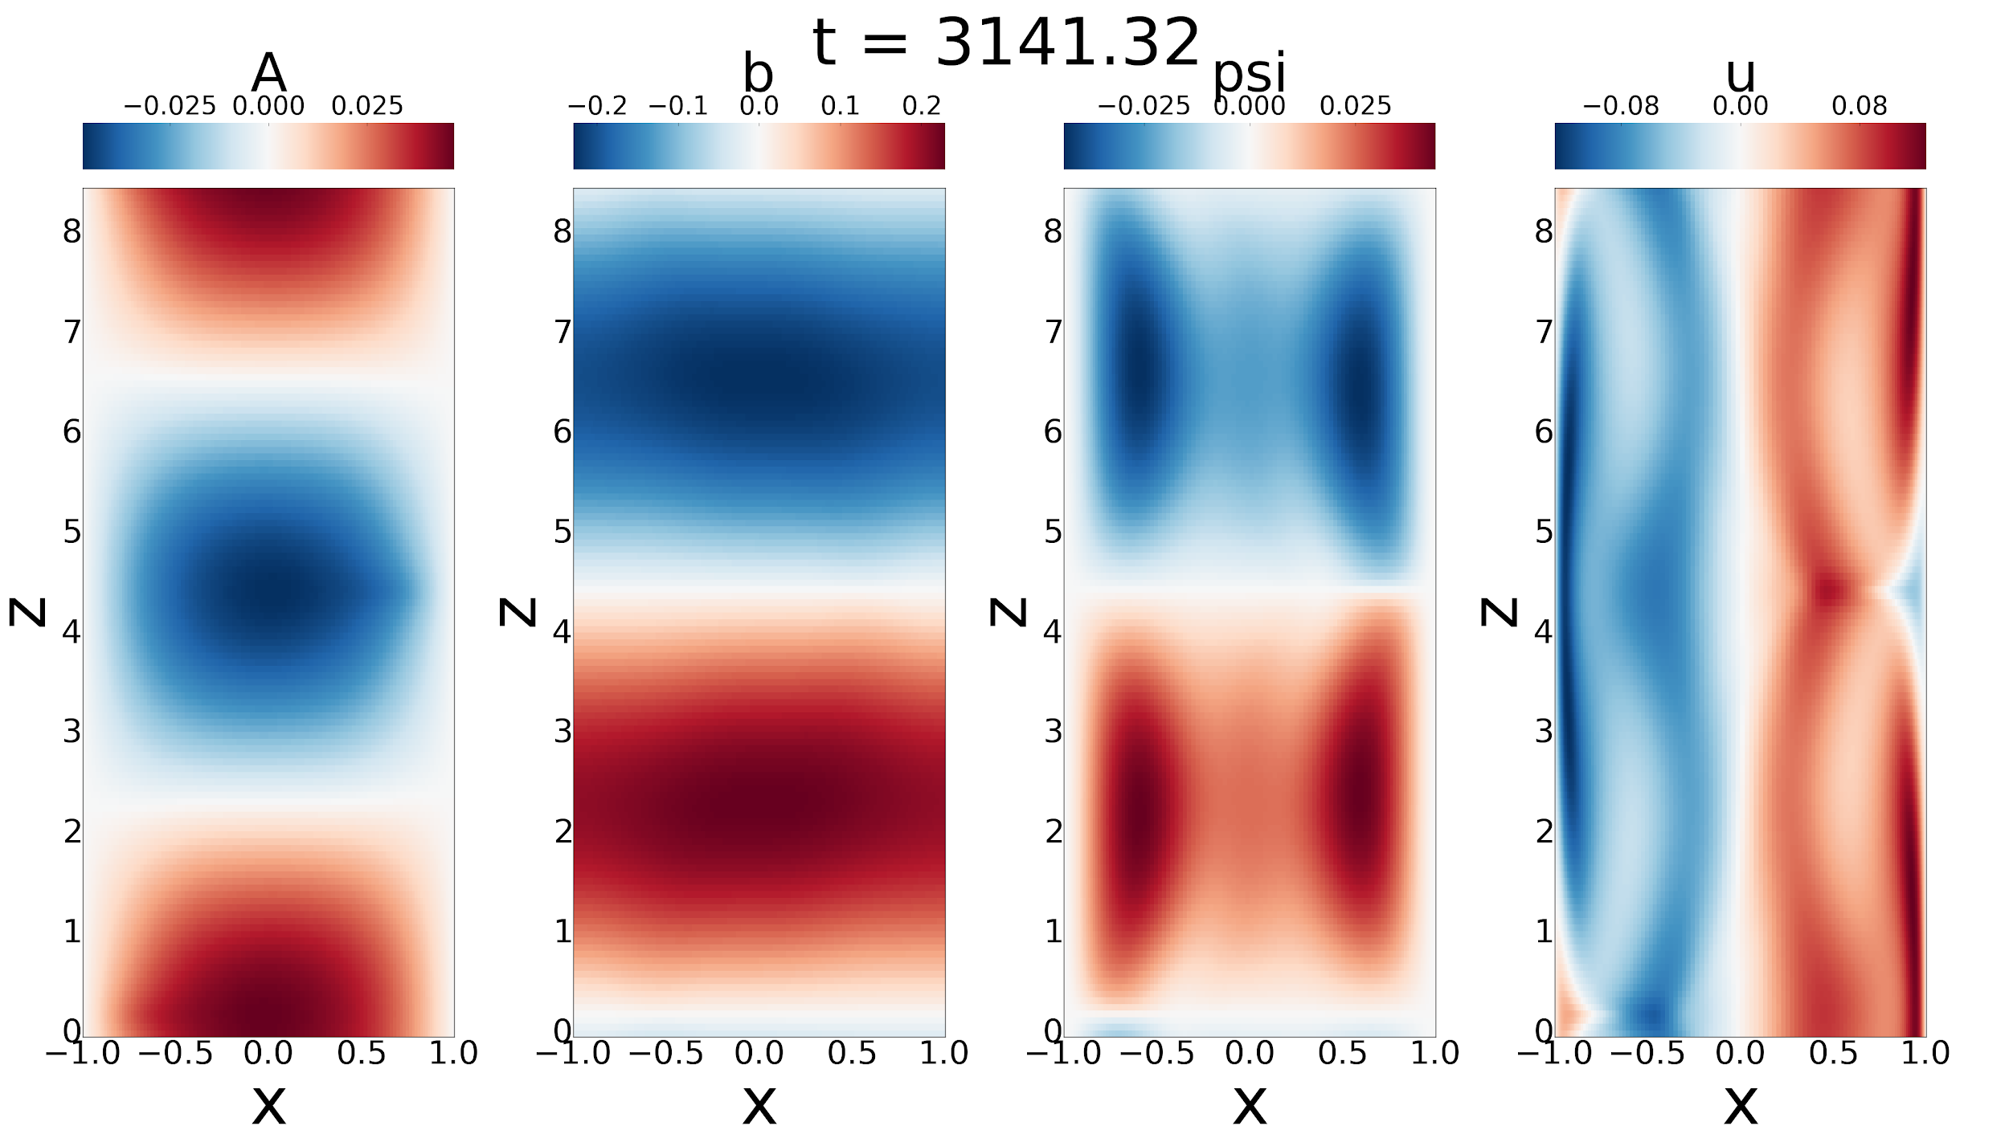
Narrow gap Numerical Simulation

Slide 51
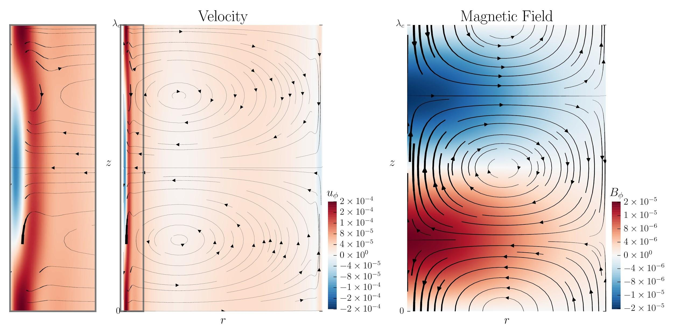
Wide gap saturated state

Slide 52
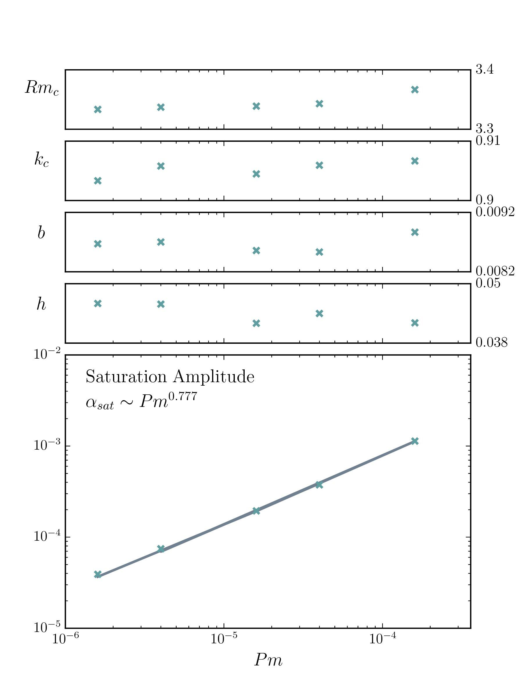
Wide gap scaling with Pm

Slide 53
Parameters entirely inaccessible to simulation!
Wide gap scaling with Pm

Slide 54
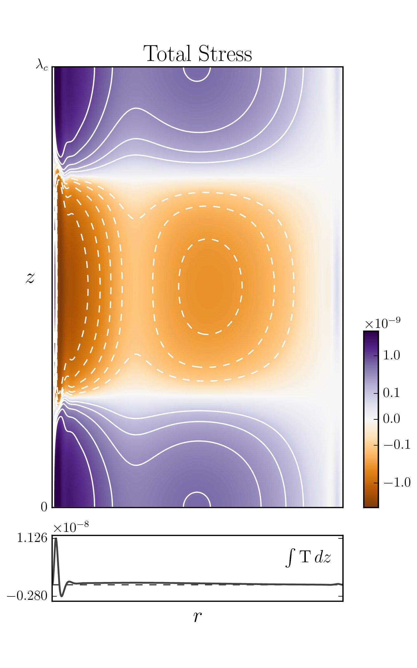
Asymmetry in positive & negative leads to transport!
Predictions for Princeton MRIX
Wide gap Angular Momentum Transport

Slide 55
Statistics: Understanding Dynamics, Searching for Extreme Events

Slide 56
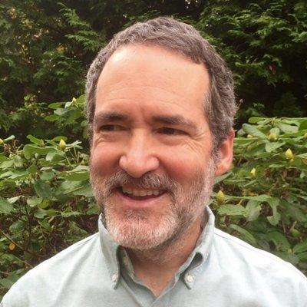
Collaborators
Steve Tobias (Leeds)
Brad Marston (Brown)

Slide 57
Classic Example: Rogue Waves
18.5 m wave!
Adcock et al (2011, Proc. R. Soc. London, Ser. A)

Slide 58
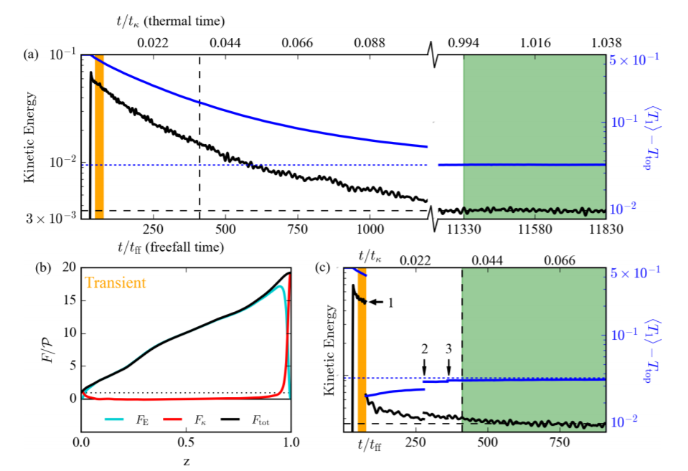
Even on slow manifold still need integrate long enough to capture statistics

Slide 59
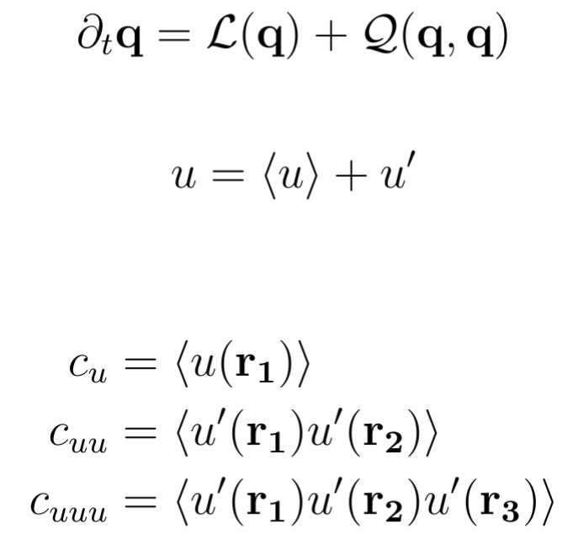
A newish technique: Direct Statistical Simulation (DSS)
Equation of motion
Decompose into mean + fluctuation

Slide 60
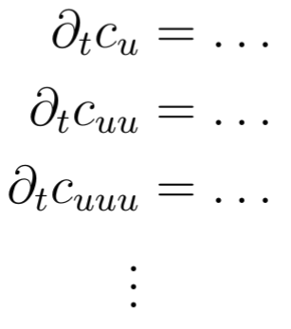
A newish technique: Direct Statistical Simulation (DSS)
CE2: most popular choice
Cumulants are smoother, so need fewer modes
But higher dimensional, so cursed.

Slide 61
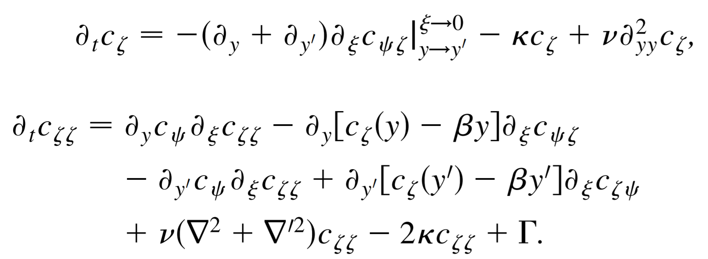
Example:

Slide 62
A newish technique: Direct Statistical Simulation (DSS)
Choice of mean to derive cumulants from
Zonal average (typical for spherical systems or fake spherical systems like Busse Annulus)
Ensemble average
Or anything that satisfies Reynolds rules

Slide 63
CE2: Works great close to equilibrium
Extensively tested on
Barotropic jet formation (Farrell & Ioannou 2007, 2013; Tobias & Marston 2011)
Magnetorotational dynamos (Squire & Bhattacharjee 2015)

Slide 64
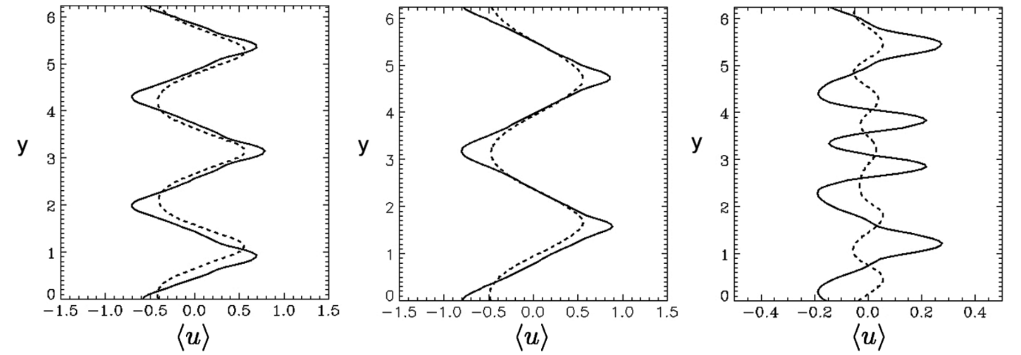
CE2: Works great close to equilibrium
But...as you go further from equilibrium, CE2 ceases to give an accurate picture of the statistics
DNS
???
CE2
Stronger forcing

Slide 65
How to fix this?
Go to CE3
Change averaging procedure
Rethink the notion of “mean” and “eddy” → GQL

Slide 66
How to fix this?
Go to CE3
Change averaging procedure
Rethink the notion of “mean” and “eddy” → GQL

Slide 67
Generalized Quasi-Linear Approximation
Λ = 0 → Quasilinear
0 < Λ < k_{max} → GQL
Λ = k_{max} → DNS

Slide 68
Generalized Quasi-Linear Approximation
Λ = 0 → Quasilinear
0 < Λ < k_{max} → GQL
Λ = k_{max} → DNS

Slide 69
Generalized Quasi-Linear Approximation
Λ = 0 → Quasilinear
0 < Λ < k_{max} → GQL
Λ = k_{max} → DNS

Slide 70
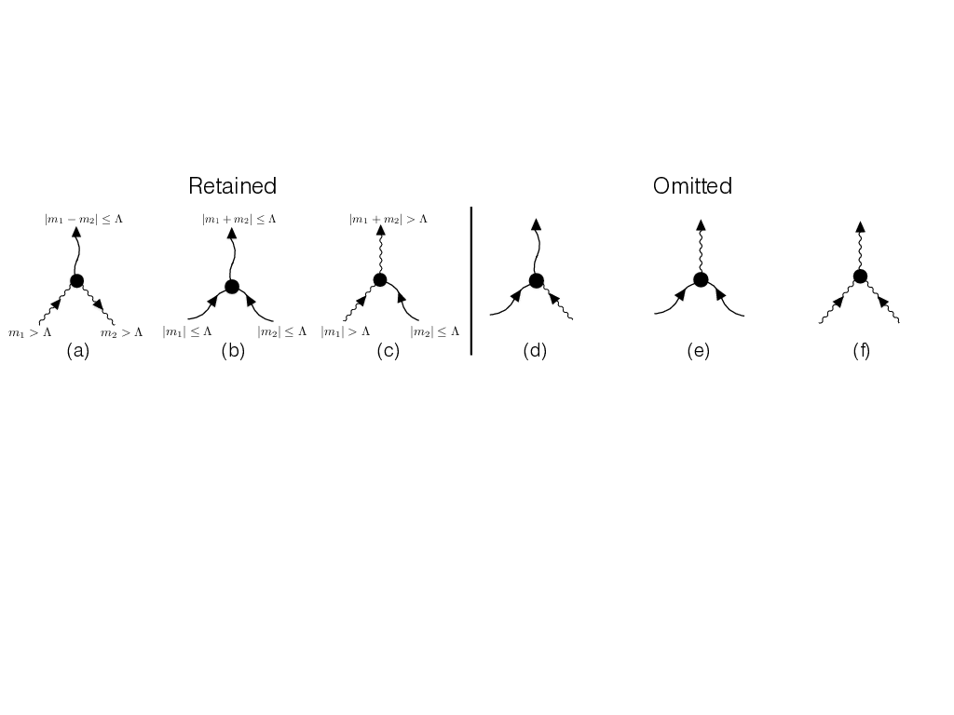
Generalized Quasi-Linear Approximation
Which nonlinear interactions to keep?
All triads eliminated in pairs → Quadratic invariants preserved! (e.g. Kraichnan 1985)

Slide 71
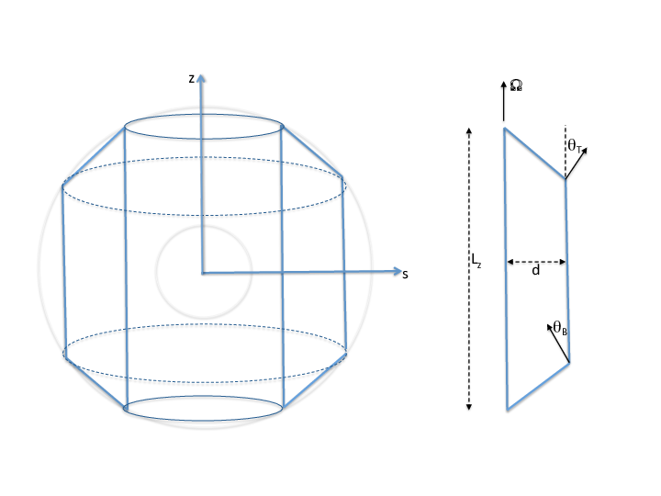
Test Case: The Busse Annulus

Slide 72
Busse Annulus
Integrate along L_{z}
gravity
x
y

Slide 73
Busse Annulus
Parameters
Geometric
β = 2 (θ_{T} - θ_{B}) d / (L_{z} Ek)
C = (2d/(|θ_{T} - θ_{B}|L_{z})^{0.5}
Ra, Pr

Slide 74
Equations

Slide 75
Equations
Extremely similar to modified Hasagawa-Wakatani equations for tokamaks! Details coming soon...

Slide 76
Equations after GQL applied

Slide 77
Busse Annulus: 3 Test Cases
Tobias, Oishi, and Marston, Proc. R. Soc. London, Ser. A (2018, accepted)

Slide 78
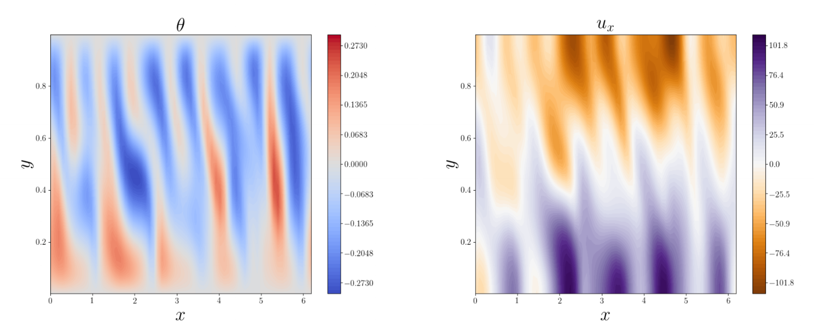
DNS Case A: large scale mean flow

Slide 79
DNS Case A: large scale mean flow
Tilt → Reynolds Stress → Mean flow

Slide 80
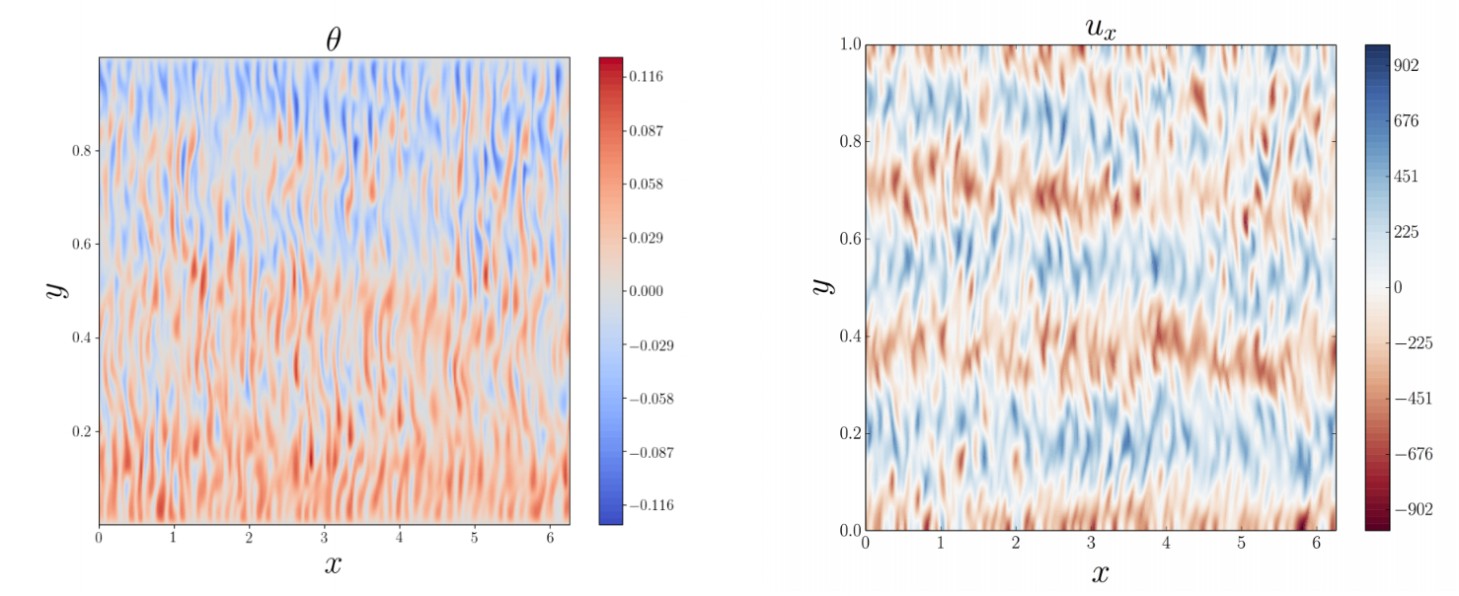
DNS Case B: Multiple jets

Slide 81
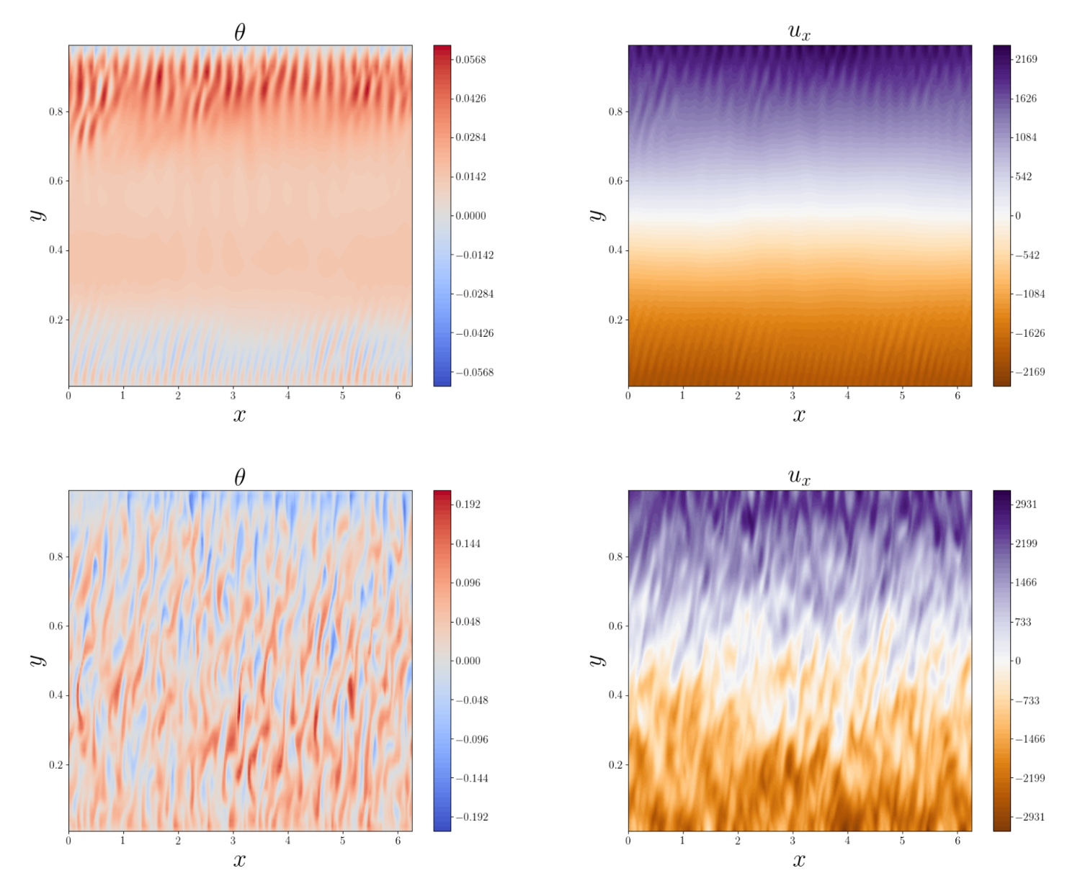
DNS Case C: Bursting jets
Shear State
Convective State

Slide 82
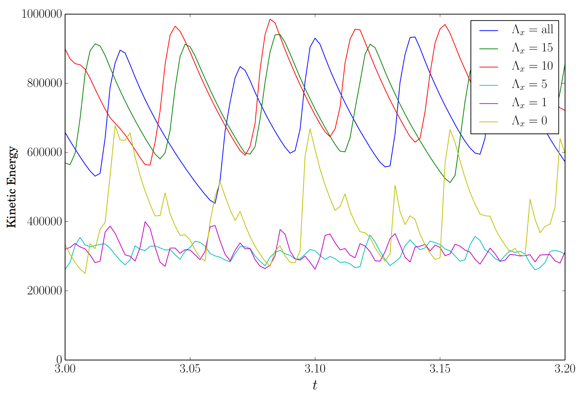
DNS Case C: Bursting jets
Relaxation oscillations

Slide 83
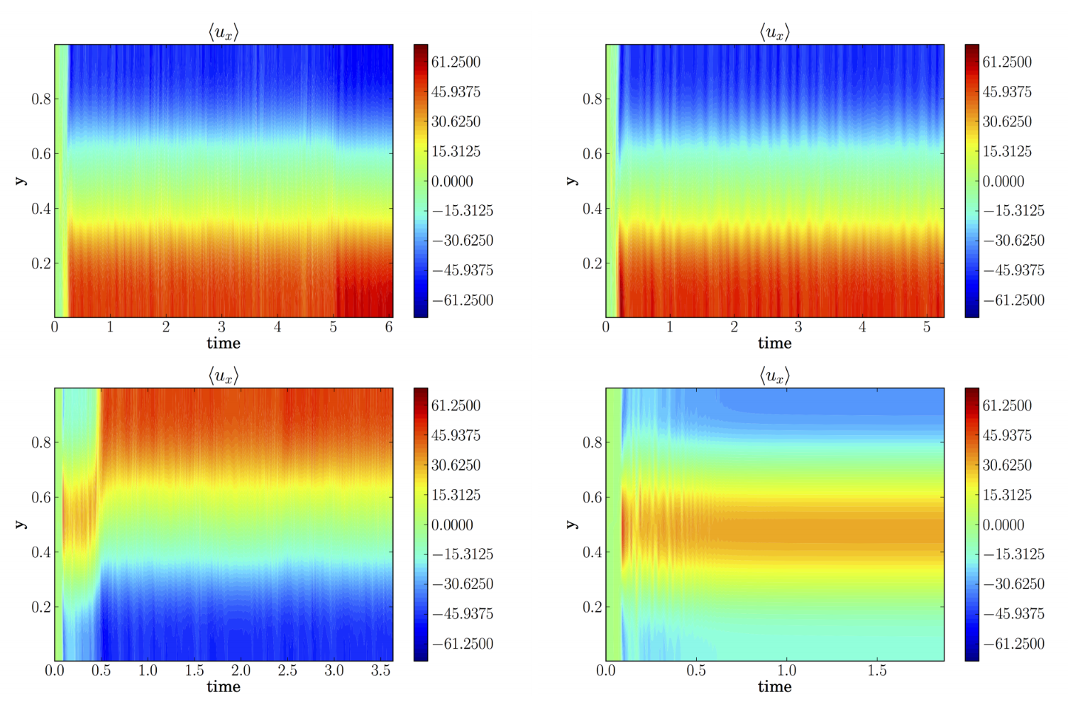
Hovmoller Diagrams: Case A
DNS
Λ = 5
Λ = 1
Λ = 0
(QL)

Slide 84
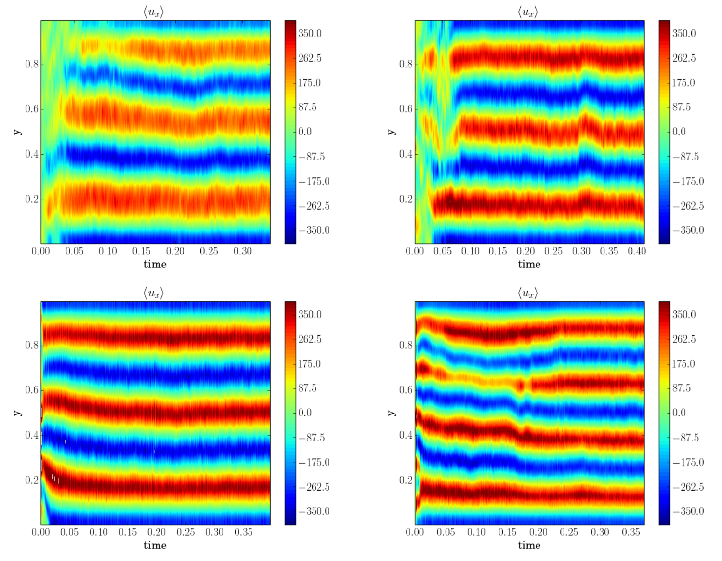
Hovmoller Diagrams: Case B
DNS
Λ = 5
Λ = 1
Λ = 0
(QL)

Slide 85
Second Cumulant

Slide 86
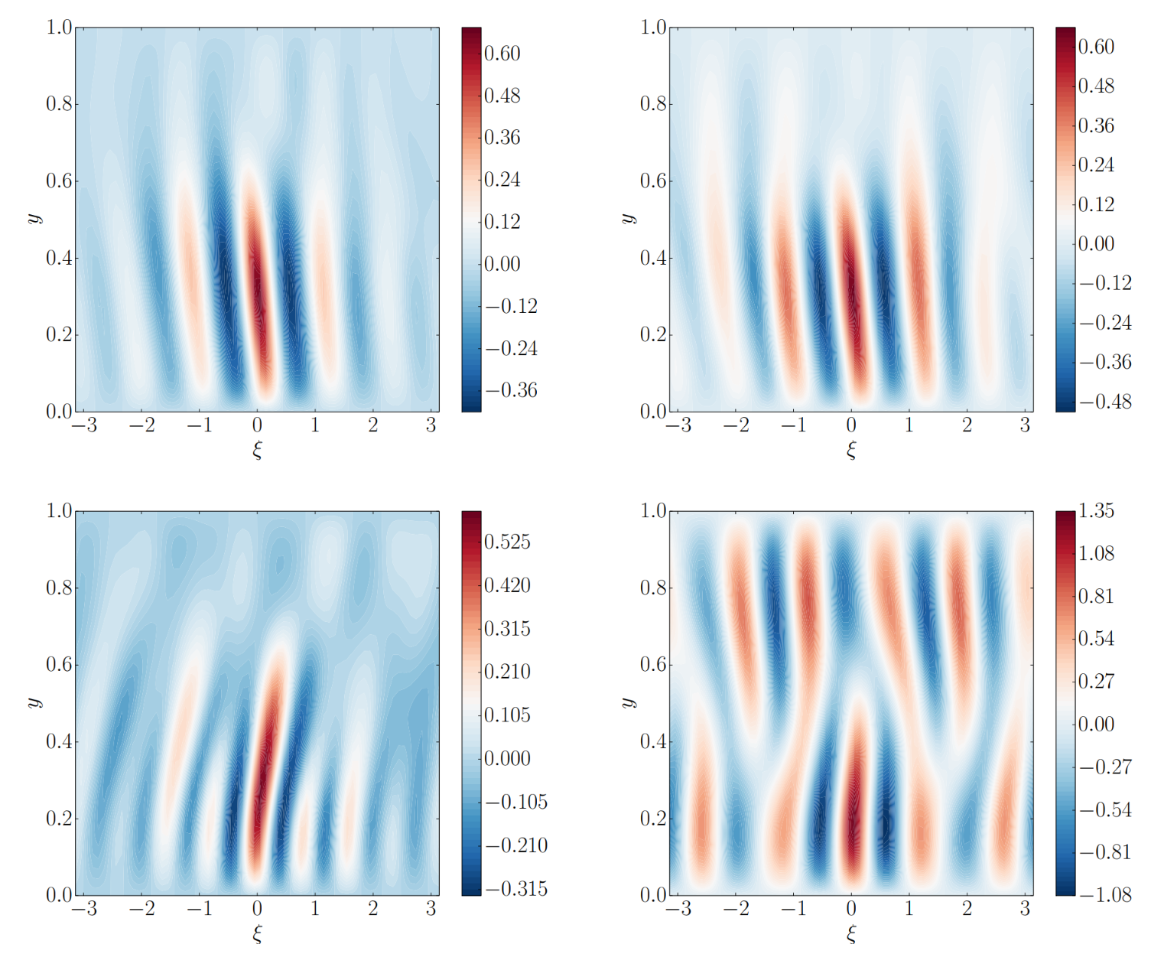
Second Cumulants: Case A
DNS
Λ = 5
Λ = 1
Λ = 0
(QL)

Slide 87
Second Cumulants: Case A
DNS
Λ = 5
QL overpredicts non-local correlations
Λ = 1
Λ = 0
(QL)

Slide 88
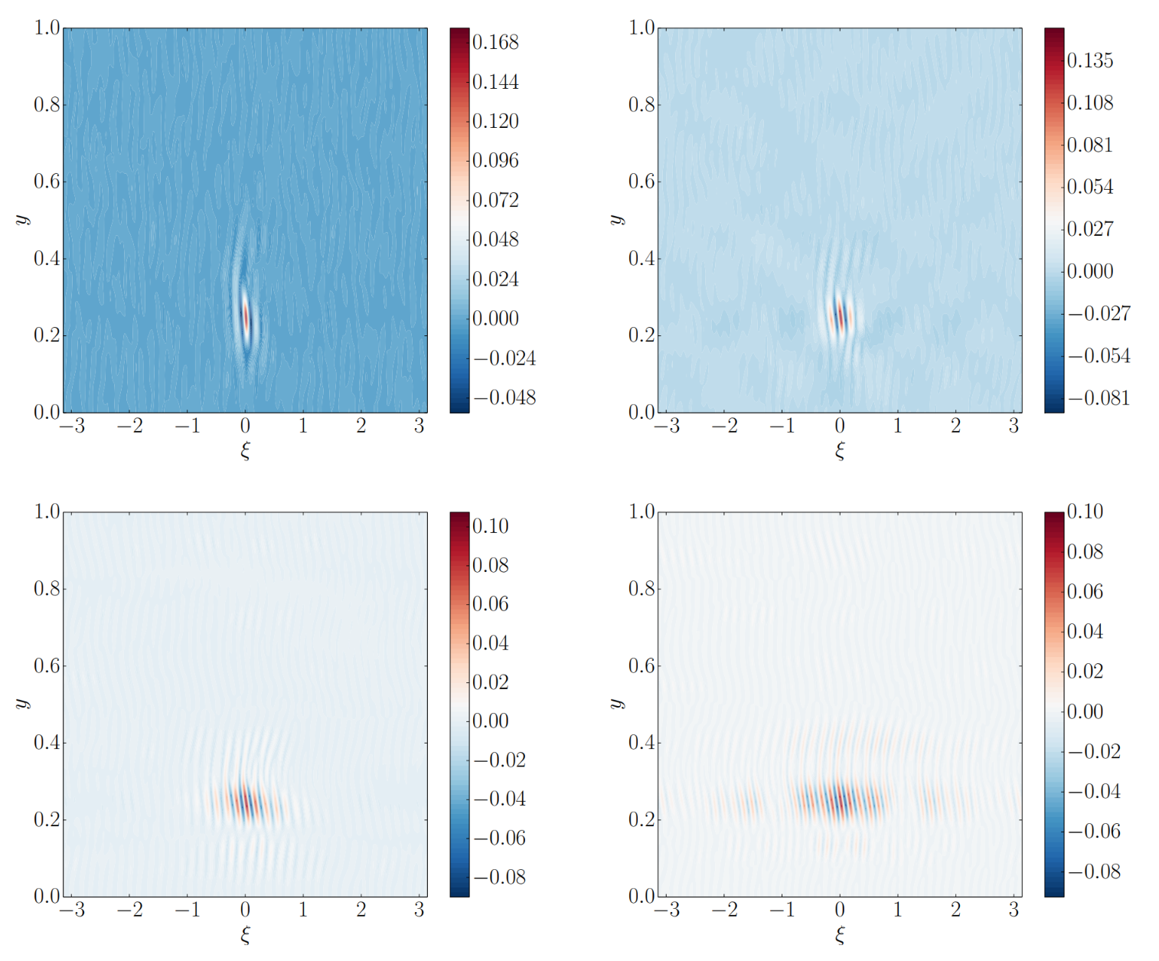
Second Cumulants: Case B
DNS
Λ = 5
Λ = 1
Λ = 0
(QL)

Slide 89
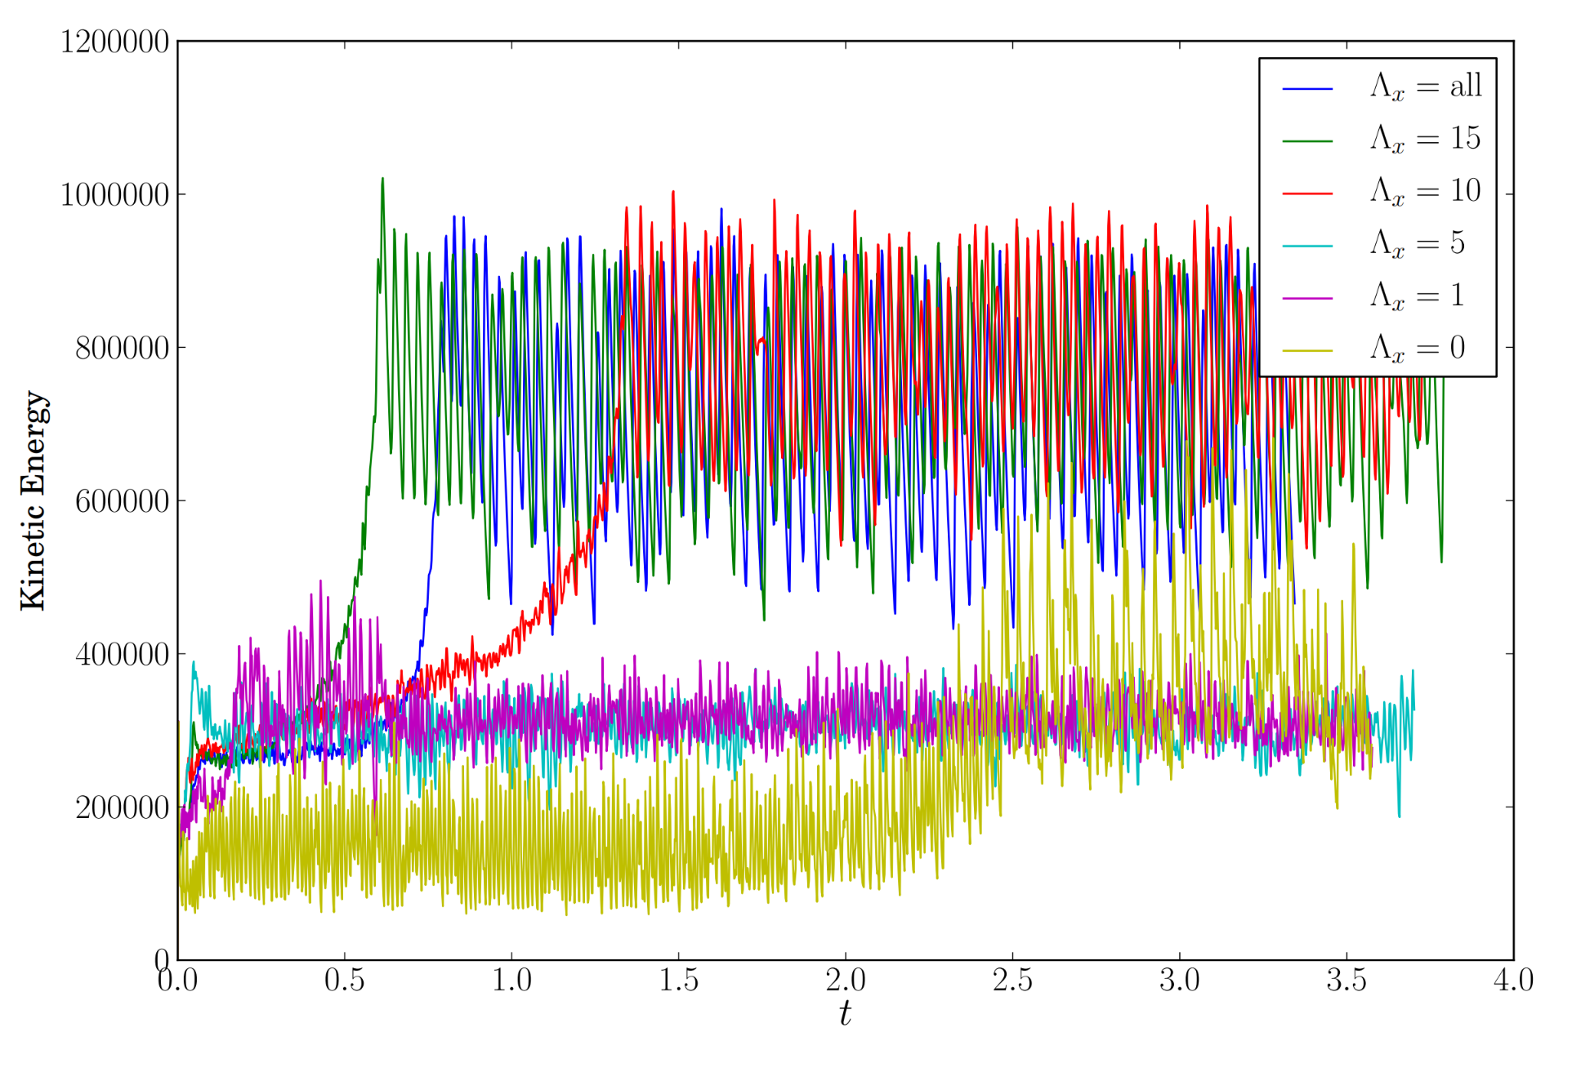
Case C: Kinetic Energy Timeseries
Blue line → DNS
Gold line → QL
All others → GQL

Slide 90
Case C: Kinetic Energy Timeseries
Blue line → DNS
Gold line → QL
All others → GQL

Slide 91
Conclusions: GQL works well for complex dynamics
...assuming you have enough modes
Next step: implement GQL into CE2 for GCE2 formulation

Slide 92
Appendix

Slide 93
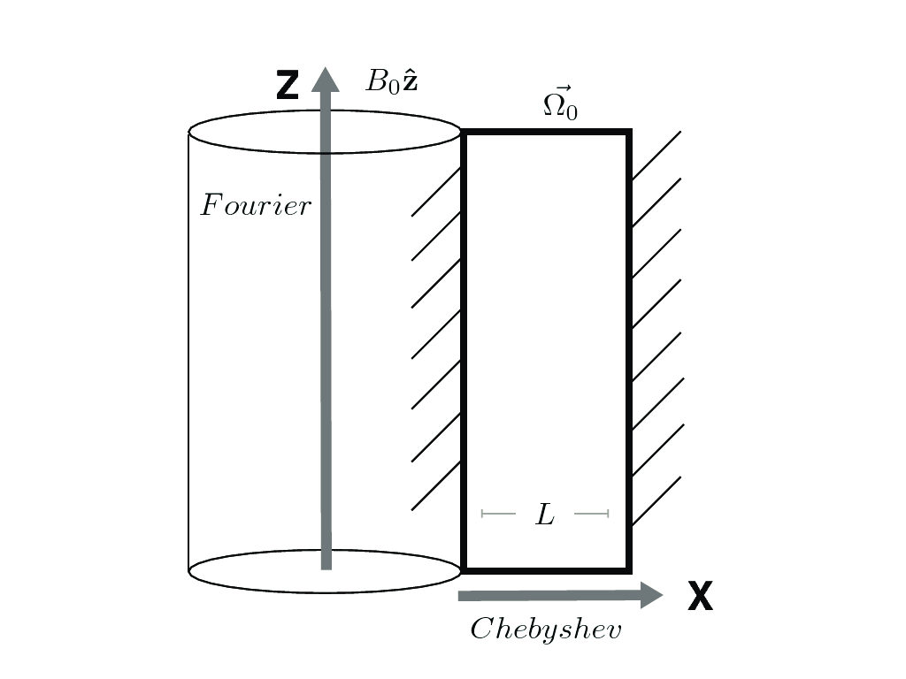
Future Directions: stratification & μ gradients
Application Massive & Evolved stellar interiors
w/Matteo Cantiello (Simons Center)
Density stratification
New physics

Slide 94
Accretion forms stars & planets!
Phil Armitage
ALMA (ESO/NAOJ/NRAO)

Slide 95
Accretion disks: mass goes in, angular momentum goes out

