Slide 1
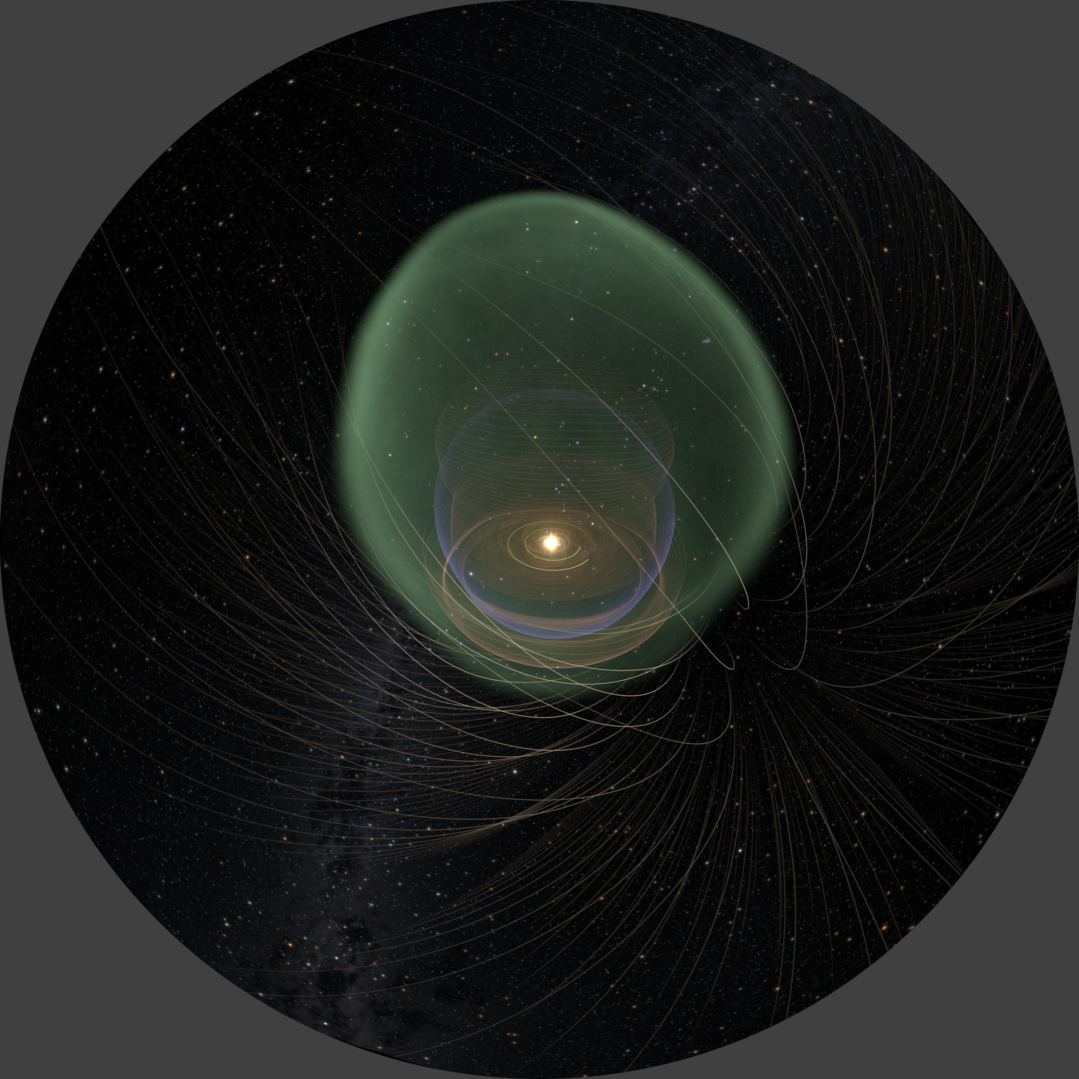

Exploring Plasma Effects at the Edge of the Solar System: Magnetic Reconnection in the Heliosheath and Heliopause
Merav Opher
Boston University
MIPSE, February 20, 2012

Slide 2
Collaborators:
Jim Drake, Kevin Schoeffler, Marc Swisdak
(Univ. of Maryland)
Gabor Toth, Tamas Gombosi (Univ. of Michigan)
Berci Zieger, Elena Provornikova, Christina Prested (Boston Univ.)
Rob Decker, Matt Hill (APL), Ed Stone (Caltech),
John Richardson (MIT)

Slide 3
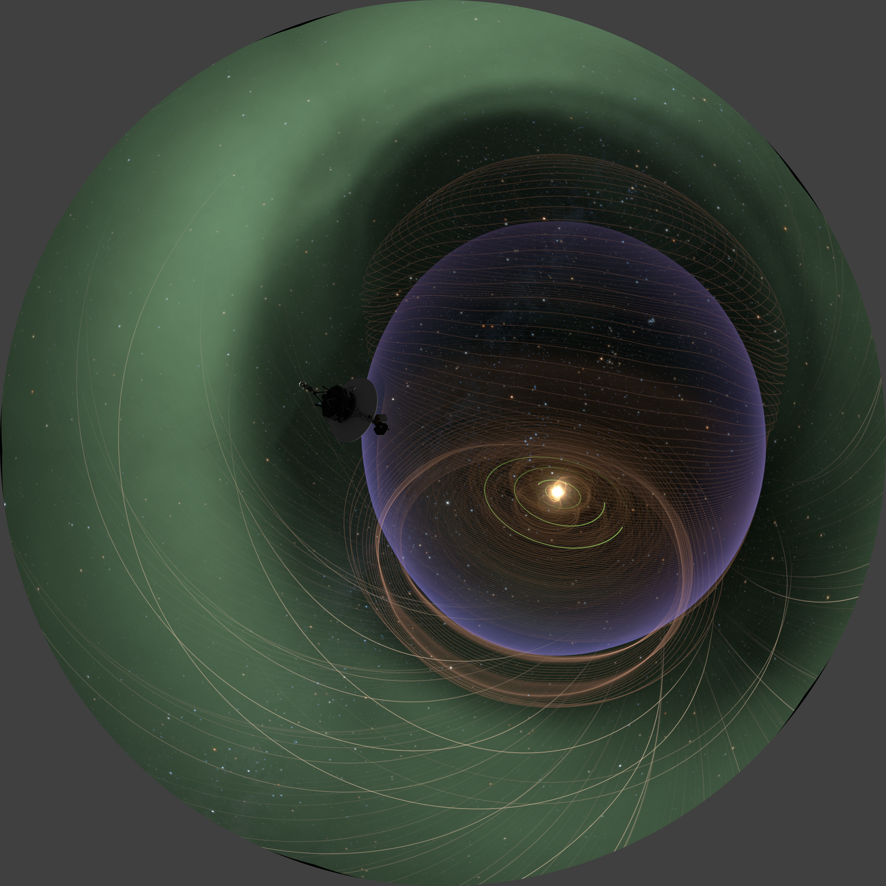
Outline:
Some of the surprises learned
Observations in the heliosheath that are key challenges to heliospheric models
Reconnection scenario in the heliosheath
Nature of the heliopause: Magnetic Highway to the Interstellar Medium?

Slide 4
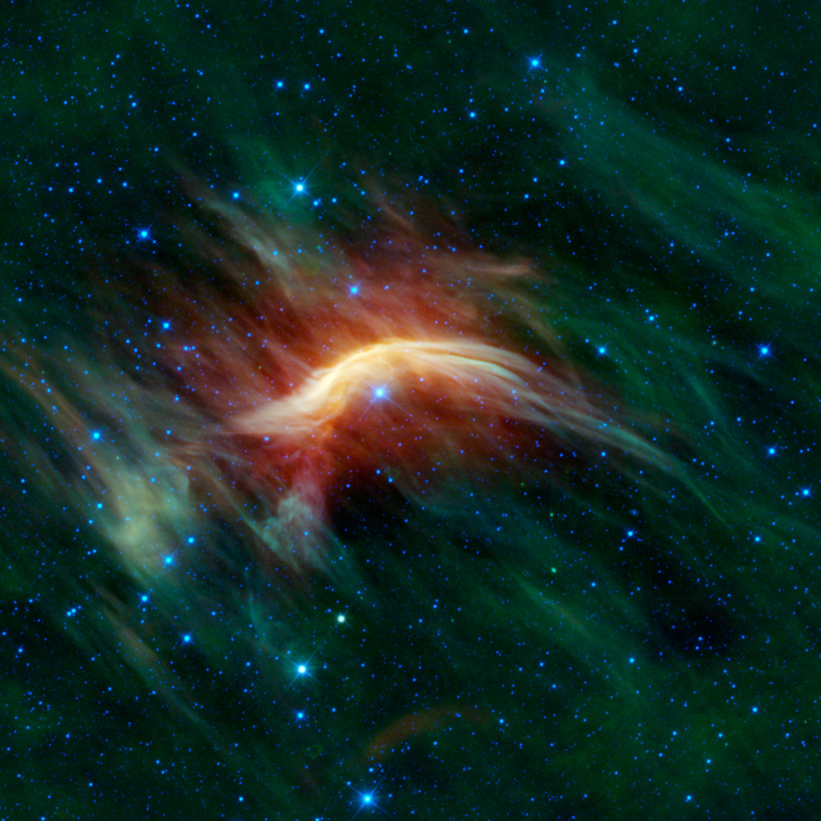
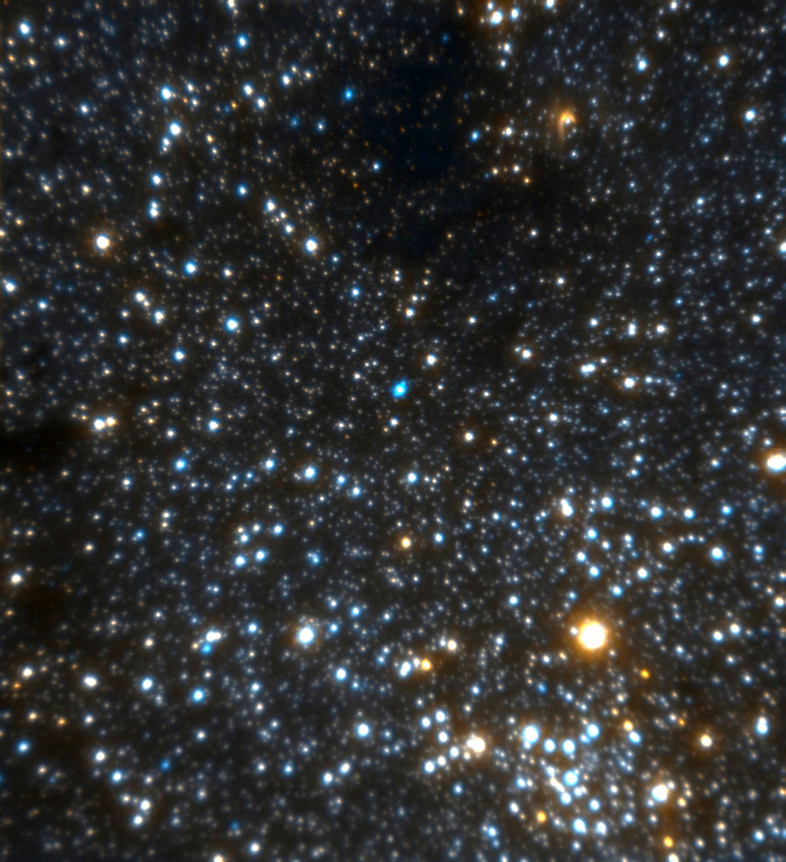
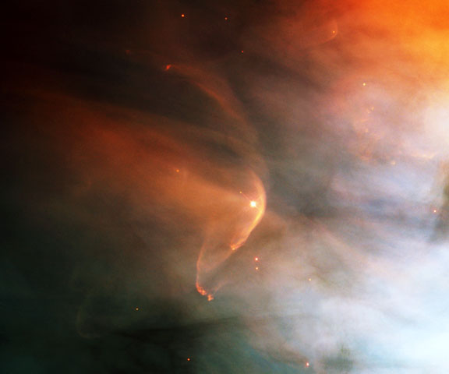
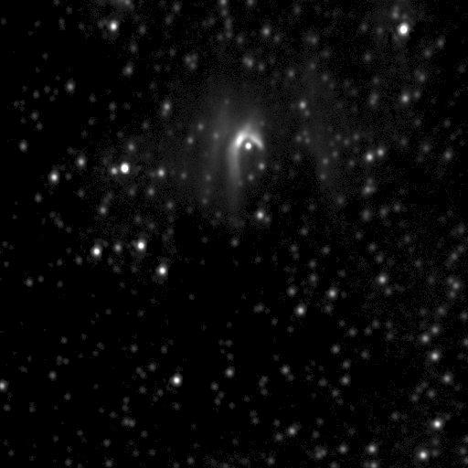
The heliosphere as test-bed for other astrospheres
WISE bow shock image, PIA13455
Closeup of IRS8, resolving the bow-shock of a fast-moving star
HST

Slide 5
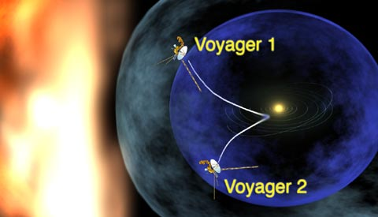
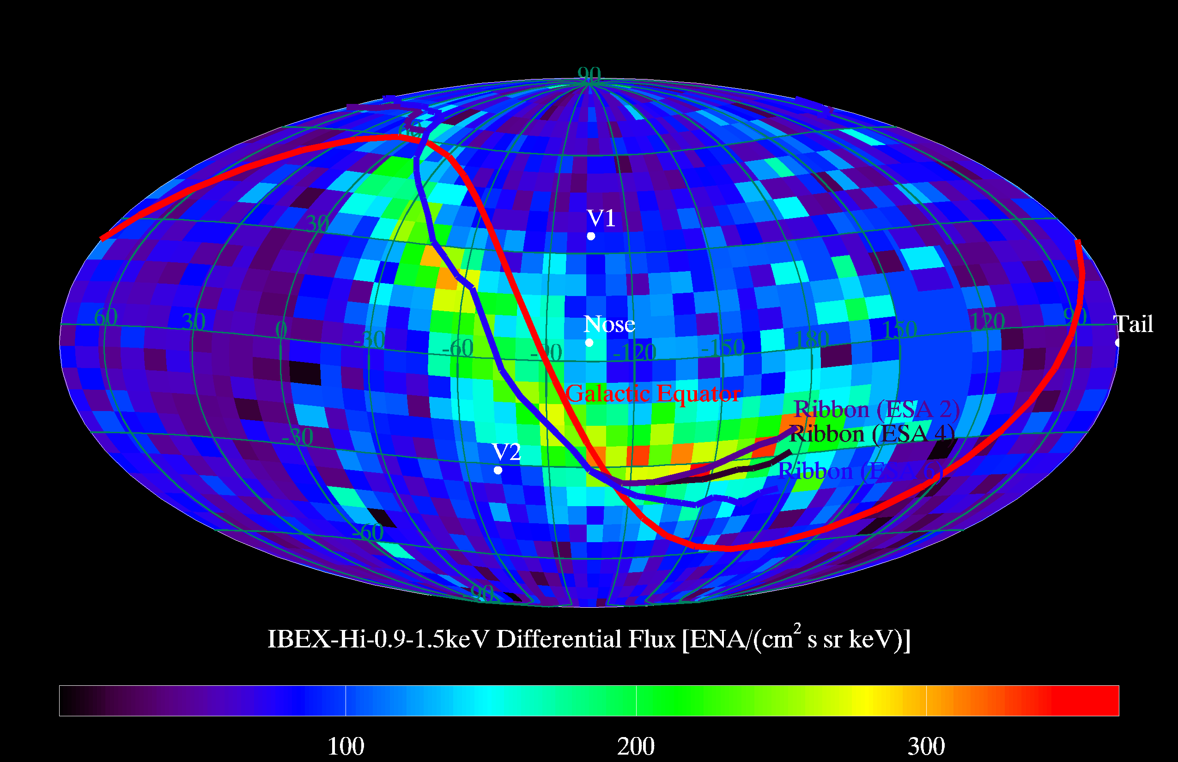
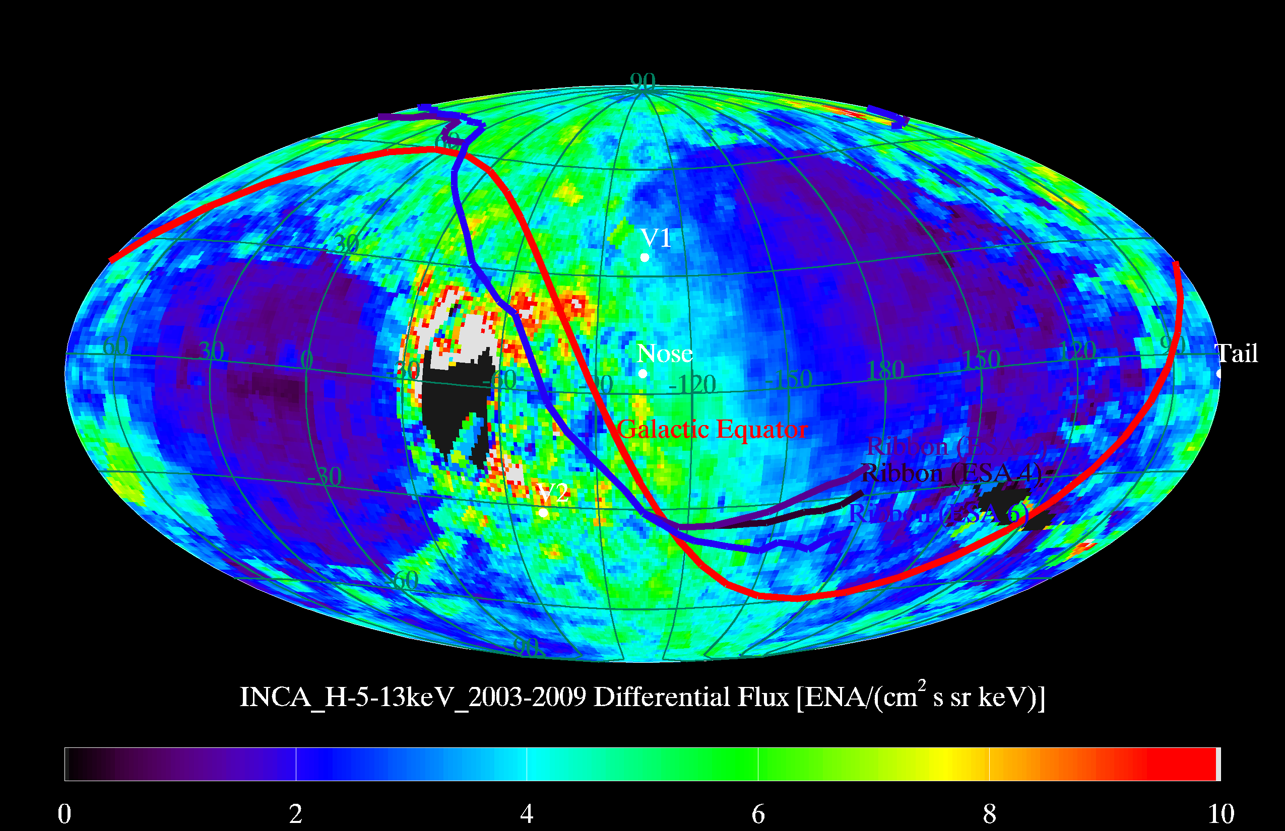
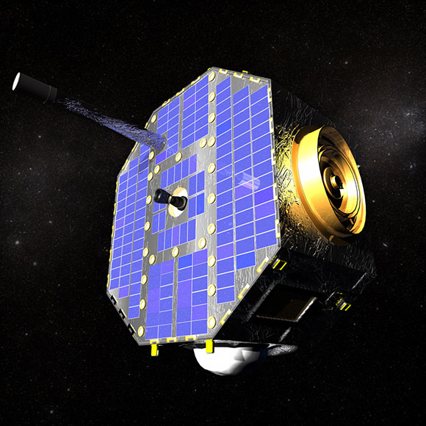
Voyager 1 in the north
Voyager 2 in the south
In-situ data
Global maps
of ENAs (IBEX, Cassini)

Slide 6
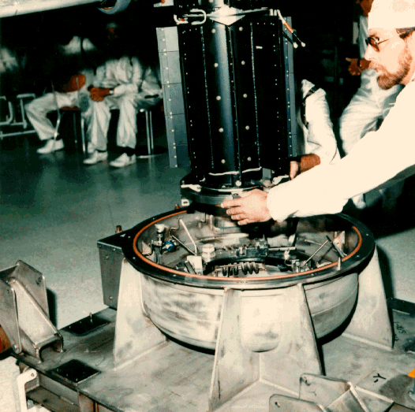
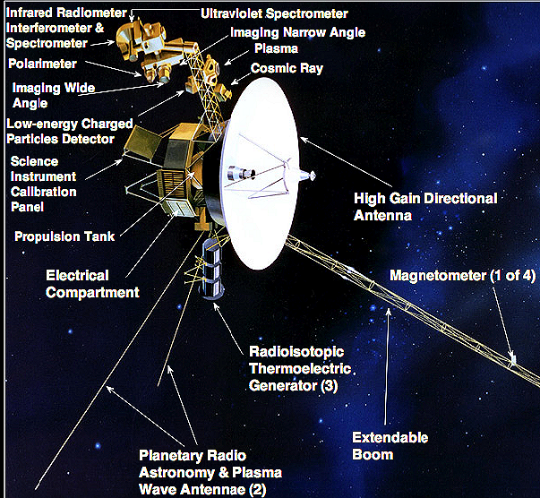
Voyager 1 and 2
Spacecraft
Launched
Voyager 2: 20 Aug. 1977
Now at 101 AU, S29.2° (217° HGI_long)
Voyager 1: 05 Sep. 1977
Now at 124 AU, N34.4° (174° HGI_long)
Separated by 125 AU in heliosheath
Farthest Man-Made Object
Notes:
Graph showing Window of Opportunity for voyager 1 and 2 every 175 years the outer planets are aligned geometrically
In such a way as to minimize the trip time and energy required to tour all four

Slide 7
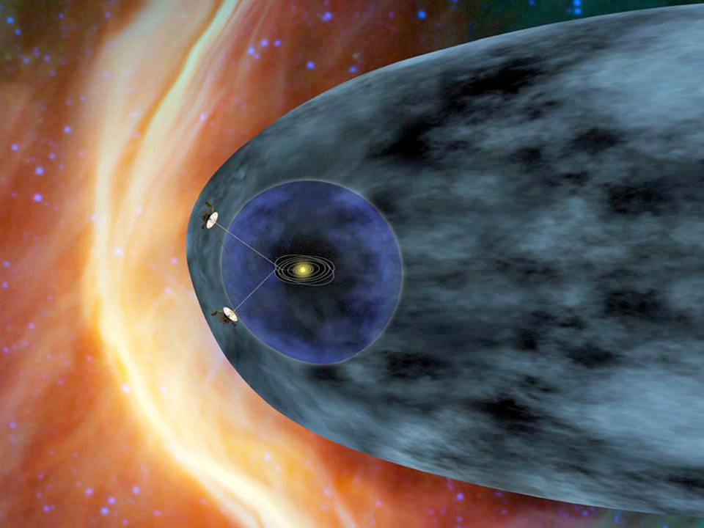
Heliosheath
Interstellar
Medium
V1
Termination Shock
V2

Slide 8
Some of the surprises learned

Slide 9
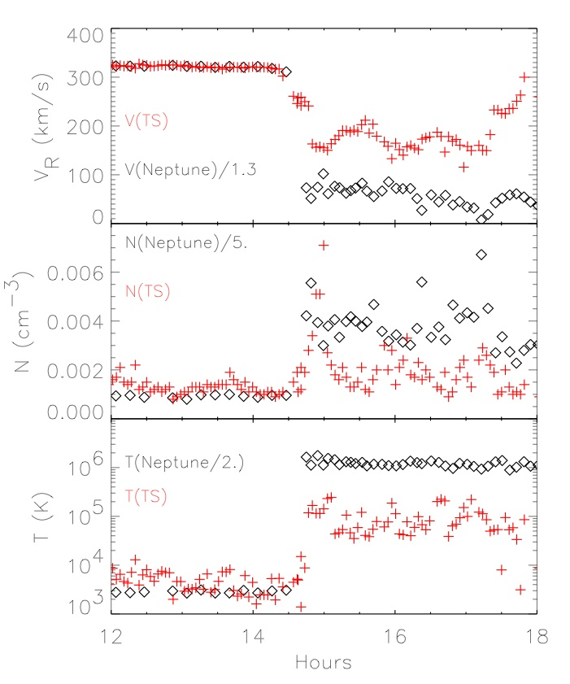
Crossing of the Termination Shock by Voyager 1 in December 2005 and Voyager 2 in August 2008
Shock is much colder than expected
~ 80% of the energy goes into supra-thermal particles
Discovery of a new paradigm:
Pickup ions carry most of the
pressure
Richardson et al. Nature 2005

Slide 10
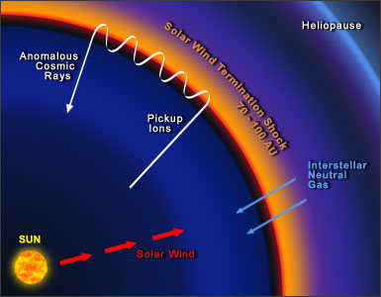
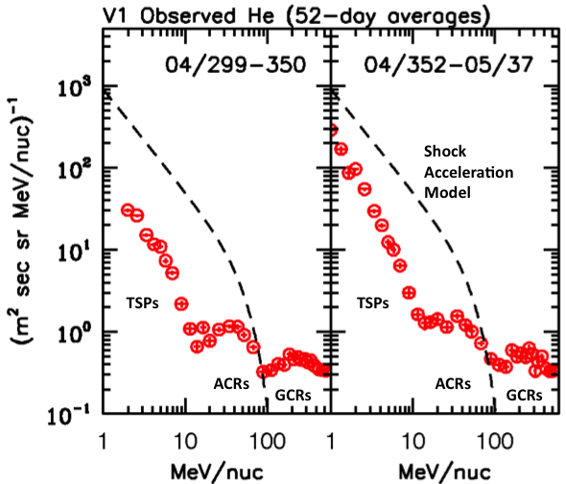
Source of Anomalous Cosmic Rays
Several proposed theories:
Termination shock more efficient
accelerator along the flanks
(McComas and Schwadron ‘06)
Heliosheath Turbulence (Fisk and Gloeckler ’06)
- Reconnection in the heliosheath (Lazarian and Opher ‘09; Drake et al. ‘10)
No evidence of the source of anomalous cosmic rays
Voyager-1 revealed that anomalous cosmic rays ≈ are not peaked at the termination shock.

Slide 11
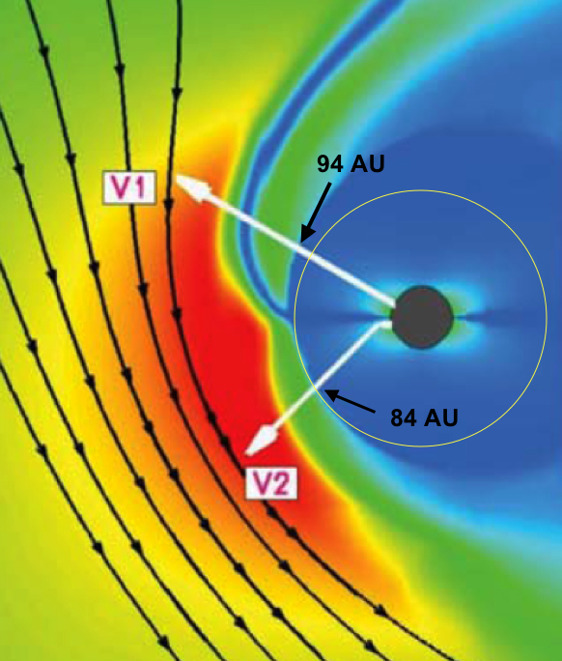
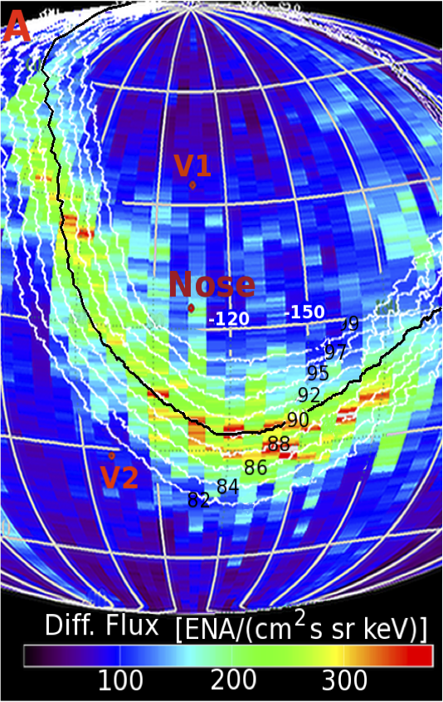
Discovery of the Influence of the Interstellar Magnetic Field on the Heliosphere
Asymmetric Heliosphere
Opher et al. ApJL 2006
Schwadron et al. Science 2009
Also observations [by SOHO/SWAN, Voyager, IBEX, and Cassini/INCA] indicate the influence of the interstellar magnetic field on the heliosphere.
Time Dependent effects account for a motion of 3 AU only (Richardson et al. Nature 2008)

Slide 12
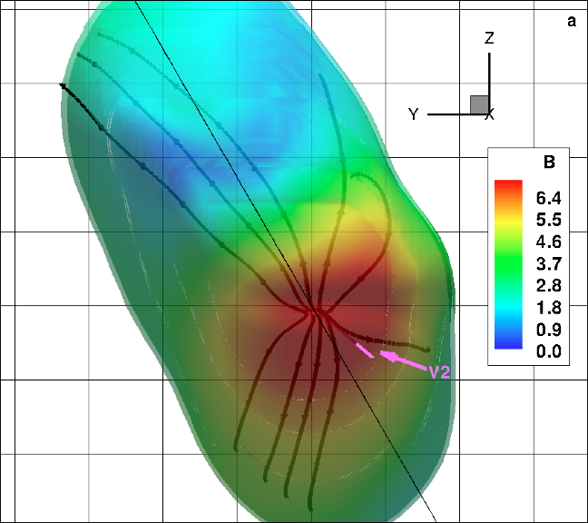
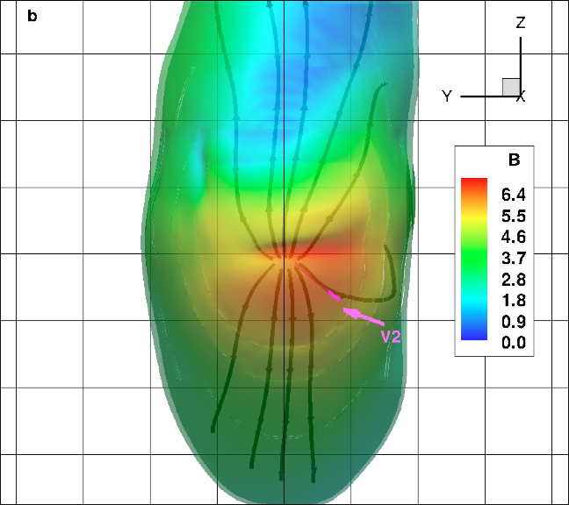
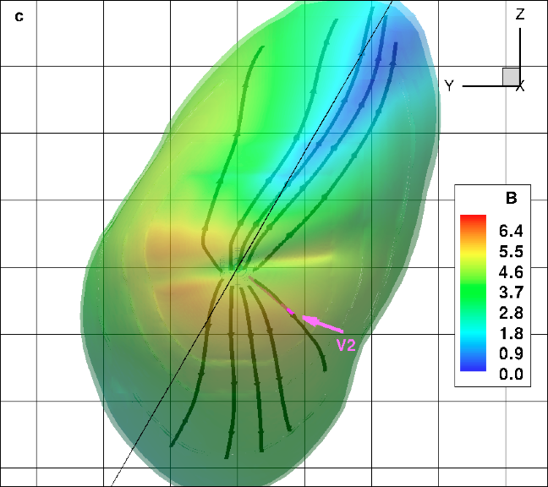
Local Interstellar Magnetic Field
Opher, Stone & Gombosi Science (2007);
Opher et al. Nature (2009)
B is 3.7-5.5μG, tilted ~20-30° from
the flow direction in the interstellar
medium and is at an angle of about
30° from the Galactic plane.
Direction different than the field
in large scale (along the galactic plane)
This is the field that can reproduce the several heliospheric asymmetries detected by Voyager
Other possible constrains: IBEX ribbon (e.g., Pogorelov & Heerikhuisen ApJ 2011; Ratkiewicz et al. 2009);

Slide 13
Observations in the heliosheath that are key challenges to heliospheric models

Slide 14
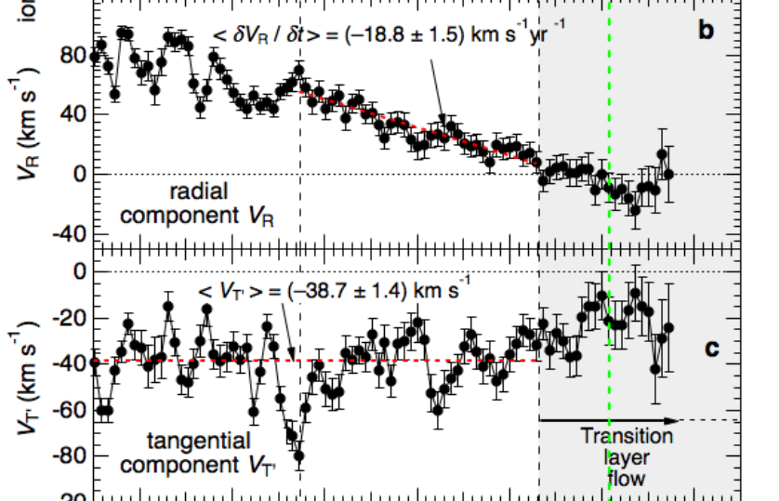
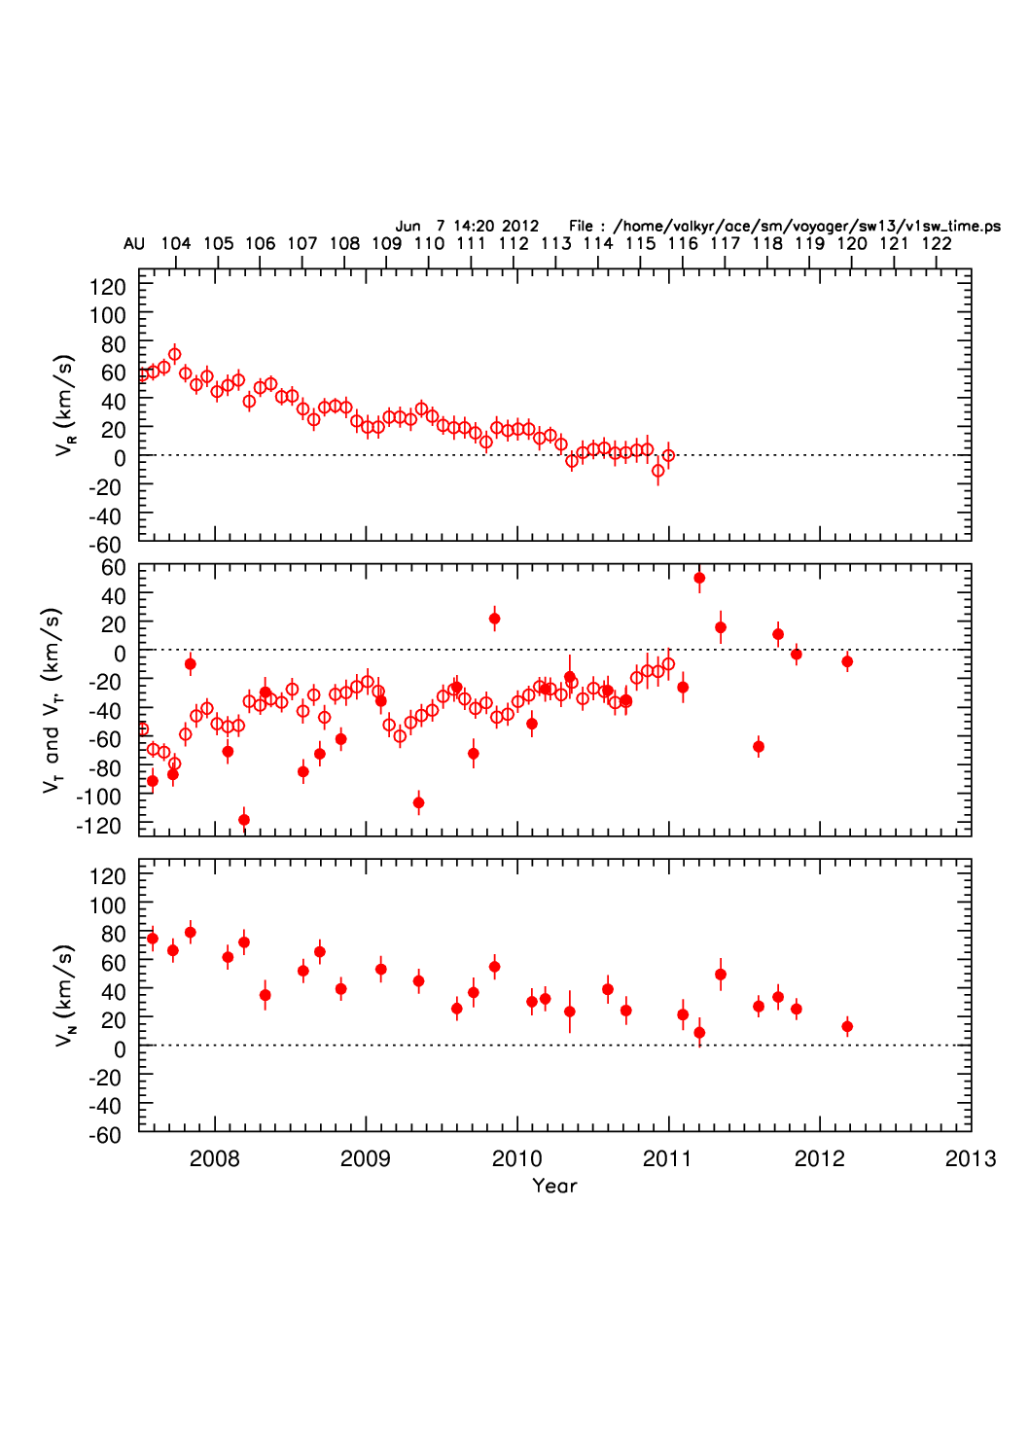
Why the speeds at Voyager 1 and 2 are so different?
What causes the stagnation region seen at Voyager 1?
LECP
Quasi-stagnation region from 113 to >121 AU
Solar wind did not turn in the N-direction
All components decreased
CRS
80
Stone & Cummings
ICRC 2011
60
40
V_{N}
20
0

Slide 15
Measurements at Voyager 2
Constant V_{R}; and V_{T} ~ 50-80km/s; V_{N} ~ 50 km/s

Slide 16
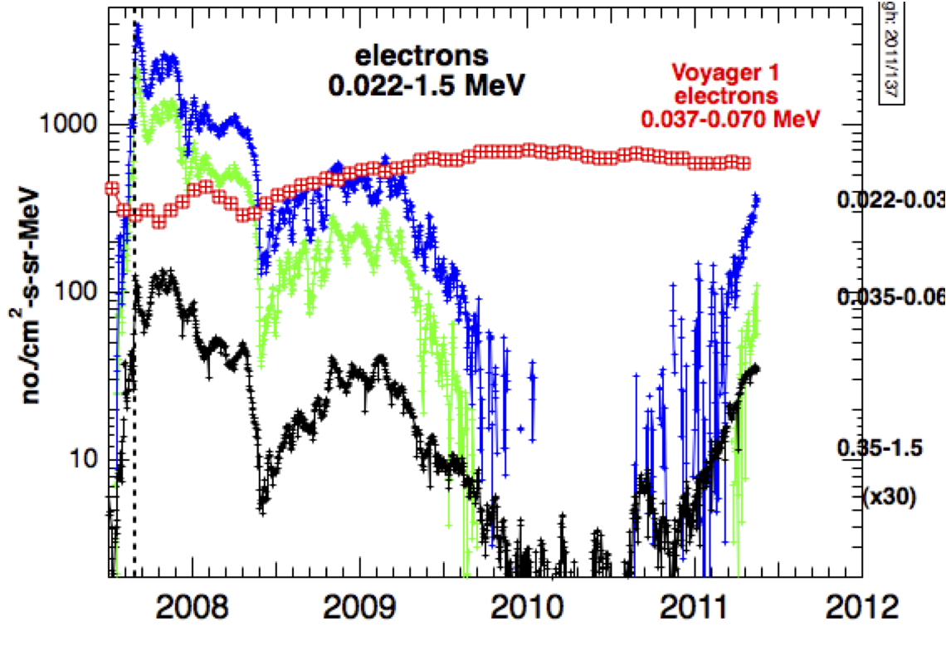
What causes the dropouts of electrons and the most energetic ACRs at Voyager 2?
Shaded areas: periods when V2 was outside the sector region

Slide 17
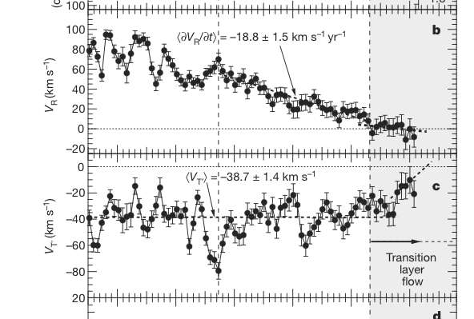
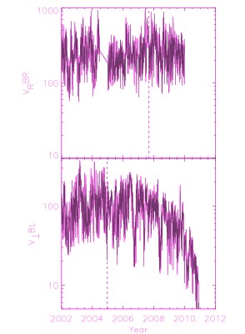
What happened to the missing azimuthal magnetic flux at Voyager 1?
Expect corresponding increase in magnetic field
Voyager 2
Conservation of magnetic flux:
B_{T} V_{R} R = constant
Voyager 1
However, while VR
was decreasing B was constant
<B> = 0.1
Richardson et al. 2013

Slide 18
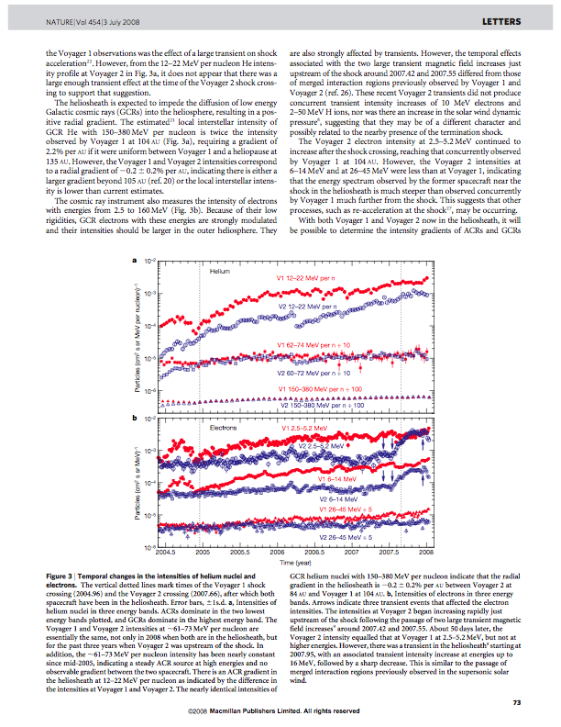
Why does the ACR spectrum roll out well into the heliosheath?

Slide 19
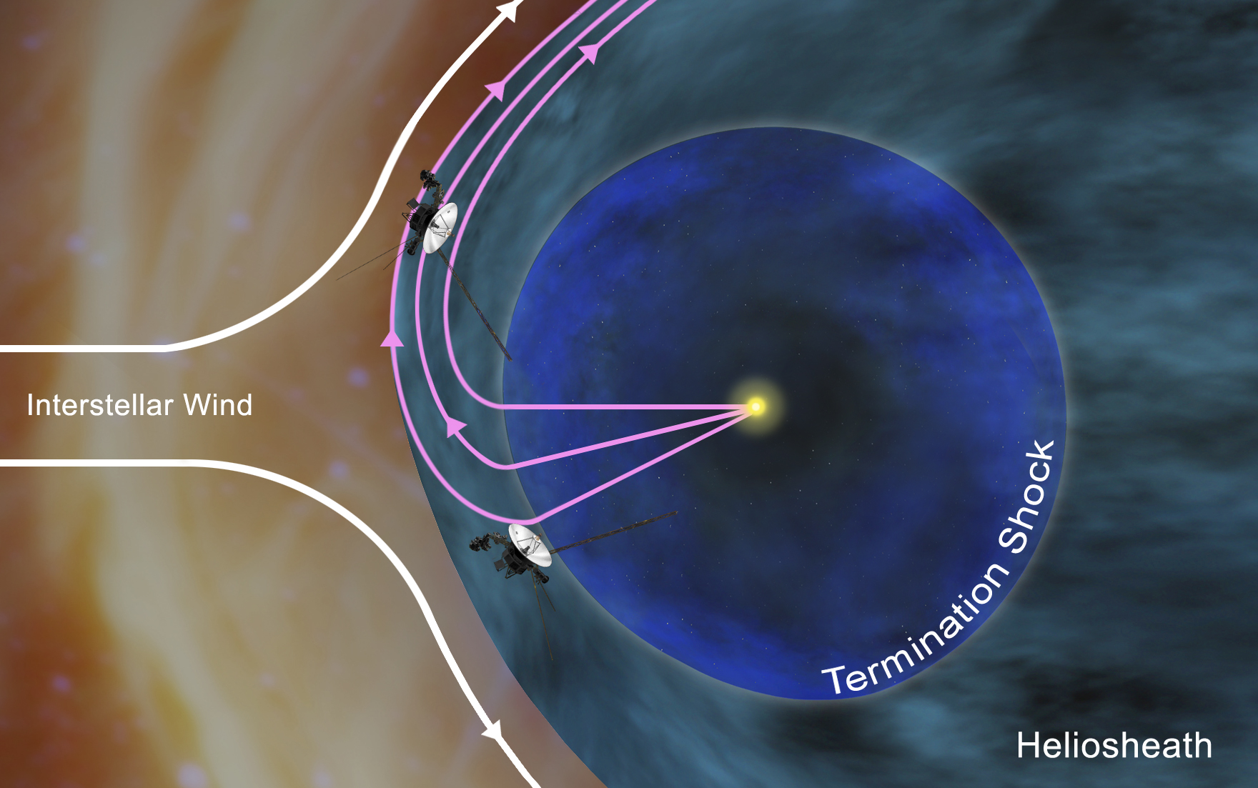
Nature of the Heliosheath: Spatial or Temporal?
Notes:
----- Meeting Notes (2/19/13 17:35) -----
mention that there are several groups studying time dependent effects

Slide 20
Key observational challenges for outer heliosphere models
Why does the ACR spectrum roll out well into the heliosheath? (reconnection, flank termination shock, turbulence)
What causes the dropouts of ~1MeV electrons and the most energetic ACRs at Voyager 2? (reconnection)
What causes the flow stagnation region seen at Voyager 1? (time dependence, reconnection)
What happened to the missing azimuthal magnetic flux at Voyager 1? (reconnection)
Reconnection of the sectored magnetic field can potentially explain all of these observations

Slide 21
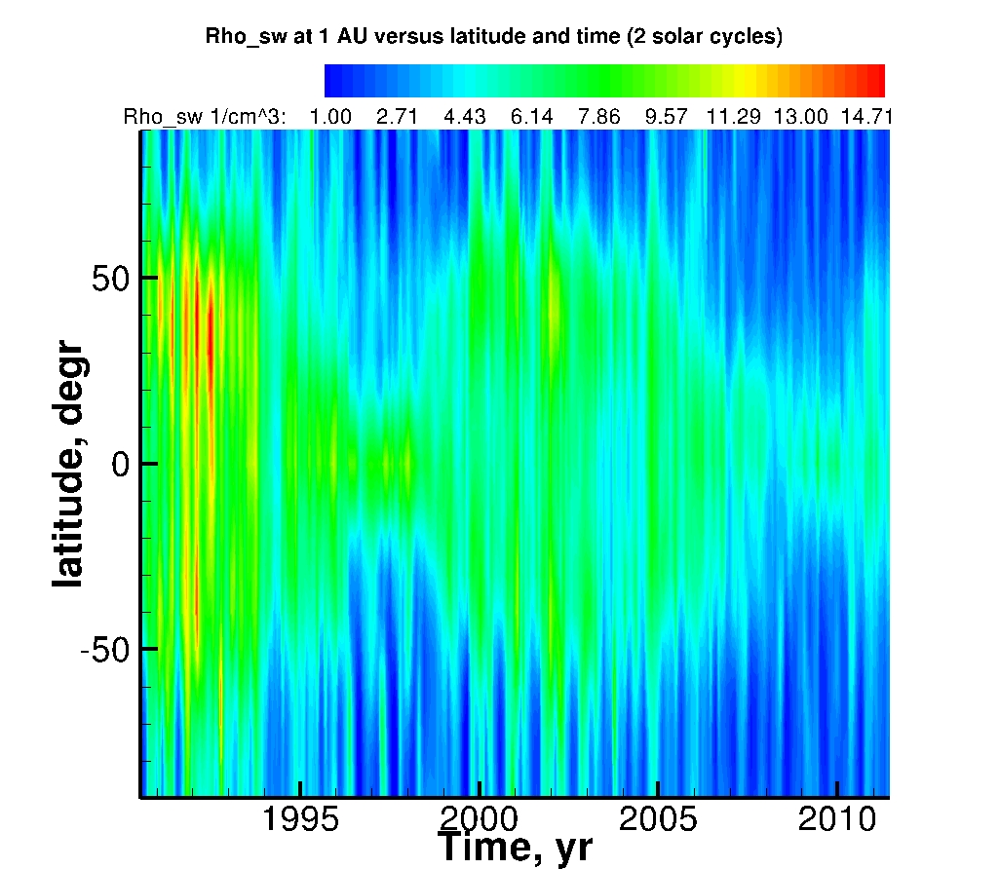
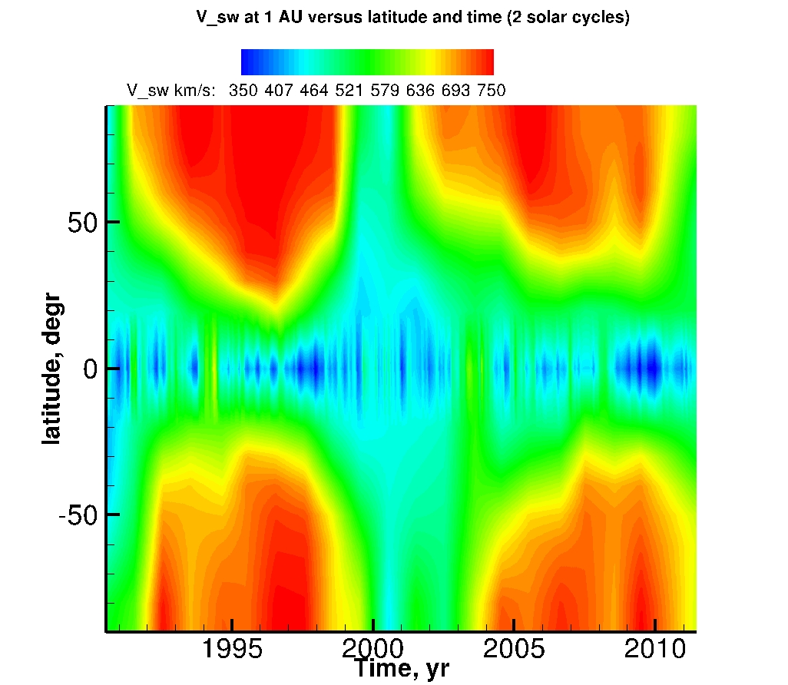
3D outer heliosphere with realistic solar cycle boundary conditions (time and heliolatitude variations)
Solar wind density and velocity at 1 AU as the functions of latitude and time (1991-2011). Density is derived from the measurements of backscattered Lyman-alpha emission (Quemerais et al. 2006, Lallement et al. 2010). Velocity is obtained from from the interplanetary scintillation data (Sokol et al. 2012)
Provornikova et al. 2013
Fig.1. Solar wind density and velocity at 1 AU as the functions of latitude and time (1991-2011). Density is derived from the measurements of backscattered Lyman-alpha emission (Quemerais et al. 2006, Lallement et al. 2010). Velocity is obtained from the interplanetary scintillation data (Sokol et al. 2012)
Notes:
1D model gas dynamic model spherical symmetric expansion from 1-3D. Charge-exchange+photoionization included

Slide 22
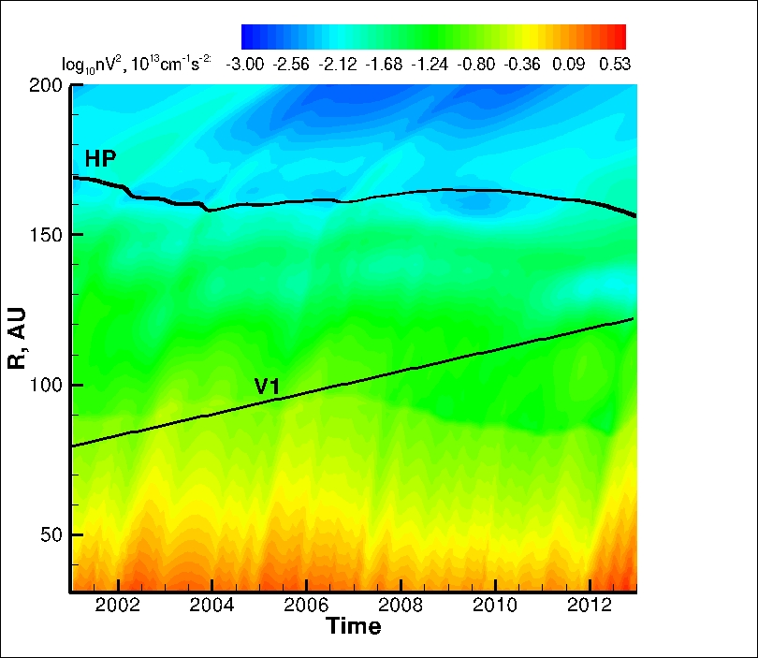
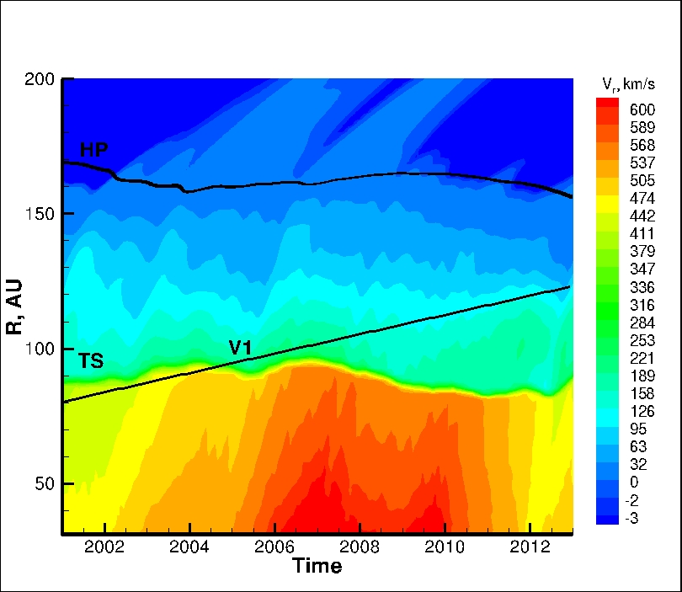
Voyager 1
Ram pressure
Radial velocity
Even though this simulation overestimate the variations of ram pressure more than observed, it does not reproduce V1 observations of zero V_{r} in the stagnation region

Slide 23
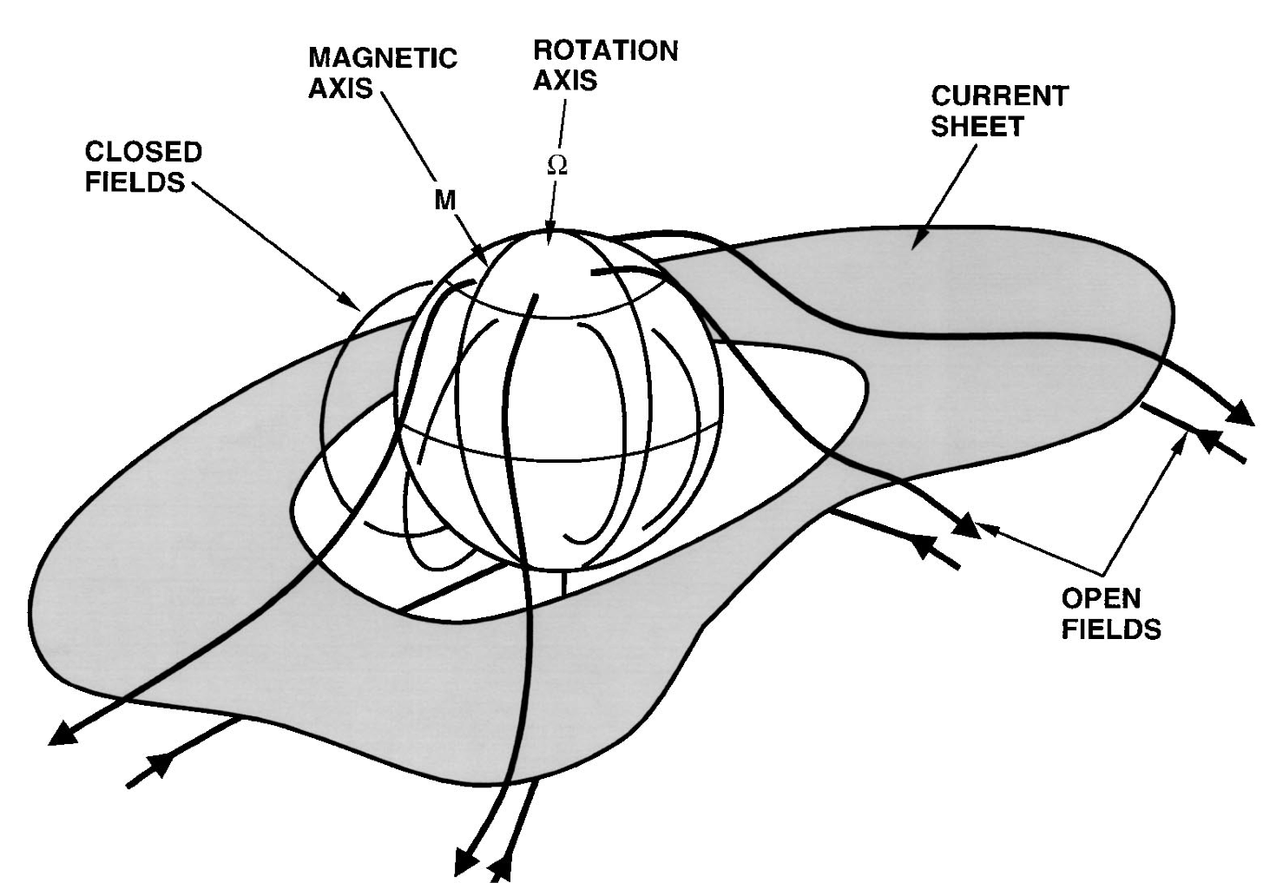
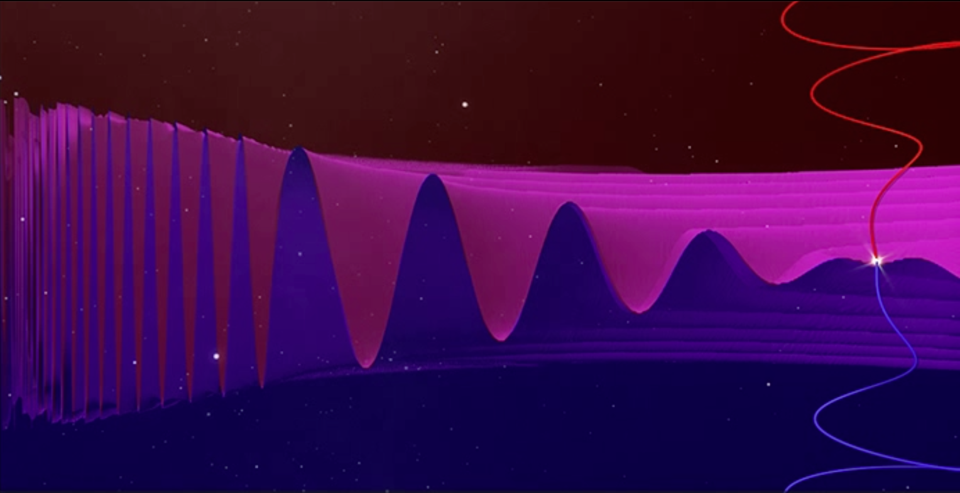
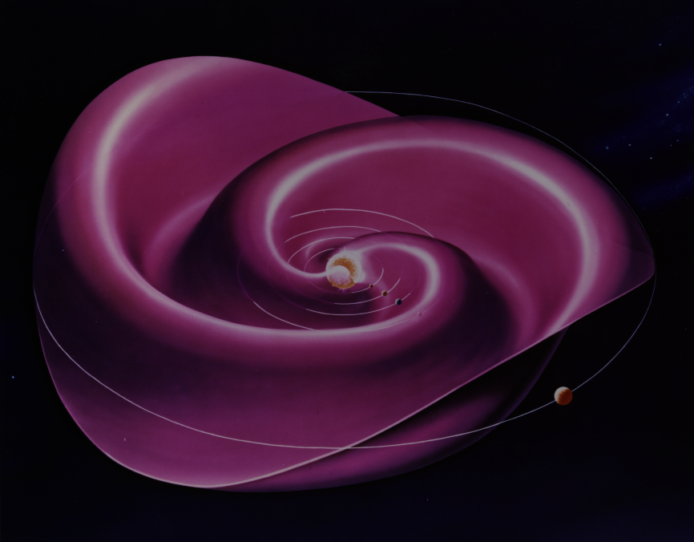
Effects of sector structure of the heliospheric field in the heliosheath
The Parker spiral field (dominantly B_{ϕ}) produces the heliospheric current sheet
Misalignment of the magnetic and rotation axes causes the current sheet to flap
Periodic reversal of B_{ϕ}
Sectors get compressed after the shock
Heliospheric current sheet

Slide 24
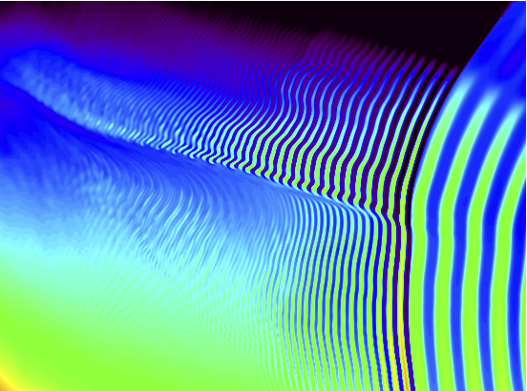
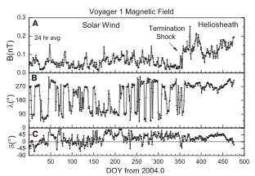
Onset of Collisionless Reconnection
The sectors get closer as they approach the HP
Collisionless reconnection onsets when the current layer falls below the ion inertial scale
Reconnection simulations (Cassak et al ’05), lab experiments (Yamada ‘07), magnetosphere observations (Phan et al ’07)
Parameters upstream of the Termination Shock (TS)
HCS thickness ~ 10,000 km based on 1AU –Winterhalter et al. 1994
This is a significant uncertainty – need 48s mag data upstream
Ion inertial scale ~ 8400 km (n ~ 0.001/cm^3)
Parameters downstream of the TS
HCS thickness ~ 3,300 km based on compression from upstream
Ion inertial scale ~ 4800 km (n ~ 0.003/cm^3)
Collisionless reconnection should onset in the HS
Similar compression and onset seen in Earth’s magnetosphere (Phan et al ‘07)
Magnetic Field
Speed

Slide 25
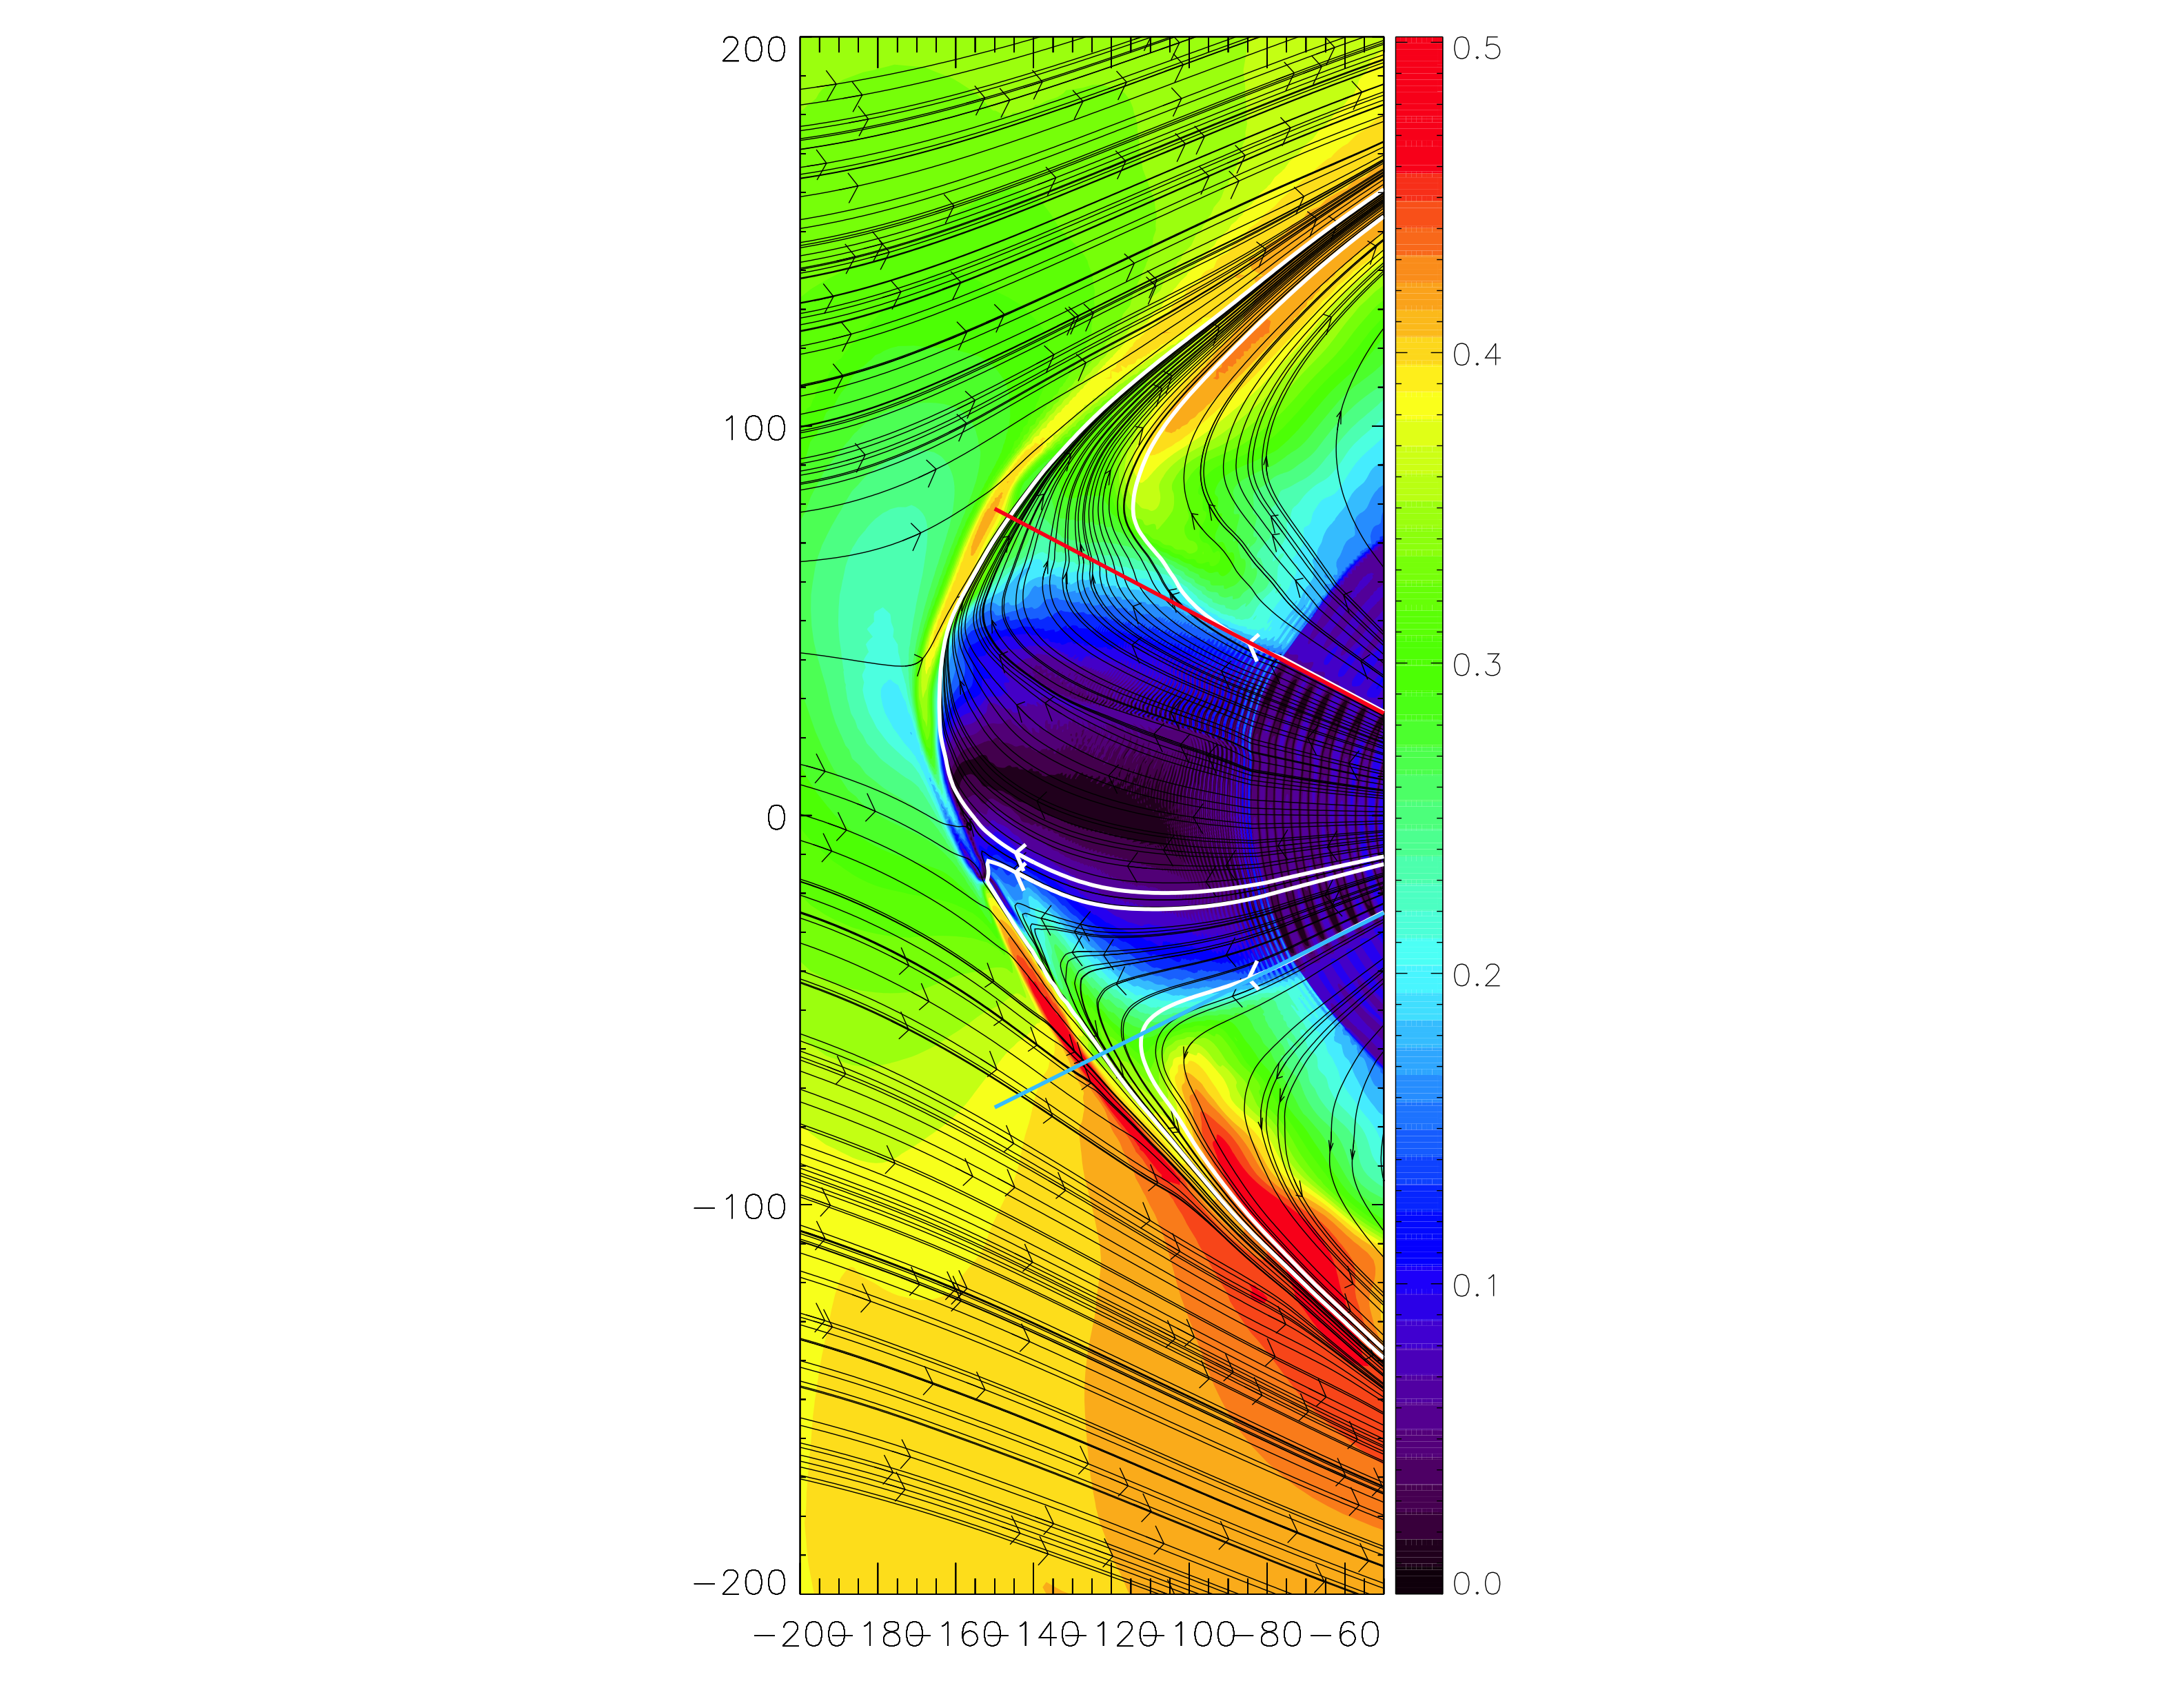
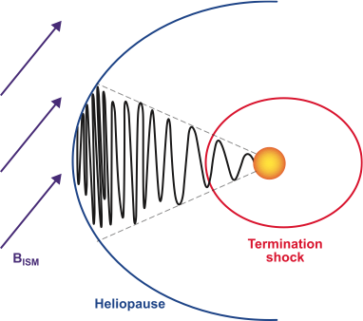
The structure of the sectored magnetic field
Opher et al. ApJ 2011
o
Sectors get closer to each other after the crossing of the Termination Shock
Our 3D MHD simulation resolved the sector allowing for reconnection to occur
(works such as Czechowski et al. (2010) and Borovikov et al. (2011) did include the tilt, but did it kinematically)

Slide 26
Simulation with a Sector Boundary of ±30°
Opher et al. ApJ 2011

Slide 27
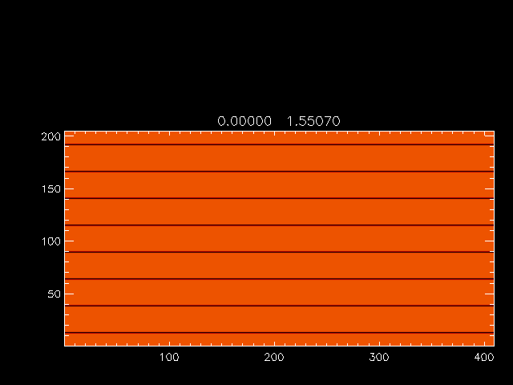

Slide 28
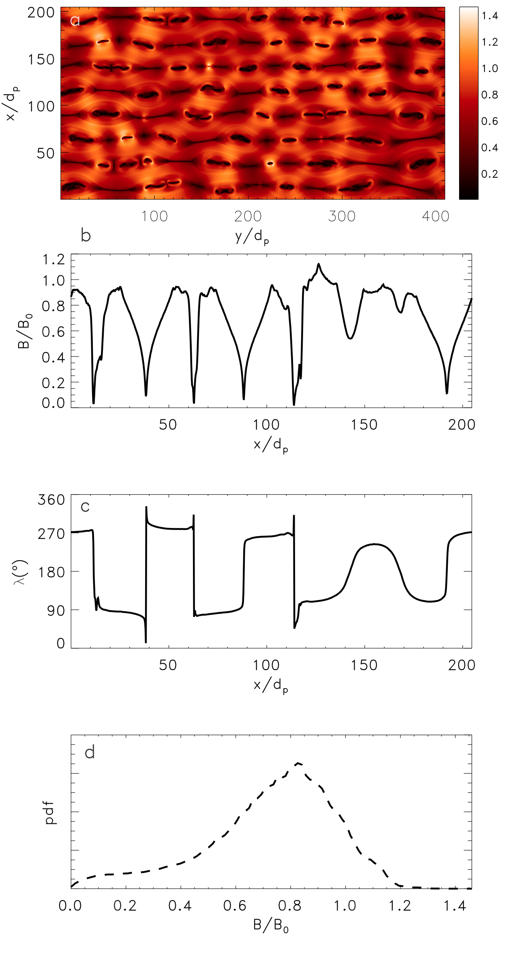
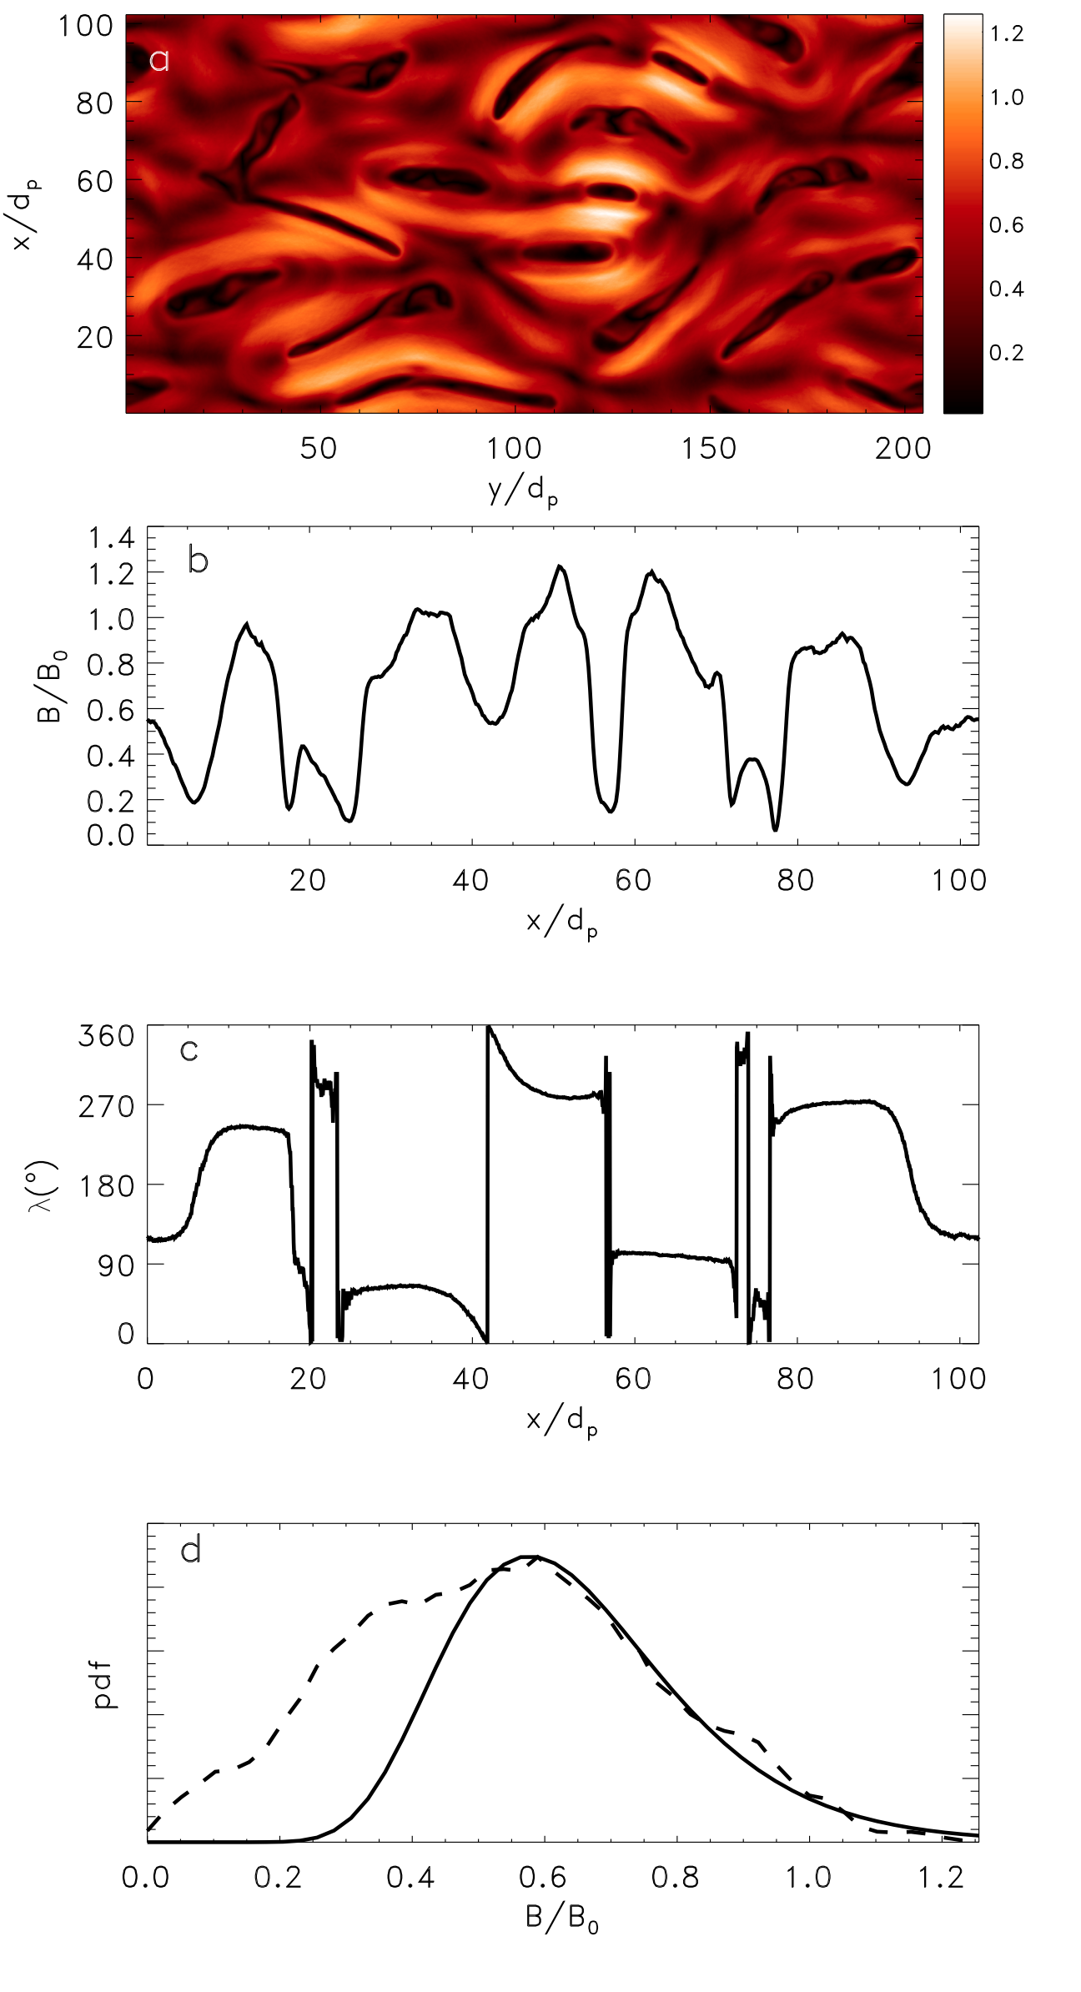
“Bubbles” stage: signatures very different than the usual signatures of reconnection
B
B
B
B
λ
λ
Early in time
“Bubbles”: Later in time

Slide 29
Firehose condition
Evolution of the Islands
Depend on the Plasma β
Contracting islands increase the parallel particle pressure
Within islands bump against the firehose condition
This condition limits island contraction
No tension in magnetic fields when the firehose condition is violated
β=0.1
β=5.0
β = particle pressure/magnetic pressure

Slide 30
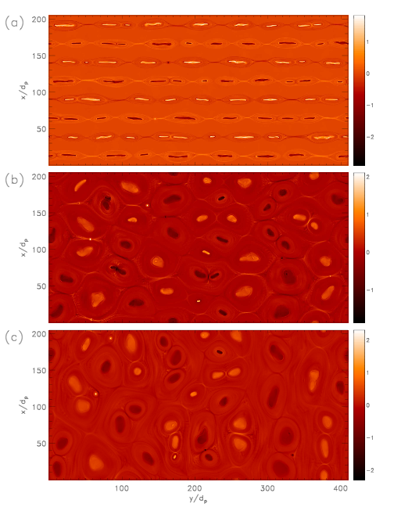
A reconnection model of the ACRs
Drake, Opher, Swisdak et al ApJ 2010
The sectored field is stable to reconnection upstream of the TS because the width of the current sheet is wider than the ion inertial length
Collisionless reconnection is very weak
The current layers compress on their approach to the heliopause
This is well documented in the case of the Earth’s magnetosphere
Dissipation of nearly all of the magnetic energy ~ 85%
The original idea was this will happen only close to the HP- we extended it (Opher et al. 2011) that it can happen downstream the TS

Slide 31
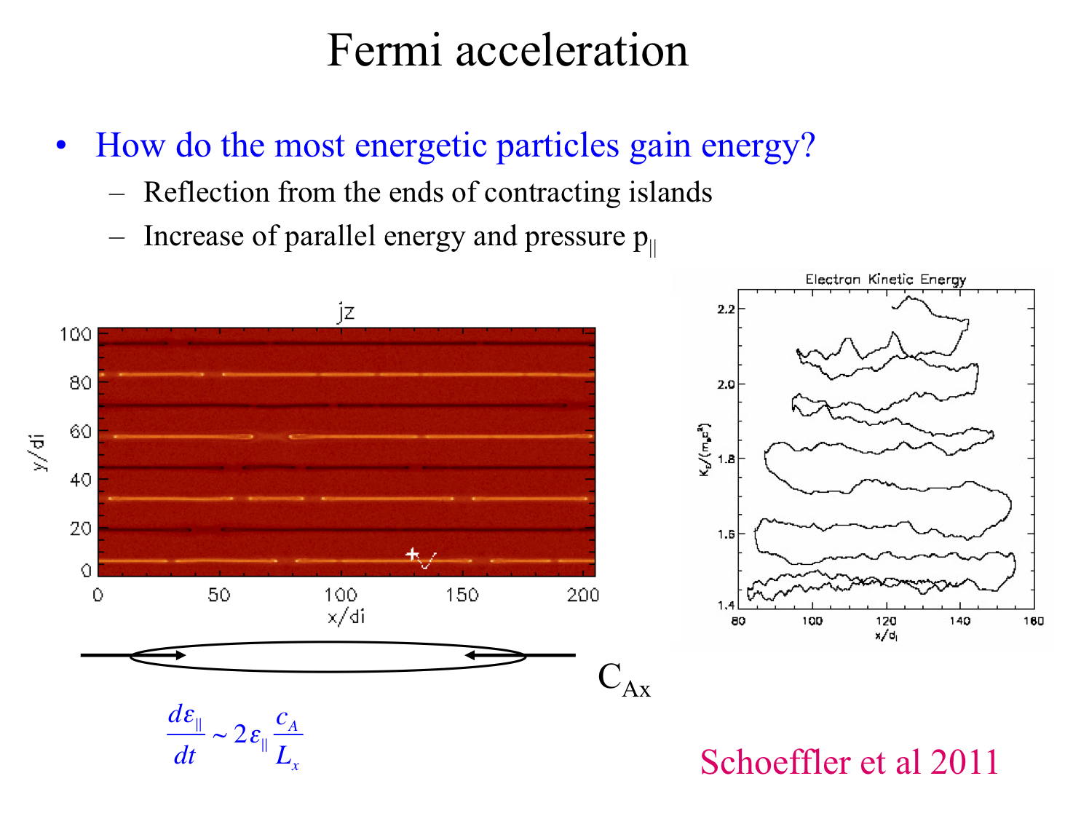

Slide 32
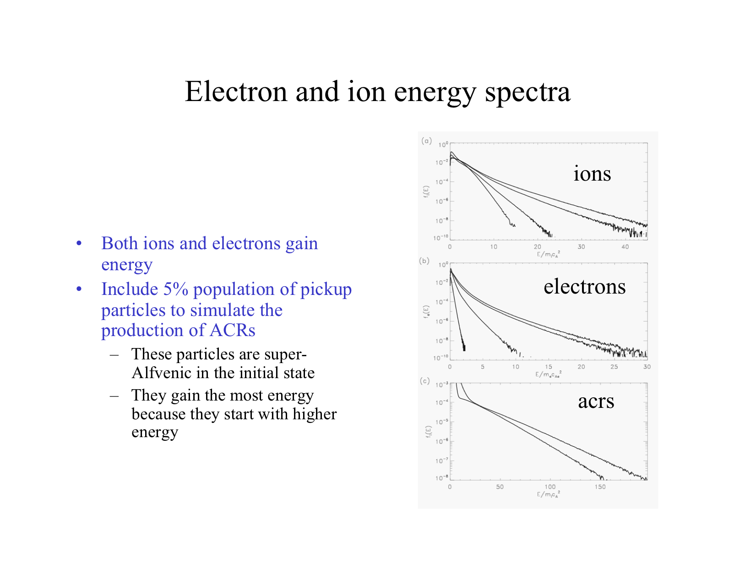

Slide 33
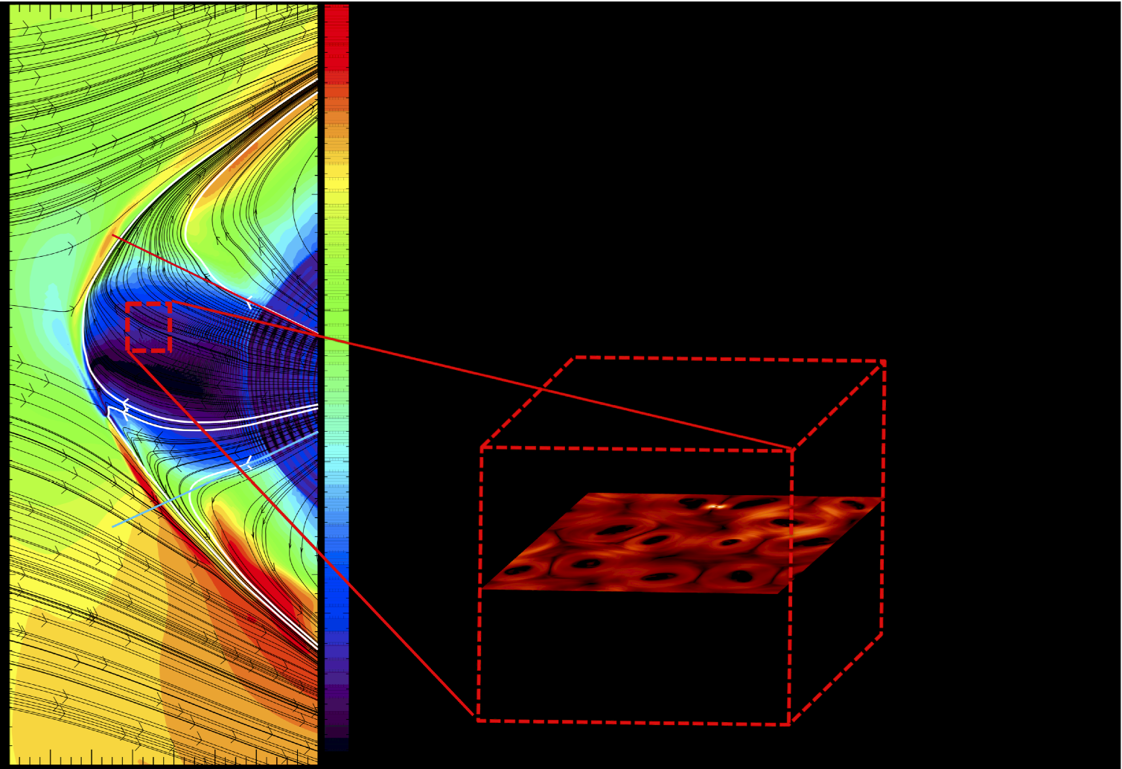
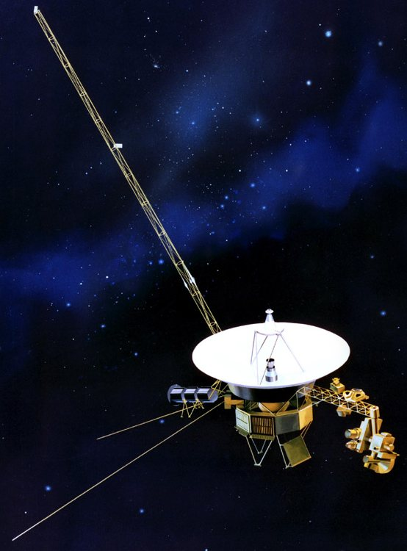
The outer heliosheath inside the sector region is filled “bubble”-like structures of magnetic field- the bubbles are convected to higher latitudes by the heliosheath flows
HP
flows
Opher et al. ApJ 2011
Notes:
Second bullet: we can also say that at late times in the reconnection process;
Can get triggetered?

Slide 34

Transport inside the sector will be different than outside
Bubbles act as local traps of energetic electrons (both GCR and low-energy)
Galactic electrons enter the heliosphere by percolating upstream through the “bubbles” regions of the sector region of the heliosheath
The edges of the sector region act as loss boundaries
Electrons leaving the sector region quickly migrate into the inner heliosphere
V1
heliopause
Galactic electrons
V2

Slide 35
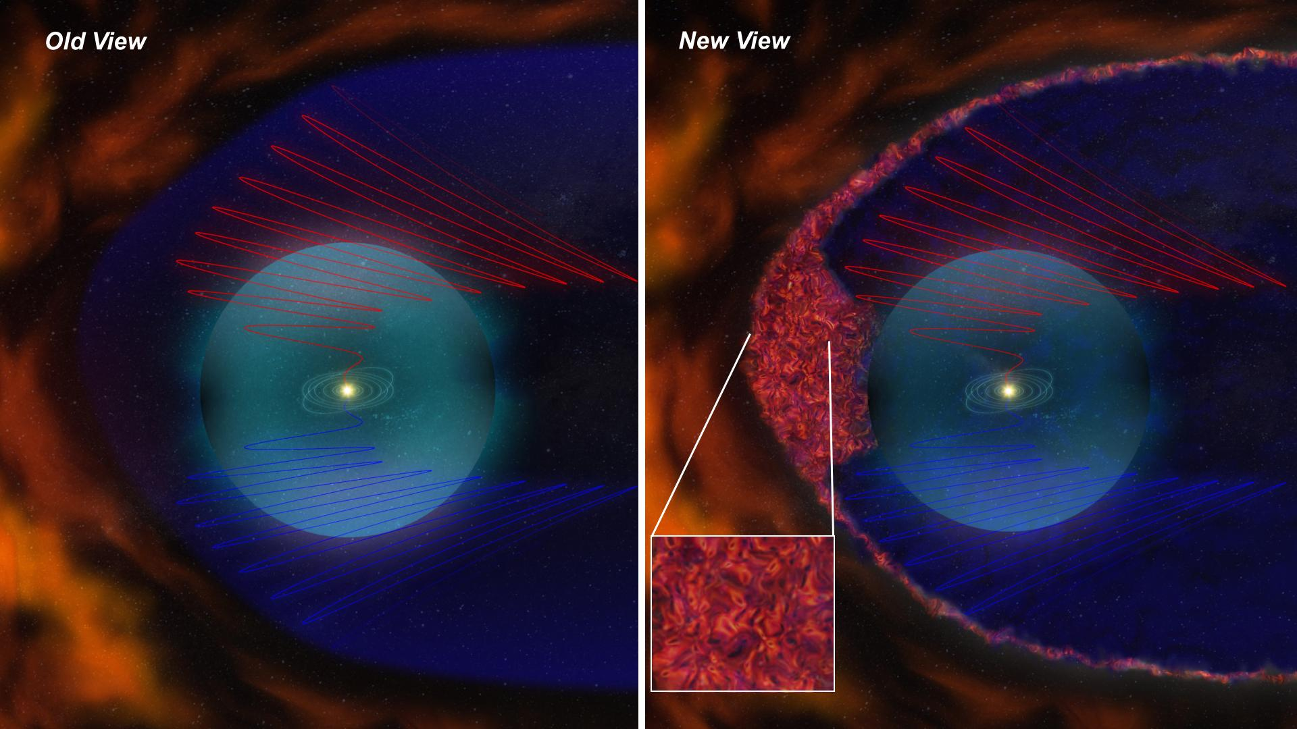
Old and a New View: The permeable heliosphere

Slide 36
Observations
Implications of Reconnection for Flows Dynamic
Change in the gradient of VR in April 2010; VR ~ 0km/s and negative
Thickness of the “Transition Layer Flow” of at least 7AU.
VT start increasing at the end of 2011.

Slide 37
Zoom in the Heliosheath
Simulation with the sector
region
Simulation without the sector
region

Slide 38
Two Different Flows in the Heliosheath
Opher, Drake et al. ApJ 2012
Magnetic Field act as a skeleton organizing the flows in region 2
Flows in region 1: filled with disconnected magnetic structures (no magnetic tension)
behaves as un-magnetized flows
Flows in region 2: magnetized

Slide 39
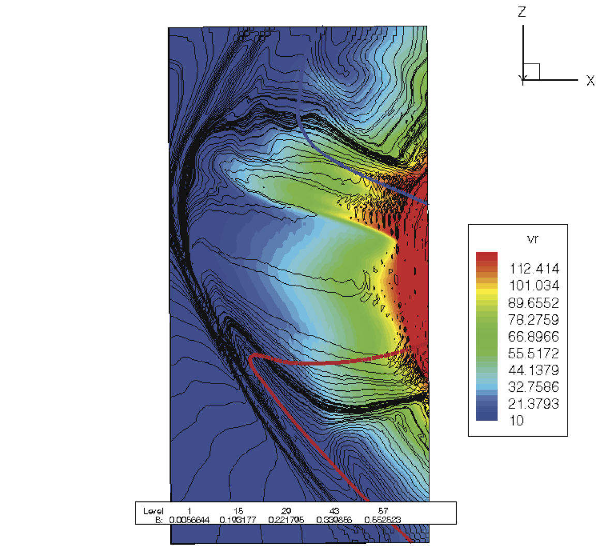
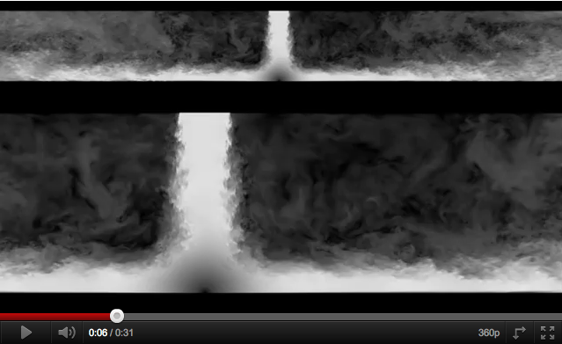
Radial Flows: More collimated inside the sector

Slide 40
Flows near the HP (Stagnation Region)
Spatial or Temporal Feature
Opher et al. 2012
The reconnection in the sector creates two type of flows in the heliosheath (Opher et al. 2012).
Global feature: a stagnation region at all latitudes in front of the HP
Other proposals: temporal (Washimi et al. 2011; Pogorelov et al. 2012)
Notes:
----- Meeting Notes (12/2/12 12:46) -----
show the extension of the stagnation region in AU

Slide 41

Porous Heliopause
In this scenario the HP is not just a tangential discontinuity but
a porous boundary

Slide 42

Interstellar magnetic field
Spiral magnetic field from solar rotation is east-west
Interstellar magnetic field is inclined about 60° to the east-west direction
When crossing the HP one should expect a change in magnetic field due to draping.
Opher et al. 2006
Acknowledg. Ed Stone

Slide 43


Heliopause Reconnection: PIC Magnetic Field
Swisdak et al. in prep
2013
Cuts from MHD model
(Prested et al. 2012)

Slide 44

Where is the Heliopause?
When Voyager 2 will enter similar region?
Porus Heliosheath: Entered region magnetically connected to outside
( Aug 25, 2012)
Termination Shock

Slide 45

Thank you!
AMNH, “Journey to the Stars”, 2009

