Slide 1


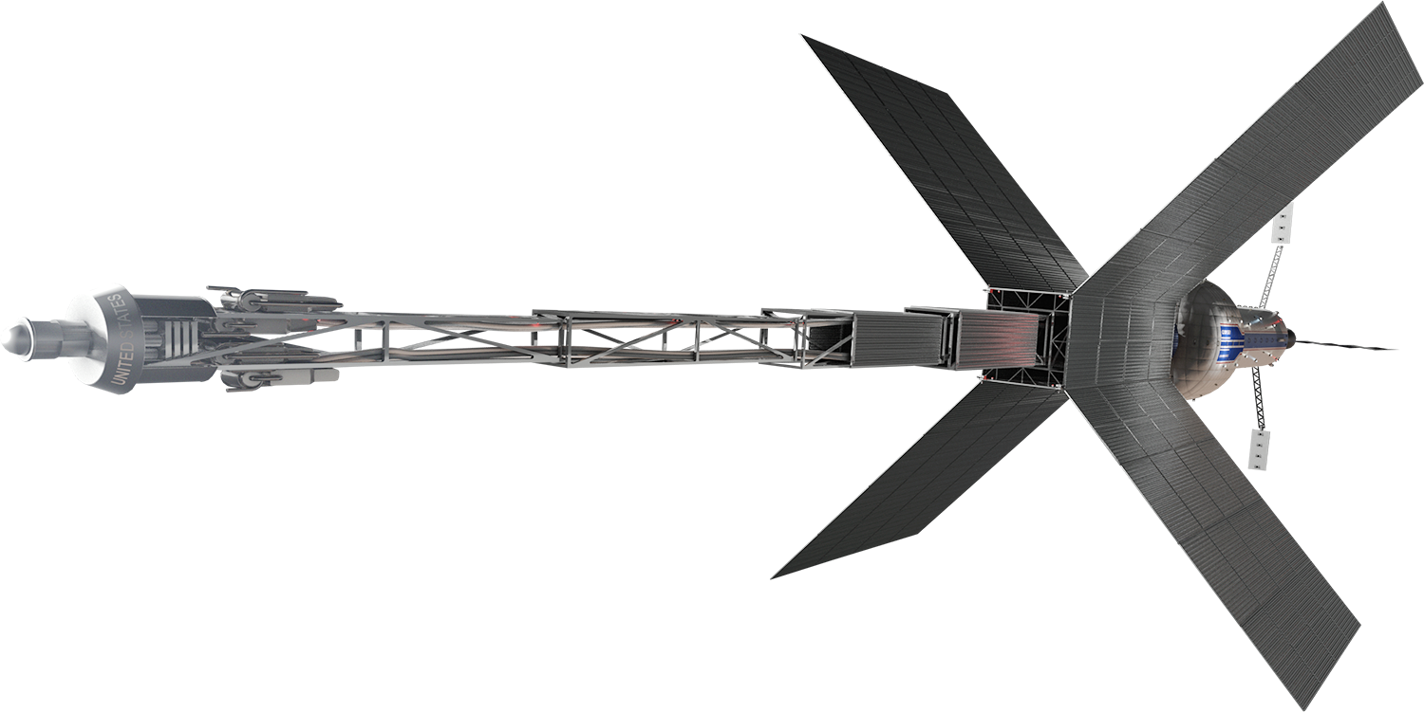
Critical Development Challenges and Potential
Advancement Paths for Megawatt-Scale
Nuclear Electric Propulsion Systems
Lecture to the Michigan Institute for Plasma Science and Engineering
30 November 2022
NASA – George C. Marshall Space Flight Center
Space Nuclear Propulsion (SNP) Project
Dr. Kurt Polzin, SNP Project Chief Engineer

Slide 2

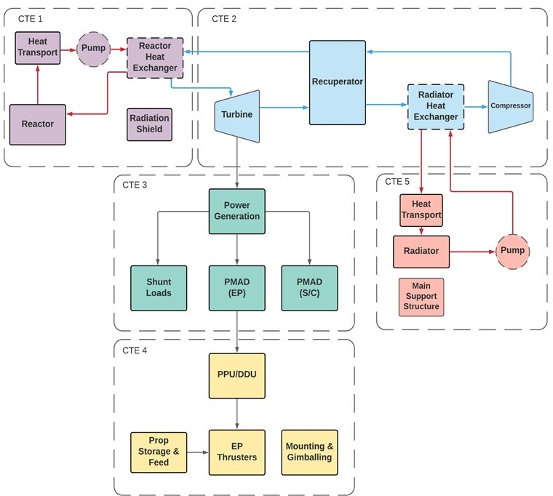
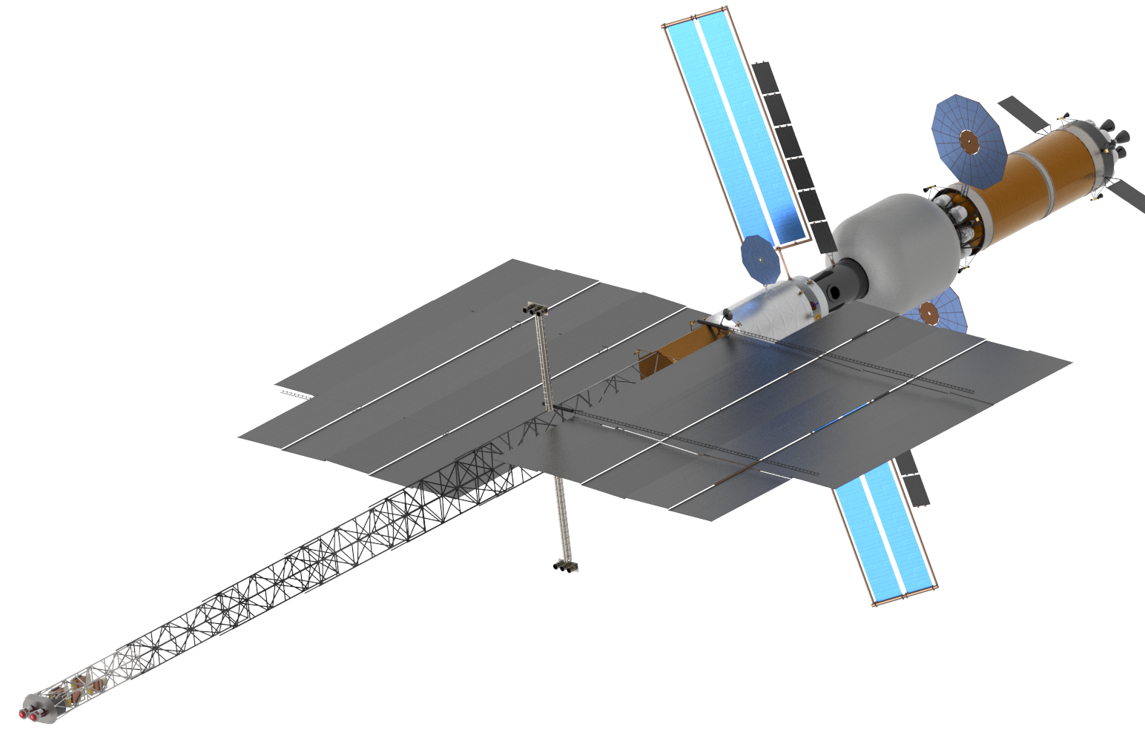
SPACE NUCLEAR PROPULSION
Nuclear Electric Propulsion (NEP): Introduction
  Nuclear reactor heat → Electricity → Electric thrusters
  System Critical Technology Elements (CTEs):
    CTE 1: Reactor and Coolant Subsystem (RXS)
    CTE 2: Power Conversion Subsystem (PCS)
    CTE 3: Power Management & Distribution (PMAD) Subsystem
    CTE 4: Electric Propulsion Subsystem (EPS)
    CTE 5: Primary Heat Rejection Subsystem (PHRS)
CTE 5
CTE 4
Note: This block diagram is illustrative. Not all items shown may be needed; some needed items may not be shown.
CTE 2
Example NEP-Chem Configuration
CTE 3
CTE 1

Slide 3
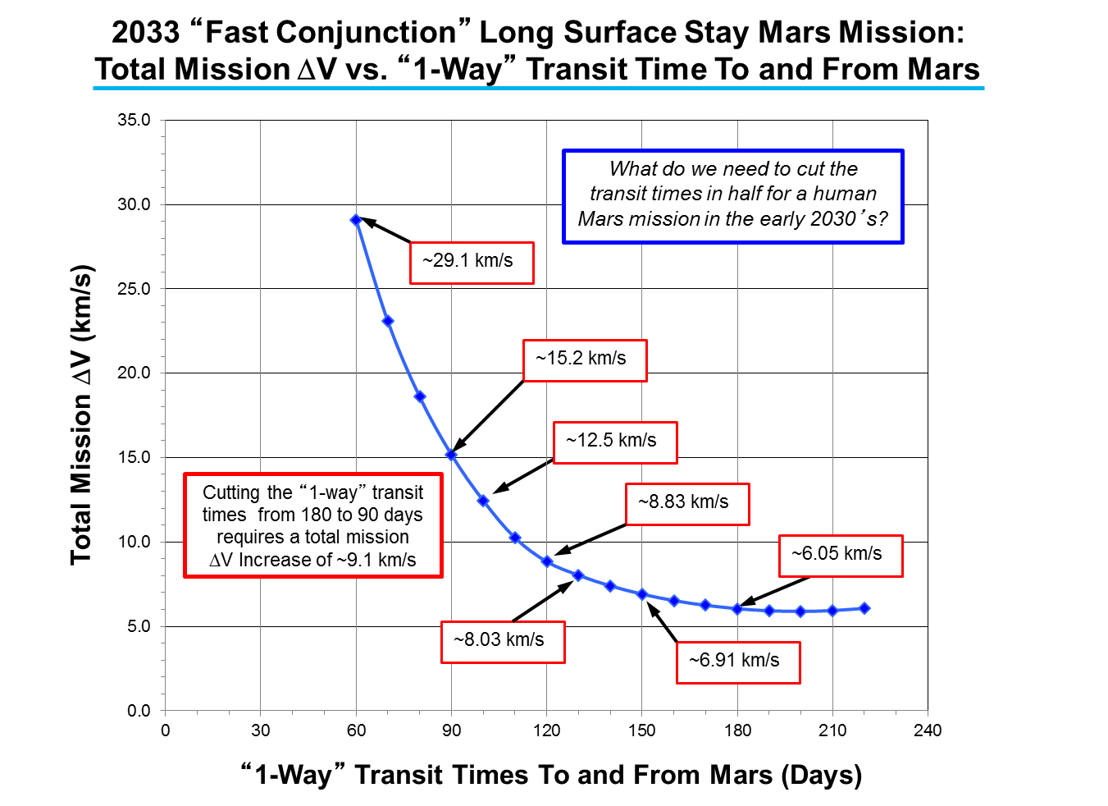
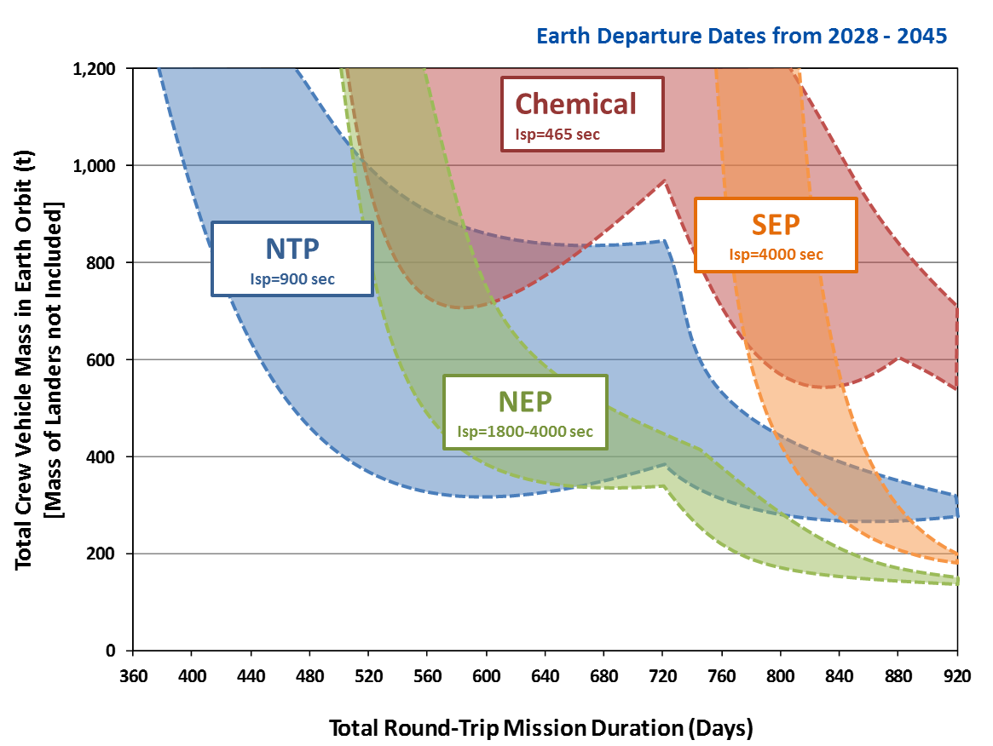
SPACE NUCLEAR PROPULSION
Why Nuclear Propulsion for Human Missions to Mars?
Short Stay Opposition Mission with Earth Departure Dates 2028-2045
High Delta V capability → potential shorter trip time (reduce exposure to galactic cosmic radiation and zero-g)
Mission robustness and potential abort scenarios
Fewer rocket launches → save time and $$$
Huge potential for growth over current capabilities

Slide 4
SPACE NUCLEAR PROPULSION
Fission-based – Different from Previous NASA “Nuclear”
Launched ‘hot’
Fission
Launched ‘cold’
U-235
Radioisotope
U-234
γ
Neutron
Neutrons
(
2.5)
5.5 MeV
190 MeV*
Fissile Nucleus
γ
Pu-238
(U-235)
α
(He-4)
Product Nuclei
U-235
(KE ­ 168 MeV)
Heat Energy = 0.023 MeV/nucleon (0.558 W/g Pu-238)
Natural decay rate (87.7-year half-life)
Heat Energy = 0.851 MeV/nucleon
Controllable reaction rate (variable power levels)
Heat produced from natural alpha (α) particle decay of Plutonium (Pu-238)
Long history of use by US
  44 Radioisotope Thermal Electric (RTGs)
  100s of Radioisotope Heater Unit (RHUs)
Thermal management and electricity
Heat produced from neutron-induced splitting of a nucleus (e.g. U-235)
Heat converted to electricity or used to directly heat a propellant
Used terrestrially for over 70 years
One flow US space power reactor (SNAP-10A) (1965)
TOPAZ reactors flown by USSR

Slide 5
SPACE NUCLEAR PROPULSION
Current Status of NEP According to Recent Independent Reviews
2020 - NASA Engineering and Safety Center (NESC) study findings:
  “The majority of critical technologies for… NEP/Chem… systems are relatively immature”
  “TRLs [technology readiness levels] in the literature are often overestimated”
  “The majority of critical technologies… for NEP/Chem… systems are at a relatively high level of advancement degree of difficulty (AD² > 4) for maturation, requiring a dual development approach”
  “The proper assessment of baseline TRL and AD² values and the estimation of requirements and resources required for advancement have been consistent issues for NEP,”
  “Non-advocate reviews should occur at the start of a technology program and at all key milestones.”
2021 - National Academies of Science, Engineering, and Medicine panel report findings:
  “Developing a MW_{e}-class NEP system for the baseline mission would require increasing power by orders of magnitude relative to NEP system flight- or ground-based technology demonstrations completed to date.”
  “Subscale in-space flight testing of NEP systems cannot address many of the risks and potential failure modes associated with the baseline mission NEP system. With sufficient M&S [modeling & simulation] and ground testing, including modular subsystem tests at full scale and power, flight qualification requirements can be met by the cargo missions that will precede the first crewed mission to Mars. Fully integrated ground testing may not be required.” (emphasis added)
  “As a result of low and intermittent investment over the past several decades, it is unclear if even an aggressive program would be able to develop an NEP system capable of executing the baseline mission in 2039.”

Slide 6
SPACE NUCLEAR PROPULSION
Challenge #1: High Assay Low-Enriched Uranium (HALEU)
Lower proliferation/security risks → Lower project cost
Allows broader engagement of expertise
Aligns with other projects developing systems to use LEU
Higher mass than HEU systems
  Initial Moderated LEU (< 20%) Conceptual Designs Very Promising
  Consistent with US policy. “The United States is committed to eliminating the use of HEU in all civilian applications, including in the production of medical radioisotopes, because of its direct significance for potential use in nuclear weapons, acts of nuclear terrorism, or other malevolent purposes.” (2012 White House “Fact Sheet”)
    Space Policy Directive 6 also mandates use of LEU in most cases
    National Security Presidential Memoranda (NSPM) 20 – Rules governing launch approval authority
  Can Space Nuclear Systems Using Low-Enriched Uranium (LEU) be Developed?

Slide 7
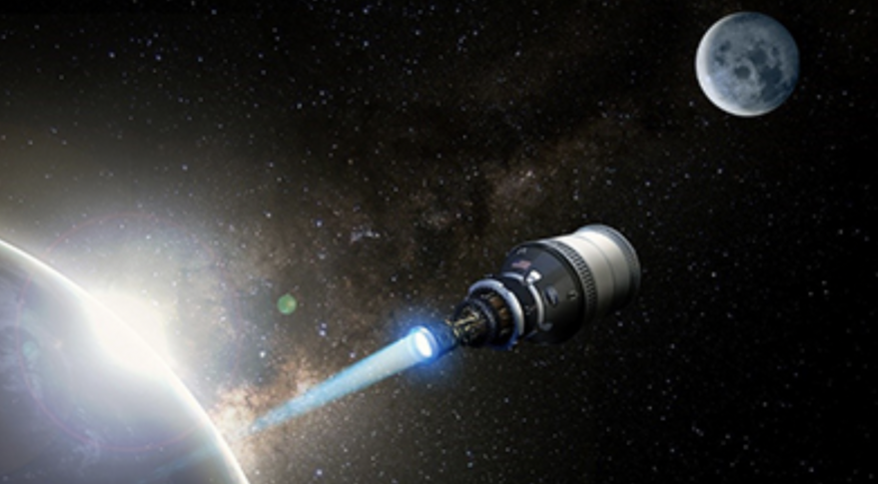
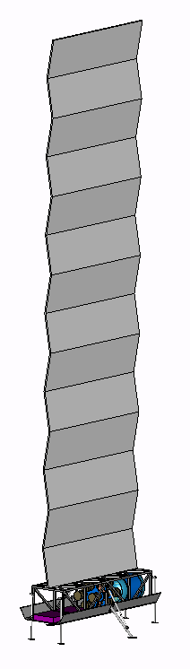
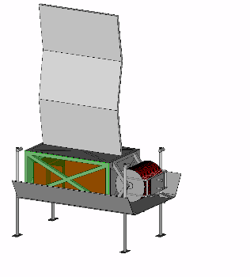
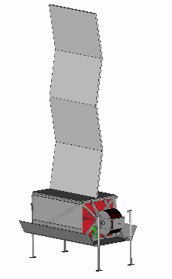
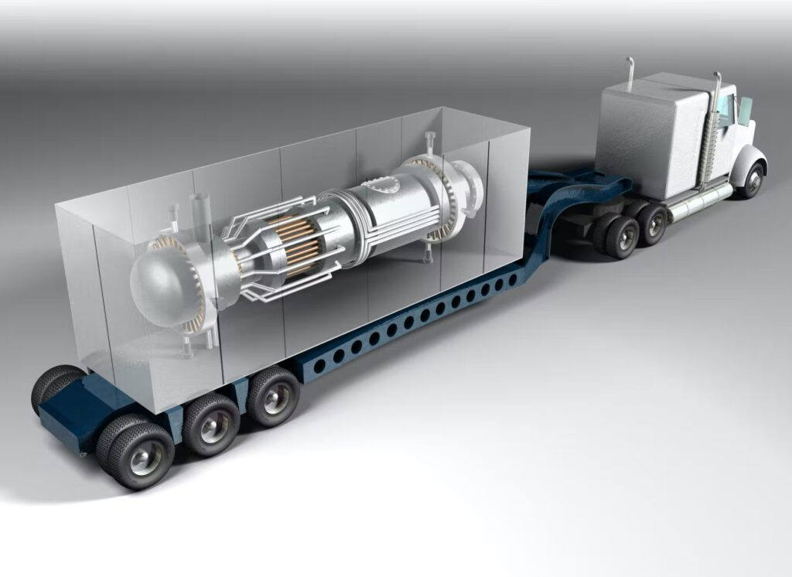
SPACE NUCLEAR PROPULSION
High-Profile HALEU Nuclear Projects
For In-Space Use
NASA Space Nuclear Propulsion (SNP) (NTP and NEP)
NASA Fission Surface Power (FSP) (10s kW_{e})
DARPA Demonstration Rocket for Agile Cislunar Operations (DRACO) (NTP)
AFRL/USSF Joint Energy Technology Supplying On-Orbit Nuclear Power (JETSON) (NEP) (10s kW_{e})
For Terrestrial Use
DOE and Commercial Terrestrial Microreactors (10-20 MW_{e})
DOD Strategic Capabilities Office (SCO) Project Pele (1-5 MW_{e})
DRACO Concept (SpaceNews, May 2022)
User I/F
Down-Converter
Pallet
1 km
Reactor Pallet
50 m
NASA FSP Concept
Controller Pallet
Mobile Microreactor Concept (PowerMag, April 2022)

Slide 8
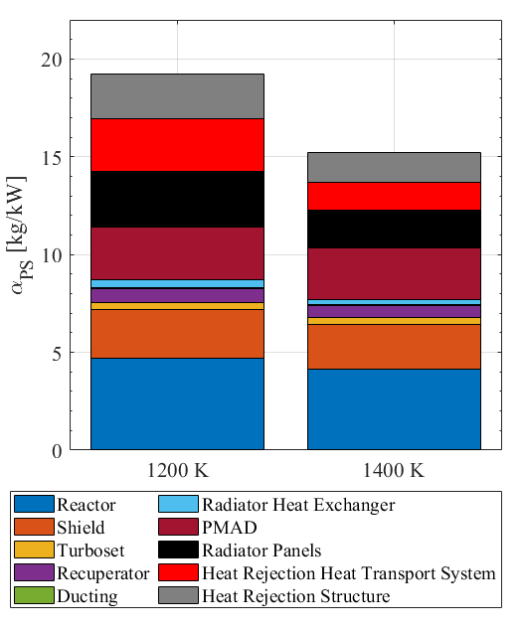

SPACE NUCLEAR PROPULSION
Challenge #2: NEP Power System
  ≥ 25,000 hours of continuous operation
  Reactor
    Similar to terrestrial, but hotter
    Not as hot as NTP
  Power Conversion
    Closed cycle
    Want a hot inlet
    Don’t want highest possible efficiency
  Heat Rejection (Radiators)
    $P=ϵσA\left(T_{rad}^{4}−T_{background}^{4}\right)$
    Want lightweight radiator at high temperature and emissivity
Closed Brayton Cycle Power Generation System
2 MW_{e} gas cooled reactor mass breakdown for PCIT of 1200 and 1400 K
Harnack et al., AIAA ASCEND, 2022. AIAA 2022-4288
  Radiators are largest, heaviest component of NEP system – reduce overall system mass at higher T

Slide 9
SPACE NUCLEAR PROPULSION
Challenge #3: Electric Propulsion System (Hall Thruster)
  NEP Propulsion Requirements
  ≥ 20,000-30,000 hours of continuous operation
  Multi-MW_{e} power throughput
  No flight experience at 10 kW_{e} or above
  Hall Thruster (Xe-fed)
    ~5 kW_{e} operational flight systems
    12.5 kW_{e} AEPS for Gateway/PPE (not yet flown)
    Brief ground tests at 100 kW_{e} on large lab-model thrusters
    Relatively massive (magnetic circuit materials)
    Difficult to pump Xe
Conceptual Hall Thruster Schematic

Slide 10
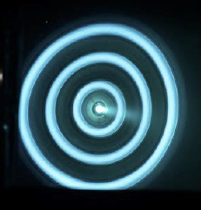
SPACE NUCLEAR PROPULSION
Challenge #3: Electric Propulsion System (Hall Thruster)
  Hall Thruster (Xe-fed)
    Challenges
      Multi-thruster high-power thruster plume and spacecraft interactions / facilities impacts – validity of ground test data
      Simultaneous operation of multiple thrusters in proximity and at power
      Power Processing Unit / Direct-Drive Unit (high power w/AC input)
      Cathode lifetime (very high currents … >> 100 A emission)
      Thruster size / stock materials availability
      Xe-propellant storage (high-pressure supercritical or cryogenic)
NASA-457 v2 Hall Thruster
U of M Nested Hall Thruster

Slide 11
SPACE NUCLEAR PROPULSION
Challenge #3: Electric Propulsion System (MPD Thruster)
  NEP Propulsion Requirements
  ≥ 20,000-30,000 hours of continuous operation
  Multi-MW_{e} power throughput
  No flight experience at 10 kW_{e} or above
  Magnetoplasmadynamic (MPD) Thruster (Li-fed)
    No operational flight systems
    Ground tests up to 500 kW_{e} at 500 hours on a lab-model thruster (minimal cathode erosion)
    Inherently high-power thruster
    Test facility cold-wall ‘pumping’
Conceptual MPD Thruster Schematic

Slide 12
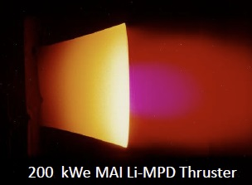
SPACE NUCLEAR PROPULSION
Challenge #3: Electric Propulsion System (MPD Thruster)
  Magnetoplasmadynamic (MPD) Thruster (Li-fed)
    Challenges
      Long-duration cathode lifetime
      Anode degradation (avoiding spot-mode discharge / ‘onset’)
      Power Processing Unit at scale (high power w/AC input)
      High-current transients on start-up / shut-down
      Limited performance database

Slide 13

SPACE NUCLEAR PROPULSION
Final Takeaways
NASA and DOE collaborating with industry and academia on SNP development efforts
  NEP Efforts
  Government-developed technology maturation plan to guide project direction and investments
  Multiple parallel development options to mature key technologies and systems
  Build and test hardware at relevant conditions (e.g., temperatures, power levels, 1 MW_{e} building blocks)
  HALEU fuel form opens door for increased participation (vs. HEU)
  Take advantage of recent and ongoing multi-agency nuclear investments
  Advance strategy that aligns with industry participation
    Including technologies not initially developed for space nuclear applications (electric aircraft, ground-based reactor designs and modeling tools)
  Work represents a broad national effort to develop the technologies and systems for Space Nuclear Propulsion and show those systems can be realized.

Slide 14
SPACE NUCLEAR PROPULSION
Questions
NASA – George C. Marshall Space Flight Center
Space Nuclear Propulsion (SNP) Project
Dr. Kurt Polzin, SNP Project Chief Engineer
kurt.a.polzin@nasa.gov

