Slide 1
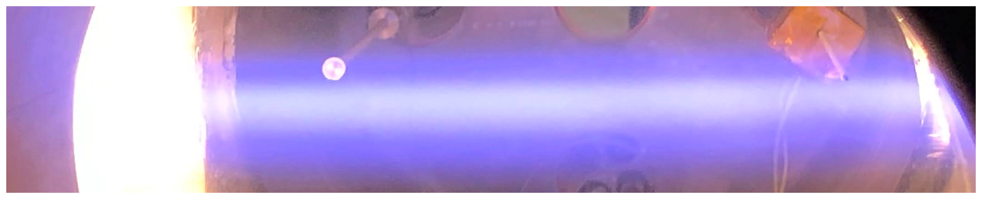
Electron-beam generated plasmas and their applications: from materials processing to space propulsion
Yevgeny Raitses
Princeton Plasma Physics Laboratory
MIPSE, Ann Arbor, MI
February 7, 2024

Slide 2







Nirbhav Chopra, Ivan Romadanov, Eduardo Rodrigues, Jacob Simmonds, Shurik Yatom, Igor Kaganovich, Santosh Kondeti, Sophia Gershman
Fang Zhao and Chris Tully (Phys.), Arthur Dogariu and Mikhail Shneider (MAE)
Andrei Smolyakov
Scott Walton, Lina Petrova, and David Boris
Kai-Mei Fu and Christian Pederson
Alex Likhanskii, Leonid Dorf, and Andrei Khomenko
Junhwi Bak and Gerardo Urdaneta Rincon

Slide 3
Synopsis
Electron beam generated plasma, intro
Focus on sub-10 keV, low power (< 1 kW), low current density < 1 A/cm²
Main applications: materials processing (e.g. ALE, ALD, polymer processing, )
Electron beams in our research
Princeton Collaborative Research Facility (PCRF)
Microelectronics and Quantum Information Systems (QIS)
Plasma propulsion
Takeaway notes
3
Notes:
3

Slide 4


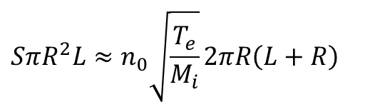
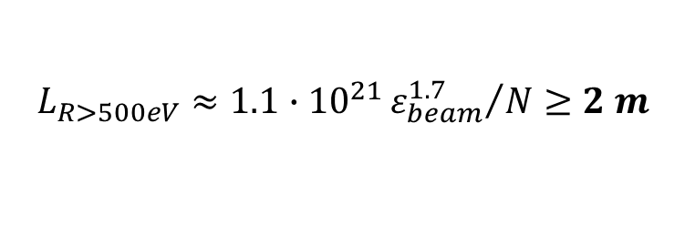
E-beam generated low temperature plasma
Energy relaxation length in inelastic range
e-Beam plasma without magnetic field
$$L_{R}≈\frac{ε_{beam}}{2\left({dε_{beam}}/{dz}\right)}≥L_{sys}$$
beam dump
(electron collector) or repeller)
cathode
plasma
Energy loss function
electrons
e-beam
ions
For $ε_{beam}≥$ 2 keV in 50 mtorr N₂ with neutral density N (m⁻³)
E
ions
$$L_{R>500eV}≈1.1∙{10}^{21}{ε_{beam}^{1.7}}/N≥2 m$$
Substrate for plasma treatment
S. Macheret, M. Shneider, R. Miles, Phys. Plasmas 13 (2006)
e-Beam required to generate the plasma
$$SπR^{2}L≈n_{0}\sqrt{\frac{T_{e}}{M_{i}}}2πR\left(L+R\right)$$
Beam electrons scattered on collisions with neutrals causing the beam expansion
R. F. Fernsler, W. M. Manheimer, R. A. Meger, et al., Phys. Plasmas 9 (1998)
Ionization by e-beam
Wall losses
$S \sim \frac{J_{b}}{e}\frac{1}{w_{i}}\frac{ε_{b}}{L}$
Notes:
4

Slide 5
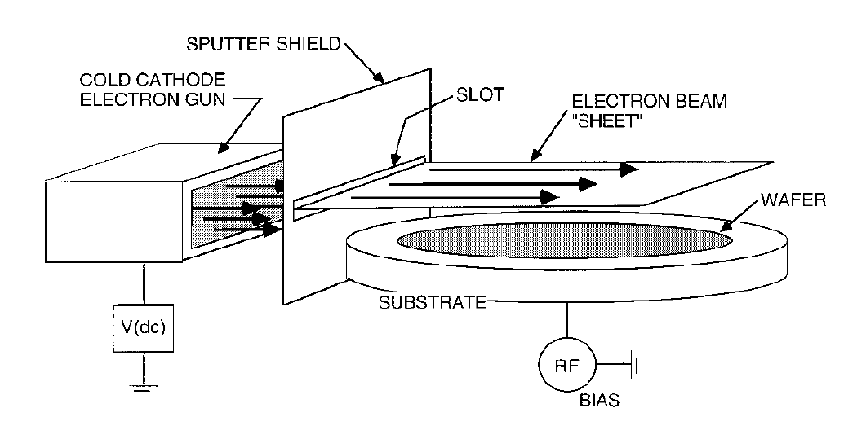
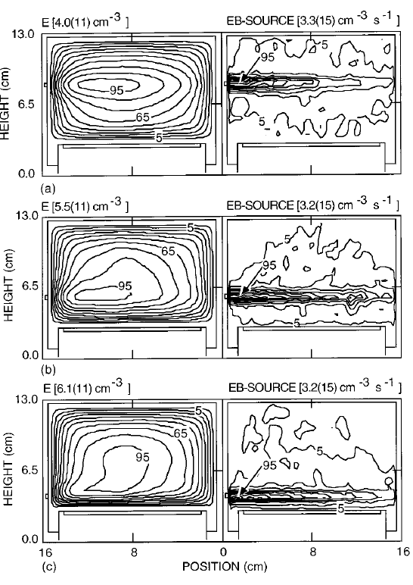
Examples of e-beam plasma systems without B-field
1.5-2 keV
30 mA
50 mtorr
Ar, O₂
< 30 eV
3 mtorr
Ar, O₂
K. D. Schatz and D. N. Ruzic Plasma Sources Sci. Technol. 2 (1993)
M. J. Kushner, W. Z. Collison, and D. N. Ruzic, J. Vac. Sci. Technol. A 14 (1996)
J. Jung et al., Phys. Plasmas 30 (2023)
100 eV
2-100 mtorr
Ar, O₂/CF₄
70 cm, 10 keV, 0.3 torr He
A S Klimov et al., Phys. Plasmas 25 (2018)
C. Lee et al., J. Vac. Sci. Technol. A 38 (2020)
Notes:
5

Slide 6
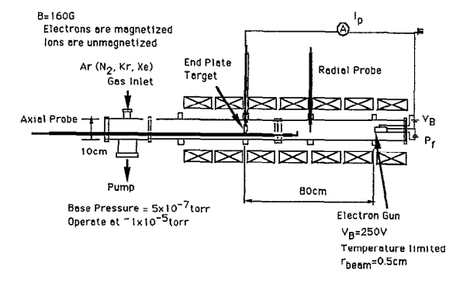
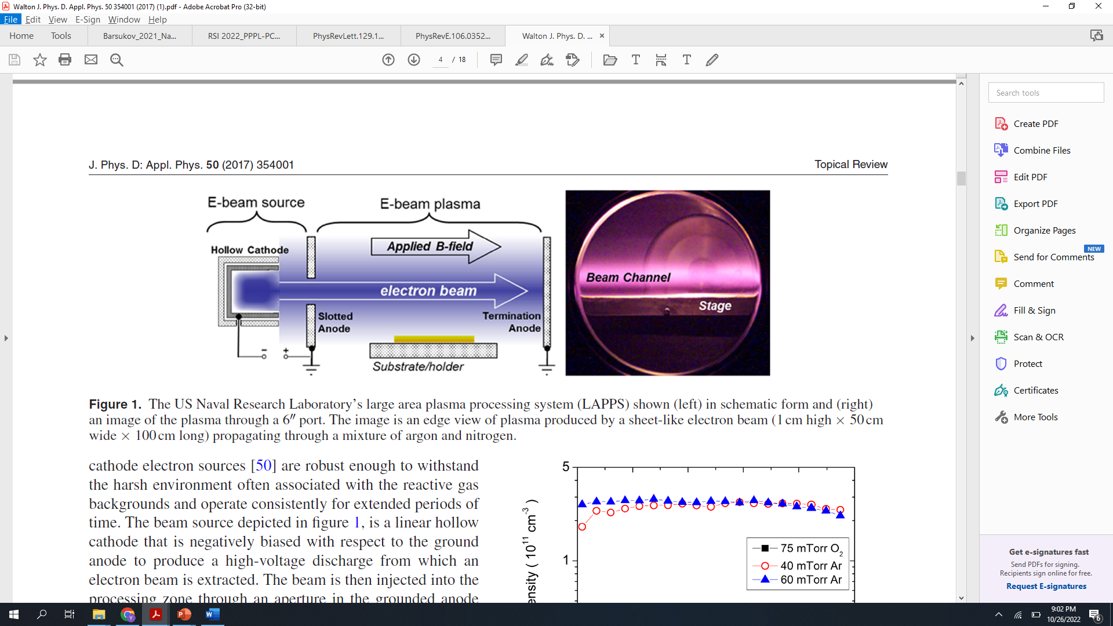
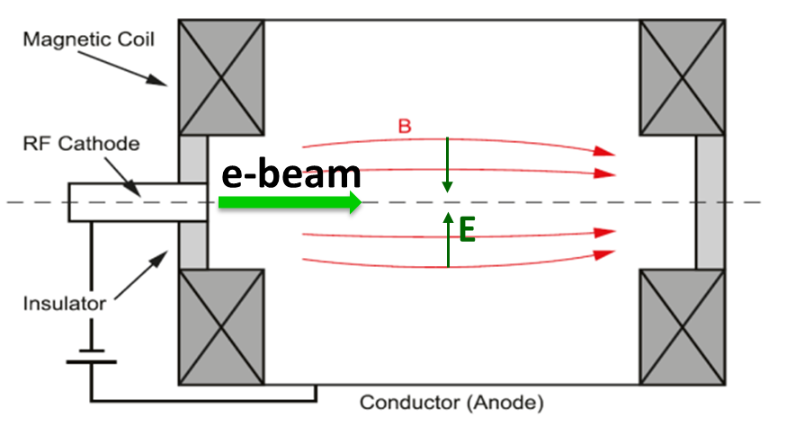
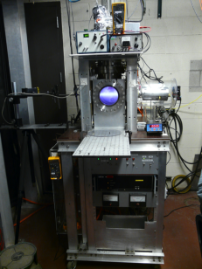
e-Beam plasma systems with B-field
Applied B-field reduces the spread of beam electrons by collisions with neutral atoms : $\frac{ω_{ce}}{ν_{eb}}≫1$
thermionic
Y. Sakawa et al., Phys. Fluids B 5 (1993)
1-10’s mtorr
Ar, N₂ O₂
2-4 keV
100 Gauss
~ 1-20 mA
0.1-10 mtorr
Ar, Xe, Kr
< 60 eV
10-1000 Gauss
~ 1-3 A
E. Rodriquez et al., Phys. Plasmas 26 (2019)
W. M. Manheimer et al., Plasma Sources Sci. Technol. 9 (2000)
S. Walton et al., Surf. Coat. Technol 186 (2004)
Notes:
6

Slide 7
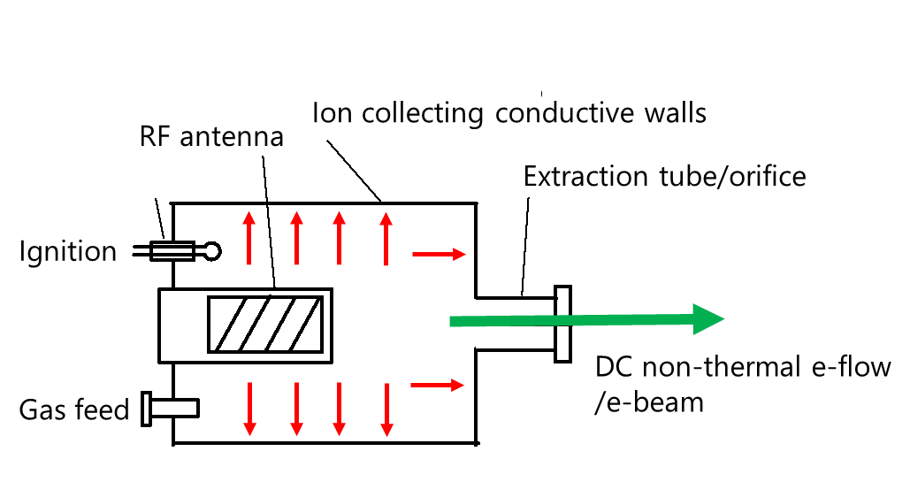
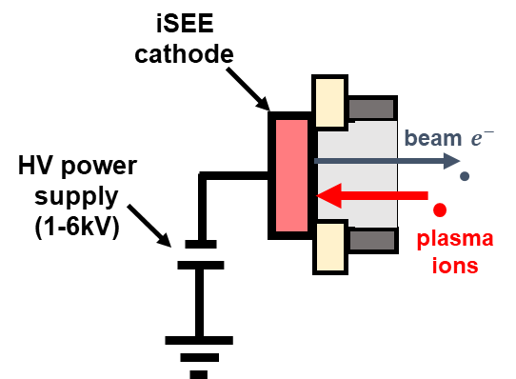
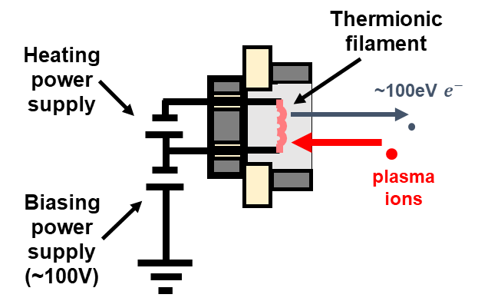
Different regimes with different sources of e-beam
Ion-Induced Secondary Electron Emission Cathode, (NRL, UIUC, Tomsk)
DC-RF (ICP) Plasma Cathode (PPPL)
Thermionic Cathode (e.g. hot filament or disk), (UCLA, PPPL etc)
Cathode type | Energy, keV | Current density, mA/cm² | Pressure, torr
iSEE | 1-10 | 1-10 | 10⁻³-10⁻¹
DC-RF | <0.1 | 10³ | 10⁻⁴-10⁻²
Thermionic | ≥ 0.1 | 10⁻³-10⁴ | 10⁻⁸ -10⁻²
Also, plasma hollow cathodes….(e.g. NRL, Oks’s group)
Notes:
7

Slide 8
Different electron sources=> Different dominant reactions
From Ref. *, Electron impact excitation, dissociation, and ionization cross sections for N₂
Cold cathode, (iSEE)
Thermionic
DC-RF
iSEE
Hot cathode
(thermionic)
DC-RF cathode
* Adapted from S. Walton et al., Surf. Coat. Technol 186 (2004)
Notes:
8

Slide 9
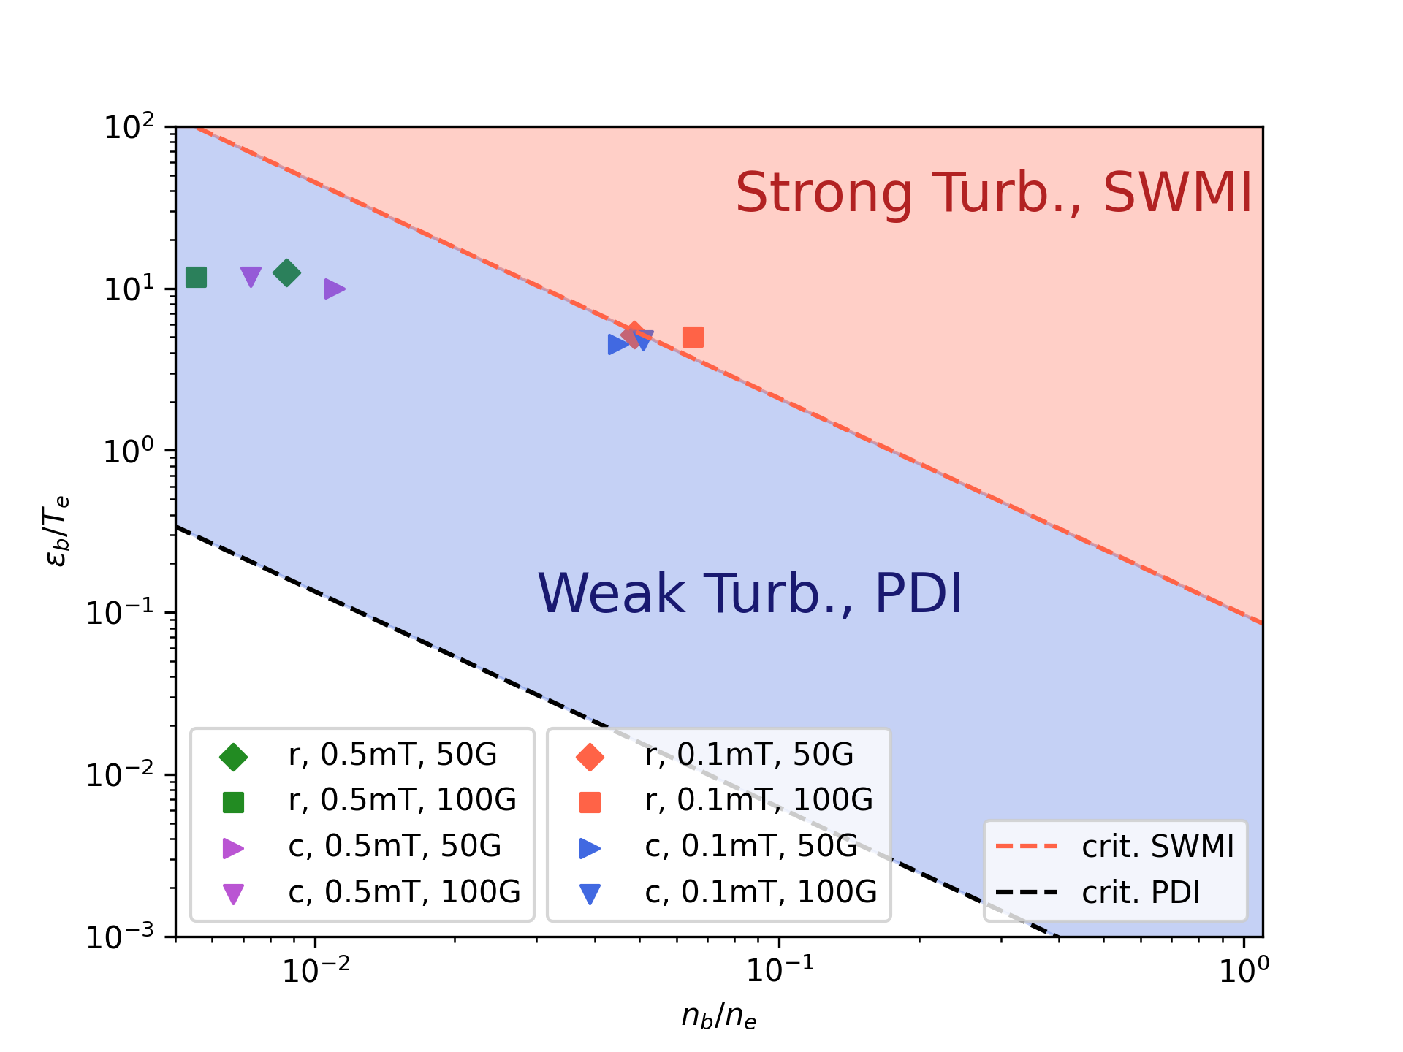

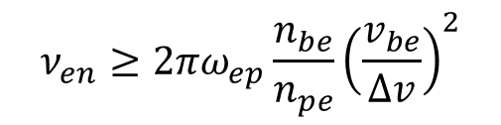
Beam-plasma instabilities
The (two-steam) stability criterion
$$ν_{en}≥2πω_{ep}\frac{n_{be}}{n_{pe}}{\left(\frac{v_{be}}{∆v}\right)}^{2}$$
R. F. Fernsler, et al., Phys. Plasmas 9 (1998)
More detail studies including PIC simulations
J_{b} ~ 70 mA/cm², 4 keV, and 50 mtorr
N. Chopra et al., in preparation
Q. Cao, J. Chen, Phys. Plasmas 30 (2023)
H. Son et al., Phys. Rev. E 106 (2022)
To mitigate beam-plasma instabilities, increase velocity spread of beam electrons, $∆v≥v_{be_max}$
R. J. Briggs, Adv. Plasma Phys. 4 (1971)
Notes:
9

Slide 10

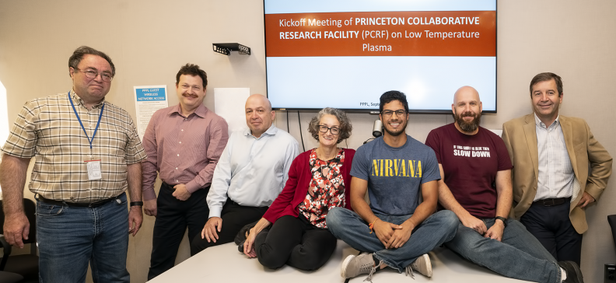
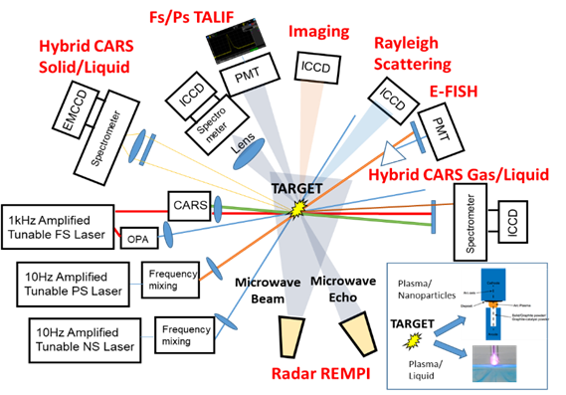
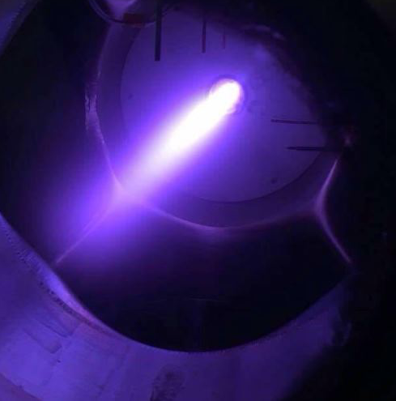
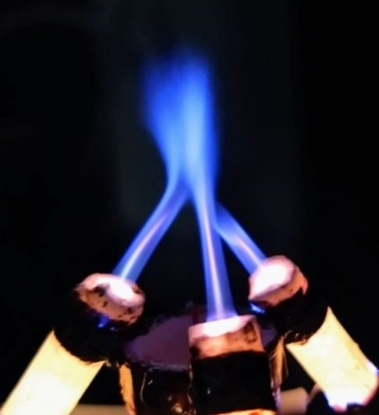
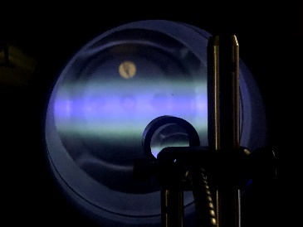
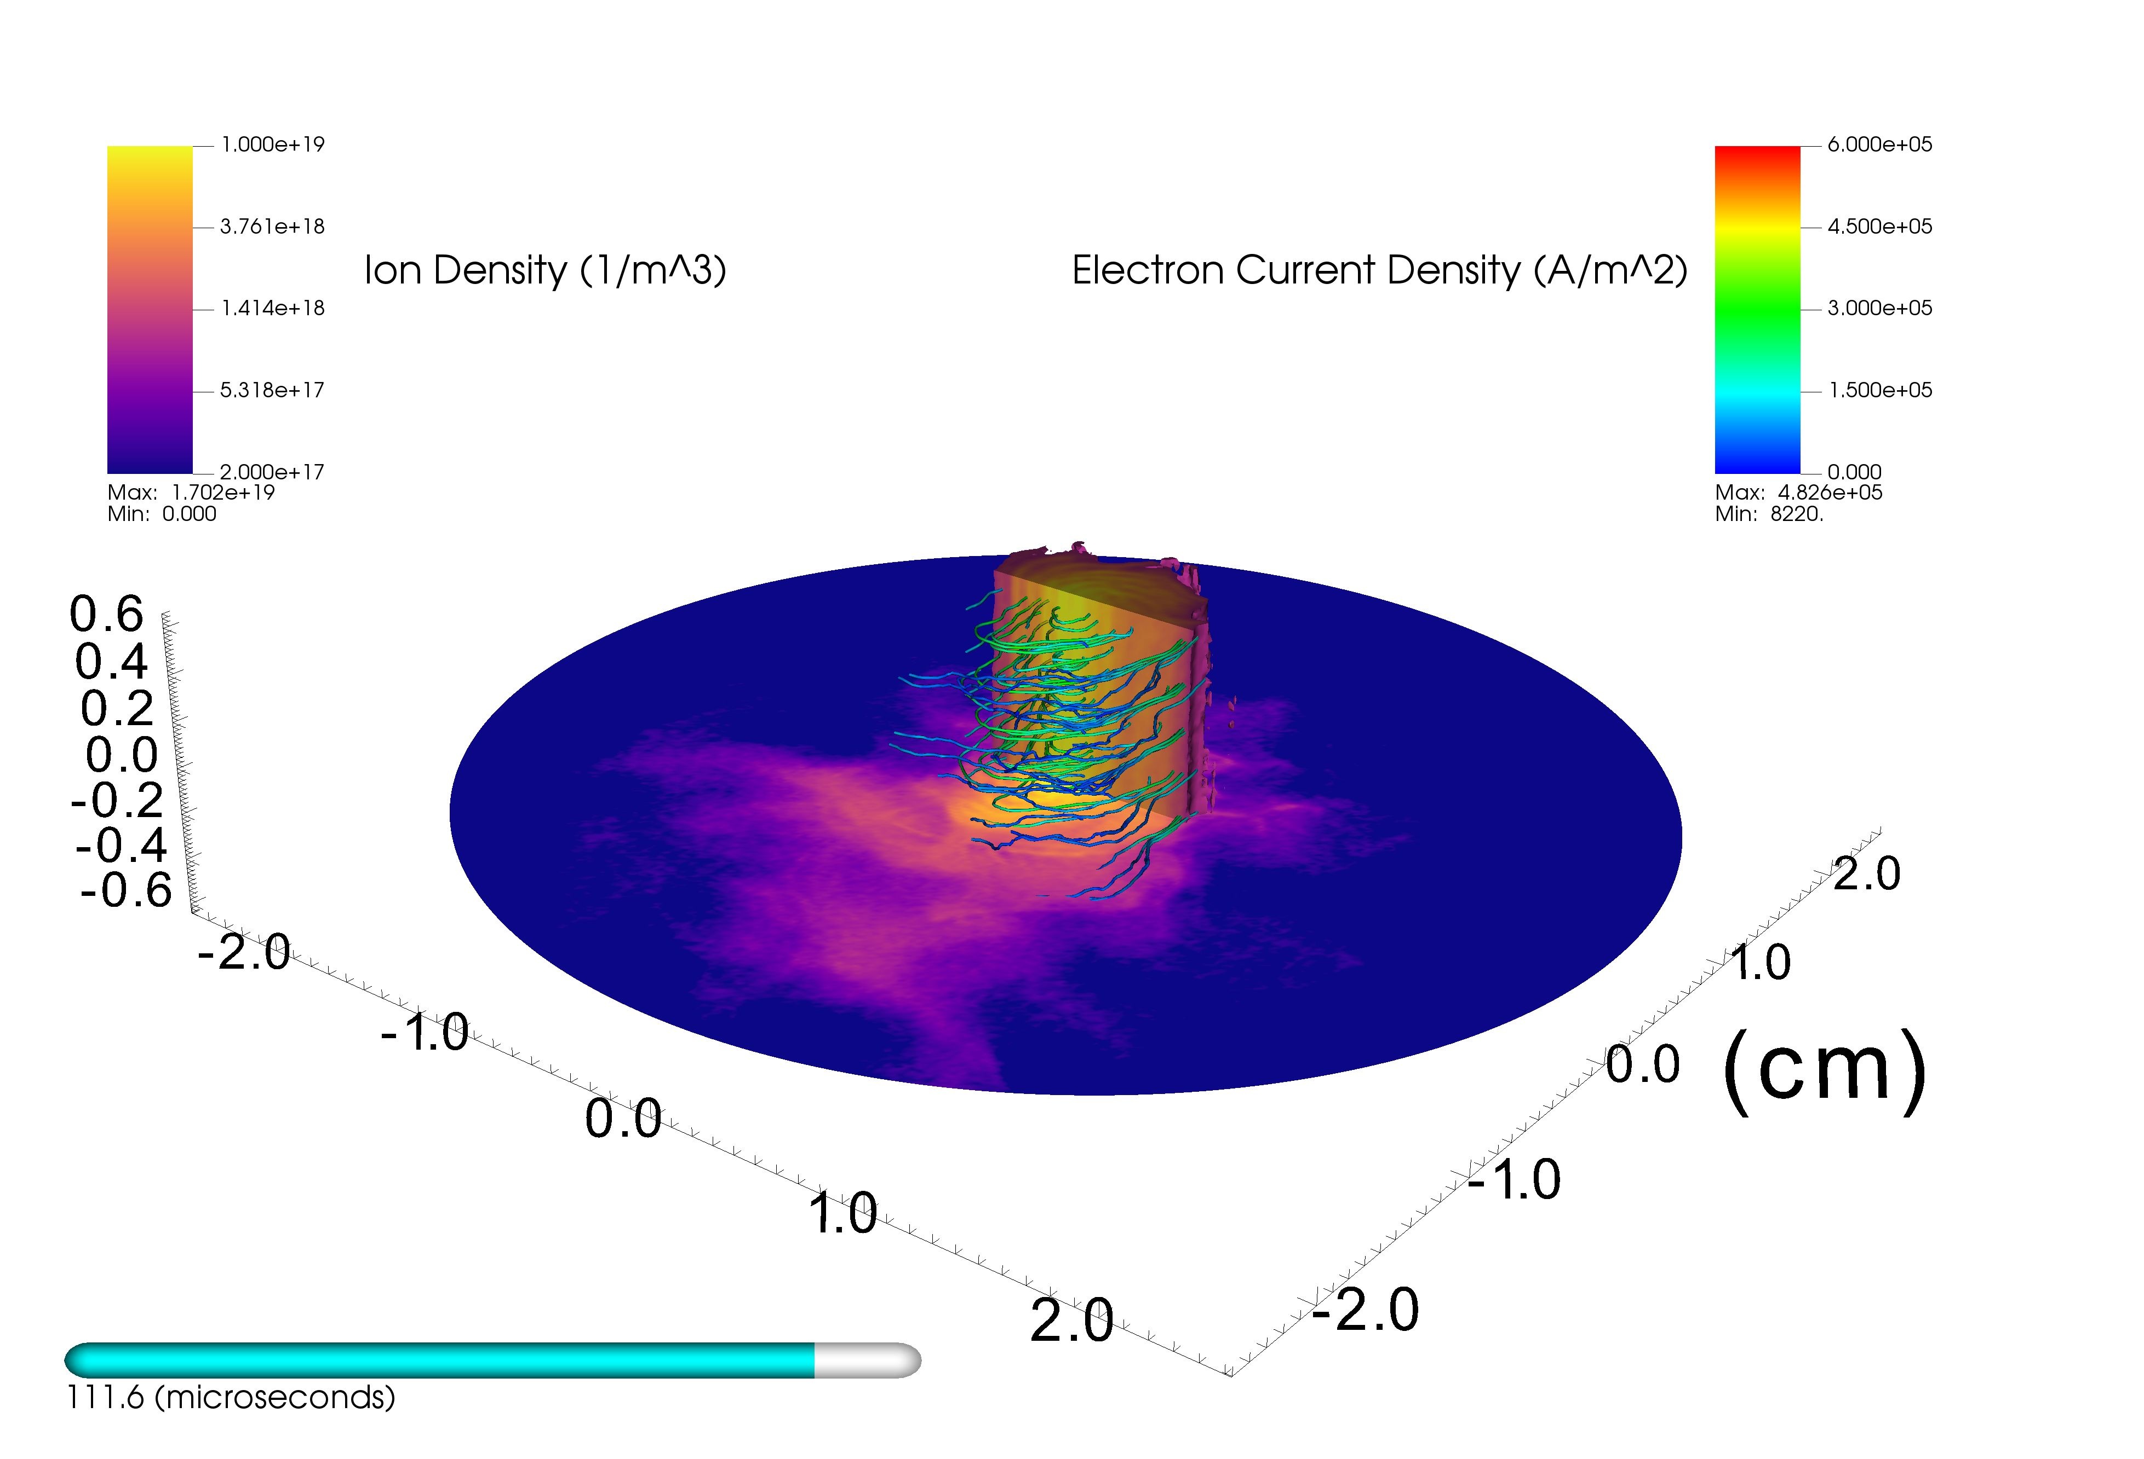
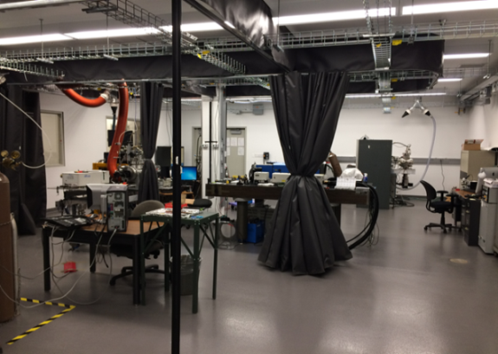
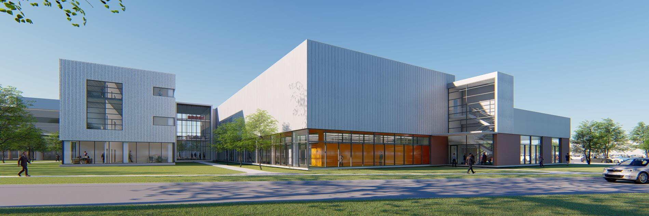
Princeton Collaborative Research Facility (PCRF)
Advanced diagnostics of plasma, gas flow, nanoparticles, plasma-surface interactions
Experts in plasma theory, computational, experiments and diagnostics
Wide range of plasma sources for basic and applied research
Basic LTP science
Plasma-liquid interactions
Low pressure ExB plasma
Mist-plasma jets
Advanced computational resources: 2D, 3D codes, HPC: CPU-GPU hybrid architecture with open-source codes
Plasma-surface interactions relevant to advanced processing
Nanosynthesis and dusty plasmas
Facilities at PPPL and Princeton > 5000 sq.ft and more coming
e-beam generated LTPs: low to moderate (~ torr) pressures
Arc discharges
Since 2019, 88 user projects
http/pcrf.pppl.gov
3-D PIC: ExB plasma structures
Notes:
10

Slide 11
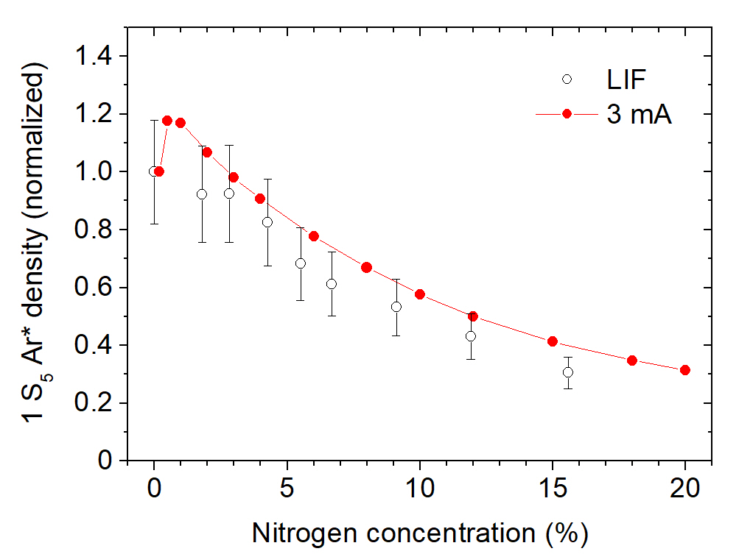
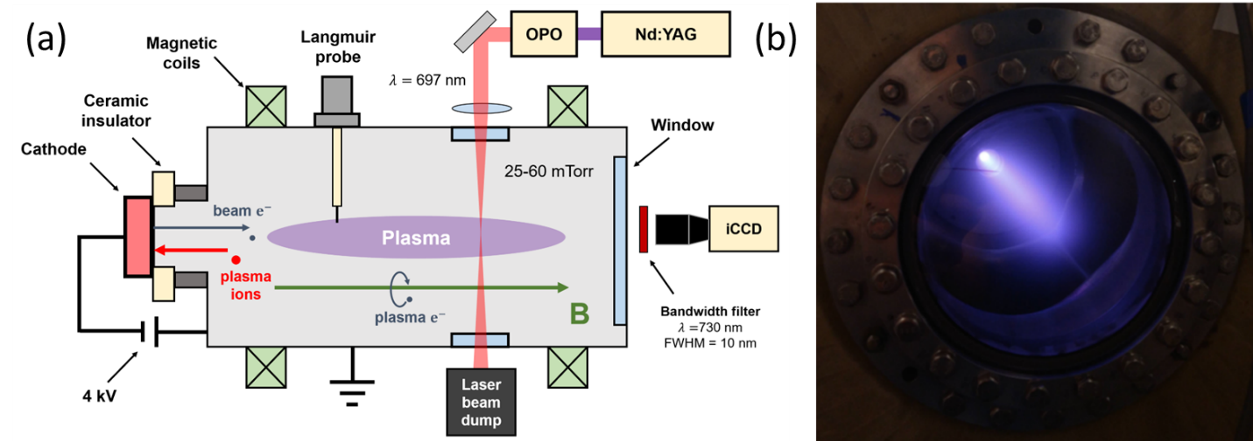
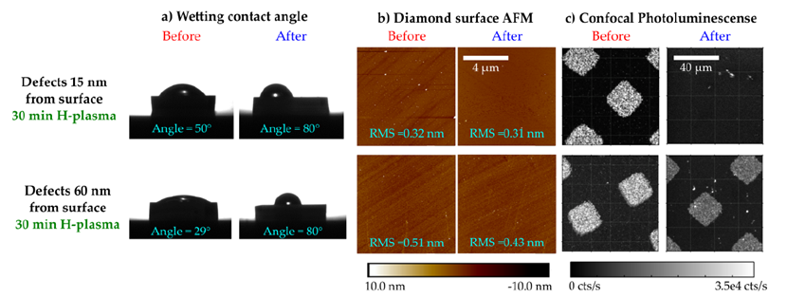
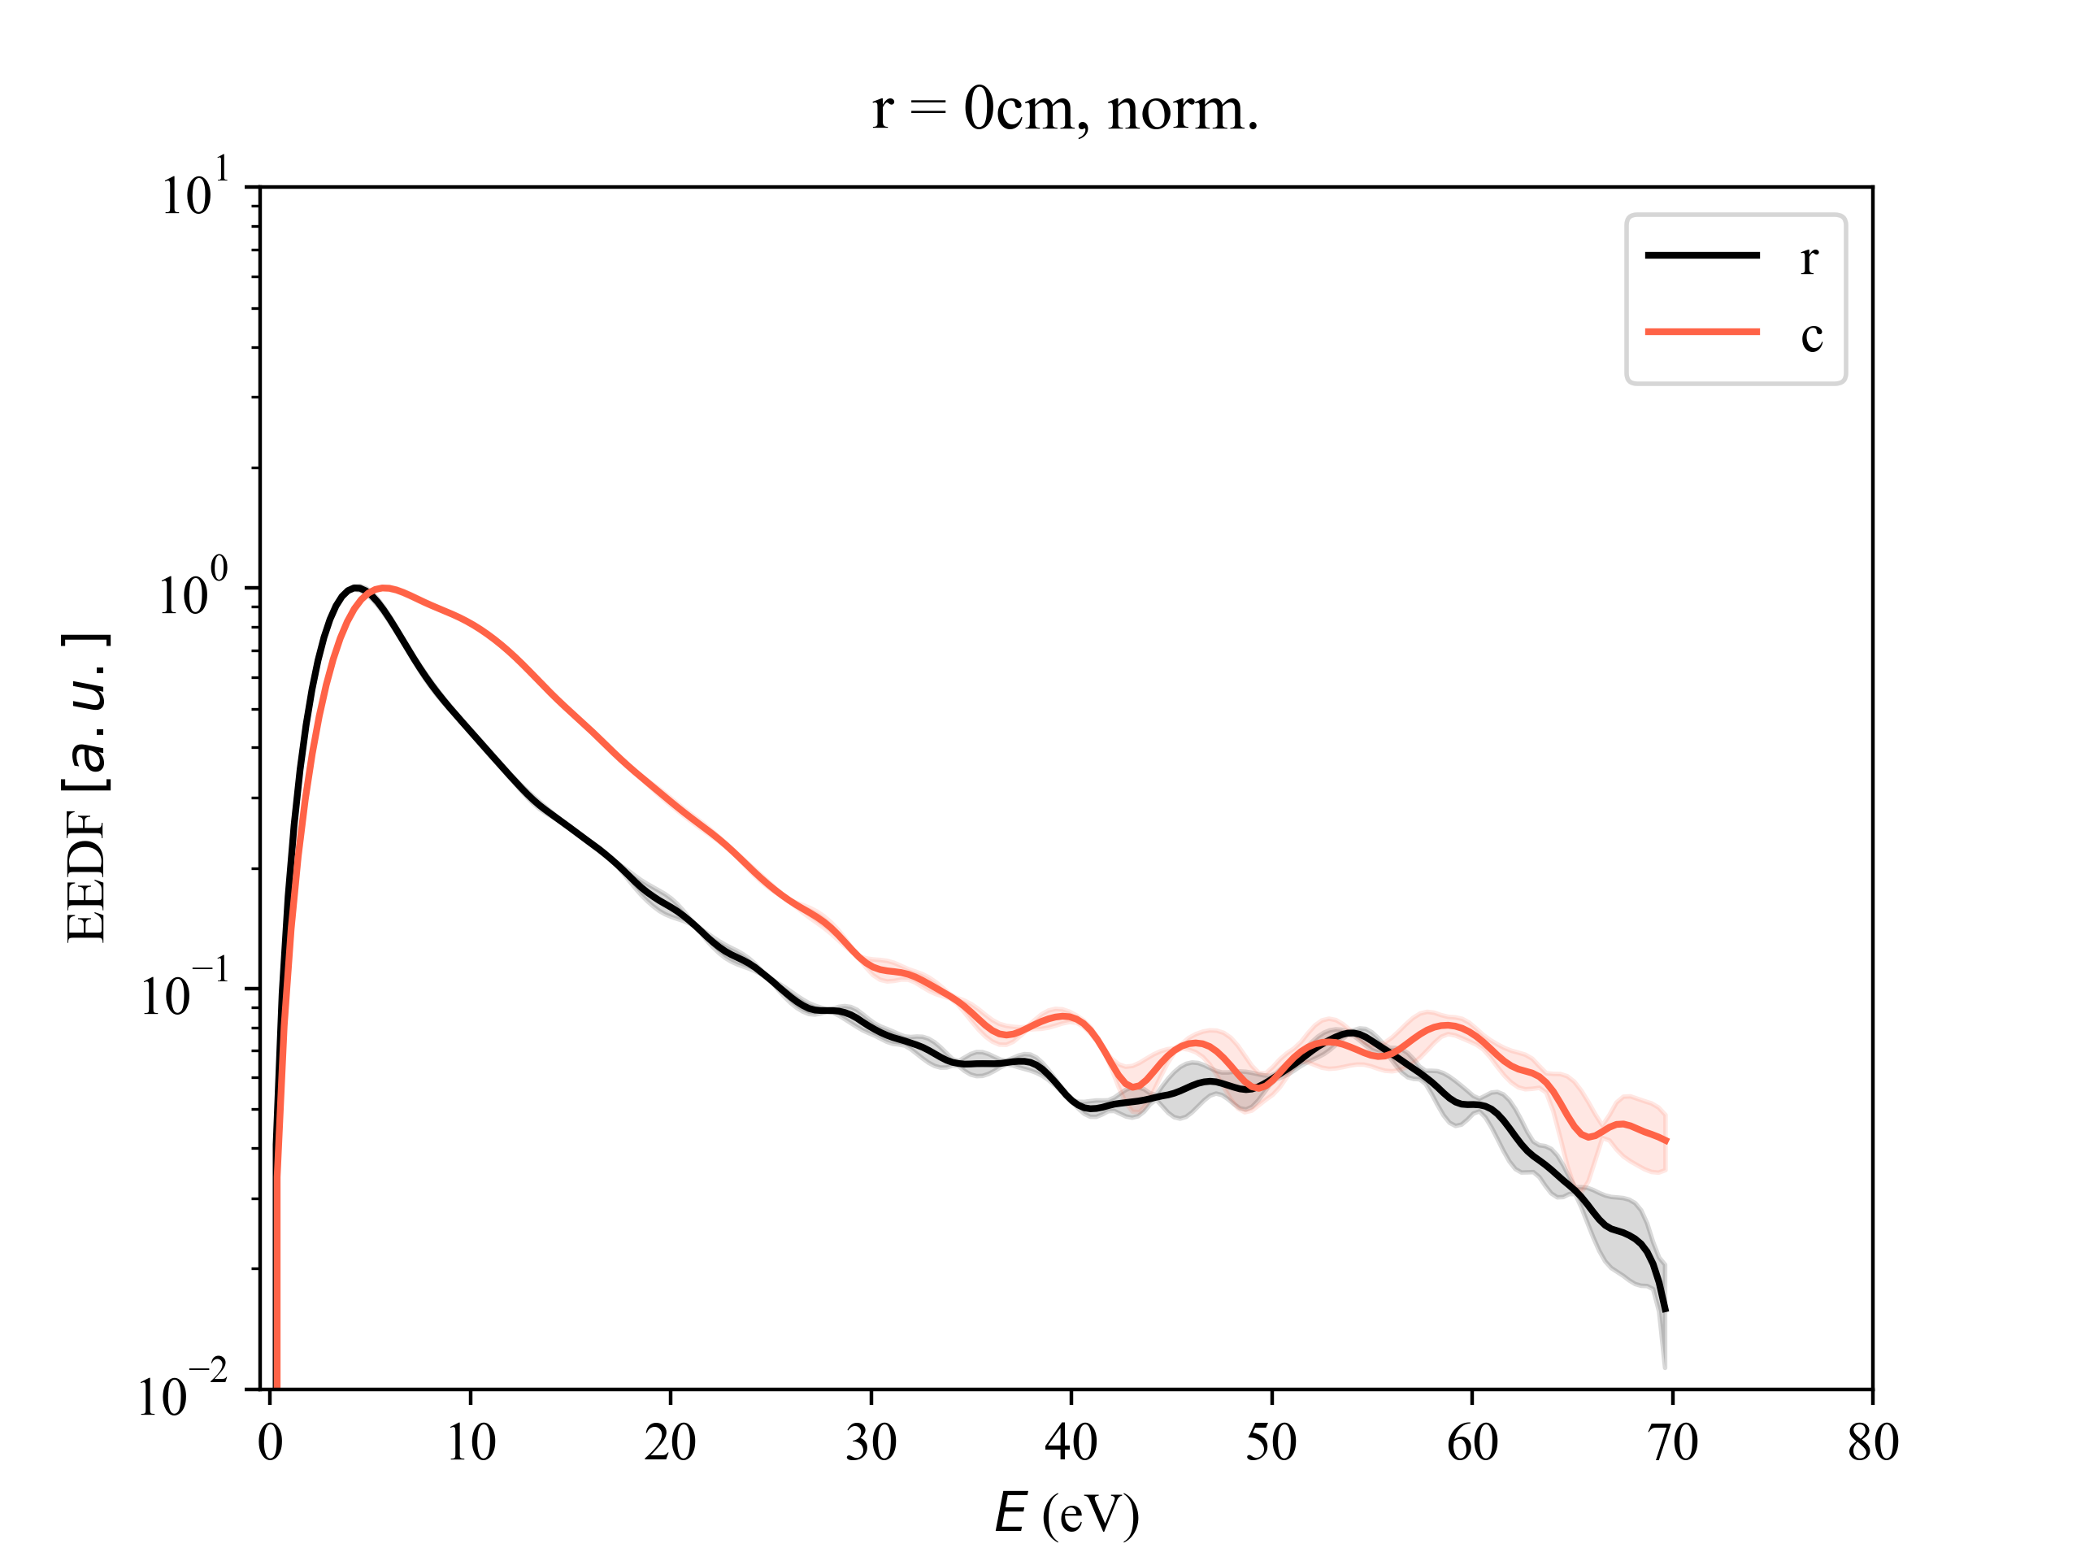
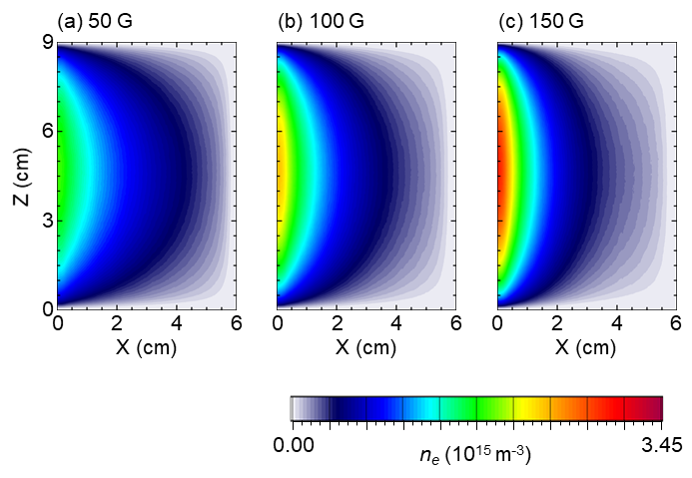

PCRF user and host projects on e-beam generated plasmas
Probing metastable species in e-beam generated plasmas User PI: Scott Walton, NRL and Host projects: S. Kondeti, S. Yatom
Cold Hydrogen Plasma Passivation for Quantum Defect Charge State Control, User PI: Kai-Mei Fu, Univ. of Washington
Plasma based hydrogen doping of semiconductors for color center qubit optimization, User PI: T. Schenkel, LBNL
LIF results
PIC simulations of e-beam plasmas
Host projects: I. Kaganovich, W. Villafana, in collaboration with Shahid Rauf, AMAT
Control of EEDF in e-beam plasmas
Host project: Y. Raitses and N. Chopra
Electrostatic wave-wave interactions in e-beam plasma, Host project: I. Kaganovich

Slide 12
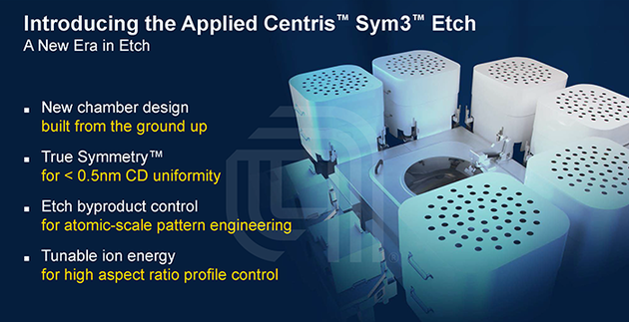
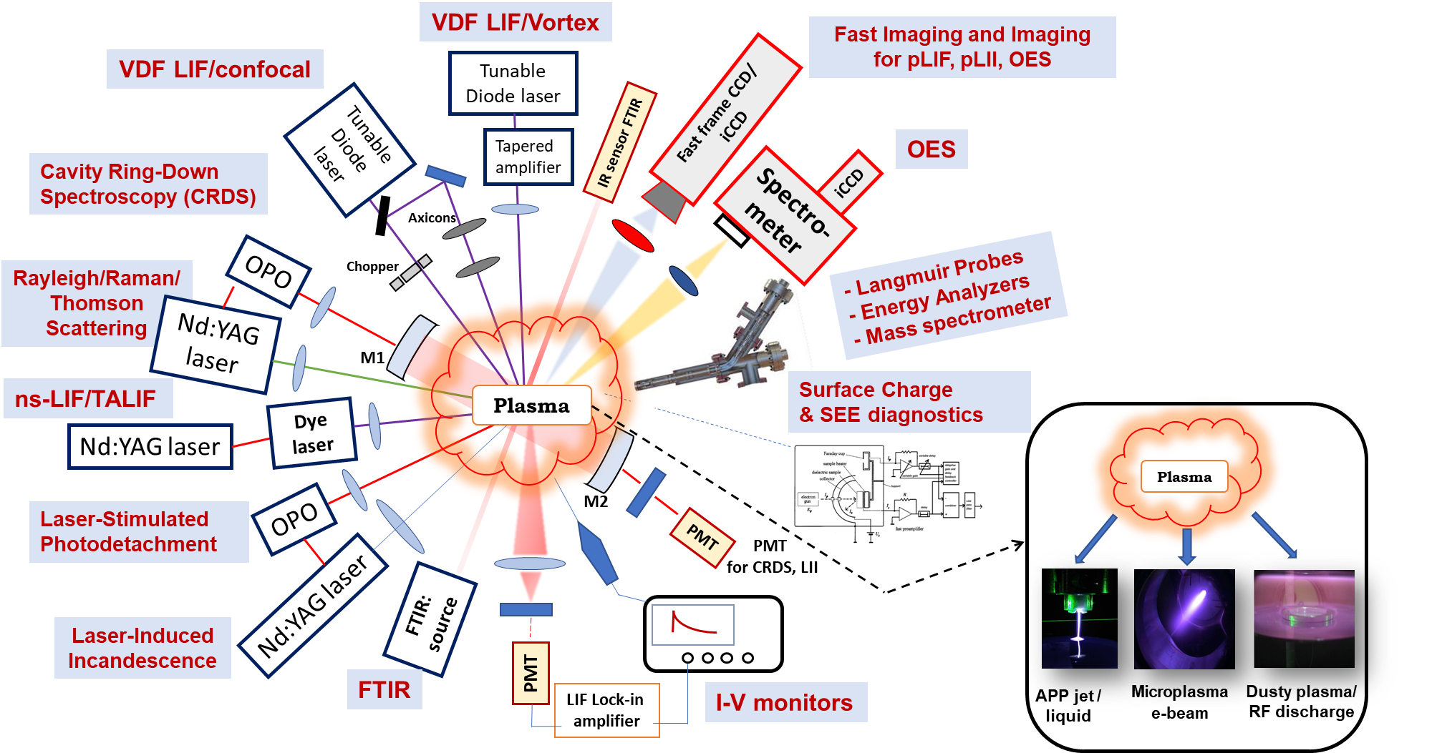
Microelectronics and QIS research at PPPL
PPPL is expanding into research on understanding plasma processes required for creating the next generation of semiconductors and QIS materials, advancing the nation’s push to shape the future of computing.
One of thrusts: noninvasive diagnostics of processing plasmas and plasma-surface interactions in state-of-the-art industrial reactors
Focus:
Plasma stoichiometry: spatially (~ 10²μm) and temporarily (~ μs) resolved diagnostics
Kinetic properties of the plasma: velocity distribution functions of electrons, ions, atoms
1-D and 2-D structured light diagnostics with minimum access requirements (e.g. confocal)
In situ surface properties (e.g. charging, chemistry)

Slide 13
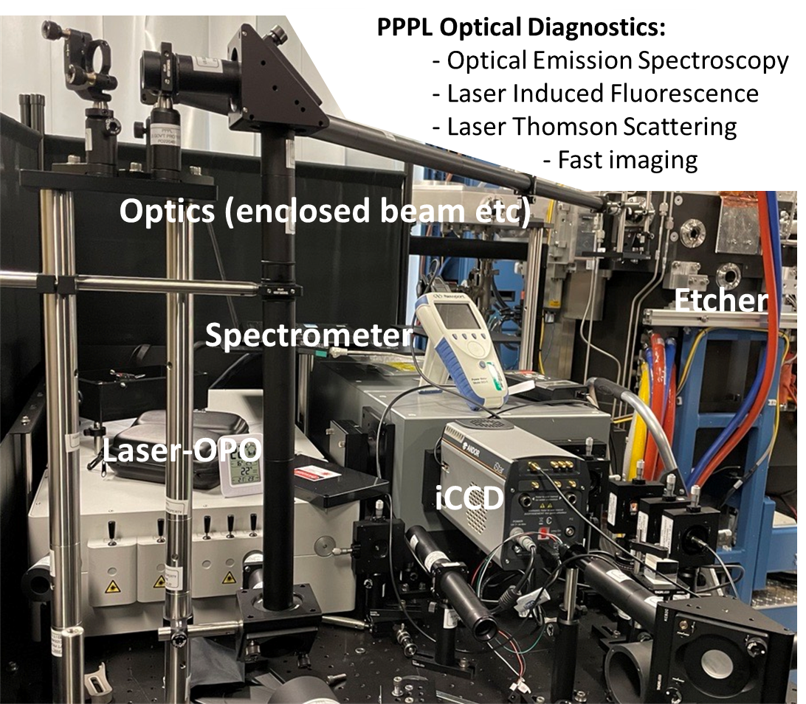

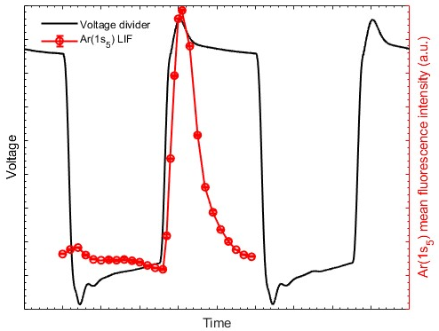
PPPL –Applied Materials Inc. collaboration
Pulsed Argon plasma source at 10’s mtorr
Santosh Kondeti
PPPL researcher
at AMAT, CA
PPPL advanced optical diagnostics installed and applied for plasma etch research at AMAT, Santa Clara, CA
LIF excitation: 696.5 nm, 8 μJ/pulse, ~10 ns,100 Hz, laser linewidth < 50 pm
LIF Fluorescence: 727.5 nm
Kondeti et al., in preparation

Slide 14
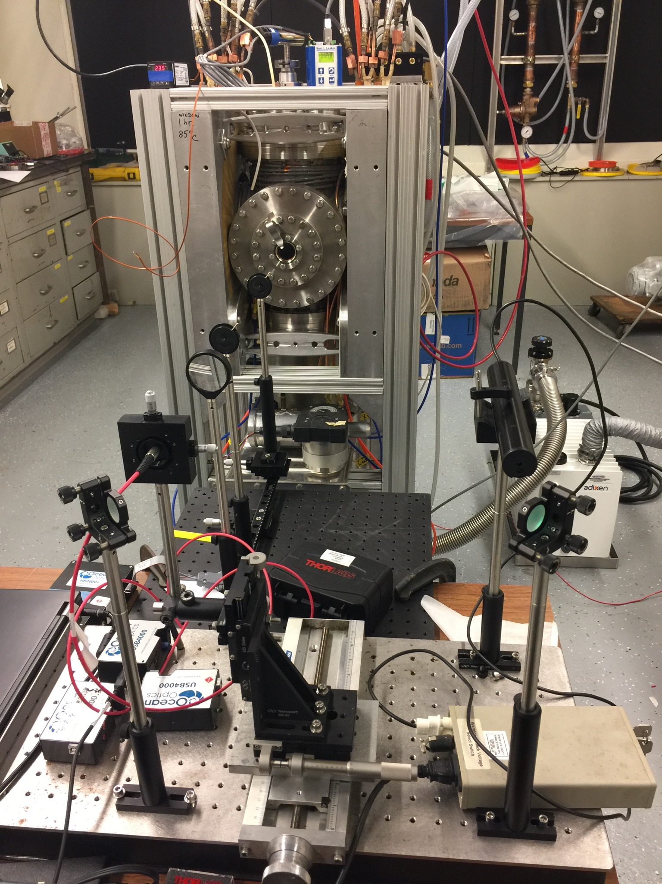
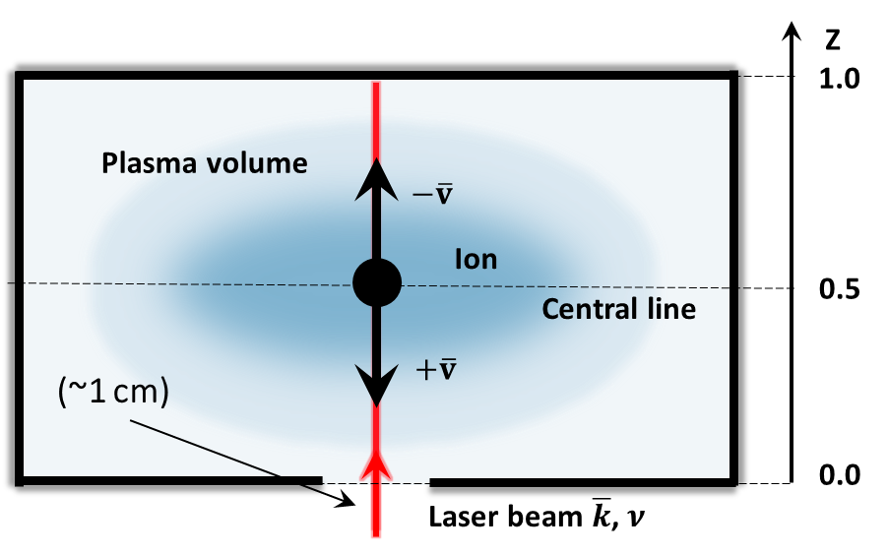
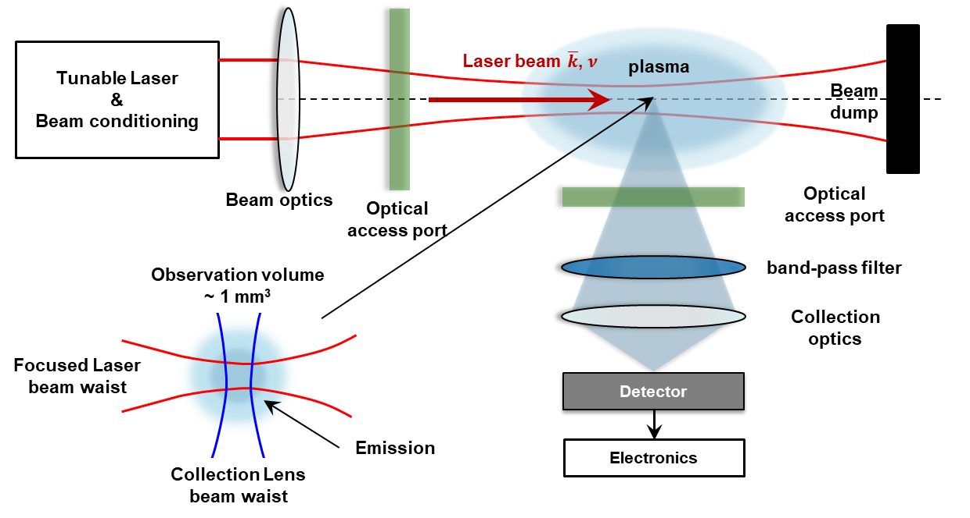
Advanced laser diagnostics for industrial plasma reactors
A strong need in spatially and temporally resolved plasma diagnostics suitable for real industrial processing reactors
Limited diagnostic access on industrial reactors due to complex geometry, uniformity perturbation, and harsh environments
For best spatial resolution, need two optical view ports at 90 deg!
Conventional Laser-Induced Fluorescence (LIF) configuration
Not applicable

Slide 15
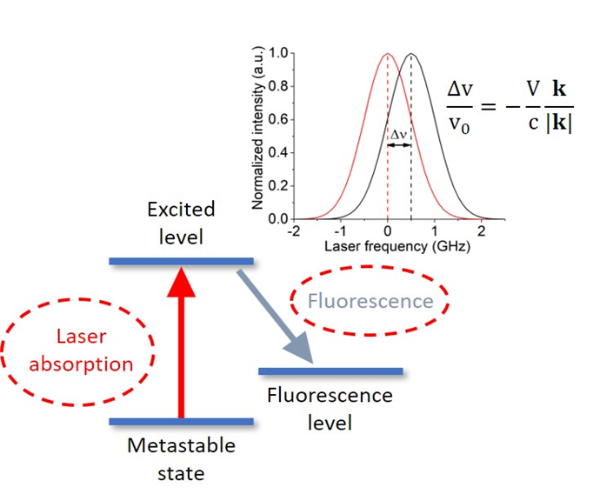
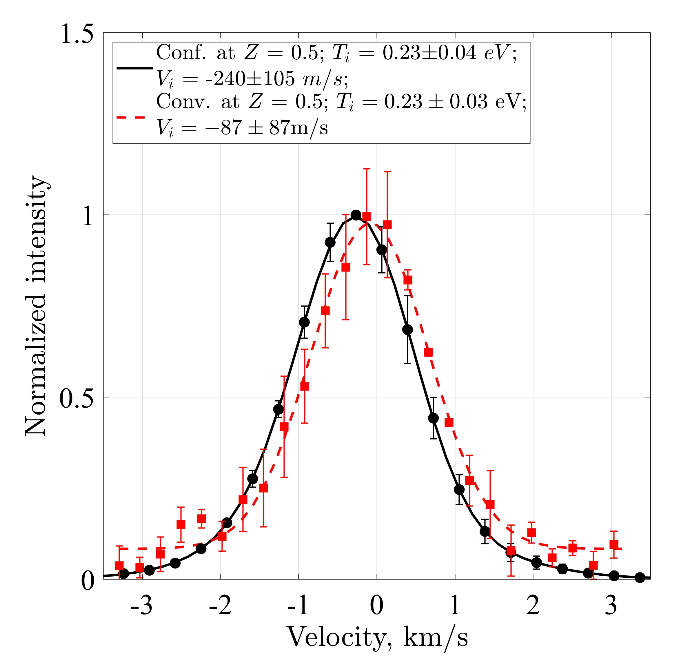

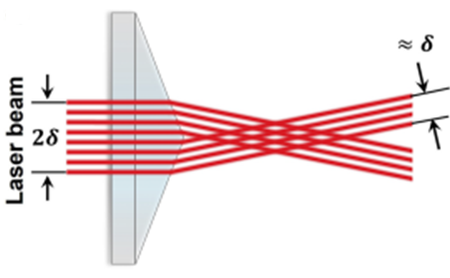
Confocal laser diagnostics for industrial plasma reactors
Confocal LIF – need only 1 viewport!
Ion Velocity Distribution Function (IVDF)
confocal vs conventional
laser beam profile
axicon 1
lens
Tunable Diode Laser
&
Beam conditioning
Dichroic mirror
Plasma volume
Collected light
axicon 2
Optical access port
collection optics
Detector
Electronics
Good agreement between IVDFs measured with confocal and conventional LIF configurations
I. Romadanov and Y. Raitses, Rev. Sci. Instrum. 97, 073002 (2023)

Slide 16
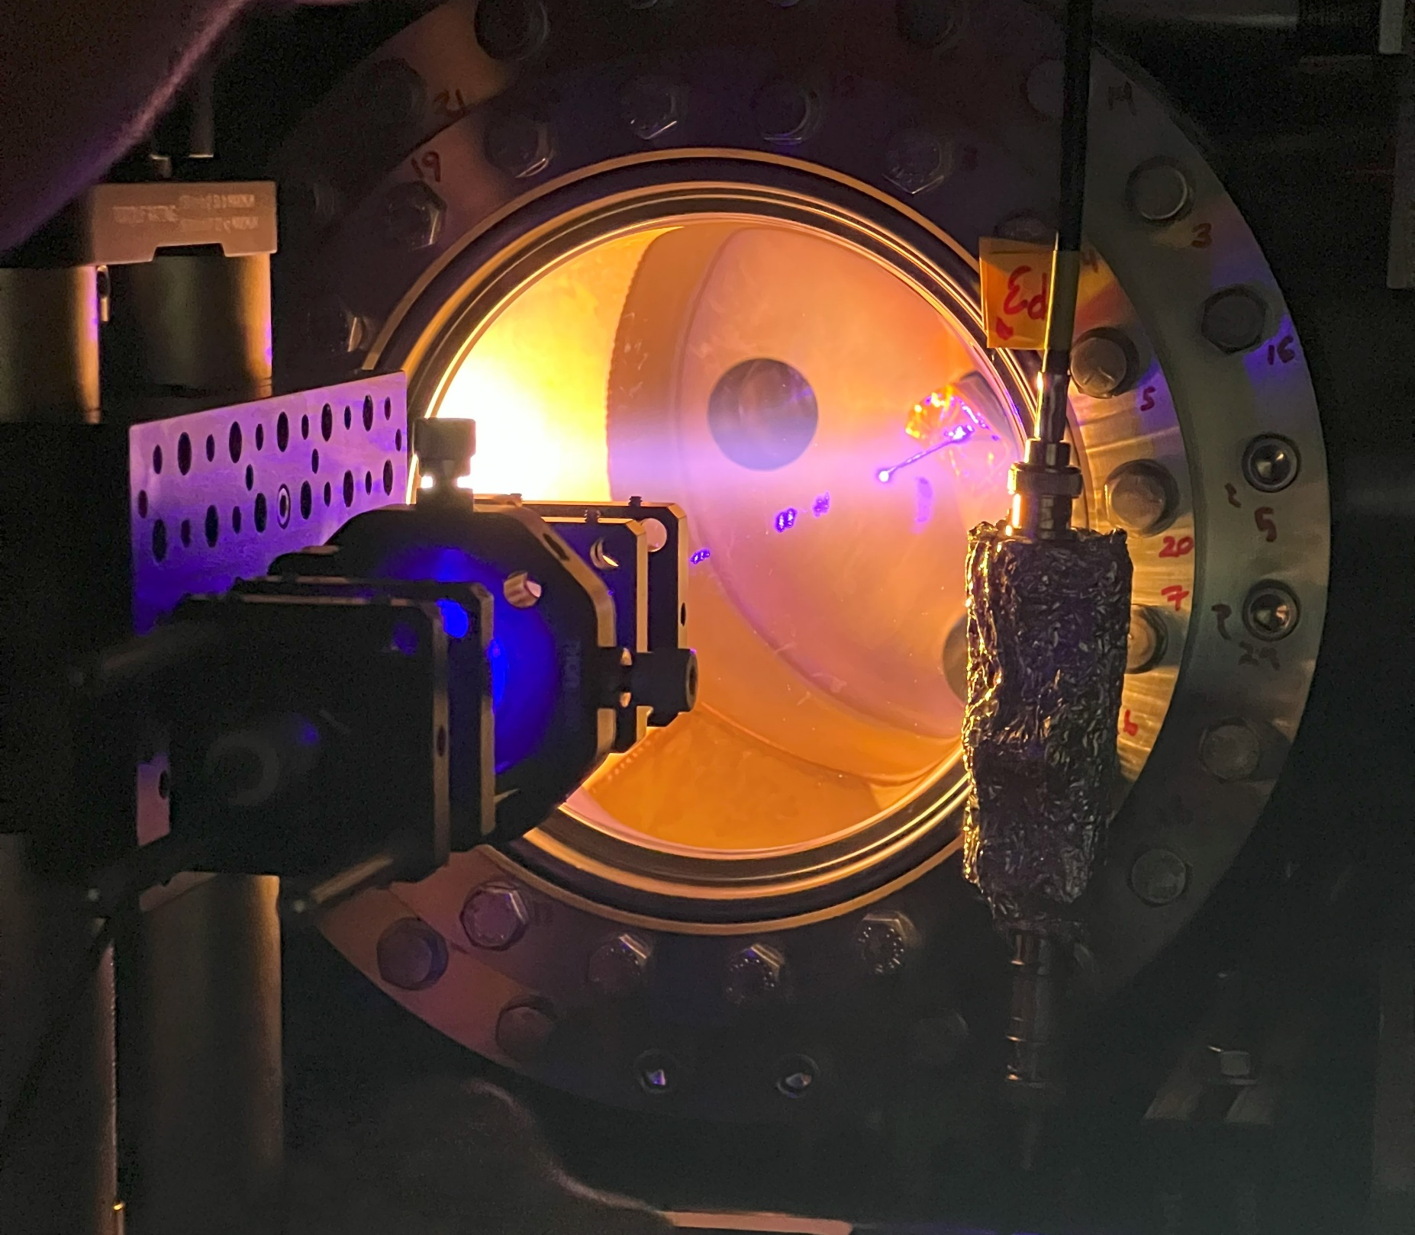
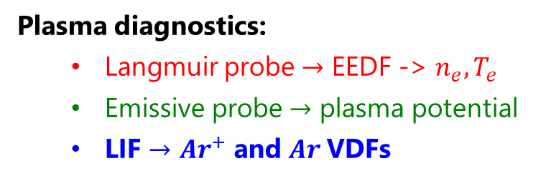
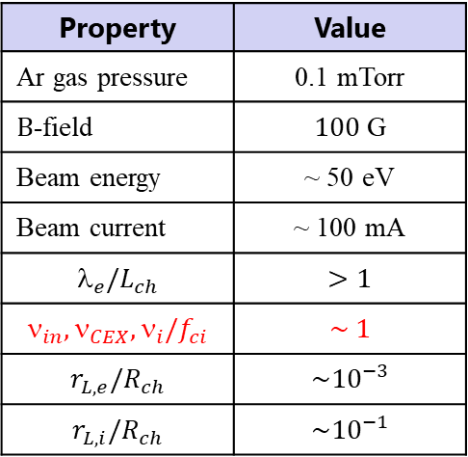
Insights of ion transport in e-beam plasma using probes & LIF
Property | Value
Ar gas pressure | 0.1 mTorr
$B$-field | $100$ G
Beam energy | ~ 50 eV
Beam current | ~ 100 mA
$$_{e}/L_{ch}$$ | $$>1$$
$$_{in},_{CEX},_{i}/f_{ci}$$ | $$\sim 1$$
$$r_{L,e}/R_{ch}$$ | $$\sim {10}^{−3}$$
$$r_{L,i}/R_{ch}$$ | $$\sim {10}^{−1}$$
Plasma diagnostics:
Langmuir probe $→$ EEDF -> $n_{e}, T_{e}$
Emissive probe $→$ plasma potential
LIF $→$ $Ar^{+}$ and $Ar$VDFs
Chopra, Romadanov, Raitses, Appl. Phys. Lett. 124 (2024)
Notes:
16

Slide 17
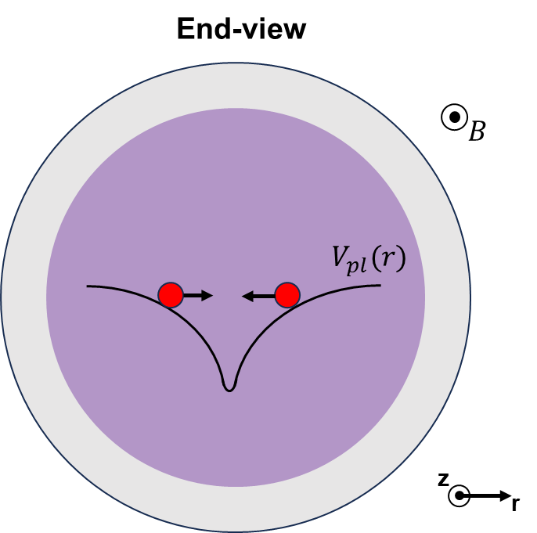

Probe results: Ion trapping in e-beam plasma region
Plasma density, electron temperature, plasma potential, and ionization rate
Consistent with Sakawa, Chen et al., Phys. Fluids B: Plasma Phys. 5, (1993)
Electric field direct ions towards the source axis, away from the chamber wall
$K_{iz}=\frac{1}{n_{e}} {\left(\frac{2}{m_{e}}\right)}^{1/2}\int_{0}^{∞}{dε σ_{iz}\left(ε\right)ε^{\frac{1}{2}}f\left(ε\right)}$
Notes:
17

Slide 18
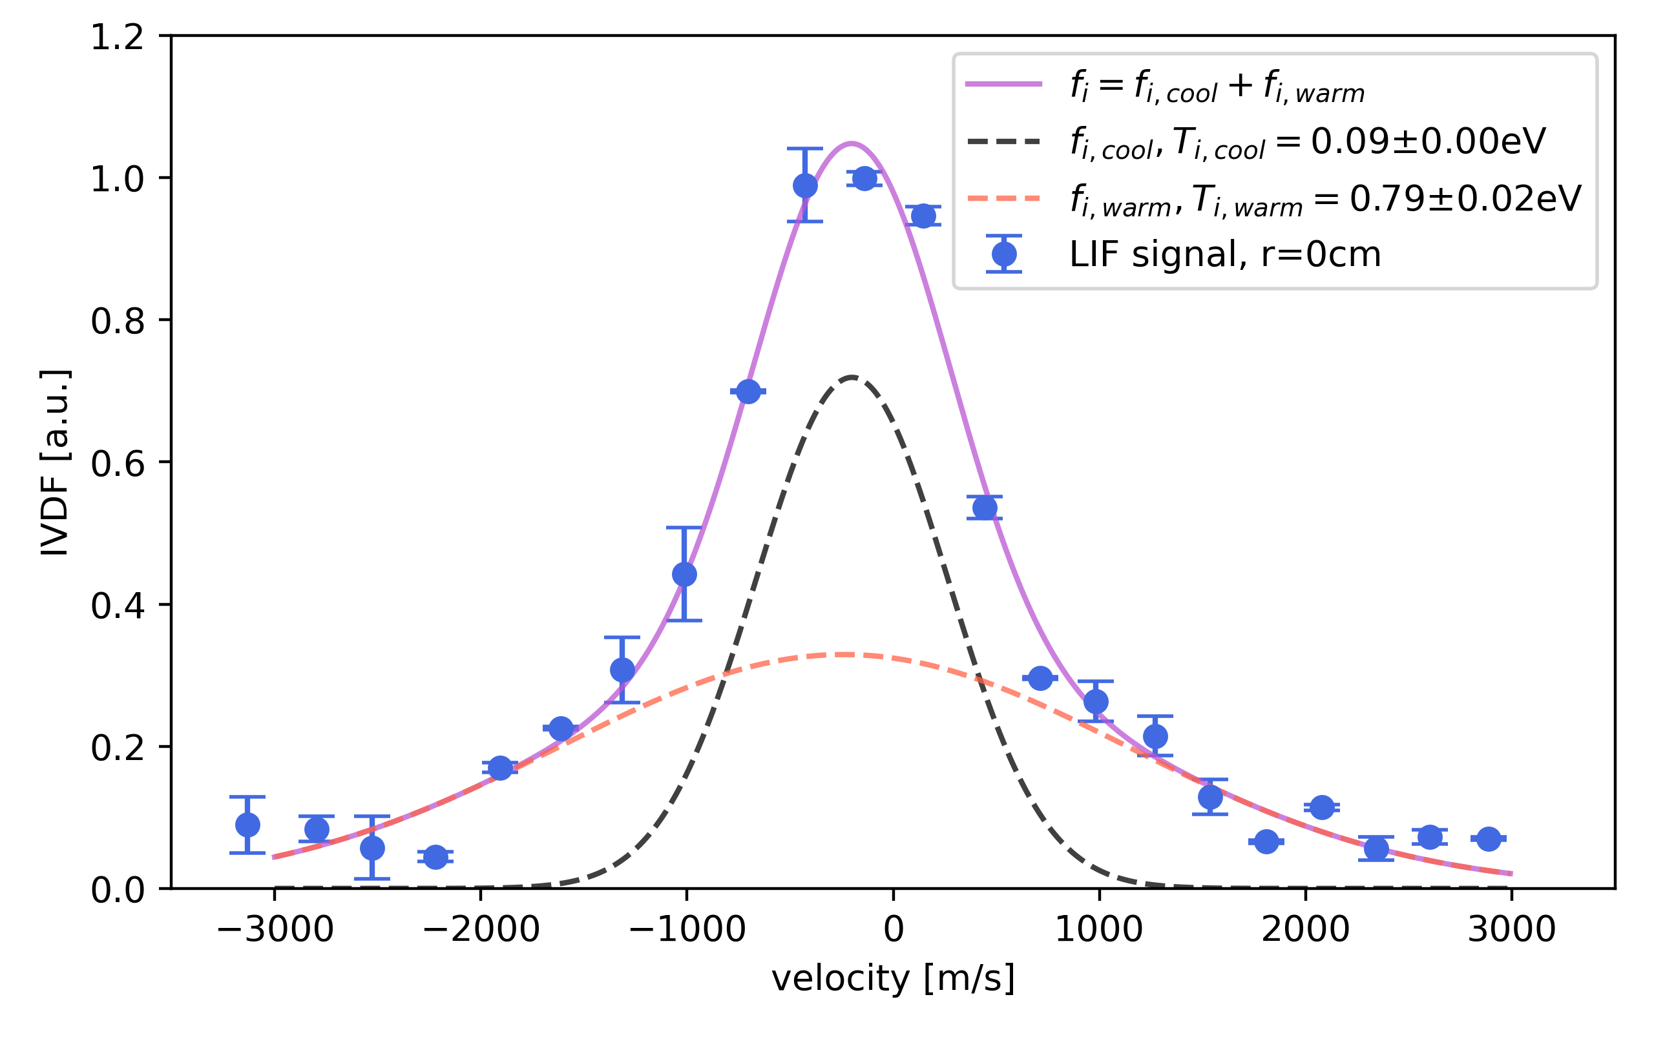
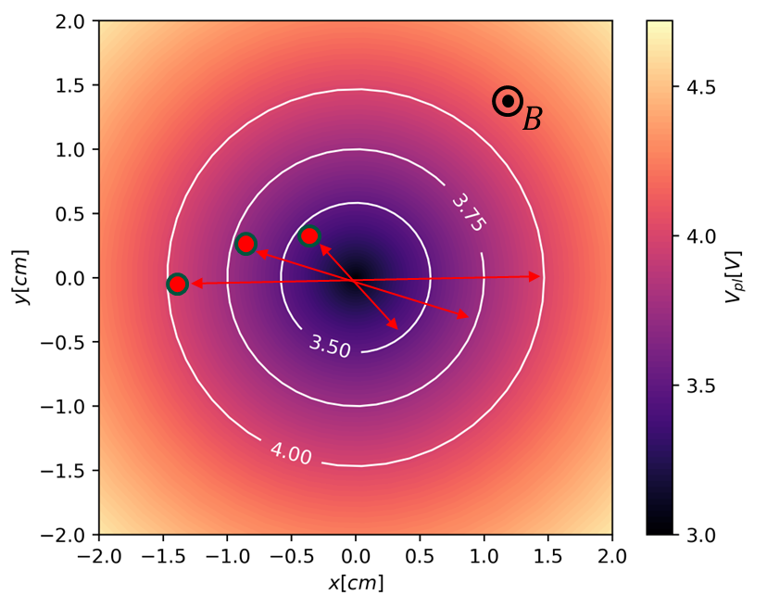
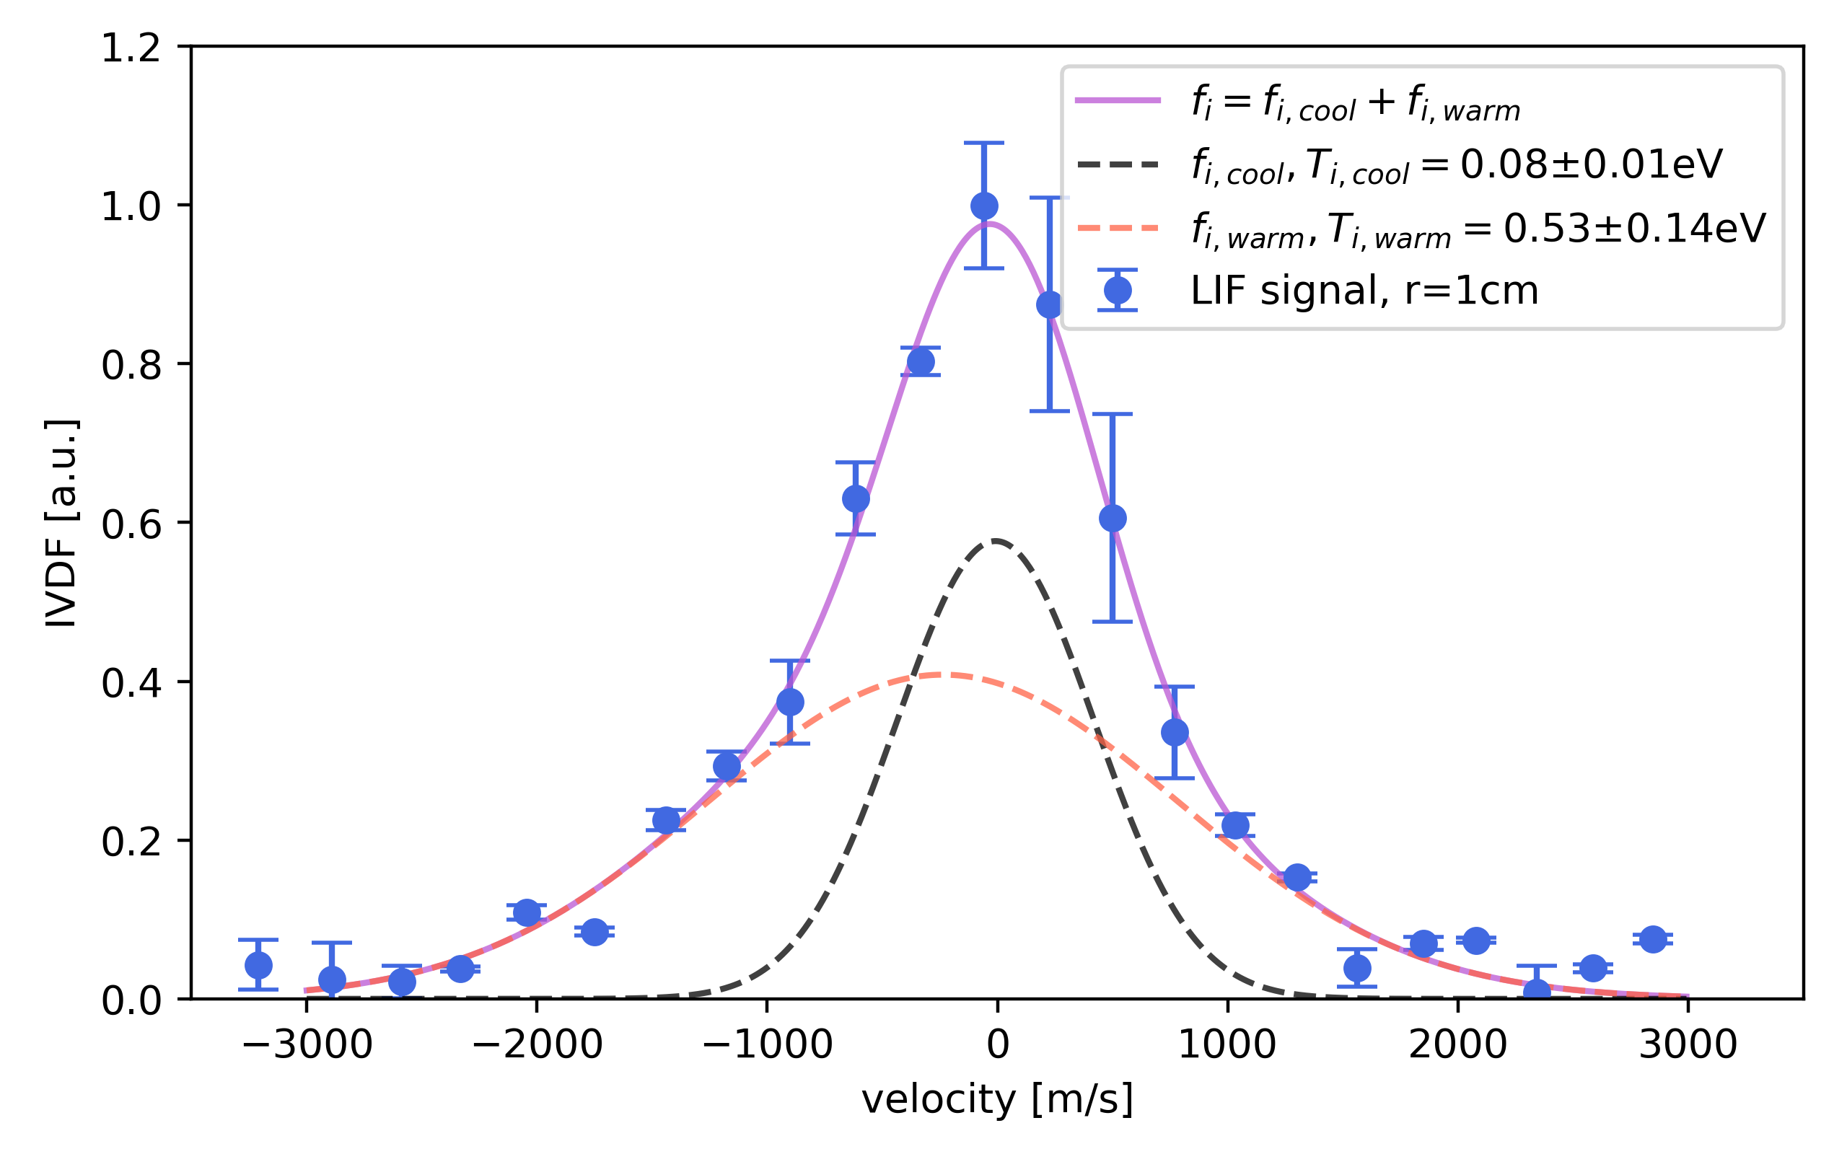
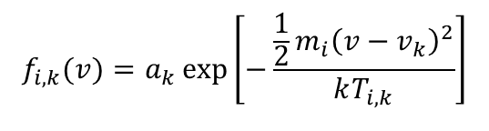



LIF results: Ion heating in e-beam plasma region
$$f_{i,k}(v)=a_{k}\exp\left[−\frac{\frac{1}{2}m_{i}{\left(v−v_{k}\right)}^{2}}{kT_{i,k}}\right]$$
$$r=0cm$$
$$f_{i}=f_{i,cool}+f_{i,warm}$$
Warm ions can diffuse against E-field, towards the chamber walls (anode), forming ion backflux.
Ions are born at different places of the potential well causing the ion energy spread - effective ion heating?
$$r=1cm$$
Chopra, Romadanov, Raitses, Appl. Phys. Lett. 124 (2024)
Notes:
18

Slide 19
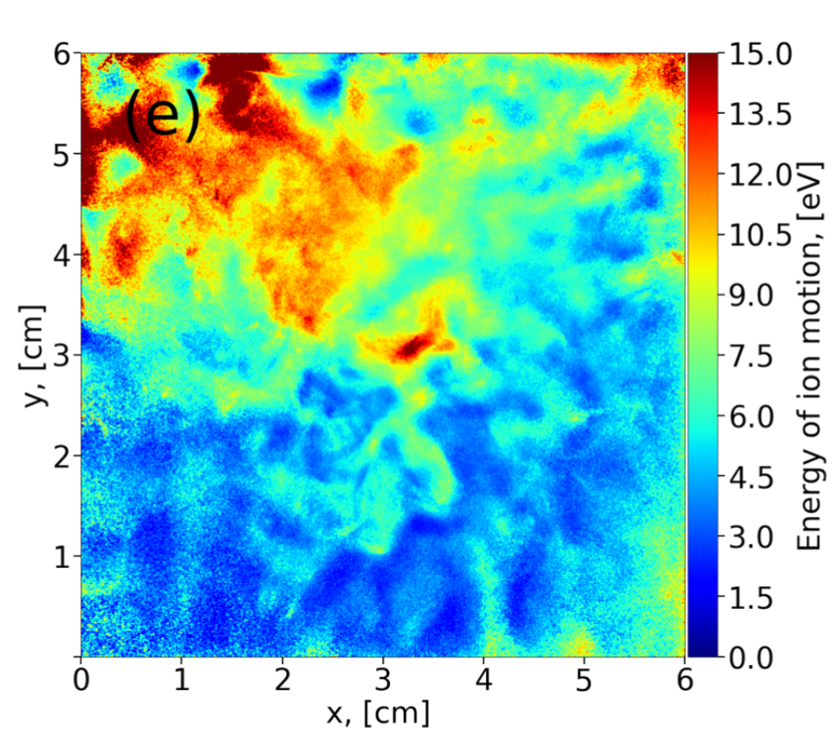
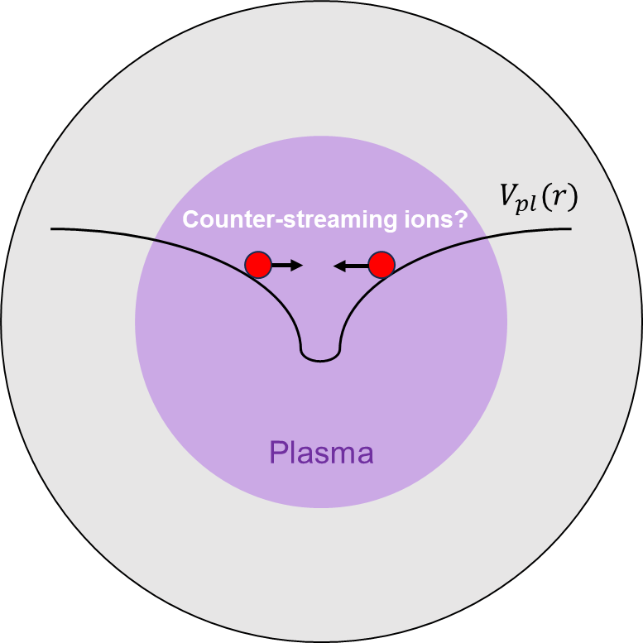
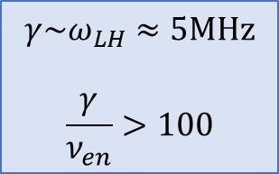
Other possible mechanisms of ion heating
Heating from collective effects, plasma instabilities:
Counter-streaming unmagnetized ion populations generated in the radial potential well with magnetized electrons → Lower hybrid instability
Ion heating in 2D PIC simulations of e-beam ExB plasma (Penning)
$$γ\sim ω_{LH}≈5MHz$$
$$\frac{γ}{ν_{en}}>100$$
Mikellides et al., J. Appl. Phys. 129 (2021)
Tyushev et al., Phys. Plasmas 30 (2023)
e-Beam-plasma instabilities
Work in progress: experimentally characterizing instabilities in e-beam ExB plasma
Sun, Chen, Kaganovich et al, Phys. Rev. Lett. 129 (2022)
Phys. Rev. E 106 (2022)
Notes:
19

Slide 20
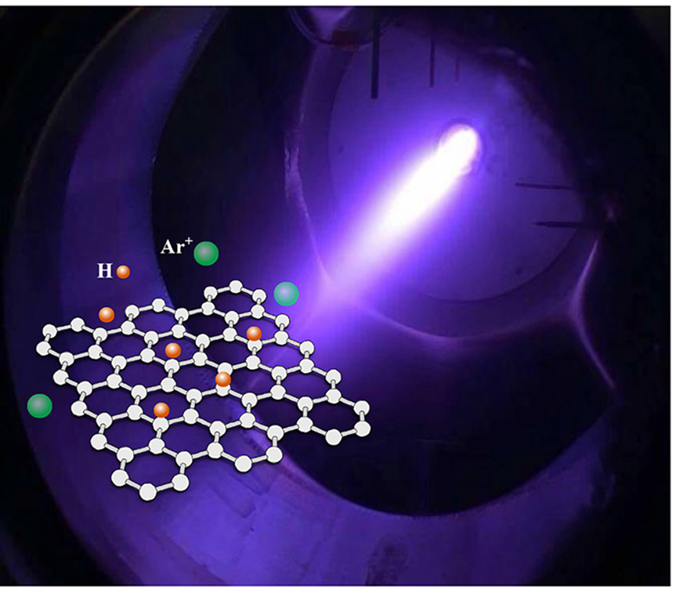
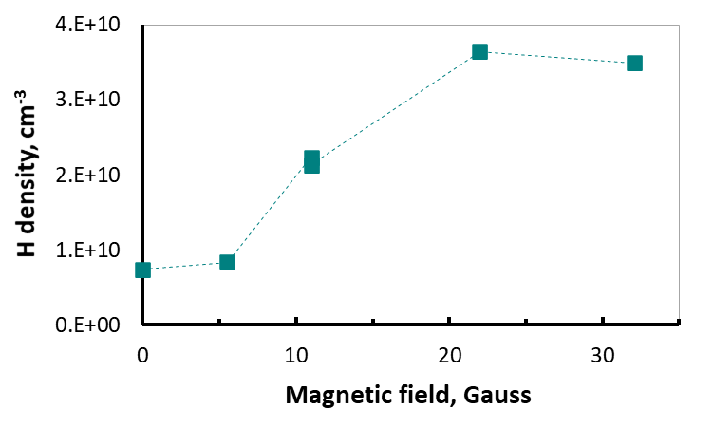

“Gentle” processing/doping of 2D with e-Beam ExB Plasma
Backflux of warm ions (and partially by cold ions from CEX) and neutrals (CEX) contributes to processing by all e-beam plasma systems.
B-field effects:
H-density in plasma by fs-TALIF
H-coverage of graphene from ex-situ Raman
e-beam ExB plasma, graphene hydrogenation
Zhao, Raitses et al., Carbon, 177 244 (2021)
Demonstrated the highest H coverage (~38%) of graphene by plasma and no damage to graphene!
Notes:
20

Slide 21





Quantum & Microelectronics Diamond
PPPL/Princeton University co-PIs: Alastair Stacey, Nathalie de Leon, David Graves, Igor Kaganovich, Yevgeny Raitses
Plasma diagnostics
Plasma modeling
Plasma/surface modeling
Oberg, Stacey, et al, 2021
N. De Leon
Synthesis experiments
Material/device delivery
(dopants)
Ashfold et al., 2020
Qubit performance 🡨🡪 Materials properties 🡨🡪 Plasma-surface interactions 🡨🡪 RF/Plasma-chemistry

Slide 22


Hydrogen passivation of diamond with e-beam ExB plasma
The same e-beam ExB plasma for QIS materials: diamond, silicon
Ex-situ evaluation of H passivation of diamond surface and color centers
Prof. Kai-Mei Fu’s group at UW
No irreversible damage to diamond surface
Christian Pederson et al., submitted (2023)
Notes:
22
a) Measurement of the wetting angle indicating a shift from hydrophilic to hydrophobic surface upon exposure to hydrogen
plasma, confirming hydrogen surface termination after plasma treatment. b) Atomic force microscopy (AFM) images showing negligible
change in the diamond surface roughness due to plasma exposure. c) Confocal microscopy images obtained with 532 nm laser excitation,
600-900 nm collection, showing PL from implanted NV and SiV defect centers. Post plasma exposure, shallow defects (15 nm from
surface) are not detected and deeper defects (60 nm from surface) exhibit reduced PL intensity, indicating a shift to an undetected charge
state. d) Comparison of PL spectra from the deeper defects confirms a change in the NV defect charge state after plasma exposure.

Slide 23

















Plasma propulsion research at PPPL
2nd International Congress on Aeronautics, London, UK, 1952
Hall Thruster Experiment (HTX) in 1998 by N.J. Fisch and Y. Raitses and graduate students L. Dorf, A. Smirnov, A. Litvak and D. Staack
Focus: Understanding of fundamental limitations of ExB plasma thrusters
http://htx.pppl.gov
1999
2022
23

Slide 24

Airbreathing plasma propulsion
A need exists for a spacecraft to occupy a very low orbit at altitudes of 100 - 200 km: Earth observation, telecommunication, science
The challenge is to overcome air drag as the air densities are not insignificant.
$$T=\sum{F_{Drag}}≈F_{front}+F_{sk}$$
For this spacecraft to be parked in this orbit indefinitely, the propellant need to be harvested from the surrounding atmosphere.
ESA air scoop –air Hall thruster for operation in 200 km orbit. http://www.esa.int/spaceinimages/Images/2018/03/Air-breathing_ion_thruster
24

Slide 25



Challenge # 1: Power requirement
Drag power, $P_{D}=F_{D}v_{0}$
$κ=90\%$vs $κ=10\%$
Interested in low altitudes of 90-200 km
Extreme power requires for < 130 -150 km
Compression, $κ≡\frac{A_{ch}}{A_{f}}$, increases power requirements.
25

Slide 26

Challenge # 2: Ambient air propellant
At 100-200 km, N₂ and atomic O key components
More energy needed on electron impact ionization of N₂ and O than on traditional EP propellants (Xe, Kr)
Negative ions of oxygen can make it harder to initiate and maintain plasma
Chemical erosion of thruster by atomic and ionic oxygen and nitrogen species
Harder to generate the thrust with lighter N and O than with Xe and Kr
1 mtorr
26

Slide 27




E-beam plasma as a solution to challenges # 1 and 2
Ionization cost for air, $w_{i}, eV$
$\frac{\text{Power} \text{per} \text{unit} \text{volume} \text{to} \text{sustain} \text{the} \text{plasma}}{\text{number} \text{of} \text{ionization} \text{events} \text{per} \text{time} }$
The minimum energy cost: 66 eV – close to the Paschen minimum
The lowest energy cost is for electron beam, 34 eV (model and experiments)^{1,2}
For non-beam EEDF or e-beam > 34 eV, energy cost is higher due to energy losses on excitation etc.
DC glow, RF- plasmas are fundamentally inefficient for ionization of air.
Solution: ionization by electron beams
$$w_{i}, eV$$
¹ Bychkov, Vasilev, Zuev, High Temperature 32 (1994)
² Macheret, Shneider, Miles, Phys. Plasmas 13 (2006)
27
Notes:
27

Slide 28




e-Beam requirements for thrust = drag compensation
From rate balance equation for e-beam ionization source,* $S \sim \frac{J_{b}}{e}\frac{1}{w_{i}}\frac{ε_{b}}{L}$
$$SπR^{2}L=\frac{J_{w}}{e}2πRL+\frac{J_{ion}}{e}πR^{2}$$
E-beam power, W
Plasma wall losses
Plasma accelerated out
-Wall flux: $J_{w}/e≈0.6n_{i}v_{Bohm}$
-Flux of accelerated ions: $J_{ion}/e=$ $n_{i}v_{i}$
Beam power needed to generated the required plasma density (to generate the thrust): $P_{b}=ε_{b}J_{b}$
*W. M. Manheimer, R. F. Fernsler, M. Lampe and R. A. Meger, PSST 9 (2000)
28
Notes:
28

Slide 29


Airbreathing e-Beam plasma thruster concept
Ionization of incoming air by magnetically confined e-beams and ion acceleration like in cylindrical Hall thruster (in diverging B-field)
Raitses and Fisch, Phys. Plasmas 8 (2001)
Kornfeld et al., IEPC (2003)
Raitses, Simmonds, Chopra, IEPC-2022- 443
29
Notes:
29

Slide 30






E×B rotating plasma structures
Experiment, Xenon, 0.1 mtorr
FFI
PIC simulations (no ionization)
Probes
Almost 100% of the electron current across the magnetic field through the spoke
5 kHz
Skoutnev et al., Rev. Sci. Instrum. 89 (2018)
Powis et al., Phys. Plasmas 25 (2018)
Rodriguez et al., Phys. Plasmas 26, (2019)
30

Slide 31




Gradient drift instability: collisionless Simon-Hoh instability
Conditions: ∇n_{eo} ≠ 0 and ∇n_{eo} ⋅ E_{r0} > 0
Ω_{ci} << ω << Ω_{ce}
Equilibrium
Density perturbation
$${\tilde{V}}_{r}=\hat{E_{θ}}/B_{z}$$
Perturbation
Instability growth rate
Heating of electrons in the spoke may enhance ionization
A. Smolyakov et al., Phys. Plasmas 20 (2013)
31
Notes:
31

Slide 32



Short-circuit effect of the boundaries
Measured time-averaged plasma properties
Insulating side walls
Instability growth rate
Conductive wall
Rodriguez et al., Phys. Plasmas 26 (2019)
With conductive boundaries the electric field is greatly reduced.
32

Slide 33

Suppression of oscillations
Oscillations of the plasma density
Rodriguez et al., Phys. Plasmas 26 (2019)
33

Slide 34





Initial experiments with e-beams in Nitrogen and Air
A 70 cm long e-beam with a thermionic cathode operating in N2 atmosphere, 0.1 microtorr
Normalized electron energy distribution function (EEDF) at the beam injection and collection
$100μ$Torr
$100$mA
60V
$B=150G$.
heating of plasma electrons?
$$ν_{en}<2πω_{ep}\frac{n_{be}}{n_{pe}}{\left(\frac{v_{be}}{∆v}\right)}^{2}$$
Mostly molecular N₂ ions
34
Notes:
34

Slide 35
Take away messages about e-beam plasmas
Sub keV e-beams for controllable production of ions & radicals for semiconductor and QIS materials processing (e.g. ALE, 2D materials, diamond)
High current density DC-RF cathodes as the source of non-thermal electrons
New physics insights with advanced diagnostics and modern computational tools:
Ion heating in the potential wall and the back ion flux to the substrate
Suppression of gradient drift instability in ExB fields by short circuit on boundaries
New regimes predicted for beam-plasma instabilities
Potential application for plasma propulsion with molecular propellants (e.g. airbreathing)
35
Notes:
35

Slide 36
Acknowledgement
The work supported by the US DOE under Contract No. DEAC02-09CH11466 and by the Air Force Office of Scientific Research
36
Notes:
36

Slide 37
Nirbhav Chopra, Ivan Romadanov, Eduardo Rodrigues, Jacob Simmonds, Shurik Yatom, Igor Kaganovich, Santosh Kondeti, Sophia Gershman
Fang Zhao & Chris Tully (Phys.), Arthur Dogariu and Mikhail Shneider (MAE)
Andrei Smolyakov
Scott Walton, Lina Petrova, and David Boris
Kai-Mei Fu and Christian Pederson
Alex Likhanskii, Leonid Dorf, and Andrei Khomenko
Junhwi Bak and Gerardo Urdaneta Rincon
37

Slide 38
Backup slides
38

Slide 39




Argon Metastable LIF: Setup and Transition Scheme
Experimental setup
Transition scheme
(11.55 eV)
LIF Signal
S. Kondeti, S. Yatom, N. Chopra, Y. Raitses
Notes:
Population dynamics is driven by laser-induced excitation from level 1 to level 2, laser-induced de-excitation from level 2 to level 1, spontaneous photo-relaxation from level 2 to levels 1,3,4 and 5 and radiation-less relaxation from level 2.
The quantification of the Ar metastable density at level 1s₅ from the measured LIF signal requires instrumental values, specific to the given optical setup and sensor as well as modeling the population dynamics of excited levels following the laser excitation of the 1s₅ .

Slide 40

Changing Ar* Metastable Density with Addition of N2
Averaged density in the center
P=60 mTorr , B=100 G
Conditions
N2 (%) | I(mA) | P_Ar (mTorr) | P_N2 (mTorr)
0 | 3.6 | 60 | 0
1.8 | 3.8 | 59.14 | 1.08
2.82 | 3.7 | 58.5 | 1.7
4.28 | 3.7 | 58.14 | 2.6
5.5 | 3.6 | 57.94 | 3.37
6.69 | 3.6 | 57.78 | 4.14
9.11 | 3.6 | 57.6 | 5.77
11.92 | 3.6 | 57.4 | 7.77
15.58 | 3.7 | 57.44 | 10.6
Beam ≈ 4 keV
S. Yatom, N. Chopra, S. Kondeti, S. Walton, Y. Raitses

Slide 41

Changing Ar* Metastable Density with N₂ at P ~ constant
P=25 mTorr , B=150 G
Conditions
N2 (%) | I(mA) | P_Ar (mTorr) | P_N2 (mTorr)
0 | 1.2 | 25 | 0
6.6 | 1.2 | 24.23 | 1.6
15.5 | 1.5 | 23.45 | 3.63
S. Yatom, N. Chopra, S. Kondeti, S. Walton, Y. Raitses

Slide 42

Effect of N₂ Addition on EEDF
Langmuir probe measurements at PCRF & comparison with NRL results
EEDFs measured at the e-beam center.
Similar to previous measurements* by NRL
Consistent with a 0-D kinetic model:**
Reduction ~2-5eV electron population due to inelastic electron energy loss to rotovibrational modes of the N₂
Indirect evidence that the N₂ addition also reduces also electron population responsible for the production of Ar*
Probe could not resolve energies ε ≤ 7 eV relevant to Ar ^{1sp5}, 11.55 eV
Future work– deploy electron energy analyzer to measure ε ~ 10’s-1000 eV
*D. Boris et al., Plasma Sources Sci. Technol. 22, 065004 (2013)
**G. M. Petrov et al., Plasma Sources Sci. Technol. 22, 065005 (2013)
Notes:
42

Slide 43



Required CHT voltage to satisfy Isp requirements
From ion energy conservation:
$$v_{i}=\sqrt{\frac{2eV_{ion}}{M}+v_{0}^{2},}$$
$V_{acl}=\frac{M}{2e}{\left(gIsp\right)}^{2}\left(1+\frac{2v_{0}}{g Isp}\right)$
Example:
Satellite diam. 0.8 m and length: 1 m
Altitude: 170 km
E-beams: 0.2 and 1 keV
Notes:
43

Slide 44



Required (minimal) plasma density
From propellant utilization $η_{p}≡\frac{I_{i}}{I_{\dot{m}}}$:
$$γ≡\frac{n_{i}}{n_{a}}=η_{p}\frac{v_{0}}{v_{i}}$$
Underestimated minimal ionization degree required to generate the required thrust:
~ 10-20%
An initial target for experiment!
Notes:
44

Slide 45


Advanced Confocal Laser Diagnostics for Industrial Reactors
A strong need in spatially and temporally resolved plasma diagnostics suitable for real industrial processing reactors
Limited diagnostic access on industrial reactors due to complex geometry, uniformity perturbation, and harsh environments
PPPL approach - an advanced confocal laser diagnostic using structured light laser beam
Successful implementation of Doppler-shift LIF on plasma source for industrial application
PPPL setup and diagnostics for studies of the industrial plasma source for ion implantation
PPPL LIF setup
Spatial resolution
Confocal (via 1 cm) vs Conventional IEDFs
I. Romadanov and Y. Raitses, Rev. Sci. Instrum. 97, 073002 (2023)

Slide 46



TALIF: Absolute Density Measurements of H atoms in e-Beam Plasma
Fs-TALIF
Broadband two-photon excitation:
- Very efficient (high intensity in fs)
- Low energy (10-100 μJ)
Fast excitation (no quenching)
Repeation: 1 kHz
H pump at 205 nm, record at 656 nm
Calibration: Kr pump at 204.1 nm, image at 826.3 nm
Arthur Dogariu
Larger Hydrogen density with B- field explains larger hydrogen coverage of graphene

Slide 47


Graphene hydrogenation in Ar+20% H₂ ExB plasma
Application example:
Control of bandgap of 2D nanomaterials
Graphene is zero bandgap semiconductor
Fully hydrogenated graphene becomes wide bandgap material (5.4 eV) – important for emerging electronics
ExB- plasma allowed to achieve a record high hydrogen coverage (36%) without damaging graphene
XPS results, ex-situ
Effect of the graphene exposure to E×B plasma
D
G
D’
2D
Fang, Raitses, Tully, Carbon 177 (2021)

Slide 48


Slide 49

Effects of the gas pressure and the magnetic field on spoke
Xenon
Spoke disappears with the pressure depending on the magnetic field and the gas
Notes:
49

Slide 50



Effect of the gas pressure is consistent with Simon Hoh instability
Xenon, V_{d}= 55 V, B= 50 Gauss
The same discharge current, 1.2 A
N_{e}
φ
T_{e}
At low pressure φ(r) supports rigid rotor ω_{E×B} ~ const
No visible spoke at high pressure, when E-field -> 0*
*Recall: ∇n_{eo} ⋅ E_{r0} > 0
Notes:
50

Slide 51



Hall thruster
Gas pressure ~ 10⁻¹ mtorr
Neutral density ~ 10¹²-10¹³ cm³
Plasma density ~ 10¹¹-10¹² cm⁻³
Highly ionized flow: Γ_{ion}/Γ_{n} > 100%
Ionization degree: from 10% to << 1%
Electron temperature ~ 20-100 eV
Ion temperature ~ 1 eV
Ion kinetic energy ~ 10²-10³ eV
Kraus and Raitses, Phys. Plasmas 25 (2018)
Collisionless, partially ionized, non-equilibrium plasma with magnetized electrons and non-magnetized ions in highly non-uniform E×B fields, with strong pressure gradients

Slide 52








Theoretical thrust density limit for Hall thrusters
Consider an ideal Hall thruster with only $E×B_{ext}$ acceleration of single charge ions without cross-field electron transport, pressure gradients, plasma flow divergence ….
Hall current, $J_{Hall}$, in the azimuthal direction is generated by the externally applied $E×B_{ext}$ fields.
Hall current induces the magnetic field, $B_{ind}$.
From electromagnetic thrust (Ref *), the thrust density due to the magnetic force:
External B-field, $B_{ex}$
$$\frac{T}{A}\sim \frac{B_{ind}B_{ext}}{μ_{0}}$$
Induced B-field, $B_{ind}$
For $B_{ind}{=B}_{ext},$probably maximum thrust density for Hall acceleration
Applied E-field, $E$
$${\left(\frac{T}{A}\right)}_{HT limit}\sim \frac{B_{max}^{2}}{μ_{0}}$$
Electron Hall current, $J_{Hall}$
*J. Simmonds, Y. Raitses, and A. Smolyakov, J. Electric Propulsion 2, 12 (2023)

Slide 53


Thrust density limits: theoretical vs achieved
For theoretical limits, assumed:
For FRC, MPD, $B_{max}\sim 1 T$
For Hall thrusters, $B_{max}\sim 0.1 T$ (magnetic core material saturation)
For ion thruster, $E_{max}\sim 10 MV/m$
Electromagnetic thruster limit
Hall thruster limit
Gridded ion thruster limit
Electrostatic thruster limit
NASA-457, theoretical for B=200 Gauss
*J. Simmonds, Y. Raitses, and A. Smolyakov, J. Electric Propulsion 2, 12 (2023)

Slide 54

What if we would build HT to operate at $B^{2}/2μ_{0 }$limit?
Potential limitations:
Excessive thermal heating of the thruster (e.g. anode by electron heat flux)
Power losses due to enhanced electron cross-field transport
Wall erosion
Transition to MPD acceleration-?
Water/propellant cooling
Anode material
Pulsed operation
Short/Pulsed operation
Soulas et al. (2012)

Slide 55

Anomalous electron cross-field transport
Large scale plasma structures
ExB rotating spoke in a Hall thruster
Small scale fluctuations
Plasma density oscillations and possible inverse energy cascade
Wall-induced effect
in a 2 kW Hall thruster
Spoke frequency ~ 10 kHz
10’s times slower than E/B
Conduct > 50-70% of the discharge current
Attributed to gradient drift instability (collisionless Simon-Hoh- type)
Ellison, Raitses, Fisch, Phys. Plasmas 19 (2012)
Smolyakov et al., Plasma Phys. Control. Fusion 59 (2017)
Tyushev et al., Phys. Plasmas 30 (2023)
Raitses, Kaganovich et al., IEEE TPS 39 (2011)
Brown and Jorns, Phys. Rev. Lett. 130 (2023)

Slide 56
e-Beam generated Penning discharge as a reference cell to study anomalous transport relevant to ExB thrusters
r
Dielectric or conductive (biased or floating) wall
z
e-flow
E
Linear device with convenient diagnostic acess
DC-RF cathode or thermionic cathode to source non-thermal electrons with energies and fluxes comparable to Hall thrusters (~ A/cm²).
Flexible magnetic field to implement B-topologies relevant to Hall thruster and magnetic nozzle
Wall materials – for short circuity and SEE-induced near wall conductivity
10”- 6-way cross chamber
-Xe, Ar, Ar+H₂, Ar+N₂, Ar+CF₄
-0.1-10 mtorr
-B-field, ≤ 10³ Gauss
-RF power: 50-100W
-DC: 30-100 V, 1-3 A
Raitses, Hendryx, Fisch, IEPC-2009-024 (2009)

Slide 57
No linear device and other ExB systems can generate DC E-field comparable to Hall thrusters
Device\Parameter | R cm | L cm | T eV | B Gauss | E_{max} V/cm
E-beam ExB systems (PPPL, NRL, AMAT) | ~10-20 | ~50 | 0.1-10 | 100 | 1-2
LAPD at UCLA | 50 | 1700 | 2-5 | 400 | 4-18
Compact Auburn Torsatron | 17 | 53 | 10 | 1000 | 5
Blaamann | 8 | 65 | 9 | 570 | 2-6
Continuous Current Tokamak | 40 | 150 | 150 | 3000 | 120
ALEXIS at Univ. Auburn | 10 | 170 | 5 | 100 | 2
Reflex arc | 2.5 | 300 | 5 | 4000 | 20
Mistral | 11.5 | 140 | 1.4 | 220
Maryland Centrifugal Experiment (MCX) | 27 | 250 | 3 | 2000
WVU Q-machine | 4 | 300 | 0.2 | 1400 | 14
Hall thrusters | 2 | 2 | 20-100 | 100-300 | 500-1000
Notes:
Of all ExB devices using DC plasmas, the strongest electric field is realized in Hall thrusters – you can see that it can 2-3 orders of magnitude higher than different linear plasma devices and even tokamak

Slide 58
Hall thruster
Collisionless, partially ionized, non-equilibrium plasma with magnetized electrons and non-magnetized ions in highly non-uniform E×B fields, with strong pressure gradients

