Slide 1
A cocktail of active ingredients – benefits and challenges for plasma medicine
Katharina Stapelmann
Assistant Professor
Department of Nuclear Engineering, North Carolina State University
MIPSE Seminar January 26, 2022
DE-SC0021329
Starting 04/01/2022

Slide 2
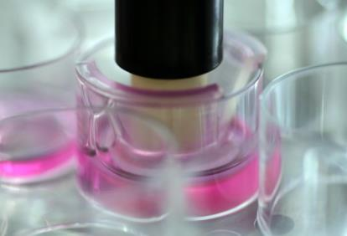
Overview
Plasma’s cocktail of active ingredients and their role in redox biology
Plasma-Liquid-Biomolecule interaction:
Organic matter in liquids becomes part of the chemistry
“Passive”: offering a target for reactions
“Active”: cells actively change chemistry

Slide 3
Plasma – a cocktail of active ingredients
Charged particles
Reactive
species
UV radiation
rf, heat,
el. field,…
Membrane, DNA, proteins, …

Slide 4
Key Roles of Reactive Oxygen and Nitrogen Species
Plasma (in air) produces the same molecules that our body uses for signaling
RONS generally react by exchanging electrons in a chemical process called redox reactions (reduction-oxidation)
Comprehensive Clinical Plasma Medicine, Springer 2018

Slide 5
RONS & Redox
Online Seminar by Prof. David Graves: Role of RONS in Plasma Medicine: Lessons from Nature https://mipse.umich.edu/ltp_seminars.php
Fang, F. Antimicrobial reactive oxygen and nitrogen species: concepts and controversies. Nat Rev Microbiol 2, 820–832 (2004). LINK

Slide 6
Redox Biology – NO and O₂⁻
NO and O₂⁻ together with other RONS have short lifetimes. If applied on the surface, any effect that occurs deeper in the tissue must come from the biological response of the system (“biological penetration depth” vs “physical penetration depth”)
NO and O₂⁻ are created in biological systems and by plasma!
Comprehensive Clinical Plasma Medicine, Springer 2018

Slide 7
Redox Biology
RONS-based therapies & plasma cause similar effect as an innate immune system oxidative burst
Plasma (at low doses) mimics an immune response to tissue damage, wounds or infection which could initiate a natural healing response
Plasma & Immune Response – Immunotherapy for Cancer Treatment?
Comprehensive Clinical Plasma Medicine, Springer 2018

Slide 8
RONS and immunogenic cell death
Tumors employ immunosuppressive strategies to escape the body’s normal immune surveillance and elimination
Exposure of antigens on tumor cells via the immunogenic cell death
Several steps in this pathway are ROS dependent
High ROS amount leads to cell death and debulking of tumor mass, the smaller tumor may be more manageable by the compromised immune system
Removal of immunosuppressive cells by plasma can be an additional beneficial outcome

Slide 9
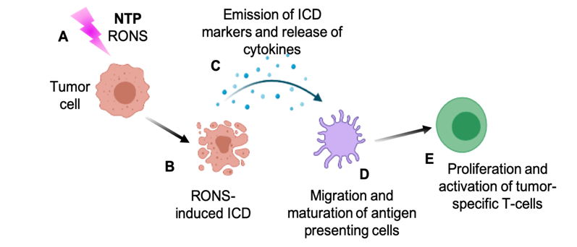
Conceptual Hypothesis
Exposure of tumor cells to NTP-produced RONS (A) leads to RONS-induced immunogenic cell death (ICD) (B) followed by emission of ICD-related markers and the release of key pro-inflammatory cytokines (C) that enhance migration and maturation of antigen presenting cells (D). These in turn stimulate the proliferation and activation of tumor-specific T-cells (E).

Slide 10
Comparison of Two Cell Populations
2 leukemic cancer cell lines: Jurkat and THP-1
Jurkat cells are of lymphoid origin (precursors of T and B lymphocytes)
THP-1 cells are of myeloid origin (precursors of macrophages and dendritic cells), have the capacity to produce cellular RONS that are used for destroying pathogens
Investigation of cell viability, damage-associated molecular patterns, phagocytosis by antigen presenting cells

Slide 11
Cell viability and Mitochondrial Superoxide
H. Mohamed et al. Cancers. 2021;13(10):2437.

Slide 12
Pro-phagocytic DAMPs
H. Mohamed et al. Cancers. 2021;13(10):2437.

Slide 13
Pro-phagocytic DAMPs
H. Mohamed et al. Cancers. 2021;13(10):2437.

Slide 14
Phagocytosis
H. Mohamed et al. Cancers. 2021;13(10):2437.

Slide 15
Stimulation of Monocyte Migration
H. Mohamed et al. Cancers. 2021;13(10):2437.

Slide 16
Summary of the Observations
THP-1 cells are more resistant to NTP-mediated cytotoxicity
Nonetheless, THP-1 cells showed increased level of chemotaxis and phagocytosis
Phagocytosis without cytotoxicity may open up new avenues for plasma oncology
Can the plasma chemistry help shed light on the two different cell responses?
H. Mohamed et al. Cancers. 2021;13(10):2437.

Slide 17
Plasma-Liquid Chemistry with Cells
H. Mohamed et al. Cancers. 2021;13(10):2437.

Slide 18
Plasma-Liquid Chemistry in the Presence of Organic Matter
Cells influence the plasma-liquid chemistry in two ways:
Passive: they just provide a target to react with
Active: cells contribute to the chemistry (e.g., mitochondrial superoxide production) or take up reactive species to neutralize them (THP-1 cells)
Closer look at reaction targets in liquids: reduce complexity

Slide 19

COST Reference Microplasma Jet
Designed as reference source: robust and reproducible
Allows to contextualize results
CCP, 13.56 MHz RF, He, He/H₂O and He/O₂
1 mm electrode distance, 30 mm plasma channel
Integrated matching network along with current and voltage probes for continuous monitoring
COST Reference Microplasma Jet
Golda J et al. Journal of Physics D: Applied Physics. 2016;49(8):84003.

Slide 20
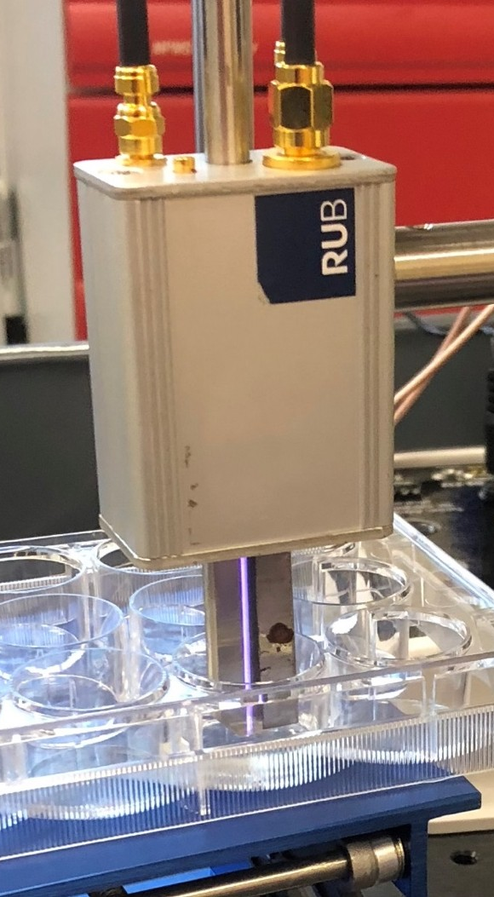
Experimental Conditions
Total gas flow: 1 slm
Power constant at 750 mW
~240 V_{RMS} for He/O₂ and He/H₂O
~215 V_{RMS} for He
Liquid treatments:
12-well plate, 1 ml treatment volume
4 mm distance from nozzle to liquid
All measurements performed in triplicate

Slide 21
He 0.6% O₂
He-only
He 2500 ppm H₂O
O
O
●OH
●OH
OH⁻
O₂^{●-}
O₃
He*
HO₂●
H₂O₂
¹O₂

Slide 22
O and OH in He/O₂ and He/H₂O
O (TALIF) and OH (LIF) in an open effluent and with a liquid interface present at 4 mm distance
O dominates in He/O₂, OH in He/H₂O
Myers, B. et al. Journal of Physics D: Applied Physics 54 (2021): 145202
Stapelmann, K. et al. Journal of Physics D: Applied Physics 54 (2021): 434003

Slide 23
Start simple: H₂O₂ formation in DI water
H₂O₂ in He/H₂O plasma-treated sample is ~30x higher than He, ~50x higher than He/O₂
Corresponds well to OES and previously reported gas phase measurements*
x50
x30
*Benedikt J et al. Plasma Sources Sci Technol. 2016;25(4):045013.

Slide 24
Isolating H₂O₂ origins using OH scavenger
H₂O₂ is produced primarily in gas phase
H₂O₂ is produced primarily in aqueous phase
H₂O₂
H₂O₂
H₂O₂
H₂O₂
●OH
●OH
●OH
●OH
H₂O₂
H₂O₂
H₂O₂
H₂O₂
●OH
●OH
●OH
●OH
H₂O₂
H₂O₂
H₂O₂
H₂O₂
H₂O₂
●OH
●OH
DMPO–OH
H₂O₂
H₂O₂
H₂O₂
DMPO
DMPO–OH
H₂O₂
H₂O₂
DMPO
DMPO
H₂O₂
●OH
H₂O₂
H₂O₂
DMPO–OH
H₂O₂
●OH
DI water
50 mM DMPO
DI water
50 mM DMPO
No difference in peroxide measured
50% reduction in peroxide measured due to ●OH scavenging by DMPO

Slide 25
Isolating H₂O₂ origins using OH scavenger
OH scavengers: Terephtalic acid (TA) and spin-trap 5,5-Dimethyl-1-pyrroline N-oxide (DMPO)
H₂O₂ ~ constant across solutions
●OH + ●OH → H₂O₂
(k = 5 x 10⁹ M⁻¹s⁻¹)
DMPO + ●OH → DMPO–OH (k = 4.3 x 10⁹ M⁻¹s⁻¹)
H₂O₂ must be produced exclusively in the gas phase
He/H₂O
Myers, B. et al. Journal of Physics D: Applied Physics 54.14 (2021): 145202

Slide 26
Isolating H₂O₂ origins using OH scavenger
He/O₂
H₂O₂ varies significantly between solutions
Observed previously in phenol*
H abstraction by O from C-H bonds
O enters liquid and reacts further to form H₂O₂
OH or HO₂ as precursor?
Myers, B. et al. J. Phys. D: Appl. Phys. 54.14 (2021): 145202
*Hefny, M. et al. J. Phys. D: Appl. Phys. 2016;49(40):404002.

Slide 27
Comparison DMPO, TA, Phenol
Ring structures
H abstraction by O from C-H bonds
O enters liquid and reacts further to form H₂O₂
When ring structures are present, H₂O₂ production increases – ring structures become part of the liquid chemistry
DMPO
TA
Phenol

Slide 28
From Ring Structures to Cysteine
Amino acid cysteine as simple model
He/H₂O
up to 1 min.: DI ~ cys ~ cys + H₂O₂
5 min: mock > DI >> cys
Cys consumed H₂O₂
Not if only H₂O₂ is present: short-lived species necessary to initiate reactions
He/O₂
DI water higher H₂O₂ concentration
Cys consumed H₂O₂
x4.2
x2
Stapelmann, K. et al. Journal of Physics D: Applied Physics 54 (2021): 434003
Notes:
RPMI: Roswell Park Memorial Institute (RPMI)
Contains amino acids, vitamins, inorganic salts, glutathione, glucose, …

Slide 29
Cysteine Modifications
Native cysteine disappears completely after 5 min He/H₂O
Primary modification He/H₂O: cystine and variations
Primary modification He/O₂: oxidation of sulfur
Stapelmann, K. et al. Journal of Physics D: Applied Physics 54 (2021): 434003
Notes:
RPMI: Roswell Park Memorial Institute (RPMI)
Contains amino acids, vitamins, inorganic salts, glutathione, glucose, …

Slide 30
Cysteine Modifications – Origin of Species
Heavy water H₂¹⁸O as liquid
He/H₂O: more ¹⁸O incorporated
¹⁸O due to hydrolysis, (V)UV or metastable impact, or ¹⁶OH H hopping
Previous observation in “clean” samples: all species originate in the gas phase*
Stapelmann, K. et al. Journal of Physics D: Applied Physics 54 (2021): 434003
*Gorbanev, Y. et al. Physical Chemistry Chemical Physics 20 (2018): 2792-2808
Notes:
RPMI: Roswell Park Memorial Institute (RPMI)
Contains amino acids, vitamins, inorganic salts, glutathione, glucose, …

Slide 31
Conclusions
Organic matter becomes part of the chemistry
Different types of organic matter affect chemistry differently
By offering a target for reactive species / precursors for other long-lived species (e.g. OH / H₂O₂)
By providing new precursors to form other species (e.g. H + HO₂ / H₂O₂)
Living cells actively contribute to liquid chemistry
By offering a target for reactive species
By uptake and neutralization of ROS
By releasing reactive species (TBD)

Slide 32
Challenges and Opportunities
Modifications on biomolecules can be tuned by using different plasma sources, voltage conditions, gas admixtures
Modifications known to nature vs unknown to nature
OH/H₂O₂-driven chemistry vs O-driven chemistry
Reversible vs irreversible modifications in nature
Translation from single amino acids to organisms?
RONS produced by plasma and in the context of redox biology
Precise manipulation of cellular responses possible?

Slide 33
Outlook – ongoing research
Identification of short-lived species in the liquid by EPR spectroscopy
NO, OH, O in water and cell culture medium
Impact of NO-, OH-, and O-rich plasma on cell culture
Response of cells to plasma treatment – different cellular markers and cell-produced chemistry
Can we use plasma and cell-produced chemistry for ”plasma endpoint detection”? → NIH grant starting 04/01/2022
Starting 04/01/2022

Slide 34
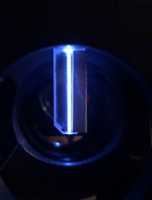
Generation & Transport of Reactive Species - from the gas phase to the liquid to biological samples
COST jet:
Plasma chemistry: what is produced and where, how does it interact with liquids, biological samples, …
DE-SC0021329
Myers, B. et al. Journal of Physics D: Applied Physics 54 (2021): 145202

Slide 35
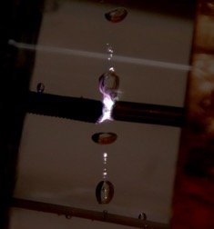
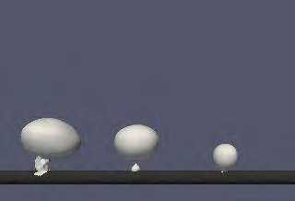


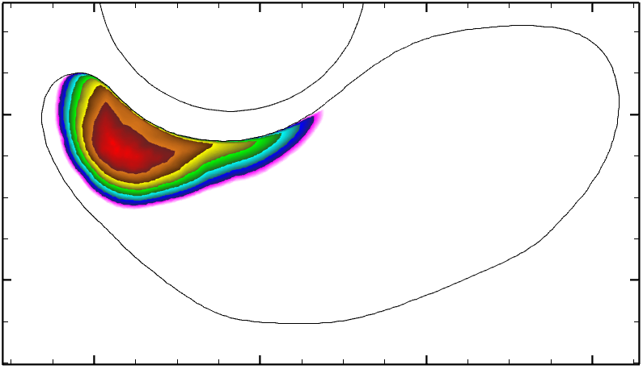

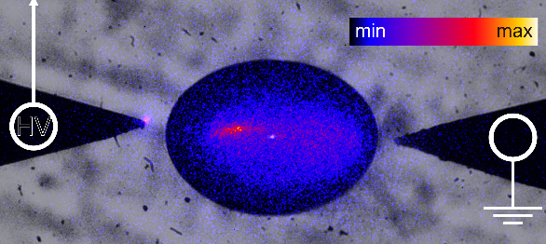
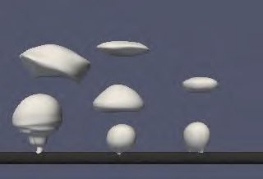






Plasma Breakdown and instabilities in the multiphase plasma-gas bubble-liquid system
Plasma Bubble Reactor for Water Treatment:
Understanding breakdown and streamer development in plasma bubbles – experimental & theoretical approach
PHY 2107901
IOPS Seminar Feb 3, 2022 11 am - Nicholas Sponsel
$$20 ms$$
$$n_{e,max }=7.9×{10}^{12} cm^{−3}$$
$$60 ms$$
Experimental investigation
Bubble shape - nonPDPSim
DNS bubble formation

Slide 36
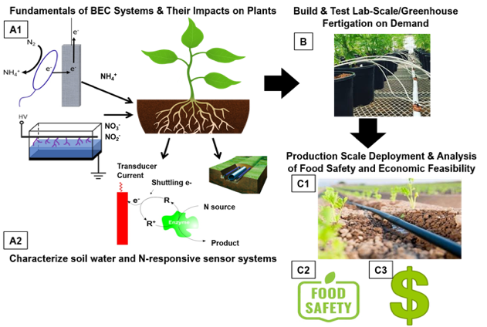
Plasma Agriculture I
“Fertigation on Demand” - Plant Sciences Initiative @ NCSU

Slide 37
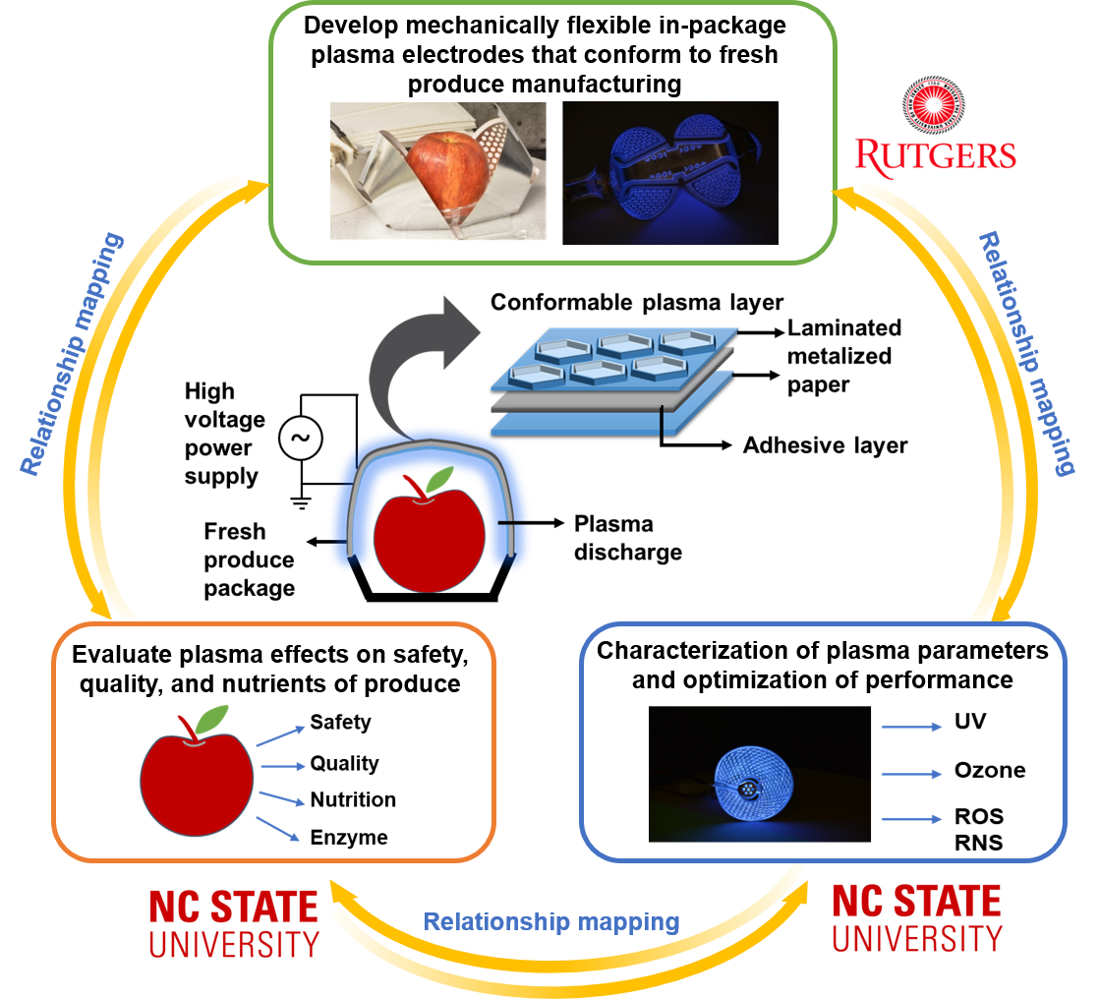
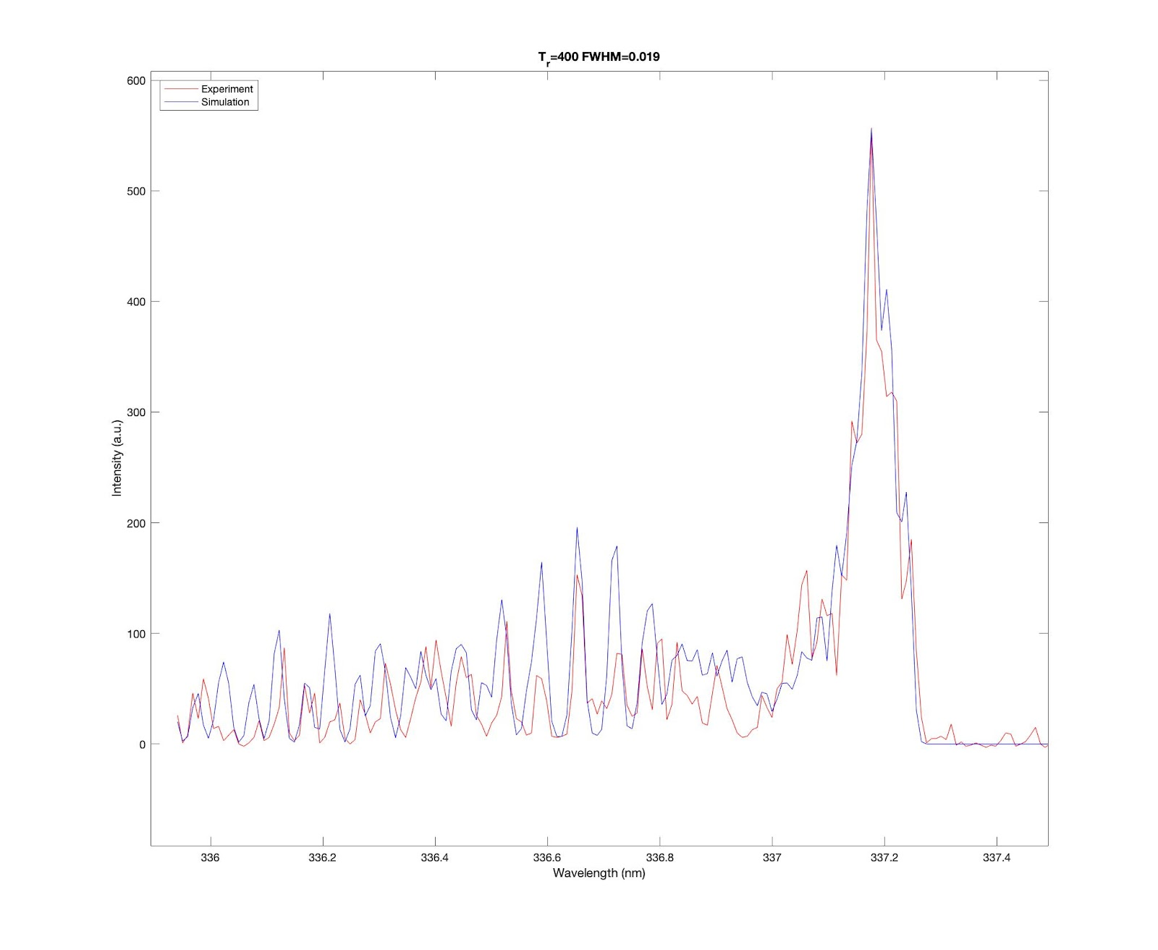
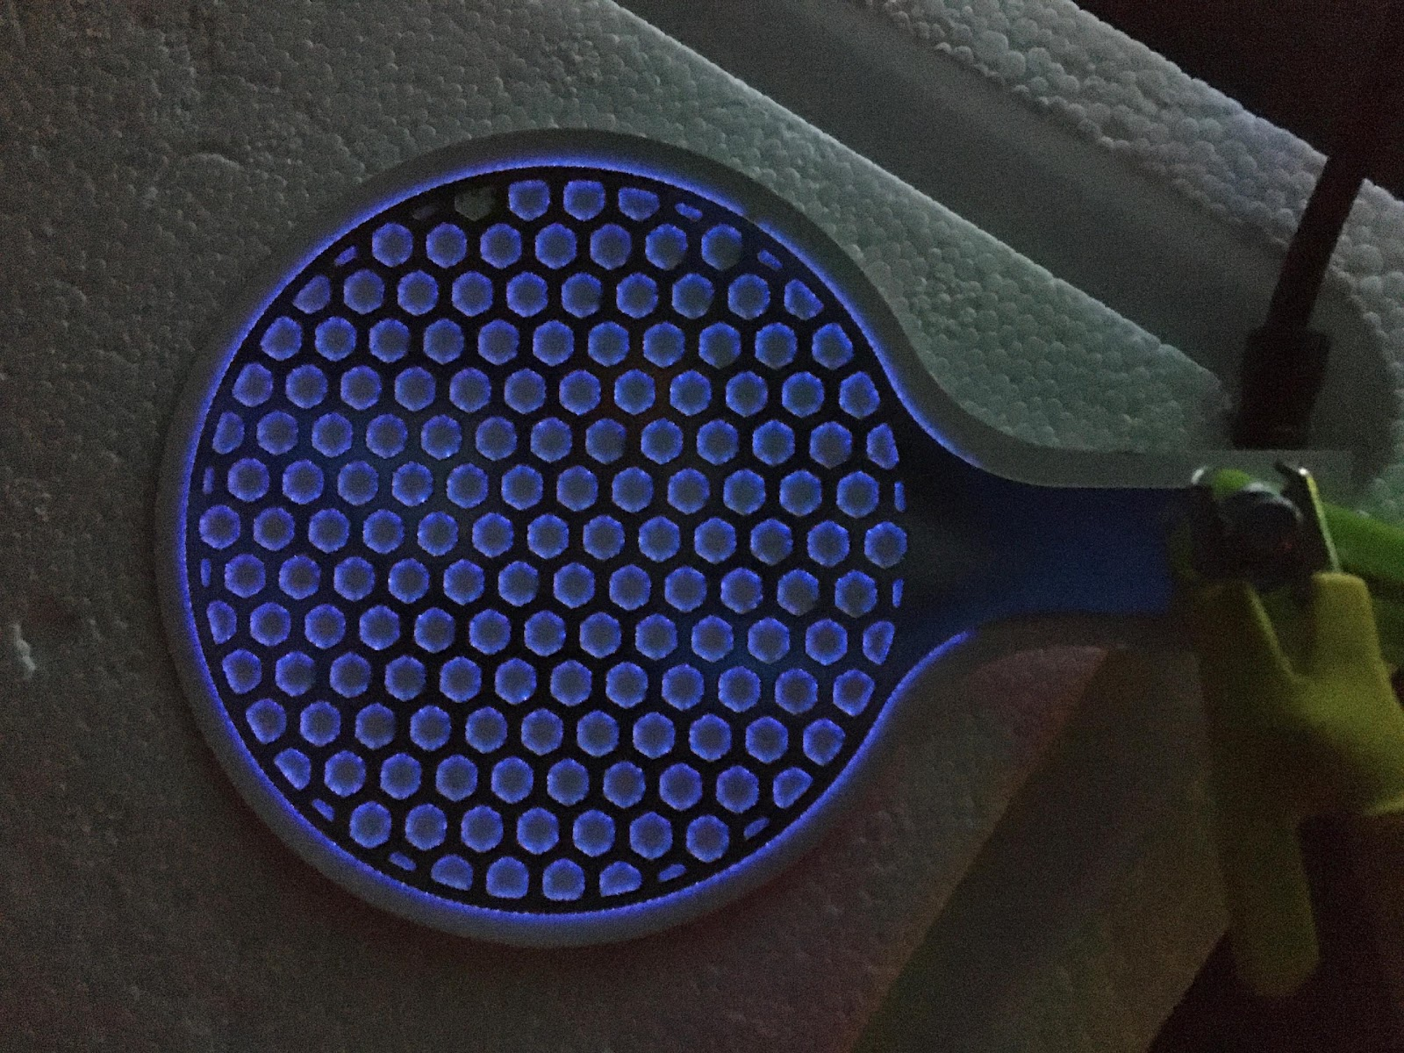
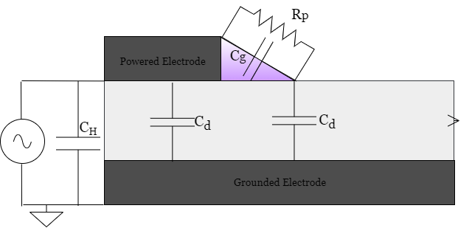
Plasma Agriculture II
Flexible DBD for treatment of fresh produce:
IOPS Seminar Feb 3, 2022 11 am – Duncan Trosan
High-quality manufacturing of packaged fresh produce with conformable in-package cold atmospheric plasma,
USDA 2020-67017-31260
In collaboration with
Dr. Deepti Salvi (NCSU) &
Dr. Aaron Mazzeo, Rutgers

Slide 38
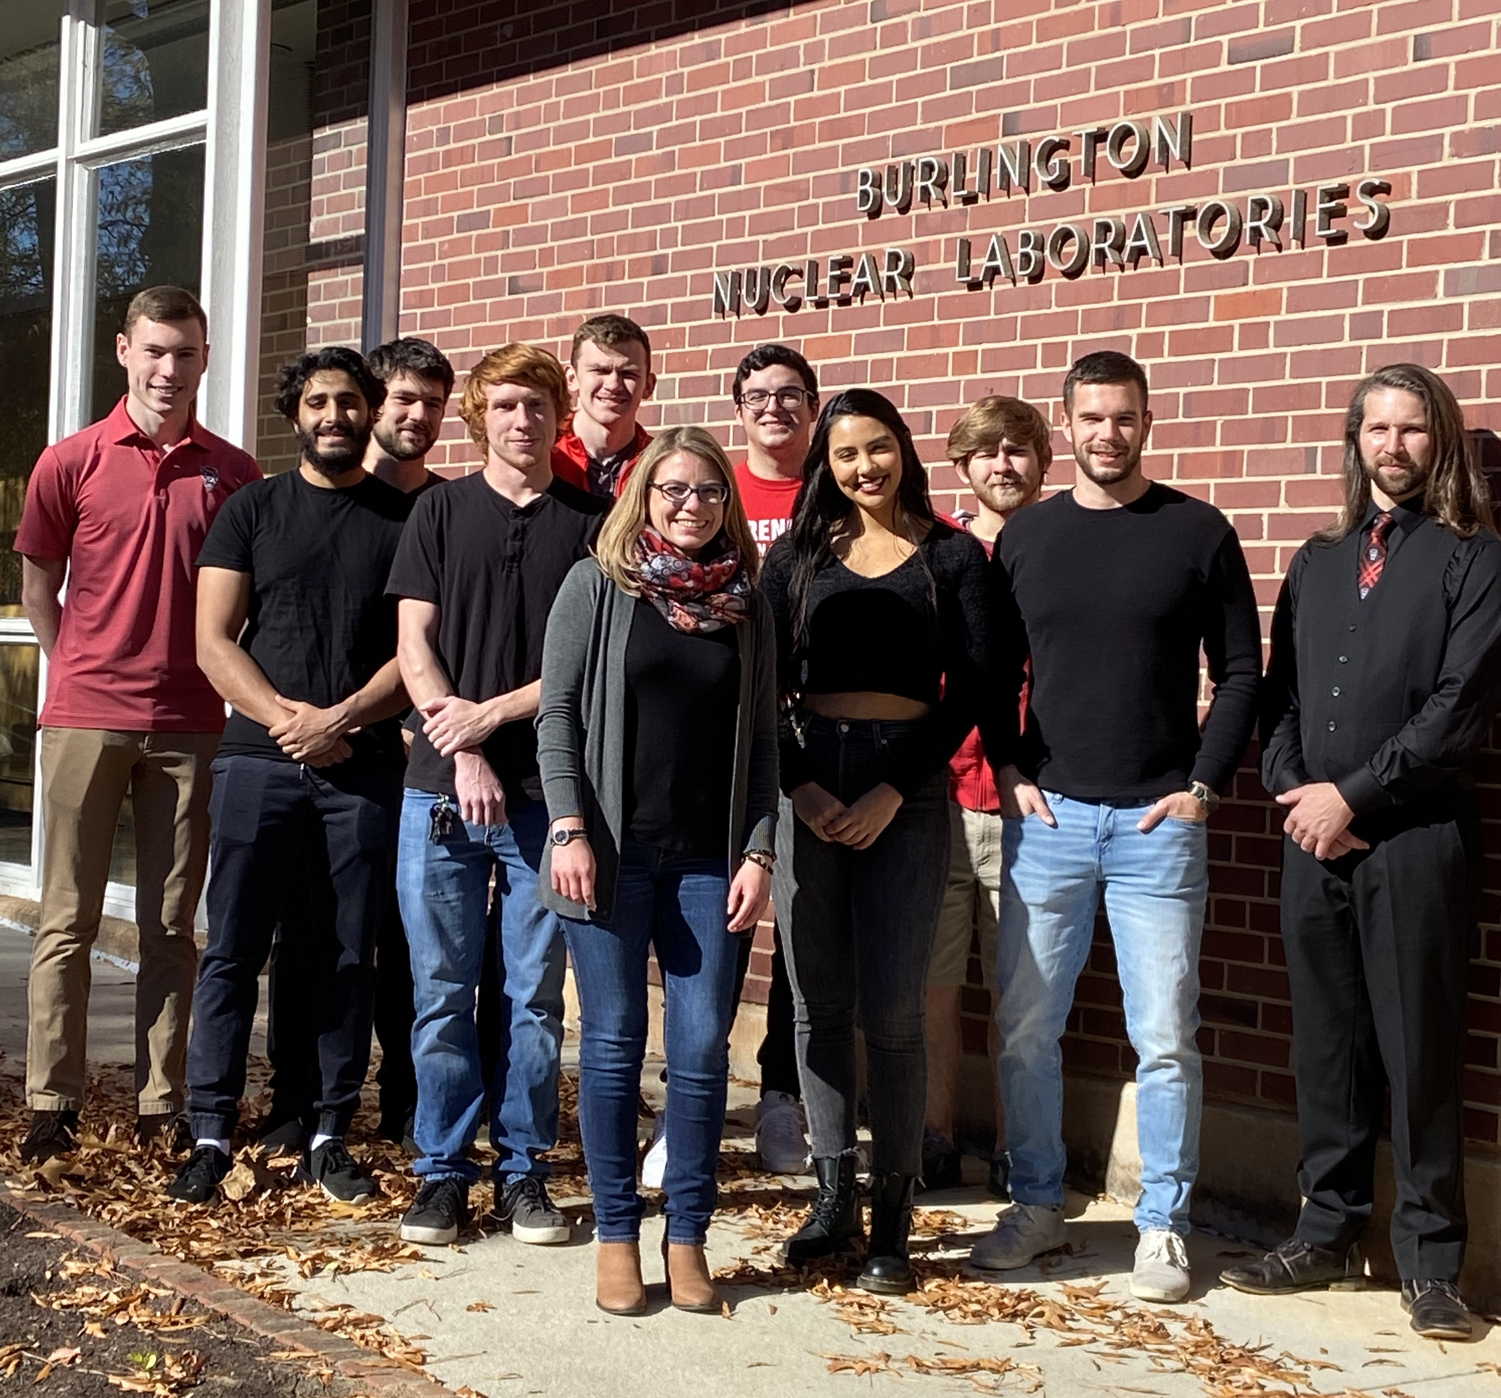
Acknowledgements
Hager Mohamed, Eric Gebski,
Fred Krebs, Vandana Miller
Brayden Myers, María J. Herrera Quesada, Eleanor Lenker, Pietro Ranieri
DE-SC0021329

