Slide 1


Transformational events and leading challenges in the fusion and plasma sciences
Edmund Synakowski
Associate Director, Office of Science
Fusion Energy Sciences
Michigan Institute
for Plasma Science and Engineering
October 7, 2015

Slide 2
Discovery that yields transformation of mindsets is a hallmark of the fusion energy sciences
The fusion energy and plasma sciences have undergone remarkable transformations over the years
Here, my interest is in research that fundamentally changes the outlook on what is possible in a field
The community has identified challenges and opportunities in fusion and plasma science where transformation is again required; we can respond to the times

Slide 3
In what follows…
A high-level examination of research results, some individual, some collective, that changed perspectives on what is possible in fusion and plasma science. Also touched upon are some social factors that enabled these ideas to “take off”
It is biased and imperfect, and topically incomplete. It is centered on transformational “events” at the expense of the all-important incremental progress that defines most research days
But even as an imperfect history, the vignettes are signposts of an important and rich story of how research transforms perspectives
Understanding our path to this day can inspire us

Slide 4
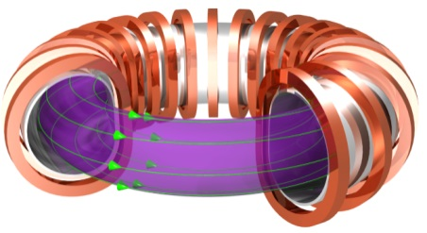
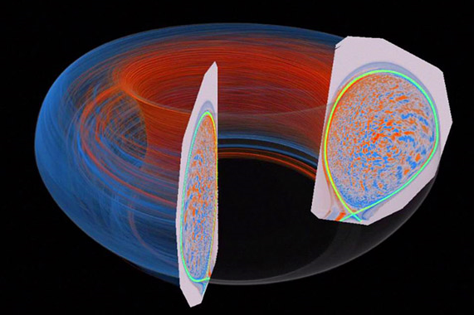
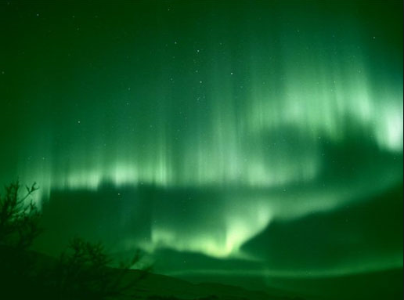
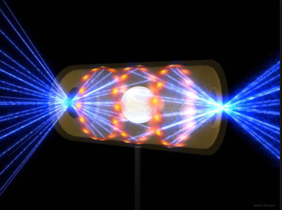

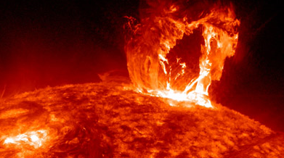
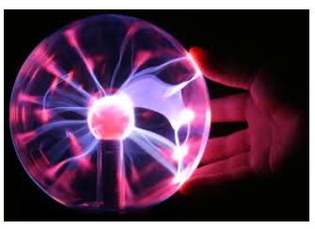
The fusion and plasma sciences are broad and tremendously rich
A great intellectual framework has been developed, with rich and complex interplay. Energy-directed research spawns great science
How did we get here?
Magnetic fusion
Simulation of DIII-D tokamak fusion plasma turbulence (PPPL)
Aurora
Inertial fusion: NIF hohlraum
Solar flare (NASA)
Centaurus A with plasma jets from central black hole (NASA)

Slide 5
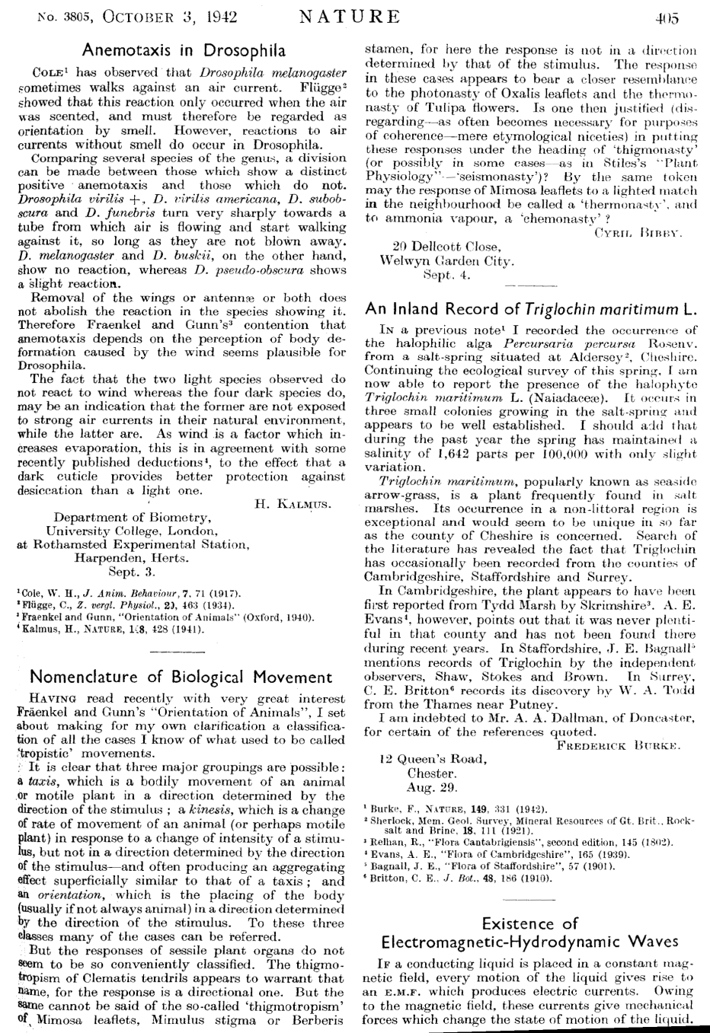
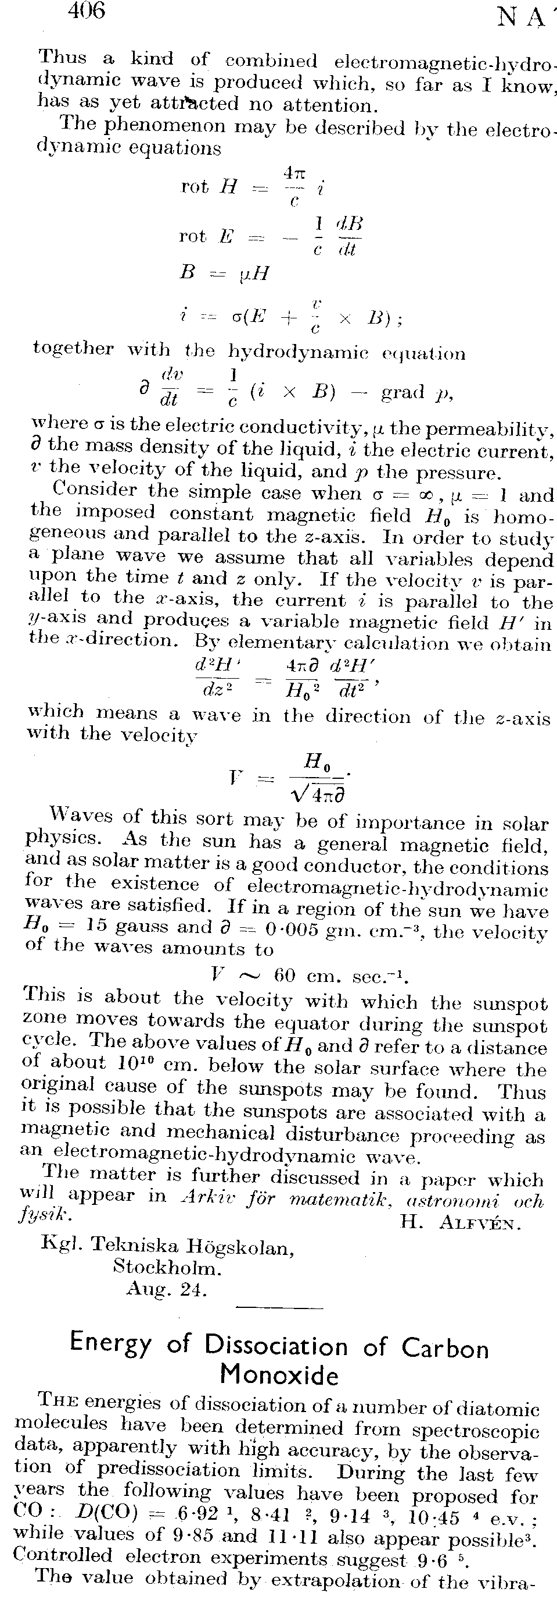
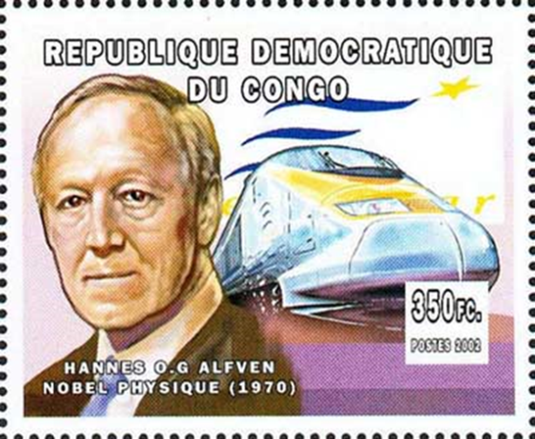
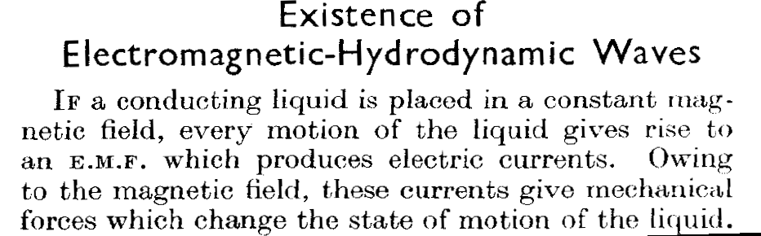
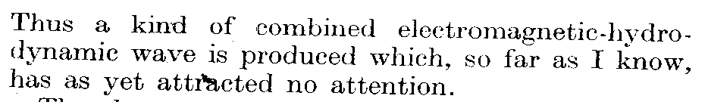
The plasma sciences have a revolutionary insight at their core
Hannes Alfvén created a major piece of the framework for fusion and plasma science by forging a union between electromagnetism and hydrodynamics (Nature, October 3, 1942)
The entire paper: “Nature” Letter

Slide 6
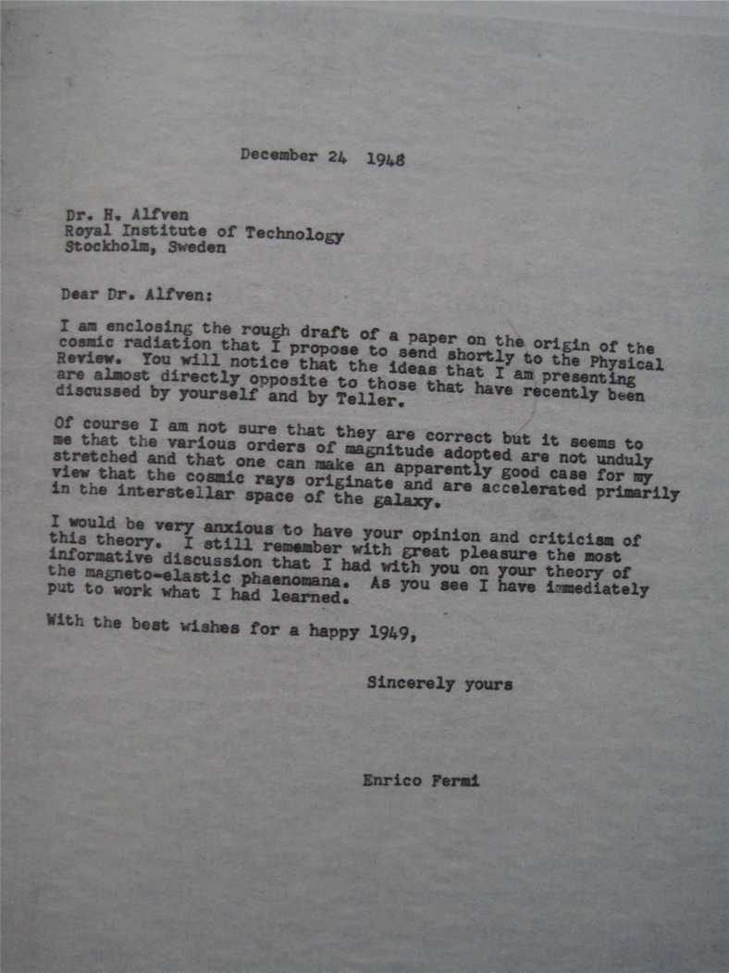
The impact of Alfvén’s work demanded the validation of and competition with others
The level of attention and credence given to Alfvén’s work jumped dramatically Fermi embraced it
Subject: the origin of cosmic rays
Alfvén and Teller vs. Fermi and Chandrasekhar debate
But for both, the essential mechanism for building energy in cosmic rays in both pictures was hydrodynamic, based on Alfven’s ideas
Letter from Fermi to Alfvén, December 1948, just following Chicago lecture

Slide 7
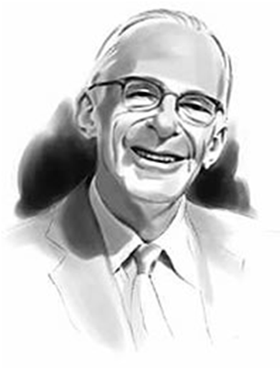
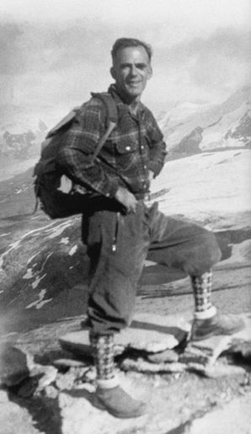
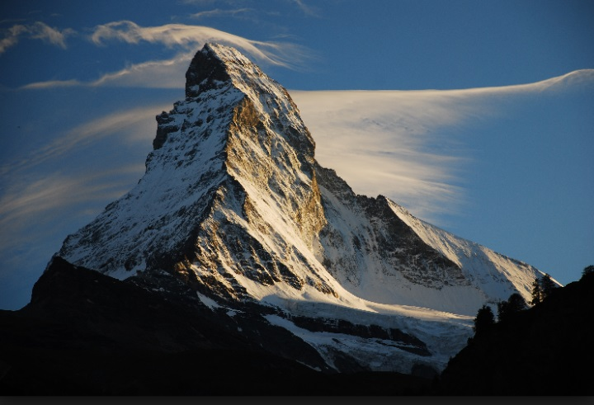
Alfvén’s ideas were introduced to Lyman Spitzer at the right time
False claim by Peron and Argentina about fusion in March 1951 (NY Times) got Spitzer thinking
Spitzer was already part of Project Matterhorn, established to support developing the H bomb. He was chosen to lead it for his expertise in plasma physics
The Peron claim got Spitzer thinking – how would one in fact make controlled fusion happen in the lab?
From Herman, 1990, “Fusion: The Search for Endless Energy”:
“As Spitzer considered this question, he recalled what he had read in a new book by Hannes Alfvén… On one of his swings up the mountainside, as he thought about ionized gases, magnetic fields, and Hannes Alfvén, Spitzer found an answer…”
Lyman Spitzer

Slide 8
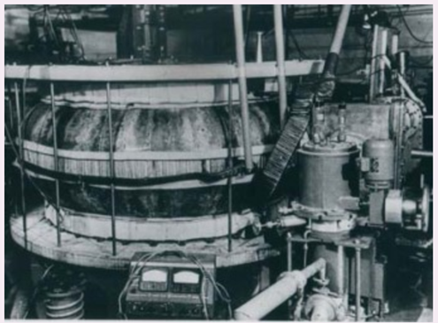
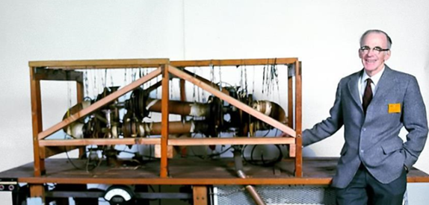
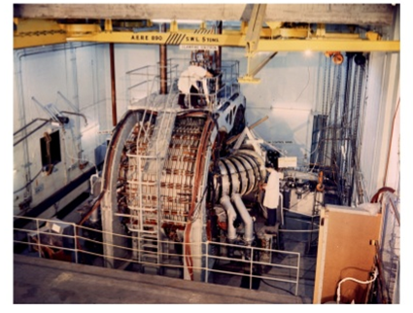
In the 1950’s, there were three major players pursuing fusion, with three related yet distinct approaches
Stellarators (US), pinches (UK), tokamaks (Soviet Union) – three independent mainline approaches in the 1950’s
First stellarator (U.S.)
First tokamak (T1, Soviet Union)
Zeta pinch (Harwell, UK)

Slide 9
1956, Harwell: Sharing for the first time reveals all of the players were developing a common scientific approach
First sharing of notes revealed that, despite different experimental vehicles that were being emphasized, there was a great deal in common with what physics had been identified, and how the issues were framed
From V. Smirnov, Nucl. Fusion 50 (2010) –
“The initiative to declassify came from the USSR. I.V. Kurchatov’s lecture in Harwell in April 1956 about fusion related high current pulsed discharges was the first step in this direction. Two years later, at the Second Geneva Conference on the NF problem, 105 papers were presented, detailing work performed in the USSR, USA, UK, Germany and other countries. Thus it was shown that, despite the regime of classification, and apparently without
any leakage of information, research had been conducted in practically identical directions. The conference did not result in an immediate collaboration in scientific research between
different countries, but it demonstrated a common scientific approach”

Slide 10
But progress was slow, and many were pessimistic about magnetic confinement
1950’s: Spitzer conjecture that Bohm diffusion dominated stellarators (D ~ kT/16eB). Rapid losses established a mindset about confinement, that it might always be poor and scale unfavorably with temperature
Stellarators were seen as the only option by some, since a path to steady-state could be envisioned. But they were cold – zero current meant no significant heating. Reliance on wave heating demanded low density, as understood at the time.
Pinches benefitted from heating by passing a current through the plasma, but were rife with instabilities

Slide 11
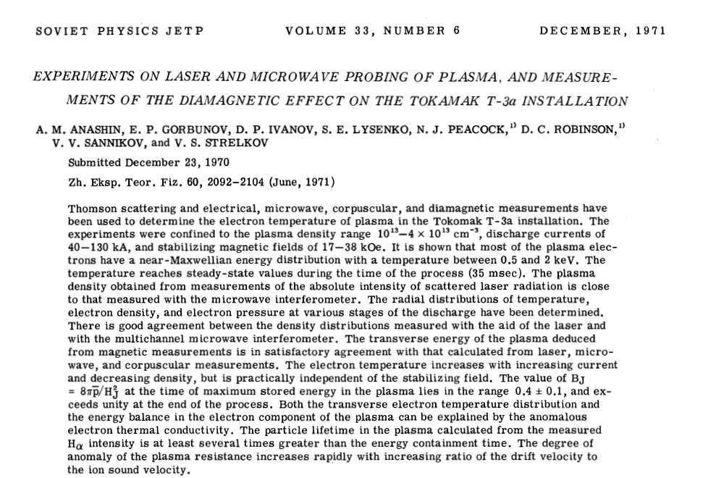
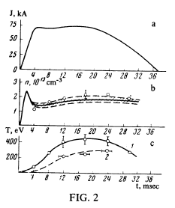
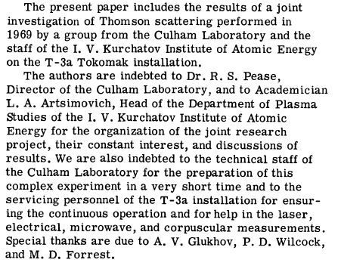
Transformation in the 1960’s– striking results from the tokamak
Soviet 1 keV Te verified by Culham researchers in the 1960’s
2-for-1 insight:
A torus, with potential of a stellarator, plus passing a current enables heating simplification over the stellarator coils
Tokamaks did better than Bohm diffusion –This fundamentally changed mindsets
This was a transformative event revealing that confinement can be dramatically better than Bohm. Also, recognized was the high value of passing a current through a toroidal plasma to both heat and contribute to the confining magnetic field
Lesson: This dramatic cold war event revealed that there is great power in the openness of our scientific practice.

Slide 12

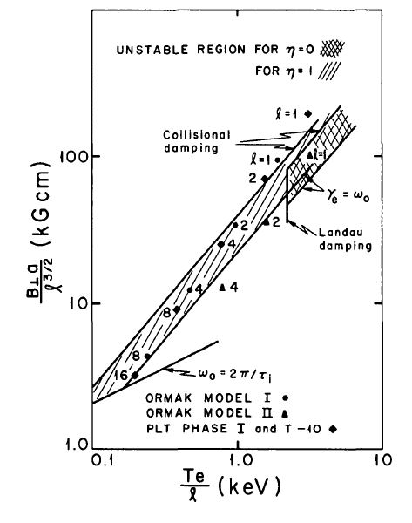
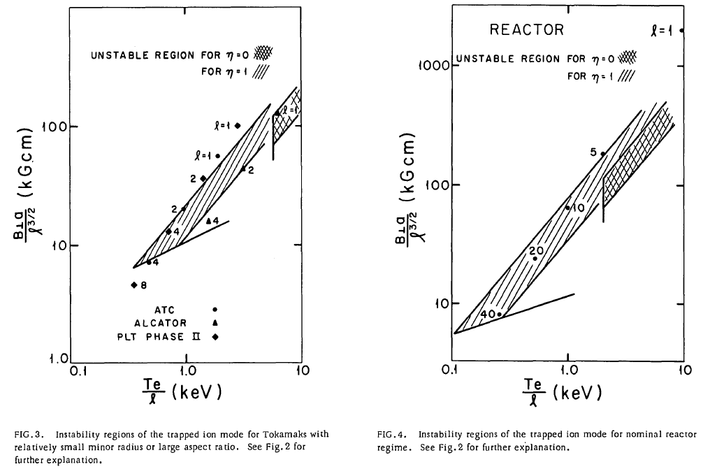
But pessimism still abounded regarding what was ultimately achievable
Known in the field as the “Universal instability”
Give credit to theorists for being bold: theory reveals that, assuming reasonable density and temperature gradients, a broad class of instabilities will be active in an upcoming line of tokamaks, and a reactor
NF Journal, January 1972
“
“
tion

Slide 13
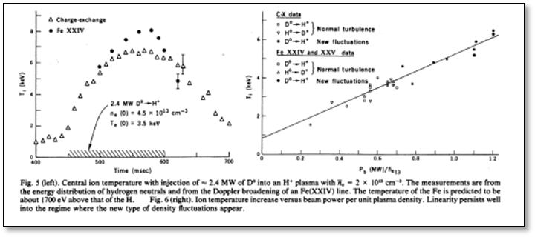
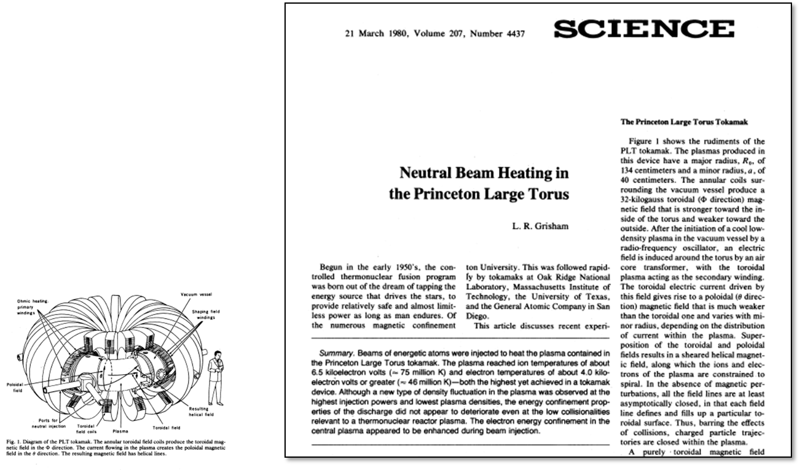
Transformation: ion temperatures approach reactor-relevance with neutral beam heating. And, no sign of the universal instability
Neutral beam heating’s success was spectacularly demonstrated on PLT at PPPL (figures from Grisham, 1980, Science)
Transformative event: Generating fusion-relevant ion temperatures changed the thinking of many regarding fusion’s potential
First reported by Eubank, IAEA 1978, and PRL 43 (270) 1979
Also, a new scientific platform is born: separating the heating and current drive set the stage for understanding bootstrap current and current drive in general in tokamaks.

Slide 14
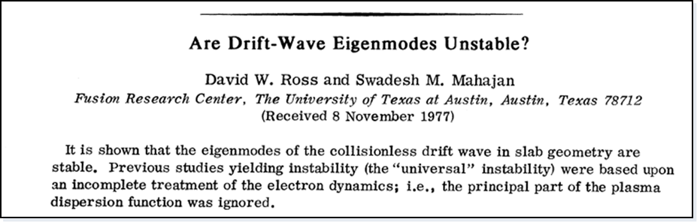
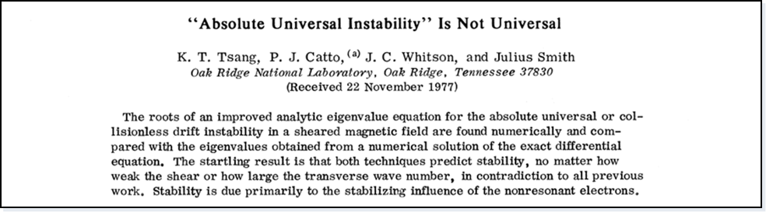
Theory responds to the PLT results
Computing and theory join to reveal that these drift instabilities may not be so universal after all
Ross and Mahajan; Tsang and Catto, PRL’s adjacent in one issue (1978)
Theory shed light on what to look for, but experiment was critical in forcing a reexamination of the theory

Slide 15
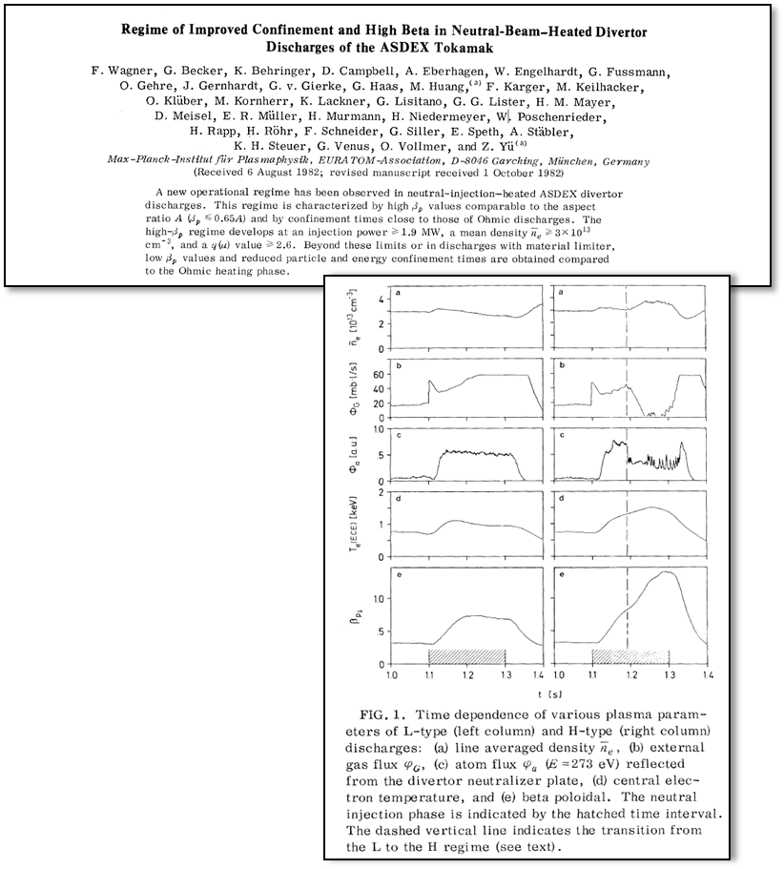
The discovery of the H mode expands our thinking: confinement can be manipulated
Wagner and the ASDEX H mode (1982) brought about at least two important changes
Mindset shift – we can control the confinement state
Impact - Visions of a more compact and affordable tokamak-based reactor suddenly seemed viable
The concept that there was more than one “mode” for tokamak confinement was expanded with this result, giving rise to the H mode and L mode
F. Wagner, PRL 49, 1408 (1982)
Origin of the improvement came to be understood to be the edge, but details of the physics remained unknown
Unexpected impact of shaping on confinement revealed but not understood

Slide 16
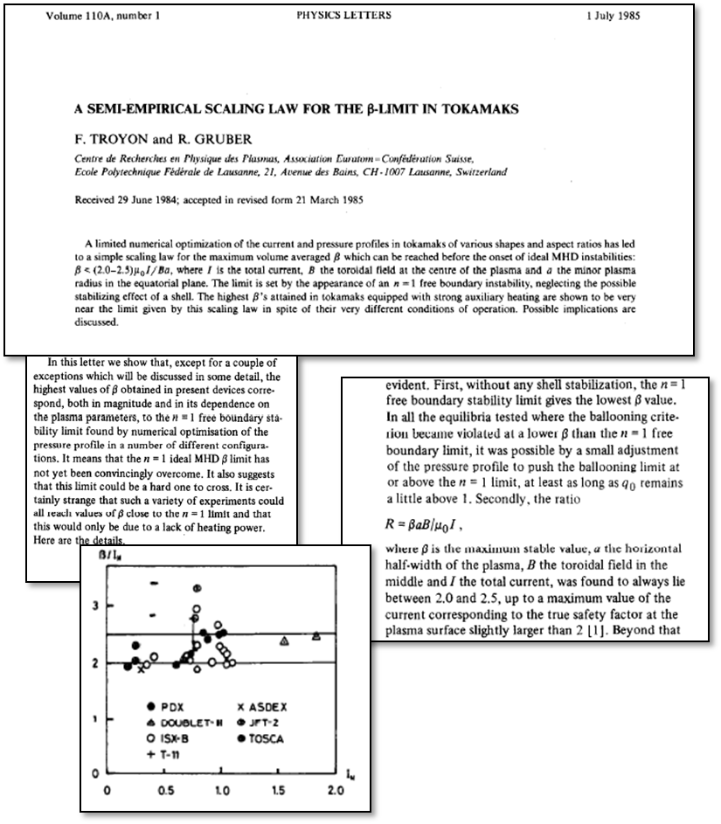
Transformation: Stability limits for a wide range of devices have common physics
Troyon carried a conviction that there is a set of simple, common physics in these disparate experiments that limits the plasma pressure
Troyon beta limit was established by comparing results from numerical studies over a wide range of experiments from tokamaks with widely varying shapes
The simplicity of the expression that describes the beta limit is striking
Lessons –
Common pressure-limiting physics presides across many devices
But as Troyon says, this stability limit “may be difficult to cross”
➔ Identification of common physics of no-wall beta limit increased attention on finding ways to exceed it

Slide 17
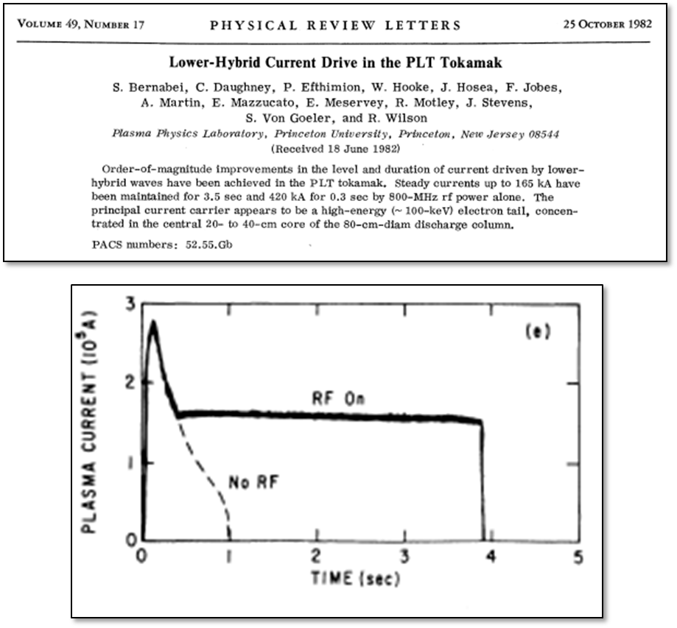
Transformation: wave physics can be used to drive current, potentially overcoming limits of the tokamak
Theory predicts efficacy of lower hybrid current drive
(Fisch, PRL 41 873 (1978)
Eye-opening demonstration that current drive is viable for a tokamak on PLT (Bernebai, 1982)
➔ An astonishing demonstration of the power of theory of wave-particle interactions
Transformations:
The tokamak could be seen as more attractive than before. Current drive can now be considered to be a viable tool for fusion plasma sustainment
Also, theory anticipated this result, rather than reacted to it

Slide 18
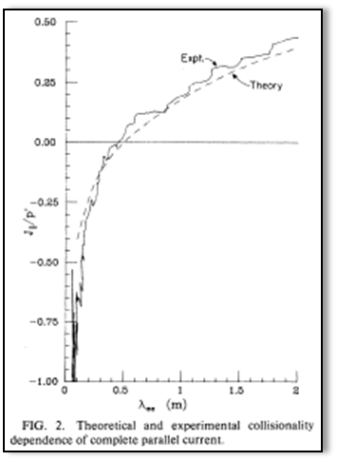
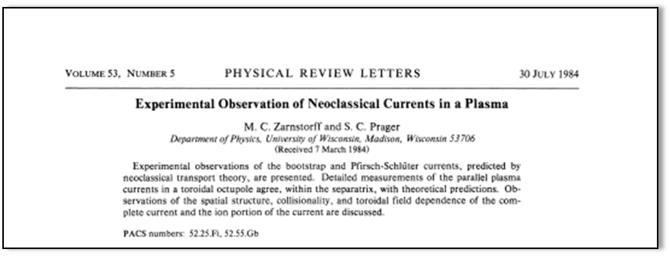
Parallel processes are well described by neoclassical theory (1)
Clearest demonstration up to that time of the validity of neoclassical theory of parallel processes: Octupole (1984, Zarnstorff and Prager, U. of Wisconsin)
- Strong confirmation that parallel processes are reasonably captured by neoclassical theory
Points to the potential of relaxing the current drive requirements on a tokamak
University-based research has direct impact on transformative physics

Slide 19
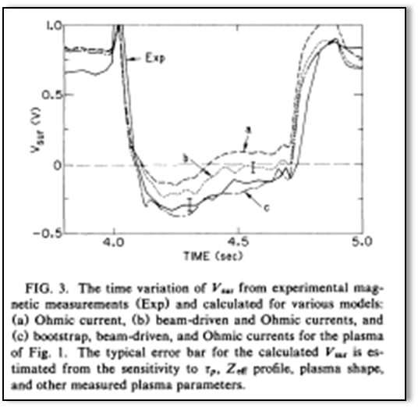
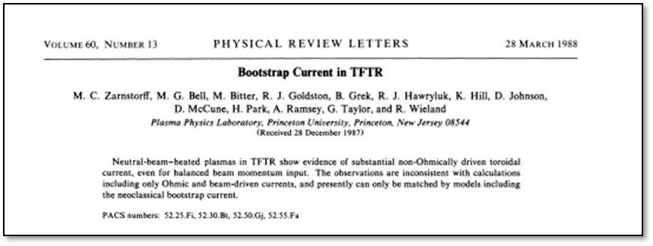
Parallel processes are well described by neoclassical theory (2)
… followed by definitive study of bootstrap current on TFTR (1988)
Transformations include:
The plasma can help itself through bootstrap current and relax the current drive requirements on a tokamak. This put emphasis on understanding profiles
University-based research has direct impact on transformative physics
With Troyon’s and Wagner’s work, and the bases of current drive being established, major elements of the basis of the advanced tokamak were now coming together.

Slide 20
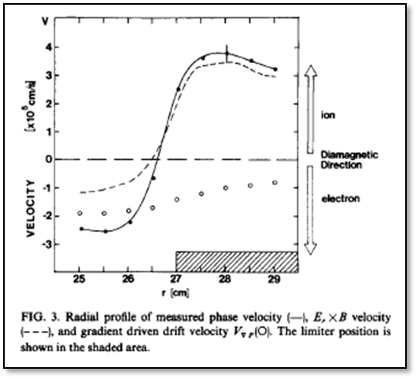
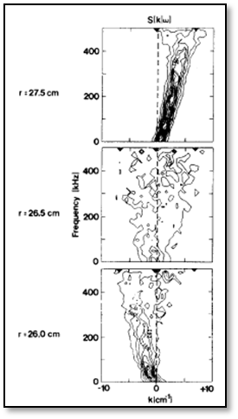
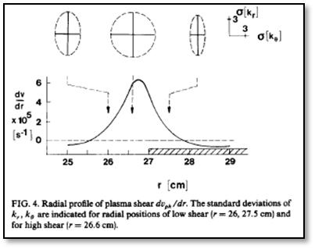
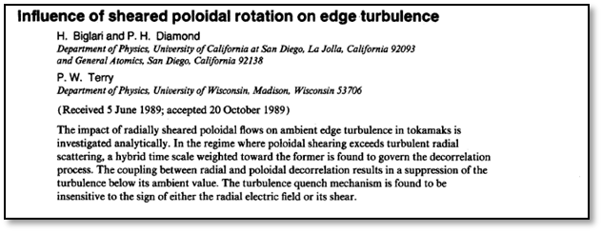
Transformation in understanding transport: in the 80’s and 90’s: realization that transport processes can be understood
The 1980’s – major explosion in detailed measurements of profiles and turbulence, and linkages to theory
A picture develops. TEXT tokamak was a central player
Turbulent structures observed at boundary – velocity shear layer connected with confinement (Ritz, Bengtson, Levinson, Powers, Phys Fluids 27 (1984) 2956
Particle fluxes measured spectroscopically and can be explained by electrostatic turbulence (Rowan, Klepper, Ritz, NF 1987)
Biglari-Diamond-Terry describe theory of shear effects on turbulence
Transport Task Force in late 1980’s further advanced this class of work nationally and then internationally
Perspective shift: Transport is knowable

Slide 21
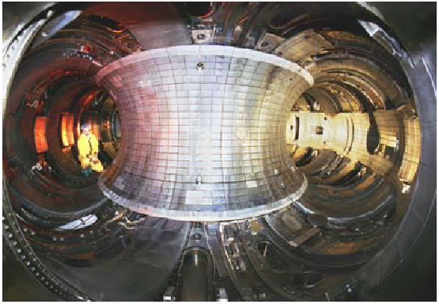
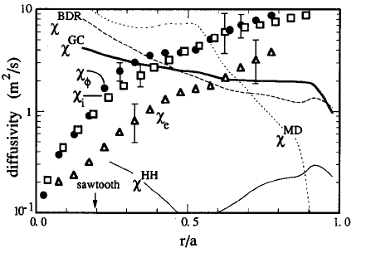
A personal view of the evolution of a slice of our science…
TFTR (‘82 - ‘97)
Extraordinary dependence of confinement on boundary conditions (Li on carbon walls)
Experimental χ_{i}, χ_{φ}
Scott et al., Phys. Fluids B 1990
… a taste of the early theory-experiment comparisons in thermal conduction
Theory

Slide 22
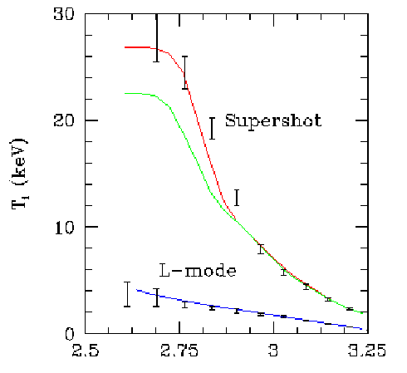
Mid-90’s: turbulence theory-based models fundamentally transform our understanding of what our scientific expectations must be
Mid 90’s: IFS-PPPL model gets T_{i}(r) in very different confinement regimes about right
Linear gyrokinetics identify critical gradients.
Nonlinear gyrofluids map out parametric shape of χ_{i}.
I (spectroscopist) hear for first time from theorists: “We think your T_{i} data are incorrect in some cases - can you reanalyze these shots?”
➔ Theorists were right: the measurement was wrong
➔realization that simulation at the level of the turbulence had to be part of future predictions
Later improvement: add further stabilization ExB shear
Stabilization of ITG/TEM modes via density peaking
Kotschenreuther, Dorland, Hammett, Phys. Plasmas 2 (1995)

Slide 23
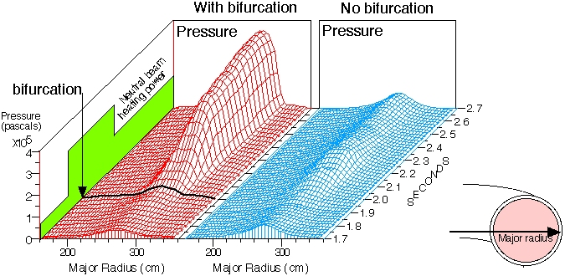
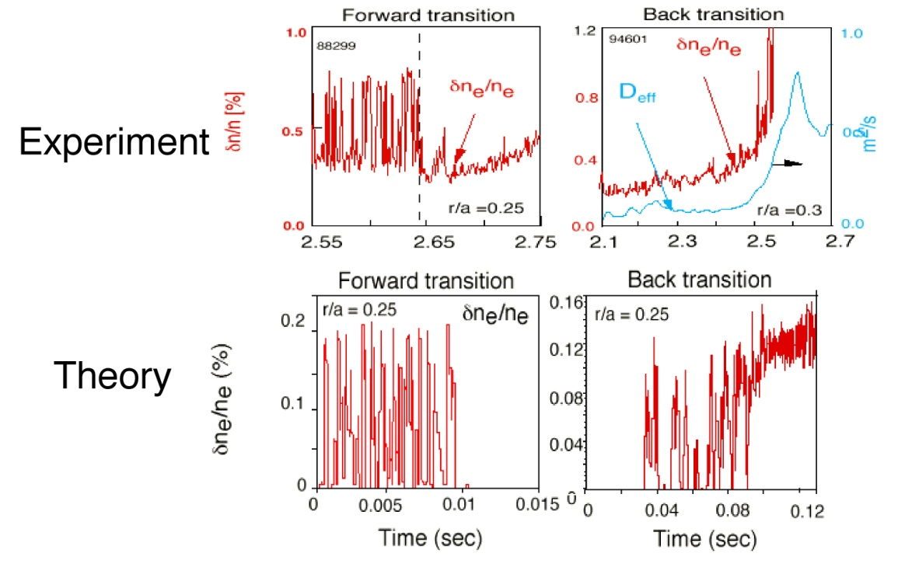
Core transport barrier studies: exciting dynamics in the plasma drive important dynamics in the community
An exciting period scientifically and with respect to the community. The theoretical minimum in core transport can be realized
Scientific cross-connects: core and edge physics. ExB shear, a bifurcating core joins the bifurcating edge, the language of phase transitions enters the lexicon…
Institutional cross talk/stimulation/competition was vibrant
Density turbulence & confinement

Slide 24
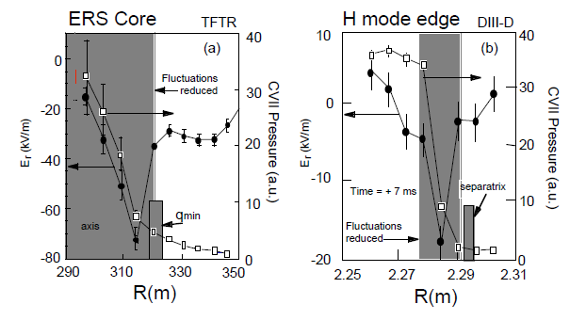
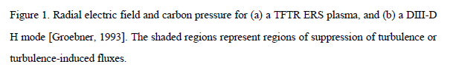
Transport barrier studies: exciting dynamics in the plasma drive important dynamics in the community
Physics commonality between
the core and the edge
the east coast and west coast

Slide 25
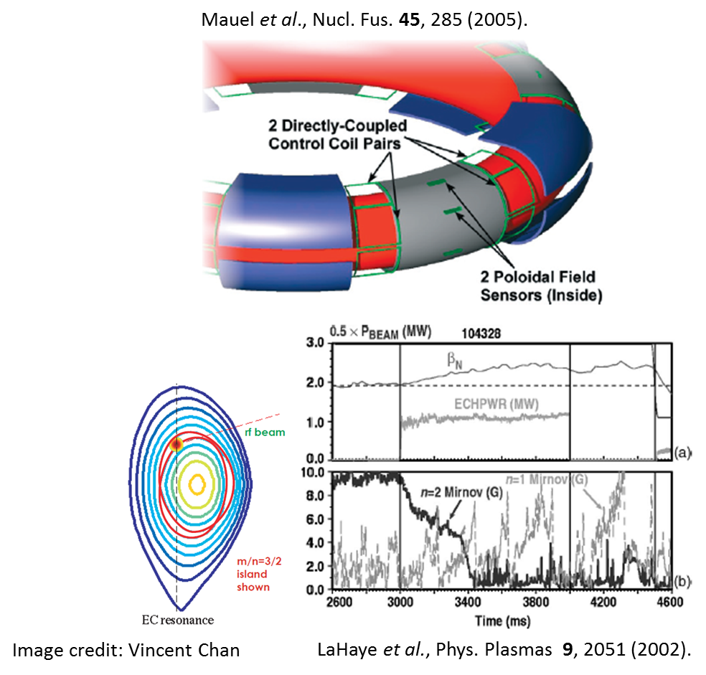
Going beyond the no-wall limit: active feedback can suppress the development of instabilities
Stabilization of the resistive wall mode (RWM) is critical for operation at high β.
Active feedback coils on the HBT have stabilized actively growing RWMs.
➔ University partnership had large impact on DIII-D and thus the world program
Neoclassical tearing modes (NTMs) may lead to loss of confinement and perhaps disruption.
Can be controlled with precise targeting of ECCD.

Slide 26
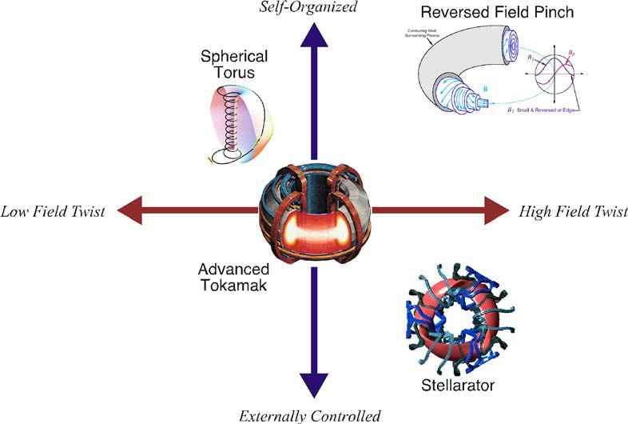
The intellectual framework that is grounded in the relatedness of physics across concepts has had profound policy implications
The intellectual enterprise had broadened and deepened since the 1950’s to the point that a community view emerged: the intellectual connections between configurations can be made, and therefore alpha particle physics studied on ITER can be bridged to alternate configurations
NSTX (PPPL)
Pegasus (UW)
RFP: MST (UW);
Spheromaks (4)
From EPAct ITER research plan
HSX (UW)
CAT (Auburn)
LHD (Japan)
Partner with W7-X (IPP, Germany)
This potential connectivity serves to help underpin the decision to move forward with a tokamak burning plasma experiment

Slide 27
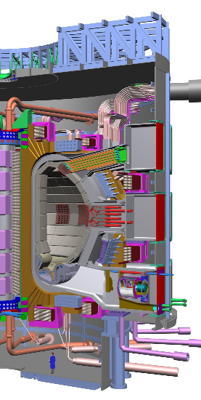
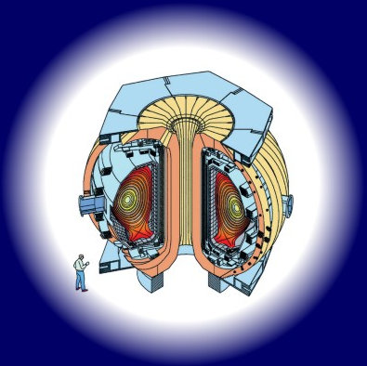
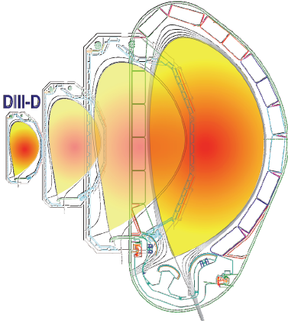
The science of ITER: a fusion science wind tunnel experiment, at scale
ITER
DIII-D
General Atomics
The science of the self-heated burning plasma state will no doubt yield transformational insights

Slide 28








Discovery plasma science is full of possibilities for transformational science
General Plasma Science
Addresses outstanding questions related to fundamental plasma properties and processes through discovery-based investigations in basic and low-temperature plasma science
High Energy Density Laboratory Plasma
High Energy Density (HED) physics is the study of ionized matter at extremely high density and temperature, approximately 100 billion Joules per cubic meter
Self Organized Systems
The study of plasma systems which exhibit properties known as “self-organization” where the plasma spontaneously alters externally applied fields in a way that reduces the degrees of freedom. Examples include the reversed field pinch, the spheromak, and the field-reversed configuration.

Slide 29

Notes:
Picture from Trident @ LANL

Slide 30





Lasers are a critical tool for exploring the frontiers of plasma science
Notes:
Upper left: Nif Hohlraum – Laser fusion
Upper right: Stimulated Raman Amplification
Lower left: Target Normal Sheath Acceleration – Ion/proton beams from laser-matter interaction
Lower middle: table top HEDLP systems produced by arrays of nano wires
Lower right: laser wakefield acceleration on HERCULES (u michigan)

Slide 31






Passive diagnostic for unprecedented measurements of plasma properties
Notes:
Upper left: Particle Imaging Velocimetry – Dusty Plasma
Upper middle: X-ray Thompson scattering
Upper right: Thompson scatter on MST
Lower Left: Laser Induced Fluoresence measureing neutral D in Tokamak
Lower middle: X-ray backlighting on NIF
Lower right: Proton Deflectometry (imaging magnetic field structure in HED plasma –MIT)

Slide 32


Excimer laser development ushered in a society-altering age of plasma science
1970: came the first report excimer lasing was in 1970 (Basov et al., Zh. Eksp. Fiz. i Tekh. Pis’ma. Red. 12, 473). Then a pause.
1974-1975: when things really took off.
From “History and future prospects of excimer laser technology” (Basting et al., RIKEN Review No. 43 (2002):
“Looking back into the mid 70’s of the 20th century it is extremely interesting to note that the (exciplex) excimer laser has been discovered basically within the short time frame of one year after investigation of fluorescence spectra of its active molecules, the rare gas monohalides.”

Slide 33



Plasma science in the laboratory opens our thinking about connecting with the cosmos
Obsesrvation, visible and x-ray
Madison Plasma Dynamo Experiment
Yamada, Reviews of Modern Physics 82 (1) 2010 (cover)
Magnetic reconnection and coronal heating
Laboratory plasma science has expanded our thinking – solar and even galactic scales can be understood with laboratory systems, appropriately scaled

Slide 34
The community has identified areas where further transformative research is required
These drive DOE priorities:
First, massively parallel computing with the goal of validated whole-fusion-device modeling will enable a transformation in predictive power, which is required to minimize risk in future fusion energy development steps.
Second, materials science as it relates to plasma and fusion sciences will provide the scientific foundations for greatly improved plasma confinement and heat exhaust for long pulse lengths.
Third, research in the prediction and control of transient events that can be deleterious to toroidal fusion plasma confinement will provide greater confidence in machine designs with stable plasmas.
Fourth, continued stewardship of discovery at the plasma science frontier that is not expressly driven by the energy goal will address frontier plasma science issues underpinning great mysteries of the visible universe.
Fifth, FES facilities will be kept world-leading through robust operations and regular upgrades.

Slide 35



This is an age of transformation: science reduces development costs
10-fold reduction in prototyping of wing designs
“ By using supercomputers to simulate the properties of the wings on recent models such as the 787 and the 747-8, we only had to design seven wings, a tremendous savings in time and cost, especially since the price tag for wind tunnel testing has skyrocketed over the past 25 years.”
- Doug Ball, Boeing (chief engineer for enabling technology and research)
Notes:
Boeing: HPC modeling exercise allowed Boeing to reduce the number of wing designs for the new 787 Dreamliner to 7. A ten-fold reduction from the number tested in designing the 767.

Slide 36





The demands on fusion materials science are extraordinary
Materials that can withstand this environment under the long-pulse or steady-state conditions anticipated in future fusion experiments are a prerequisite to the future of fusion research and development activities
A leading opportunity for partnership with computing
Space shuttle rocket nozzle
Re-entry vehicle
~1
<10
85
2000
Power Load [MW/m²]
PWR
ITER
transients
GE90-115B
ITER steady state
Supports: 22 graduate students

Slide 37
Community engagement workshops have taken place to identify fusion and plasma science opportunities
Following the FESAC Strategic Planning and Priorities Report (2014), FES plans to seek further community engagement and input through a series of technical workshops in 2015
The deliverable from each workshop will be a report, written by a community steering committee, about scientific challenges and opportunities
Workshop | Date | Location | Chair / Co-Chair | DOE Contact
Workshop on Integrated Simulations for Magnetic Fusion Energy Sciences | June 2-4 | Rockville, MD | Paul Bonoli (MIT) / Lois McInnes (ANL) | John Mandrekas
Workshop on Transients | June 8-12 | General Atomics | Charles Greenfield (GA) / Raffi Nazikian (PPPL) | Mark Foster
Workshop on Plasma-Materials Interactions | May 4-7 | PPPL | Rajesh Maingi (PPPL) / Steve Zinkle (Tennessee) | Pete Pappano
Workshops on Plasma Science Frontiers | June 30-July 1 (#1) & October (#2) | Washington, DC area | Fred Skiff (Iowa) / Jonathan Wurtele (UC Berkeley) | Sean Finnegan

Slide 38
After 50 years of research: we have the the basis for developing an integrated understanding of burning plasma science
At every point in the journey, potential show-stopping circumstances have been overcome with often surprising advances that expand our thinking about what is even possible in fusion and plasma research
Advances have expanded our concepts not only about the nature of the end goal, but about our standards regarding the nature of scientific investigation. We now understand the underlying plasma processes to be knowable and controllable
This understanding serves as the underpinning for fusion science and plasma science more broadly
This progress also serves to create a deep basis for how we understand the connectedness between confinement concepts, and ITER’s value to them

Slide 39
The history of the fusion and plasma sciences can inspire us as we strive for the next essential transformations
We continue to make fundamental advances that inform our understanding of what is possible in fusion energy and discovery sciences. Throughout the history of fusion and plasma science, potential show-stopping circumstances have been overcome with surprising and often brilliant advances that expand our thinking
Transformational advances in transport, stability, wave-particle interactions, boundary physics, and low temperature plasma science have expanded our thinking not only about the end goal, but about our standards regarding the nature of the scientific investigation. In each of these areas, we now understand the underlying plasma processes to be knowable and controllable
Areas that will find increased emphasis in the coming years are areas with a history of positive transformation, and a demand for further such developments

Slide 40
Thank you

Slide 41

Plasma wake field acceleration may transform the way we accelerate particles…
Plasma accelerator schemes, first proposed by John Dawson in the 1970s, come in two basic types: plasma wake field acceleration and laser wake field acceleration.
In the plasma based acceleration, one bunch of fast-moving particles drives the plasma wave that accelerates another bunch. Both bunches must start out at ultra-relativistic energies, traveling so close to the speed of light that their separation doesn’t change even as the first bunch loses energy and the second gains energy. The scheme is being developed as a way to boost the energy of large linear accelerators.
You Tube video on plasma wake field acceleration: https://www.youtube.com/watch?t=28&v=KjoH1ZZrAik

Slide 42


Stellarator re-emergence enabled by intellectual and engineering developments
The field understands in a way it could not in the 50’s and 60’s of the requirements in both plasma science understanding and manufacturing precision requirements and capabilities. Advances in both make the stellarator a possibility
Concept of optimizing the confinement concept further emerges, based a new understanding underlying symmetries that can be included in a stellarator B field (Boozer, series of Phys. Fluids papers, 1980-1984)
Will the future path tack towards the optimized stellarator?
Concept-expanding ideas enabled by theory and computation advances: desired B field properties, including desired symmetries, can be used to prescribe a coil geometry
From Boozer, Phys. Plasmas 5 (1998) 1647

Slide 43




Partnerships have high value within DOE as well as in the field
Foundations
From the early days of the MFECC (predecessor to NERSC) to today’s Leadership Computing Facilities, HPC has played a significant role in fusion research -- essential component of the strategy to develop predictive capability
Initial un-optimized performance
Partnerships between fusion scientists and computational scientists, under SciDAC, have accelerated the rate of scientific discovery in fusion plasma science by improving the performance of fusion codes on Leadership Computing Facilities and addressing challenging data management and visualization issues associated with high-performance computing.
Performance after SUPER optimizations (CPU only)
(4x improvement using SUPER & GPUs)
Maximum # of Titan cores

Slide 44


Gyrokinetic simulations using the NERSC supercomputer resolve a long-standing transport under-prediction
Howard et al., Phys. Plasmas 21, 112510 (2014).
First simulation to resolve turbulence using real electron/ion mass ratio.
Simulations by Dr. Nathan Howard comprised the 3rd largest use of NERSC in 2013 and the 1st largest use in 2014.
> 10⁸ CPU hours
Major finding: inclusion of electron-scale turbulence significantly enhances both the ion-heat and electron heat fluxes.
May explain prior discrepancies between experiment and simulation which tended to under-predict heat fluxes.

Slide 45



Multi-institutional partnership strengthens understanding of edge instability control
Foundations
Simulations of B perturbations including the plasma response, effective for suppression (left) and ineffective (right)
Observation of a multimode plasma response and its relationship to density pumpout and ELM suppression,
Paz-Soldan et al., PRL 114, 105501 (2014)
High impact on ITER design and fusion programs worldwide
Pedestal bifurcation and resonant field penetration at the threshold of ELM suppression in DIII-D tokamak,
Nazikian et al., PRL 114, 105002 (2014)
RMP coils

Slide 46

First-of-kind measurement and theory comparison of edge instability enabled with overseas partnership
Foundations and Long Pulse
Large scale numerical simulations of magnetic fusion plasmas using plasma models such as MHD are believed to provide a useful tool to predict the stability limits and size of instabilities in the edge of a fusion plasma.
Until recently, it has been too difficult to measure plasmas on the very fast times and small spatial scales required to confirm the validity of such models.
Recent measurements of electron temperature on the KSTAR tokamak (NFRI, Daejeon, S. Korea) allow the first detailed, quantitative comparison.
Nonlinear resistive MHD simulations at large scale carried out with the M3D code, part of the DOE FES and SciDAC programs, show surprisingly good agreement.
The experiment measures a dominant toroidal mode number n=10, while the simulation predicts n=13-14.
Both the toroidal and poloidal (vertical direction in the picture) spacing in the simulation are surprisingly close to the experimental results, as well as being relatively insensitive to the details of the plasma edge.
In contrast, the linear eigenmodes from small perturbation theory have a very different shape and require extra, non-MHD physics to select the observed toroidal harmonic number.
Experimental electron temperature T_{e} from ECE Imaging during an inter-ELM edge instability on the KSTAR tokamak (left) compared to temperature T from a saturated edge instability computed by nonlinear MHD numerical simulation (right). The non-axisymmetric parts are shown over a small cross section of the outer edge of the torus, at matching toroidal angle (red or yellow is positive, blue negative). Dashed white line (left) or black line (right) shows the plasma edge; in the simulation, solid black lines are contours of total T.
Acknowledgement: Linda Sugiyama (MIT)

Slide 47
The invention of the laser was also a transformational event for fusion and plasma science
From McCrory, 2009, presentation at NIF commissioning:
Ruby laser invented May 1960, T. Maiman, Hughes Research Laboratory
Nuckolls, 1961 looking since the late 1950’s for a tool for igniting small amounts of fusion fuel in the laboratory, immediately recognizes the laser as a hammer for the task
He was joined by Kidder, 1961
Nuckolls was able to publish after declassification, 1972. Predicted < 1 kJ of laser light would be required

Slide 48










Lesson from our history: scientific power of lab/university partnerships
Advanced tokamak
Stellarator
tokamak
DIII-D
HBT-EP
Germany
Spherical tokmaak
Pegasus
CTH
spherical
tokamak
W7-X
Auburn U.
NSTX-U
HSX
U. Wisconsin
There is scientific strength in both configuration overlap and complementarity
LTX

Slide 49


Plasma wake field acceleration – recent breakthroughs
Initial designs of experiment for plasma wake field were conceived in 1984 at UCLA by the group led by Joshi, the recipient of the 2006 APS Maxwell Prize for his work and insight in applying plasma concepts to high energy electron and positron acceleration, and exploring related aspects of plasma physics.
Recently Joshi (at UCLA), and Litos and Hogan (both at SLAC), and their colleagues have taken a leap forward. In their plasma wake field accelerator, the plasma wave is created by a 20-GeV electron bunch from SLAC’s linear accelerator. A second bunch of equally energetic electrons follows close behind.
With SLAC’s purpose-built Facility for Advanced Accelerator Experimental Tests, the researchers could place the trailing bunch at just the right spot in the plasma wave to increase the bunch energy by 1.6 GeV over just 30 cm of plasma.
Simulations of a plasma wake field interaction, with beam density shown in orange, plasma-electron density in blue, and the longitudinal electric field as an orange curve. (a) The drive bunch clears away the plasma electrons, leaving a region of strong but inhomogeneous electric field in its wake. (b) If the trailing bunch is large enough and positioned in the right spot, it can flatten the electric field so that the trailing bunch is uniformly accelerated.
Energy profiles of the simulated and actual electron bunches after they interact with the plasma.
In both cases, the drive bunch, which begins with an energy just above 20 GeV, loses energy and broadens. The trailing bunch gains energy and is dominated by the sharply peaked core.
Joshi et al., Nature 311, 525 (1984); DOI: 10.1038/311525a0
M. Litos et al., Nature 515, 92 (2014)

