Slide 1
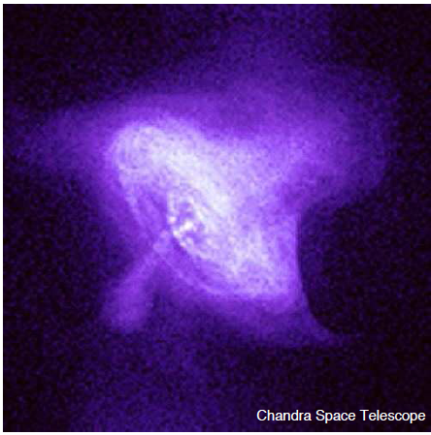
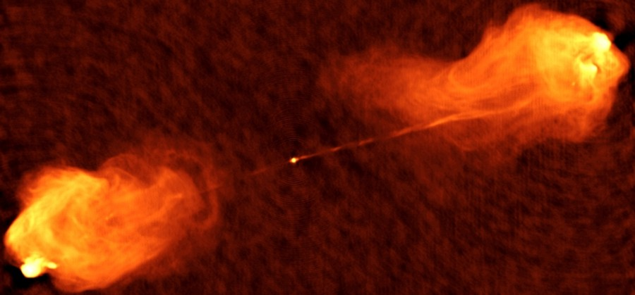
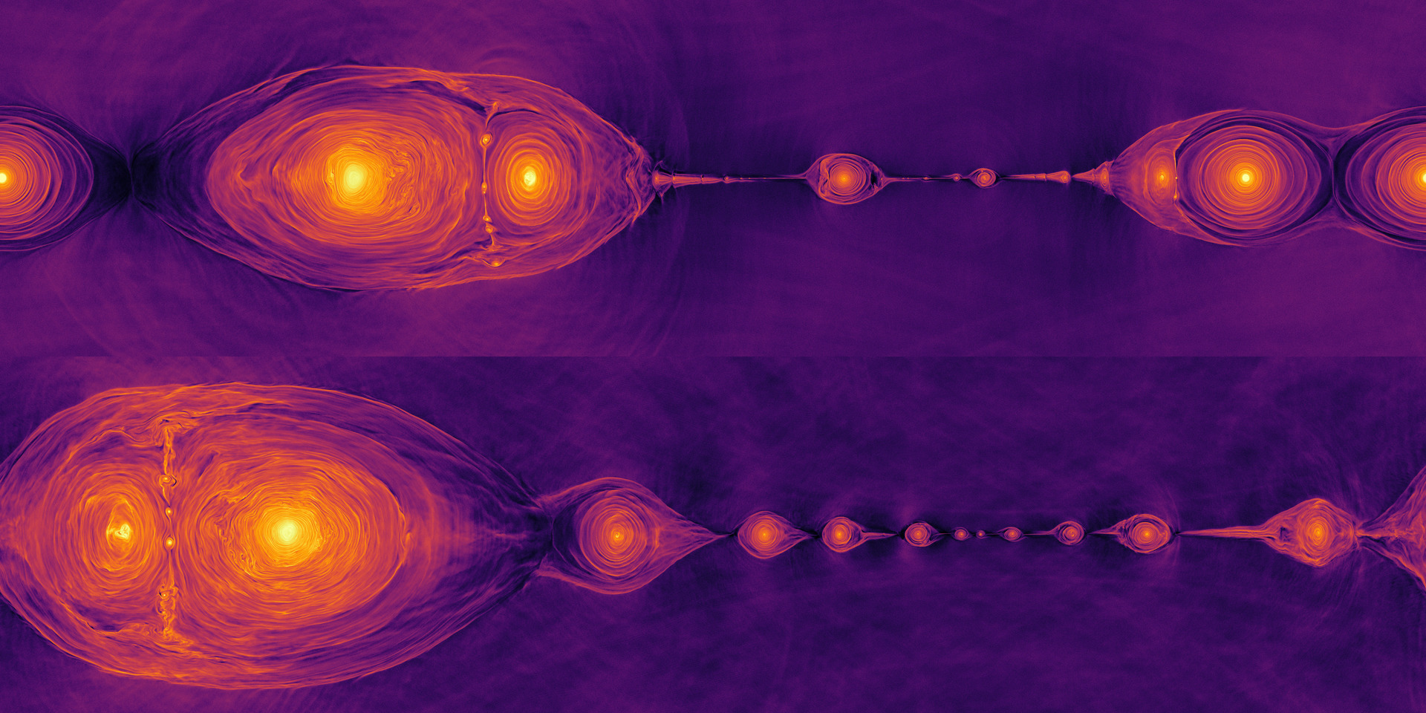
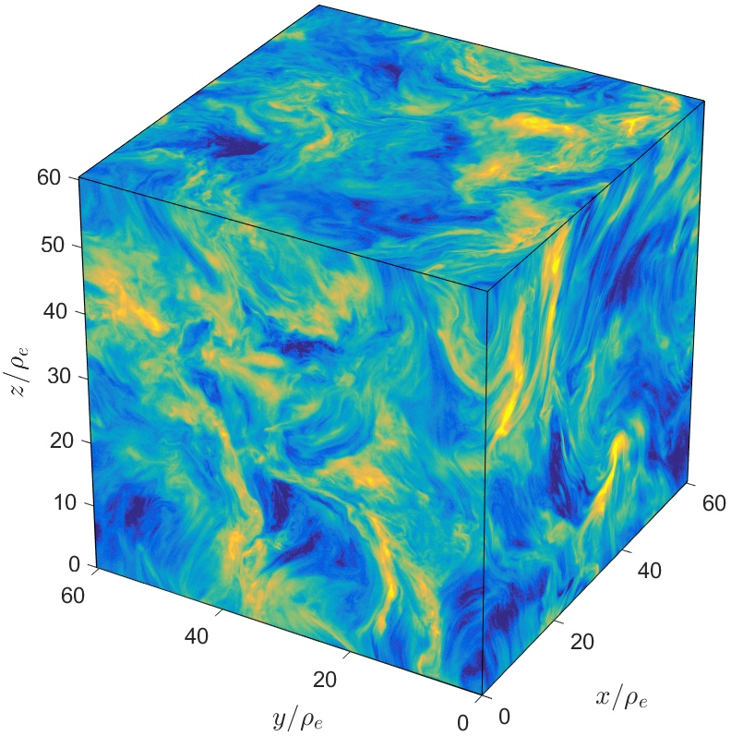
Extreme Plasma Astrophysics: a Shining New Frontier
Dmitri Uzdensky
University of Colorado Boulder
Theorerical Plasma Astrophysics at Colorado:
G. Werner, M. Begelman, A. Chen, F. Bacchini, J. Dexter, N. Scepi
grad students: (John Mehlhaff), Kai Wong, Lia Hankla, Omar French
Work supported by NSF, NASA, DOE; INCITE, XSEDE
MIPSE Plasma Seminar, October 12, 2022

Slide 2
OUTLINE
Introduction:
  The Plasma Universe
  What is Plasma Astrophysics?
  What is Extreme Plasma Astrophysics?
Examples of Recent Radiative-PIC Numerical Studies of Extreme Plasma Processes:
  Radiative Relativistic Magnetic Reconnection;
  Radiative Relativistic Kinetic Turbulence.
Future Outlook:
  What can laser experiments do?
Summary

Slide 3
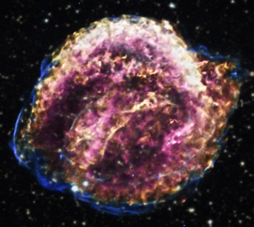
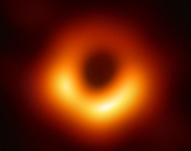
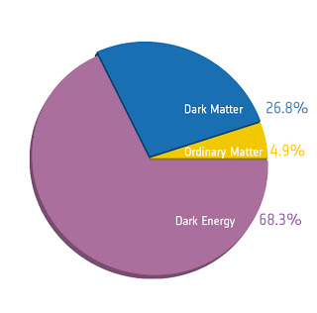
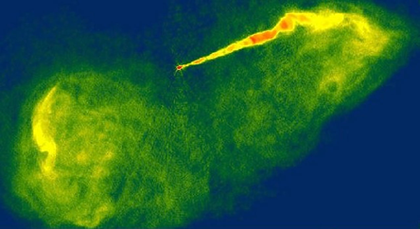
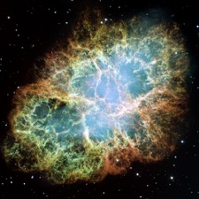
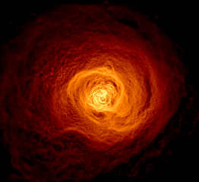
The Plasma Universe
Kepler’s Supernova (SNR)
Cyg A, radio
BH accretion flow M87 EHT
Most ordinary baryonic visible matter in the Universe is plasma.
Crab Nebula (PWN)
M87 (AGN jet)
Perseus Cluster (ICM)

Slide 4
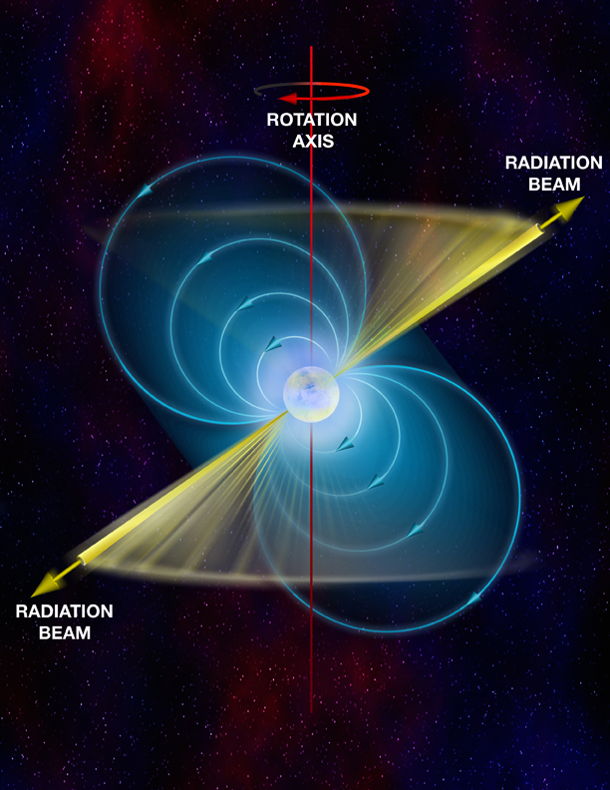
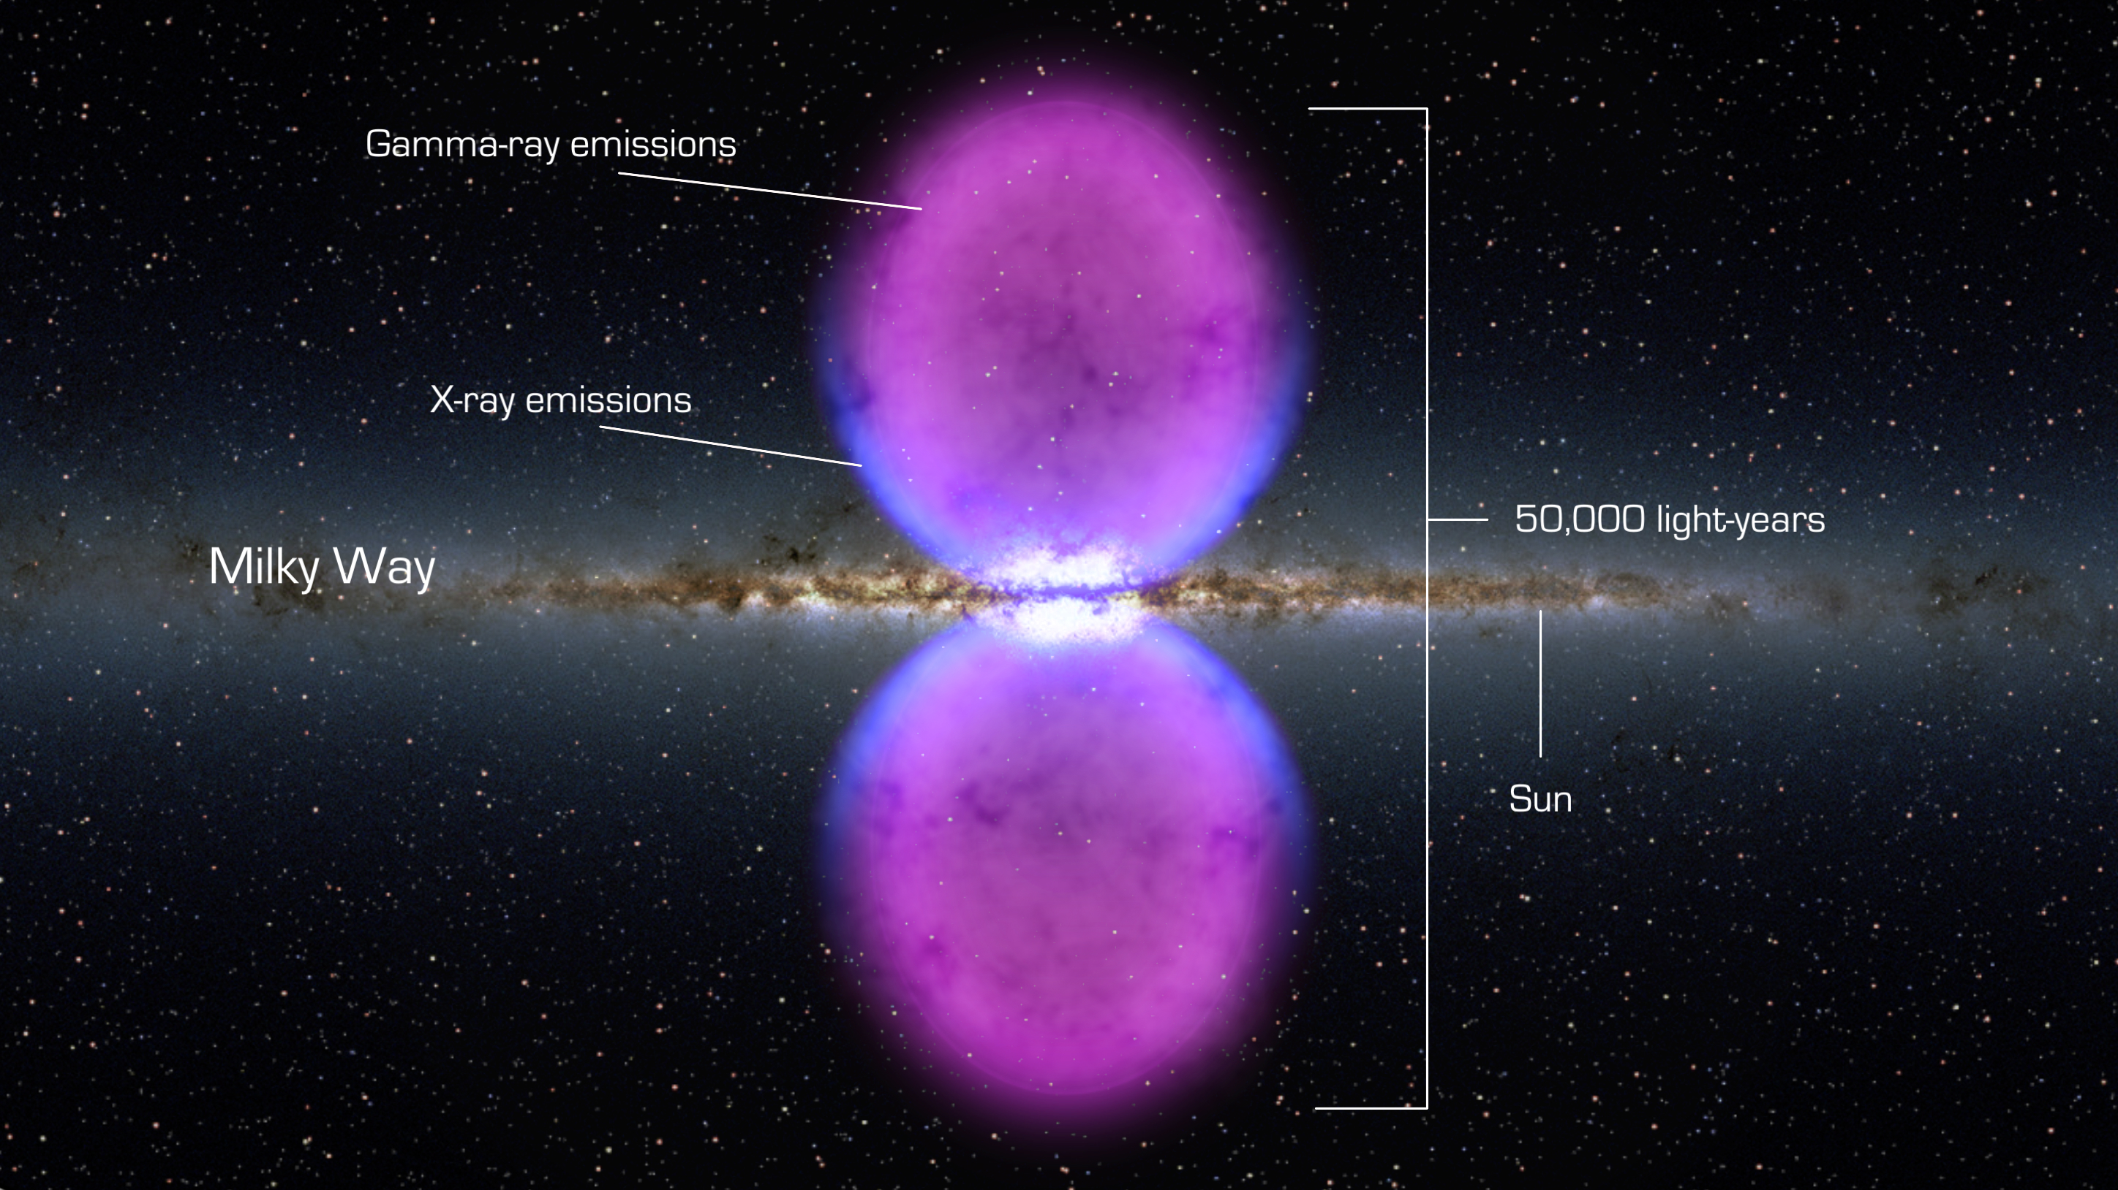

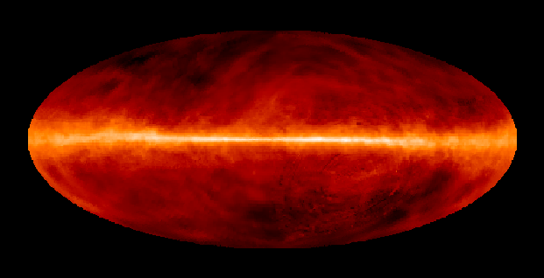
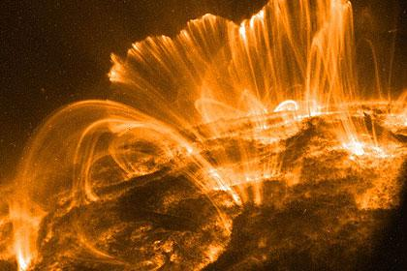
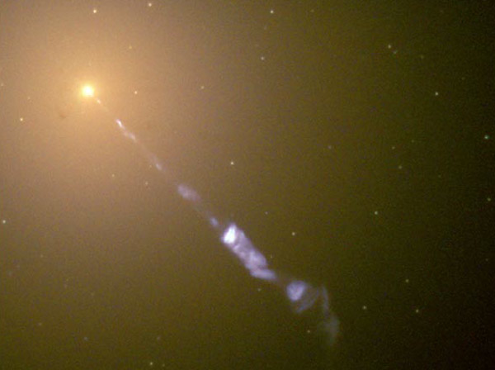
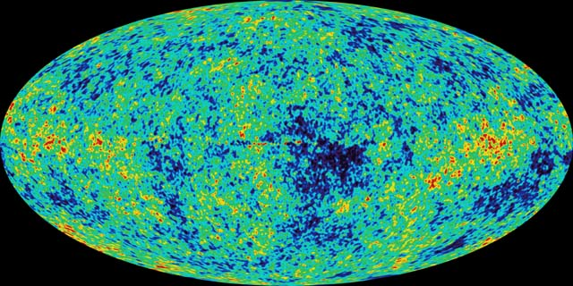
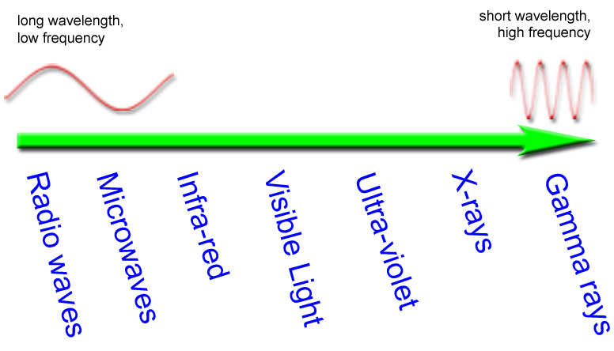
The Shining Universe
Universe consists of 68% dark energy, 27% dark matter and only 5% of ordinary baryonic matter.
But baryonic matter makes 100% of the light we see!
Stars
Radio Pulsars
Solar Corona
Fermi Bubbles
21 cm Hydrogen
CMB
M87 Jet
10⁻⁶ eV
1 meV
1 eV
1 keV
1 MeV

Slide 5
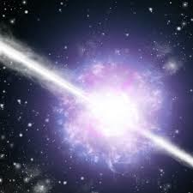
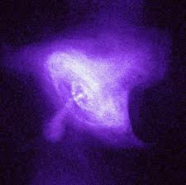
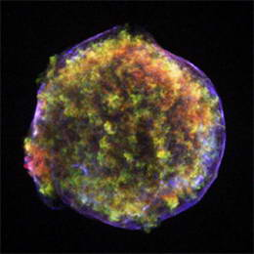
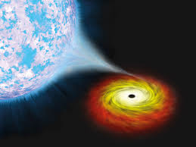
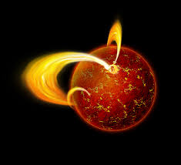
High-Energy Universe
6 orders of magnitude in photon energy from CMB (1 meV), through IR, visible, UV, to X-rays (keV).
High-energy astronomy: γ-rays alone cover > 6 orders: MeV – TeV
X-ray and γ-radiation is often nonthermal and variable (flaring)
High-energy universe is very rich and diverse.
Accretion
disks
GRB
PWN
Supernovae
PWN
Magnetars
PULSARS
AGN/Blazar jets
1 keV
1 MeV
1 GeV
1 TeV

Slide 6
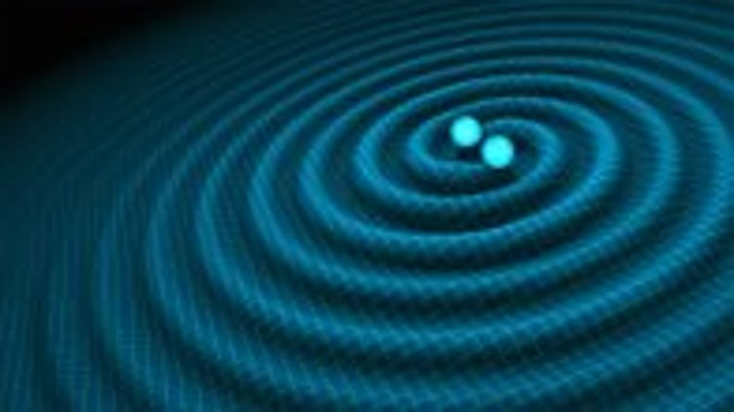
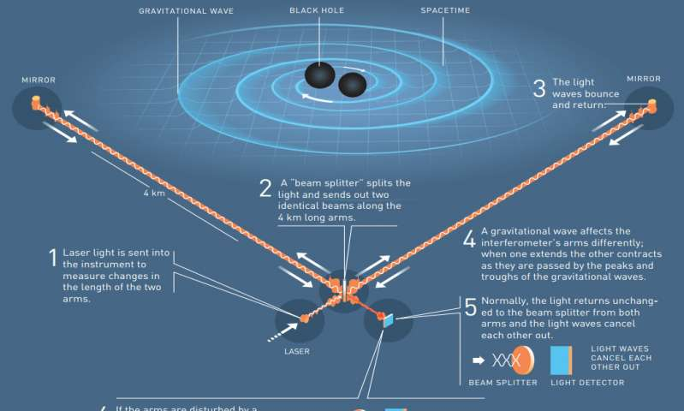
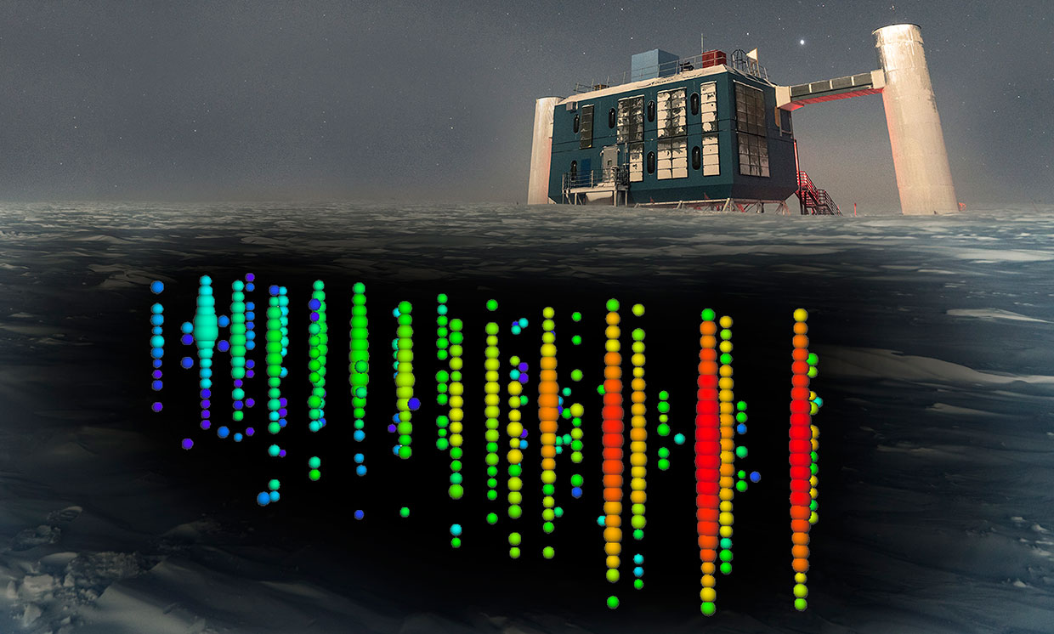
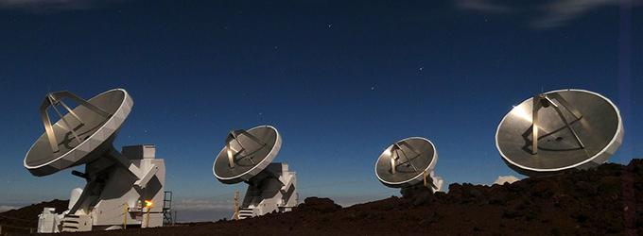
Multi-Messenger Revolution
Recent multi-messenger Discoveries:
GWs from merging BHs and NSs (LIGO)
PeV neutrinos from BH jets (IceCube)
Ultra-High Energy (10²⁰ eV) Cosmic Rays
Black Hole shadow in M87 (EHT)
Fast Radio Bursts (VLA, Arecibo)
Physical understanding lags behind observations.
Understanding EM & particle signals requires Plasma Physics
LIGO
M87 (AGN jet)
IceCube
𝞶
EHT
Notes:
• We now live in the era of MMA/ at the dawn of MMA, when for the first time astronomical observations are systematically done with something other than EM waves…
• A flood of exciting recent MMA discoveries probes fundamental physics around BHs and NSs and captures the imagination of scientists and general public. Examples include:
• GW events from merging BHs and NSs -- LIGO
• VHE neutrinos and UHECRs from supermassive black-hole-driven relativistic jets – IceCube and Auger
• Images of BH shadow in M87 – EHT
• Fast Radio Bursts (FRBs) – VLA, Arecibo, Green Bank
However, our physical understanding of these spectacular phenomena often lags behind the observations.
EM components of all these enigmatic energetic, explosive phenomena are powered by energy release/conversion processes, accelerating particles to very high energies, and thus producing all the light we see, across the entire EM spectrum. The same processes are also responsible for producing non-EM messengers like cosmic rays and very high energy neutrinos. A key, fundamental physics question is how the energy is released and transformed to the observed light and neutrinos. The Rosetta stone for this challenge is written in the language of plasma physics.
It is plasma physical processes that lie at the heart of these phenomena.
We can't understand them without plasma physics!
For example:
BH EHT Image: one of the most recognizable that has achieved rock-star status--- decoding it is about plasma physics, what we see here is plasma.
But the physical conditions in many of these exotic plasma environments are extreme, qualitatively different from the more familiar, traditional plasmas we encounter in the solar system.
Roger:
Although we have emphasized our desire to expand the plasma frontier to understand new physics, there is no denying that much of the impetus for this proposal has come from astrophysics. Major discoveries throughout the entire seventy-octave EM spectrum and the comparable gravitational radiation, cosmic ray and neutrino spectra are happening all the time. Several, since we submitted the proposal.
NSF-supported facilities have detected gravitational waves from merging cosmic objects, imaged the shadow of a black hole, detected cosmic PeV neutrinos and measured the composition, spectrum, and anisotropy of 100 EeV cosmic rays.
Each of these observational discoveries leads, inexorably, to extreme plasma physics.

Slide 7
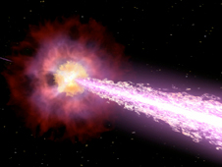
High-Energy Particle Acceleration and Emission in Astrophysical Plasmas
Crab, X-ray
M87, optical
GRB, imagination
Cyg A, radio
Astrophysical plasmas shine.
Extremely ultra-relativistic particles pervade the Universe and emit high-energy gamma-rays
Produced by powerful cosmic explosions (supernovae, Gamma-Ray Bursts) or by relativistic objects: Neutron Stars, Black Holes and their relativistic outflows: jets, winds.
Radiative cooling time << travel time from central engine → in-situ particle acceleration.

Slide 8
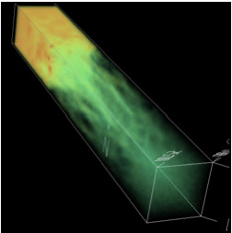
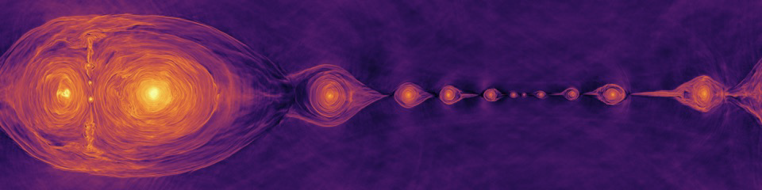
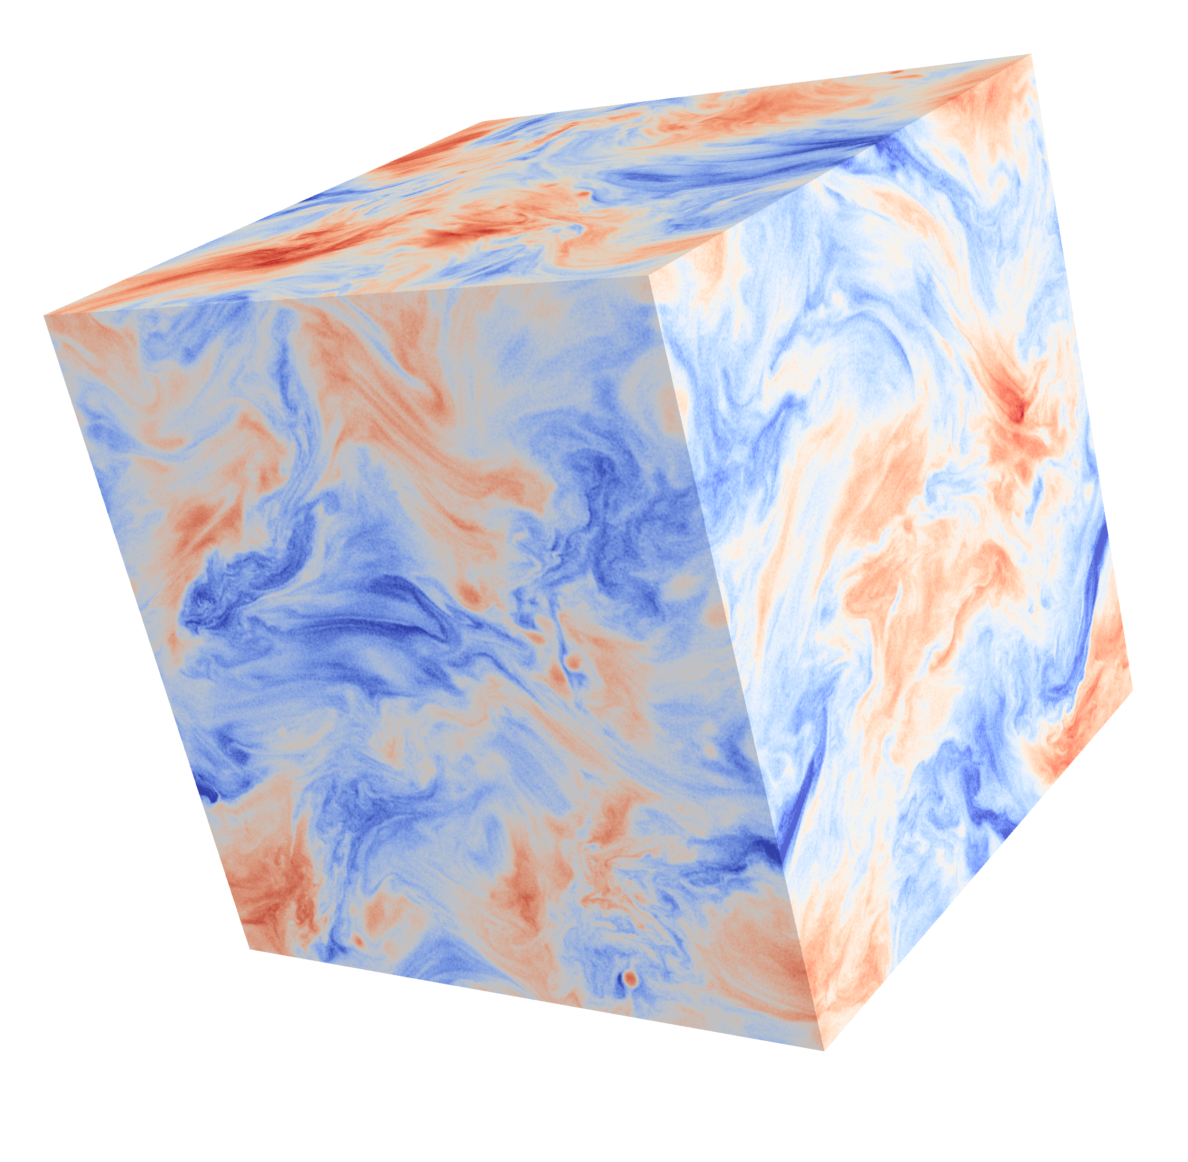
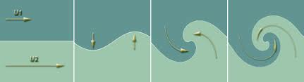
Dissipation/Acceleration Mechanisms
In Astrophysics particles are accelerated by complex nonlinear collective plasma processes.
AVAILABLE FREE ENERGY
Bulk Kinetic
- longitudinal:
shocks
- transverse:
shear (KH) instability
Magnetic (Poynting flux)
current sheets:
Magnetic reconnection
SiNGULAR
Structure
TURBULENCE

Slide 9
Space and Astro plasmas are complex, multi-component systems
Thermal
gas/plasma
Nonthermal particles (CRs)
Magnetic field
These components are often in energy equipartition:
e.g., ISM in our Galaxy: U_{gas} ~ U_{magn} ~ U_{turb} ~ U_{CR} ~ U_{rad}
Turbulence/waves
Radiation
Large-scale bulk motions (rotation/jets)

Slide 10
Components and Processes
Energy Exchange between plasma components: collective plasma processes.
Thermal
gas/plasma
collisions
reconnection
Nonthermal particles (CRs)
Magnetic field
turb. dissipation
reconnection
Studying these energy exchange processes is the realm of
Plasma Astrophysics
radiative processes
instabilities
(e.g., kink)
dynamo
radiative processes
shocks
dynamo
reconnection
shocks
Turbulence/waves
Radiation
Large-scale bulk motions (rotation/jets)
instabilities (MRI, KH)
radiation-driven winds

Slide 11
OR CAN WE ??
Plasma physics is mature.
Extensive knowledge base of collective plasma processes built over decades of theoretical, computational, experimental research.
We can apply this rich traditional plasma knowledge
to high-energy astrophysical plasmas!
Not so fast!
… would be warranted if these plasmas were governed by the same physics, same equations….
But this is not always the case!
Notes:
Plasma Physics is a mature discipline.
Extensive knowledge base of plasma processes has been built over decades of extensive theoretical, computational, and experimental research.
So we can draw upon this rich traditional plasma knowledge and apply it to high-energy astrophysical plasmas!
Or, can we?
I would like to push back a bit on this conventional wisdom.
Such a translation would be warranted if these plasmas were governed by the same physics, obeyed the same equations….
But this is not always the case.

Slide 12


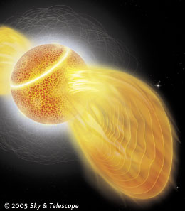
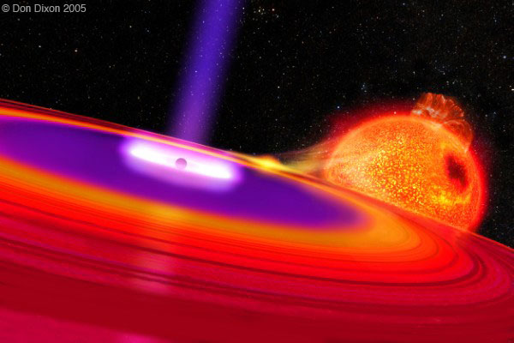
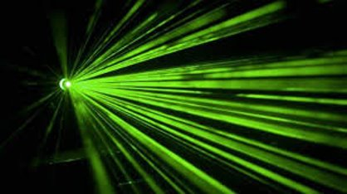
Traditional & Extreme Plasma Physics
Traditional Plasmas
New: Extreme Plasmas
Electrons and ions
Non-relativistic
Non-radiating
Applications:
- Most lab plasmas
- Solar corona
- Earth’s magnetosphere
“Exotic”* Physics:
e⁻e⁺ pairs (+ ions), photons
Relativistic (Special & General)
Radiation (cooling, drag, pressure)
QED effects (e.g., pair creation)
*These effects may be exotic for traditional plasma physicists, but not for high-energy astrophysicists.
Applications:
Neutron Stars (NSs) & Black Holes (BH):
Magnetospheres of pulsars, magnetars
NS and BH accretion disks, jets
Cosmic blasts (SNe, GRB)
NS-NS mergers
Early Universe
and soon…
Laser-plasma lab experiments!
Based on 19th Century Physics!
Based on 20th Century Physics!
Notes:
What do I mean by this?
Well, traditional plasmas consist of electrons and ions that are non-relativistic and don’t interact with radiation; and the number of particles is conserved.
This dominates plasma research, in most laboratory experiments, space and solar physics, and in fact in many areas of astrophysics.
In contrast, Extreme Plasmas may have electron-positron pairs (with or without ions), are often relativistic, and interact strongly with photons, which should therefore be considered a new essential component alongside charged particles. On the more extreme end, QED effects like pair creation become important, and so even the number of particles in not conserved!
Exotic as they sound, such plasmas are common in high-energy astrophysics, namely, around NSs and BHs, and they manifest themselves in many spectacular phenomena.
In addition, these plasma conditions have existed in the very early Universe shortly after the Big Bang.
And importantly, we are now on the verge of being able to create and study them in the lab using powerful lasers.

Slide 13






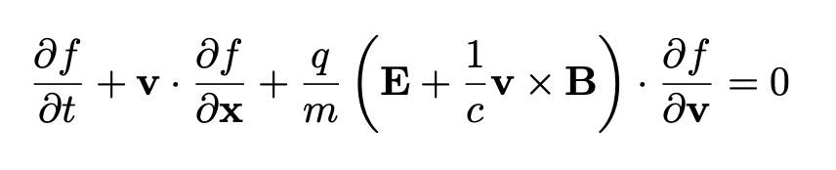

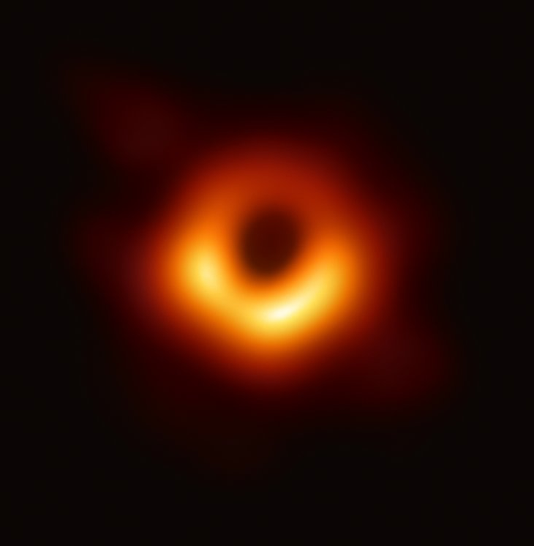
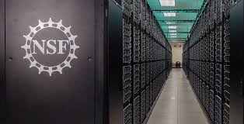



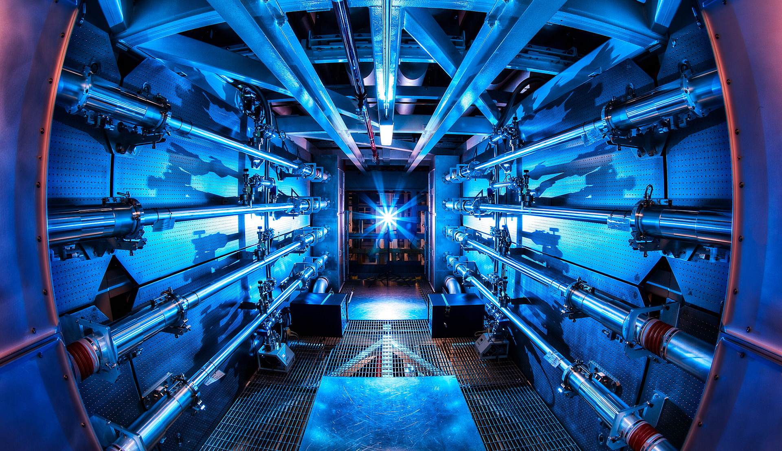

Extreme Plasma (Astro)Physics
This calls for development of Extreme Plasma Astrophysics:
systematic inclusion of these “exotic” physical effects into kinetic plasma framework.
--- intellectually exciting Frontier of Fundamental Physics
astrophysical motivation
Shocks
Windows on
the Universe
Turbulence
Neutron stars
Reconnection
Gravitational
waves
Image of a
Black Hole
Classical
Plasma
Theory
$$\frac{∂A}{∂t}$$
Multi-
Messenger
Astrophysics
Observations
Extreme
Plasma AstroPhysics
radiative/QED kinetic plasma codes
laser-plasma capabilities
Advanced
Computation
High-Energy-Density Laser
Experiments
Exascale computing
Machine learning
Multiscale methods
will draw young talents!
High-intensity MRI facilities
General-relativistic algorithms
Harnessing
the Data Revolution
High-energy
facilities
Plasma-2020 & Astro-2020 Decadal Surveys whitepaper: "Extreme Plasma Astrophysics” https://arxiv.org/abs/1903.05328
Slide credit: L.Willingale, F.Fiuza
Notes:
Exploring and conquering this Extreme Plasma Frontier of Fundamental Physics is now particularly timely,
because observations, theory, sims, experiments are all rapidly advancing and converging towards this field.
This research has a strong Astrophysical Motivation, including Multi-messenger, as I just described.
And it is enabled by a confluence of:
• Recent breakthroughs in analytical classical plasma theory.
• Advanced first-principles radiative and QED plasma simulation codes, which are now further benefitting from new multi-scale approaches.
and
• Rapid progress in ultra-intense lasers and diagnostics, such as the NSF-funded ZEUS facility.
Thus, we live in a unique moment and should capitalize on it. NOW is the discovery time!
We have real opportunities for major paradigm shifts, leading to completely new concepts, ideas, tools, … new ways of thinking.
The novelty and synergies of this emerging area will excite talented young scientists and will attract them to the field, which is critical in fact for this endeavor to succeed.
1:05/1:10
------------------------------------
Total for Slide Group 1 (reading):
6:20 / 8:00
6:50
6:20
6:35
Total for Slide Group 1 (blind):
7:20
7:30
7:15
7:15
7:05
*****************************************************************************
[Right NOW is the time to embark on this adventure. The sense of urgency is provided by a confluence and synergies of exciting multi-messenger astrophysics discoveries, and rapid recent advances in fundamental plasma theory, computational techniques, and laser-plasma experiments. Right now is discovery time with real opportunities for major paradigm shifts.]
1:00

Slide 14
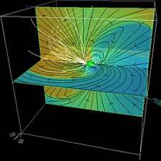
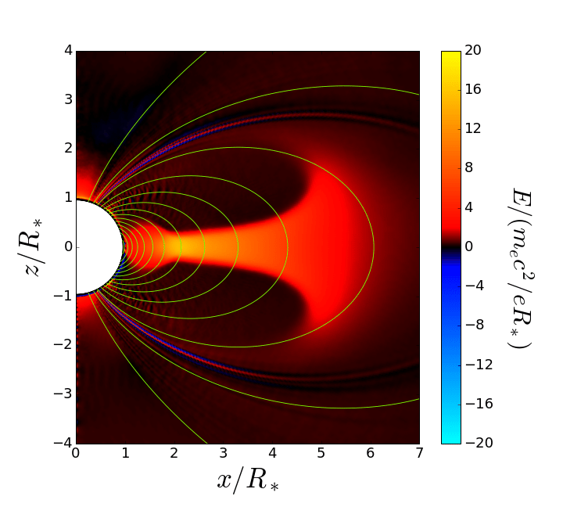
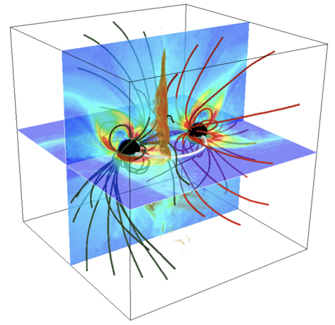
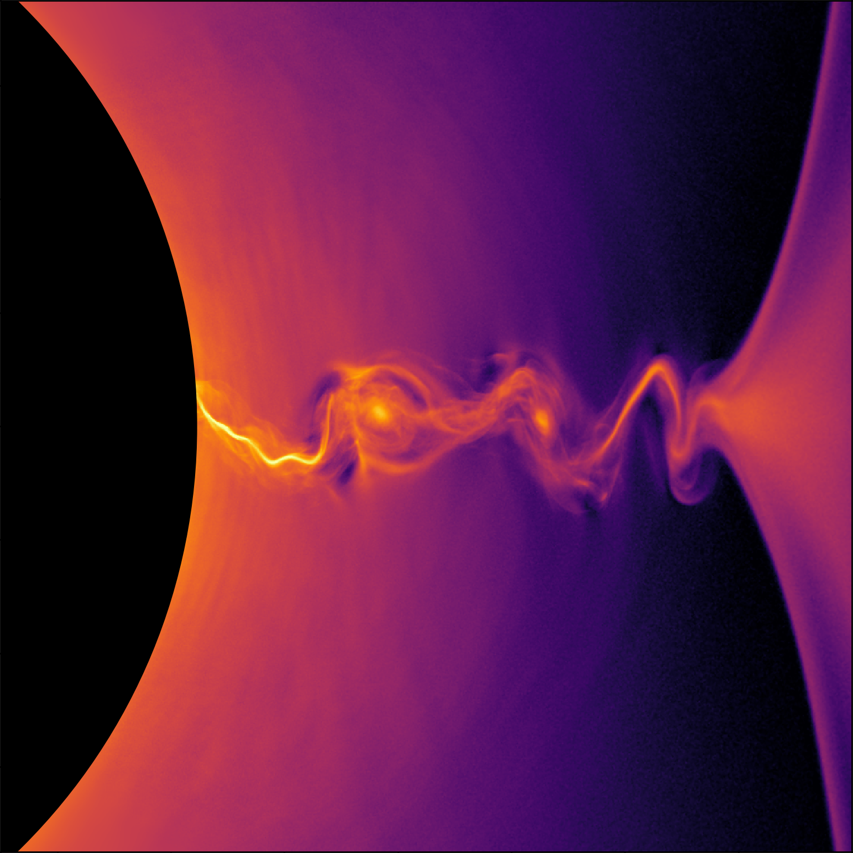
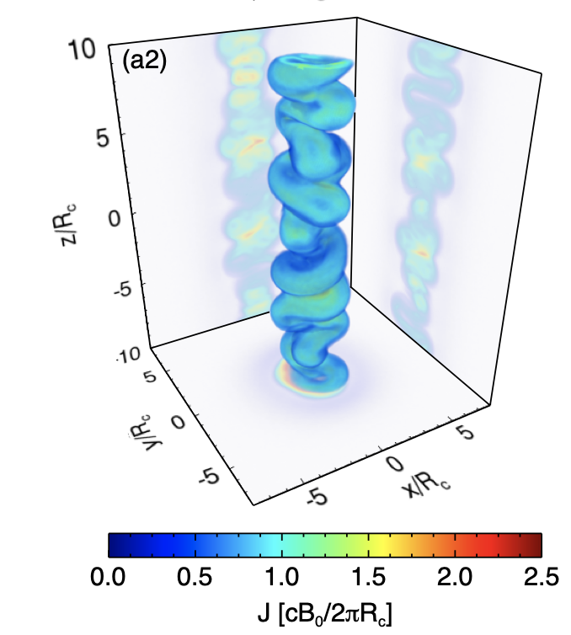
Problems of (Extreme) Plasma Astrophysics
Local:
Collective Plasma Processes
Global:
Astrophysical Systems
Waves
Instabilities
Reconnection
Turbulence
Shocks
Pair Cascades
B
v
Pulsar Magnetosphere
Magnetar Magnetosphere
Merging NSs
Accreting BH Magnetosphere
Spitkovsky
B
v
Chen & Beloborodov
Magnetic Reconnection
Kelvin-Helmholtz Inst.
QUESTIONS:
Philippov
How is energy dissipated?
How is it partitioned btw. ens & ions?
How does nonthermal particle acceleration work?
What is the spectrum of turbulence?
What coherent field, flow structures form?
What light is produced?
How many e⁺e⁻ pairs are created?
Parfrey et al.
Something in between:
Mesoscopic Problems
Alves et al.

Slide 15
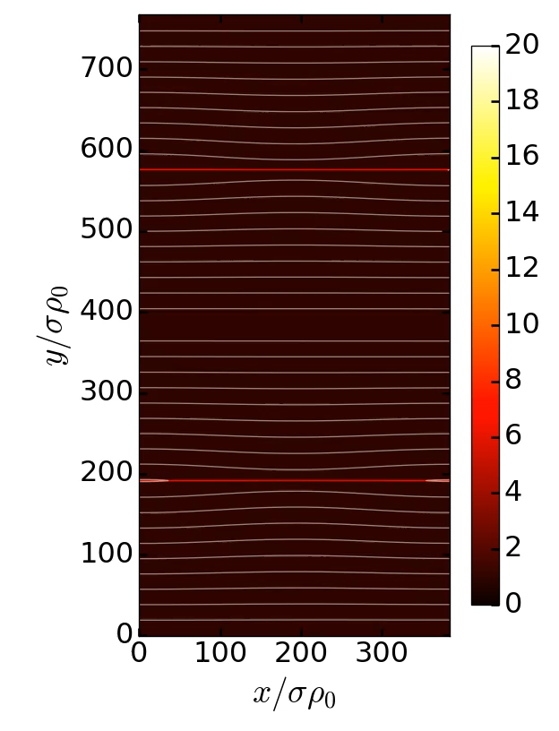
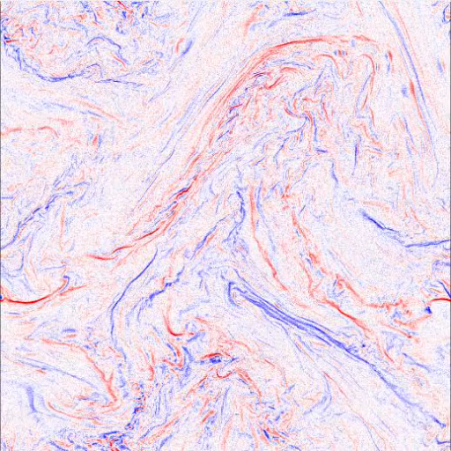
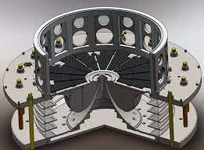
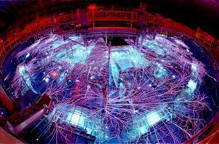
Tools of Extreme Plasma Astrophysics
Analytical Theory
Massively-parallel simulations:
Radiative GRMHD and Radiative Particle-in-Cell (PIC) (incl. QED-PIC):
  relativistic radiative PIC codes: Zeltron, Tristan-MP, Aperture, OSIRIS, Runko, GRPIC
  include radiation reaction on emitting particles
  e⁺e⁻ pair or electron-ion plasma + photons
  Hundreds of billions simulated particles
  (10⁴)²-cell (2D) or (10³)³-cell (3D) grids
  Run on hundreds of thousands cores
HED Laboratory Plasma Experiments:
  Laser Plasma (NIF, LLE, SLAC, Michigan, Rutherford)
  Pulsed Power (Imperial, MIT, Sandia)
Mehlhaff et al.’20
Zhdankin et al. ’18

Slide 16
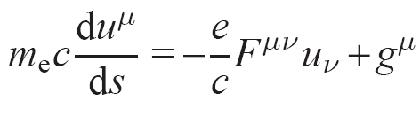
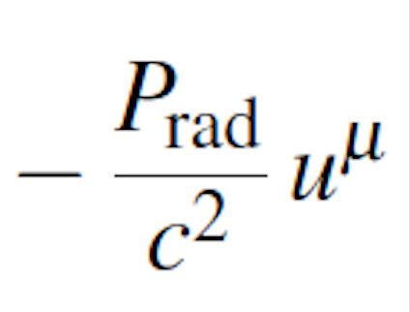



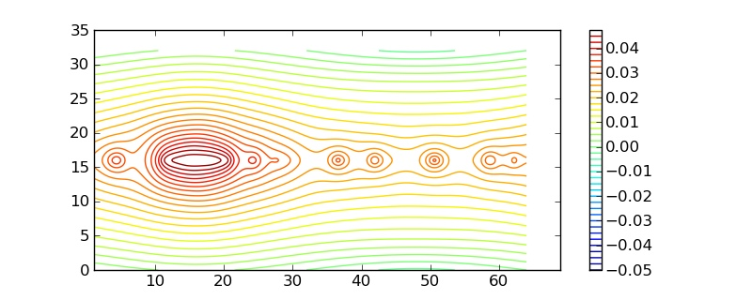

Radiative Plasma Astrophysics
Radiaction ( = Radiation Reaction) force on emitting particles is important in many high-energy astro systems:
Fluid-level manifestations:
  - Radiative cooling; - Radiative drag on bulk plasma flows;
  - Radiation pressure; - Compton-drag resistivity.
Radiation is often our only observational probe into astro systems.
How does, e.g., a reconnection layer look like, literally?
What are the prompt radiative signatures (spectra,
lightcurves) seen by an outside observer?
Radiation reaction 4-force
For relativistic particles:
g^{μ} ≈
Lorentz 4-force
Two main (classical) radiation mechanisms:
Synchrotron: in magnetic energy density U=B²/8π
Inverse-Compton (IC) scattering (Thomson limit): ambient bath of soft photons of energy density U.
: 4-velocity
: Electromagn. field tensor
: Relativistic interval

Slide 17
Examples of Recent Radiative-PIC Simulations of Radiative Relativistic Collective Plasma Processes
New radiative-PIC codes and powerful computers enable ab initio simulation studies of extreme astrophysical collective plasma processes.
Magnetic Reconnection
(Greg Werner)
Kinetic Plasma Turbulence
(Vladimir Zhdankin)

Slide 18
Radiative Relativistic Magnetic Reconnection
image credit: G. Werner & J. Mehlhaff

Slide 19


Introduction: Magnetic Reconnection
Magnetic reconnection is a rapid rearrangement of magnetic field topology, breaking ideal-MHD.
Reconnection results in a violent release of magnetic energy and its conversion to:
  electron and ion heating
  bulk flow kinetic energy
  non-thermal particle acceleration
  radiation
E

Slide 20




Traditional Magnetic Reconnection in the Solar System

Slide 21
Radiative Reconnection in Astrophysics
(Uzdensky 2016 review)
Pulsar magnetospheres, winds, PWNe
Black hole accretion disks & coronae
Active galactic nuclei (AGN/ blazar) jets* powered by supermassive BHs
(producing CRs, PeV neutrinos, TeV γ-ray flares)
Gamma-Ray Bursts (GRBs)
exploding massive stars
or NS-NS mergers* - gravitational wave sources
Magnetar magnetospheres
(ultra-magnetized neutron stars: γ-ray flares)
Crab
M87
GRB
* Multi-messenger astrophysics

Slide 22

PIC Simulations of Relativistic Magnetic Reconnection with inverse-Compton (ICy) Radiative Cooling
Werner, Philippov, Uzdensky 2019
Relevant to coronae of black-hole accretion disks
Also: Sironi & Beloborodov (2020); Ortuño-Macías & Nalewajko (2019); Mehlhaff et al. (2020-21)

Slide 23

n_{e}
y
Werner & Uzdensky 2021
x

Slide 24
PIC Simulations of Radiative Reconnection with ICy cooling
(Werner, Philippov, & Uzdensky 2019)
Radiative-PIC (Zeltron) sims of relativistic pair-plasma reconnection with inverse-Compton radiation cooling.
Weak cooling (large γ_{rad}/σ): usual hard power law
Strong cooling (small γ_{rad}/σ): variable steep power law
Intermediate (medium γ_{rad}/σ): both power laws
no cooling
medium cooling
strong cooling

Slide 25


Kinetic Beaming of Particles and Radiation
(Mehlhaff, Werner, Uzdensky, Begelman 2020)
Relativistic reconnection focuses accelerated particles into narrow beams/fans (Uzdensky et al. 2011, Cerutti et al. 2012)
Focusing is energy-dependent (higher energy -> stronger collimation):
  “kinetic beaming”
But: beams diverge and isotropize over time...unless radiaction cools them first...
low-energy particles isotropize before radiating away their energy
high-energy particles radiate away their energy before isotropizing
Angular distributions of emitted photons

Slide 26





QED-Radiative-Reconnection-Powered Pair Creation in NS & BH Magnetospheres
Rel. PIC Simulations of Reconnection with Synchrotron Radiation and Pair Creation
Schoeffler, Grismayer, Uzdensky, Fonseca, Silva ‘19
1-photon in strong-B pair production (OSIRIS)
Hakobyan, Philippov, Spitkovsky ‘19
2-photon (γγ) pair production (TRISTAN)
New QED Module for Zeltron
(developed by J. Mehlhaff):
discrete photon macroparticles
Klein-Nishina QED effects
(γγ) pair production

Slide 27

Relativistic Radiative Turbulence
Astrophysical applications:
PWN, hot BH accretion flows, AGN/blazar jets, GRBs.
Notes:
Magnetic Reconnection is not the only kinetic plasma process that is important in HE astrophysics and that it being actively investigated, including in the radiative relativistic regime.
Other important processes include shocks and kinetic turbulence. Here I will tell you about our recent advances in understanding radiative turbulence.

Slide 28
3D PIC Simulations of Relativistic Kinetic Turbulence with External Inverse-Compton Radiative Cooling
(Zhdankin, Werner, Uzdensky, Begelman 2020)
Emissivity
(Also: Comisso & Sironi; Nattila & Beloborodov)

Slide 29



Steady-State Particle Distribution
(Zhdankin, Werner, Uzdensky, Begelman 2020)
Thermal part
Nonthermal part
Nonthermal energy
Quasi-thermal particle distribution
Power-law tail quenched by cooling
Nonthermal number

Slide 30



Turbulent Kinetic Beaming
Low-energy particles
High-energy particles
“Kinetic” beams
Intermittent high-energy beams – Kinetic Beaming!
Similar to magnetic reconnection
(c.f., Cerutti et al. 2012, 2013; Mehlhaff et al. 2020)

Slide 31


Prospects for Experimental Studies
But how do we know that our simulations are correct?
What can lab experiments do?
Powerful, high-intensity lasers such as ZEUS give us the Experimental Branch of Extreme Plasma Physics.
In Astrophysics, high-energy particles are accelerated by collective plasma processes (shocks, reconnection, turbulence) in extreme environments near BHs and NSs.
Collective plasma processes (and particle acceleration) are already studied in laser-plasma expts, yielding valuable insight.
PIC simulations + theory: efficient high-energy relativistic nonthermal particle acceleration requires relativistic regime:
  u ~ V_{A} ~ c ⟺ > 1
Vulcan Laser: Nilson et al. 2006
$$σ=\frac{B_{0}^{2}}{4πn_{b}mc^{2}}$$
Previous moderate-intensity (10¹⁴-10¹⁵ W/cm²) laser expts (NIF, Omega, Hercules, Vulcan…) cannot achieve relativistic conditions, are not optimal for studying relativistic plasma dynamics.

Slide 32





Prospects for Experimental Studies
What can lab experiments do?
PIC simulations + Theory: efficient high-energy relativistic nonthermal particle acceleration requires relativistic regime:
  u ~ V_{A} ~ c ⟺ > 1
It is difficult to make bulk ions relativistic but it’s possible to make relativistic electron component!
Possible routes:
Current: Relativistic electron-only reconnection (slow ions) with high-intensity (10¹⁸ W/cm²) lasers (e.g., Omega-EP)
Near Term: ZEUS (3 PW) → relativistic pair plasmas
Long Term: Next-generation multi-PW kJ-class lasers will create macroscopic (L ≳ 10² d_{e}, 𝛌_{D} , 𝜌_{L}) relativistic pair plasma, providing an experimental platform for studying relativistic collective processes.
$$σ=\frac{B_{0}^{2}}{4πn_{b}mc^{2}}$$
Raymond et al. 2018
April 2022, Sorbonne Univ., Paris, France
Stay tuned for MP3 Workshop Report!

Slide 33
SUMMARY
Understanding extreme astrophysical systems --- neutron stars & black holes -- demands Extreme Plasma Astrophysics: kinetic plasma physics with nontraditional, “exotic” physics:
  special and general relativity;
  pair plasmas;
  radiation;
  pair creation;
  QED effects in strong magnetic fields.
Conquering this frontier is now possible, theoretically and computationally: we have developed 1st-principles plasma codes incorporating these effects.
Rapid progress in laser and pulsed-power technology may soon enable laboratory exploration.
The Future of Extreme Plasma Astrophysics is bright!
But we do need bright young people!

