Slide 1
COMPUTATIONAL INVESTIGATION OF PLASMA ENHANCED ALD OF SiO₂*
Chenhui Qu, and Mark J. Kushner
University of Michigan, Ann Arbor, MI 48109-2122 USA
chenqu@umich.edu, mjkush@umich.edu
Pulkit Agarwal, Yukinori Sakiyama and Adrien Lavoie
LAM Research Corp. Tualatin, OR 97062 USA
Pulkit.Agarwal, Yukinori.Sakiyama, Adrien.LaVoie@lamresearch.com
International Online Plasma Seminar (IOPS)
January 30th 2020
* Work supported by LAM Research Corp. DOE Office of Fusion Energy Sciences and National Science Foundation.

Slide 2
AGENDA
Introduction to Plasma Enhanced Atomic Layer Deposition
Description of the models
Base Case PEALD of SiO₂
Scaling of Film Characteristics
Plasma exposure time
Oxygen radical reaction probability
Aspect Ratio (AR)
Pressure
Power
Concluding Remarks
University of Michigan
Institute for Plasma Science & Engr.
IOPS_2020

Slide 3
PLASMA ENHANCED ATOMIC LAYER DEPOSITION
SiO₂ plasma enhanced ALD by O₂ plasma
Passivation of surface with Si precursor (e.g., bis(tertiary-butylamino)silane, BTRS, C₈H₂₂N₂Si)
O₂ plasma removes CHN and oxidizes Si.
Ideally self limited in both steps.
Process development for HAR features
G, Oehrlein, ECS-JSST 4, N5041-N5053 (2015)
M. Putkonen, Thin Solid Films 558, 93 (2014)
University of Michigan
Institute for Plasma Science & Engr.
K. Kanarek, Lam Research
IOPS_2020
Notes:
pictures

Slide 4
CHALLENGES OF PEALD
In plasma enhanced ALD (PEALD) process, film properties are sensitive functions of plasma reactive fluxes during oxidation step
Ion and neutral energy and angular distributions (IEAD, NEAD)
Excited state vs ground state neutral reactants ion fluxes
To minimize damage, ion energies are typically low by operating at high pressure – reactants are then dominantly neutral radicals.
High aspect ratio (HAR) features are then not able to take advantage of anisotropic fluxes and are subject to conduction limits.
Consequences of UV/VUV photon fluxes dominantly affect top of feature.
We discuss the influence of plasma conditions on PEALD, focusing on deposition rate, uniformity and surface coverage.
PEALD of SiO₂
Ar/O₂ capacitively coupled plasmas (CCP) of a few Torr
University of Michigan
Institute for Plasma Science & Engr.
IOPS_2020

Slide 5
REACTOR SCALE MODELING: Ar/O₂ CCPs
Electron, Ion Cross Section Database
Plasma Chemistry and Surface Reaction Mechanisms
Plasma Chemistry
Monte Carlo Simulation
Matchbox
Circuit Model
Frequency and Time-Domain Wave Equation
Electron Monte Carlo Simulation
Fluid Kinetics
Poisson
FDTD Maxwell
Radiation Transport
Static B-Field
Surface
Chemistry
Module
The Hybrid Plasma Equipment Model (HPEM) is a modular simulator that combines fluid and kinetic approaches.
University of Michigan
Institute for Plasma Science & Engr.
IOPS_2020

Slide 6
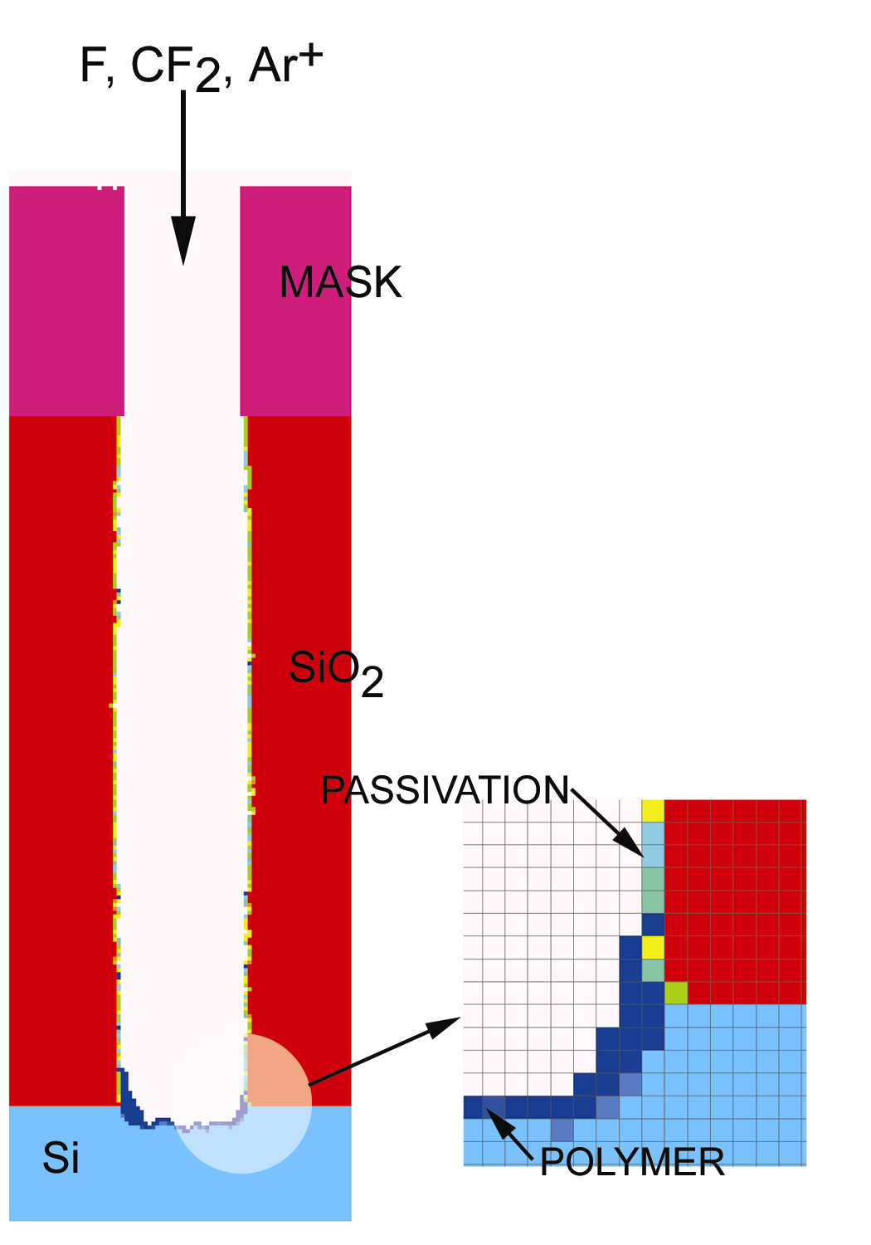
MONTE CARLO FEATURE PROFILE MODEL
Profile is defined on a 3D “voxel” mesh, with cells representing a material.
Gas phase pseudo-particles are launched with fluxes, energy and angular distributions derived from Hybrid Plasma Equipment Model (HPEM).
Trajectories of particles are tracked until striking solid.
Surface reaction mechanism defines outcome of collisions.
Chemical reaction (material change)
Etching (removing cells)
Deposition (adding cells)
Implantation and mixing
Charging addressed through solution of Poisson's equation.
University of Michigan
Institute for Plasma Science & Engr.
IOPS_2020
Notes:
pictures

Slide 7
PROCEDURE FOR MODELING PEALD OF SiO₂
PEALD process followed by ..→ precursor → plasma → precursor → ..
Generic precursor Si-R_{g} (R represents organic), nominally BTRS (CH₃)₃SiN(CH₃)₂
Use separate colors for Si-R and O on alternating steps to distinguish layering.
Purge processes are not considered – passivation and deposition immediately follow each other.
Steric hindrance, blocking sites by Si-R(s), is not included. “Perfect” ALD of 1 monolayer/cycle is then allowed.
University of Michigan
Institute for Plasma Science & Engr.
IOPS_2020
Notes:
pictures

Slide 8
TEST MECHANISM FOR MODELING SiO₂ PEALD
PEALD process:
..→ precursor → plasma → precursor → ..
Si-R_{g} + W → Si-R Initial Passivation
Si-R + O⁽*⁾_{g} → Si- + OR_{g} Oxidation of R
Si- + O⁽*⁾_{g} → Si-O Oxidation of Si
Si-O + Si-R_{g} → Si-O-Si-R Passivation of O
(Si-R_{g}, O_{g})+M→ (Si-R_{a}, O_{a}) Adsorption
Si-R + M⁺_{g} → Si- + R_{g} + M_{g} Sputtering of R
Si-O + M⁺_{g} → Si- + O_{g} + M_{g} Sputtering of O
Si- + M⁺_{g} → Si_{g} + M_{g} Sputtering of Si
University of Michigan
Institute for Plasma Science & Engr.
IOPS_2020
Notes:
pictures

Slide 9
TEST MECHANISM FOR MODELING SiO₂ PEALD
Mechanism includes adsorption and desorption of precursors and O atoms, though not recombination of O to yield O₂.
Empirical reaction probabilities with calibration to experiments.
High energy ion sputtering on the surface:
P₀= 0.2; ε_{th}= 15 eV; ε_{ref}= 50 eV; n = 0.5
Ions neutralize on surfaces and become “hot neutrals” with same reaction probabilities.
UV/VUV absorption produces defects
hν + Si → Si*
hν + O → O*
University of Michigan
Institute for Plasma Science & Engr.
IOPS_2020
Notes:
pictures

Slide 10
PEALD REACTOR GEOMETRY
Capacitively coupled plasma (CCP)
Top electrode powered: 500 W, 10 MHz, V_{rf} = 379 V, V_{dc} = -54 V
Gas flows at 2 Torr
Primary: Ar/O₂ = 80/20, 5 slm
Secondary: O₂ 6 slm
University of Michigan
Institute for Plasma Science & Engr.
IOPS_2020

Slide 11
PLASMA PROPERTIES
Secondary O₂ input has little influence on bulk plasma.
Peak electron density [e] = 3.2 x 10¹⁰ cm⁻³.
Peak density at corner of the electrode due to E-field enhancement.
Dominant ions: O₂⁺ and O⁻
O₂⁺ production through Penning ionization and charge exchange.
High O⁻ density due to high rate of dissociative attachment to O₂.
2 Torr, Ar/O₂ = 4/1, 5 slm, 500 W (10 MHz)
University of Michigan
Institute for Plasma Science & Engr.
IOPS_2020

Slide 12
IONIZATION SOURCES
Electron temperature (T_{e}) is uniform in bulk plasma.
High T_{e} in sheath due to low [e].
High pressure, thin sheath, weak Ohmic heating in plasma bulk.
High ionization source within thin layer of sheath due to stochastic heating.
High rate of beam ionization by secondary electron emission.
Plasma sustained in γ-mode.
2 Torr, Ar/O₂ = 4/1, 5 slm, 500 W (10 MHz)
University of Michigan
Institute for Plasma Science & Engr.
IOPS_2020

Slide 13
PLASMA FLUXES TO WAFER
Dominant neutral fluxes: O, O₂(a¹∆_{g}) and O₂(b¹Σ_{g}⁺) by factors of 100-1000 compared to ions
Dominant ion fluxes: O₂⁺ and Ar⁺
Ar* (excited states) and VUV photon fluxes commensurate to ions.
Primary reactants essentially uniform over 30 cm wafer.
2 Torr, Ar/O₂ = 4/1, 5 slm, 500 W (10 MHz)
University of Michigan
Institute for Plasma Science & Engr.
IOPS_2020

Slide 14
ENERGY-ANGLE DISTRIBUTIONS ONTO WAFER
DC bias = -53 V
Sheath is collisional (MFP ≈ 0.04 cm) – bulk of ions have energy < 15 eV with tail to 30-40 eV.
Broad ion angular distribution (±10-25º).
Neutrals essentially isotropic with temperature of 0.03 eV.
Neutrals gain some energy from charge-exchange heating to produce tail.
2 Torr, Ar/O₂ = 4/1, 5 slm, 500 W (10 MHz), V_{dc}=-53 V
2-decade log-scale
University of Michigan
Institute for Plasma Science & Engr.
IOPS_2020

Slide 15
SiO₂ PEALD
PEALD in trench: 100 nm × 500 nm (AR=5)
10 nm depth, reflective boundary condition at front and back.
Mesh size: (0.5 nm)³ cubic
Flux of precursor (Si-R) is same magnitude as O flux during plasma exposure (1 × 10¹⁹ cm⁻²s⁻¹).
Base case:
Precursor exposure: 0.3 s
Plasma exposure: 0.2 s
0.98 nm/cycle (1.0 is fully saturated)
Reaction probabilities:
O_ + Si-R_{g} → O_ + Si-R_ p = 0.004
Si_ + O_{g} → Si_ + O_ p = 0.01
University of Michigan
Institute for Plasma Science & Engr.
Animation Slide
IOPS_2020
Notes:
pictures

Slide 16
FLUXES AND SURFACE COMPONENTS
Fluxes to bottom of feature in sample area of (5 nm)²
Si-R: Precursor exposure
O, O₂⁺, Ar⁺: Plasma exposure.
Small decrease in Si-R and O fluxes due minor increase of AR as deposition proceeds (5 vs 6.8)
Surface coverages during passivation and oxidation steps. Perfect ALD = 1.0.
Small changes in fluxes which produce non-saturated coverage on one step are magnified on successive steps.
University of Michigan
Institute for Plasma Science & Engr.
IOPS_2020
Notes:
pictures

Slide 17
PLASMA EXPOSURE TIME
Plasma exposure time, t_{p}, must be long enough to oxidize previous Si-R_, and passivate exposed Si_ to form Si-O_ and prepare for precursor.
Processes that are unsaturated have lower initial Si-O_ (prior to passivation) and lower Si-R_ (prior to oxidation) leading to porosity.
Deposition rates (nm/cycle):
t_{p} = 0.01s: 0.58
t_{p} = 0.2 s: 0.98
More vacancies when t_{p} is small – depositing layers affected by the structure of lower layers.
Surface coverage approaches saturation when t_{p} > 0.15 s
End of process
University of Michigan
Institute for Plasma Science & Engr.
IOPS_2020
Notes:
pictures

Slide 18
O REACTION PROBABILITY
O reaction probability (p_{O}): 4x10⁻⁴ to 0.01.
Relatively uniform deposition over range of p_{O} while rate and quality of film are sensitive to p_{O}.
Deposition rate (nm/cycle):
p_{O} = 4x10⁻⁴ : 0.68
p_{O} = 0.01: 0.98
Indistinguishable layers with low p_{O} as far from saturation.
High O flux compensates low p_{O} to some degree.
Surface coverage approaches saturation when p_{O} > 0.006
End of process
University of Michigan
Institute for Plasma Science & Engr.
IOPS_2020
Notes:
pictures

Slide 19
p_{O}τ_{p} SCALING
Plasma exposure time τ_{p} and and p_{O} are varied to keep p_{O}τ_{p} = 8 x 10⁻⁵ (s).
O flux and O_ surface nearly constant for τ_{p} > 0.08 s.
A critically large τ_{p} is required for the O flux to “visit” each site, independent of reaction probability.
University of Michigan
Institute for Plasma Science & Engr.
End of process
IOPS_2020
Notes:
pictures

Slide 20
ASPECT RATIO
Increase AR (5 to 20) for constant height.
Larger AR already challenged by conduction limits of isotropic neutral precursors.
As deposition proceeds, effective AR increases.
Deposition rate then becomes a function of height, leading to pinch-off.
Quality of film degrades as neither passivation or oxidation are fully saturated at large AR.
Exposure times must increase as conduction limits are reached.
University of Michigan
Institute for Plasma Science & Engr.
IOPS_2020
Notes:
pictures

Slide 21
ASPECT RATIO
Increase AR (5 to 20) for constant height.
Larger AR already challenged by conduction limits of isotropic neutral precursors.
As deposition proceeds, effective AR increases.
Deposition rate then becomes a function of height, leading to pinch-off.
Quality of film degrades as neither passivation or oxidation are fully saturated at large AR.
Exposure times must increase as conduction limits are reached.
Fluxes to bottom of feature
University of Michigan
Institute for Plasma Science & Engr.
IOPS_2020
Notes:
pictures

Slide 22
PRESSURE SCALING
Lower pressures: 0.5 Torr, 1.5 Torr, 500 W.
[e] increases with pressure with greater uniformity.
Pressures above 0.5 Torr appear “1-dimensional” with ionization sources restricted to sheaths producing a more symmetric system.
dc bias: 0.5 Torr -230 V (V_{rf} = 441 V) 1.5 Torr -101 V (V_{rf} = 332 V)
2.0 Torr -53 V (V_{rf} = 379 V)
University of Michigan
Institute for Plasma Science & Engr.
IOPS_2020
Notes:
pictures

Slide 23
PRESSURE SCALING
O and O₂⁺ fluxes to wafer increase with pressure,
Charge exchange from Ar⁺.
More dissociative attachment and recombination.
Longer mean free path produces high energy tail to IEAD.
NEAD of neutral species not sensitive to pressure.
University of Michigan
Institute for Plasma Science & Engr.
IOPS_2020
Notes:
pictures

Slide 24
PRESSURE SCALING
Film quality degrades with decreasing pressure
Lower O fluxes encroach on not saturating each step.
Higher ion energies encroach on sputtering thresholds which produce vacancies.
End result is defects and moderately lower deposition rate
Deposition rate (nm/cycle):
500 mTorr: 0.91
1.5 Torr: 0.98
University of Michigan
Institute for Plasma Science & Engr.
IOPS_2020
Notes:
pictures

Slide 25
POWER SCALING
Power 300 W, 500 W and 700 W at 2 Torr.
Sheaths are highly collisional with ionization and radical sources close to electrodes.
Peak electron and radical densities scale with power.
However, with the upper electrode powered, much the increase in flux flows to the top electrode and not the bottom.
V_{rf}/V_{dc}: 286 V / -12 V for 300 W
335 V / -100 V for 700 W
University of Michigan
Institute for Plasma Science & Engr.
IOPS_2020
Notes:
pictures

Slide 26
POWER SCALING
Power: 300 W to 700 W.
IEAD extends to higher energies to reflect increase in V_{rf}.
Increase in ion energy is only nominal as ion mean free path is short.
Increase in fluxes to the wafer lag behind increase in power as majority of add flux flows to the powered electrode.
University of Michigan
Institute for Plasma Science & Engr.
IOPS_2020
Notes:
pictures

Slide 27
POWER SCALING
With small change in fluxes, system remains saturated for range of powers.
Nominally higher ion energies produce some sputtering and defects though this is a small effect.
Deposition rate (nm/cycle):
300 W: 0.98
700 W: 0.98
University of Michigan
Institute for Plasma Science & Engr.
IOPS_2020
Notes:
pictures

Slide 28
VIA DEPOSITION
2 Torr; 500 W; 10 MHz; Ar/O₂ = 80/20
Diameter 100 nm, height 500 nm.
End of process
Vias have larger surface to volume ratio than trenches and so are more sensitive to AR.
Other than requiring more plasma exposure to reach saturation, the majority of trends are the same as for trenches.
University of Michigan
Institute for Plasma Science & Engr.
IOPS_2020
Notes:
pictures

Slide 29
CONCLUDING REMARKS
Plasma enhanced atomic layer deposition (PEALD) of SiO₂ using an Ar/O₂ CCP was computationally investigated.
A wide range of plasma operating conditions produce saturating fluxes that self-terminate steps and produce “ideal” deposition.
Expect narrower range of operating conditions when accounting for steric blocking of sites.
Mobile adsorbates are essential to achieving “ideal” deposition and so may introduce heightened sensitivity to temperature.
Lower limit on pressure is about 1 Torr before defects are introduced by sputtering.
Increasing initial aspect ratio (AR) and increasing AR when filling features introduces conduction limits which must be compensated for by increasing fluxes or exposure time to maintain saturation.
Once defects are produced, shadowing and inability for mobile adsorbates to breech defects cascade their influence.
University of Michigan
Institute for Plasma Science & Engr.
IOPS_2020

