Slide 1
Dynamics of Strongly Coupled Two-Component Plasma via Ultrafast Spectroscopy
Dr. Alexander Bataller
North Carolina State University
Department of Nuclear Engineering
International Online Plasma Seminar
9:00 am – February 27th, 2020

Slide 2





Putterman Laboratory
Department of Physics
Bataller Laboratory
Department of Physics
Department of Nuclear Engineering
Prof. Seth Putterman
Dr. John Koulakis
Dr. Alexandra Latshaw
Prof. Alex Bataller
Matthew Lippy

Slide 3
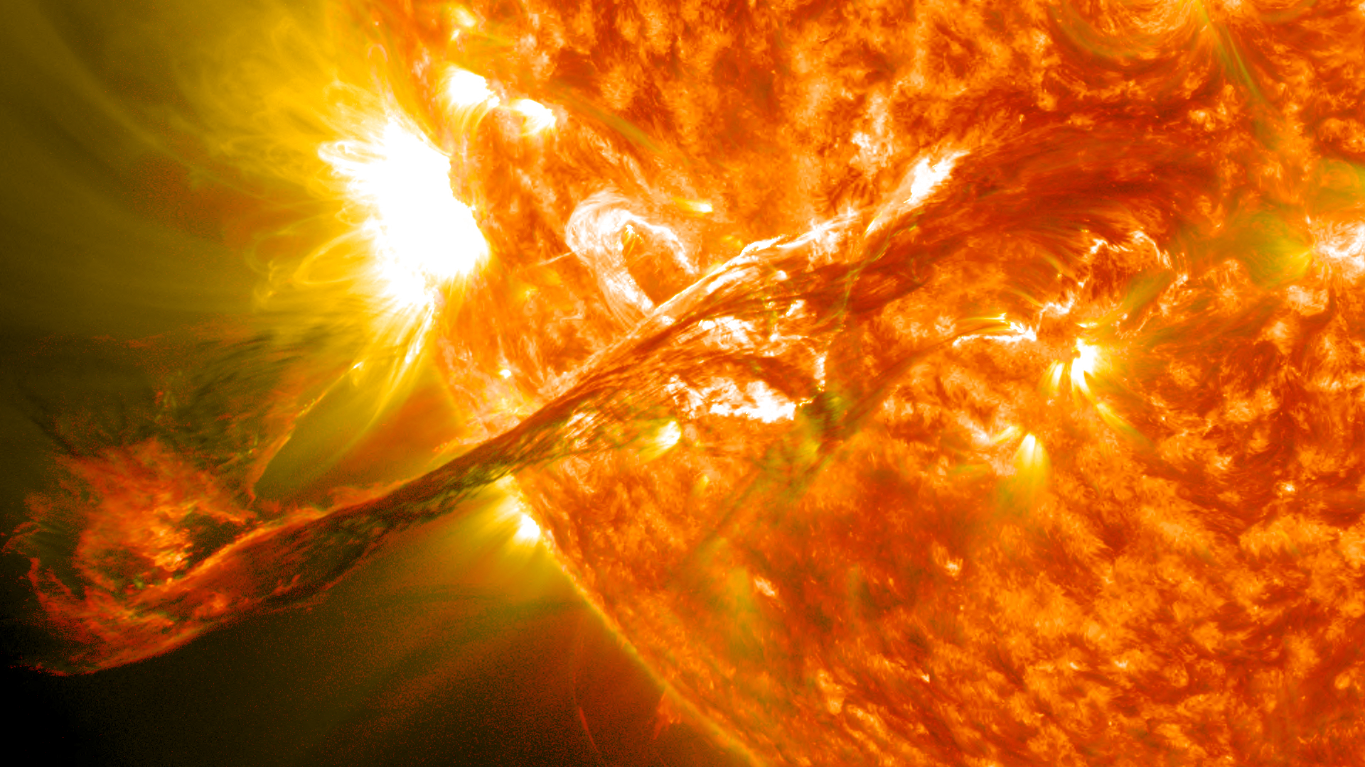
Dilute Plasma
Plasma is a system of unbound charged particles
Stellar, interplanetary, interstellar, and intergalactic media are mostly dilute plasmas (>99% of visible universe)
Atomic plasma
www.wikipedia.org
Notes:
What is a plasma slide. Defines a plasma with emphasis that it’s a system of charged particles. This is an important distinction because ions and electrons aren’t the only particles that can make plasma. Essentially any charged particle can. For the example of atoms: solid, liquid, gas, gas plasma. This state of matter represents >99% of the visible universe. So if you’re interested in understanding the universe, might want to understand plasma.

Slide 4
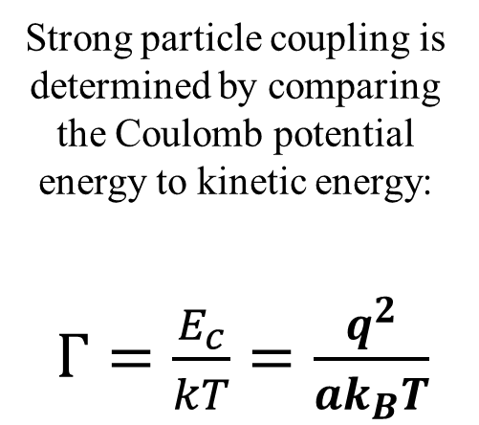


Strongly Coupled Plasma
$$Γ≪1$$
$$Γ≫1$$
Strong particle coupling is determined by comparing the Coulomb potential energy to kinetic energy:
$Γ=\frac{E_{c}}{kT}=\frac{q^{2}}{{ak}_{B}T}$
Notes:
So now that we have an idea of the many plasmas that exist, lets focus our attention to a certain class of plasma and the topic of this seminar, the strongly coupled plasma.
How a plasma behaves is determined, in part, by how much particles interact with one another.
We quantify this interaction with what’s known as the strong coupling parameter Gamma, which is defined as the coulomb potential energy to its kinetic energy. For low gamma…, for high gamma…

Slide 5
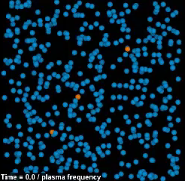
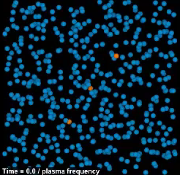
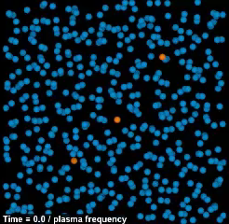



Strongly Coupled One-Component Plasma
$$Γ=0.1$$
$$Γ=1$$
$$Γ=10$$
https://www.lanl.gov/projects/dense-plasma-theory
Notes:
Here’s a 3D particle in a cell (molecular dynamics) simulation showing a one-component plasma when particles start slowing down, i.e. Gamma getting larger
OCP consists of a single species with a neutralizing background to prevent a Coulomb explosion.
G=0.1 particles zip through the system with very little interaction/deflections (gas-like)
G=1, particles are now effected
G=10 strong particle interactions are dominating the system…leads to different behavior (similar to liquid)

Slide 6
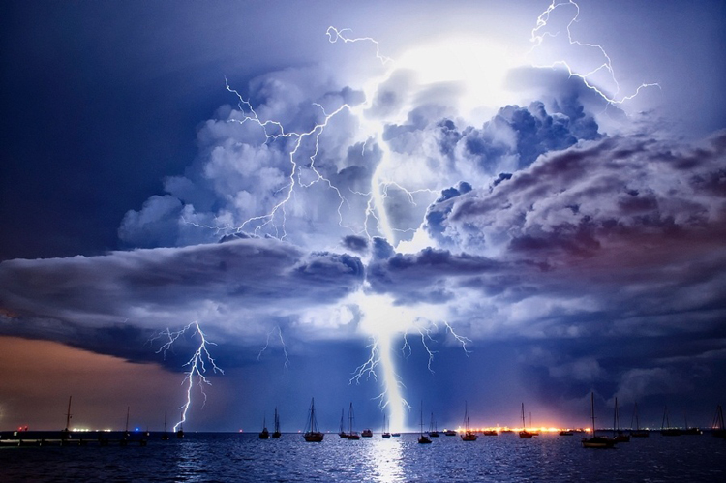
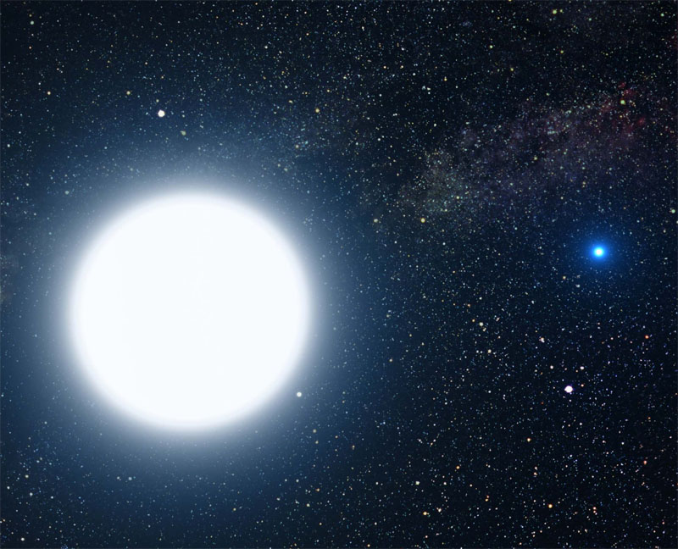
Dense Plasma In Nature
Lightning: Dense plasma with temperatures approaching 40,000 K
White Dwarf: Planet-sized stars represent the evolutionary endpoint of >95% of stars
www.wikipedia.org
Artist’s impression of Sirius A and Sirius B. Credit: NASA, ESA and G. Bacon (STScI)
Notes:
Closer to home, natural plasmas play an important role in our atmosphere. Lightning is important as it establishes keeps the planet from overcharging, nitrate and ozone production. Ionosphere formed by cosmic/uv radiation allows long distance radio communication.

Slide 7
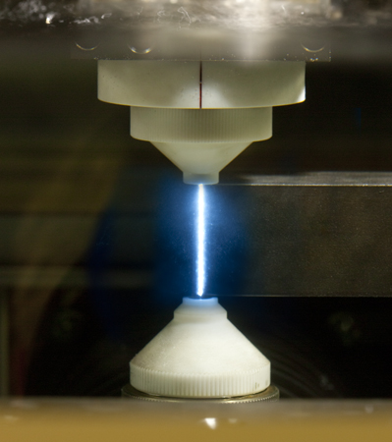
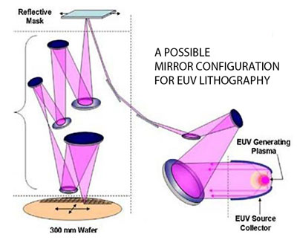
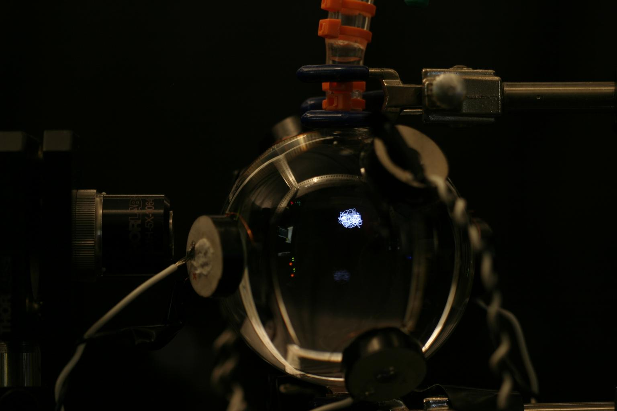
Dense Plasma Applications
Many applications: material processing, EUV light source, launchers and thrusters, semiconductors and plasmonics, and sonochemistry
Plasma Machining
Photolithography
Sonoluminescence
http://wireedmsoftware.com/
www.nist.gov
Notes:
Many applications using plasma exist, so this list is not all inclusive. But for example,…
A major effort of humanity is to produce fusion energy, which has been a major motivator in plasma science.

Slide 8
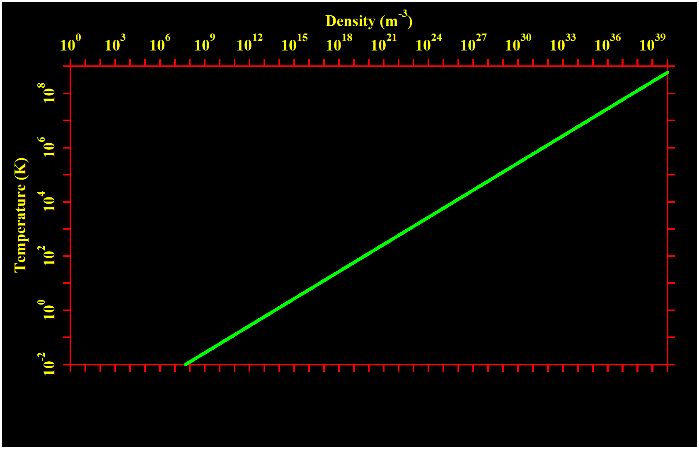
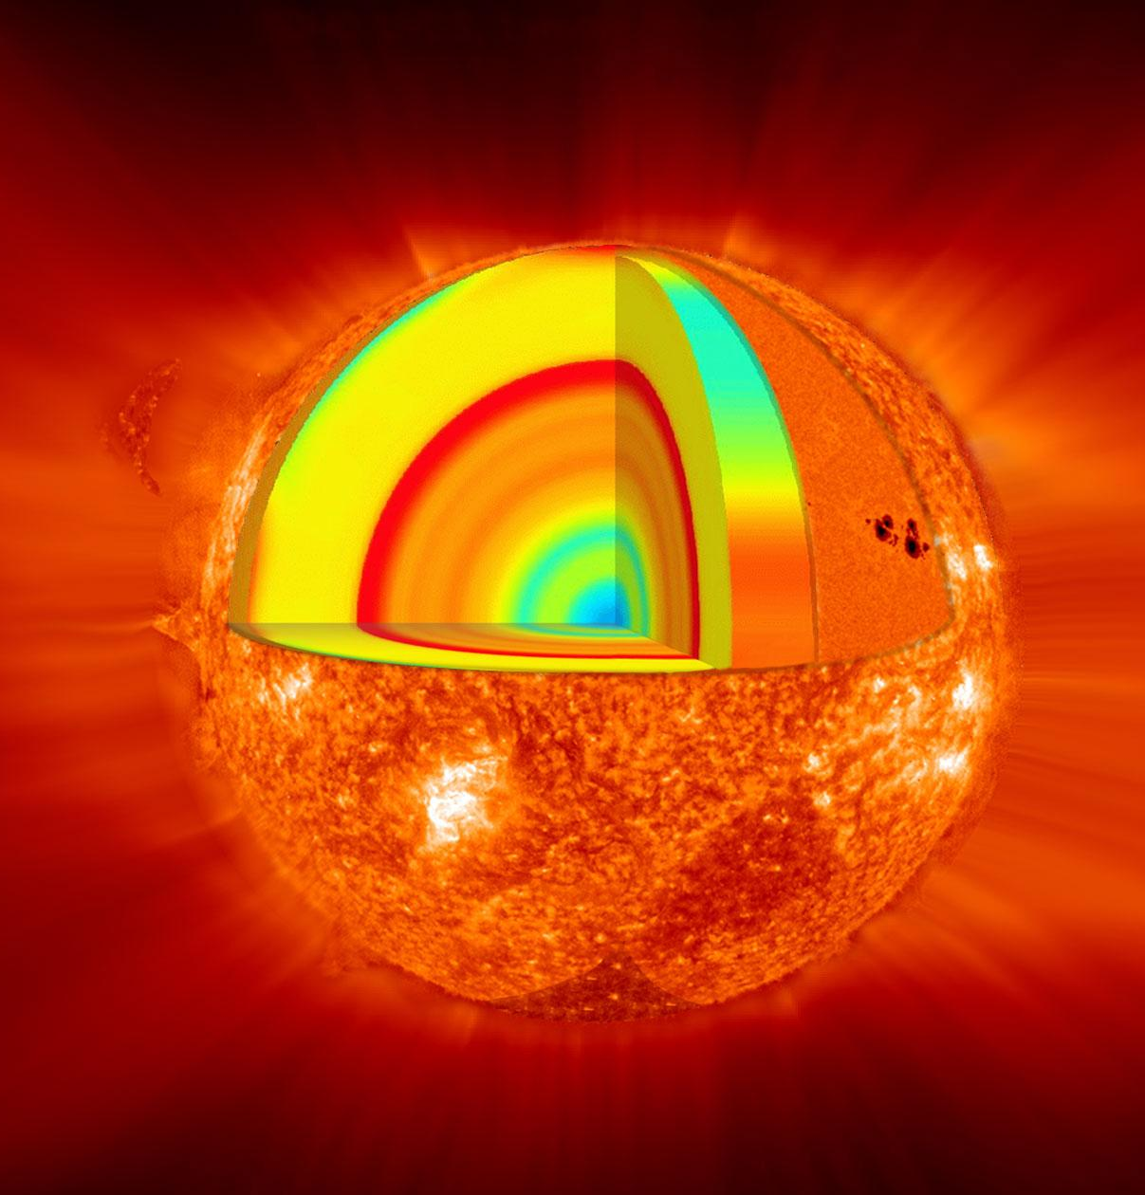
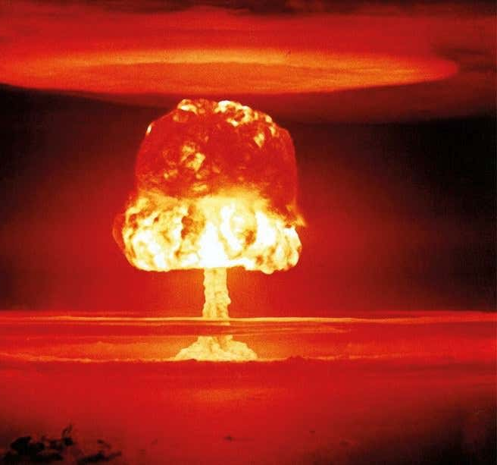
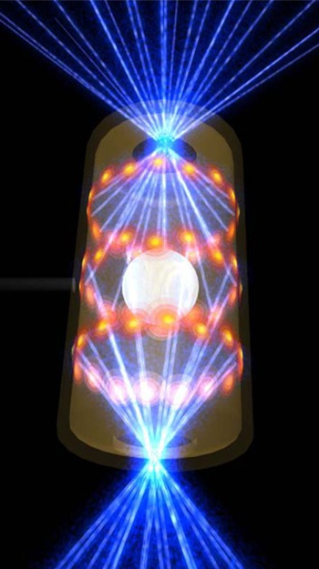
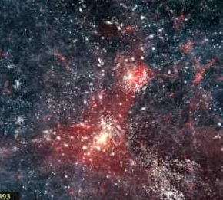




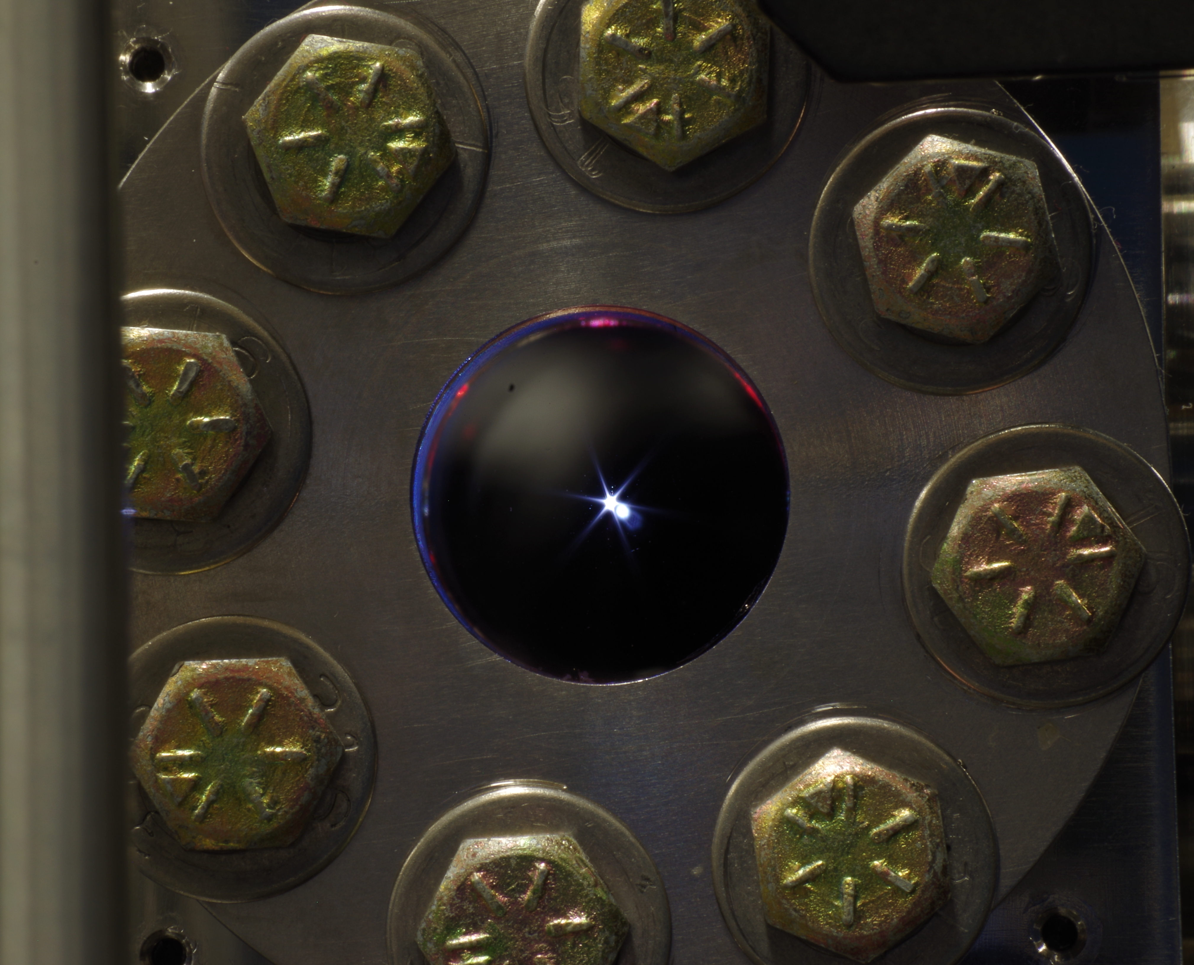
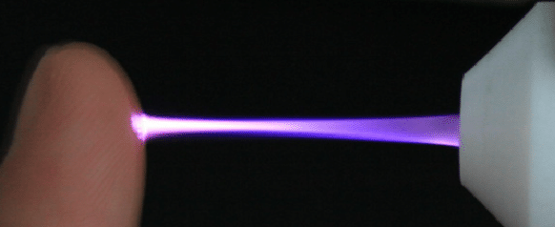
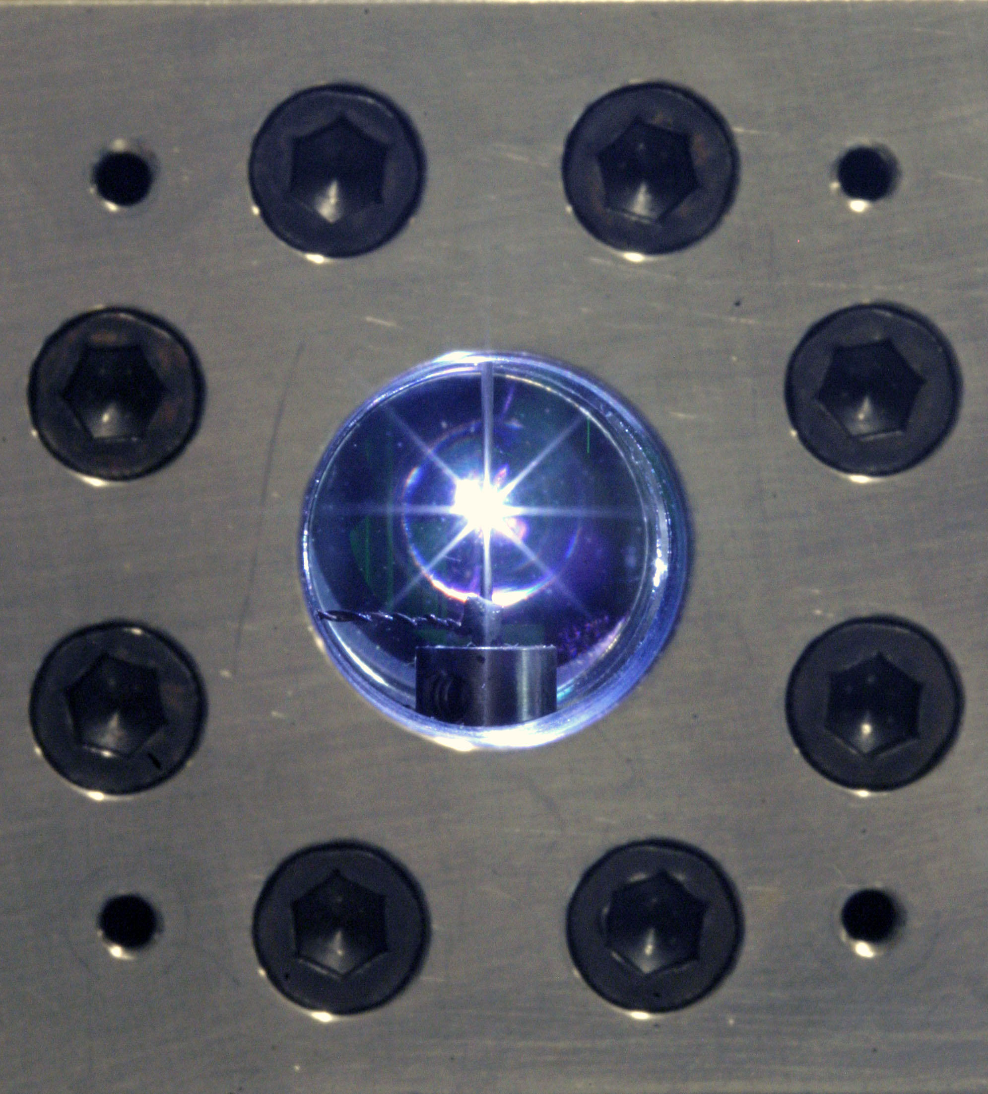
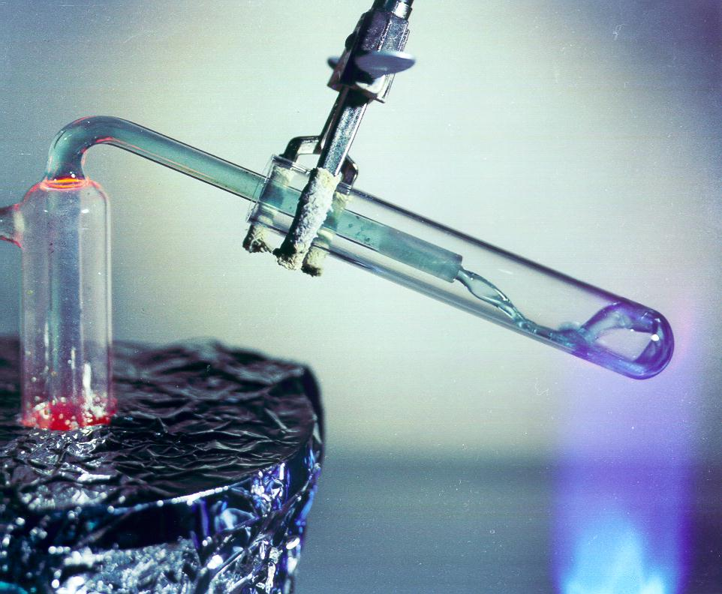
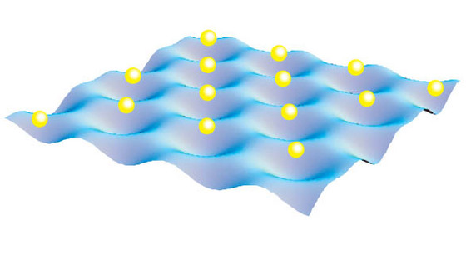
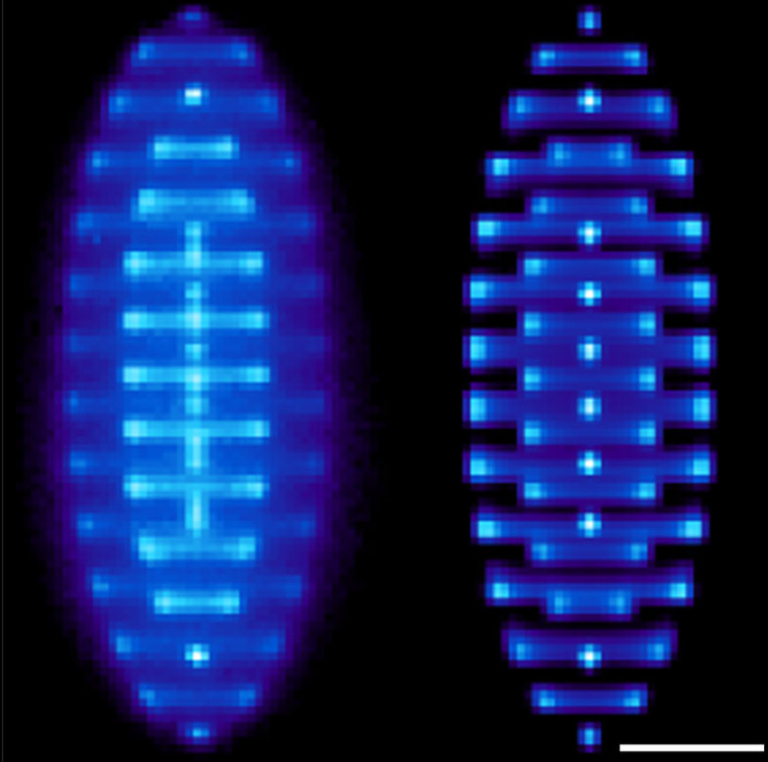


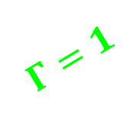
NS
Crust
WD
Core
BD
Core
Intergalactic
Sonoluminescence
Jupiter Core
$$Γ≪1$$
Earth Core
Molten Salt
Laser
Breakdown
Spark Discharges
Electrons on Liquid Helium
$$Γ=1$$
$$Γ≫1$$
Notes:
So where does SCP fit in the plasma world?
T-n diagram showing vast parameter space for atomic plasmas
Gamma = 1 is shown here which separates dilute and scp
Dilute, quickly mention types of plasma
SCP, quickly mention types of plasma
My research as a graduate student was focused in this region of parameter space, which has very important applications. Atmospheric to solid density plasma which include electrothermal launchers and lightning.
Will now discuss these three systems, SL, SD, and LB. Curious story of a plasma phase transition begins with SL, but then is shown in all 3 systems.

Slide 9
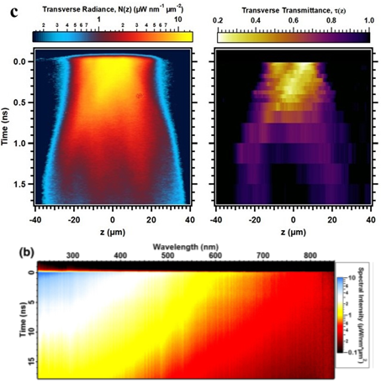
Unknowns of Dense Plasma
Plasma phase transition
n_{e}(T, n_{a})
Plasma properties
Pressure - internal energy - transport
Energetic limiting
Unknown mechanism
“The derivation of a kinetic equation for strongly coupled Coulomb systems has so far eluded us.”
Jerome Daligault, LANL
Bataller, A., et al. "Blackbody Emission from Laser Breakdown in High-Pressure Gases." Physical Review Letters 113.7 (2014): 075001.
Bataller, A., Putterman, S., Pree, S., and Koulakis, J. “Observation of Shell Structure, Electronic Screening, and Energetic Limiting in Sparks.” Physical Review Letters, 117, 085001 (2016).
Bataller, A. W. (2014). Exploring the universality of sonoluminescence

Slide 10
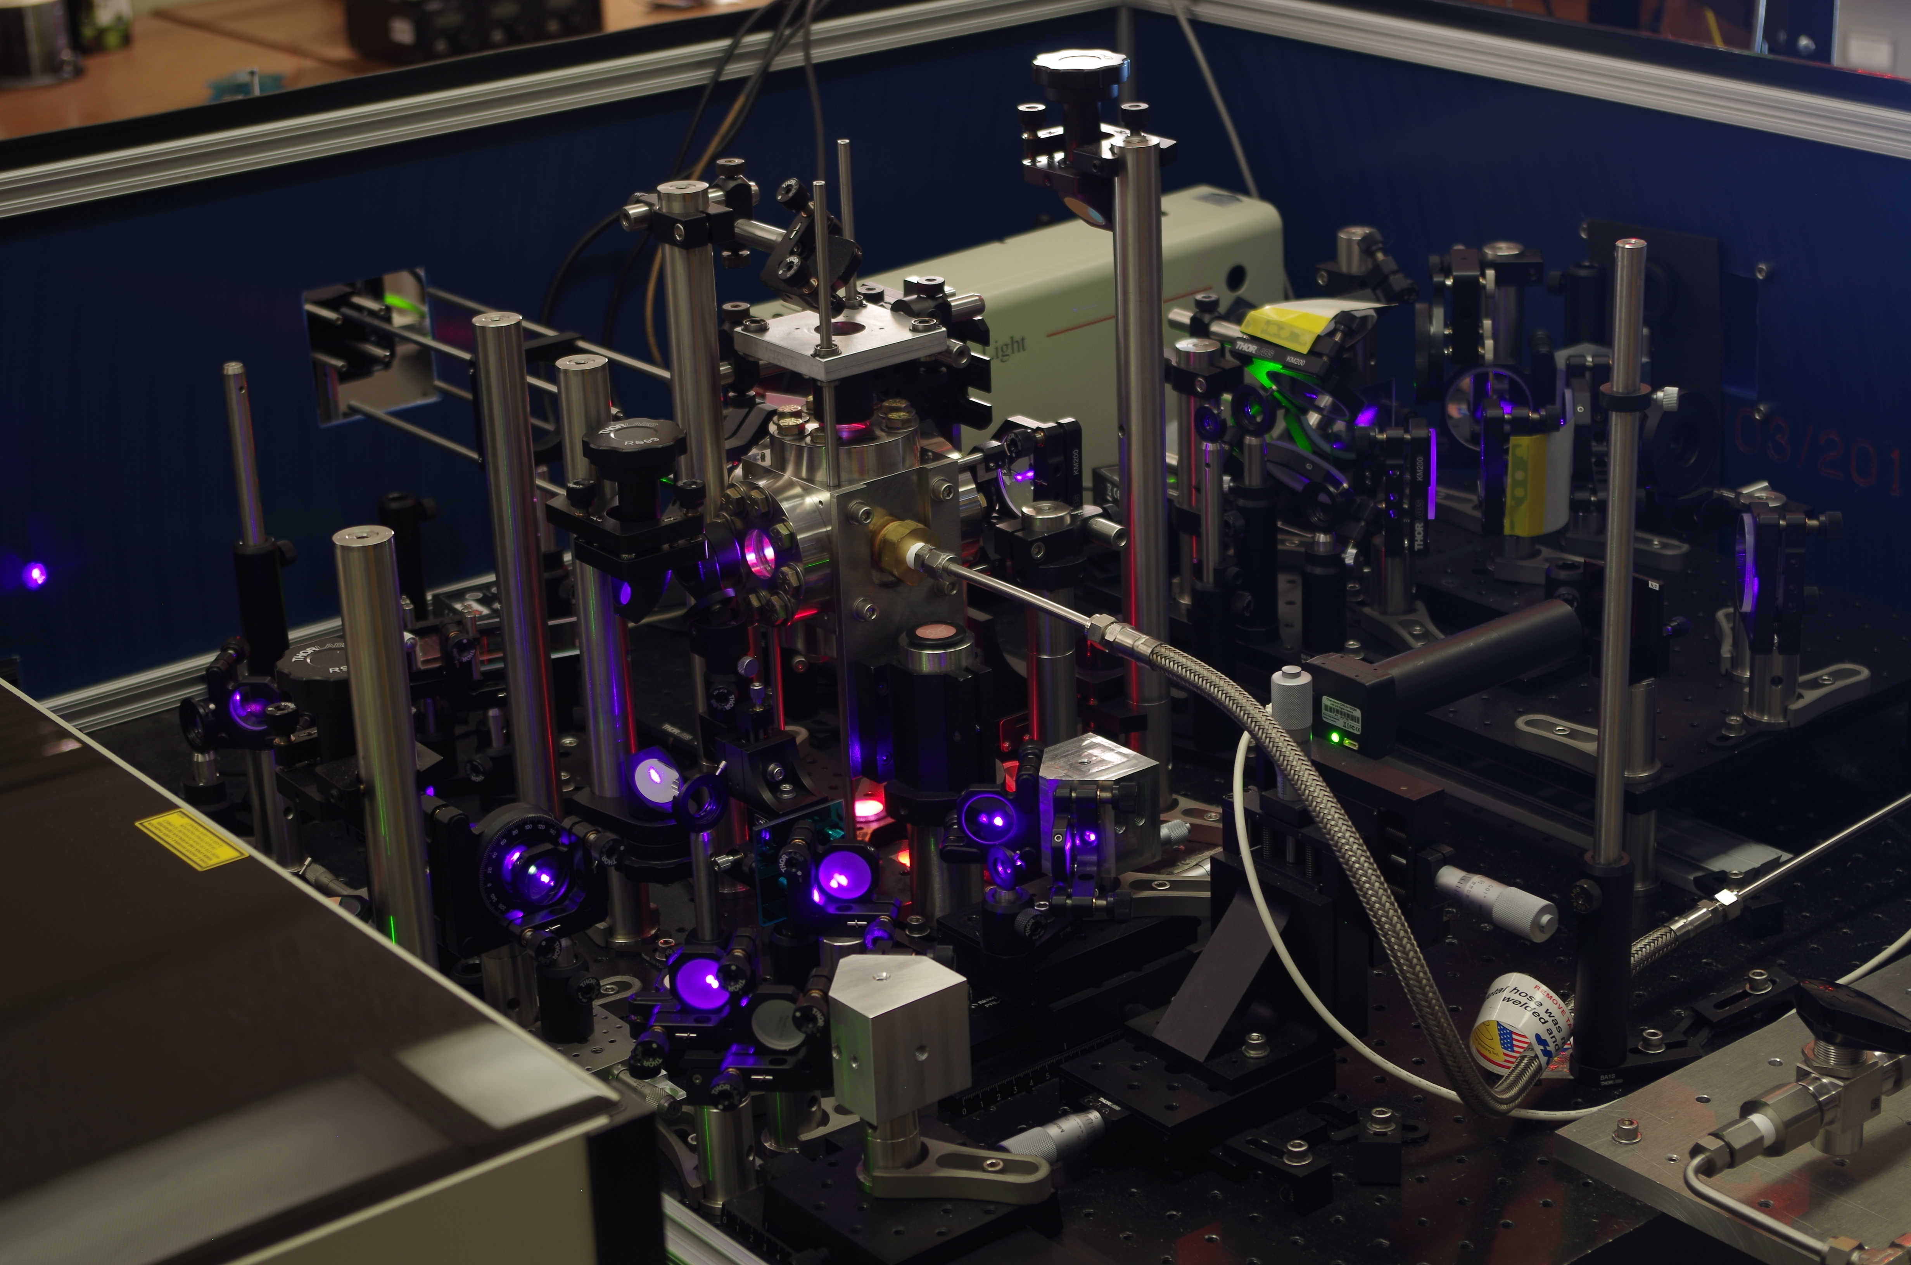
Ultrafast Laser Breakdown
Notes:
This is the system I built at UCLA

Slide 11
Benchmark System for Two-Component SCP
Benefits of femtosecond laser breakdown in compressed gases
Isochoric heating → well-defined initial conditions
Variable atomic density → large parameter space
Highly-regenerative → fast data acquisition (100 Hz)
Pump-probe → femtosecond time resolution
Electrodeless → prevents contamination and excellent optical access
Homogenous target → spatially stable with cylindrical symmetry
H₂ vs. D₂ → Large mass difference for differentiating hydrodynamic motion, near identical electronic structure, limited ionization for well-bounded charge density, and theory friendly
Bataller, A. W. (2014). Exploring the universality of sonoluminescence
Notes:
This is the system I built at UCLA

Slide 12
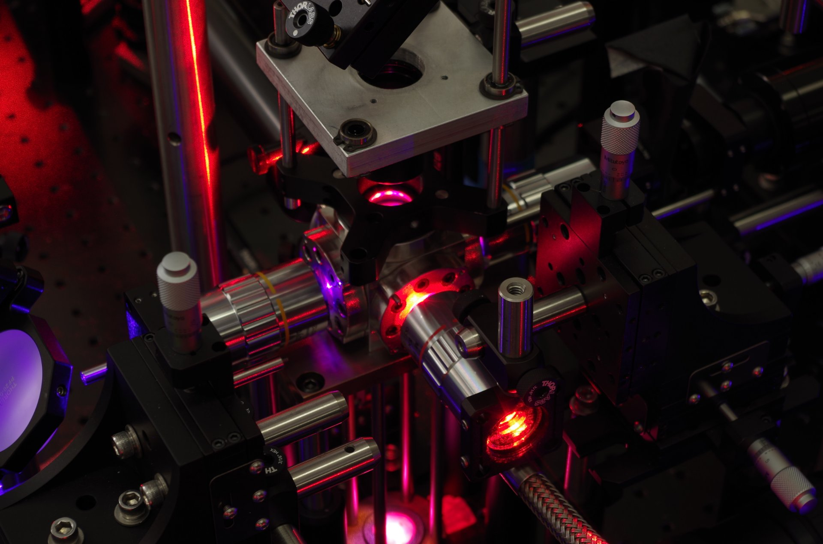
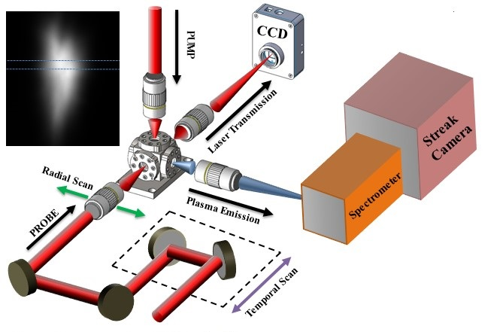
Experiment – Emission and Transmission
Femtosecond pump-probe technique accesses timescales shorter than a streak camera and can confirm blackbody in transmission
Combining emission with transmission creates a powerful plasma analysis tool
Bataller, Alexander, et al. "Dynamics of strongly coupled two-component plasma via ultrafast spectroscopy." Optics letters 44.23 (2019): 5832-5835.

Slide 13
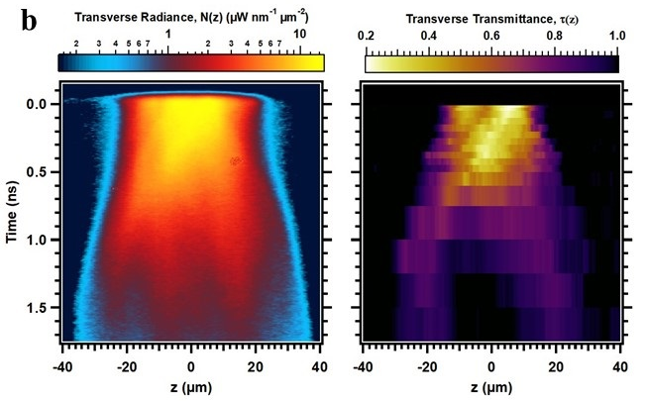
Plasma Emission and Laser Transmission
Bataller, Alexander, et al. "Dynamics of strongly coupled two-component plasma via ultrafast spectroscopy." Optics letters 44.23 (2019): 5832-5835.

Slide 14
Plasma Spectral Emission
Spectral emission (xenon on right) shows strong line emission at low density in all space-time
At critical gas density, spectrum is completely continuous at early times…micron-sized blackbody!
0.5 bar
5 bar
Bataller, A., et al. "Blackbody Emission from Laser Breakdown in High-Pressure Gases." Physical Review Letters 113.7 (2014): 075001.

Slide 15
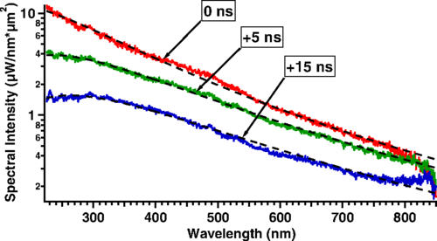
Temperature: Blackbody fit
  Temperature
  Opacity
  Estimate of charge density (>10²⁰ cm⁻³)
  Electron-ion collision time
  Bremsstrahlung mean-free path
Xe 5 bar
Bataller, A., et al. "Blackbody Emission from Laser Breakdown in High-Pressure Gases." Physical Review Letters 113.7 (2014): 075001.

Slide 16
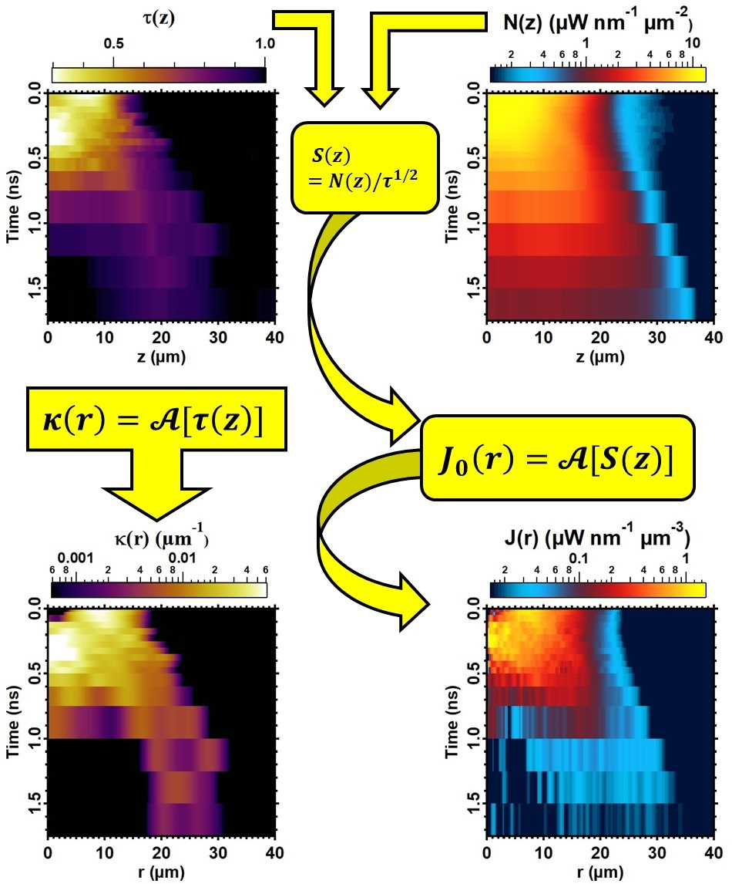
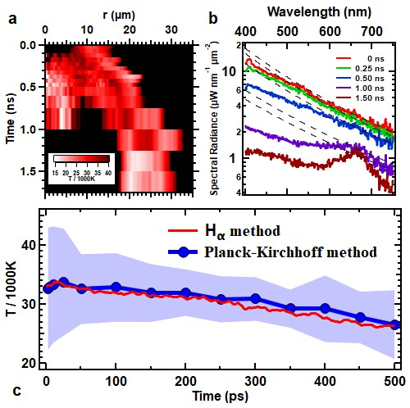
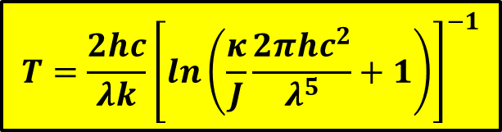
Temperature: Planck-Kirchhoff Method
H₂ 10 bar
$$T=\frac{2hc}{λk}{\left[\ln\left(\frac{κ}{J}\frac{2πhc^{2}}{λ^{5}}+1\right)\right]}^{−1}$$
Bataller, Alexander, et al. "Dynamics of strongly coupled two-component plasma via ultrafast spectroscopy." Optics letters 44.23 (2019): 5832-5835.

Slide 17
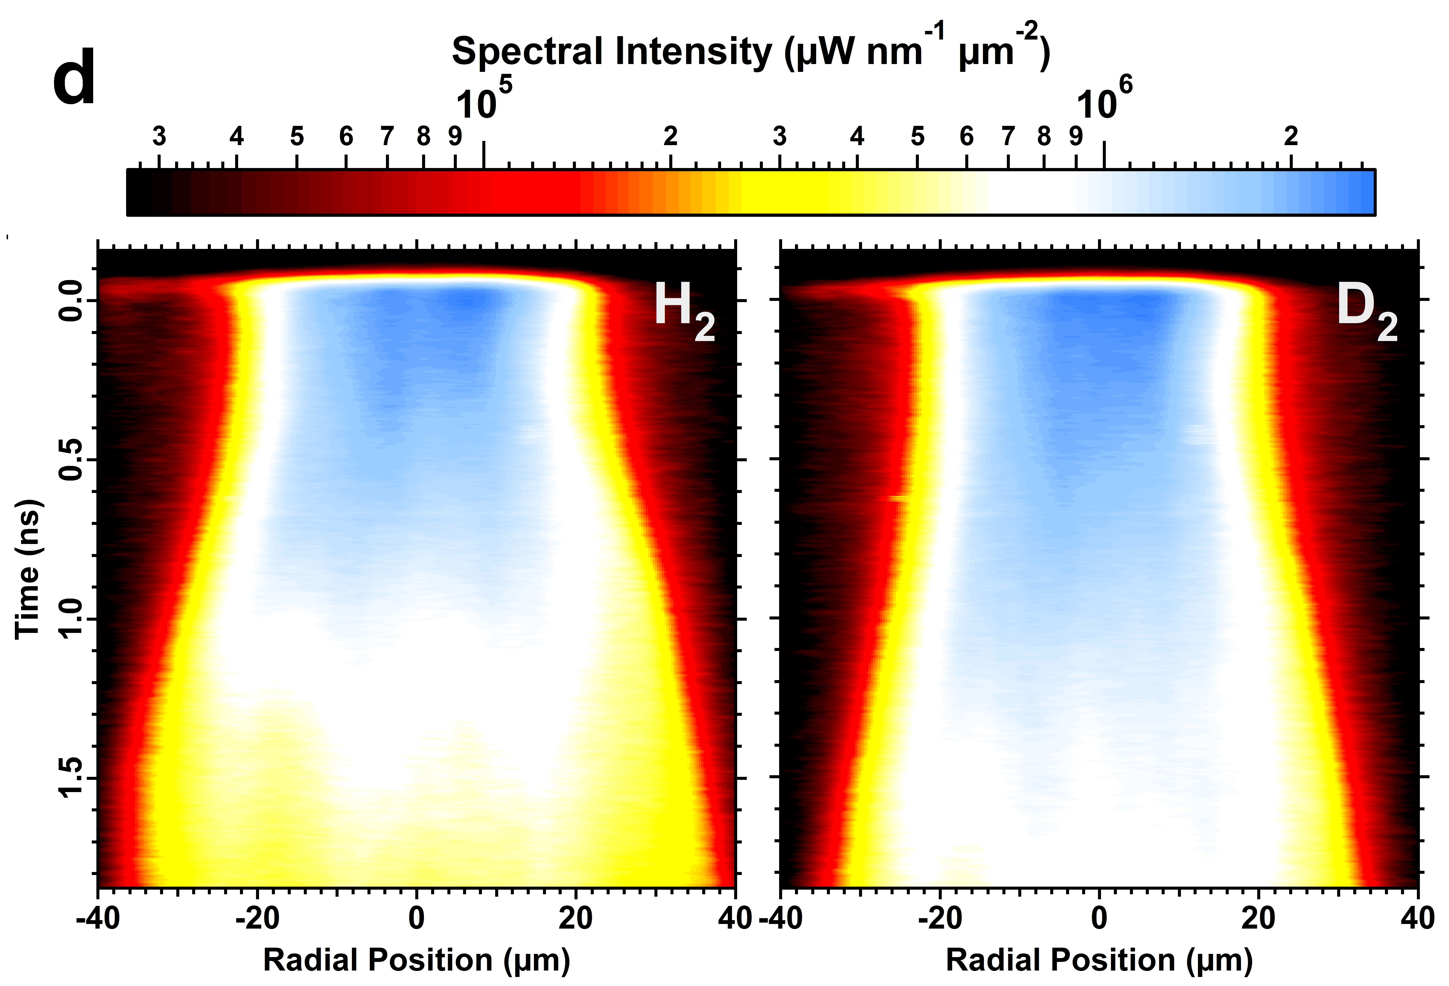
Hydrodynamics – H₂ vs D₂
10 bar
Comparing hydrodynamics of H₂ vs. D₂ for same laser breakdown conditions
Nearly identical electronic structure gives the same initial plasma state, but a factor of 2 difference in mass

Slide 18
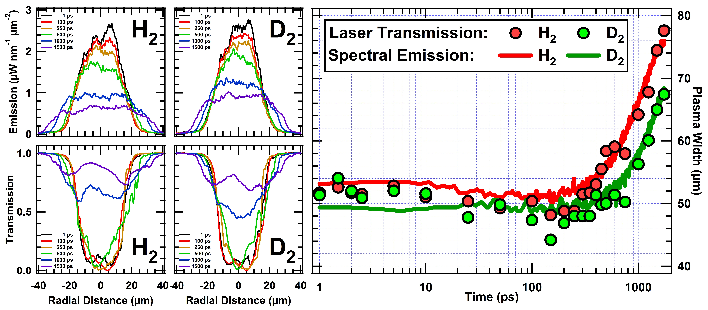
Hydrodynamics – H₂ vs D₂
10 bar

Slide 19
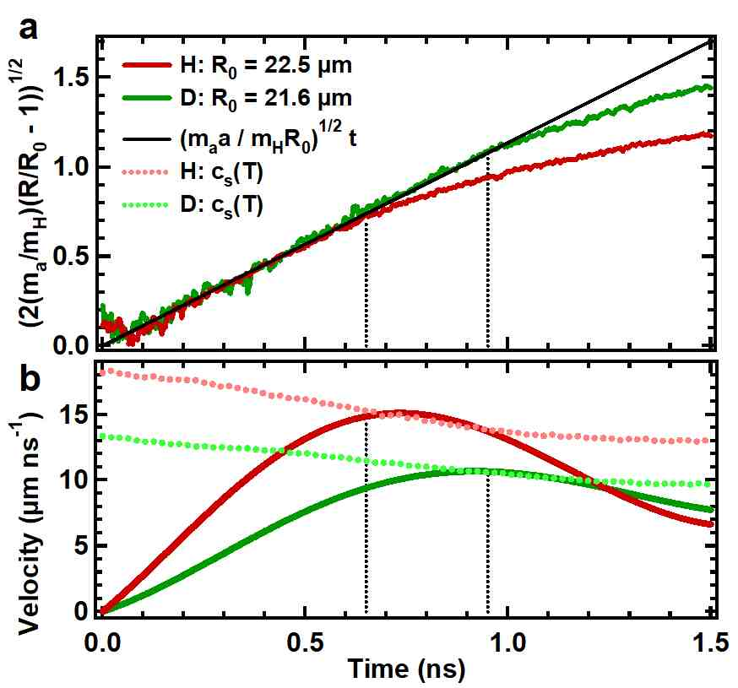


Hydrodynamics – H₂ vs D₂
10 bar
Euler’s Equation (before shock)
Momentum conservation from the compressible Euler:
$ρ\left(∂v/∂t\right)=−∇p$,
$m_{a}n_{a}\left(ΔR\right)a=−\left(∂p/∂r\right)ΔR=−Δp$,
$m_{a}a=28.4±0.9 \text{Da} μ\text{m} {\text{ns}}^{−2}$ (measured)
$$m_{a}n_{a}a=\left(28.\text{4 }\text{Da} μ\text{m} {\text{ns}}^{−2}\right)\left(5×{10}^{20}{ \text{cm}}^{−3}\right)=235 \text{bar} μ{\text{m}}^{−1}$$
$Δp\sim P=\left(n_{a}+n_{e}\right)kT=3.0 \text{kbar}$ (45% ionization from Saha’s equation)
During acceleration, ΔR~12 μm and is approximately constant and therefore $∂p/∂r\sim 250 \text{bar} μ{\text{m}}^{−1}$.
Both initial temperature and matching accelerations support our claim that nearly identical plasma conditions are achieved upon laser breakdown.
Constant acceleration?
For a plasma surface initially at R₀, its location at time ‘t’ when its acceleration is constant obeys
$$\begin{aligned}{\left\{2\frac{m_{a}}{m_{H}}\left[\frac{R\left(t\right)}{R_{0}}−1\right]\right\}}^{1/2}={\left(\frac{m_{a}a}{m_{H}R_{0}}\right)}^{1/2}t\end{aligned}$$
where a is the radial acceleration and m_{a}(m_{H}) is the atomic(hydrogen) mass
Initial radial expansion dynamics show approximately constant acceleration
Self-consistent check on temperature: plasma velocity saturates at the speed of sound when the acceleration ends

Slide 20
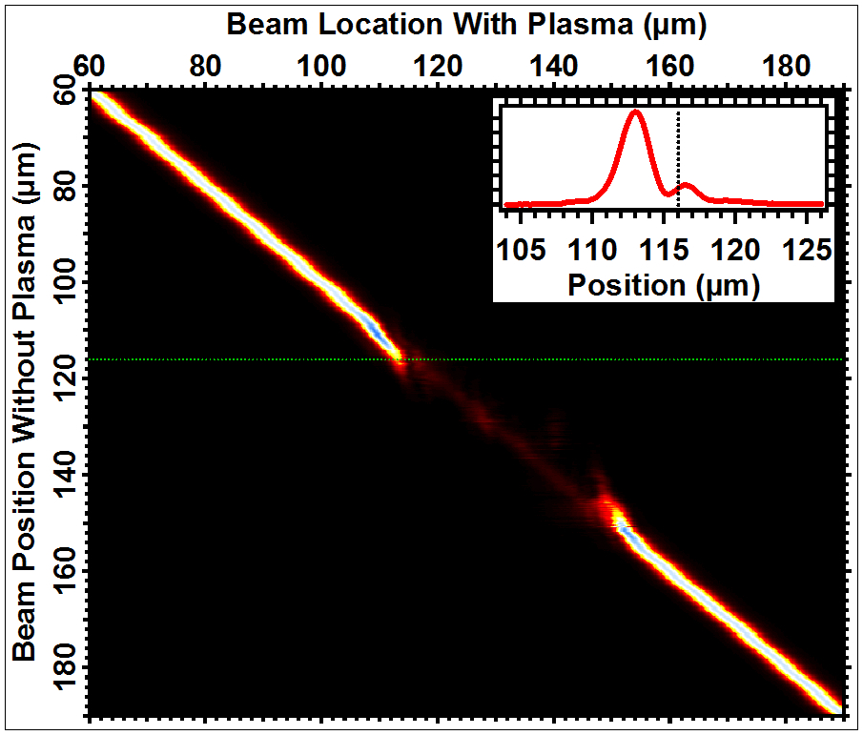
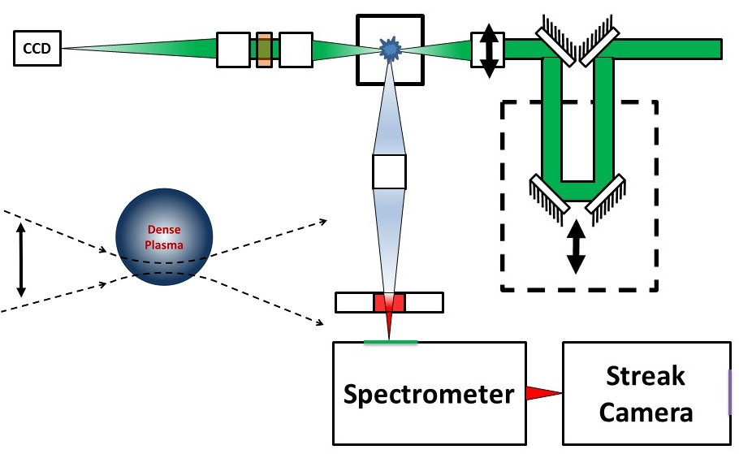
Beam Deflection
10 bar

Slide 21
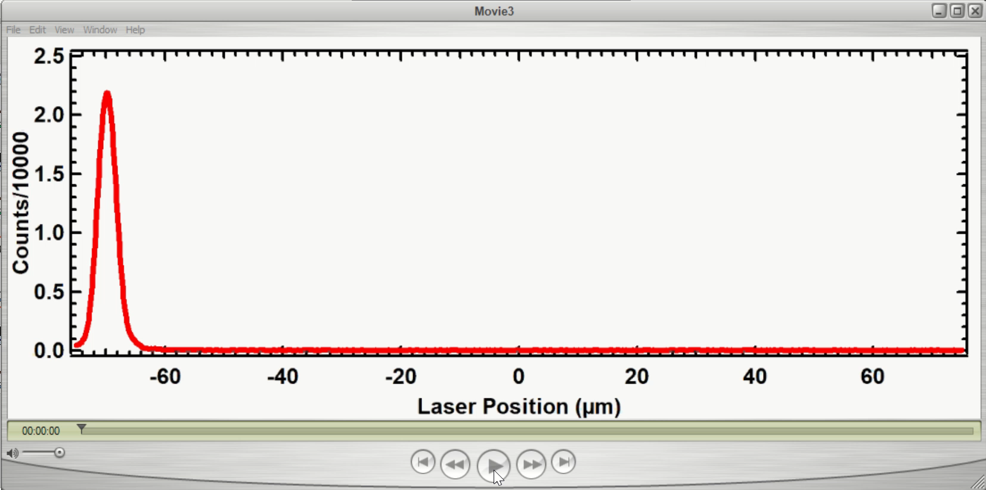
Beam Deflection
10 bar
Future work:
Analyze beam displacement and connect with plasma parameters at the boundaries

Slide 22
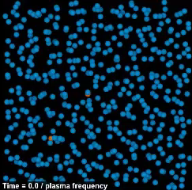
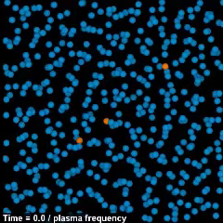
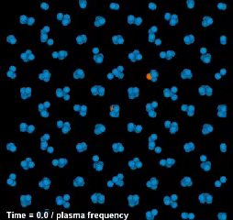



Wigner Crystallization of a One-Component Plasma
$$Γ=50$$
$$Γ=150$$
$$Γ=175$$
https://www.lanl.gov/projects/dense-plasma-theory

Slide 23
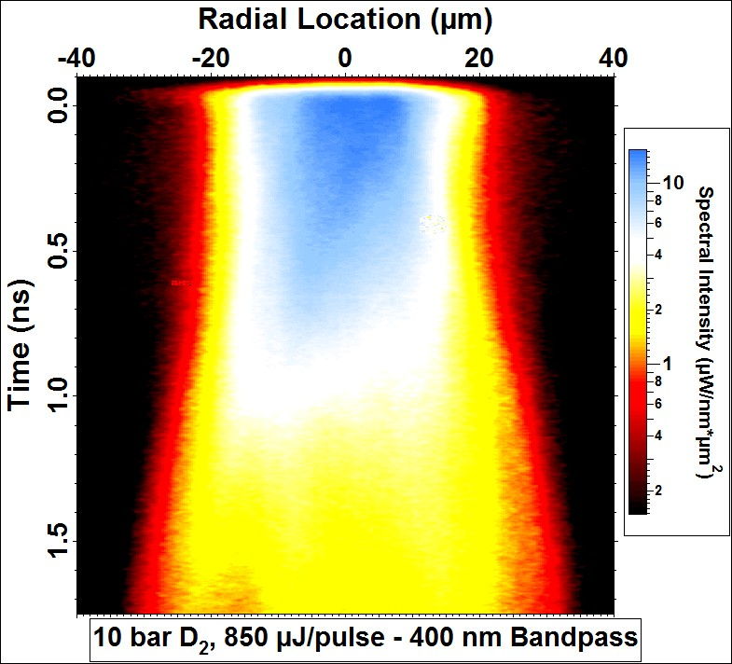
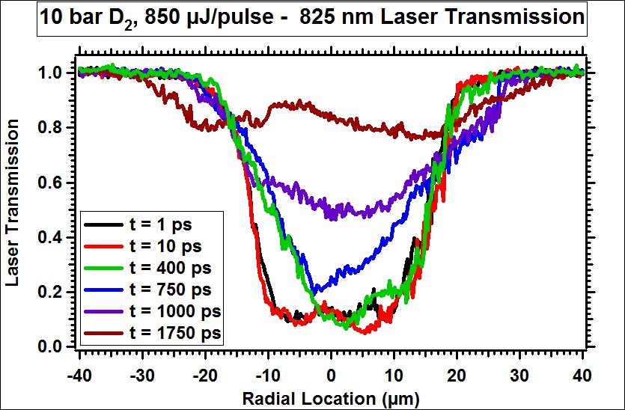
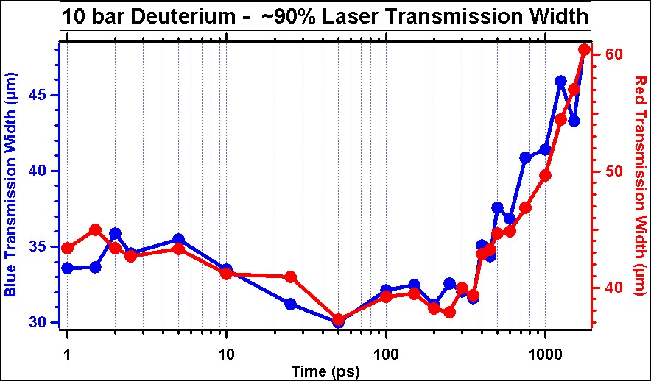
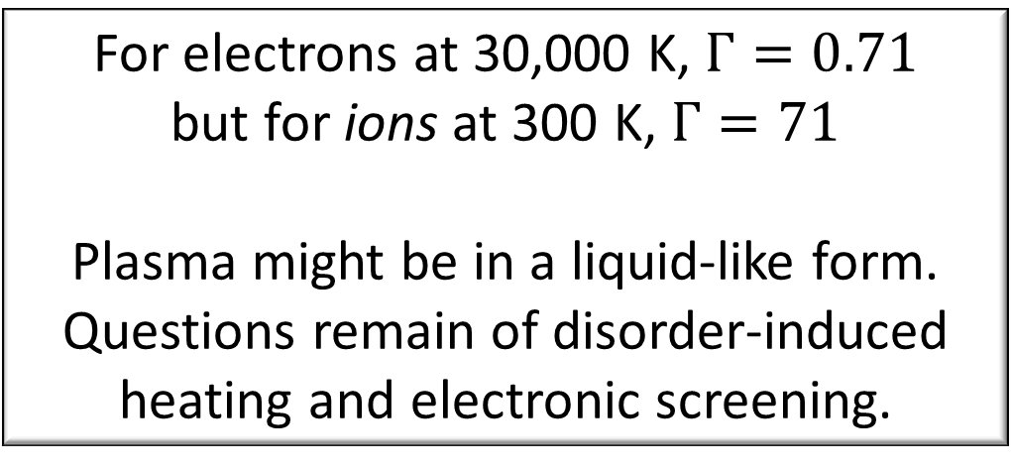
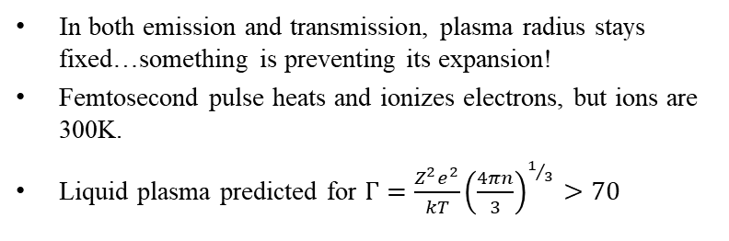
Laser Breakdown:
Plasma Condensation?
In both emission and transmission, plasma radius stays fixed…something is preventing its expansion!
Femtosecond pulse heats and ionizes electrons, but ions are 300K.
Liquid plasma predicted for $Γ=\frac{Z^{2}e^{2}}{kT}{\left(\frac{4πn}{3}\right)}^{1/3}>70$
For electrons at 30,000 K, $Γ=0.71$
but for ions at 300 K, $Γ=71$
Plasma might be in a liquid-like form. Questions remain of disorder-induced heating and electronic screening.
Bataller, A., et al. "Blackbody Emission from Laser Breakdown in High-Pressure Gases." Physical Review Letters 113.7 (2014): 075001.

Slide 24
Conclusions
10 bar
Demonstration of strongly-coupled plasma (Γ=0.55) formation in <1 ps.
Model-independent temperature method from combined emission and transmission
Isochoric conditions created…possibility of two-temperature conditions (T_{e}>>T_{i})
Constant acceleration during initial plasma expansion

Slide 25
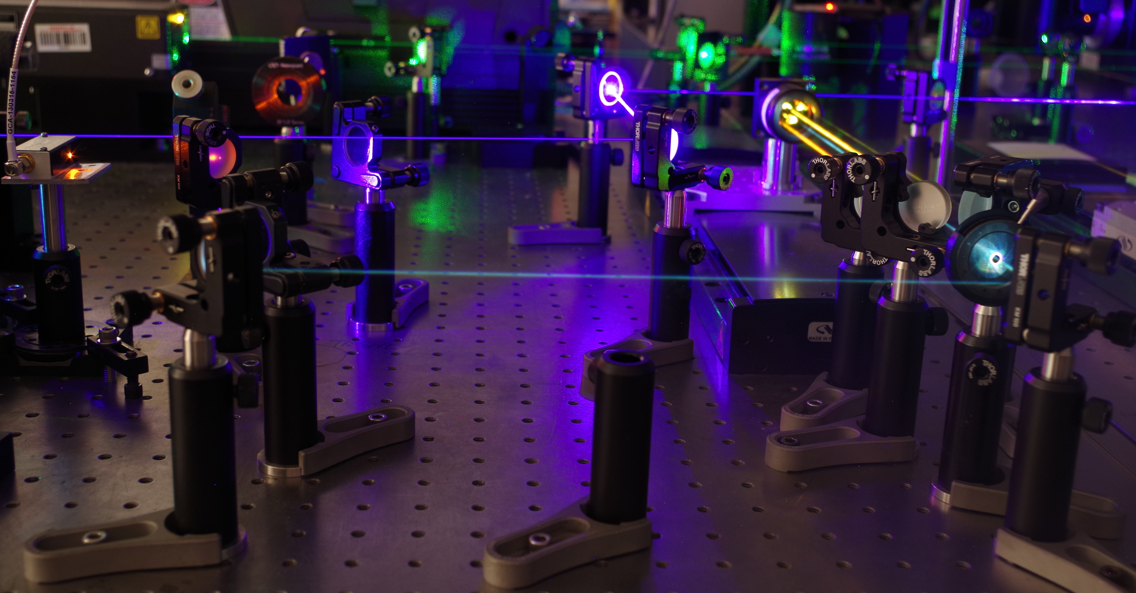
Thank you!
Q&A

