Slide 1
Cost Jet: Liquid chemistry and impact on biological samples
Brayden Myers
North Carolina State University

Slide 2
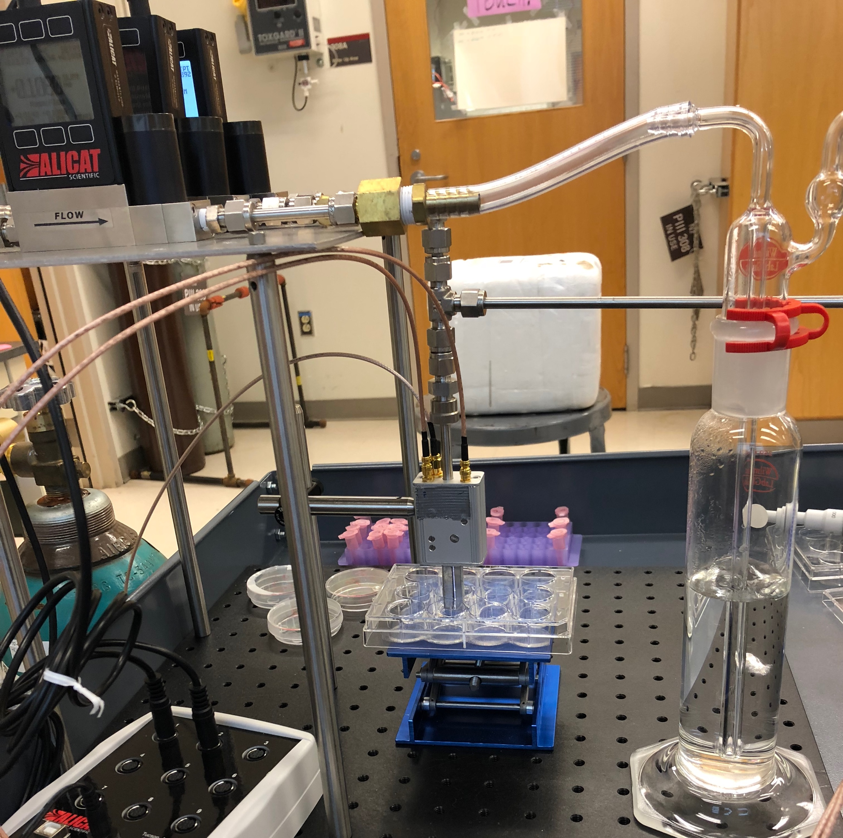
Overview
Introduction
  Importance of reactive species
  COST Reference Source
  Motivation
Experimental setup
  Plasma treatment parameters
Results and Discussion
  HTA fluorescence assay
  Hydrogen peroxide quantification
    Impact on biological samples
  EPR spectroscopy
    DMPO
    TEMP
    TEMPO
Conclusion
COST jet treating solution

Slide 3
Overview
Introduction
  Importance of reactive species
  COST Reference Source
  Motivation
Experimental setup
  Plasma treatment parameters
Results and Discussion
  HTA fluorescence assay
  Hydrogen peroxide quantification
    Impact on biological samples
  EPR spectroscopy
    DMPO
    TEMP
    TEMPO
Conclusion
COST jet treating solution

Slide 4
Reactive species production in atmospheric pressure plasma jets (APPJs)
Applications of atmospheric pressure plasmas are contingent on production of reactive species (ROS and RNS)
Non-equilibrium plasma jets are ideal for a wide range of applications
  High reactive species density
  Low gas temperature (below 40° C)
Focus of our experiments is on three ROS of known importance:
  Atomic oxygen (O)
  Hydroxyl radicals (•OH)
  Hydrogen peroxide (H₂O₂)
Most reactive species originate in the gas phase
  Dissociative collisions between molecules and electrons or metastables
  Second order reactions involving other reactive species
Species produced are highly dependent on gas admixture
e⁻
e⁻
O₂
O
O
Dissociative collision between an oxygen molecule and an electron

Slide 5

COST Reference Microplasma Jet
Designed as a reference source to expedite research into APPJs for use in biomedical applications
  Simple, robust, and reproducible
  Contextualizes results
Capacitively coupled, 13.56 MHz RF discharge in helium or argon w/ small molecular admixtures
  Typically O₂, H₂O, or N₂
  1 mm gap distance (30 mm³ plasma volume)
Integrated matching network along with current and voltage probes for continuous monitoring
External tuning network used in COST-predecessors
COST Reference Microplasma Jet [1]
[1] Golda J et al. Journal of Physics D: Applied Physics. 2016;49(8):84003.

Slide 6
He 0.6% O₂
He-only
He 2500 PPM H₂O
O
O₂⁻
O
●OH
●OH
OH⁻
O₃
¹O₂
He*
HO₂
H₂O₂

Slide 7
Relevant work using the COST jet or COST-predecessor
March 2016: Use of isotopic labeling to determine source of ●OH in plasma treated aqueous solution [2]
April 2017: Oxygen atoms shown to be critical to inactivating leukemia cells [5]
December 2018: We perform comparison study between COST jet and nspDBD at Drexel’s College of Medicine [6]
January 2016: COST jet introduced [1]
September 2016: Atomic oxygen suggested to hydroxylate phenol [3] – Later proven using isotopic labeling [4]
January 2019: EPR measurements of spin-trap TEMP to show O is reacting with chloride anions [7]
[1] Golda J et al. Journal of Physics D: Applied Physics. 2016;49(8):84003.
[2] Gorbanev Y et al. Chemistry – A European Journal. 2016;22(10):3496-3505.
[3] Hefny M et al. Journal of Physics D: Applied Physics. 2016;49(40):404002.
[4] Benedikt J et al. Physical chemistry chemical physics: PCCP. 2018;20(17):12037-12042.
[5] Bekeschus S et al. Scientific reports. 2017;7(1):2791-12.
[6] Ranieri P et al. Applied Sciences. 2020;10(6):2025.
[7] Gorbanev Y et al. Phys Chem Chem Phys. 2019;21(8):4117-4121.

Slide 8
Motivation
Experiments showed similar cellular response from different plasma sources
  COST jet with He/O₂ admixture → atomic oxygen driven chemistry
  nspDBD → ●OH driven chemistry
Two possibilities:
1) One reactive species is responsible and produced in similar amounts in both plasma systems
2) The sum effect of two different cocktails of reactive species happens to be similar
To answer: differentiate between effects of ●OH and O driven aqueous chemistry
MitoSOX (top), cell viability (bottom), and CRT expression (right), exhibit similar responses to COST jet and nspDBD treatment [1]
[1] Ranieri P et al. Applied Sciences. 2020;10(6):2025.

Slide 9
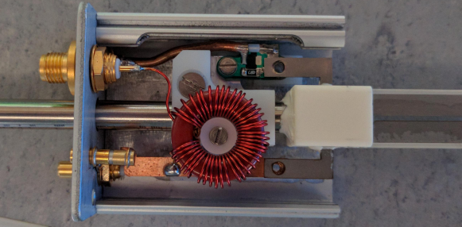
Overview
Introduction
  Importance of reactive species
  COST Reference Source
  Motivation
Experimental setup
  Plasma treatment parameters
Results and Discussion
  HTA fluorescence assay
  Hydrogen peroxide quantification
    Impact on biological samples
  EPR spectroscopy
    DMPO
    TEMP
    TEMPO
Conclusion

Slide 10
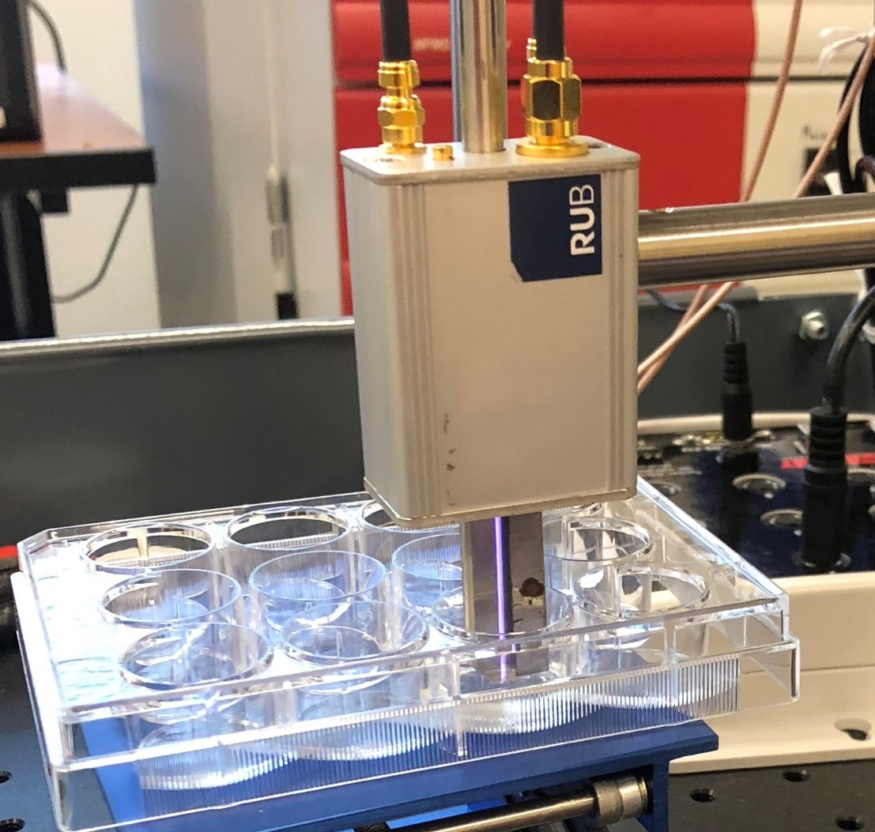
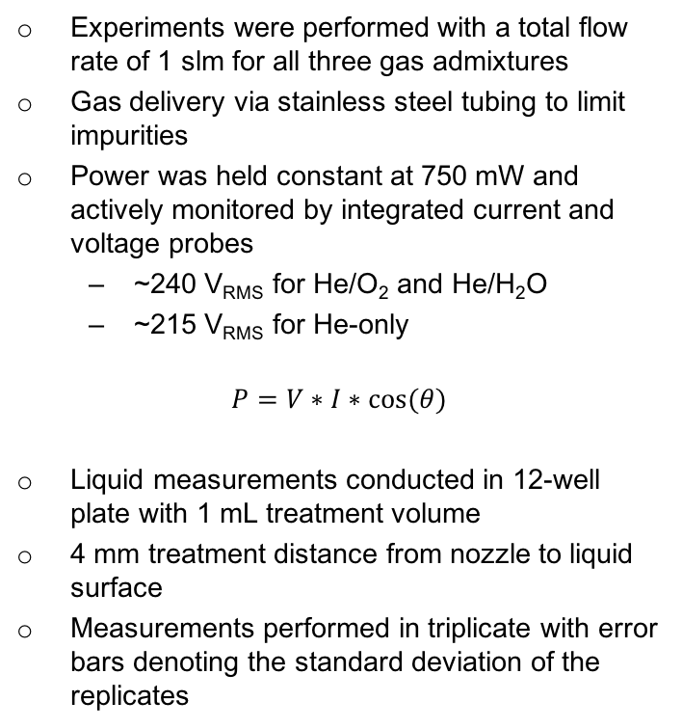
COST Jet setup
Experiments were performed with a total flow rate of 1 slm for all three gas admixtures
Gas delivery via stainless steel tubing to limit impurities
Power was held constant at 750 mW and actively monitored by integrated current and voltage probes
  ~240 V_{RMS} for He/O₂ and He/H₂O
  ~215 V_{RMS} for He-only
$$P=V∗I∗cos⁡(θ)$$
Liquid measurements conducted in 12-well plate with 1 mL treatment volume
4 mm treatment distance from nozzle to liquid surface
Measurements performed in triplicate with error bars denoting the standard deviation of the replicates
COST jet treating 1 mL of solution in a 12‑well plate.

Slide 11
Overview
Introduction
  Importance of reactive species
  COST Reference Source
  Motivation
Experimental setup
  Plasma treatment parameters
Results and Discussion
  HTA fluorescence assay
  Hydrogen peroxide quantification
    Impact on biological samples
  EPR spectroscopy
    DMPO
    TEMP
    TEMPO
Conclusion
●OH
●OH
●OH
●OH
●OH
●OH
●OH
●OH
●OH

Slide 12
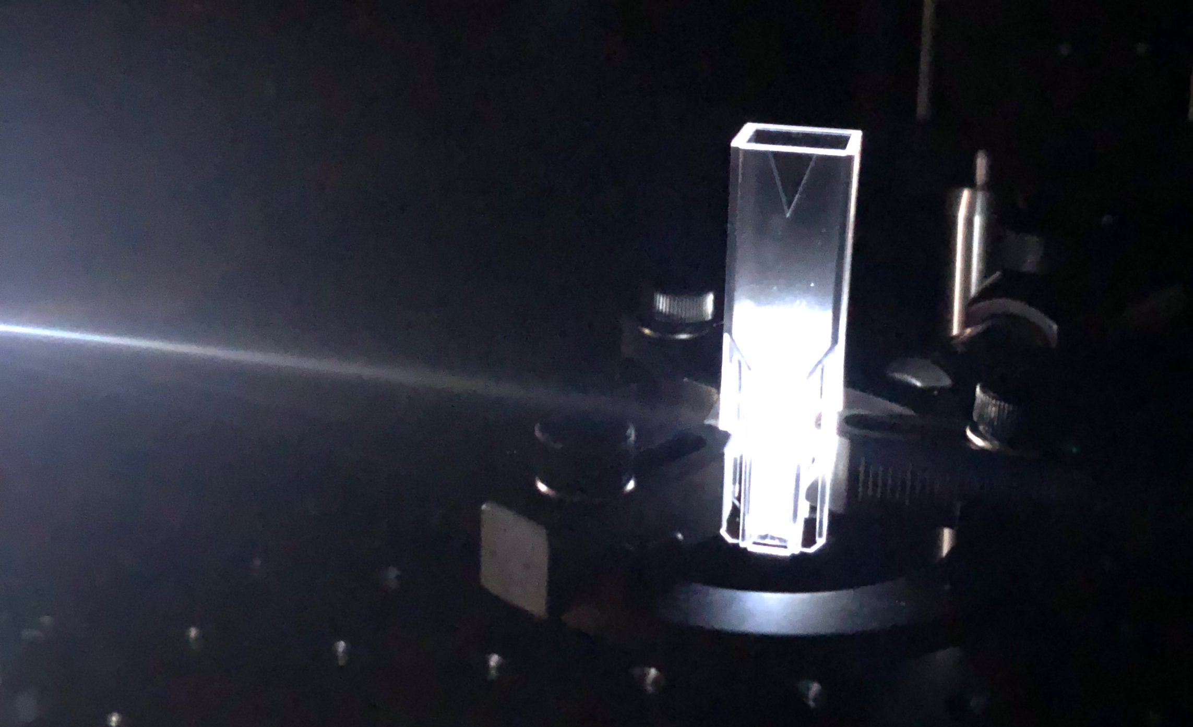
Background
HTA Fluorescence assay (terephthalate dosimetry) is widely used to detect OH radicals in many fields including plasma science
Selective in the presence of O₂⁻, HO₂, ¹O₂(Δ), and H₂O₂ [1], making it preferable to other probes
For our experiments:
50 mM TA with 100 mM NaOH (needed to dissolve TA in solution)
Fluorescence measured 90 degrees off axis with QEPro spectrometer, 310 nm light supplied by an LDLS (laser-driven light source)
Concentrations were derived using a standard curve of HTA stock solution
[1] Šnyrychová I, Hideg É. Functional Plant Biol. 2007;34(12):1105-1111.

Slide 13
HTA production
Unexpectedly, highest production rate in He/O₂ where •OH delivery from gas phase should be smallest
More production in He-only than suggested by gas phase •OH measurements using COST-predecessor [1]
Production rate decreases considerably, especially in He/O₂ plasma-treated solution
  150 µM of HTA produced in first minute
  Only 50 µM by the fifth minute
  Slowing trend is less notable for other admixtures
Concentration of HTA produced by plasma treatment of 50 mM TA.
[1] Benedikt J et al. Plasma Sources Sci Technol. 2016;25(4):045013.

Slide 14
Possible explanations
For anomalous HTA production:
1) Despite its supposed selectivity, another radical species is responsible, potentially O
  Phenol has similar structure to TA and was hydroxylated by atomic O [1, 2]
2) ●OH is produced in second order reactions in liquid
To test: peroxide measurements in plasma-treated liquid
For slowing rate of production:
1) Plasma-generated ●OH is increasingly interacting with long-lived species aggregating during treatment
2) Degradation of HTA
To test: degradation experiment with stock solution of HTA
[1] Hefny M et al. Journal of Physics D: Applied Physics. 2016;49(40):404002.
[2] Benedikt J et al. Physical chemistry chemical physics: PCCP. 2018;20(17):12037-12042.

Slide 15
HTA degradation
100 µM stock solution of HTA treated with plasma
Considerable degradation evident with most effective gas admixtures for production being the most effective for degradation
Most “degradation” is likely further hydroxylation but atomic oxygen is also known for ring cleavage reactions
Cannot take production data verbatim
Ample atomic oxygen available to hydroxylate TA
HTA degradation after plasma treatment with an initial concentration of 100 μM.

Slide 16
Overview
Introduction
  Importance of reactive species
  COST Reference Source
  Motivation
Experimental setup
  Plasma treatment parameters
Results and Discussion
  HTA fluorescence assay
  Hydrogen peroxide quantification
    Impact on biological samples
  EPR spectroscopy
    DMPO
    TEMP
    TEMPO
Conclusion
Anomalous HTA production for He/O₂ admixture
  Selectivity
  ●OH production in liquid
Considerable degradation of HTA

Slide 17
Overview
Introduction
  Importance of reactive species
  COST Reference Source
  Motivation
Experimental setup
  Plasma treatment parameters
Results and Discussion
  HTA fluorescence assay
  Hydrogen peroxide quantification
    Impact on biological samples
  EPR spectroscopy
    DMPO
    TEMP
    TEMPO
Conclusion
●OH
●OH
●OH
●OH
H₂O₂
H₂O₂
H₂O₂
H₂O₂
Determine whether ●OH or O is hydroxylating TA

Slide 18
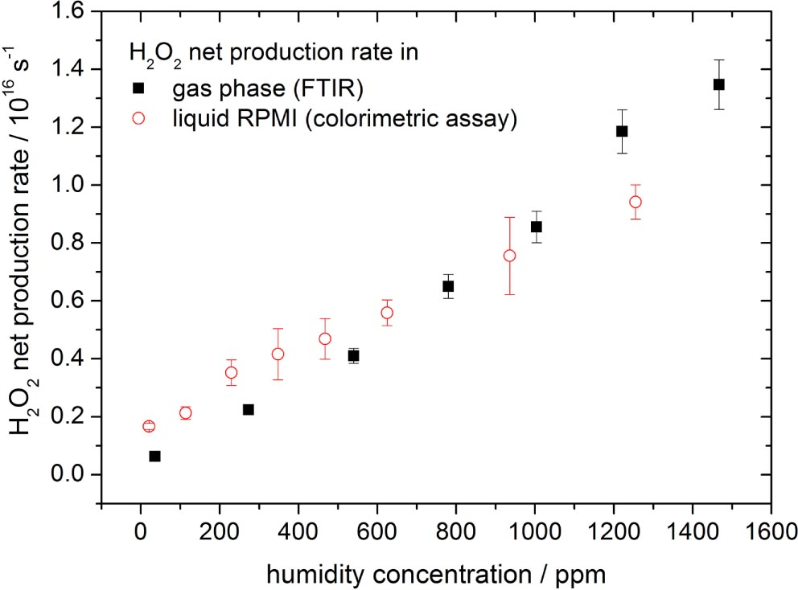
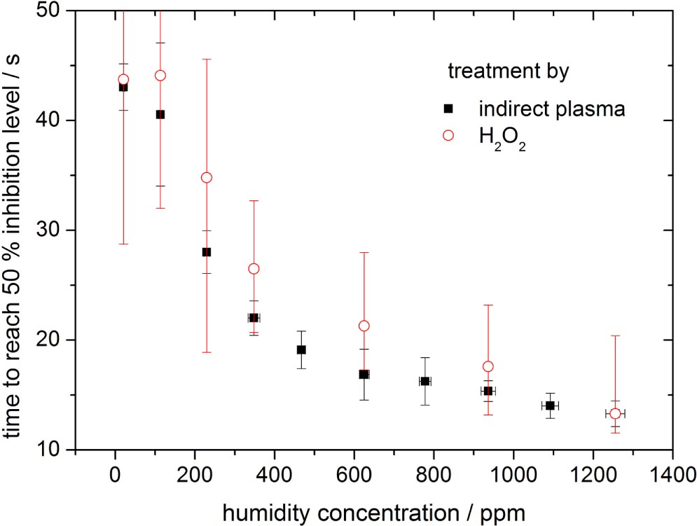
Background
Peroxide is one of the most important long-lived species for applications of plasma
In some cases nearly the entire effect of plasma treatment can be ascribed to peroxide
Primary source is often recombination of ●OH in gas phase or liquid
Two questions we hope to answer using peroxide measurements:
1) Is there gas phase ●OH production not captured in OES spectra of active plasma for any of the gas admixtures?
2) Is there second order ●OH produced in the liquid during He/O₂ plasma treatment?
Measurements are performed using a colorimetric assay, concentrations derived using a standard curve of pre-made H₂O₂
H₂O₂ concentration with increasing humidity in kINPen (top) corresponding effect on skin cells (bottom) [1]
[1] Winter J et al. J Phys D: Appl Phys. 2014;47(28):285401.

Slide 19
Peroxide formation in DI water
Corresponds well to OES data and gas phase measurements on COST-predecessor [1]
  H₂O₂ in He/H₂O plasma-treated sample is ~30 times higher than He-only and ~50 times higher than He/O₂
Confirms there is no unexpected ●OH production in gas phase that would explain HTA production with He/O₂ or He-only
x50
x30
[1] Benedikt J et al. Plasma Sources Sci Technol. 2016;25(4):045013.

Slide 20
Isolating origins of peroxide using DMPO
H₂O₂ is produced primarily in gas phase
H₂O₂ is produced primarily in aqueous phase
H₂O₂
H₂O₂
H₂O₂
H₂O₂
●OH
●OH
●OH
●OH
H₂O₂
H₂O₂
H₂O₂
H₂O₂
●OH
●OH
●OH
●OH
H₂O₂
H₂O₂
H₂O₂
H₂O₂
H₂O₂
H₂O₂
●OH
H₂O₂
●OH
DMPO-OH
H₂O₂
DMPO
DMPO-OH
H₂O₂
H₂O₂
DMPO
DMPO
●OH
H₂O₂
●OH
H₂O₂
H₂O₂
DMPO-OH
H₂O₂
DI water
50 mM DMPO
DI water
50 mM DMPO
No difference in peroxide measured
50% reduction in peroxide measured due to ●OH scavenging by DMPO

Slide 21
During He/H₂O plasma-treatment
Peroxide concentrations remains nearly constant across all solutions
Because ●OH recombination occurs at roughly the same rate as ●OH trapping by DMPO, peroxide must be produced almost exclusively in gas phase
  ●OH + ●OH → H₂O₂
  (k = 5 x 10⁹ M⁻¹s⁻¹ [1])
  DMPO + ●OH → DMPO-OH (k = 4.3 x 10⁹ M⁻¹s⁻¹ [2])
Peroxide inhibition in DMPO gives an estimate of amount of ●OH entering liquid
  50 µM less peroxide in DMPO after 5 minutes compared to DI, suggests ~100 µM of ●OH entering liquid
  Supported by 92 µM of HTA produced after 5 mins in He/H₂O plasma-treated TA
Peroxide measured in He/H₂O plasma-treated solution, <3% error for all measurement points
[1] Buxton G et al. Journal of Physical and Chemical Reference Data. 1988;17(2):513-886.
[2] NDRL/NIST solution kinetics database.

Slide 22
During He/O₂ plasma-treatment
Peroxide generation in He/O₂ plasma-treated solution varies considerably depending on solution, suggests production in liquid
Observed in phenol [1], potentially due to H abstraction
  Abstracted hydrogen atom interacts with solvated molecular oxygen: H + O₂ → HO₂
  Subsequently: HO₂ + HO₂ → H₂O₂ + O₂
  Alternatively: HO₂ + H → H₂O₂ (k = 10¹⁰ M⁻¹s⁻¹ [2])
whether ●OH or HO₂ is main precursor remains unclear
  Direct H abstraction by atomic O to produce ●OH has been documented in gas phase
DMPO traps both OH and H – inhibition compared to TA expected
Necessitates further experiments to determine whether ●OH or O is hydroxylating TA
Peroxide generation in He/O₂ plasma-treated liquid
[1] Hefny M et al. Journal of Physics D: Applied Physics. 2016;49(40):404002.
[2] NDRL/NIST solution kinetics database.

Slide 23
Importance for applications
Peroxide formation (amount and location) can be controlled by changing two variables
  Gas admixture
  Solution composition
Can control peroxide delivery while retaining desired short-lived ROS
  Concentration dependent for TA
Plasma-driven biocatalysis [1] vs. plasma oncology [2]
He/O₂ Plasma-treated solution
[1] Yayci A et al. ChemSusChem. 2020;13(8):2072-2079.
[2] Bekeschus S et al. Scientific reports. 2017;7(1):2791-12.

Slide 24
Effects on biological samples
Mock treatments are often used in an attempt to isolate effects of short-lived species produced during plasma treatment
  Concentrations of a long-lived species (i.e. peroxide) are measured and then added artificially from a stock solution
Varying production of H₂O₂ in He/O₂ plasma-treated solution is problematic, necessitates measuring in solution
He/O₂ based mock treatment of Jurkat cells
x1.05
x12
Untreated
H₂O₂ in DI
Untreated
H₂O₂ in DI
H₂O₂ in RPMI
H₂O₂ in RPMI
[1] Ranieri P et al. Applied Sciences. 2020;10(6):2025.

Slide 25
Overview
Introduction
  Importance of reactive species
  COST Reference Source
  Motivation
Experimental setup
  Plasma treatment parameters
Results and Discussion
  HTA fluorescence assay
  Hydrogen peroxide quantification
    Impact on biological samples
  EPR spectroscopy
    DMPO
    TEMP
    TEMPO
Conclusion
●OH from gas phase is not hydroxylating TA
  Measurements in TA and DMPO inconclusive
  Necessitates more experiments
Peroxide origin varies based on gas admixture
  Important implications for applications
Peroxide production varies substantially in He/O₂ plasma-treated solution

Slide 26
Overview
Introduction
  Importance of reactive species
  COST Reference Source
  Motivation
Experimental setup
  Plasma treatment parameters
Results and Discussion
  HTA fluorescence assay
  Hydrogen peroxide quantification
    Impact on biological samples
  EPR spectroscopy
    DMPO
    TEMP
    TEMPO
Conclusion
Use EPR spectroscopy to measure ●OH formed in liquid
  Answer selectivity question
  Inform peroxide formation mechanisms

Slide 27
Background
Electron paramagnetic resonance (EPR) spectroscopy relies on spin traps to detect short-lived radical species
  Relatively stable spin adducts are formed when radicals are “trapped”
  Adducts possess an unpaired electron which is measured by the EPR
First derivative of the absorption signal is recorded
  Double integral of the signal is analogous to concentration
Spectrum shape is unique to each adduct
Often used for detecting radicals relevant for biological applications
For our experiments:
ELEXSYS E500 X-Band EPR spectrometer (9.4 GHz)
Spectra simulated using PEST WinSIM 2002 available from NIEHS, hyperfine constants also from NIEHS
  Calibrated using TEMPO

Slide 28
DMPO to measure ●OH in liquid
DMPO can trap a number of short-lived radicals including ●OH, O₂⁻, and H atoms
  Each radical produces it’s own respective adduct, discernable in EPR spectra
  Selectivity can still be an issue due to the quick decay of DMPO-OOH to DMPO-OH
  DMPO-OH is inherently unstable
By trapping OH radicals in plasma-treated liquid, DMPO should be able to answer whether second order ●OH is responsible for anomalous HTA production in He/O₂ and He-only cases
Experiments were performed using an initial concentration of 50 mM DMPO
  Adduct concentration derived using a stock solution of the stable adduct TEMPO
  Time between plasma treatment and measurement was ~3 minutes
The spin-trap DMPO and its reaction pathways with •H, •OH, and O₂⁻. DMPO‑OH can be produced by •OH or decay of DMPO‑OOH.

Slide 29
DMPO-OH production
DMPO-OH concentration reflects OES measurements and H₂O₂ production in DI water, no DMPO-OH produced in He/O₂ case
So atomic O must be hydroxylating TA, right?
  Spectra give reason to be cautious
In He/H₂O plasma-treated solution:
Compare DMPO-OH production after 1 minute to ●OH suggested by peroxide in DMPO
  13 µM of DMPO-OH after 1 minute
  20 µM per minute of ●OH implied by difference of peroxide concentration between DI water and DMPO
In He-only case:
Spectra shows evidence of DMPO-H, consistent with atomic O abstracting H and peroxide measurements which showed more H₂O₂ in TA than DI water
DMPO-OH production after plasma treatment of 50 mM DMPO.

Slide 30
Plasma-treated DMPO spectra
He/H₂O
He/H₂O plasma treatment results in distinct DMPO-OH peaks
He-only plasma treatment shows evidence of DMPO-OH and DMPO-H
He/O₂ plasma treatment results in a messy spectra with many low amplitude features
  Degradation of adduct may be occurring
  O₂⁻ can produce and degrade DMPO-OH
  Ring cleavage reactions with atomic O
He-only
He/O₂

Slide 31
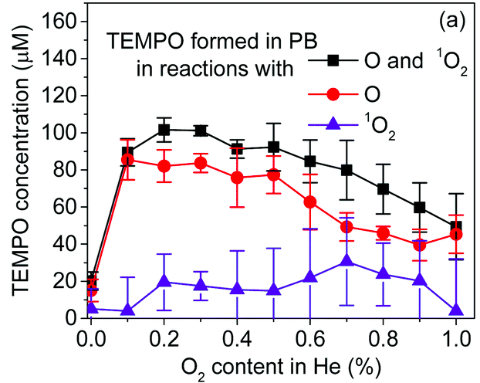
TEMP to measure ●O_{(aq)}
Spin trap TEMP has been shown to trap plasma-generated atomic O in liquid [1, 2]
  Produces stable adduct TEMPO, which is already used for deriving concentration
  Can trap other ROS including O₃ and ¹O₂(Δ), but we can limit contribution to TEMPO signal using previous experiments
By using TEMP to trap ●O, we can determine whether atomic O is present in a large enough quantity in liquid to explain HTA production in the case of He/O₂ plasma treatment
Experiments were performed using an initial concentration of 50 mM TEMP
  Adduct concentration derived using a stock solution of the stable adduct TEMPO
  Time between plasma treatment and measurement was ~3 minutes
[1] Elg D et al. J Phys D: Appl Phys. 2017;50(47):475201.
[2] Gorbanev Y et al. Phys Chem Chem Phys. 2019;21(8):4117-4121.
TEMPO production in PB after 1 min of treatment with COST jet [2]

Slide 32
TEMPO production
TEMPO formation trend closely reflects that of HTA
  Strongly suggests atomic O is at fault for unexpected HTA production
  Trends match closely for He-only and He/H₂O
Flattening (and even reversal) of curve
  Degradation of adduct seems plausible
TEMPO formation after plasma treatment of a 50 mM TEMP solution.
Concentration of HTA produced by plasma treatment of 50 mM TA.

Slide 33
TEMPO production by He/H₂O plasma
Surprising considering emission spectra shows almost no O in He/H₂O plasma
  ●OH recombination in effluent produces either peroxide or atomic O (at a 6:1 ratio according to reaction rates):
  ●OH + ●OH + M → H₂O₂ + M (k = 9.1 x 10⁻¹² cm⁻³ at 298 K [1])
  ●OH + ●OH → H₂O + O (k = 1.5 x 10⁻¹² cm⁻³ at 298 K [1])
  After 1 minute of plasma treatment a 7:1 ratio of H₂O₂:TEMPO is measured
Important note: atomic O is present for all three solutions
  Introduces considerable uncertainties in any measurements using the HTA fluorescence assay
●OH
●OH
●OH
●OH
M
[1] IUPAC task group on atmospheric chemical kinetic data evaluation.
M
H₂O₂
O
H₂O

Slide 34
Potential TEMPO degradation
Not all interactions result in the loss of EPR signal

Slide 35
TEMPO degradation
TEMPO is degraded in a very similar manner to HTA, despite its stability
  Supports previous assertion DMPO-OH was degraded by He/O₂ plasma treatment
  Further evidence atomic O is responsible for both production and degradation of HTA
OH radicals and H atoms can also degrade; difficult to isolate effects without reaction rates for O
Reiterates problem of using chemical probes to measure short-lived reactive species during plasma treatment – especially in the presence of atomic O !
TEMPO degradation after an initial conc. of 1 mM.
HTA degradation after plasma treatment with an initial concentration of 100 μM.

Slide 36
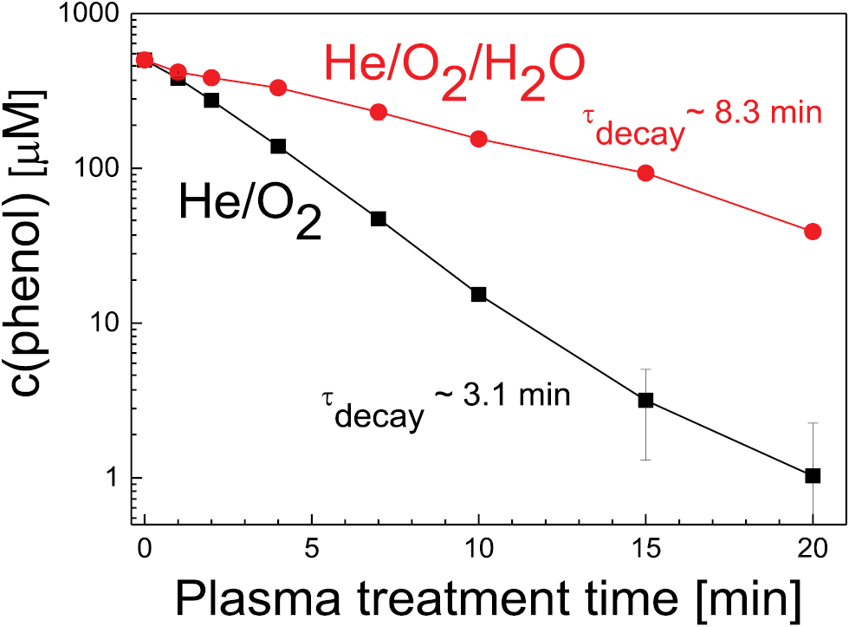
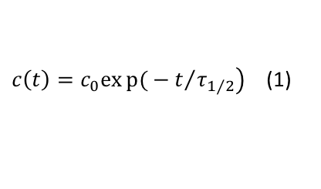
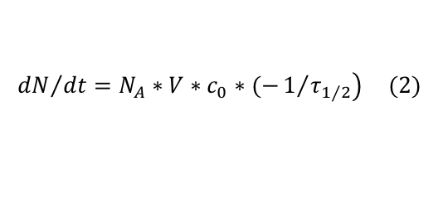
Degradation to quantify solvated ROS
By using exponential decay of HTA and TEMPO (eq. 1), can solve for initial degradation rate at time t = 0 (eq. 2) [1]
Measuring degradation may capture a larger fraction of reactive species
  Number of pathways that lead to degradation > number that lead to production
Dependent on initial concentration [2]
For He/H₂O and He-only, degradation is likely a result of both ●OH and O
$c\left(t\right)=c_{0}exp{(}−t/{\left.τ_{1/2}\right)}$(1)
$${dN}/{dt}=N_{A}∗V∗c_{0}∗(−1/{\left.τ_{1/2}\right)} (2)$$
Phenol degradation after treatment with COST predecessor [1]
Gas admixture | HTA Deg. (τ_{1/2}) | dN/dt (s⁻¹) | TEMPO Deg. (τ_{1/2}) | dN/dt (s⁻¹) | ROS flux (s⁻¹)
Helium/oxygen | 1.2 mins | -8.4 x 10¹⁴ | 1.1 mins | -9.1 x 10¹⁵ | 2 x 10¹⁶ (O) [3]
Helium/water | 2.2 mins | -4.6 x 10¹⁴ | 7.4 mins | -1.4 x 10¹⁵ | 1 x 10¹⁵ (OH) [4] *
Helium-only | 4.3 mins | -2.3 x 10¹⁴ | 10.3 mins | -9.7 x 10¹⁴ | 1.5 x 10¹⁴ (OH) [4] *
* - gas phase measurements performed at a lower voltage, estimated ROS flux extrapolated from densities
[1] Hefny M et al. Journal of Physics D: Applied Physics. 2016;49(40):404002.
[2] Gorbanev Y et al. Plasma Sources Sci Technol. 2016;25(5):055017.
[3] Ellerweg D et al. New J Phys. 2010;12(1):013021.
[4] Benedikt J et al. Plasma Sources Sci Technol. 2016;25(4):045013.

Slide 37
Overview
Introduction
  Importance of reactive species
  COST Reference Source
  Motivation
Experimental setup
  Plasma treatment parameters
Results and Discussion
  HTA fluorescence assay
  Hydrogen peroxide quantification
    Impact on biological samples
  EPR spectroscopy
    DMPO
    TEMP
    TEMPO
Conclusion
Atomic oxygen is hydroxylating TA
Efficiently degrades DMPO-OH and TEMPO
Degradation may be more effective for estimating solvated ROS

Slide 38
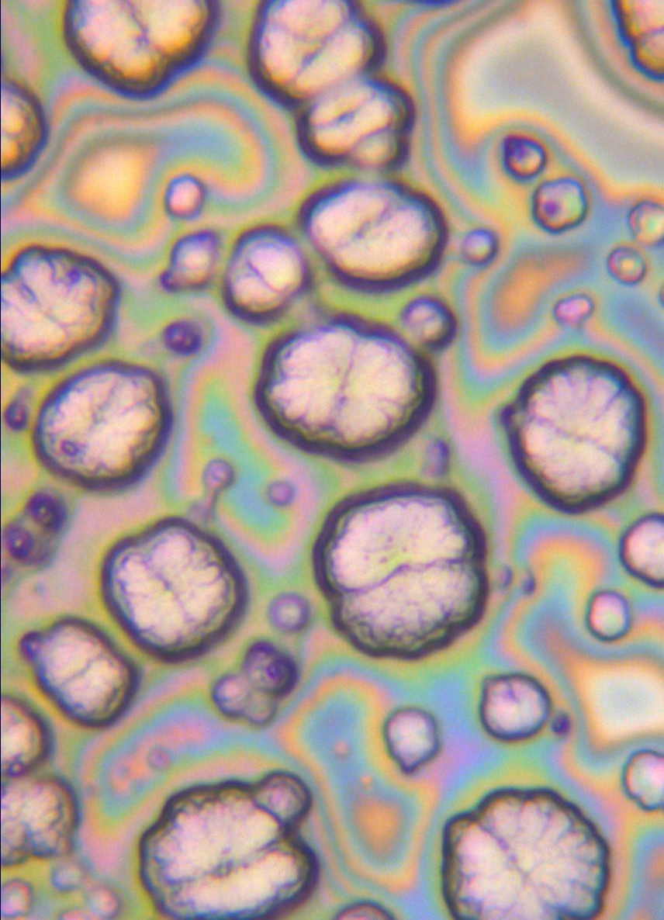
Overview
Introduction
  Importance of reactive species
  COST Reference Source
  Motivation
Experimental setup
  Plasma treatment parameters
Results and Discussion
  HTA fluorescence assay
  Hydrogen peroxide quantification
    Impact on biological samples
  EPR spectroscopy
    DMPO
    TEMP
    TEMPO
Conclusion
He/O₂ plasma-treated TA magnified x50

Slide 39
Conclusions
Abundance of atomic oxygen in plasma-treated liquid but poorly understood interactions w/ very few known reaction rates
  Suggests potential importance of atomic O for applications
  Difficult to isolate its effects
Chemical probes are subject to degradation during plasma treatment, especially in the presence of atomic oxygen – proceed with caution
  No perfect technique for measuring atomic O or other ROS in presence of O
  Degradation might be a better quantitative estimate of solvated ROS
Location of peroxide production can be tailored based on gas admixture and treated solution
Non-selectivity of 2-hydroxyterephthalic acid fluorescence assay (terephthalate dosimetry)
  Atomic O hydroxylates TA indistinguishably from ●OH
  O was present in all three gas admixtures we used
*Manuscript has been submitted to Phys. Chem. Chem. Phys.
He/O₂
●O
●O
●O
O₂⁻
●O
●O
●O
O₃
¹O₂
●O
●O

Slide 40
Acknowledgements
NC State Plasma for Life Sciences: Dr. Katharina Stapelmann, Dr. Pietro Ranieri, and Duncan Trosan
NC State METRIC: Patrick Hewitt and Dr. David Shultz
Drexel College of Medicine: Hager Mohamed, Leah Dobossy, Keely Beyries, Dr. Fred Krebs, and Dr. Vandana Miller

Slide 41
References
1. Golda J et al. Journal of Physics D: Applied Physics. 2016;49(8):84003. doi: 10.1088/0022-3727/49/8/084003.
2. Niemi K et al. Plasma Sources Sci Technol. 2011;20(5):055005. doi: 10.1088/0963-0252/20/5/055005.
3. Šnyrychová I, Hideg É. Functional Plant Biol. 2007;34(12):1105-1111. doi: 10.1071/FP07150.
4. Benedikt J et al. Plasma Sources Sci Technol. 2016;25(4):045013. doi: 10.1088/0963-0252/25/4/045013.
5. Hefny M et al. Journal of Physics D: Applied Physics. 2016;49(40):404002. doi: 10.1088/0022-3727/49/40/404002.
6. Benedikt J et al. Physical chemistry chemical physics: PCCP. 2018;20(17):12037-12042. doi: 10.1039/C8CP00197A.
7. NDRL/NIST solution kinetics database. https://kinetics.nist.gov/solution/
8. Buxton G et al. Journal of Physical and Chemical Reference Data. 1988;17(2):513-886. doi: 10.1063/1.555805.
9. Winter J et al. J Phys D: Appl Phys. 2014;47(28):285401. doi: 10.1088/0022-3727/47/28/285401.
10. Elg D et al. J Phys D: Appl Phys. 2017;50(47):475201. doi: 10.1088/1361-6463/aa8f8c.
11. Gorbanev Y et al. Phys Chem Chem Phys. 2019;21(8):4117-4121. doi: 10.1039/C8CP07550F.
12. IUPAC task group on atmospheric chemical kinetic data evaluation. http://iupac.pole-ether.fr/#.
13. Gorbanev Y et al. Plasma Sources Sci Technol. 2016;25(5):055017. doi: 10.1088/0963-0252/25/5/055017
14. Ellerweg D et al. New J Phys. 2010;12(1):013021. doi: 10.1088/1367-2630/12/1/013021.
15. Bekeschus S et al. Scientific reports. 2017;7(1):2791-12. doi: 10.1038/s41598-017-03131-y.
16. Ranieri P et al. Applied Sciences. 2020;10(6):2025. doi: 10.3390/app10062025.
17. Benedikt J et al. Physical chemistry chemical physics: PCCP. 2018;20(17):12037-12042. doi: 10.1039/C8CP00197A.
18. Gorbanev Y et al. Chemistry – A European Journal. 2016;22(10):3496-3505. doi: 10.1002/chem.201503771.
19. Yayci A et al. ChemSusChem. 2020;13(8):2072-2079. doi: 10.1002/cssc.201903438.

