Slide 1
Plasma facing surface materials and their affects on LP pulsed plasma characteristics
Joel Brandon, Dr. Steve Shannon

Slide 2
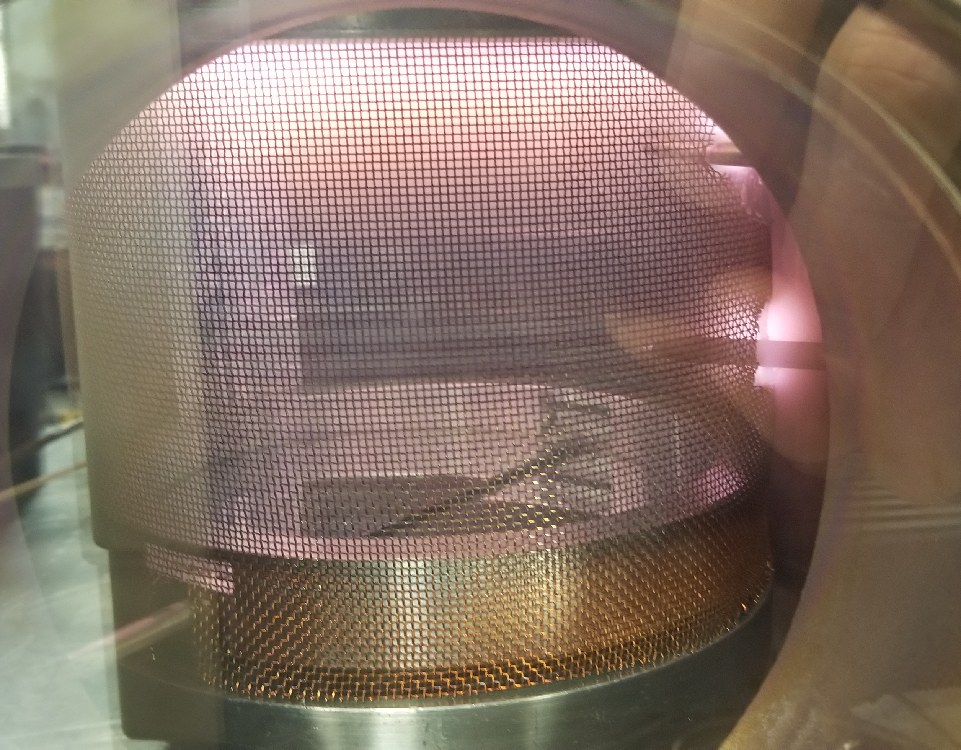
Summary
Summary
Background on topic
Electron sources
Secondary emission
$α+γ modes$
Dissociative recombination
Hypothesis
HPEM Modeling results
Changes in [O] density
Chamber Setup
Experimental work
Future work
Measurables
Modifications

Slide 3
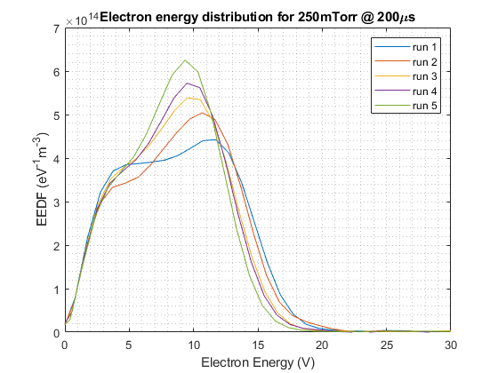
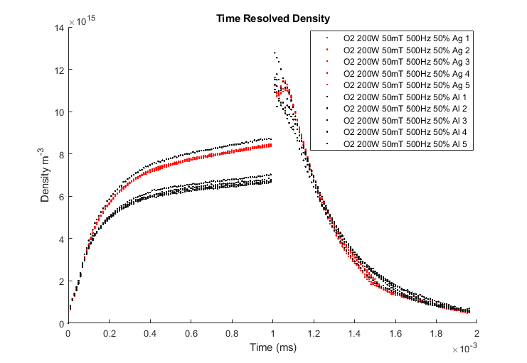
Summary

Slide 4
Electron Sources
Secondary surface electrons
Photoelectric
Photons
Potential Ejection
Ions
Metastables
Kinetic Ejection
Fast Ions
Fast neutrals
Ionizing collisions
Electron – neutral
Charge exchange
Penning Ionization
Associative detachment
Dominant
Assumed
negligible

Slide 5
Potential Ejection - Auger Emission
Auger Neutralization
Auger De-excitation
2 possible pathways
“Theory of Auger ejection of electrons by metals” - Hagstrum 1954

Slide 6
$$E→γ→H Mode$$
OES of 844 O line emission in 300 mTorr $O_{2}$ plasma
$γ$-like mode separates E and H mode
E-H transition supported by secondary electron emission
2) Zaka-ul-Islam

Slide 7
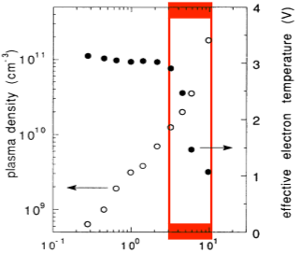
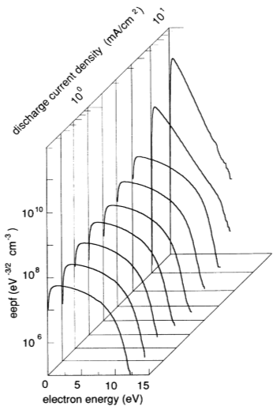
$$α→γ in CCP$$
LP measurements in CCP show change in EEDF through transition
Expect to see this change in $Ar$ and $O_{2}$
5) Godyak 1992

Slide 8
Modeling Efforts – $O_{2}$ recombination
$O+O+M→O_{2} \left(γ_{O}\right)$
As $γ_{O}$ increases [O] decreases and [$O_{2}$] increases
$O^{−}+O→O_{2}+e^{−}$
As the O atoms available for dissociative recombination decrease, $O^{−}$ would increase, $e^{−}$ would decrease due to this equation
$$γ_{O}=0.015$$
$$γ_{O}=0.001$$
3) Shibata et al

Slide 9
Hypothesis
Through material considerations in source design we can create a new knob for transient control and power efficiency of pulsed plasmas by manipulating electron sources.

Slide 10
$O_{2}$ Modeling

Slide 11
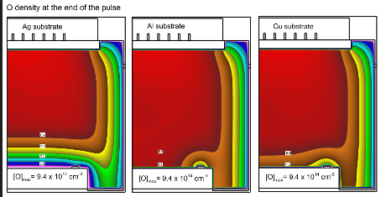
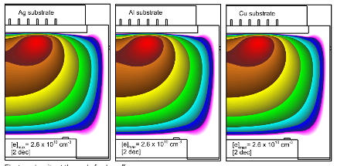
Modeling - $O_{2}$ continued HPEM
Unrecognizable difference in electron density
Noticeable differences in [O] density at electrode

Slide 12
Chamber Setup

Slide 13
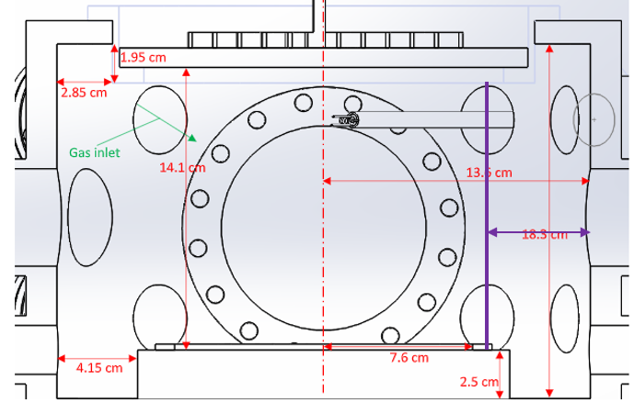
Chamber setup

Slide 14
Review of experimental work

Slide 15
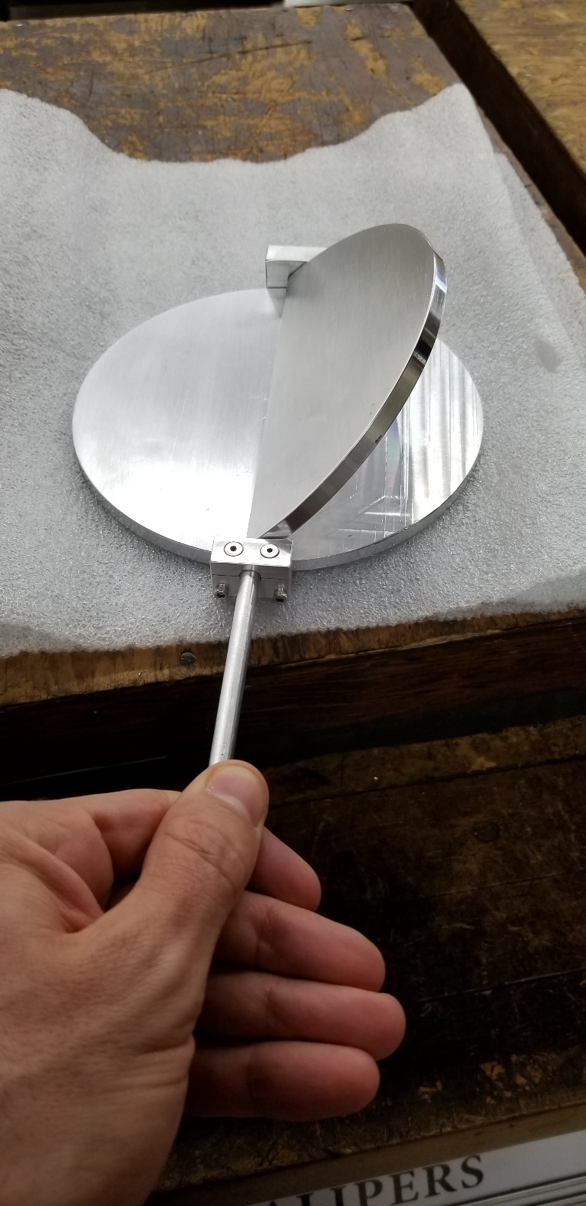
Exp Design
Feedthrough on vacuum chamber allows rotation, effectively changing surface material of grounded cathode in active plasma
No venting of chamber
6” diameter
One whole face covered in copper tape while one side remains aluminum

Slide 16
Pulsing data for O2 on Cu and Al surfaces
SS density has changed
Visible difference in rate of rise at the point of E-H transition
Upon just flipping from Al to Cu, pressure reading changed by 3-4mTorr
Possibly gas heating, dissociation, or ionization
Process was done with constant match settings
Readings on surfaces were alternated; Al, Cu, Al, Cu, Al, Cu
Data taken with LP
500Hz, 200W, 190 mTorr

Slide 17
Smith Chart from surface to surface
Z=48.699 Z=51.026
4m

Slide 18
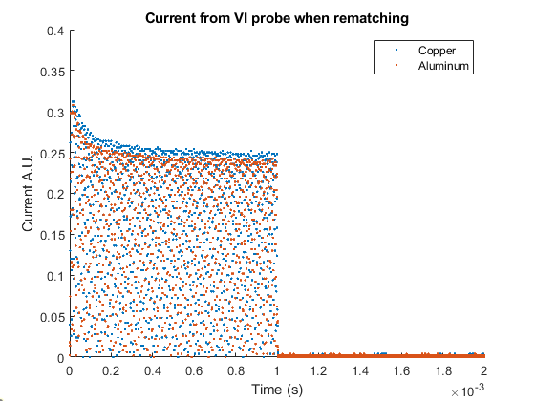
E-H Transition
Current from VI probe plugged into O-Scope
Current decreases faster for aluminum, showing swifter transition from E-H mode
Al surfaced plasma has more $O^{−}+O$collisions resulting in higher plasma conductivity
It was hypothesized that this would exist as a result of changing the secondary electron emission coefficient by changing surface material
Still undetermined if this is an effect of recombination or surface electron emission
Differences in re-matching vs constant match were minimal and showed same trend
E-H transition
Al Cu

Slide 19
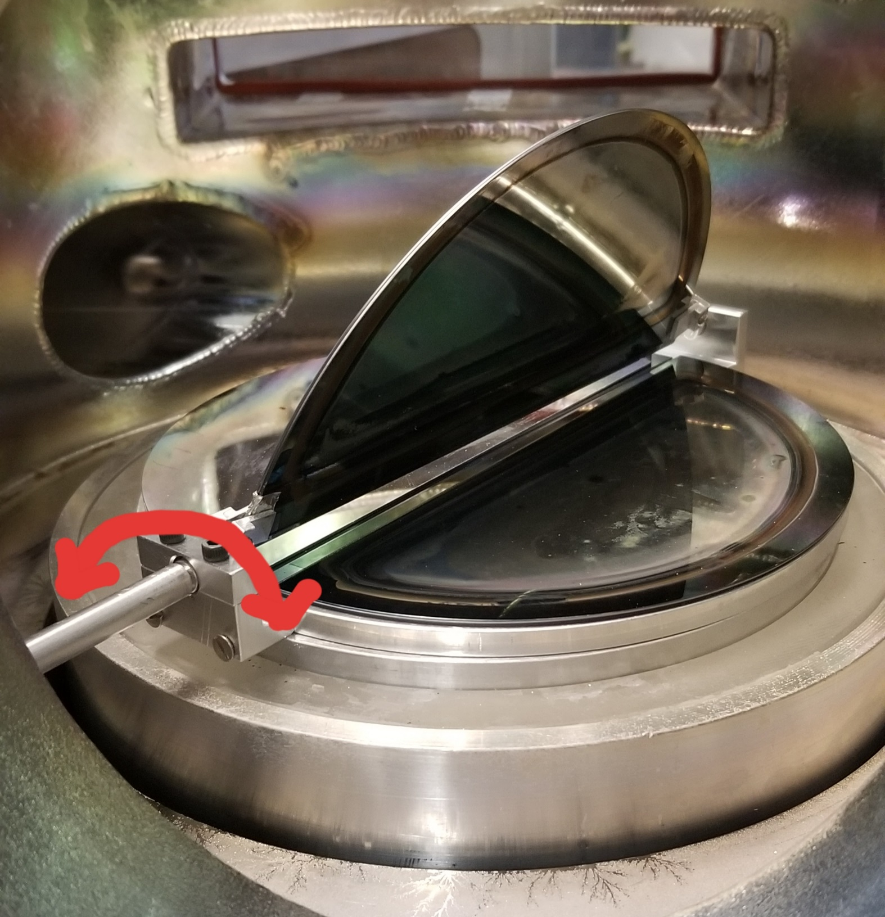
Electrode setup
Similar electrode setup to previous experiment
Surfaces are now thin film deposits
Surfaces tested
Magnesium
Aluminum
Copper
Silver`
Half wafer

Slide 20
50mT pulsed density
~30% increase in $n_{e}$ for silver surface
Opposite what would be expected from recombination effects

Slide 21
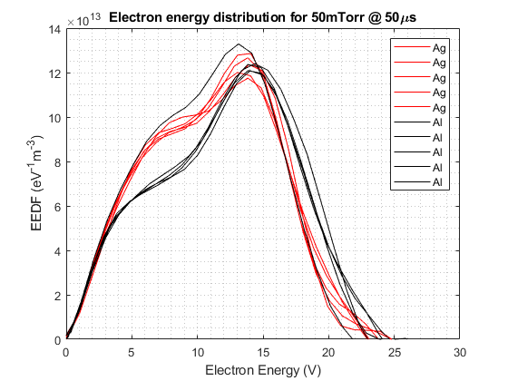
50mT EEDFs
Evolution of EEDF from transient to SS
High energy electrons play role in transient
High energy electrons lose their role with the silver cathode
$$g_{ε}=\frac{2M_{e}}{e^{2}A_{p}}{\left(\frac{2e}{M_{e}}\right)}^{\frac{1}{2}}\frac{d^{2}I_{p}}{dV^{2}} {\left(V_{p}−V_{probe}\right)}^{\frac{1}{2}}$$

Slide 22
100mT

Slide 23
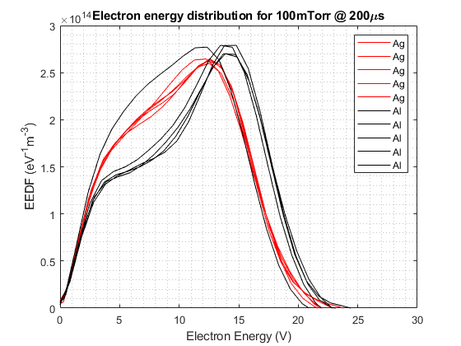
100mT EEDFs
Still a similar evolution from 50mTorr but less difference between the 2 approaching SS

Slide 24
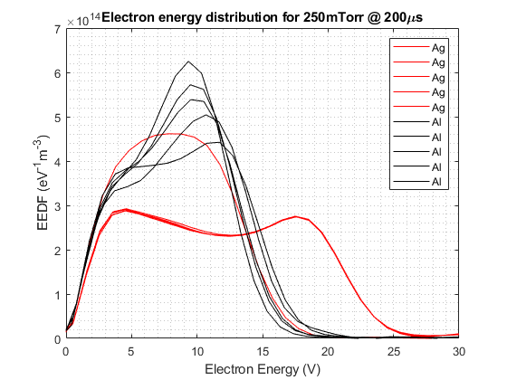
250 mTorr data
Less distinct temporal evolution as suggested by 50 →100 mTorr case
Longer term pulse to pulse change for Ag

Slide 25
Early runs with silver thin film
50mTorr Al outlier was last run
100mTorr Al outlier was 3rd of 5 runs
Subsequent runs for material ~2 min apart

Slide 26
Mesh netting to eliminate edge light-up
Degradation of silver coating after O2 plasma exposure
Degradation of copper film after O2 plasma exposure

Slide 27
Future modifications to experiment

Slide 28
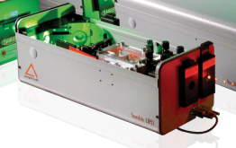
Optical parametric oscillator for O atom measurements
$$photo diode$$
$$Spectrum$$
$$Analyzer$$
$$f_{Pump}=f_{1}+f_{2}$$
$$LIF, LAS$$
$$internal detector$$
$$of OPO$$
$$wide spectrum of laser$$
$$wavelengths$$
$$205.5−2750 nm$$
$$f_{1}$$
$$f_{2}$$
$$frequency doubler$$
(attachment for OPO)
$$f_{Pump}$$
$$optical parametric$$
$$oscillator$$
$$Series of mirrors$$
$$and crystals$$
Laser output 410-2500nm (18.5k) or 192-2750nm (62.7k)
$$Nd:YAG$$

Slide 29
Future modifications
Expandable bellows for Langmuir probe insertion
Shrink chamber size
OES measurements for OH contamination
Re-oxidize surfaces when Al EEDF changes form
Compare machined Al surface with Al tape surface
Surface roughness

Slide 30
Review
Machined surface vs copper tape showed consistent changes in pulse profile as well as pressure change between the two surfaces
Differences in EEDF between surfaces stronger at low pressures
Visible difference in pulse density profile for recombination experiments
No visible difference in pulse profile for surface electron experiments
Silver degradation visible through first set of runs

Slide 31
References
“Cold-cathode discharges and breakdown in argon: surface and gas phase production of secondary electrons” – Phelps and Petrovic 1999
“Energetic electron avalanches and mode transitions in planar inductively coupled radio-frequency driven plasmas operated in oxygen” – Zaka-ul-Islam 2011
“Effect of Surface Material on Spatiotemporal Structure in $O_{2}$ RF Glow Discharge” – Shibata et al 1995
“$O_{2}$ adsorption on Silicon and Germanium” – Hagstrum 1961
“Evolution of the Electron-Energy-Distribution Function during rf Discharge Transition to the high voltage mode” – Godyak 1992
“Vacuum Thermionic Work Functions of Polycrystaliline Be, Ti, Cr, Fe, Ni, Cu, Pt, and 304 SS” –Wilson 1966
“Material dependent modeling of secondary electron emission coefficients and its effects on PIC-MCC simulation results of capacitive RF plasmas” – Daksha et al. 2019
“Recombination of neutral oxygen atoms on stainless steel surface” Mozetic and Zalar 2000

