Slide 1
Plasma Electrolytic Oxidation (PEO) at High Frequencies: Characterization and Control
IOPS Presentation: Patrick Hermanns

Slide 2
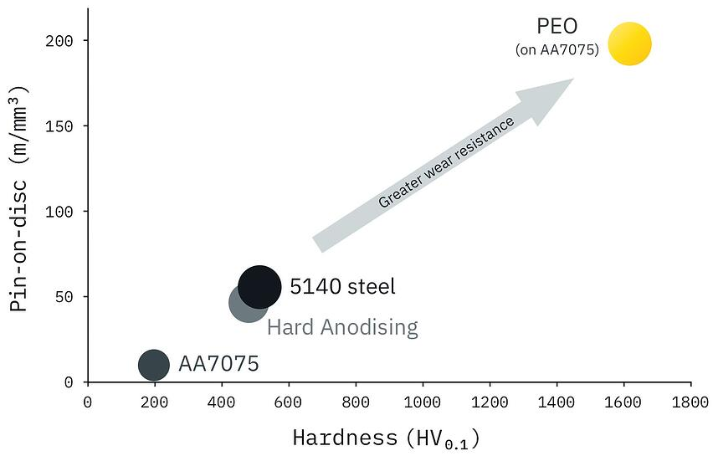
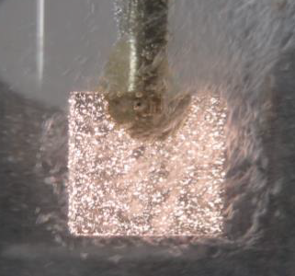
Plasma Electrolytic Oxidation
Plasma (enhanced) Anodization
Al → Al₂O₃
Source: keronite.com

Slide 3
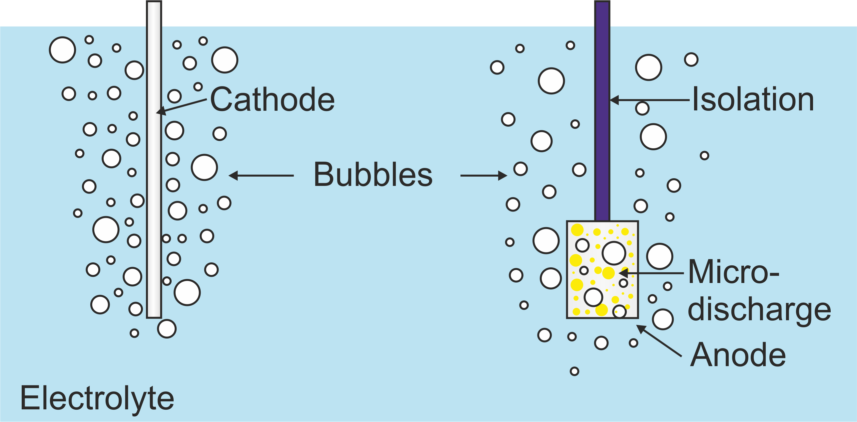
Electrochemical process
OH⁻
H⁺
$$2Al^{3+}+3OH^{−}→Al_{2}O_{3}+3H^{+}$$
$$2Al^{3+}+3O^{2−}→Al_{2}O_{3}$$

Slide 4
Time dependent process

Slide 5
Time dependent process

Slide 6
Time dependent process

Slide 7
Time dependent process

Slide 8
Time dependent process

Slide 10
Porous surface
Aluminum oxide melts and resolidifies on the surface
Crater-like structures at center of microdischarge ignition
Highly porous surface is established during coating
Problem: Microdischarge energy increases with time and locally destroys the oxide coating

Slide 11
Problem
?
Electrical parameters
- Current amplitude I
- Pulse On-time T_{on}
- Pulse Off-time T_{off}
- Duty-Cycle $θ$
- Pulsing frequency f
Microdischarge behaviour
- Number density n_{MD}
- Microdischarge size A_{MD}
- Photo Intensity I_{MD}
- Time constants $τ_{On}$
- Lifetme $τ_{MD}$
- Electron density n_{e}
I(t)
$τ_{MD}$ , $τ_{On}$
$I_{MD}$ , A_{MD} , n_{e}
I
T_{on}
T_{off}
t
n_{MD}
T = 1/f
Anode

Slide 12
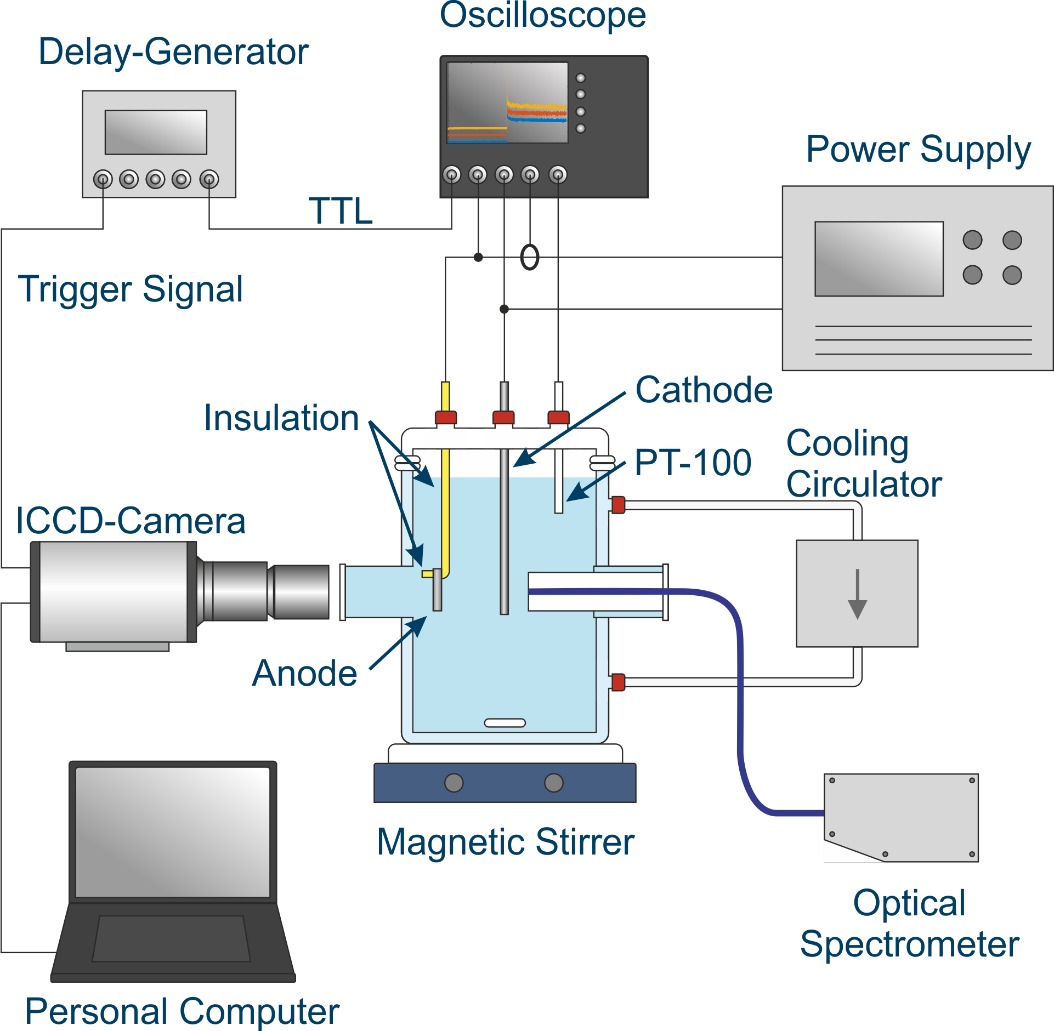
Experimental Setup
Electrolyte: dest. water + $2 g/l$ KOH
Anode material: Al 6061 alloy ($20⋅10⋅2 mm$)
Cathode material: stainless steel ($d = 4 mm$)
Generator: Magpuls MP2-30, galvanostatic mode, unipolar (rectangular) pulsing

Slide 13
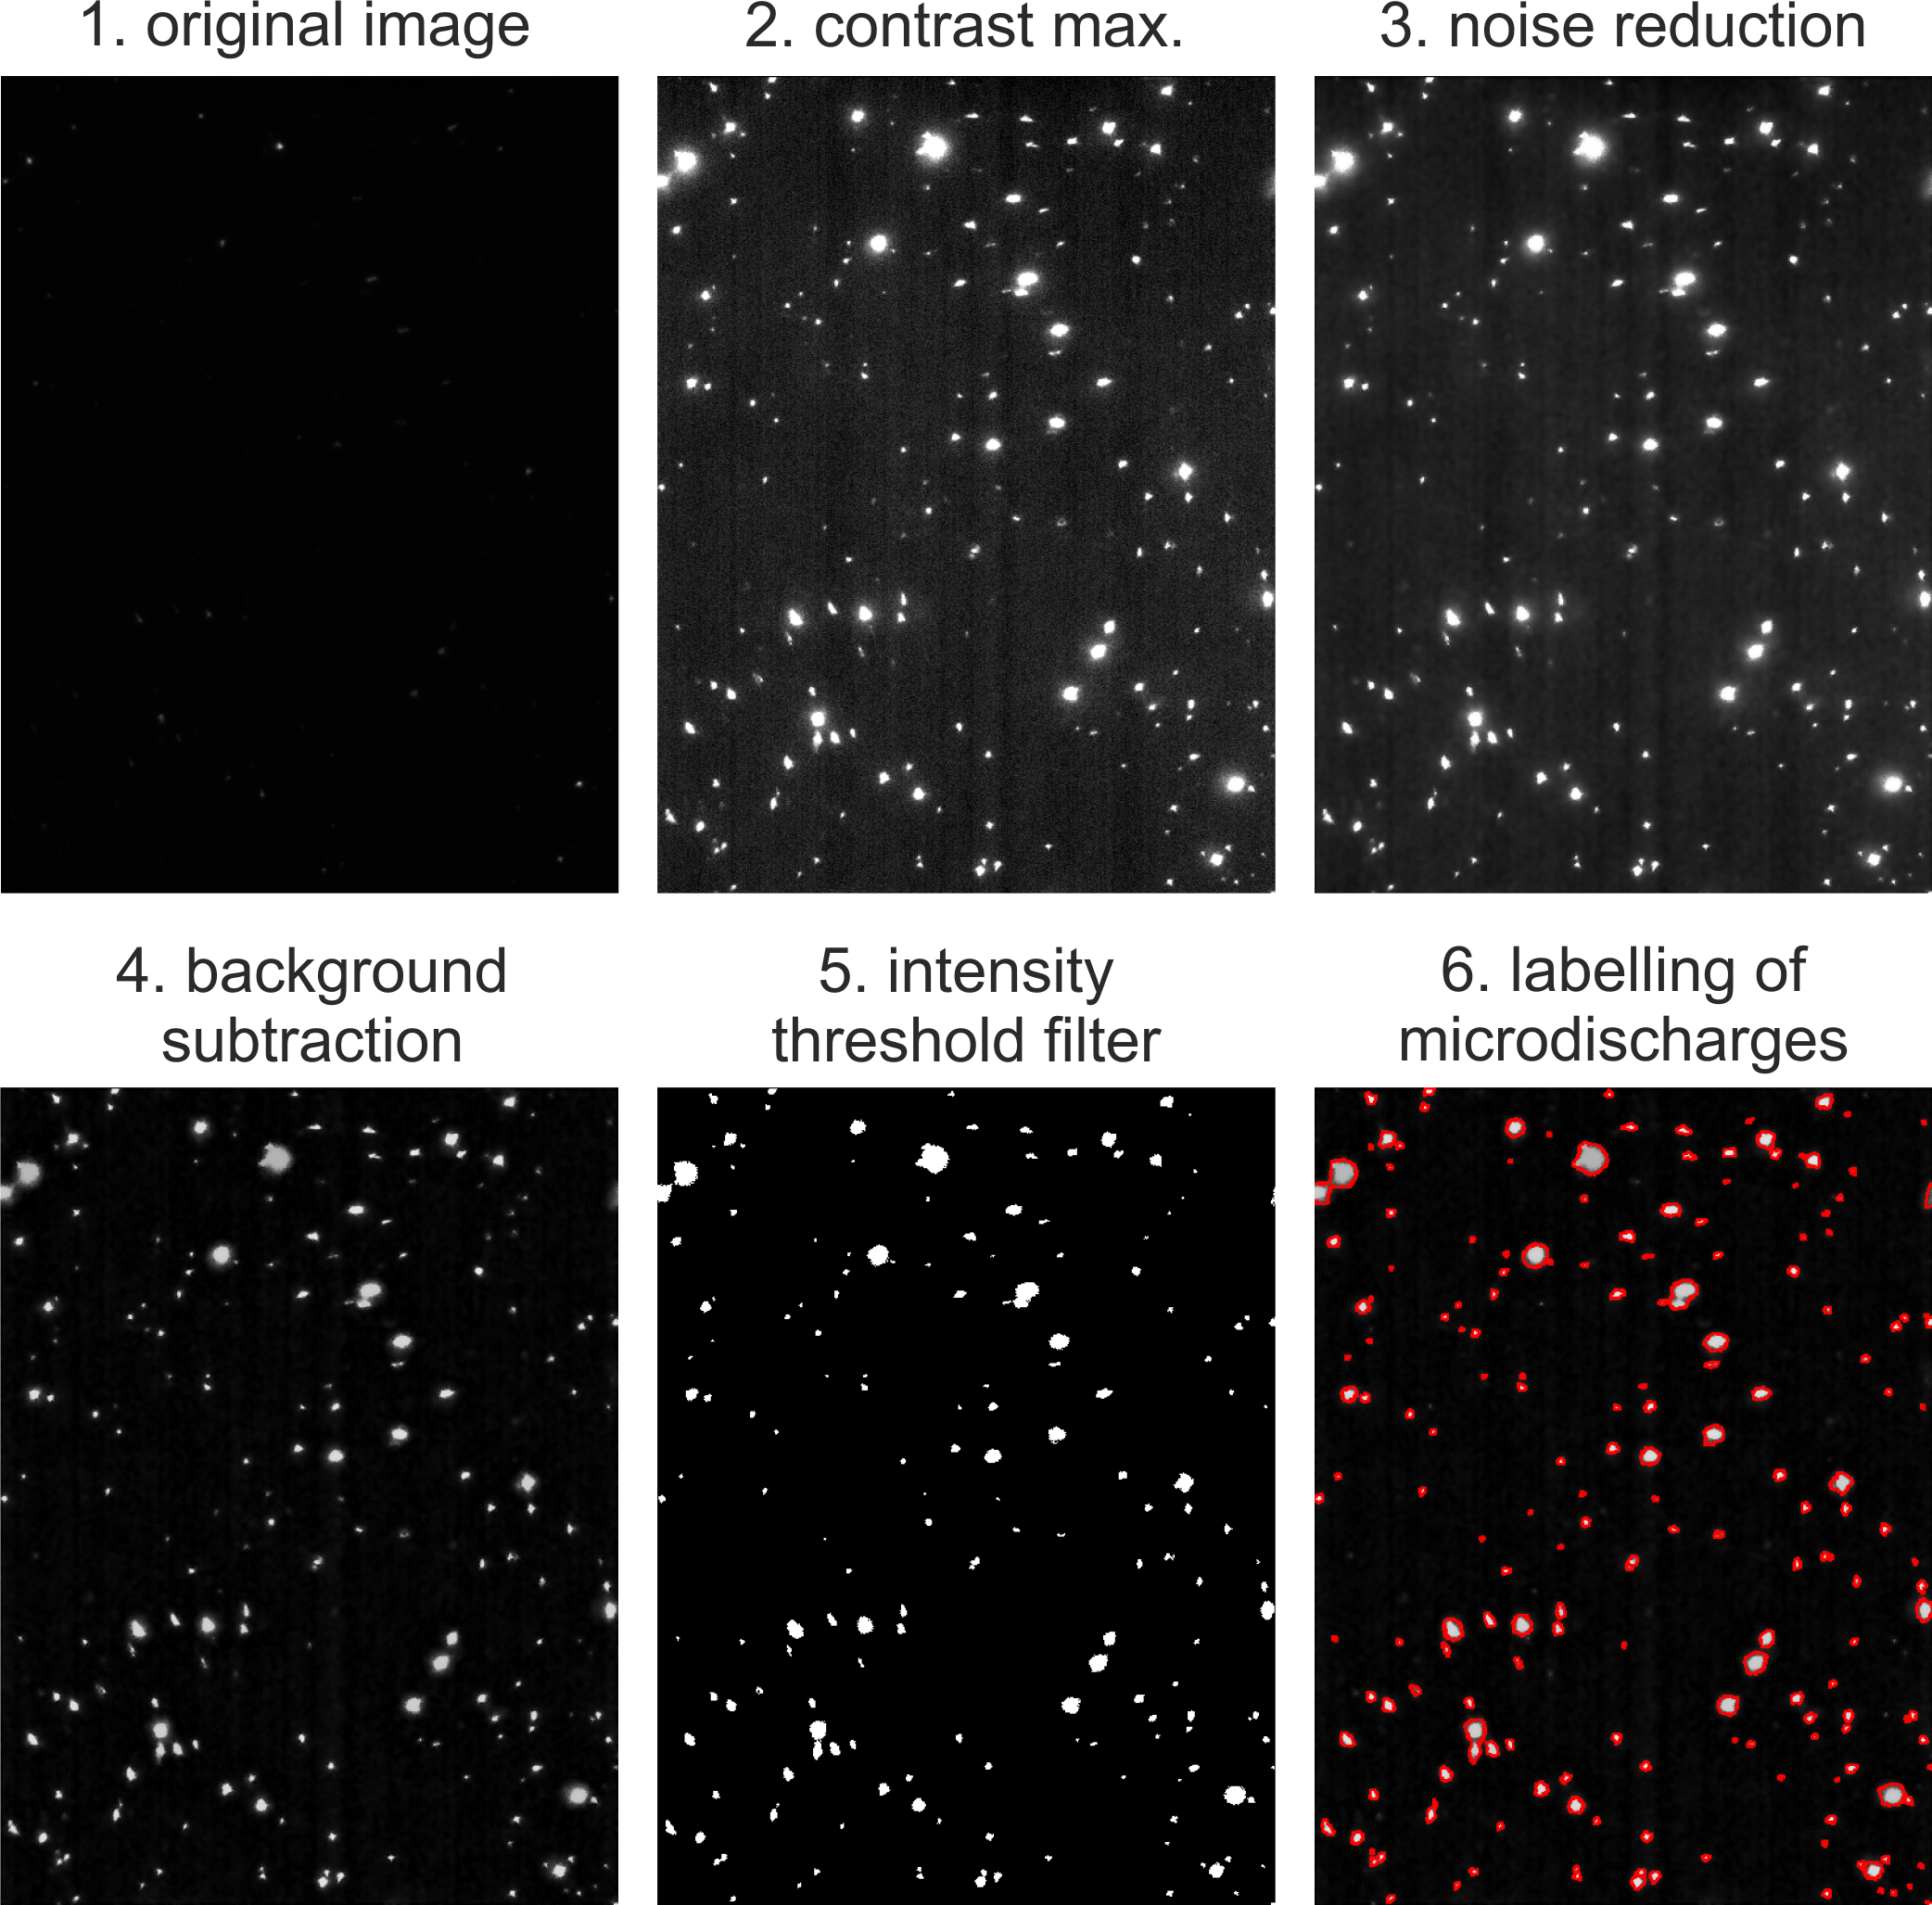
MD Detection
Image analysis during process
Fast algorithm to enable in situ measurements
Threshold filter regarding photo-intensity to create binary image
MD size, number density and photointensity are calculated
Time for processing of one image: $t_{tot} < 90 ms$

Slide 14
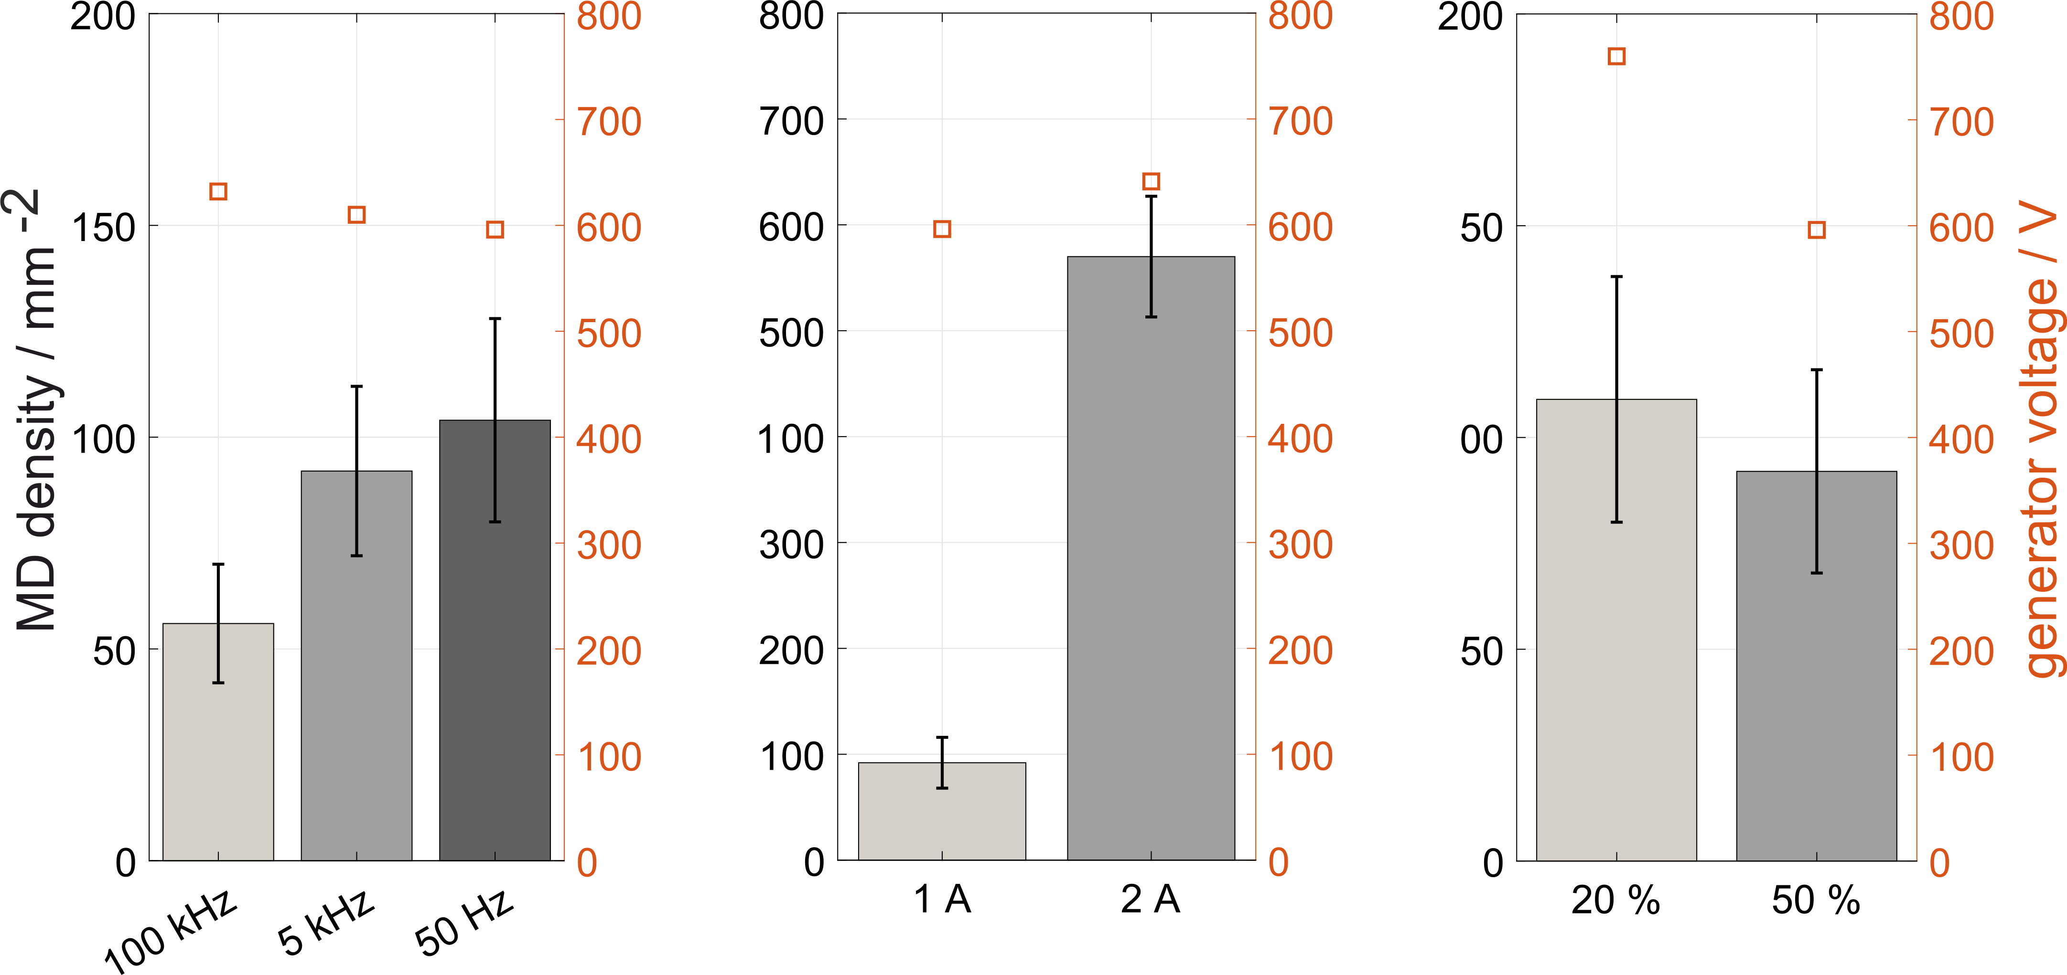
Parameter variation
Standard parameters:
$$t = 15 min; f = 5 kHz; θ = 50 \%; I =1 A$$
Frequency
Current
Duty-Cycle
Standard parameters:
$$t = 15 min; f = 5 kHz; θ = 50 \%; I =1 A$$

Slide 15
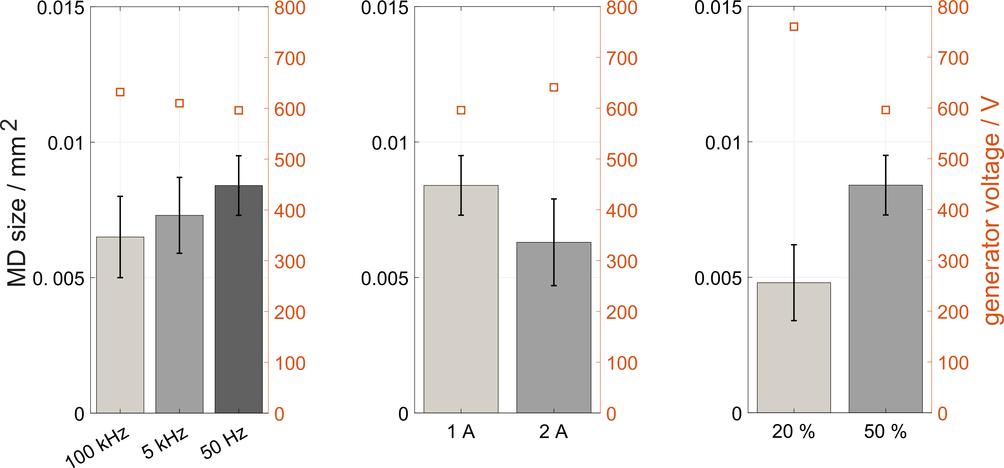
Parameter variation
Standard parameters:
$$t = 15 min; f = 5 kHz; θ = 50 \%; I =1 A$$
Frequency
Current
Duty-Cycle
MD size and MD density can be controlled by changing the duty-cycle and the current density!

Slide 16
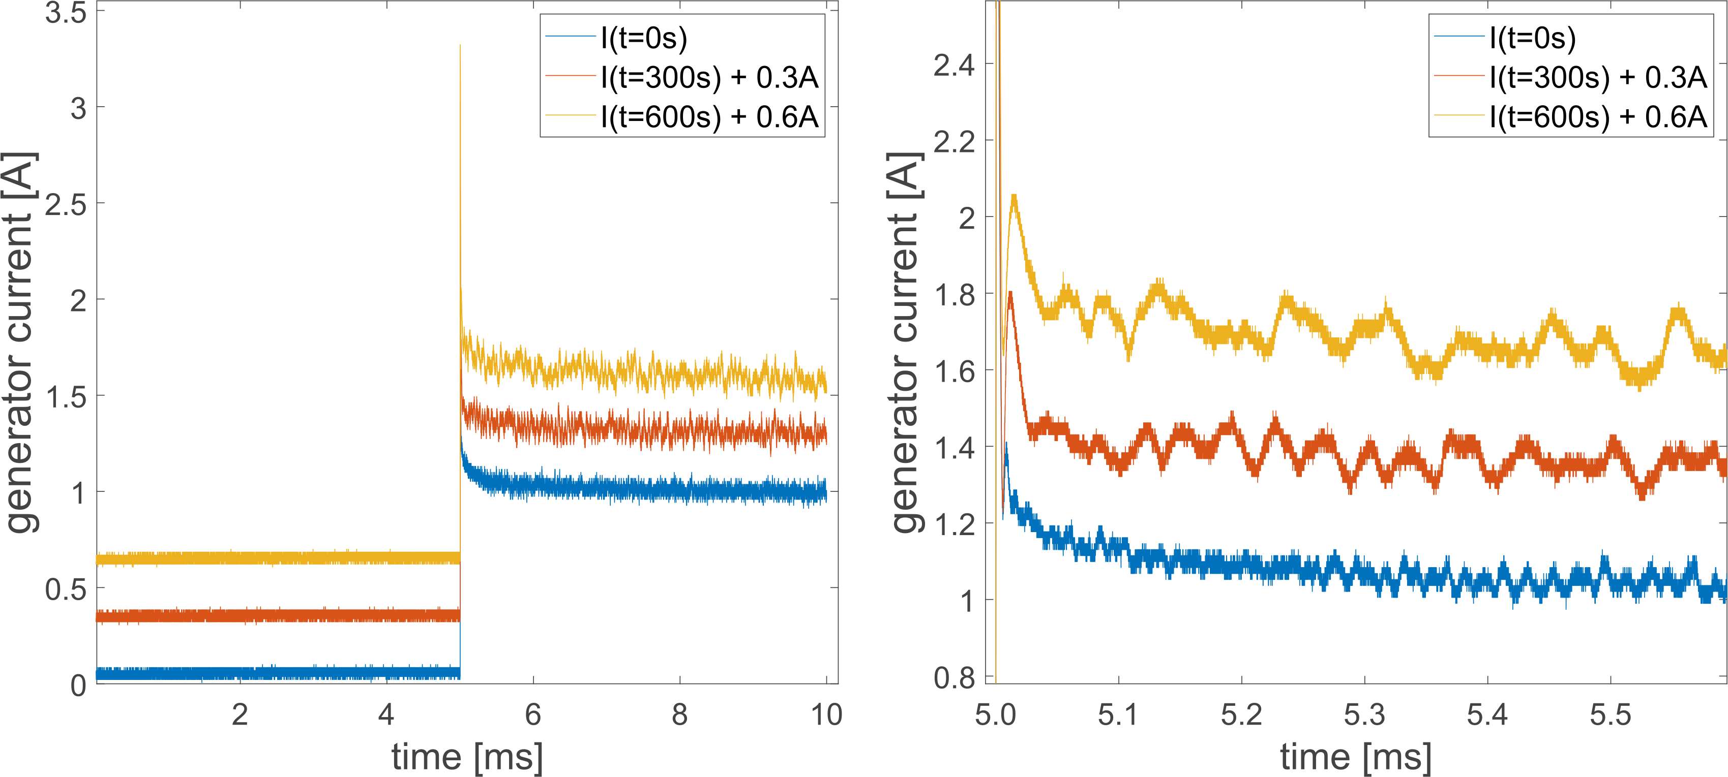
Lifetime of MDs (current pulses)

Slide 17
Lifetime of MDs
Analysis of current pulses by wavelet transform
Fitting of wavelet function by translation b and dilation s:
Wavelet coefficients (like fourier coefficients):
$$Ψ_{s, b}(t)= \frac{1}{\sqrt{s}}Ψ\left(\frac{t−b}{s}\right)$$
$$W_{Ψ}\left(s, b\right)= \frac{1}{\sqrt{s}}\int_{−∞}^{∞}{x\left(t\right)⋅}Ψ\left(\frac{t−b}{s}\right)dt$$
Source: towardsdatascience.com

Slide 18
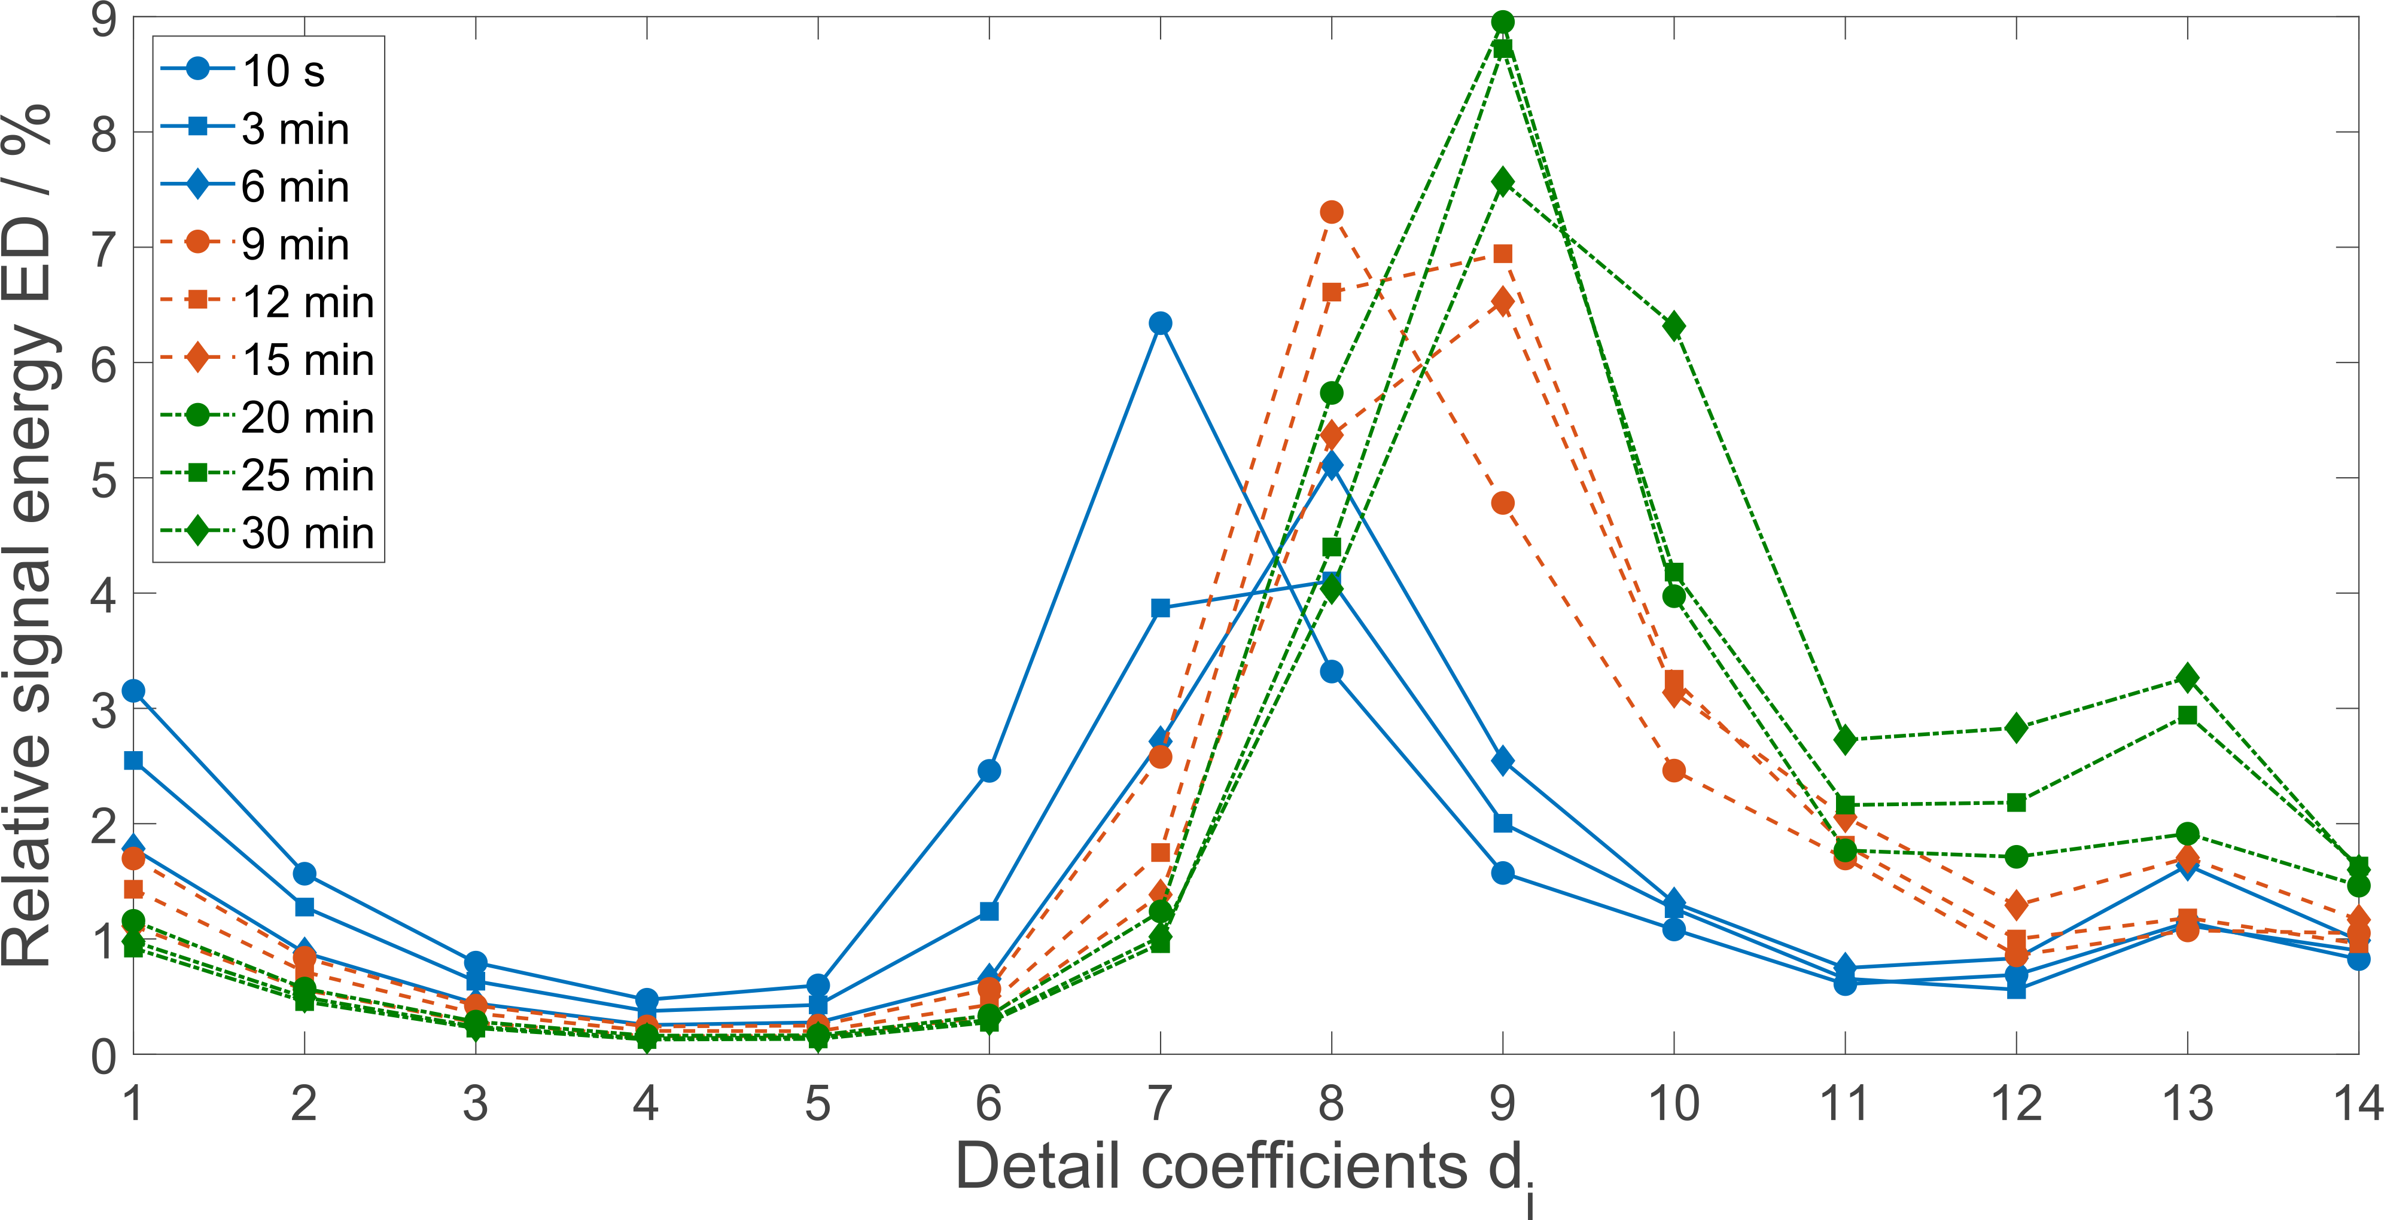
Results wavelet transformation
$$t_{d13} =1.6 ms$$
Lifetime of MDs is in the kHz range! Influence of frequency in this region?
$$t_{d6} =6 µs$$

Slide 19
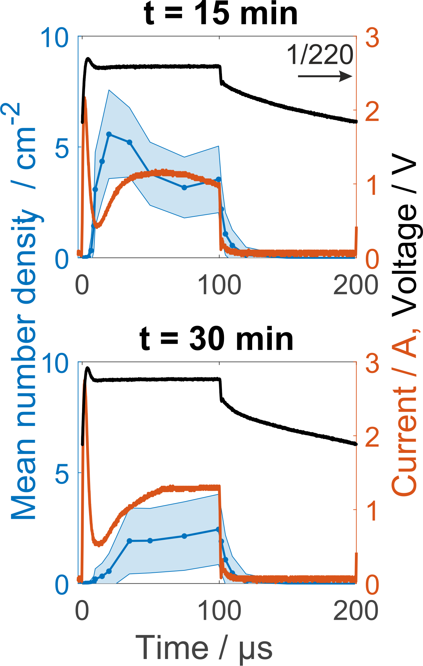
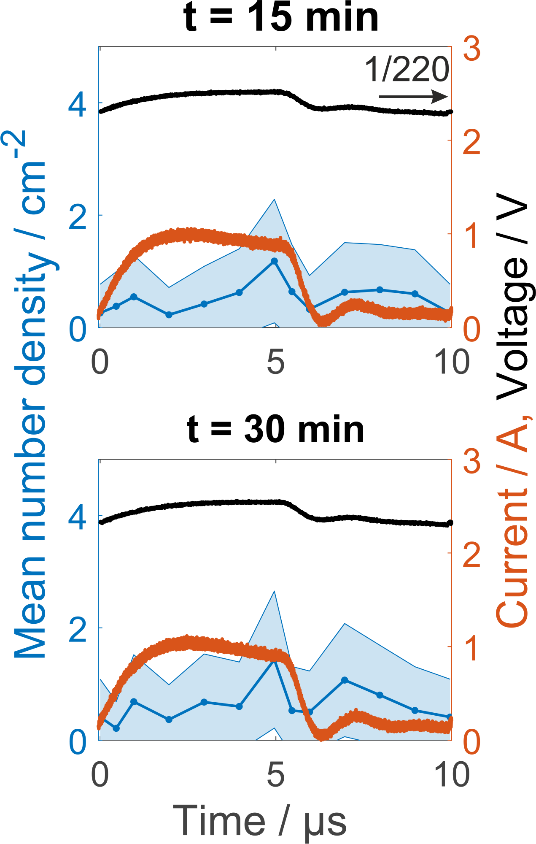
Phase resolved MD dynamics
MDs cannot follow the generator frequency if the pulsing time is shorter than the MD lifetime!
f = 5 kHz
f = 100 kHz

Slide 20
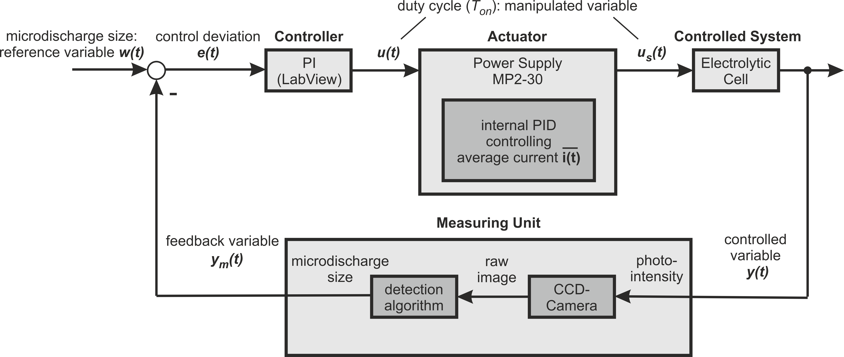
In situ MD control scheme

Slide 21
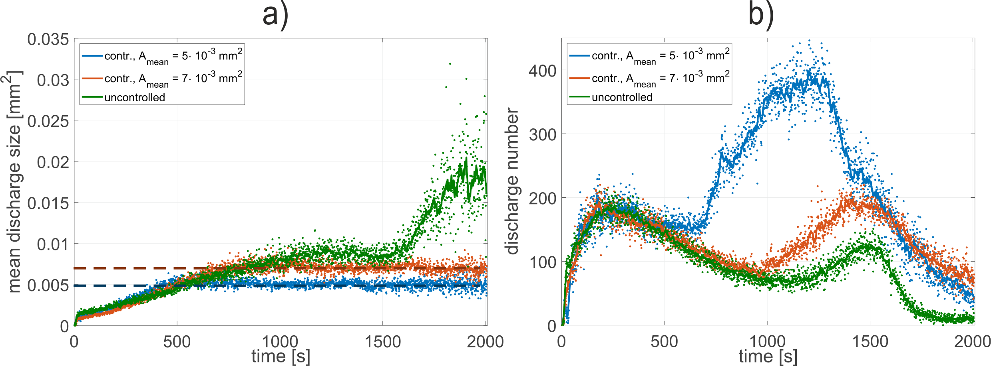
Results MD control (camera)
MD size
MD number

Slide 22
Results MD control (pictures)
Uncontrolled
Controlled

Slide 23
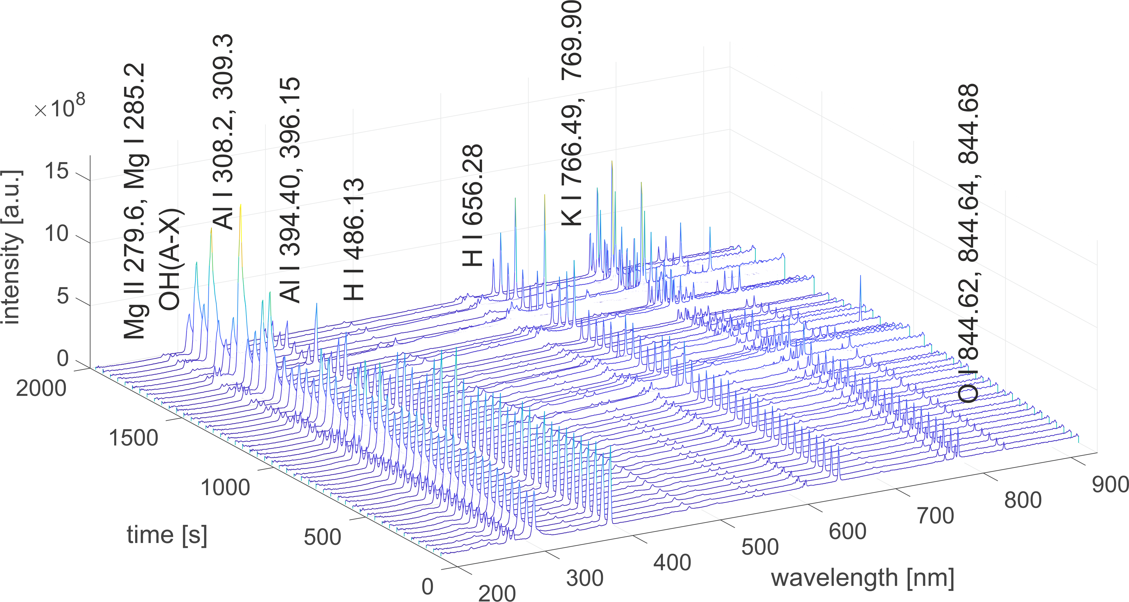
Results MD control (OES)
Uncontrolled

Slide 24
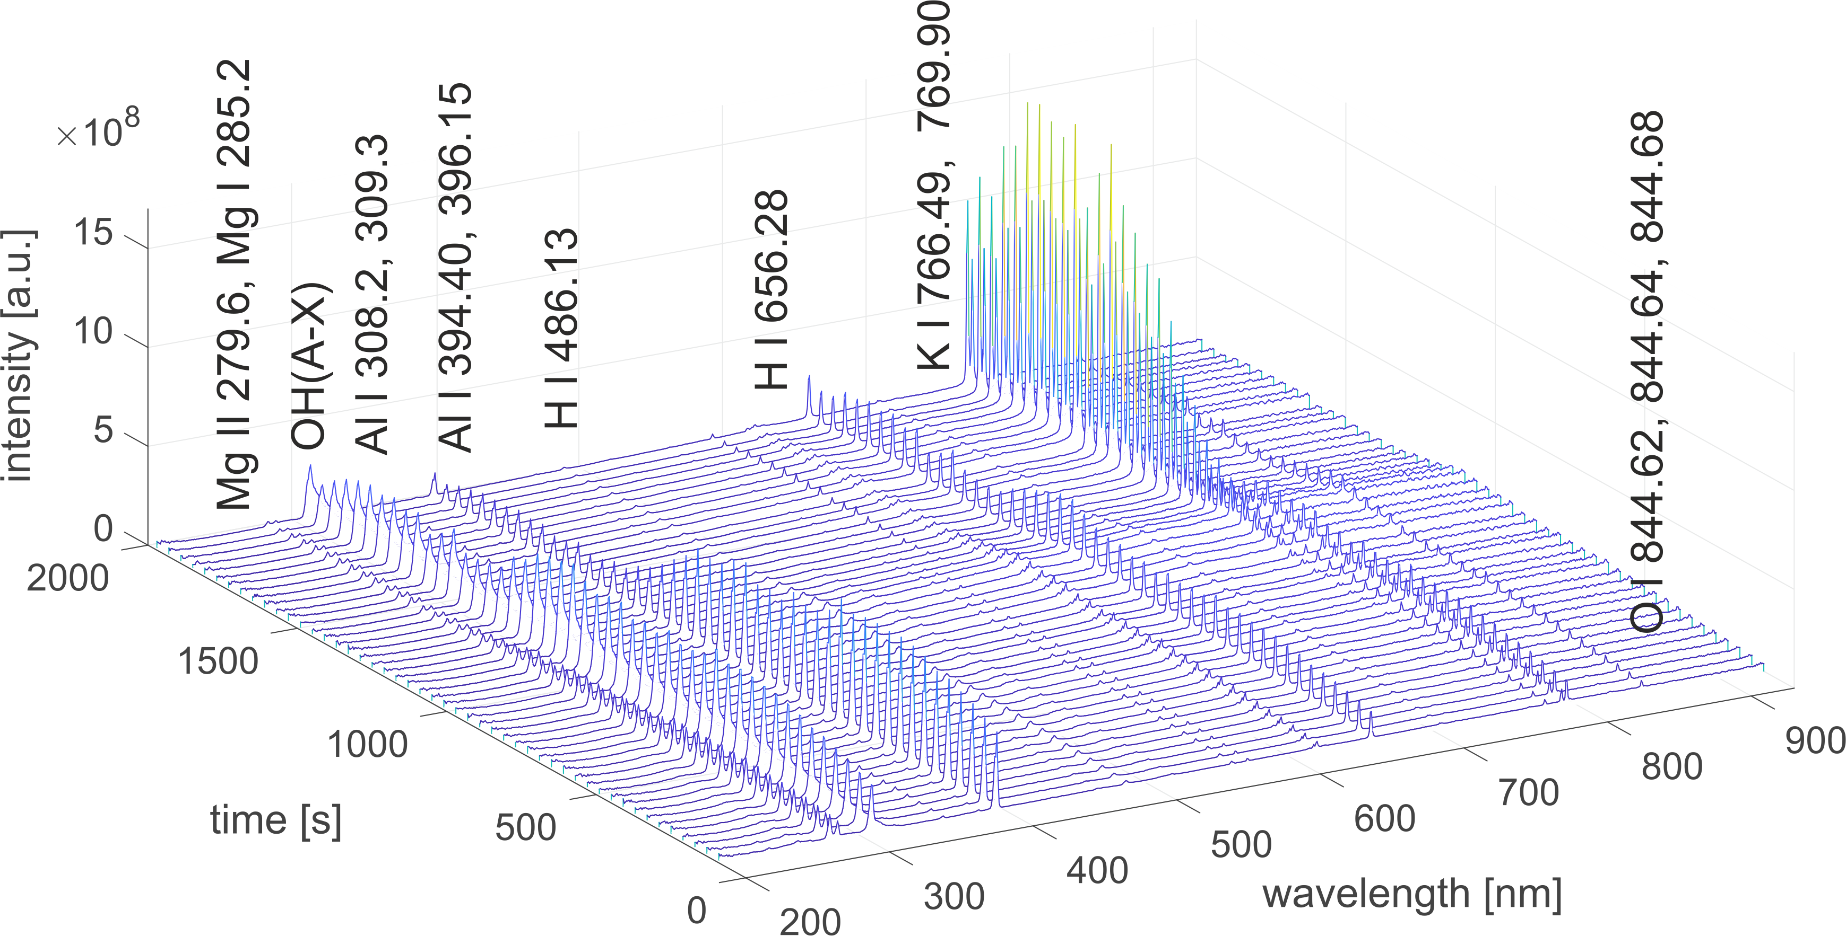
Results MD control (OES)
Controlled

Slide 25
Results MD control (SEM)
Uncontrolled
Controlled

Slide 26
Conclusion
MD lifetime is in the range between 6 µs and 1600 µs
Current density and duty-cycle can adjust the MD number density and size
Pulsing frequency has to be in the range of the microdischarge lifetime to control microdischarges
Microdischarge properties can be controlled to distinct values with an in situ closed-control loop. By this the microdischarge energy can be controlled indirectly
Outlook: Further material characterization of produced oxide coatings

Slide 27
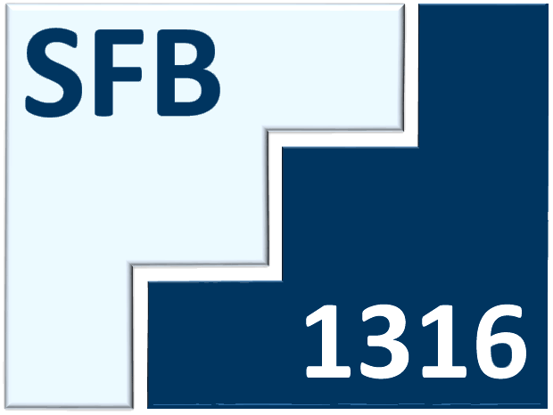
Thank you for your attention! Special thanks to people from:
¹Hermanns et al. 2020 J. Phys. D: Appl. Phys. 53 435204
²Hermanns et al. 2021 J. Phys. D: Appl. Phys. 54 045205

