Slide 1
Atomic oxygen determination in the COST jet: from the gas phase with a liquid target to the liquid
Brayden Myers
North Carolina State University

Slide 2
Motivation
Viability of Jurkat cells after plasma treatment with the COST jet and a nspDBD. [1]
Concentration of HTA produced by plasma treatment of 50 mM TA. [2]
TEMPO degradation after an initial conc. of 1 mM. [2]
Experiments showed similar cellular response from different plasma sources
-COST jet with He/O₂ admixture → atomic O driven chemistry
-nspDBD → ●OH driven chemistry
Attempts to measure ●OH and atomic O in liquid are complicated by:
-Lack of selectivity when both ●OH and O are present
-Degradation of chemical probes by atomic O
-Limited aqueous phase reaction rate data for O atoms
ATOMIC OXYGEN IS A PROBLEM
[1] Ranieri P et al. Applied Sciences. 2020;10(6):2025.
[2] Myers B et al. J. Phys. D: Appl. Phys. 2021; 54(14):145202.

Slide 3
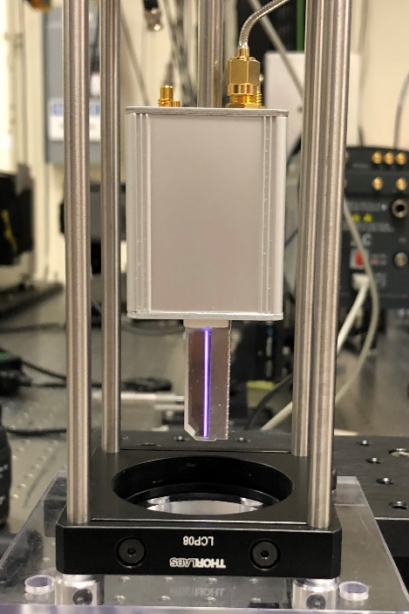
Experimental
COST Reference Source [1]
Capacitively coupled, 13.56 MHz RF discharge in helium or argon w/ small molecular admixtures
Typically O₂, H₂O, or N₂
1 mm gap distance (30 mm³ plasma volume)
Integrated matching network along with current and voltage probes for continuous monitoring
Experimental aims for gas phase O measurements
Use TALIF to measure atomic oxygen densities in the effluent of the COST jet
Absolutely calibrate with Xe
In situ determination of decay rates*
Measure with a liquid interface present to allow the most effective comparison with aqueous phase measurements
COST Reference Microplasma Jet
[1] Golda J et al. J Phys D: Appl. Phys. 2016;49(8):84003.

Slide 4
Experimental cont.
TALIF Measurements
Broadly tunable laser scanned across J=2 resonance for atomic oxygen
Centered at 225.64 nm
Laser focused with a planoconvex lens for a beam width of ~100 microns through the effluent
Pulse width of 30 ps, 50 Hz repetition rate
Red-sensitive ICCD with 3 ns gate width used to capture TALIF signal at 844.9 nm
Allows for 27 x 27 micron spatial resolution in the effluent
Plasma source moved on translational stage to allow for spatial scan of the effluent
4

Slide 5
TALIF measurements of O atoms
Raw signal acquired by spectrally scanning over excitation wavelength of J=2 resonance and integrating over resulting Gaussian signal distribution
Predictably shows considerable differences between admixtures
Signals require absolute calibration to extract true density and spatial evolution of O

Slide 6
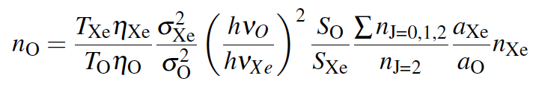
Absolute density calibration using Xe
Xenon is used for calibration because of its very similar excitation and fluorescence scheme
An identical experimental setup was used to record S_{xe} to minimize experimental uncertainty
Xe resonance was spectrally scanned and the resulting Gaussian signal distribution was integrated
I² dependence was verified for both O and Xe TALIF signals

Slide 7
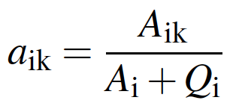
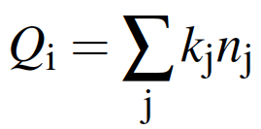
Decay rates of laser-excited O(3p ³P_{J})
At atmospheric pressure, collisional quenching is main de-excitation mechanism
Very sensitive to background gas composition as collisional quenching coefficient can vary by orders of magnitude between species
Temperature and pressure effects also play a role
Experimental limitations often preclude direct measurement at atmosphere
Laser must be faster than decay rate
To compensate:
Collisional quenching coefficients are extrapolated from low pressure assuming a linear pressure/quenching relationship
Experiments are performed in a helium atmosphere to allow application of a single quenching rate across area of interest
Not necessarily true
Not reflective of conditions during applications

Slide 8
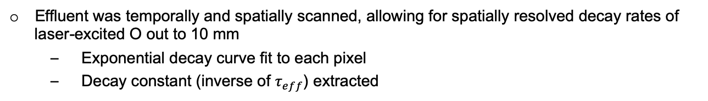
Temporal scans of TALIF signal
Effluent was temporally and spatially scanned, allowing for spatially resolved decay rates of laser-excited O out to 10 mm
Exponential decay curve fit to each pixel
Decay constant (inverse of $τ_{eff}$) extracted

Slide 9
In situ O(3p ³P_{J}) effective lifetimes
Effective lifetimes as short as 1 ns could be measured
In situ measurements account for:
Temperature and pressure effects
Ambient air mixing
RONS species production in active plasma and effluent
Relevant for operating conditions found during application

Slide 10
Absolute density calibration of O TALIF
Note outward expansion of highest densities
Revealed by in situ measurements
~30% increase in experimental accuracy

Slide 11
Examination of formation and extinction pathways
He/O₂ admixtures
O exclusively formed in active plasma
Extinction driven by O₃ production
He/H₂O
O produced in second order ·OH recombination (·OH + ·OH → O + H₂O)
Wide variety of ROS (·OH, HO₂, H₂O₂) responsible for extinction
He-only
Convolution of both
Slow density decay result of few reaction partners

Slide 12
O TALIF in the presence of a liquid (4 mm)
He 0.6% O₂
Decay rates are largely unchanged
No discrepancy in background gas composition
Observed for all 3 admixtures
Significant reduction in recorded O density close to water surface
Likely due to obstruction of gas flow
Atomic oxygen’s short-lived nature results in more time to react with slowed flow velocity
Needs to be accounted for if estimating O flux from open effluent measurements

Slide 13
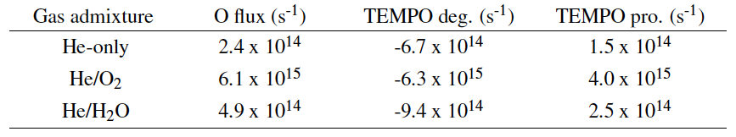
Comparison with EPR estimates of O_{aq}
TEMPO production (TEMP+O) is likely selective for O but subject to degradation, concentrations of TEMPO measured after one minute
TEMPO degradation is probably a result of O and other ROS
Very good agreement observed between O flux and TEMPO production for all three admixtures, considering degradation
In He/O₂ plasma-treated liquid:
TEMPO degradation is driven by O and is therefore a better indicator of O entering liquid than TEMPO production
For other admixtures:
Degradation is only partially mediated by O so TEMPO degradation is not in close agreement with O flux

Slide 14
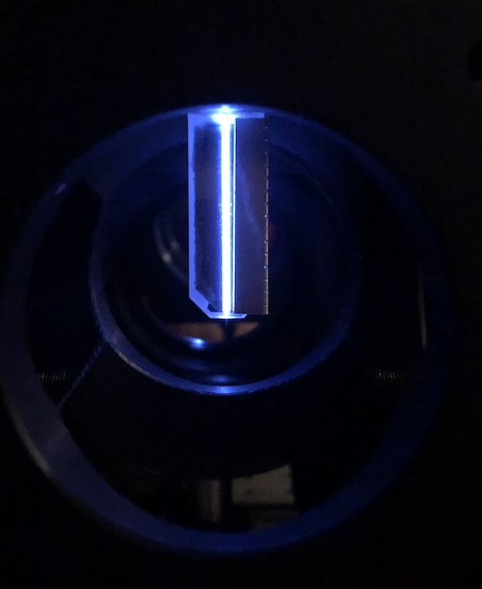
Conclusion
Spatially resolved absolute densities of atomic oxygen in the COST jet were found for several gas admixtures
Decay rates were recorded in situ at atmospheric pressure allowing for ~30% improvement in experimental accuracy
Largely unchanged with a liquid surface present
Examined O formation and extinction mechanisms in effluent
Active plasma for He/O₂ admixtures
·OH self reaction for He/H₂O plasma
Using the same experimental conditions as our liquid phase measurements allows direct comparison to TEMPO production and degradation
Very good agreement observed
Varying O contribution to TEMPO degradation
Submitted to Journal of Physics D: Applied Physics

Slide 15


Acknowledgements
Dr. Edward Barnat, Sandia National Labs
Dr. Katharina Stapelmann, Advisor

