Slide 1

New insights into the physics and chemistry of ICP discharge in CF₄/O₂ mixture Dmitry Levko, C. Shukla, R. R. Upadhyay, and L. L. Raja
Esgee Technologies Inc.
1301 S. Capital of Texas Hwy.
Suite B-330
Austin, Texas 78746
(www.esgeetech.com)

Slide 2
Company Overview
Industry leader in non-equilibrium and thermal plasma multiphysics simulation
Location Austin, Texas, USA
History Incorporated 2003
Market International customer base across US, Europe, and Asia
Team Diverse team with domain expertise in plasmas, reactive flows, gas and surface chemistries, thermal fluids, electromagnetics and hybrid plasma systems
Products Develops, supports, consults, and distributes the OverViz Simulation Suite and OverViz modules. Offers academic and commercial licenses

Slide 3
Motivation
Plasma etching is a critical unit process used in semiconductor manufacturing (plasmas used in 40-45% of the fabrication steps in leading microchip manufacturing);
The etch process has both physical and chemical attributes; therefore, to maximize the efficiency of reactor design, processing engineers need full-fidelity multiscale multispecies computational tools;
Feedgas mixes for plasma etching are usually complex because of the conflicting requirements on etch rate, selectivity to mask and underlayer, and anisotropy;
Detailed mechanisms for plasma etch processes are not well understood for a majority of process gases; the development, validation, and improvement of these mechanisms is a constant endeavor;
Some of the existing mechanisms of plasma chemical reactions even contradict each other.

Slide 4
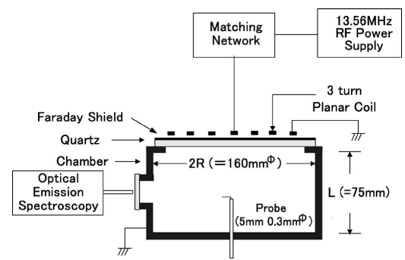
Experiments Chosen for Validation
Experimental setup
Kimura and Noto, J. Appl. Phys. 100, 063303 (2006) (ICP discharge in CF₄/O₂ mixture)
Kimura and Ohe, J. Appl. Phys. 92, 1780 (2002) (ICP discharge in pure CF₄)

Slide 5
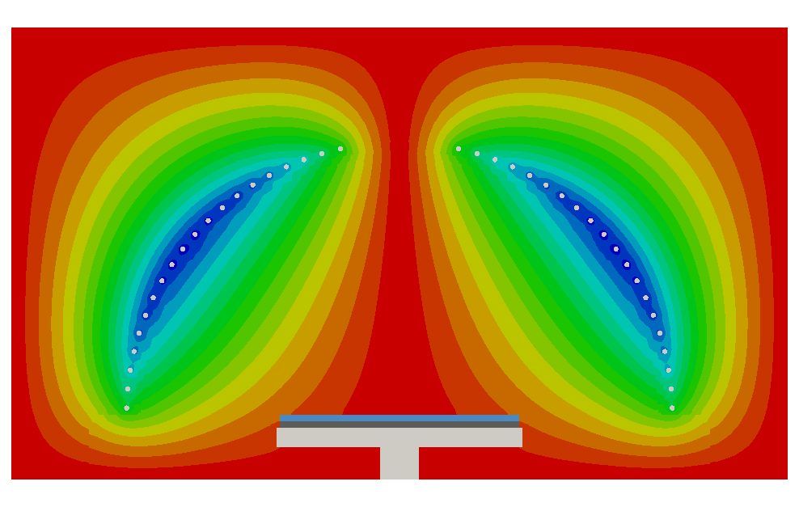





OverViz Simulation Suite
Parallelized, scalable framework for creating 1D/2D/3D, coupled simulations using a comprehensive suite of multiphysics modules
Software Packages
VizGlow
Non-equilibrium cold plasma systems
VizSpark
Thermal (arc) plasma systems
VizGrain
Gas-DSMC, PIC, hybrid-plasma / macro-particle kinetics
ChemZone
Generalized 0D fast reactor model for complex chemical reactive systems
Each package includes following modules (ChemZone includes only VizData)
VizEM
VizFlow
VizData
VizMesh
Static and wave electromagnetic fields in both time and frequency domains
Robust flow modeling from incompressible to high-Mach compressible
Comprehensive database of finite-rate chemistries and equilibrium thermodynamics
Hybrid unstructured 2D mesh generation tool

Slide 6


 | Module Capability | VizGlow | VizSpark | VizGrain | ChemZone
Non-equilibrium (glow) plasma | Basic Non-equilibrium (glow) plasma physics
 | Self-consistent formulation
 | Quasi-neutral formulation
 | Drift-diffusion transport
 | Ion momentum transport equation
 | Conducting dielectric
Thermal (arc) plasma | Basic thermal (arc) plasma physics
 | Material ablation model
 | Chemical equilibrium property module
Particle model | Particle In Cell(PIC) particle dynamics model
 | Ion angular and energy distribution functions
Global 0D plasma | Basic global 0D plasma physics
 | Reaction mechanism sensitivity analysis
 | Forward reaction rate analysis
Chemistry | Finite-rate chemistry
Flow model (VizFlow) | Incompressible fluid flow
 | Laminar fluid flow
 | Buoyant natural convection
 | Conjugate heat transfer
 | Moving body dynamics
EM wave (VizEM) | Electrostatics
 | Electromagnetics
Database (VizData) | Finite rate chemistry database
 | Equilibrium property database
Mesher (VizMesh) | 2D geometry model creation
 | Hybrid structured/unstructured 2D meshing
Common feature | 1D/2D/3D model support
 | Parallel computing
 | Steady state simulation
 | Transient simulation
 | External circuit model
 | Custom User Expressions (CUX)
 | Import external mesh (Gambit/CGNS/Nastran)
 | Export result (Tecplot/VTK/Paraview Ensight)

Slide 7
Modeling Setup
VizGlow simulation geometry
VizMesh to generate an unstructured mesh
VizEM for modeling of electromagnetic wave – plasma interaction
VizData for modeling of chemically reactive multispecies plasma in the gas (plasma) domain and at the plasma-wall interfaces
VizGlow for the self-consistent modeling of non-equilibrium plasma

Slide 8



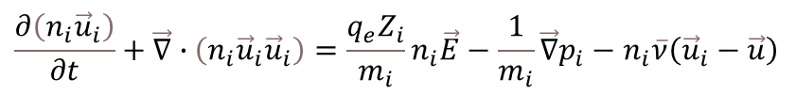


VizGlow Fluid Model of ICP Reactor
Continuity equation for species densities:
$$\frac{∂n_{k}}{∂t}+ \vec{∇}∙{\vec{Γ}}_{k}= {\dot{G}}_{k}$$
Drift-diffusion approximation for electrons:
Momentum conservation for all ions:
$${\vec{Γ}}_{k}= μ_{k}n_{k}\vec{E}−D_{k}\vec{∇}n_{k}$$
$$\frac{∂\left(n_{i}{\vec{u}}_{i}\right)}{∂t}+\vec{∇}∙\left(n_{i}{\vec{u}}_{i}{\vec{u}}_{i}\right)=\frac{q_{e}Z_{i}}{m_{i}}n_{i}\vec{E}−\frac{1}{m_{i}}\vec{∇}p_{i}−n_{i}\overline{ν}\left({\vec{u}}_{i}−\vec{u}\right)$$
Electron energy balance equation:
$$\frac{∂}{∂t }\left(\frac{3}{2}k_{B}n_{e}T_{e}\right)+\vec{∇}∙\left(\frac{5}{2}k_{B}T_{e}{\vec{Γ}}_{e}−κ_{e}\vec{∇}T_{e}\right)=P_{e}^{wave}+q_{e}{\vec{Γ}}_{e}∙\vec{∇}φ−q_{e}\sum_{i}{∆ε_{i}^{th}r_{i}−\frac{3}{2}}k_{B}n_{e}\sum_{k}{\frac{2m_{e}}{m_{k}}\left(T_{e}−T_{g}\right)ν_{m,k}}$$
Poisson’s equation for electrostatic potential:
Maxwell’s equations in the time-domain:
$$\vec{∇}∙\left({−ε}_{0}\vec{∇}φ\right)=ρ_{c}$$
$$∇^{2}\tilde{A}+\left(μεω^{2}−iμσω\right)\tilde{A} =−μ{\tilde{j}}_{ext}$$
For more details, see:
L.L. Raja, S. Mahadevan, P.L.G. Ventzek and J. Yoshikawa, J. Vac. Sci. Technol. A 31(3), 031304 (2013)

Slide 9
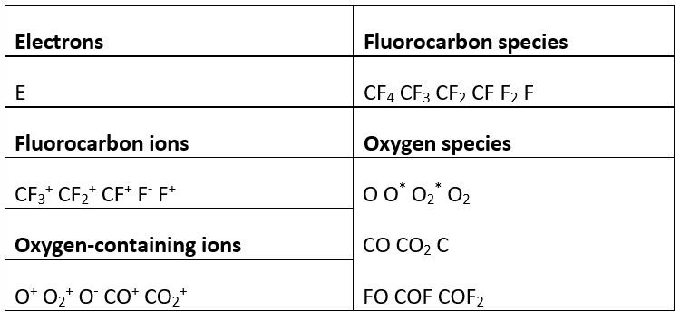
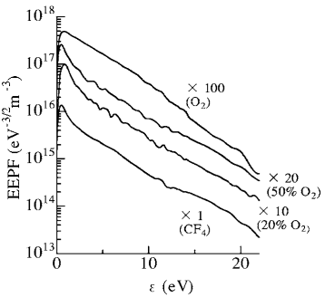
VizGlow Mechanism of Plasma Chemical Reactions
Experimentally measured EEDFs (Kimura and Noto, J. Appl. Phys. 100, 063303 (2006))
The mechanism includes:
11 charged species;
16 neutral species;
133 plasma chemical reactions (41 electron-neutral reactions among them);
The rate coefficients of e-n reactions are for the Maxwellian EEDF;
For full mechanism, see:
D. Levko, C. Shukla, R.R. Upadhyay and L.L. Raja, J. Vac. Sci. Technol. B 39, 042202 (2021)

Slide 10
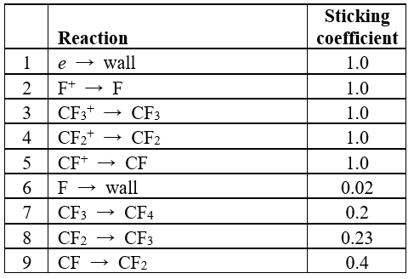
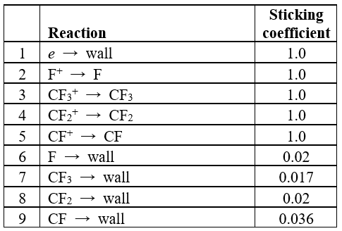
VizGlow Surface Reaction Mechanisms
Toneli, Pessoa, Roberto, and Gudmundsson, Plasma Source Sci. Technol. 28, 025007 (2019)
Levko, Shukla, Upadhyay, and Raja, J. Vac. Sci. Technol. B 39, 042202 (2021)

Slide 11
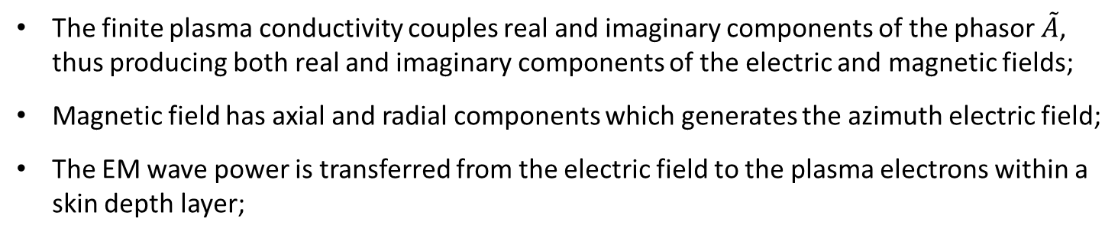
EM Wave Deposition into the Plasma
Imaginary and real components of the EM wave electric field
The finite plasma conductivity couples real and imaginary components of the phasor $\tilde{A}$, thus producing both real and imaginary components of the electric and magnetic fields;
Magnetic field has axial and radial components which generates the azimuth electric field;
The EM wave power is transferred from the electric field to the plasma electrons within a skin depth layer;

Slide 12
Plasma Parameters for Pure CF₄ (10 mTorr; 70 W)
x10¹⁶ m⁻³
eV
V
The electron temperature is the highest near the quartz window, where almost all EM wave power is absorbed by the electrons;
The gas ionization rate is also the highest here;
The electron density peaks on the discharge axis at a distance away from the window due to the diffusion-controlled balance;
Electron heating by the ES field is negligibly small in comparison with the EM wave heating;

Slide 13
Plasma Parameters for Pure CF₄ (10 mTorr; 70 W)
13
x10¹⁶ m⁻³
Dominant positive ions are CF₃⁺
They are mainly generated in the ionization reaction:
CF₄ + e → CF₃⁺ + F + 2e
Other channels are less efficient due to the radical densities being much smaller than the density of CF₄;
The peak value of the negative ion density F⁻ exceeds that of the electrons; these species are mainly generated in reaction:
CF₄ + e → F⁻ + CF₃
Plasma electronegativity is ~1; therefore, the plasma transport is still governed by the electropositive description (see, for instance, Lisovskiy and Yegorenkov, EPL 99, 35002 (2012));

Slide 14
Dominant Neutral Species for Pure CF₄ (10 mTorr; 70 W)
14
×10¹⁹ m⁻³
The fluorine atoms are mainly generated in these two reactions:
CF₄ + e → CF₃ + F + e
CF₄ + e → CF₃⁺ + F + 2e
Their rate coefficients in the electron temperature range 4-5 eV are comparable;
The dominant reaction for CF₂ generation is the reaction
CF₃ + e → CF₂ + F + e

Slide 15
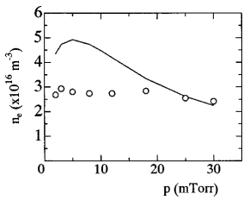
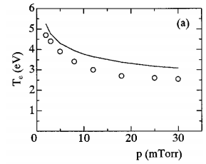
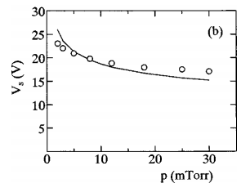
Experimental Data for Mechanism Validation
15
Both experimental and modeling results were taken from Kimura and Ohe, J. Appl. Phys. 92, 1780 (2002);
Modeling results were obtained using the global model, i.e. for spatially averaged quantities with the assumption about the uniform electron spatial distribution;
Although this assumption can be valid for small diameter flow-tube type ICP reactors, it is not necessarily valid in a stove-top ICP configuration, where electromagnetic heating of the electrons is confined to a narrow skin depth region in the vicinity of the antenna;

Slide 16
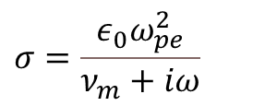
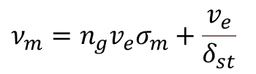
Stochastic Heating Model Implemented within VizGlow
In an ICP plasma, electrons gain energy from the EM wave electric field by two mechanisms
In the first mechanism, the wave energy is transferred to the electrons through the oscillating electric field within a skin depth layer near the plasma surface by collisional (ohmic) dissipation;
In the second mechanism, plasma electrons are “stochastically” heated by the oscillating inductive electric fields;
Although the first mechanism is always realized at all pressure regimes, the latter mechanism is efficient only at low gas pressures. In this limit, non-local and transit-time effects are important.
In VizGlow, we introduced the “effective” electron-neutral collision frequency:
$$ν_{m}=n_{g}v_{e}σ_{m}+\frac{v_{e}}{δ_{st}}$$
It is used in the electron transport, electron energy balance equation as well as in the EM equations through the plasma conductivity
$$σ=\frac{ε_{0}ω_{pe}^{2}}{ν_{m}+iω}$$
For more details, see:
Vahedi, Lieberman, DiPeso, Rognlien, and Hewett, J. Appl. Phys. 78, 1446 (1995)

Slide 17
VizGlow vs. Experimental Data
17

Slide 18




Influence of the Stochastic Heating Length Scale (10 mTorr; 70 W)
18
Electron density
No stochastic heating
$δ_{st}=$ 1 cm
$δ_{st}=$ 2 cm
x10¹⁶ m⁻³
Electron temperature
eV
No stochastic heating
$δ_{st}=$ 1 cm
$δ_{st}=$ 2 cm

Slide 19
Influence of the Background Gas Pressure (70 W)
19
Electron density
x10¹⁶ m⁻³
Ion F⁻ density
x10¹⁶ m⁻³

Slide 20
Conclusions
20
We used the self-consistent axisymmetric multi-fluid numerical model to analyze an inductively coupled plasma discharge in pure CF₄ for the conditions typical for the plasma etching applications;
We developed a mechanism of plasma chemical reactions for both CF₄/O₂ mixture and pure CF₄ and validated them against the experimental data;
We found that accounting for the stochastic electron heating leads to the accumulation of electrons closer to the quartz window;
We obtained that accounting for the stochastic heating is necessary to explain experimentally measured plasma parameters;
We analyzed the influence of the background gas pressure on the plasma parameters. We obtained that for the pressure of 5 mTorr the plasma is electropositive with the dominant negative species as electrons. An increase of gas pressure led to the increase of the plasma electronegativity.

Slide 21
End of Presentation

