Slide 1


Physics of negative hydrogen ion sources: a review
L. Schiesko

Slide 2

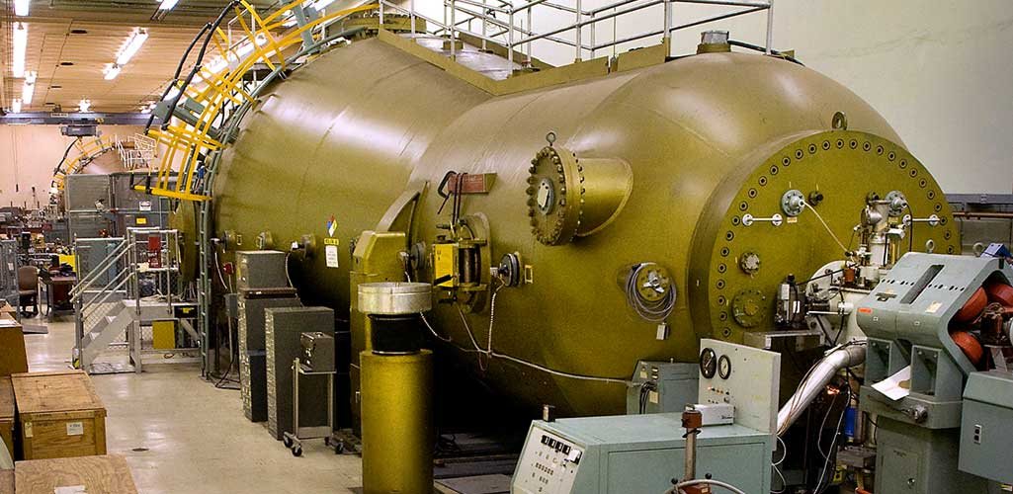
Historical need of H⁻/D⁻ sources
Van de Graaf and Tandem accelerators
Double the acceleration voltage with one HV terminal
Removal of 2 e⁻ is simple !
Stripping foil (carbon)
Brookhaven National Laboratory
337 MeV Au ions and any other kind of ions
H⁻/D⁻ [U_{HV}] H⁺/D⁺ [U_{HV}]
V
+U_{HV}
+U_{HV}
Double stripping of negative ions
H⁻/D⁻ [RT]
H⁺/D⁺ [2U_{HV}]
0
X
L. Alvarez, Rev . Sci. Inst. 22, 705 (1951)
G. I. Budker and G. I. Dimov, in Trudy Mezhdunarodnoi Konf. Po Uskoritelyam (1963)
G. I. Budker, G. I. Dimov, and V. G. Dudnikov, Atomnaya Energiya 22, 348 (1967)

Slide 3
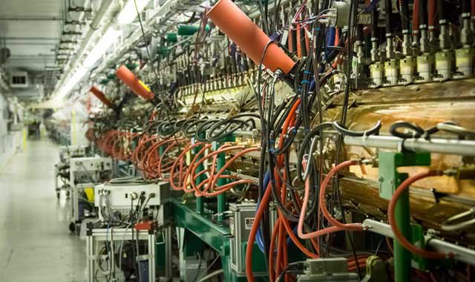
Main applications of H⁻/D⁻ sources
1960’s used in cyclotron and charge-exchange was used for cyclic high-energy proton accelerators
1970’s H⁻ / D⁻ for to inject H⁰ / D⁰ with E > 100 keV / nucleons: injection into magnetic fusion device (1 MeV required for ITER)
G. I. Budker and G. I. Dimov, in Proceedings of the Conference on High Energy Accelerators, 993 (1963)
K. W. Ehlers, Nucl. Instrum. Methods 32, 309 (1965)
O. Felden et al., AIP Conf. Procs. 1515 321 (2013)
K. H. Berkner et l., Nucl. Fusion 15 249 (1975)
M. Bacal and M. Wada, Plasma Sources Sci. Technol. 2 190309 (2020)
Neutron sources: spallation neutron source
M. P. Stockli et al., AIP Conf. Procs. 1869 030010 (2017)
H⁻/D⁻ production much more difficult than H⁺/D⁺
Oak Ridge National Laboratory

Slide 4
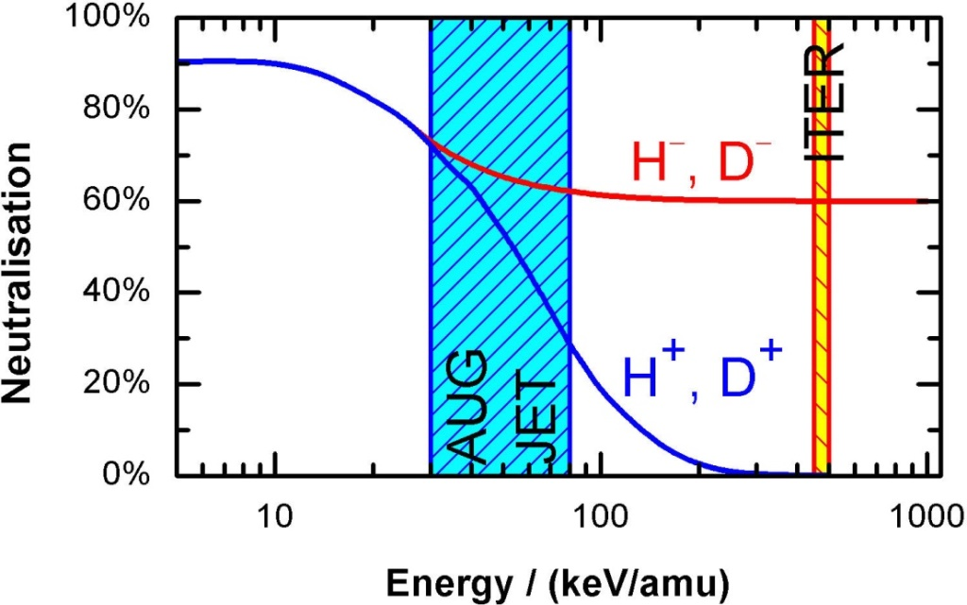
Do we really need negative ions ?
Proton generation very simple and effective, not negative ions !
Example: ITER Neutral Beam Injectors requires 1 MeV H⁰ or 870 keV D⁰ for plasma heating
Neutralisation efficiency by stripping of positive ions too small
Example: particle accelerators, double charge-exchange doubles the acceleration energy
Negative ions generated in a low temp. plasma source

Slide 5
Content of this talk
  Fundamental mechanisms governing low pressure, low temperature H⁻/D⁻ sources
    Volume enhanced mechanisms
    Surface conversion mechanisms
    Typical setup and comparison of sources
  Mostly used source diagnostics
    Amperemeters, Langmuir probes, OES
    Laser detachement, cavity ringdown spectroscopy, Fowler method
  Theory and modelling
    0D, 1D Fluid and kinetic, 2D and 3D Particle-in-cell
  Beam physics and beam properties: out of the scope but questions are welcome

Slide 6
Outline
Work principle
  Volume negative ions generation and destruction mechanisms, example of source
  Surface negative ions generation, example of source
Diagnostics
Theory and modelling
Conclusion

Slide 7
Outline
Work principle
  Volume negative ions generation and destruction mechanisms, example of source
  Surface negative ions generation, example of source
Diagnostics
Theory and modelling
Conclusion

Slide 8



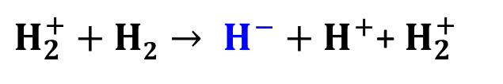


Volume generation mechanism
Main generation mechanism: two steps process
  Vibrational excitation of H₂ / D₂ by electron impact
  Dissociative electron attachement to a ro-vibrationally excited H₂ / D₂
Other mechanisms
1 2
$$H2\left(0,0\right)+e→ H2\left(v^{′},J\right)+e→H+H^{−}$$
Volume effect: M. Bacal, Phys. Scripta 2/2 467 (1982)
$H+e→ H^{−}+$ $hν$
$$H^{+}+H2→ H^{−}+H_{2}^{+}$$
$H_{2}^{+}+e→ H^{−}+$ $H^{+}$
$H_{2}^{+}+H2→ H^{−}+H+2$ $H^{+}$
$$H_{3}^{+}+e→ H^{−}+H_{2}^{+}$$
$H_{2}^{+}+H2→ H^{−}+$ $H^{+}$+ $H_{2}^{+}$
Smaller cross-section, minority plasma molecular ions
M. Bacal et al., J. Appl. Phys. 129, 221101 (2021)
T. J. Millar, C. Walsh, and T. A. Field, Chem. Rev. 117, 1765–1795 (2017)

Slide 9
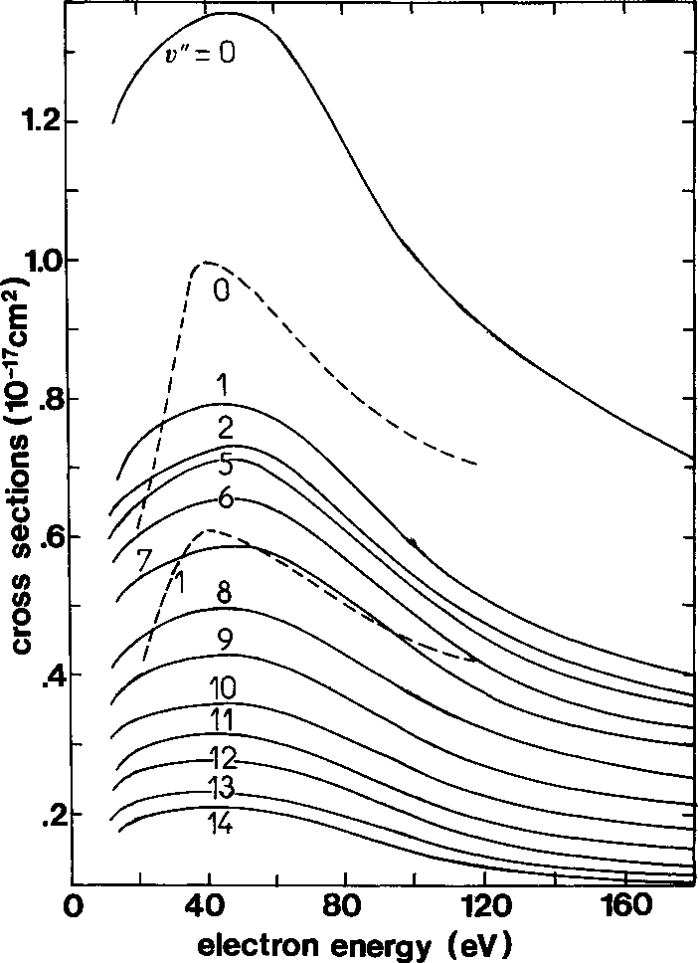
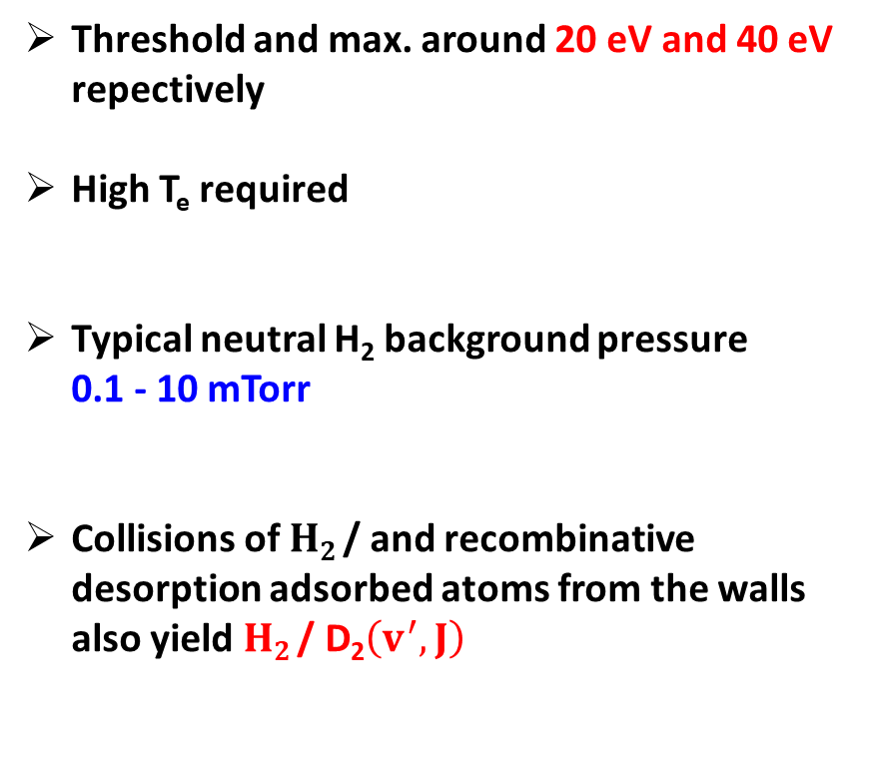
Excitation of hydrogen molecules
Vibrational excitation of H₂ / D₂ by electron impact
$$e+H2 \text{/ }\text{D}\text{2}\left(0,0\right)→ H2 \text{/ }\text{D}\text{2}\left(v^{′},J\right)+e$$
Threshold and max. around 20 eV and 40 eV repectively
High T_{e} required
Typical neutral H₂ background pressure
0.1 - 10 mTorr
Collisions of $H2 \text{/ }$and recombinative desorption adsorbed atoms from the walls also yield $H2 \text{/ }\text{D}\text{2}\left(v^{′},J\right)$
J. Marx et al., Journ. de Physique 46 1667 (1985)

Slide 10

Dissociative electron attachement (DEA)
Dissociative electron attachement to a ro-vibrationally excited H₂ / D₂
Cross section very small for v’ = 0
Gain of several orders of magnitude for v’ > 1
Low energy electrons needed for DEA attachement !
$$H2\left(v^{′},J\right)+e →H+H−$$
J. Horacek et al., Phys. Rev. A 70, 052712 (2004)

Slide 11
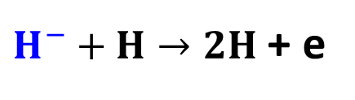

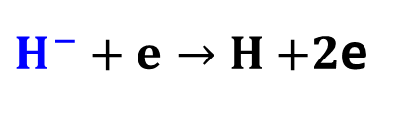




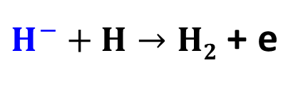
Main destruction mechanisms
H electron affinity is 0.7542 eV
H⁻ / D⁻ easily destroyed in low temperature plasma volume:
[1] negligible for T_{e} < 2 eV: use of magnetic field (MF $∝$ 10 mT) to reduce T_{e}
Magnetic field
[1]
$H^{−}+e→H+$2e
$∝$T_{e}
R. K. Janev et al., Elementary Processes in Hydrogen-Helium Plasmas (1985)
$$H^{−}+H^{+}(H_{2}^{+}or{ H}_{3}^{+})→2H$$
$∝$T⁺
$H^{−}+H→2H$ + e
C. Sidis et al., Phys. Rev. Lett. 47, 1280 (1981)
$H^{−}+H→H2$ + e
$∝$T_{H}
Increase of H⁻ volume generation (source dep.)
Decreases the H⁻ destruction by e⁻ collision
Reduces the amount of co-extracted electrons

Slide 12
Example of volume source setup
High and low energy electrons: H₂(v’,J) and electron attachement / minimization of H⁻ destruction and co-extracted electrons
Use of a magnetic field with a typical induction of 10 mT
RF possible
H⁻
H₂(v’,J)
Typical parameters: p = 0.1 - 10 mTorr, 10¹⁵⁻¹⁷ m⁻³ positive ion density, T_{e} between 1 and 10 eV, kW range power and up to tens of kV for beam
Performance of tens of mA.cm⁻² for the beam
D. Faircloth et al., New J. Phys. 20 025007 (2018)

Slide 13
Outline
Work principle
  Volume negative ions generation and destruction mechanisms, example of source
  Surface negative ions generation, example of source
Diagnostics
Theory and modelling
Conclusion

Slide 14

Surface generation mechanism
Image potential: near surface downshift of H affinity level
Overlapping of surface VB and atom EA: electron tunneling possible
Back-tunneling is possible when leaving the surf. (neutralization)
Electron affinity fixed to 0.75 eV for H, thus, low mat. WF must be used !
Low mat WF around 2 to 3 eV (Cs, Ba, LaB6, K, Rb …)
Negative surface ionization
Fundamental level
Vacuum level
Conduction band
Fermi level
Valence band
G. Cartry et al., New J. Phys. 19 025010 (2017)
$$P^{−}∝exp⁡[−(WF−EA)]$$

Slide 15
Surface atomic and molecular mechanisms
For plasma volume atomic species: negative surface ionization (backscattering):
  single (H⁰/D⁰) or double electron capture (H⁺/D⁺)
  fragmentation upon impact and negative ionization of molecular ions (H_{x}⁺/D_{x}⁺) with x = 2 or 3
Sputtering followed by surface negative ionization of an adsorbed H or D atom by an incoming plasma ion (energy and surface temp. dependent)
Backscattering
H atoms
C atoms
Sputtering
L. Schiesko et al., Plasma Sources Sci. Technol. 19 045016 (2010)

Slide 16
Low work function materials
Alkali metal evaporated from an oven is performed, mostly Cs
Dipole effect and Cs-Cs orbital overlapping decreases the WF
Strong reduction of the WF, on most of the material over which it is deposited
Bulk Cs WF recovered for more than 1 mono-layer
Electron rich
Electron poor
Dipole
Surface
Bulk W
Topology of
W covered Cs (DFT)
S. Chou et al., J. Phys. Condens. Matter 24 445007 (2017)
L. W. Swanson and R. W. Strayer, J. Chem. Phys. 48, 2421 (1968)

Slide 17
Example of surface conversion source setup
High and low energy electrons: H₂ dissociation and minimization of H⁻ destruction and co-extracted electrons, magnetic field 10 mT
Cs evaporated from an oven, covers all the chamber surfaces
Filament driven
or external RF coil
H⁻
Cs inlet
H⁰
D. Faircloth et al., New J. Phys. 20 025007 (2018)
Typical parameters: p = 0.1 - 10 mTorr, 10¹⁶⁻¹⁸ m⁻³ positive ion density, T_{e} between 1 and 20 eV, kW range power and up to tens of kV for beam
Performance of tens of mA.cm⁻² for the beam

Slide 18
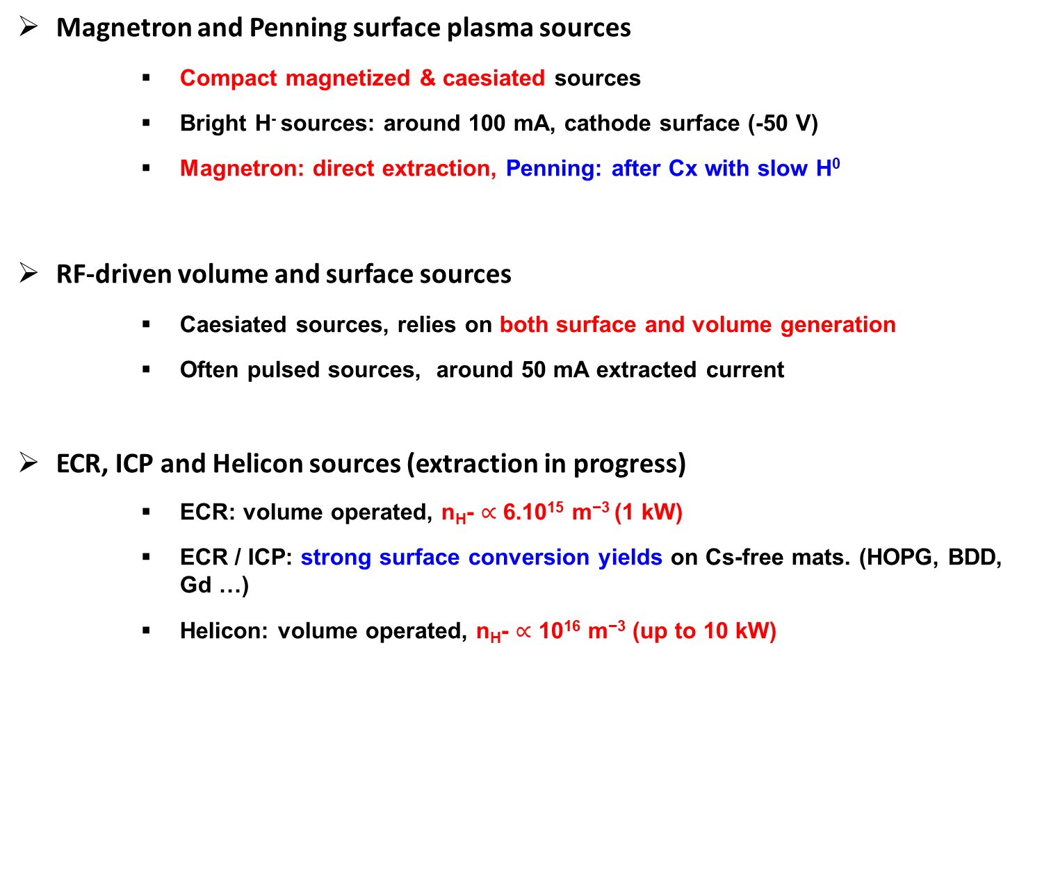
Other sources
Magnetron and Penning surface plasma sources
  Compact magnetized & caesiated sources
  Bright H⁻ sources: around 100 mA, cathode surface (-50 V)
  Magnetron: direct extraction, Penning: after Cx with slow H⁰
RF-driven volume and surface sources
  Caesiated sources, relies on both surface and volume generation
  Often pulsed sources, around 50 mA extracted current
ECR, ICP and Helicon sources (extraction in progress)
  ECR: volume operated, n_{H}- $∝$ 6.10¹⁵ m⁻³ (1 kW)
  ECR / ICP: strong surface conversion yields on Cs-free mats. (HOPG, BDD, Gd …)
  Helicon: volume operated, n_{H}- $∝$ 10¹⁶ m⁻³ (up to 10 kW)
Penning: D. Faircloth et al., AIP Conf. Proc. 1390 205 (2011)
Magnetron: D. S. Bollinger, AIP Conf. Proc. 1655 070002 (2015)
J. Lettry et al., AIP Conf. Proc. 1869 030002 (2017)
M. P. Stockly et al., AIP Conf. Proc. 1869 030010 (2017)
M. Cavenago et al., Rev. Sci. Instrum. 91, 013316 (2020)
Cs free
Cs free review: F. Taccogna et al., Eur. Phys. J. D 75 227 (2021)
Sources for acclerators review: D. Faircloth et al., New J. Phys. 20 025007 (2018)
ECR: S. Aleiferis et. al, Plasma Sources Sci. Technol. 27, 075015 (2018)
ECR / ICP: G. J. Smith et al., J. Phys. D: Appl. Phys. 53 465204 (2020)
Helicon: D. S. Bollinger, AIP Conf. Proc. 1655 070002 (2015)

Slide 19
Outline
Work principle
  Volume negative ions generation and destruction mechanisms, example of source
  Surface negative ions generation, example of source
Diagnostics
Theory and modelling
Conclusion

Slide 20
Source performance: amperemeters
Most important diagnostic for source performance !
Cs-free source: volume operation low H⁻, high e⁻
Cs evaporation: reduction of co-ext. e⁻ and strong increase of ext. H⁻
Cs management: control of the evaporation rate can be tricky !
Pure volume
C. Wimmer, L. Schiesko et al., Rev. Sci. Inst. 87 02B310 (2016)
« Cs effect »: Y. I. Belchenko et al., Nucl. Fusion 14, 113 (1974)

Slide 21
Optical Emission Spectroscopy (OES)
LOS integrated, non-invasive technique, absolute calibration
Basics of OES: U. Fantz, Plas. Sources Sci. Techn. 15 S137 (2006)
Determination of n_{e} by H_{β} and H_{γ} line intensity-ratio (Balmer series), T_{e} coupling of OES to a collisional-radiative (CR) model
Atomic and molecular hydrogen density, neutral gas temperature: H_{γ} / Fulcher line intensity-ratio coupled to CR
D. Wünderlich et al., J. Quant. Spectrosc. Radiat.
Transfer 110, 62 (2009)
D. Wünderlich et al., J. Quant. Spectrosc. Radiat.
Transfer 240, 106695 (2020)
U. Fantz. et al., Nucl. Fusion 46 S297 (2006)
Monitoring of Cs and impurities (O, H₂O, N₂ etc…)
B. Zaniol et al., Rev. Sci. Inst. 91 013103 (2020)

Slide 22
Local plasma parameters: Langmuir probes
Local plasma parameters but invasive technique!
Electron branch one must enforce
Often not fullfilled due to RF and B !
Solution for correct electron branch evaluation:
Estimation of the electronegativity
V. Godyak, J. Phys. D.: Appl. Phys 44 233001 (2011)
FF. Chen, Plas. Sources Sci. Techn. 21 055013 (2012)
H. Amemiya, J. Phys. D: Appl. Phys. 23, 999 (1990)
J. Bredin et al., Phys. Plas. 21 123502 (2014)
Electron rich Ion-Ion
L. Schiesko et al., Plas. Phys. & Contr. Fusion 53 085029 (2011)

Slide 23
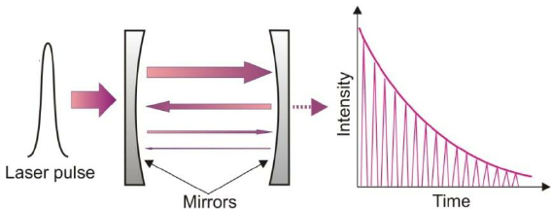
Negative ion density (LOS integrated)
Laser photodetachement coupled to RF compensated Langmuir probe
Cavity ring-down spectroscopy
Nd:YAG @ 1064 nm
M. Park et al., Phys. Plas. 28 023505 (2021)
Nd:YAG @ 1064 nm
Fit of the laser exponential ringdown decay H⁻ density
H. Nakano et al., J. Instr. 11 C03018 (2016)

Slide 24
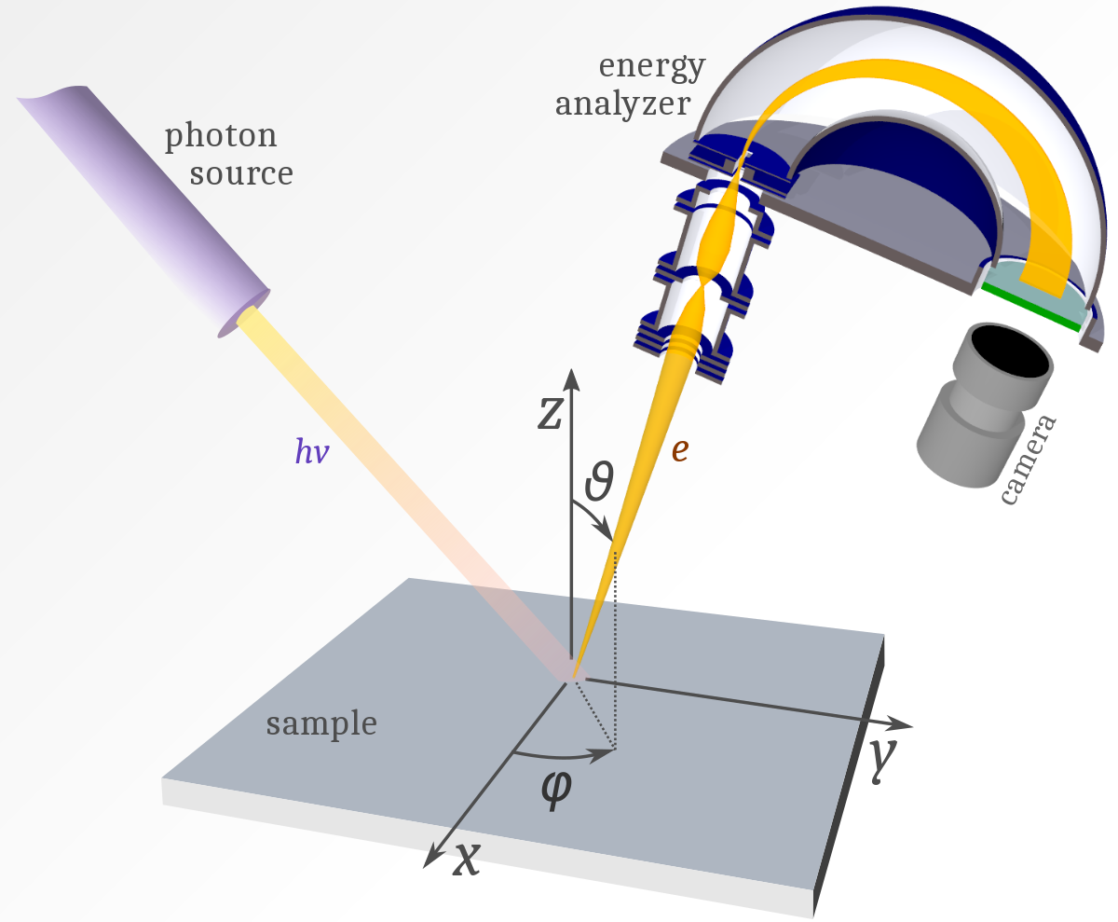
Work function evaluation
Photoelectron emission
Biased collector
R. Friedl et al., Rev. Sci. Inst. 87 043901 (2016)
Photocurrent normalized to the square root of the surface temperatures is prop. to the WF χ (plus a constant A)

Slide 25
Summary of commonly used diagnostics
Diagnostic | Parameter | Global, Local, LoS int. | Invasive | Remarks
Amperemeter | H⁻ and e⁻ currents | Global or local | No | Performance
Optical emission spec. | n_{e}, Te, nH⁰ and more… | LoS | No | Absolute calib. + CR model
Langmuir probe (LP) | Typical plasma params. | Local | Yes | Careful analysis
Laser photodet. + LP | nH⁻ | Local | Yes | Alignment !
Cavity ringdown | nH⁻ | LoS | No | Alignment !
Fowler | WF | Local | No | Between plasma pulses
Diagnostics review: K. Tsumori et al., App. Phys. Rev. 8 021314 (2021)

Slide 26
Outline
Work principle
  Volume negative ions generation and destruction mechanisms, example of source
  Surface negative ions generation, example of source
Diagnostics
Theory and modelling
Conclusion

Slide 27
Global model (0D)
Set of coupled particle and power balance equations, neglects spatial derivatives but simple implementation and efficient !
Difficulty: accurate cross sections / rates coefficients needed
LXCat database: E. Carbone et al., Atoms 9, 16 (2021)
NIST database: V. K. Shen et al., NIST Standard Ref. Database 173
http://doi.org/10.18434/T4M88Q
S. H. Scarlett et al., Plasma Sources Sci. Technol. 28, 025004 (2019)
Without Cs
With Cs
Averkin S. N. et al., AIP Conf. Proc. 2011 050026 (2018)
Accurate qualitative results (0D) to determine trends
Review Global Modelling: A. Hurlbatt et al., Plasma Process Polym. 14 1600138 (2017)

Slide 28
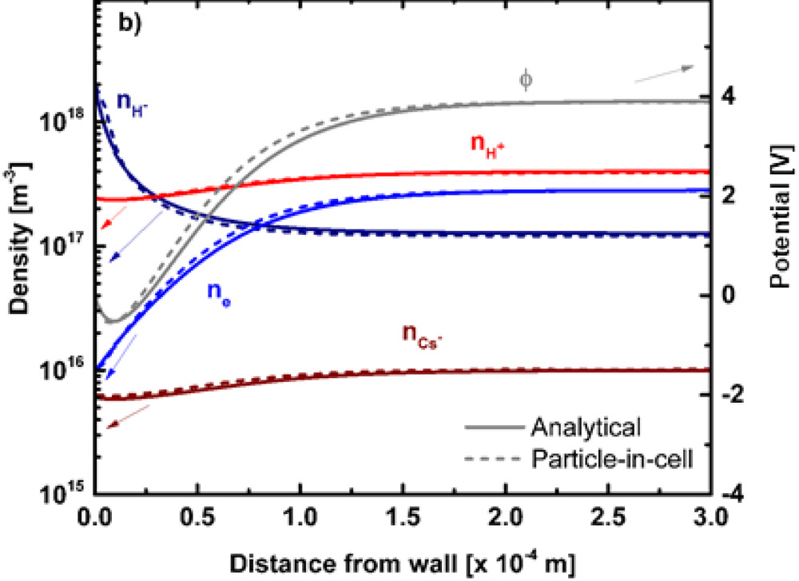
1D fluid and kinetic models
Fluid: moments of Boltzmann equation
Kinetic: truncated Maxwellian solutions of the Vlasov eq.
Transported negative ions: space-charge limitation (Child-Langmuir)
Very quick and accurate results, useful for parameters scans
plasma-wall
interaction
For
Fluid
Kinetic
(Wall-)
Wall
R. McAdams et al., Plasma Sources Sci. Technol. 20, 035023 (2011)
L. Schiesko et al., J. Appl. Phys. 127 033302 (2020)

Slide 29
2D fluid for magnetized plasma transport
Fluid: moments of Boltzmann equations
Magnetic fields: drifts, at least 2D needed !
Very general models including neutrals (Navier-Stockes eqs.) and surface processes as well as self-consistent RF coupling (Maxwell eqs.)
Reproduces non-trivial charged particles transport: ExB, diamagnetic drifts
Extraction region
8 mT
B
B
8 mT
Extraction region
Source
Source
S. Lishev, L. Schiesko et al., AIP Conf. Proc. 1655 040010 (2015)
G. J. M. Hagelaar et al., Plasma Sources Sci. Technol. 20, 015001 (2011)

Slide 30
3D Particle-In-Cell (PIC): bulk plasma
PIC: self-consistent particle method
3D: realistic transport w/r magnetic field
Requires massive parallelisation (OpenMP, OpenMPI, OpenAcc etc…)
B
8 mT
Source
Modelling
B
Beam
Experiments
Extraction
LP
B
G. Fubiani et al., Phys. Plas. 20 113511 (2013)
Very good agreement with Langmuir probe measurements
3D: simulations close to reality !
Modelling: G. Fubiani et al., New J. Phys. 19 015002 (2017)
Experimental: L. Schiesko et al., Plas. Phys. Cont. Fus. 54 105002 (2011)

Slide 31
3D Particle-In-Cell (PIC): H⁻ extraction
Understanding the negative ion extraction is a key parameter
2D cannot fully unveil transport and extraction of H⁻ in a magnetized plasma
Discrimination between direct and indirect extraction of surface generated H⁻
Beam formation and properties such as divergence, perveance …
z = 0 plane
B
Beam
Meniscus
B
Surface H⁻
A. Revel et al., Journ. App. Phys. 122 103302 (2017)

Slide 32
Summary theory and modelling
Different possibilities for modelling
  qualitative, qantitative, predictive…
Global model / 0D
  volume averaged results, fast implementation,
  limitations on known rate coefficients is the major drawback
1D kinetic / fluid / PIC
  usually for plasma-wall interaction, quick and very accurate results
2D fluid or PIC
  transport of magnetized plasma species, presence of drifts
3D PIC
  simulations as close as possible to reality needed,
  negative ion generation, transport and extraction,
  time consuming, small volume simulated, cluster needed

Slide 33
Outline
Work principle
  Volume negative ions generation and destruction mechanisms, example of source
  Surface negative ions generation, example of source
Diagnostics
Theory and modelling
Conclusion

Slide 34
Conclusion
Negative ion sources are an unavoidable setup for high energy accelerators / neutral beam injectors
Main generation and destruction mechanisms well understood:
  Volume: dissociative attachement to rovibrationnaly excited H₂
  Surface: backscattering or sputtering of an adsorbed hydrogen as a negative ion, low WF material, Cs evaporation or Cs-free
Different plasma sources available: RF, ECR, Filament…
For both generation mechanisms, > 10 eV and < 2eV are needed !
Use of a magnetic field: separation of the source in a high Te and a low Te
Magnetic field very effective, but generates drifts !
Many diagnostics can be used for plasma parameters, Cs monitoring, densities…
Modelling and theory well developped: 0D, 1D, 2D and 3D models /particle-in-cell give hints on the underlying physics and can be predictive

Slide 35
Challenges: isotopic effect
Hydrogen vs. Deuterium
Extracted D⁻ < H⁻ and more co-ext. electrons in D₂ although stronger B
Mitigation possible
  with the use of potential rods near the extraction system
  ‘Cs shower’: oven evaporating near the first accelerator grid
Review Deuterium operation: M. Bacal et al., Plasma Sources Sci. Technol. 29, 033001 (2020)
Short pulses
D. Wünderlich et al., Nucl. Fusion 61 096023 (2021)

Slide 36
Challenges: ITER NBI
ITER requirements: 40 A D⁻ at 1 MeV during 1h cw, never simultaneously achieved !
At Consorzio RFX, SPIDER: full-scale prototype (100 kV), MITICA: entire ITER NBI (1 MV) under construction
Beam uniformity, div < 7 mrad, Cs uniformity, 1 MV voltage holding, co-ext. electrons, thermal and thermomechanical issues, radiations from ITER …
SPIDER
G. Serianni et al., Rev. Sci. Inst. 91 023510 (2020)

