Slide 1
Pulsed plasma for plasma processing
Steven Shannon
Presented at the Online LTP Seminar
26 May 2020
Work shown has been supported by The National Science Foundation, Samsung Electronics, Applied Materials, and MKS Instruments

Slide 2
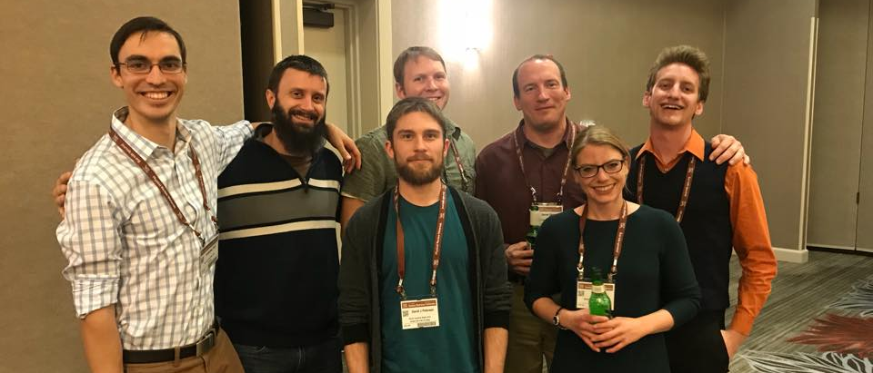
Plasma Science at NCSU
Emphasis is on industrial and medical applications as well as fusion science
Four faculty
Mohamed Bourham – fusion science, plasma assisted coatings, plasma material interactions
Katharina Stapelmann – biological and medical applications
Alexander Bataller – ultrafast spectroscopy, laser plasmas
Steve Shannon – industrial applications, fusion science, advanced diagnostics, RF systems
13 graduate student researchers, 4 undergraduate researchers

Slide 3
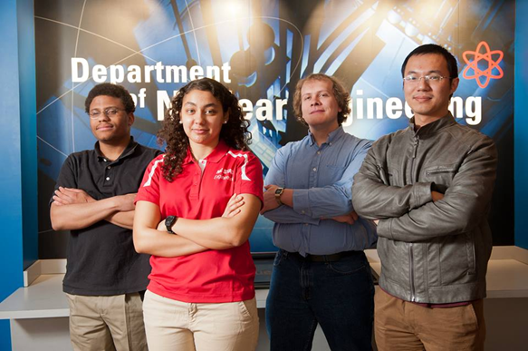
Plasma Science is one of the NE focus areas
Power design and safety analysis
Security and non-proliferation
Plasma science and engineering
Materials, waste forms, and storage
Computational science
Radiation science and engineering
133 undergrads, 123 graduates, 22 faculty, 2 centers (CASL and CNEC), and 1 nuclear reactor
$9.5 million in research expenditures and 17 new grants awarded in FY2016

Slide 4
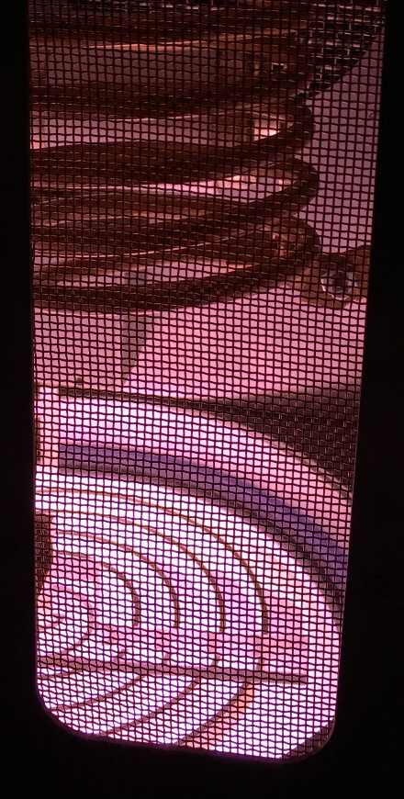
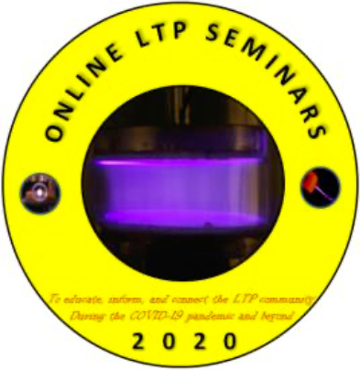
All I have to do is talk…
Joel Brandon
Yao Du
Kristopher Ford
Elijah Martin
John McDuffie
David Peterson
Carl Smith
Matthew Talley
Yuhua Xiao
Abdullah Zafar
Plus countless collaborators, co-workers, and other students – Naman Bhatt, Cade Binkley, Brandon Byrns, John Caughman, Lee Chen, Thai Cheng Chua, Hamilton Clark, David Coumou, Corey DeChant, Vincent Donnelly, Ahmed El-Saghir, Valery Godyak, David Graves, David Green, Casey Icenhour, Brayden Myers, Kyung Sun Kim, Travis Koh, Philip Kraus, Theresa Kummerer, Mark Kushner, Alex Lindsay, Richard Martineau, Ervin Miller, Josh Morsell, Sang Ki Nam, Alok Ranjan, Katharina Stapelmann, Mohammed Shutafyi, Shaun Smith, Peter Ventzek, John Verboncour, Russ Westerman, Scott White, Jang-Gyoo Yang, Yiting Zhang

Slide 5
Overview of presentation
Pulsed plasmas for manufacturing – a brief introduction
Power coupling into pulsed systems
Time resolved diagnostics for pulsed systems
Electronegative plasmas in pulsed environments
Closing remarks

Slide 6
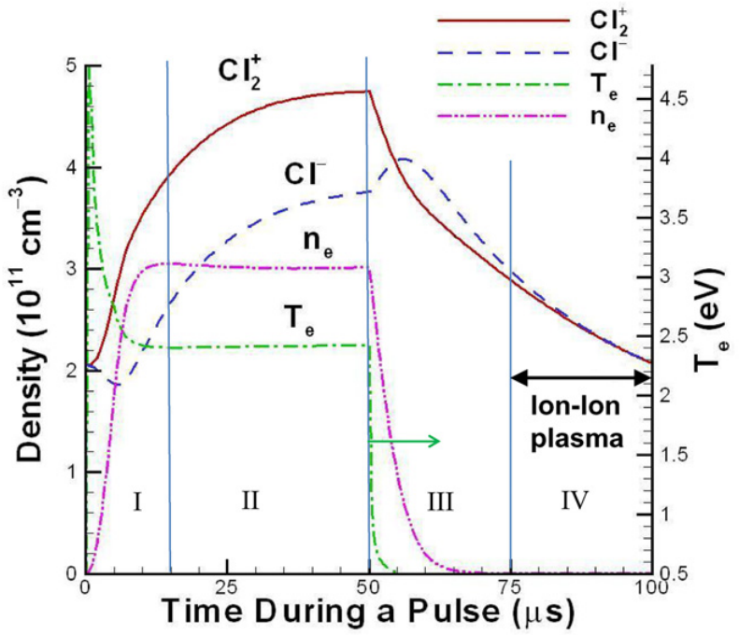
Why Pulsed Plasmas
Steady state conditions are governed primarily by particle and energy balance
Forcing transient conditions open up a wider range of temperatures (chemistry) and densities (flux)
Additionally, timing of chemistry and particle flux can be staged through phase lock pulsing
2D fluid model of 5 kHz pulsed ICP. 320 W, 20 mTorr Cl₂^{[2]}
D. Economou. Journal of Physics D: Applied Physics 47.30 (2014): 303001.
S. Banna et. al Journal of Vac. Sci. and Technol. A 30, 040801 (2012)

Slide 7
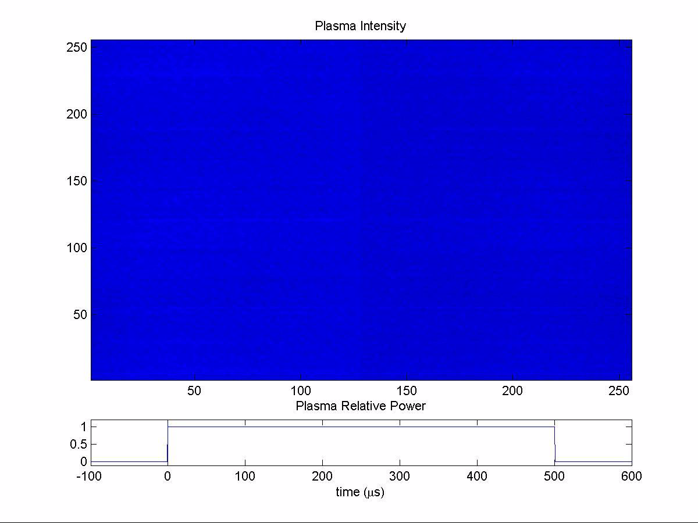
Time varying plasmas present significant challenges for efficient RF power delivery in processing systems
Slow transients demand smooth impedance matching and power compensation – consistent tuning trajectories, accurate power measurement (gas transitions during short process steps (BARC open, endpoint of large open area processes, etc.)
Rapid transients (RF pulsing, Bosch, magnet pulsing, step transition) do not have manufacturing-ready auto tuning match solutions (but there are some really good ideas out there). Matching network and antenna design need to account for transient impedance mismatch during specification and design
This talk will introduce these problems and present some examples on how they may be addressed
13.56 MHz
50% D.C.
1kHz Pulse
200W Peak
Ground
Electrode
RFEA

Slide 8
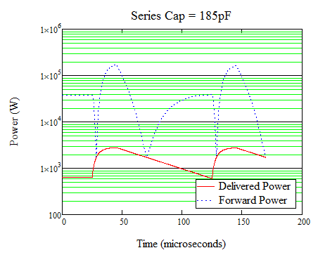
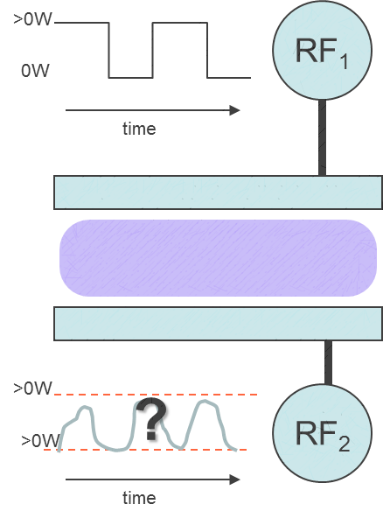
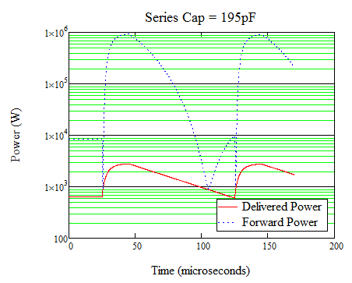
A motivational illustration
Assumes a 10¹⁰cm⁻³ Ar plasma with 100V bias on bottom electrode
Passive L-type match with typical series and shunt circuit elements
Significant power transients generated due to V_{bias} dependence on n_{e} as well as load impedance shift due to pulse cycle.
Within-pulse measurement and control loop response is needed to stabilize these systems over larger process ranges

Slide 9
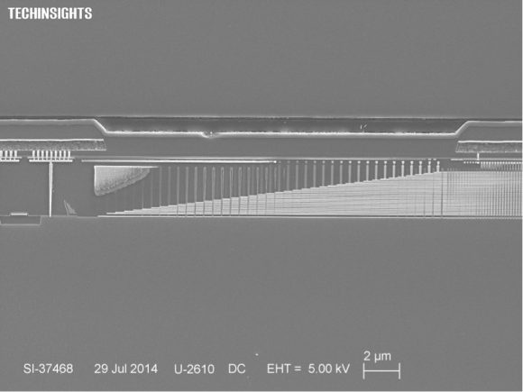
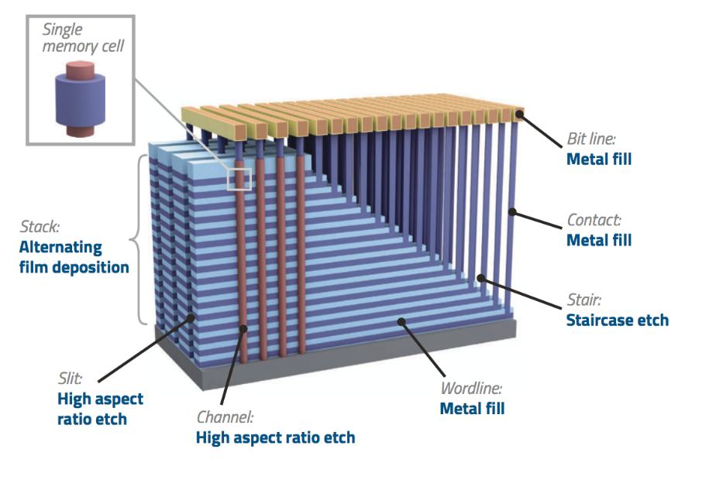
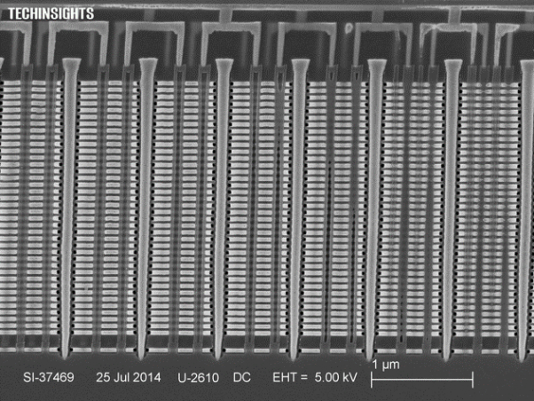
The basic challenge – control for complex features
Harmeet Singh, “Overcoming challenges in 3D NAND volume manufacturing, Solid State Technology Magazine, July 2017
Dick James, “The Second Shoe Drops – Samsung V-NAND Flash”, www.chipworks.com, 5 August 2014
Control of ions and reactive species are critical for the formation of complex features (such as HAR and atomic layer processes). Partitioning power between these key parameters is a key step in plasma source optimization for manufacturing.

Slide 10
What are we trying to optimize (and trying to avoid)?
What we want
What we don’t want
Uniform power deposition (or power based uniformity control)
Controllable deposition in plasma and sheath regions
Reproducible power WTW and in single processes
Fast time response
Unreasonable power mismatch
High dissipation in non-plasma elements
Narrow operating range and control levels
Unnecessary power delivery complexity
These are by no means exhaustive lists of what we want and what we don’t want. These are only examples taken from a larger list to motivate topics in this presentation

Slide 11
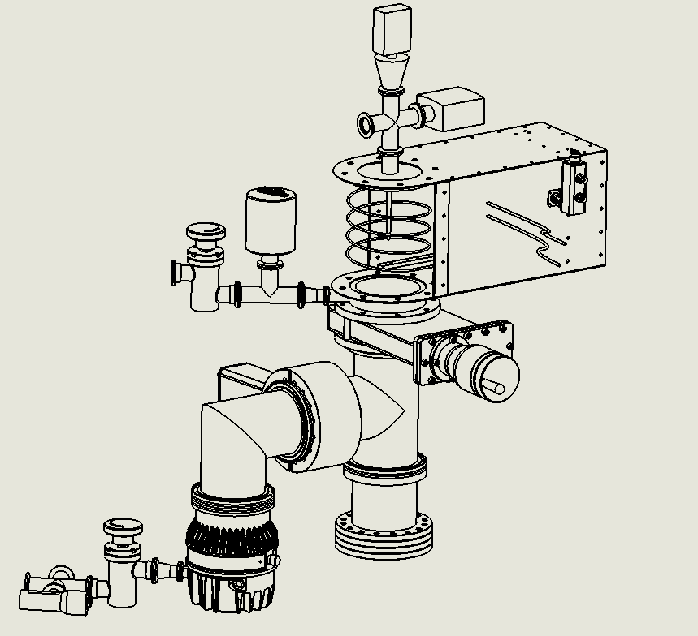
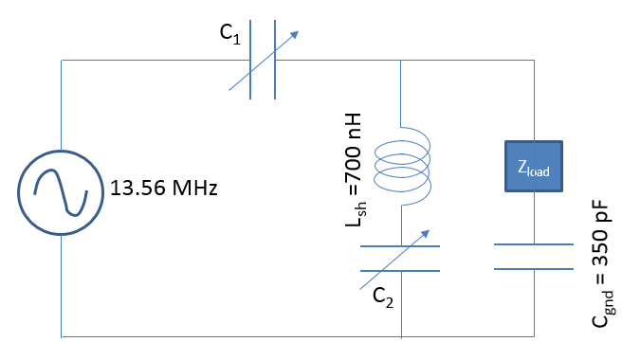
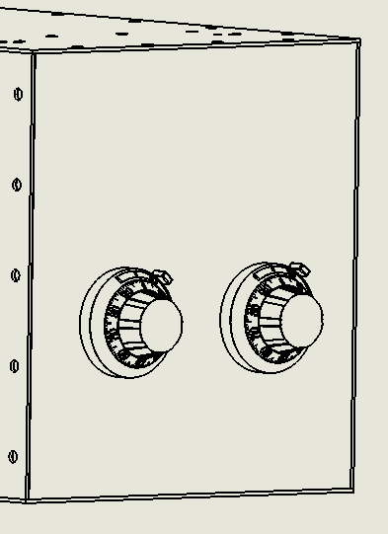
Pulsed ICP power delivery
Langmuir
Probe
RF in
Inficon Triple gauge
Gas Inlet
20 – 290pf
Directional coupler to Network Analyzer
VI Probe
Baratron gauge
Foreline
VI Probe
Throttle
Valve
Capacitance Controls
3.5 turn copper coil
Symmetrical chamber gas flow
Pre-match impedance measurement
50mTorr Baratron gauge
Gas Out
Optical Window
Turbo Pump
Foreline gauge

Slide 12
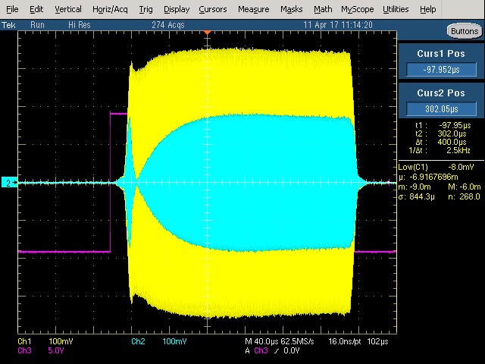
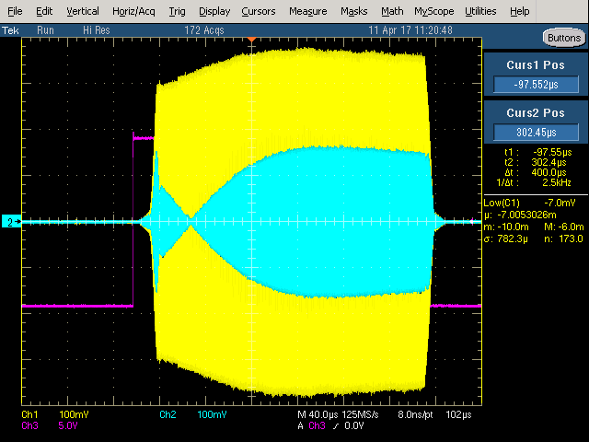
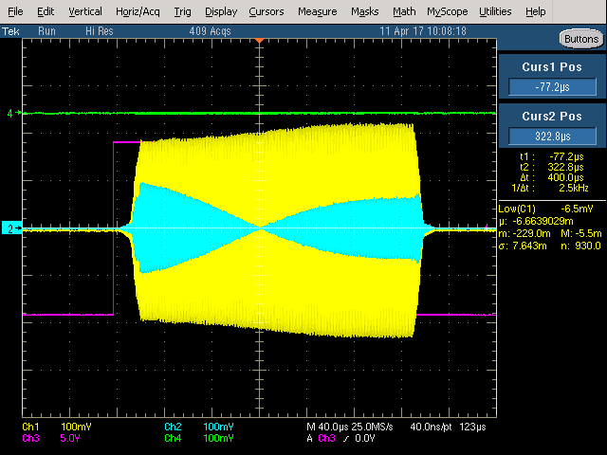
Transient measurements – high resolution time measurements for pulsed RF systems

Slide 13
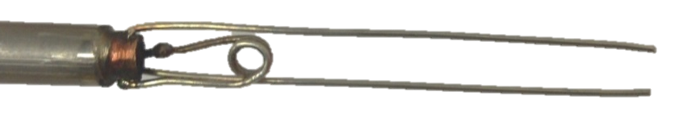
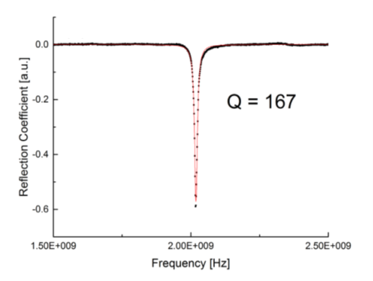
How do we measure density on sub microsecond time scales?
Resonator
Loop Antenna
Metal Ring
Insulating Ring
Coaxial Cable
Ground
Resonator
DC Float
Resonator

Slide 14
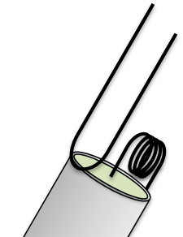





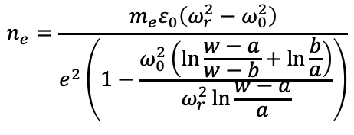



Collisional and Sheath Considerations
Simplified Probe/Plasma
Model
Collisional Model
Sheath Model
l
w
l
w
l
w
Wire radius = a
Sheath thickness = b
$$ω_{r}≈\frac{πc}{\left(2l+w\right)\sqrt{ε_{p}}}$$
$$ω_{r}≈\frac{πc}{\left(2l+w\right)\sqrt{ε_{p}}}$$
$$ω_{r}≈\frac{πc}{\left(2l+w\right)\sqrt{ε_{p}}}$$
$$ε_{p}≈ε_{0}\left(1−\frac{ω_{p}^{2}}{ω_{r}^{2}}\right)$$
$$ε_{p}=1−\frac{ω_{p}^{2}}{ω_{r}\left(ω_{r}−iν_{me}\right)}$$
$$ε_{p}=f\left(plasma\right)+f(sheath)$$
$$n_{e}=\frac{m_{e}ε_{0}}{e^{2}}\left(ω_{r}^{2}−ω_{0}^{2}\right)$$
$$n_{e}=\frac{m_{e}ε_{0}}{e^{2}}\left(ω_{r}^{2}−ω_{0}^{2}\right)\left(1+{\left(\frac{ν_{me}}{ω_{r}}\right)}^{2}\right)$$
$$n_{e}=\frac{m_{e}ε_{0}\left(ω_{r}^{2}−ω_{0}^{2}\right)}{e^{2}\left(1−\frac{ω_{0}^{2}\left(\ln{\frac{w−a}{w−b}+\ln{\frac{b}{a}}}\right)}{ω_{r}^{2}\ln{\frac{w−a}{a}}}\right)}$$
Sands et. al. PSST 16 (2007) 716-725

Slide 15
Pulsed ICP power delivery
20 – 290pf
VI Probe
3.5 turn copper coil
Symmetrical chamber gas flow
Pre-match impedance measurement
50mTorr Baratron gauge

Slide 16
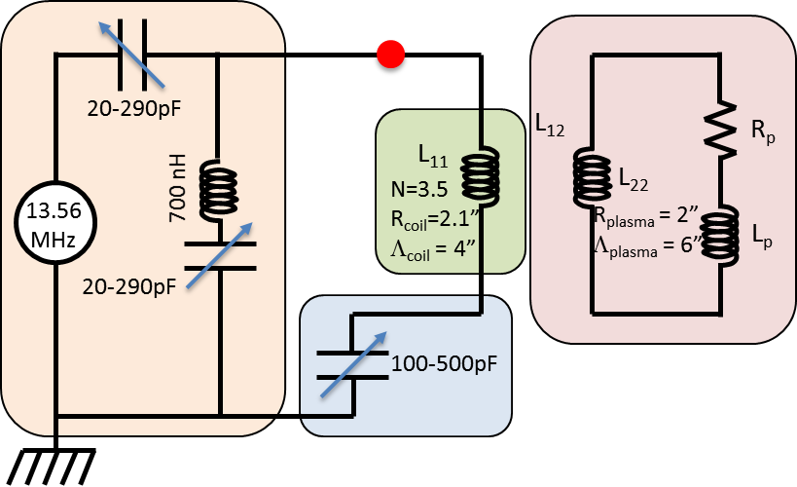
What can we use an integrated plasma / match model for?

Slide 17

This could enable tailored power delivery
$$\sim Δ12μs$$
13.525
13.5
13.4
13.35
13.3

Slide 18



Simplified ICP model for circuit analysis
H_{z}
L₁₂
R_{p}
Power Supply
L₁₁
L₂₂
E_{θ}
L_{p}
Power Conditioning
R_{p} and L_{p} contain plasma parameters – n_{e} (same as capacitive model), ν_{eff} and σ_{eff} (collisional terms with stochastic modifications), and δ_{p} (skin depth, depends on n_{e}, collision terms, and T_{e}). If we have a good collision model we can build a similar impedance matrix for n_{e} and T_{e} here

Slide 19
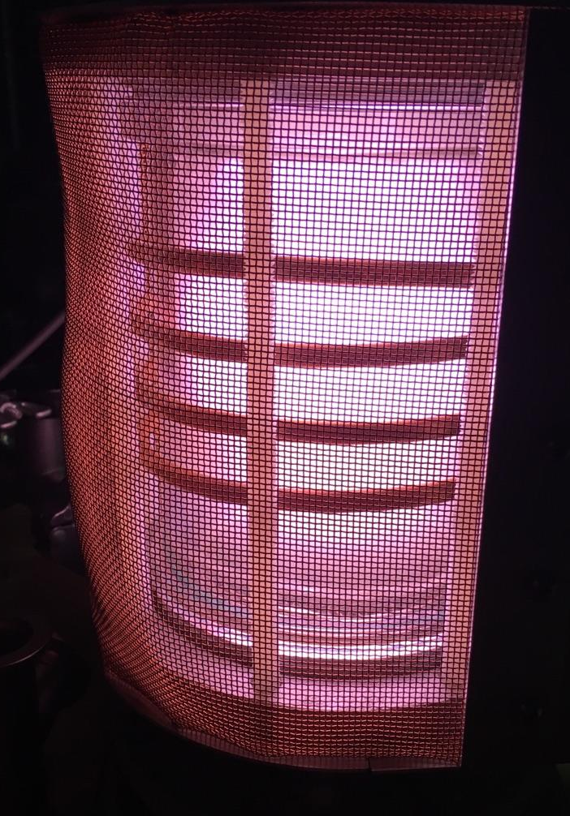
Combining plasma model with chamber design
20-290pF
L₁₂
R_{p}
L₁₁
700 nH
N=3.5 R_{coil}=2.1”
Λ_{coil} = 4”
L₂₂
13.56 MHz
R_{plasma} = 2”
Λ_{plasma} = 6”
L_{p}
20-290pF
100-500pF
Plasma load
Inductive Antenna
Antenna termination
Matching Network
VI Probe

Slide 20
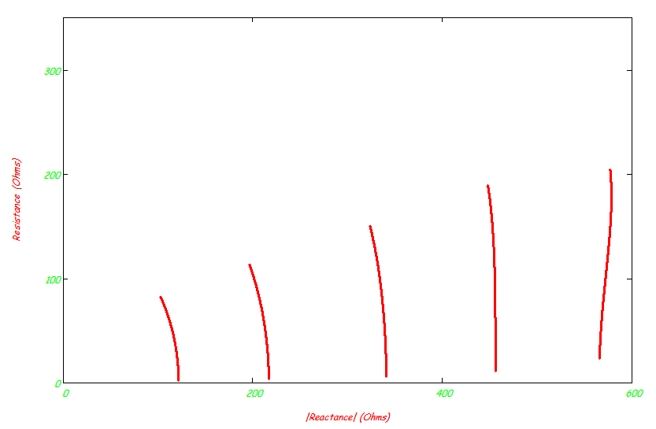
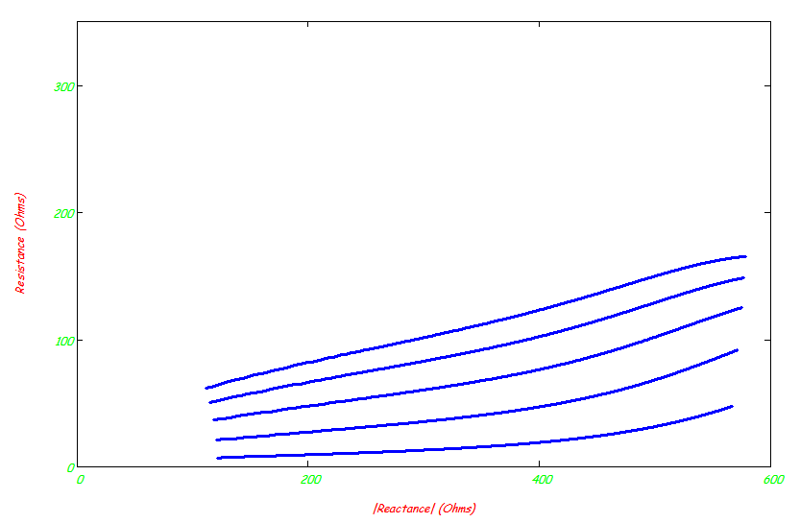
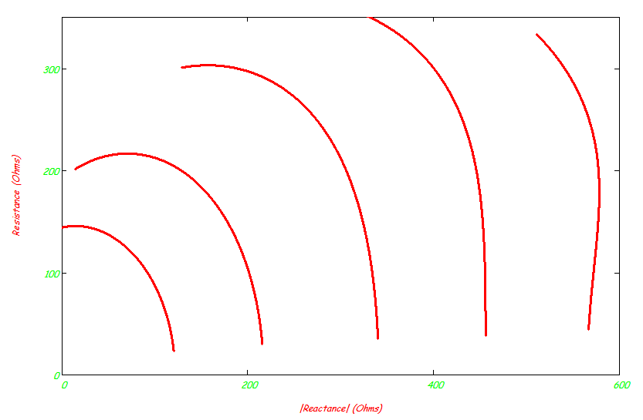
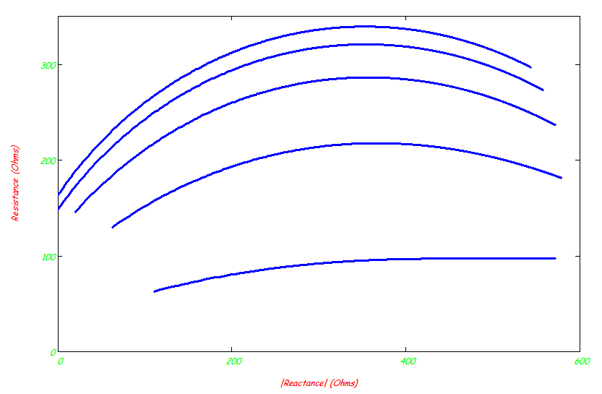
Plasma parameters vs. electrical impedance
5 mTorr Argon
50 mTorr Argon
5 eV
4 eV
3 eV
1 x 10¹¹ cm⁻³
3 x 10¹⁰ cm⁻³
2 eV
1 x 10¹⁰ cm⁻³
5 eV
3 x 10¹⁰ cm⁻³
1 x 10¹⁰ cm⁻³
1 x 10¹¹ cm⁻³
3 x 10⁹ cm⁻³
4 eV
3 x 10⁹ cm⁻³
1 x 10⁹ cm⁻³
3 eV
1 x 10⁹ cm⁻³
1 eV
2 eV
1 eV
Good variability of load impedance with respect to density and temperature give a non-invasive method to measure key plasma parameters for process development and studying new source configurations

Slide 21
How Accurate is the Model? Always an important question to ask
Comparison of n_{e} calculated () from circuit equations with measured n_{e} taken with a Langmuir probe ()
Ar, 75W applied RF at 13.56MHz
ICAROS Reactor, NCSU

Slide 22
Typical Global ICP Model (Leiberman)
L₁₂
R_{p}
L₁₁
L₂₂
RF
L_{p}
Plasma load
Inductive Antenna
Antenna termination
Matching Network
VI Probe
This assumes a “thin skin depth” approximation for the transformer equations. Skin depth is only accounted for in plasma resistance and plasma inductance.
Does skin depth impact transformer coupling parameters? (Spoiler… it does)

Slide 23
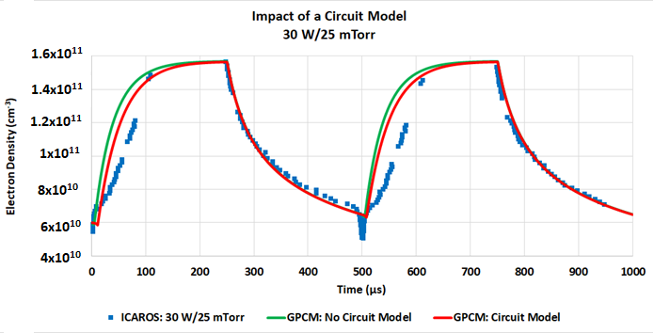
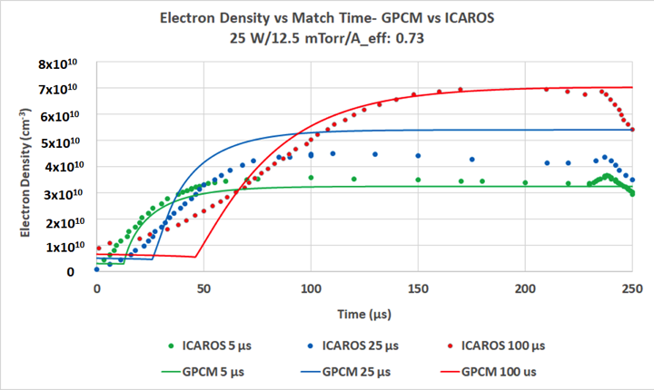
Overall Impact of a Circuit Model
Integrated plasma / circuit model does a good job capturing most trends, but power on density trajectories have never quite matched up as well.

Slide 24
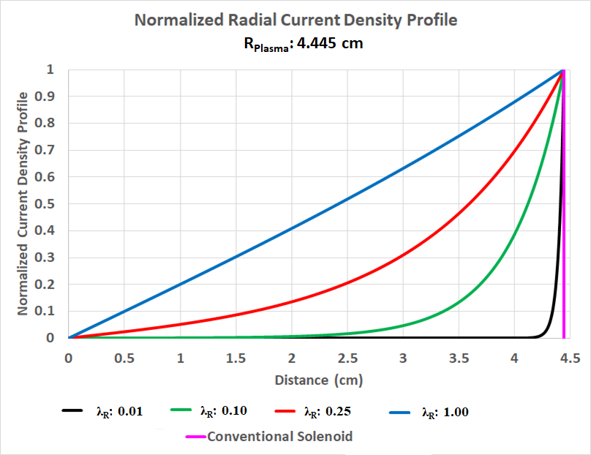
Impact of Skin Depth Dependence
Paramount to capture impact that skin depth has on evolution of plasma parameters in ON-Cycle
Lieberman’s equivalent circuit model of a plasma assumes a thin skin depth for all relevant components
Distribution of current is at the edge of the plasma
When λ_{R} → 0 radial current density profile converges to solution of a solenoid

Slide 25
Impact on L₁₂ & L₂₂

Slide 26
Dependence on Plasma Radius (R_{Plasma})

Slide 27
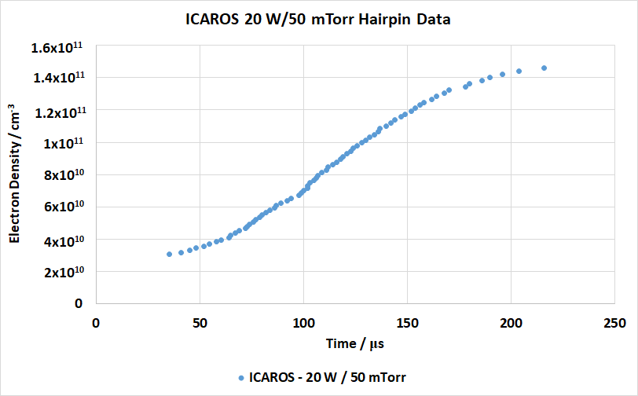
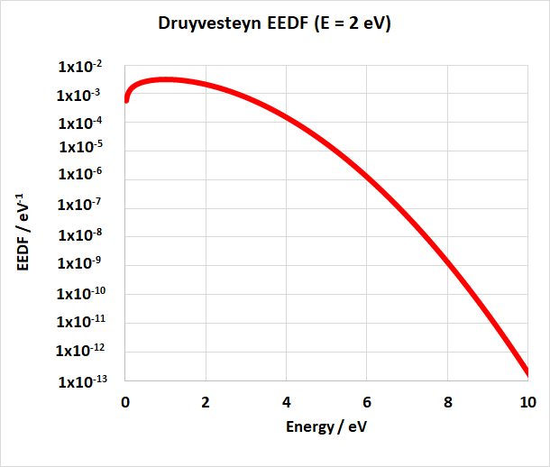
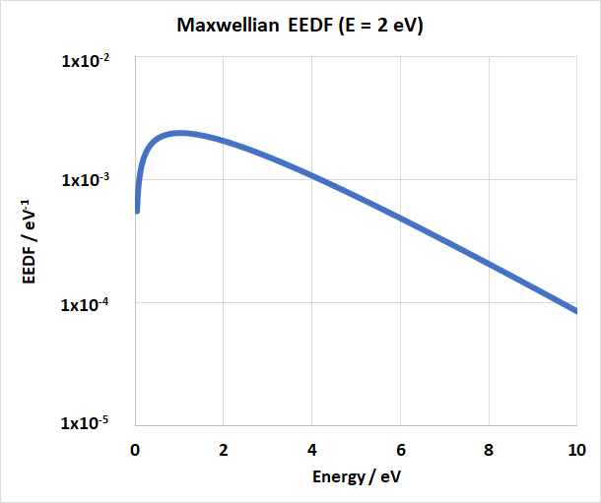
Still missing that “concave up” feature
Druyvesteyn EEDF
Generalized EEDF
Maxwellian EEDF
Seo et al, Journal of the KPS 48(3) 414-421 (2006)

Slide 28
The Generalized EEDF
The evolution of the EEDF from a Druyvesteyn in the early on cycle to the Maxwellian at close to SS can be captured via a generalized EEDF
Where
*Note: Γ is the incomplete lower gamma function

Slide 29
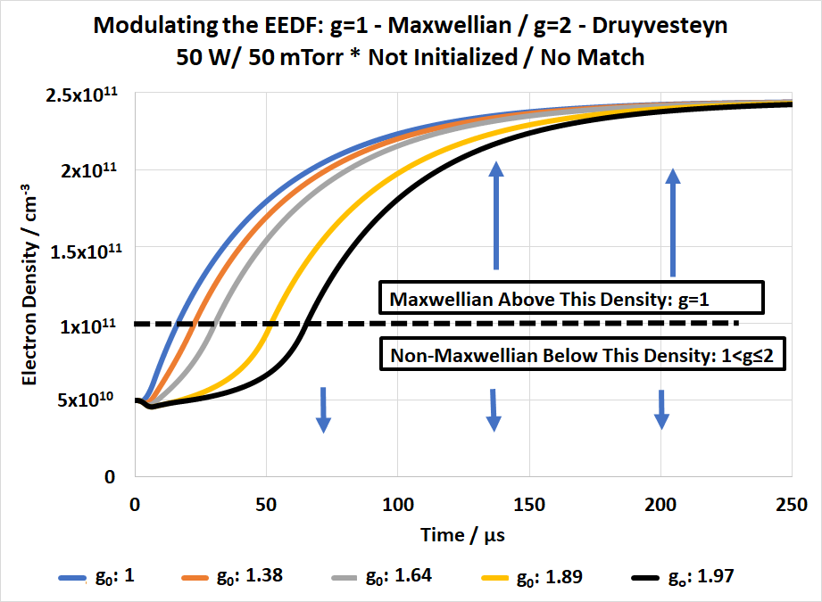
What does this look like?
Some Notes:
Reduced Ionization efficiency when g>1
dn_{e}/dt converges for all cases when g=1
n_{e Lower Bound} occurs at starting density
n_{e Upper Bound} occurs at inflection point
Pressure dependence is expected as dn_{e}/dt rises with decreasing pressure

Slide 30
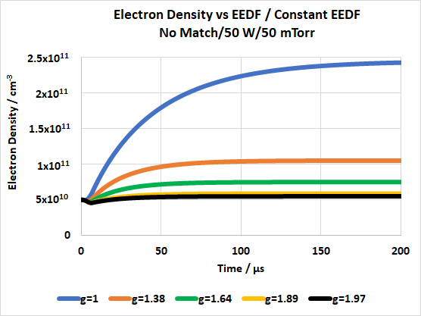
What happens if we keep g constant?
Dn_{e}/dt and ionization decreases g→2. This is responsible for concavity

Slide 31
Possible source of concavity change
-Concavity is caused by an upward shift in the high energy tail of the EEDF.
-The increase in the rates of ionization, excitation and elastic scattering cause an inflection point.
Constant EEDF
Modulating EEDF

Slide 32
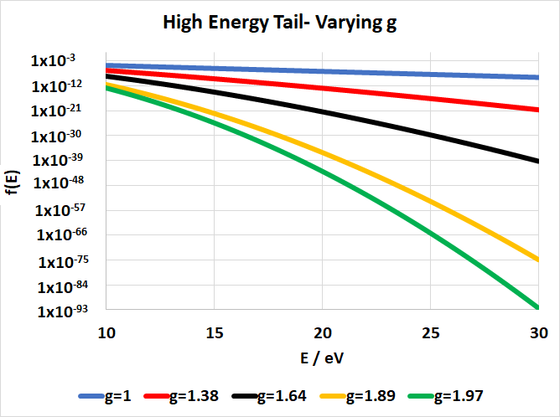
High Energy Tail
Tail at steady state
Depressed ionization at early on cycle characteristic of upward concavity
Tail at early on cycle

Slide 33
Takeaways

Slide 34
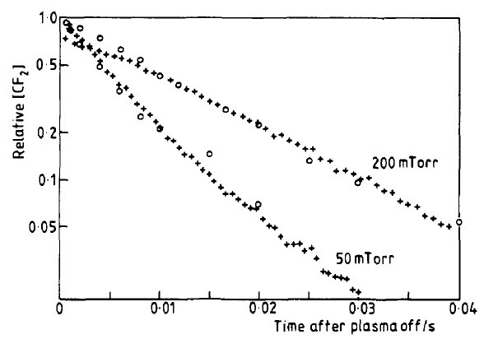

What about chemistry control in pulsed systems
Consider idealized case of [X](t)
An RF pulse of long duration creates a pseudo-steady state
At discrete times in the afterglow, shine a light for data points related to [X]
Plot those data points as an exponential decay to find k_{Total}
Active Glow
After Glow
Laser
Laser
$$[X]$$
t
RF trigger pulse
Free radical density
Ideal snapshot in time → k_{Total}
Laser Induced Fluorescence (+) and Pulse Induced Fluorescence (o) results for CF₂ in CF₄ capacitively coupled plasma^{[1]}
[1] - Hancock, G. et al. Journal of Physical Chemistry 94.8 (1990): 3269-3272.

Slide 35
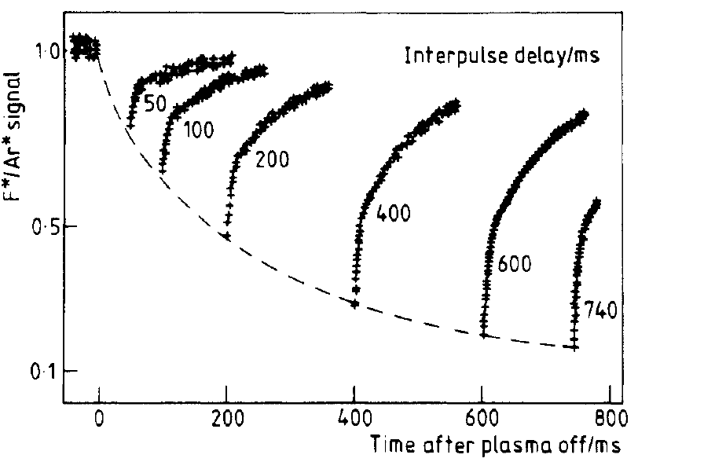


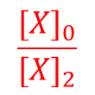
Pulse Induced Fluorescence Method
Vary the off time between active RF pulses of 10 ms (to reach same steady state regardless of off time)
Collect radical emission, which is proportional to [X]
Normalize it to long on time, steady state intensity [X]₀ and find k_{Total}
Active Glow
After Glow
$$\frac{{[X]}_{0}}{{[X]}_{1}}$$
Spectrometer
t_{off,1}
t
$$[X]$$
$$\frac{{[X]}_{0}}{{[X]}_{2}}$$
t
RF trigger pulse
Free radical density
Ideal snapshot in time → k_{Total}
t_{off,2}
t
PIF raw data in CF₄ capacitively coupled plasma^{[3]}
[1] - Hancock, G. et al. Journal of Physical Chemistry 94.8 (1990): 3269-3272.

Slide 36
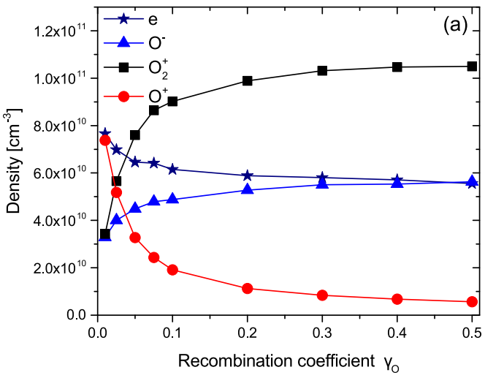
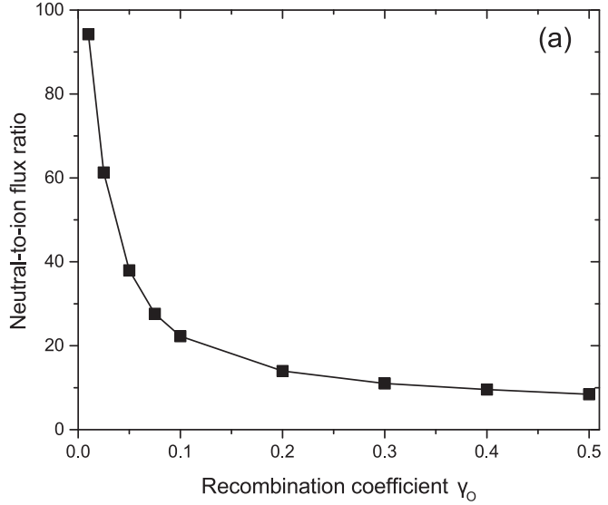
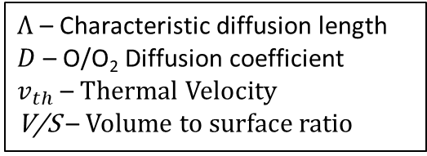
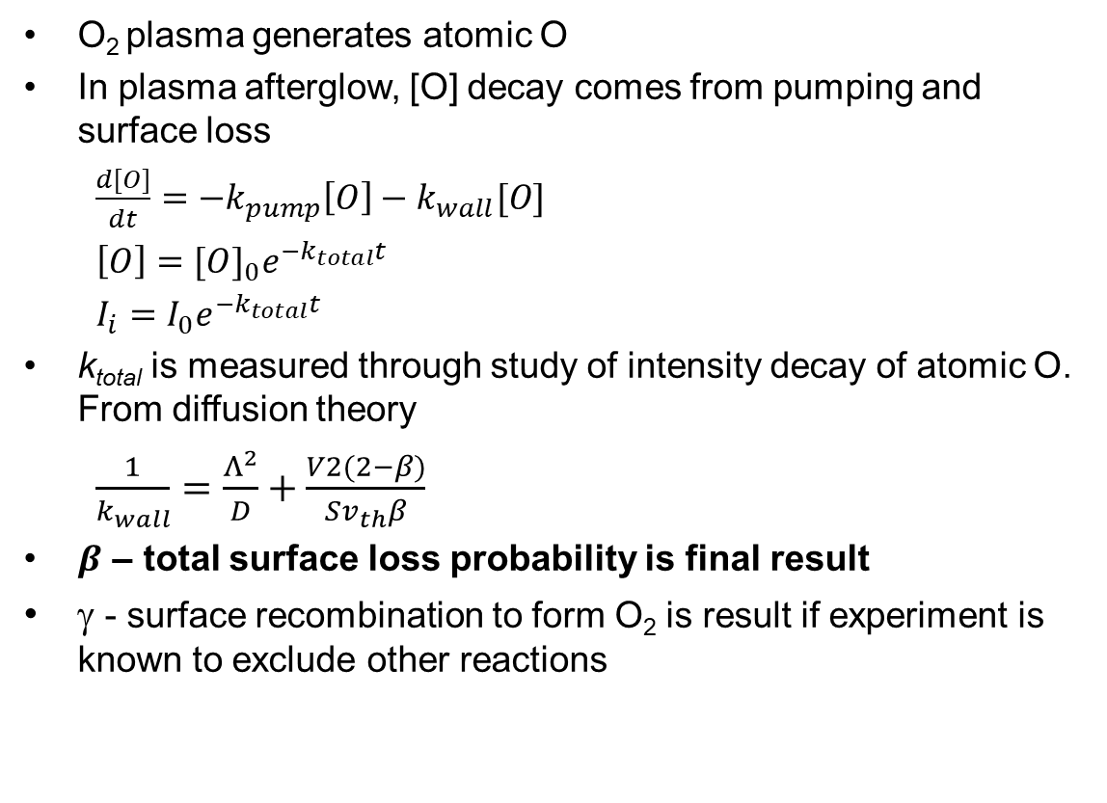
What can we get from PIF?
O₂ plasma generates atomic O
In plasma afterglow, [O] decay comes from pumping and surface loss
$\frac{d[O]}{dt}=−k_{pump}\left[O\right]−k_{wall}[O]$
$\left[O\right]={[O]}_{0}e^{−k_{total}t}$
$I_{i}=I_{0}e^{−k_{total}t}$
k_{total} is measured through study of intensity decay of atomic O. From diffusion theory
$\frac{1}{k_{wall}}=\frac{Λ^{2}}{D}+\frac{V2(2−β)}{Sv_{th}β}$
$β$ – total surface loss probability is final result
γ - surface recombination to form O₂ is result if experiment is known to exclude other reactions
$Λ$ – Characteristic diffusion length
$D$ – O/O₂ Diffusion coefficient
$v_{th}$ – Thermal Velocity
V/S – Volume to surface ratio
Top - HPEM Density profiles at radial and axial center of processing ICP. Bottom – Radical:Ion Flux Ratio at Wafer Surface^{[1]}
[1] Gibson et al. Plasma Phys. Control. Fusion 59 (2017)

Slide 37

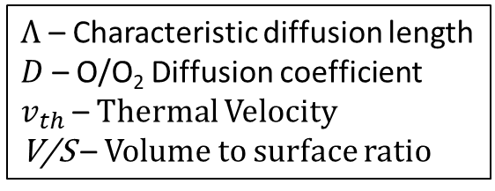
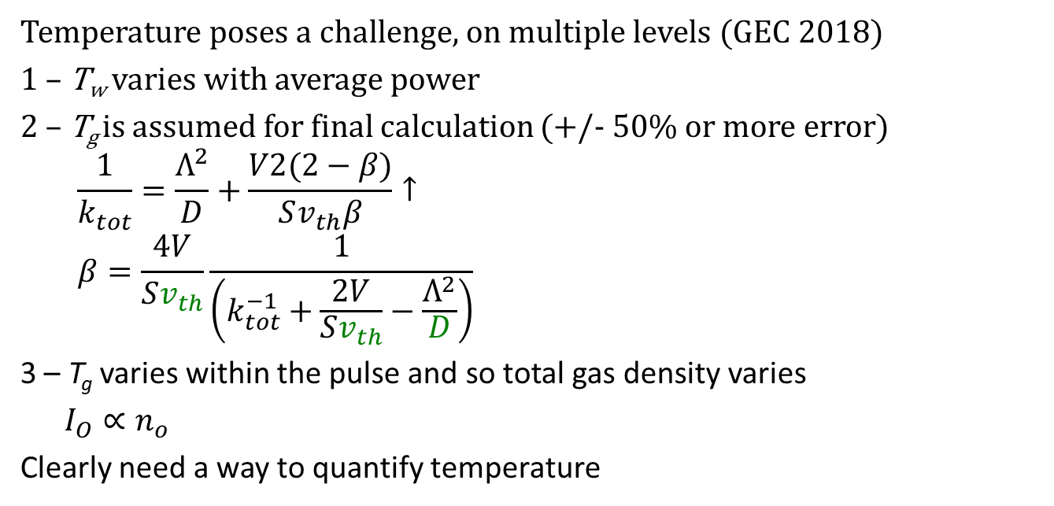


PIF Challenges
Temperature poses a challenge, on multiple levels (GEC 2018)
1 – T_{w} varies with average power
2 – T_{g} is assumed for final calculation (+/- 50% or more error)
$$\frac{1}{k_{tot}}=\frac{Λ^{2}}{D}+\frac{V2(2−β)}{Sv_{th}β}↑$$
$$β=\frac{4V}{Sv_{th}}\frac{1}{\left(k_{tot}^{−1}+\frac{2V}{Sv_{th}}−\frac{Λ^{2}}{D}\right)}$$
3 – T_{g} varies within the pulse and so total gas density varies
$I_{O}∝n_{o}$
Clearly need a way to quantify temperature
$Λ$ – Characteristic diffusion length
$D$ – O/O₂ Diffusion coefficient
$v_{th}$ – Thermal Velocity
V/S – Volume to surface ratio
T_{g}
$$\frac{I_{0}}{I_{1}}$$
t_{off,1}
t
T_{g}
T_{g}
$$\frac{I_{0}}{I_{2}}$$
t_{off,2}
t
t

Slide 38
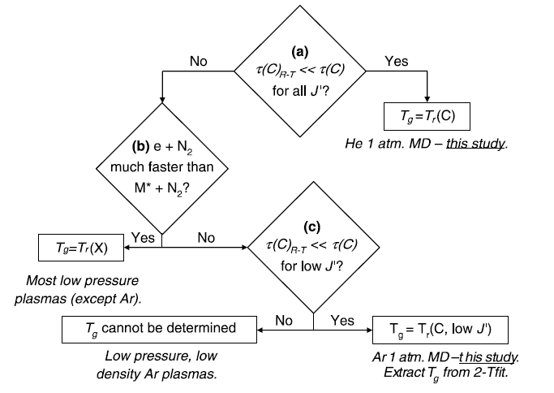
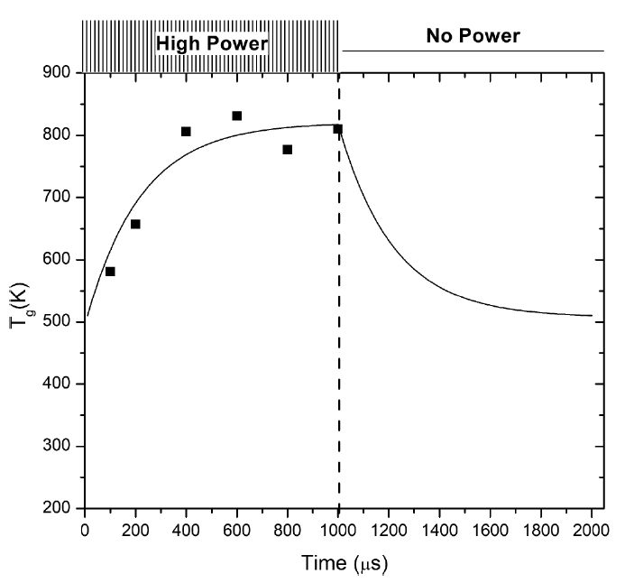
Improving PIF – T_{g}(t) from T_{rot}(t)
Measured T_{rot} of the molecular gas
N₂ emission is brighter, more easily characterized than O₂ rotational bands (2nd positive system in 334 nm band)
T_{g} reduces the uncertainty in D, v_{th} of β expression
T_{g} corrects emission intensity as well
High Pressure Case
N₂(T_{r}=T_{g}) + *M / e⁻ → *N₂(T_{g}≠T_{r}) + *M / e⁻
*N₂(T_{g}≠T_{r}) + X(T_{r}=T_{g}) → → *N₂(T_{r}=T_{g}) + X(T_{r}=T_{g})
*N₂(T_{r}=T_{g}) → N₂(T_{r}=T_{g}) + hv(T_{r})
Low Pressure Case
N₂(T_{r}=T_{g}) + e⁻ → *N₂(T_{r}=T_{g}) + e⁻
*N₂(T_{r}=T_{g}) → N₂ + hv(T_{r})
Figure 2^{[1]}. Flow chart for determining if N₂(C³Π_{u} v’=0 → B³ Π_{g} v’’=0) is in equilibrium with translational temperature of Cl₂
[1] Q. Wang et al. 2007 J. Phys. D: Appl. Phys. 40 4202
[2] T. Ma et al. J. Appl. Phys. 125, 023301 (2019);
Figure 3^{[2]}. Gas temperature from T_{rot} of N₂ in a Cl₂/O₂ plasma

Slide 39
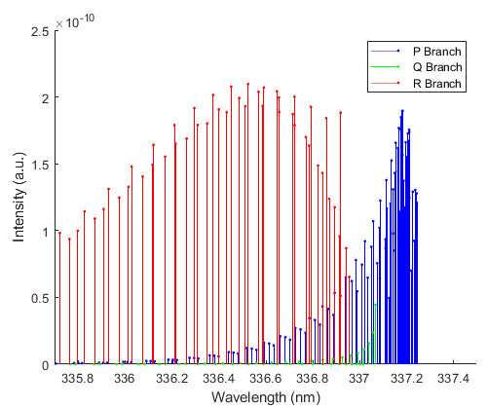

Rotational Spectra
Trial T_{r} are used to calculate full spectrum and the best fit determined from χ² error minimization
MATLAB code is available in dissertation
Key criterion – uncertainty in T_{r} (is our sharpening tool too coarse?)
Pure simulation lines for J=40

Slide 40



Time Resolved T_{r}
Quantified experimental error through replicates
Quantified simulation error through bootstrap method

Slide 41


T_{r}(t) Results
Plasma conditions: 200 W, 50 mTorr, 95/5% O₂/N₂
Pulsed with 10 ms main pulse, 1 ms probing pulse with 12.5 Hz frequency
T_{r} relative error was between 6-9% for all cases
Heating and cooling rates were remarkably close (85%)
Used fits to generate T_{g}(t) correction for PIF, which had a higher sample rate
Time resolved temperature results after main pulse
Example spectrum with simulation fit

Slide 42
Improving PIF – Experiment
Confined plasma region isolates atomic O loss on quartz
Probing pulse fixes T_{wall}
Echelle provides data for T_{r}(t), PI-Max provides I(t) data for β
200 W, 50 mTorr with 95/5% O₂/N₂ chosen for higher signal-noise ratio
Wavelength filter isolates 844 nm line of O
Gas Delivery
Triple Gauge
13.56 MHz Generator
Aspheric Lens
Fiber
Matching Network
Baratron
Directional Coupler
External Trigger
Roughing Valve
Gas Outlet
Pinhole Aperture
Echelle 4000+ Spectrometer
Off-Axis Parabolic Mirror
Aspheric Lens
Wavelength Filter
PI-Max3 iCCD

Slide 43



Improved PIF Data
Applied temperature correction to account for changing gas density
$\frac{I_{i}}{N_{i}}=\frac{I_{ss}}{N_{ss}}e^{−k_{total}t}$ Ideal Gas Law $I_{i}T_{i}=I_{ss}T_{ss}e^{−k_{total}t}$
i refers to discrete data in the afterglow, ss to the steady state values
The starting intensity is what we care about – must necessarily be lower and so k_{total} will increase
Example 10 µs acquisition from iCCD
Example temperature correction for one pixel, one probe pulse

Slide 44




PIF Data processing
Project main pulse backwards, Obtain I_{diss exc}
Multiply each I(t) pixel by T_{r}(t) fit
Subtract I_{diss exc} pixel by pixel
~5 GB of iCCD data
Find I(t_{off}) at each ring
Normalize Ring Data
Azimuthally Average
Fit 2 exponential decay
Use k constants to calculate β
[1] - Cartry, G., L. Magne, and G. Cernogora 2000
Decay data for outermost ring

Slide 45


Results
Two decay coefficients for k_{total,1} and k_{total,2} leads to two loss coefficients
Immediate afterglow β₁ is more applicable for plasma processing
Without T_{g} correction β₁=[0.23,0.79] considering T_{g} assumption from [400,500] K and goodness of fit
β₁ is higher than any literature value
Pressure dependence, source type
GEC 2019
[10] – Gilles Cartry et al 2006 Plasma Sources Sci. Technol. 15 479
[14] - J P Booth et al 2019 Plasma Sources Sci. Technol. 28 055005
[24] - Fletcher, D. & Meyers, J. Journal of Thermophysics and Heat Transfer 31.2 (2016)
[96] - S. Wickramanayaka et al. Japanese journal of applied physics 30.11R (1991)

Slide 46


$$E→γ→H Mode$$
OES of 844 O line emission in 300 mTorr $O_{2}$ plasma
$γ$-like mode separates E and H mode
E-H transition supported by secondary electron emission
2) Zaka-ul-Islam

Slide 47





Modeling Efforts – $O_{2}$ recombination
$O+O+M→O_{2} \left(γ_{O}\right)$
As $γ_{O}$ increases [O] decreases and [$O_{2}$] increases
$O^{−}+O→O_{2}+e^{−}$
As the O atoms available for associative recombination decrease, $O^{−}$ would increase, $e^{−}$ would decrease due to this equation
$$γ_{O}=0.001$$
$$γ_{O}=0.015$$
3) Shibata et al

Slide 48



Modeling - $O_{2}$ continued HPEM
Very small difference in electron density
Noticeable differences in [O] density at electrode

Slide 49

Pulsing data for O2 on Cu and Al surfaces
SS density has changed
Visible difference in rate of rise at the point of E-H transition
Upon just flipping from Al to Cu, pressure reading changed by 3-4mTorr
Possibly gas heating, dissociation, or ionization
Process was done with constant match settings
Readings on surfaces were alternated; Al, Cu, Al, Cu, Al, Cu
Data taken with LP
500Hz, 200W, 190ish mTorr

Slide 50
Enabled transient density study for pulsed RF as well as plasma oscillations

Slide 51

Closing remarks
Plasmas operated outside of steady state conditions through repetitive pulsing present a wider range of operating conditions than can be achieved through steady state power dissipation
Tool design considerations ranging from power delivery, impedance matching, and material selection can influence these transient conditions
Simplified plasma models that enable integration with equivalent circuit models of plasma sources lend some insight into mechanisms that drive transient conditions
Time resolved plasma diagnostics further serve to validate these models and provide insight into how these sources respond to modulated power
Kevin Gibb, “Samsung’s 14 nm LPE
FinFET Transistors”, EETimes, 2016

