Slide 1
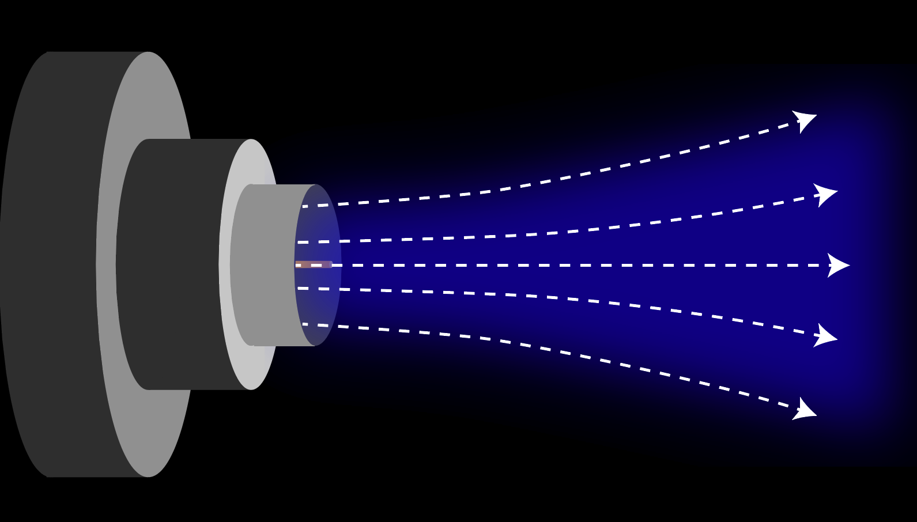
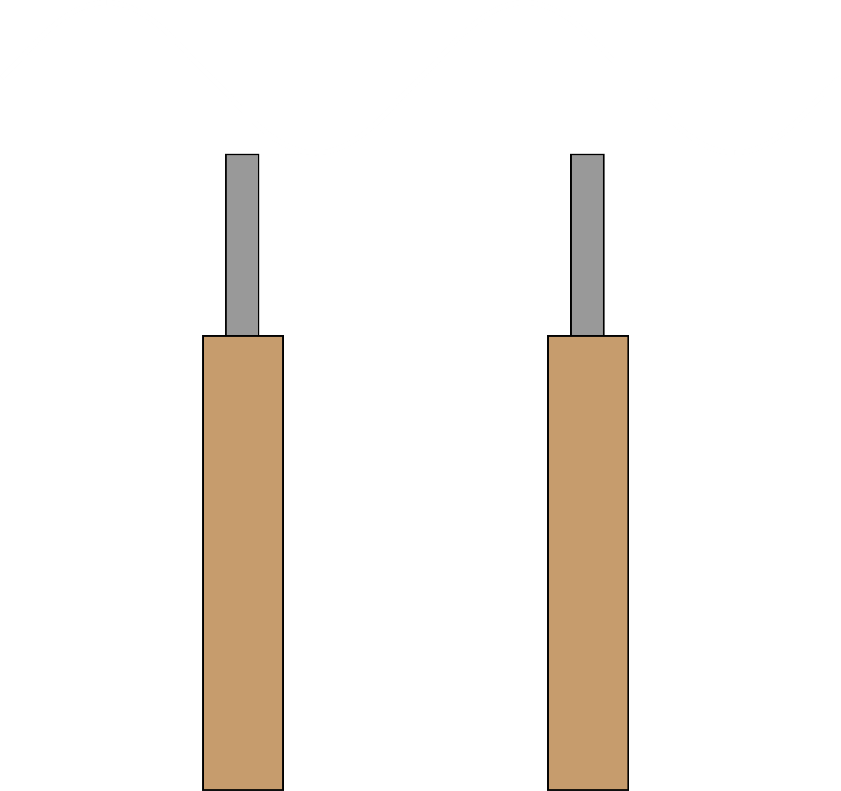
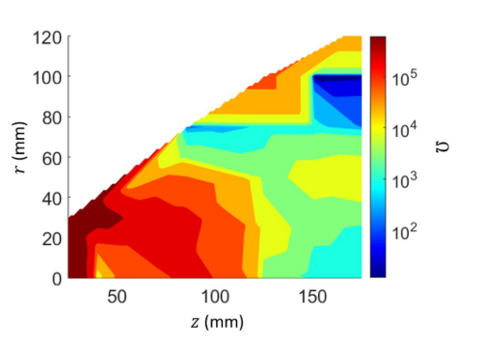
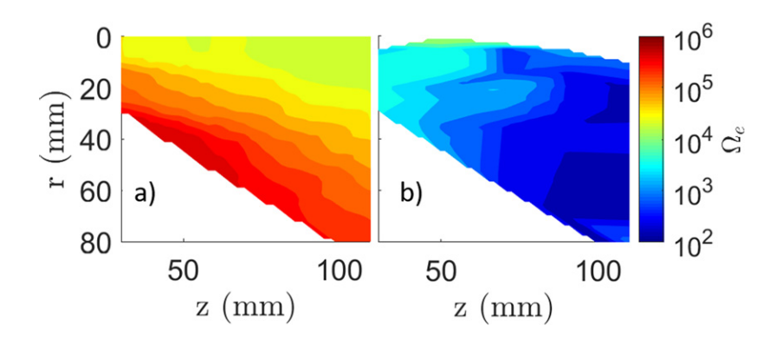
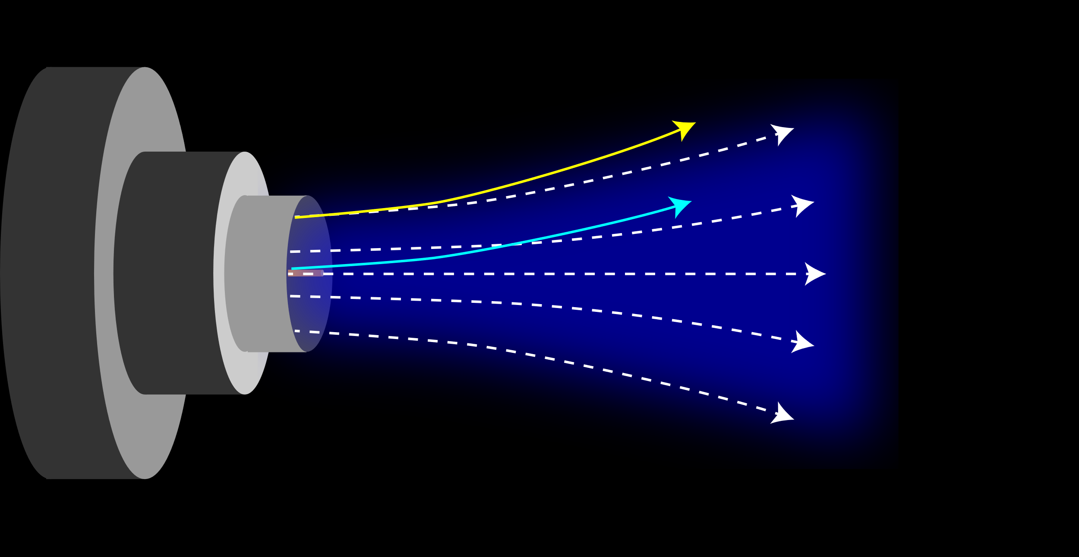
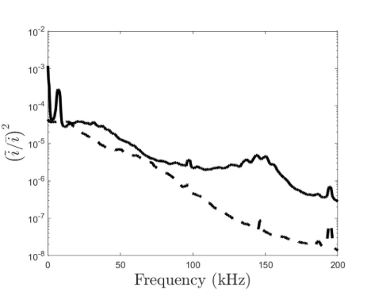
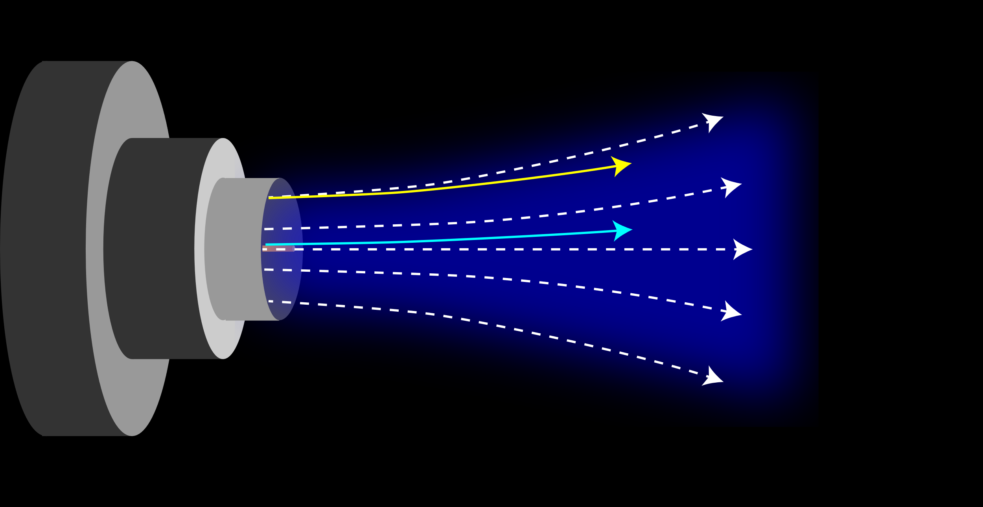
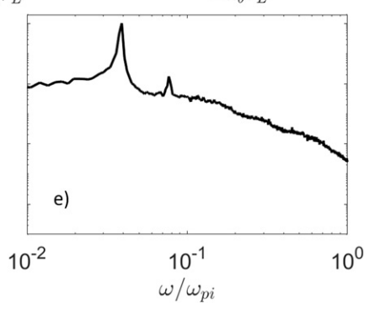
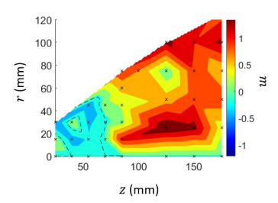
The Influence of Instabilities on Electron Dynamics in a Magnetic Nozzle
Shadrach Hepner and Benjamin Jorns
Introduction
Methods
Discussion
Diverging magnetic field cools plasma, converting thermal energy into directed kinetic energy
Electron dynamics govern thrust production via ambipolar diffusion
Readings on electrostatic probes at negative current can read oscillations in number density²
Phase delay from two probes next to each other can provide the wavenumber of the waves at each frequency
Three pairs can provide full propagation
$${\tilde{n}}_{i}(ω, k)$$
Can define an effective collision frequency $ν_{eff}=−e<δE δn>$ using the dispersion relation
The resulting Hall parameter shows an effect- although not as significant as the incoherent mode (panel 1)
However- the upstream propagation direction may push electrons inward, possibly converging the electron beam
Magnetic nozzle
$$Δx$$
Understanding electron dynamics is key to understanding the operation of magnetic nozzles- diverging electrons will induce radial electric fields and converging electrons will lessen them
Background
Results
$$\tilde{I}$$
$$\tilde{I}$$
Converging electrons
We have previously studied the impact of an incoherent lower hybrid drift instability in a magnetic nozzle (top)
However, low frequency modes also appear (bottom)
Previous analysis did not consider the coherent modes
Tested high (dashed) and low (solid) flow
Incoherent instability everywhere
High flow damped coherent oscillations
Low flow: ~8 kHz and ~150 kHz signatures
This work focuses on the 8 kHz mode
$${\tilde{u}}_{e}$$
Conclusions
Coherent low frequency mode observed in a magnetic nozzle
Effect on electron motion not as significant as the incoherent mode
However- may provide convergent transport
$${\tilde{u}}_{i}$$
Low flow
Hall parameter (measure of magnetization) induced from a) classical effects and b) a lower hybrid drift instability in the plume of a magnetic nozzle¹
Diverging electrons
High flow
Example power spectrum exhibiting coherent signals (a.u.)¹
Can define as azimuthal mode $m=k_{θ}r$
Develops into $m=1$ downstream
Identify as anti-drift instability
References
How does the presence of low frequency instabilities impact electron transport?
¹Hepner, S., Wachs, B., & Jorns, B. (2020). Appl. Phys. Lett., 116(26), 263502. https://doi.org/10.1063/5.0012668
²Beall, J. M., Kim, Y. C., & Powers, E. J. (1982). J. Appl. Phys., 53(6). https://doi.org/10.1063/1.331279

