Slide 1
Analysis of Miram Curves with Two-Dimensional Work Function Distributions*
Abhijit Jassem, Y. Y. Lau
¹Department of Nuclear Engineering and Radiological Sciences
University of Michigan, Ann Arbor, MI
11th Annual MIPSE Graduate Student Symposium
November 9-13, 2020
*Work supported by DARPA, AFOSR, ONR, and L3Harris Electron Device Division.

Slide 2
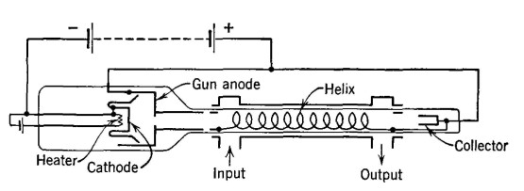
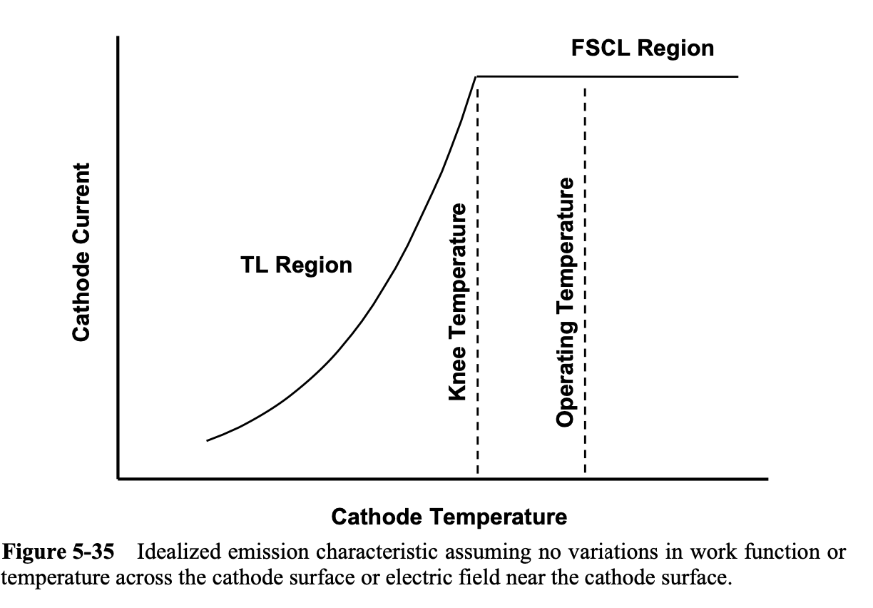
Motivation
Life of thermionic cathode is highly dependent on operating temperature
Miram curves (J_{anode} vs T plot for thermionic cathode) show transition from temperature limited to space charge limited regimes
Knee on Miram curve, usually the preferred operating point, is much broader than 1D theory indicates. Physical origin remains unclear.
Example of Miram curve (Adapted from: A. S. Gilmour, Klystrons, Traveling Wave Tubes, Magnetrons, Crossed-field Amplifiers, and Gyrotrons. Artech House, 2011.)

Slide 3
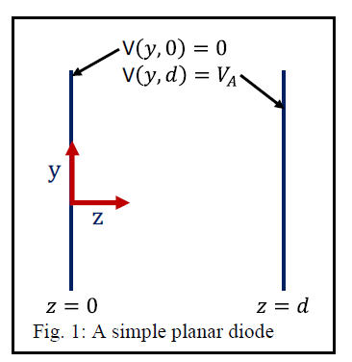
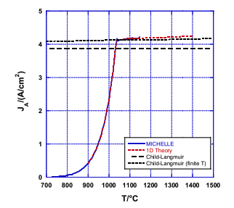
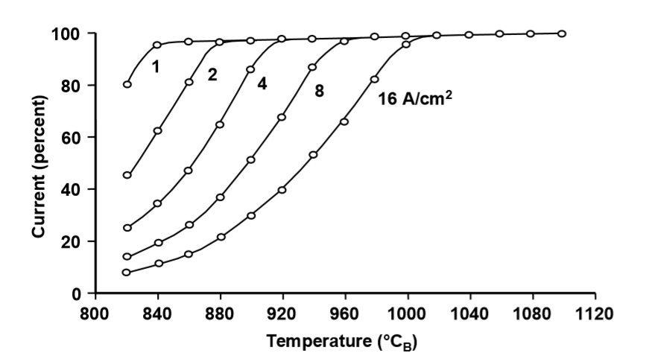
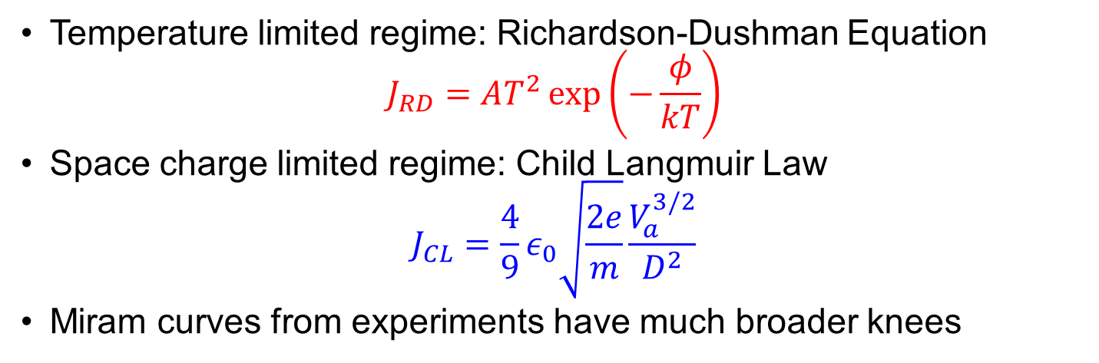


1D Theory of Miram Curves
Temperature limited regime: Richardson-Dushman Equation
$$J_{RD}=AT^{2}\exp\left(−\frac{φ}{kT}\right)$$
Space charge limited regime: Child Langmuir Law
$$J_{CL}=\frac{4}{9}ε_{0}\sqrt{\frac{2e}{m}}\frac{V_{a}^{3/2}}{D^{2}}$$
Miram curves from experiments have much broader knees
x
$$J_{anode}$$
1D Miram curve
$$J_{emit}$$
space charge limited
  V_{a} = 179.5 V
  d = 0.381 mm
  B_{z} = ∞
  J_{emit} = Richardson-Dushman
  Maxwellian f(v)
temperature limited
Experimental Miram curves (Gilmour)

Slide 4
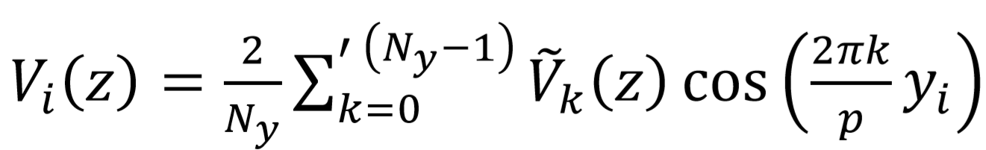
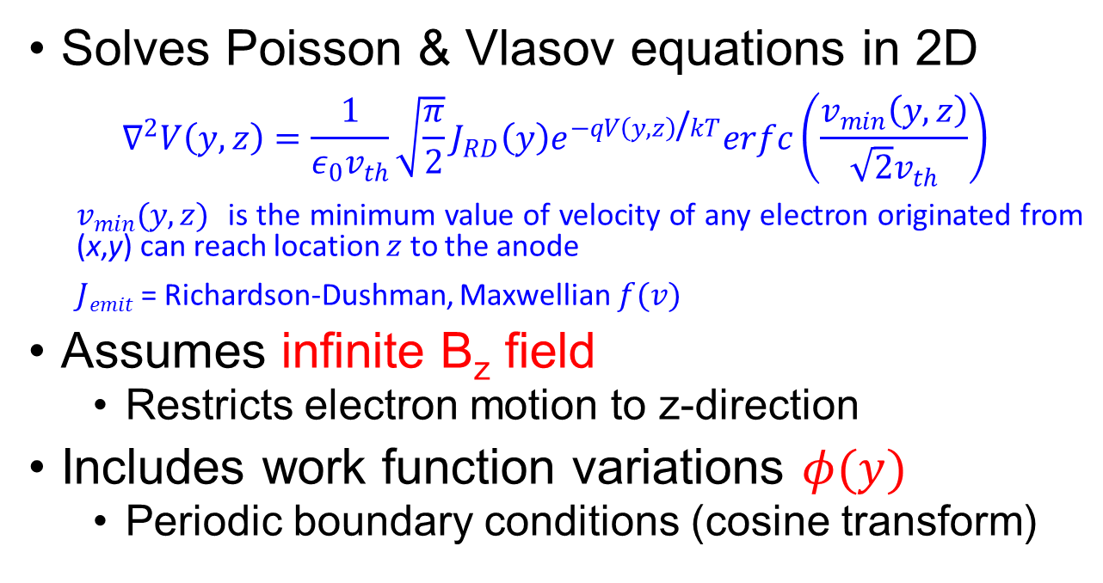
1-1/2D Model Formulation [1]
Solves Poisson & Vlasov equations in 2D
$$∇^{2}V\left(y,z\right)=\frac{1}{ε_{0}v_{th}}\sqrt{\frac{π}{2}}J_{RD}\left(y\right)e^{−qV\left(y,z\right)\text{/}kT}erfc\left(\frac{v_{min}\left(y,z\right)}{\sqrt{2}v_{th}}\right)$$
$v_{min}(y,z)$ is the minimum value of velocity of any electron originated from (x,y) can reach location $z$ to the anode
$Jemit$ = Richardson-Dushman, Maxwellian $f(v)$
Assumes infinite B_{z} field
  Restricts electron motion to z-direction
Includes work function variations $φ(y)$
  Periodic boundary conditions (cosine transform)
  V_{a} = 179.5 V
  d = 0.381 mm
  B_{z} = ∞
  J_{emit} = Richardson-Dushman, Maxwellian f(v)
  [1] D. Chernin, Y. Y. Lau, J. J. Petillo, S. Ovtchinnikov, D. Chen, A. Jassem, R. Jacobs, D. Morgan, J. H. Booske, “Effect of
  nonuniform emission on Miram curves,” IEEE Trans. Plasma Sci. 48, 146 (2020).

Slide 5
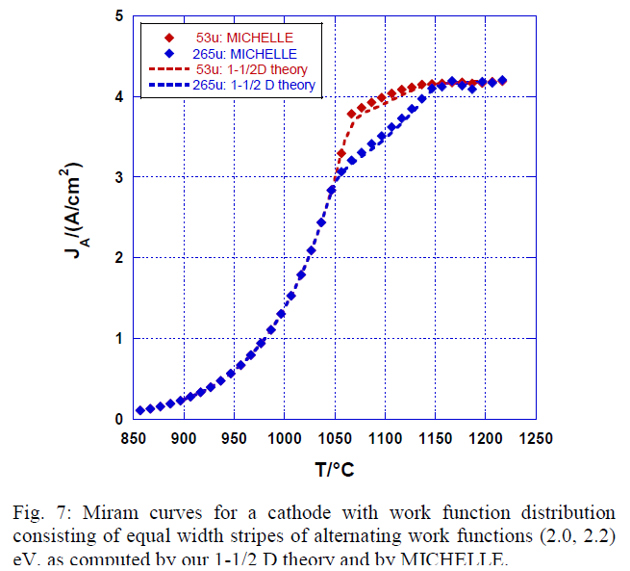
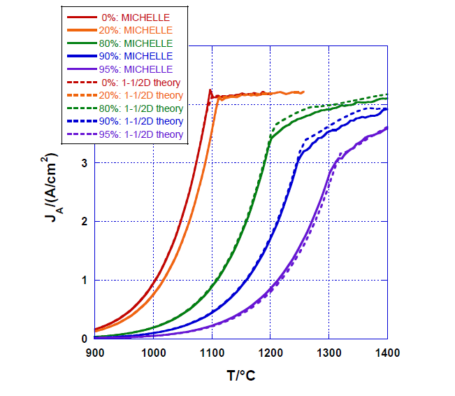




Results from 1-1/2D Model [1]
  Theory: B = ∞ (“1-1/2 D” Model)
  MICHELLE: B = 0
  Transverse motion has a very small effect on the Miram curve.
  1-D Child-Langmuir law is always observed at high T, even if significant fraction of area non-emitting.
0%
80%
95%
$$a=53μm$$
$$a=265μm$$
10 eV
(non-emitting)
2.1 eV
$$20 μm$$
2.0 eV
2.2 eV
20% non-emitting
80% non-emitting
$$a$$
  [1] D. Chernin, Y. Y. Lau, J. J. Petillo, S. Ovtchinnikov, D. Chen, A. Jassem, R. Jacobs, D. Morgan, J. H. Booske, “Effect of
  nonuniform emission on Miram curves,” IEEE Trans. Plasma Sci. 48, 146 (2020).
  [2] R. Umstattd and J. Luginsland, “Two dimensional space charge limited emission: Beam edge characteristics and
  applications,” Phys Rev. Lett. 87, (2001)

Slide 6
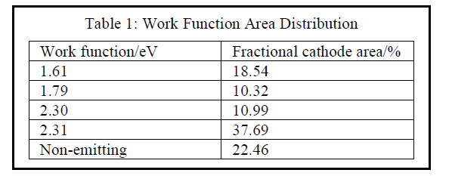
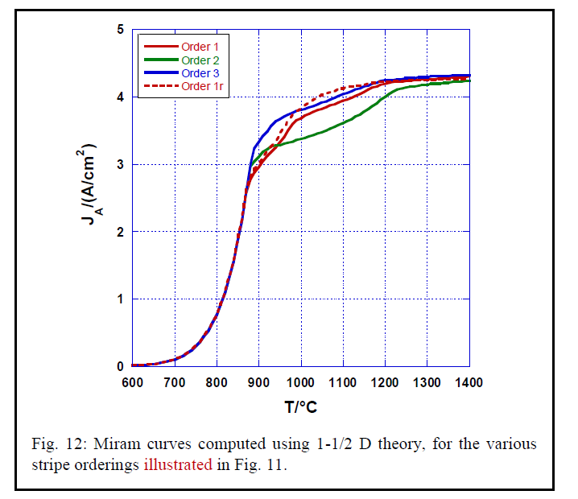
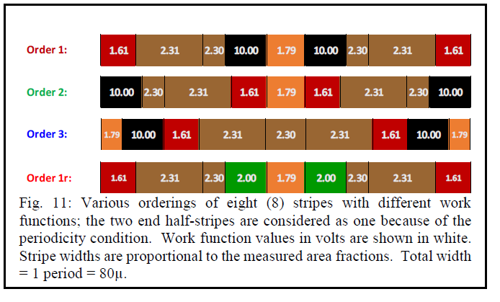
Results from 1-1/2D Model (Multistripe) [1]
  V_{a} = 179.5 V
  d = 0.381 mm
  B_{z} = ∞
  J_{emit} = Richardson-Dushman, Maxwellian f(v)
  [1] D. Chernin, Y. Y. Lau, J. J. Petillo, S. Ovtchinnikov, D. Chen, A. Jassem, R. Jacobs, D. Morgan, J. H. Booske, “Effect of
  nonuniform emission on Miram curves,” IEEE Trans. Plasma Sci. 48, 146 (2020).

Slide 7

Extension to 2-1/2D Model
From Striped (1.5D) to Checkerboard (2.5D)
Increased current compensation effect in Checkered (2.5D)
  Emission from 2.0eV is enhanced while emission from 2.2eV is suppressed (relative to striped case)
Reasonable agreement with MICHELLE (B_{z} = 20T)
  V_{a} = 179.5 V
  d = 0.381 mm
  B_{z} = ∞
Striped
(1.5D)
Checkered
(2.5D)
$$s=53μm$$
2.0 eV
2.2 eV

Slide 8
Examination of Current Compensation Effect
Sample Line 1 (Central)
Sample Line 2 (Edge)
2.2 eV
2.0 eV
2.2 eV
2.2 eV
2.0 eV
2.2 eV

Slide 9

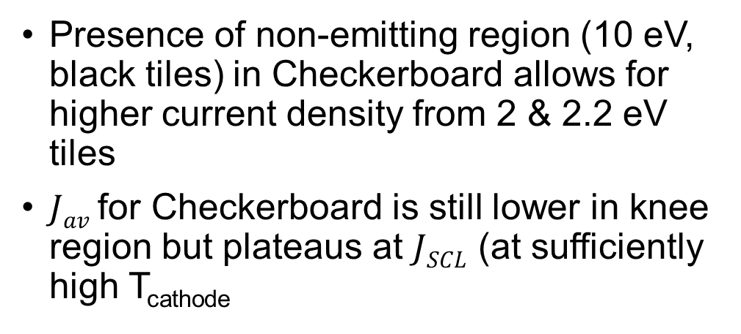
2-1/2D Model
Checkered work function tiles
Presence of non-emitting region (10 eV, black tiles) in Checkerboard allows for higher current density from 2 & 2.2 eV tiles
$Jav$ for Checkerboard is still lower in knee region but plateaus at $JSCL$ (at sufficiently high T_{cathode}
Checkered Variant
Checkered
10 eV
(non-emitting)
$$s=53μm$$
2.0 eV
2.2 eV

Slide 10

2-1/2D Model
Random distributions constructed from experimental work functions
Work Function [eV] | Experiment [1] | Rand I | Rand II | Rand III
1.61 | 18.54 | 17.97 | 12.89 | 7.42
1.79 | 10.32 | 9.77 | 8.59 | 7.42
2.3 | 10.99 | 9.38 | 11.33 | 11.33
2.31 | 37.69 | 43.75 | 37.50 | 37.11
10 (non-emitting) | 22.46 | 19.14 | 29.69 | 36.72
Rand II
(non-emit +10%)
Rand III
(non-emit +15%)
$$s=2.5 μm$$
Rand I
  [1] D. Chernin, Y. Y. Lau, J. J. Petillo, S. Ovtchinnikov, D. Chen, A. Jassem, R. Jacobs, D. Morgan, J. H. Booske, “Effect of
  nonuniform emission on Miram curves,” IEEE Trans. Plasma Sci. 48, 146 (2020).

Slide 11
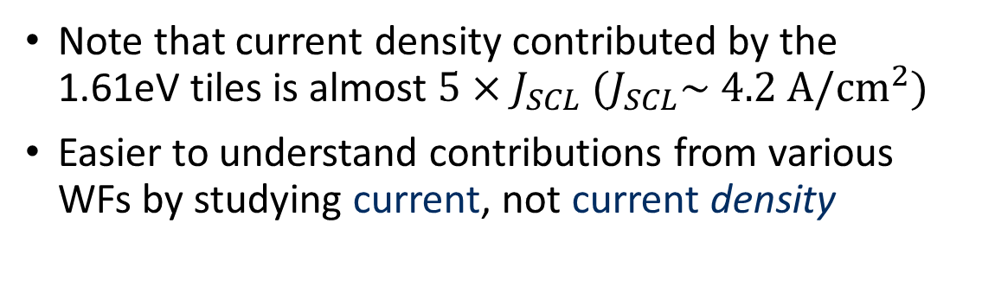

Contributions from WF Regions
Rand I
(Random distribution based on exp. data)
Note that current density contributed by the 1.61eV tiles is almost $5×J_{SCL} (J_{SCL}\sim 4.2 {\text{A}\text{/}\text{cm}}^{2})$
Easier to understand contributions from various WFs by studying current, not current density
Work Function [eV] | Fractional cathode area in Rand I
1.61 | 17.97
1.79 | 9.77
2.3 | 9.38
2.31 | 43.75
10 (non-emitting) | 19.14
Rand I
$$s=2.5 μm$$

Slide 12

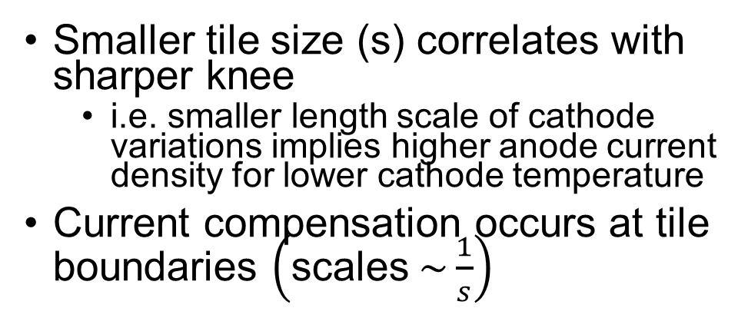
2-1/2D Model
Effect of tile size on random distribution
Smaller tile size (s) correlates with sharper knee
  i.e. smaller length scale of cathode variations implies higher anode current density for lower cathode temperature
Current compensation occurs at tile boundaries $\left(\text{scales} \sim \frac{1}{s}\right)$
Rand I
$$s$$

Slide 13

2-1/2D Model
Effect of ‘fill-up’ on Rand I
Randomly select a fraction of 10eV (non-emitting) tiles and replace them with 1.6eV tiles
  Simulates effects of non-emitting areas
Shifts entire Miram curve to the left
$$s=2.5 μm$$
Rand I
¼ replaced
¾ replaced

Slide 14
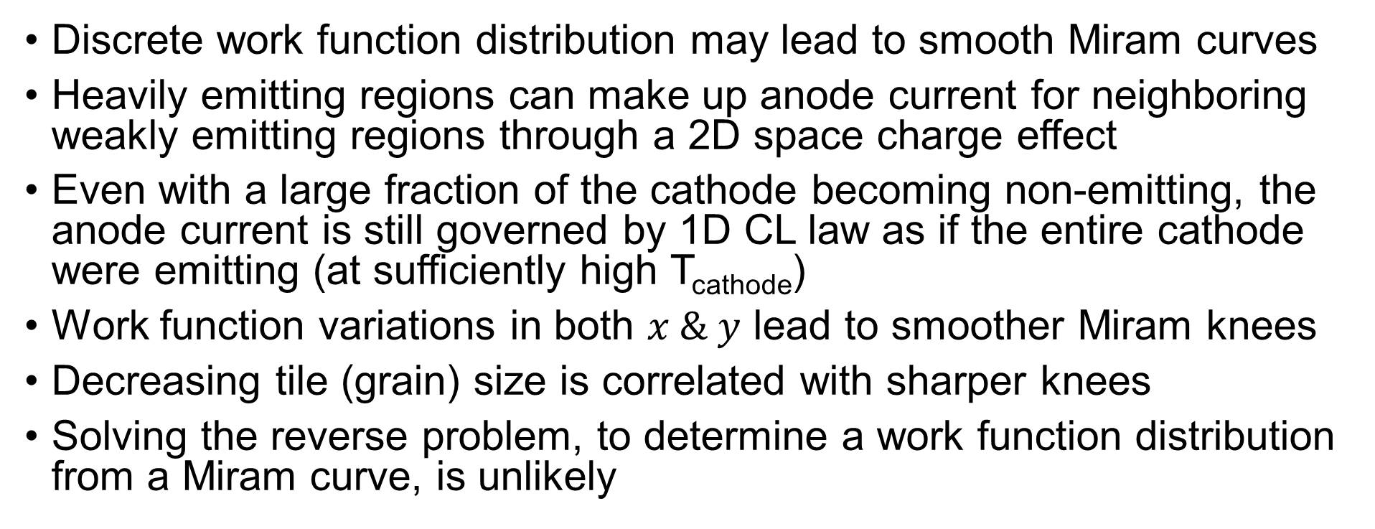
Conclusions
Studies into the shape of Miram curves using a novel 2-1/2D model
Discrete work function distribution may lead to smooth Miram curves
Heavily emitting regions can make up anode current for neighboring weakly emitting regions through a 2D space charge effect
Even with a large fraction of the cathode becoming non-emitting, the anode current is still governed by 1D CL law as if the entire cathode were emitting (at sufficiently high T_{cathode})
Work function variations in both $x \& y$ lead to smoother Miram knees
Decreasing tile (grain) size is correlated with sharper knees
Solving the reverse problem, to determine a work function distribution from a Miram curve, is unlikely

Slide 15
Acknowledgements
Colleagues at Leidos, Inc., Reston, VA
  D. Chernin
  J. J. Petillo
  A. Jensen
  S. Ovtchinnikov

