Slide 1


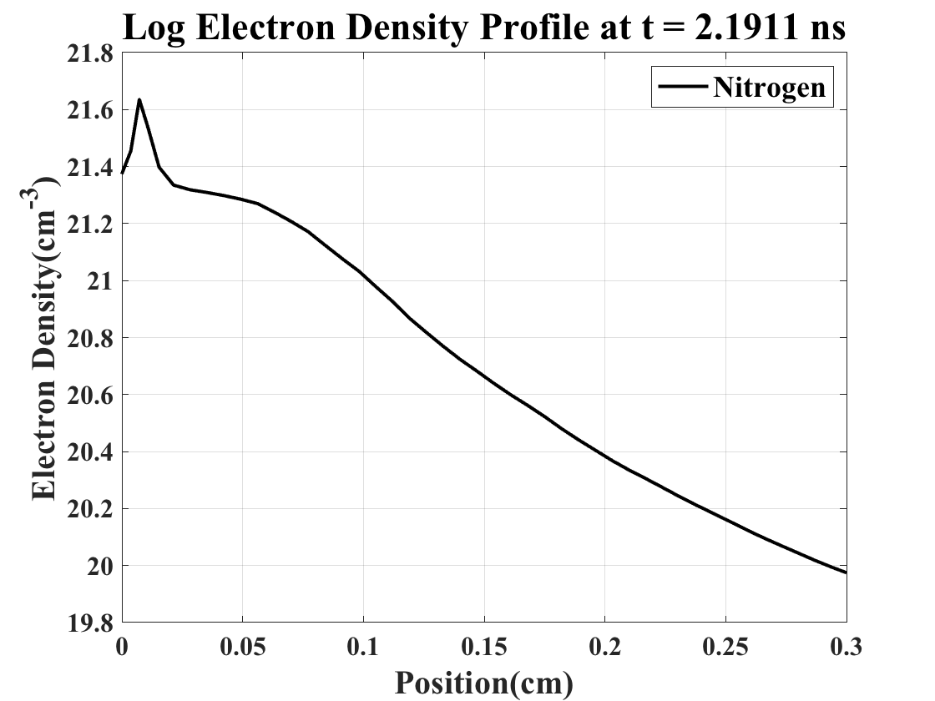
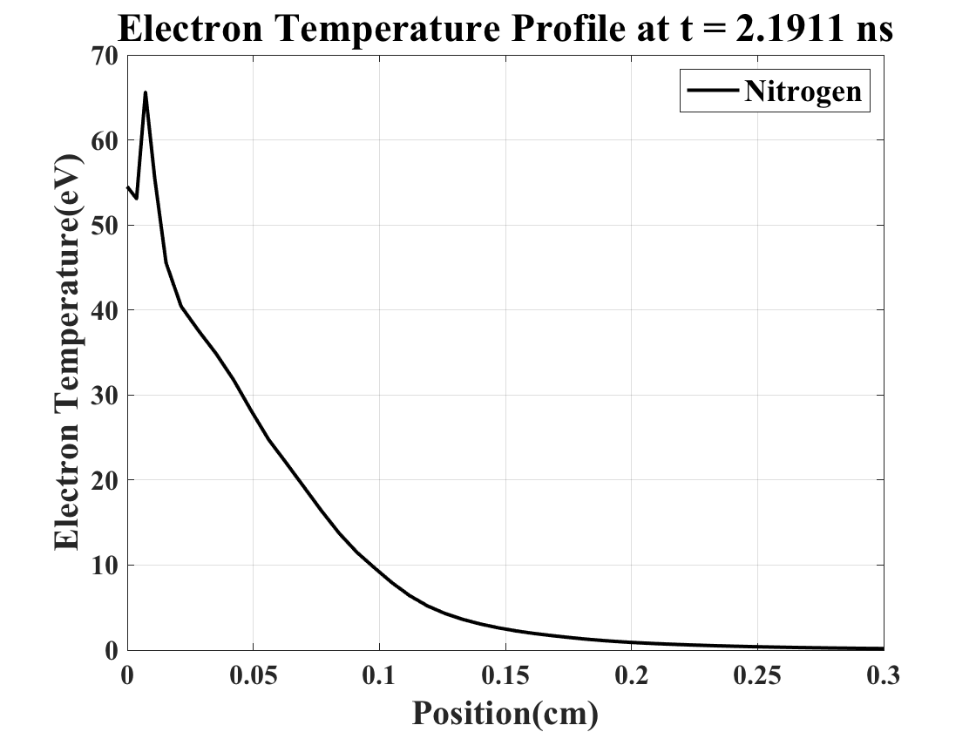
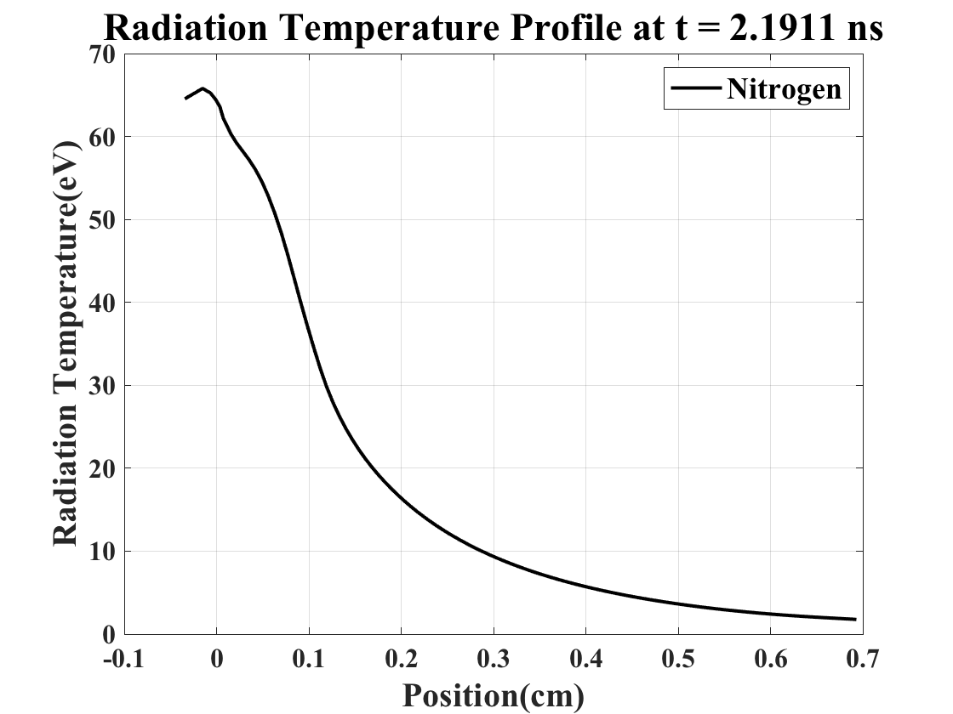
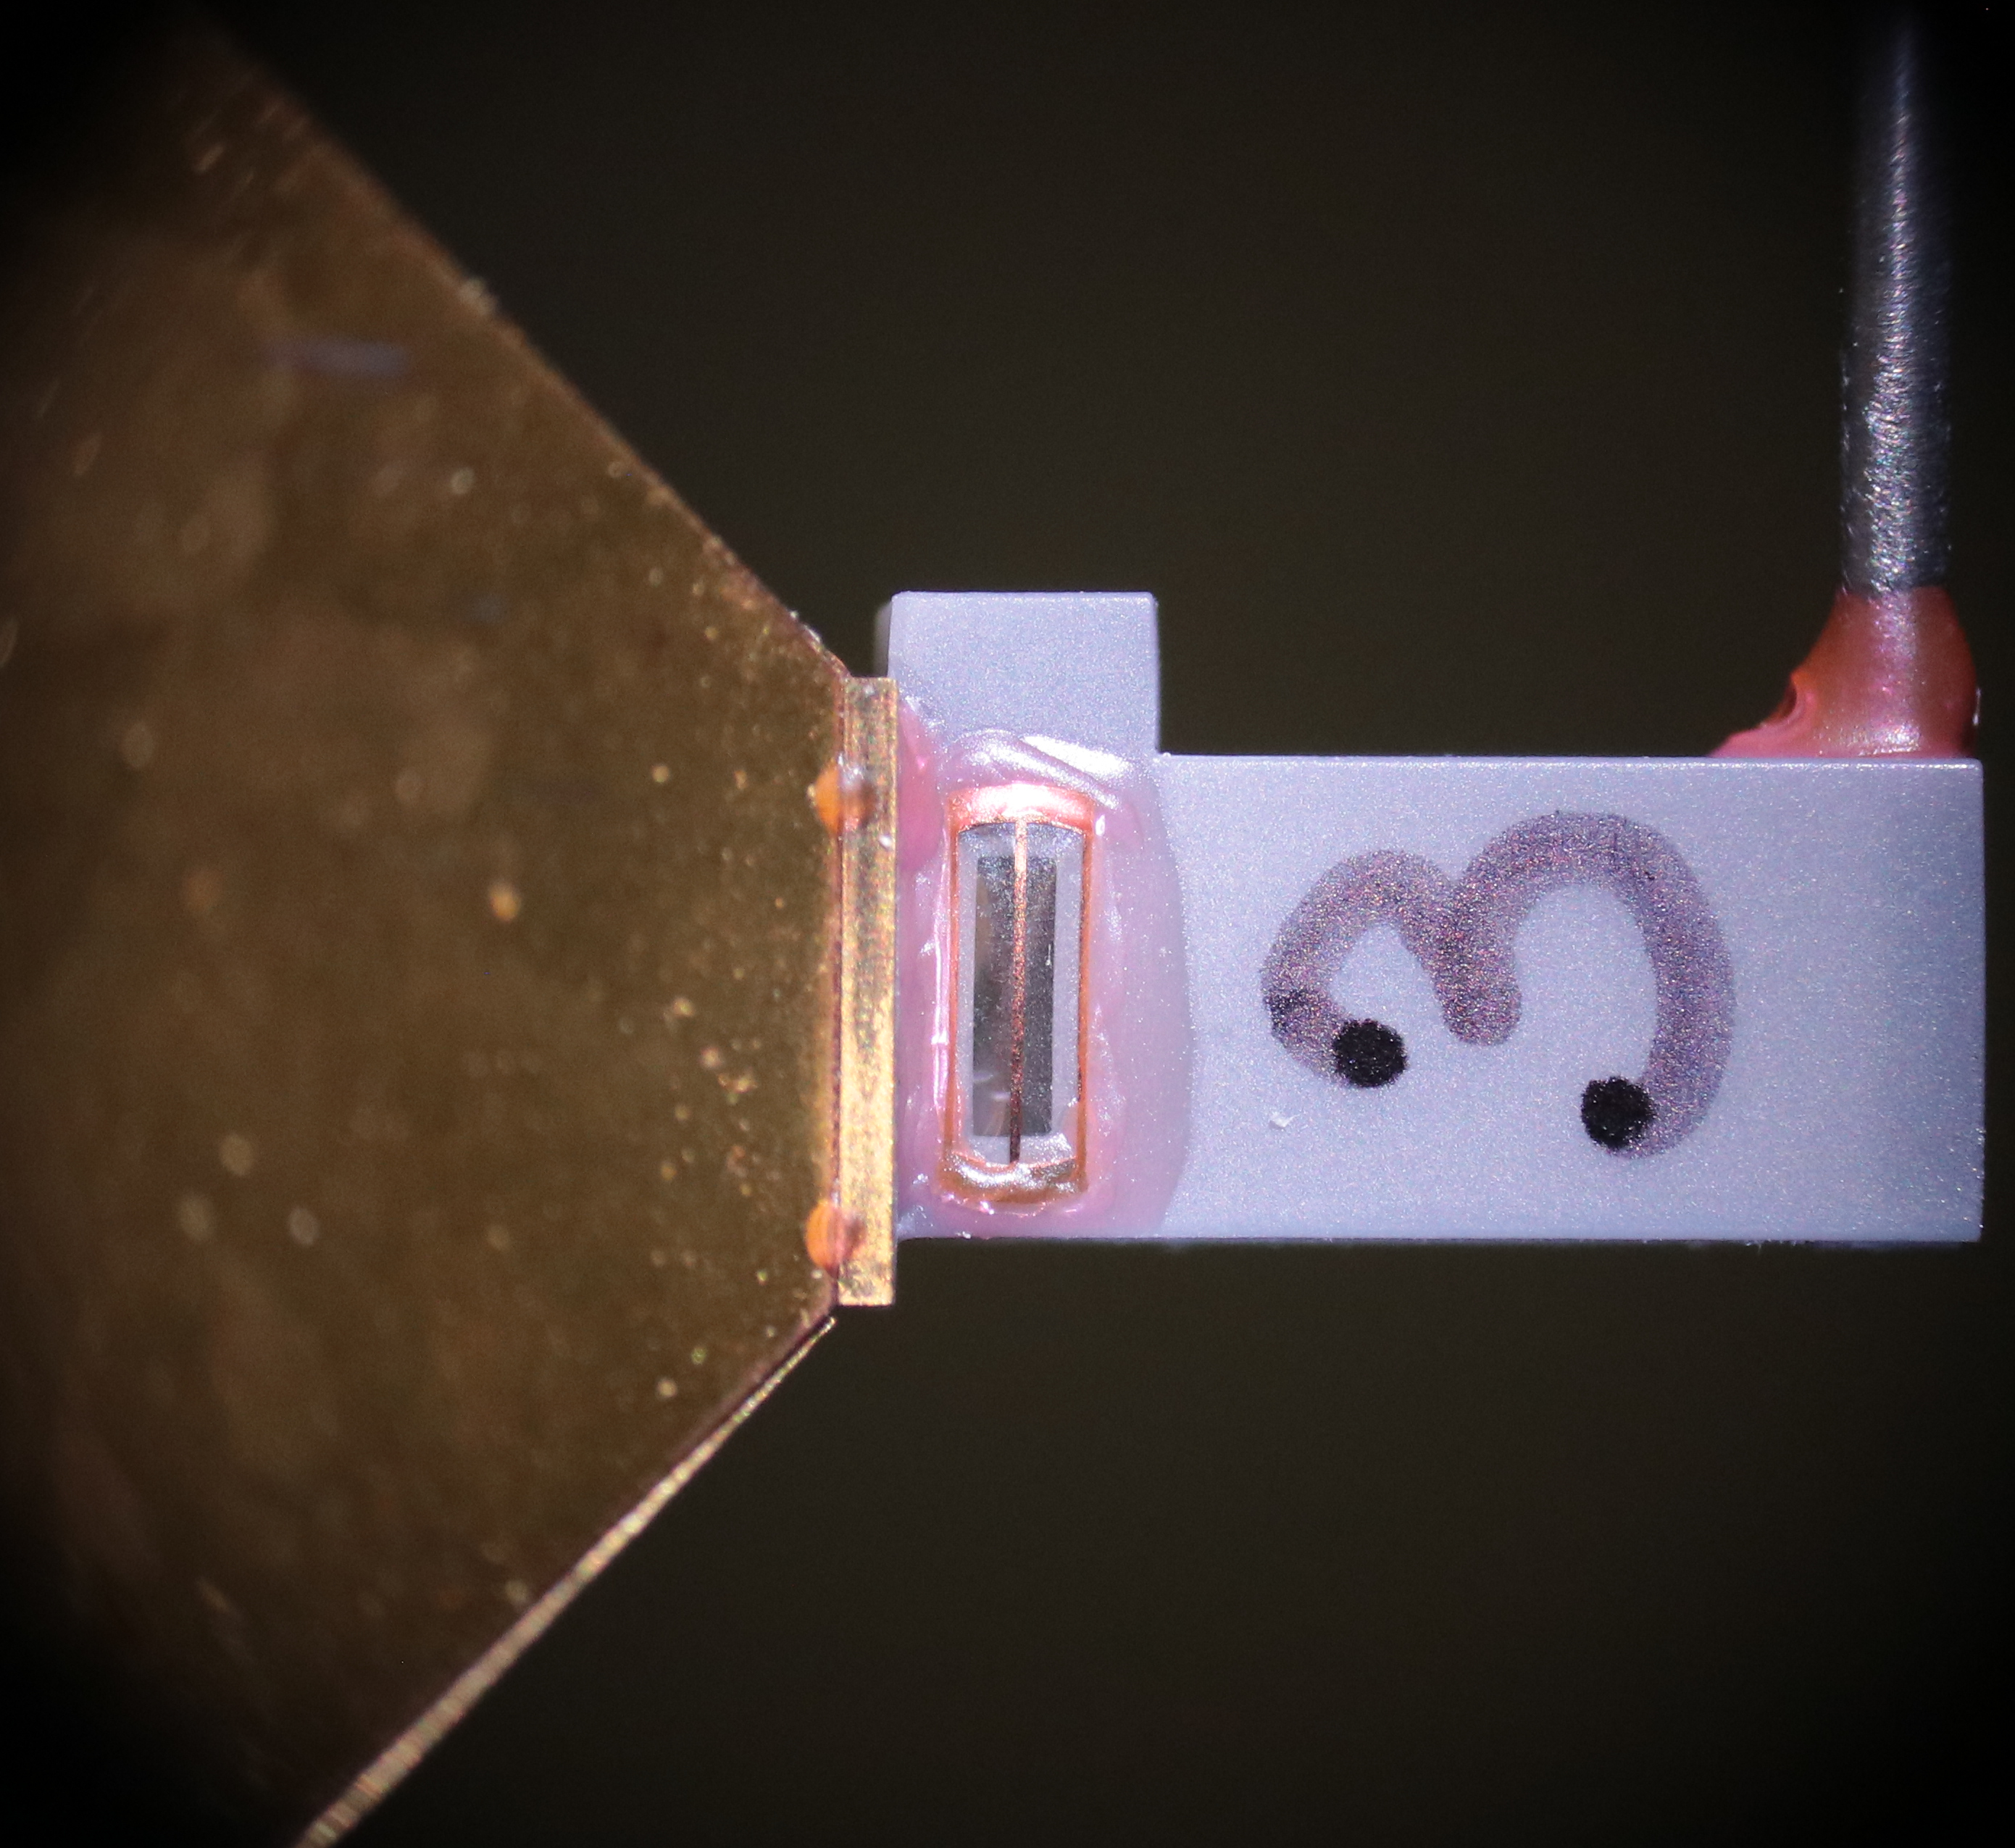
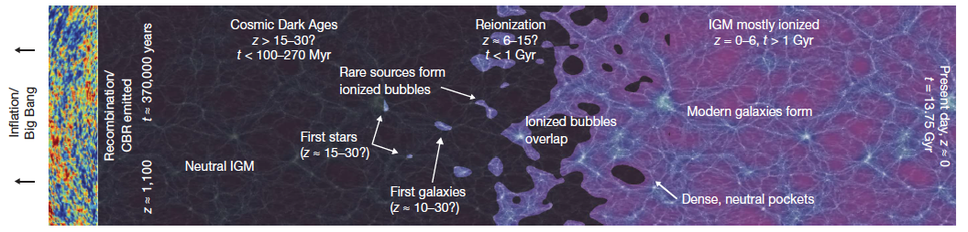
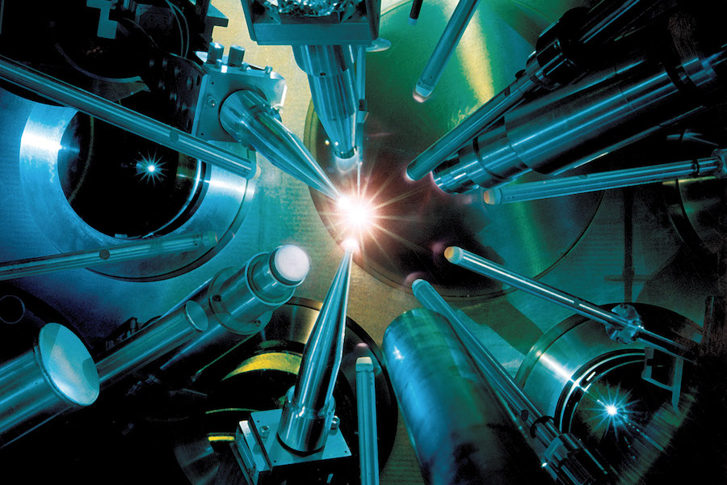
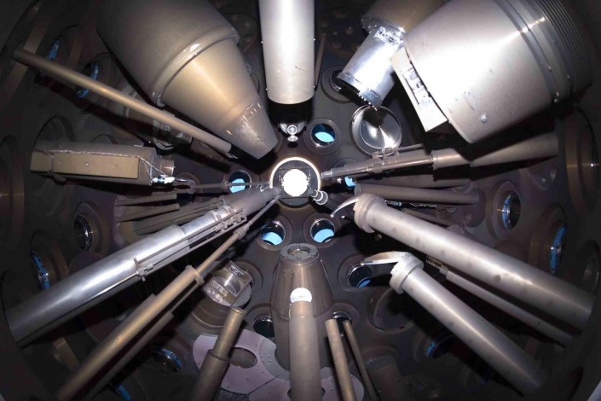
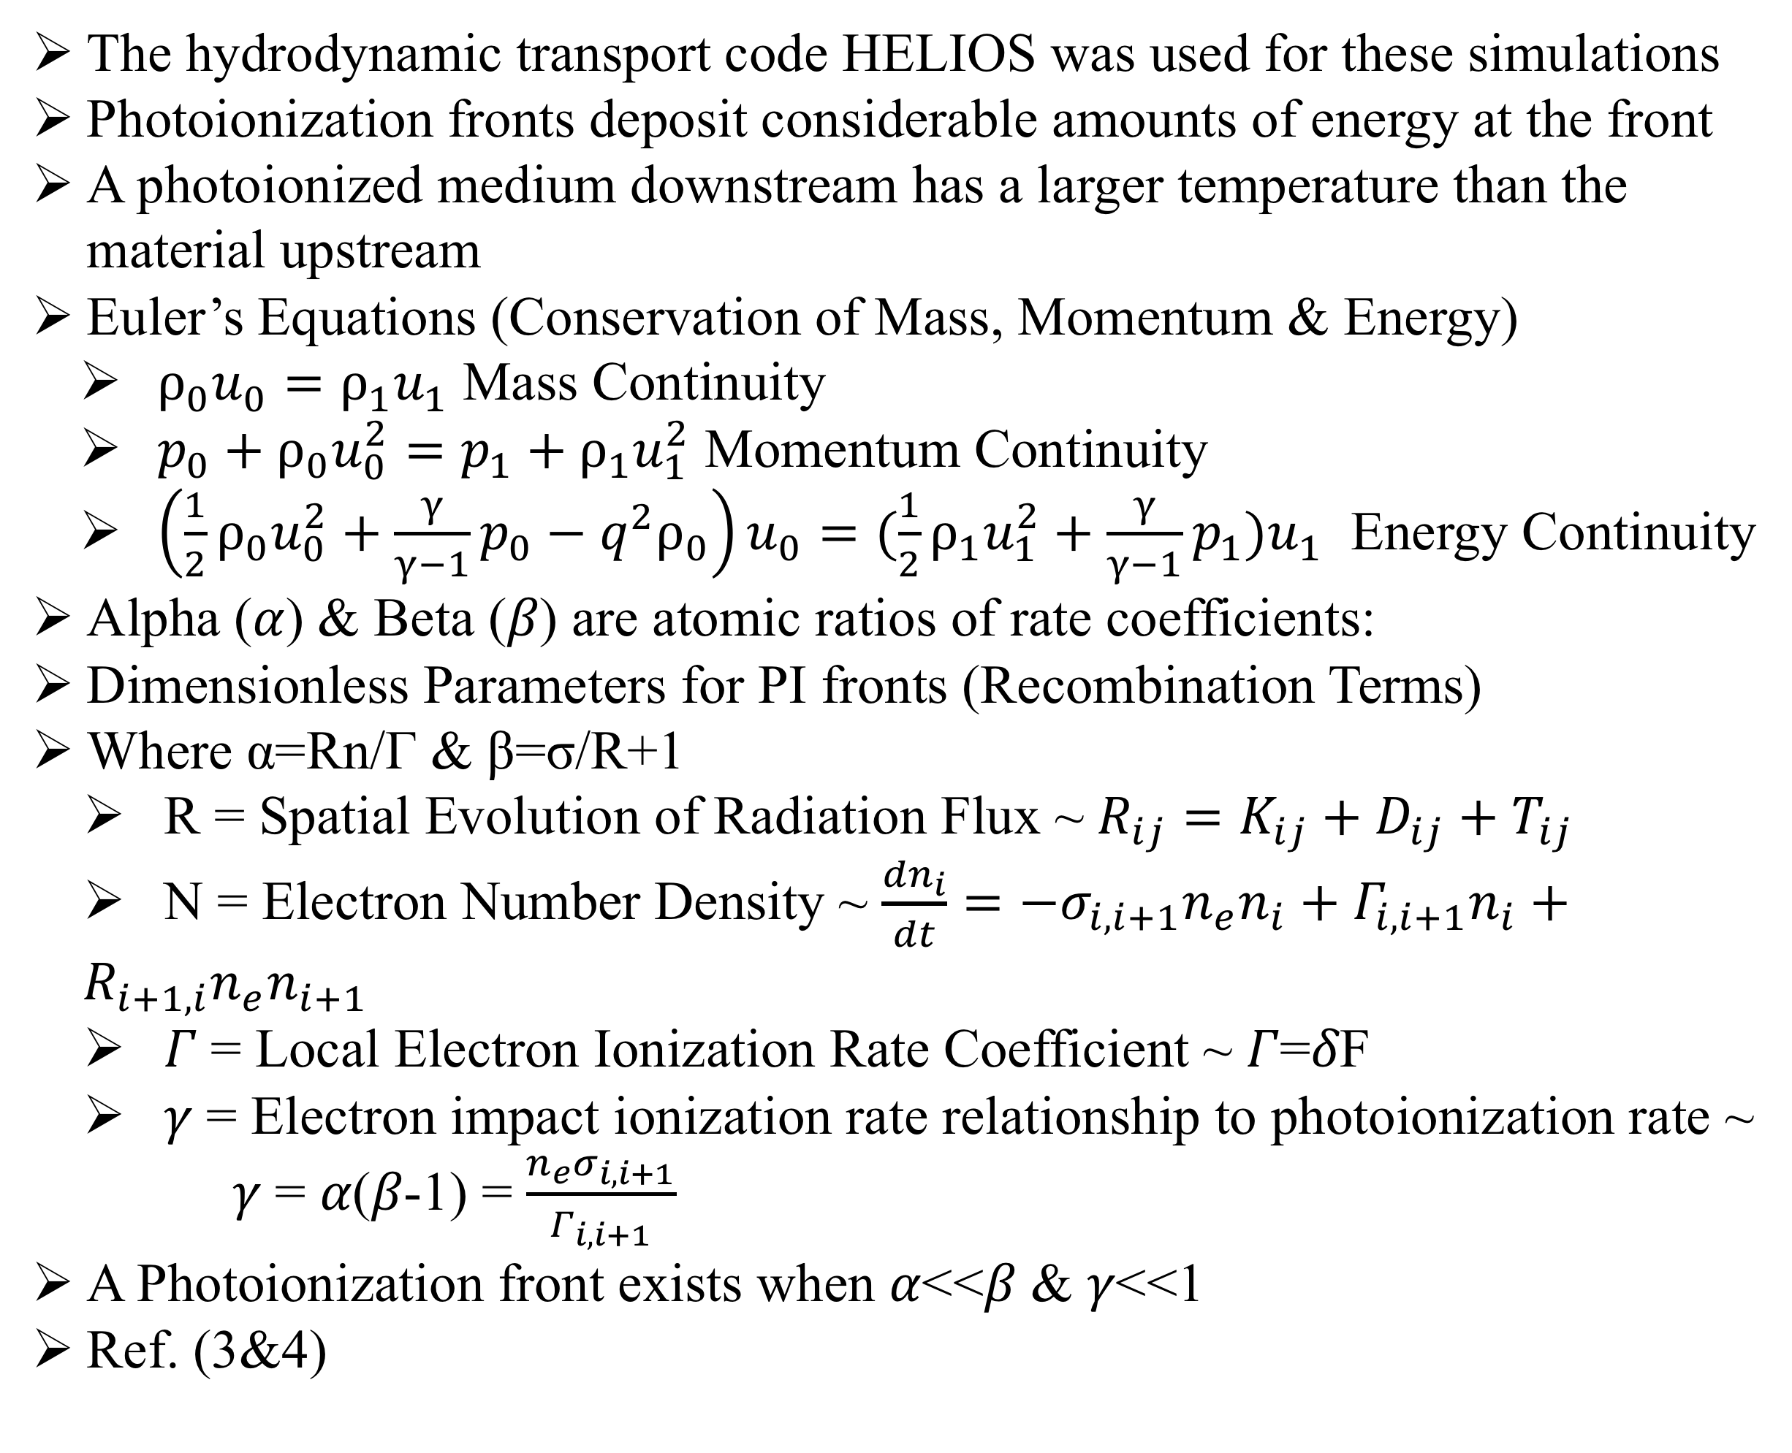
Observation of Photoionization Fronts in Laboratory Experiments
Kwyntero Kelso¹, Heath LeFevre¹, Sallee Klein¹, Paul Keiter^{1,2}, William Gray¹, Joshua Davis¹, R Drake¹, Carolyn Kuranz¹
¹Center for Laboratory Astrophysics, University of Michigan, Ann Arbor, Michigan. ²Los Alamos National Laboratory, Los Alamos, New Mexico.
Photoionization Fronts in Various Settings
Laser Irradiated thin Au foil providing X-rays which drive PI Fronts
Ion Density and Temperature Measurements of Nitrogen gas in cell
1. High-Energy-Density Physics (HEDP): Laser generated x-ray photons drive high temperature and density fluctuations into the gas cell, where we study laboratory astrophysics on ionized dynamics.
Photoionization fronts (PI Fronts)
  Described as “ionization fronts” in astrophysical literature
  Plays a role in the evolution of the early universe
  About 380,000 years post Big Bang, during the Cosmic Dark ages which began once all hydrogen and helium recombined
  The first dense structures were made of mostly dark matter mini-halo mergers forming star populations and galaxies
  From the heating and ionization of the surrounding gas, these star populations created photoionization fronts giving structure to galaxies
  Considering the fluctuations in the cosmic microwave background (CMB) , emitted during the era of recombination
Creating regimes in a laboratory setting
  Photoionization front is generated in nitrogen medium
  Project laser UV photon source (10¹⁴ W/cm²) onto a 500nm gold foil to drive X-ray flux (80-90eV)
  This x-ray flux drives a heat front through the gas cell with pressures of 8.56 atmospheres
Kilo-Joule laser facility required, i.e. (OMEGA) Laboratory for Laser Energetics at the University of Rochester
UV Photons
X-ray Photons
Target cell design
Electron Density & Temperature with Radiation temperature
Conclusions & Future Work
Ionization State & Atomic Ratio Results for Transitioning Medium
Generated these synthetic plots running a HELIOS simulation
Demonstrated the computational capabilities to simulate photoionization front data
The set up of this model yields the valuable characteristics necessary to output photoionization front relevant quantities
Refine the design of a Photoionization front experiment at the OMEGA laser facility, testing capabilities to detect front
Collect streaked camera spectra from photoionization front transition
Design new diagnostic/instrument to detect moving front
Timeline for the Evolution of the Universe (Robertson et al. ref.1 below)
The hydrodynamic transport code HELIOS was used for these simulations
Photoionization fronts deposit considerable amounts of energy at the front
A photoionized medium downstream has a larger temperature than the material upstream
Euler’s Equations (Conservation of Mass, Momentum & Energy)
  $ρ_{0}u_{0}=ρ_{1}u_{1}$ Mass Continuity
  $p_{0}+ρ_{0}u_{0}^{2}=p_{1}+ρ_{1}u_{1}^{2}$ Momentum Continuity
  $\left(\frac{1}{2}ρ_{0}u_{0}^{2}+\frac{γ}{γ−1}p_{0}−q^{2}ρ_{0}\right)u_{0}=(\frac{1}{2}ρ_{1}u_{1}^{2}+\frac{γ}{γ−1}p_{1})u_{1}$ Energy Continuity
Alpha (𝛼) & Beta (𝛽) are atomic ratios of rate coefficients:
Dimensionless Parameters for PI fronts (Recombination Terms)
Where α=Rn/Γ & β=σ/R+1
  R = Spatial Evolution of Radiation Flux ~ $R_{ij}=K_{ij}+D_{ij}+T_{ij}$
  N = Electron Number Density ~ $\frac{{dn}_{i}}{dt}=−σ_{i,i+1}n_{e}n_{i}+Γ_{i,i+1}n_{i}+R_{i+1,i}n_{e}n_{i+1}$
  𝛤 = Local Electron Ionization Rate Coefficient ~ 𝛤=𝛿F
  𝛾 = Electron impact ionization rate relationship to photoionization rate ~
  𝛾 = 𝛼(𝛽-1) = $\frac{n_{e}σ_{i,i+1}}{Γ_{i,i+1}}$
A Photoionization front exists when 𝛼<<𝛽 & 𝛾<<1
Ref. (3&4)
Acknowledgements/References
This work is funded by the U.S. Department of Energy NNSA Center of Excellence under Cooperative Agreement number DE-NA0003869, and the National Laser User Facility Program, grant number DE-NA0002719, and through the Laboratory for Laser Energetics, University of Rochester by the NNSA/OICF under Cooperative Agreement No. DE-NA0003856.
Robertson, B. E. et al. (2010) “Early star-forming galaxies and the reionization of the Universe”. Nature, 468(7320), 49-55
Drake, R. P. et al. (2016) “Design of Laboratory Experiments to Study Photoionization Fronts Driven By Thermal Sources”. The Astrophysical Jo, 833:249 (20pp)
Gray, W. J. et al. (2018) “Laboratory Photoionization Fronts in Nitrogen Gas: A Numerical Feasibility and Parameter Study”. The Astrophysical Jo, 858:22 (13pp)
Gray, W. J. et al. (2019) “Atomic Modeling of Photoionization Fronts in Nitrogen Gas”. Physics of Plasmas 26, 052901
OMEGA Target Chamber (Physics today & LLE facility website(lle.Rochester.edu))

