Slide 1
Utilizing A Global Model to Identify Relevant Reactions in Chemically Complicated Plasma Systems
Janez Krek¹, Yangyang Fu^{1,2}, and John P. Verboncoeur^{1,2}
¹ Department of Computational Mathematics, Science and Engineering, Michigan State University
² Department of Electrical and Computer Engineering, Michigan State University
e-mail: krek@msu.edu, fuyangya@msu.edu, johnv@msu.edu
Benefits of utilizing global models:
identifying main reaction pathways in multi-species plasma systems
reducing number of reactions
suitable for parameter sweeping
can be utilized as chemistry engine for fluid model codes (hybrid simulation codes)
provide rapid calculation times ~ 1min (not days)
The kinetic global model framework (KGMf):
Is a Python based open-source implementation of a global model, designed to investigate macroscopic plasma characteristics in systems with large reactions sets, such as plasma assisted combustion [1] or inverse combustion (CO₂ → CH₄) [2].
[1] G. M. Parsey, PhD thesis, MSU, 2017
[2] P. Koelman et.al, Plasma Process Polym., 14, 1600155 (2017).
Work supported by Air Force Office of Scientific Research (AFOSR) Grant No. FA9550-18-1-0062 and U.S. Department of Energy (DoE) Plasma Science Center grant DE-SC0001939
Notes:
We are presenting here a use of global models to identify relevant reactions in plasma systems. Global models were chosen because of their speed of simulations with times on order of minutes, their capability do capture general system’s behavior. This makes them suitable for doing large number of simulation for parameter sweeping or performing sensitivity analysis.
The KGMf is a Python based open-source simulation code using global models.

Slide 2
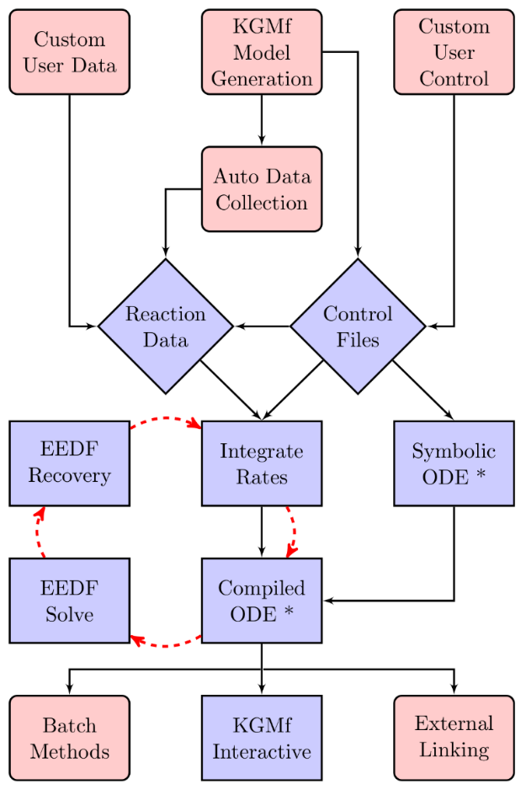
1. Identify Relevant Reactions with the KGMf
Approach depends on desired results:
Sensitivity analysis of the species densities on reaction rate errors (cross sections or rate coefficients).
KGMf
KGMf
$$K_{i}±∆K_{i}$$
$$σ_{i}±∆σ_{i}$$
KGMf
KGMf
$$n_{j}±∆n_{j}$$
KGMf
Contribution of reactions on creation/destruction of species (dominant reaction rate pathways analysis Koelman et.al [3], PumpKin[4]).
KGMf
PumpKin
Reaction number reduction
KGMf
Flowchart from [1]
[3] P. Koelman et.al, Plasma Sources Sci. Technol., 28, 75009 (2019).
[4] A.H. Markosyan, Comput. Phys. Commun., 185, 2697 (2014).
Notes:
The method for identifying relevant reactions depends on desired results and are applied at different parts in the KGMf’s flow.
Sensitivity analysis is used to define the system’s sensitivity on errors in input parameters – e.g. reaction rate coefficients, reaction set (leaving out or adding reactions). Sensitivity analysis usually involves large number of independent parameters due to non-linear nature of plasma systems where we can not simply assume/define the affect of one input parameter on selected result.
The dominant reactions is used to define the contribution of each reaction on selected simulation result – e.g. density of a species, temperature. This could be used to define reduced reaction set that is still capable to adequately describe the system in question.

Slide 3
2. PumpKin – define dominant reaction pathways
Dominant pathways are defined by PumpKin (pathway reduction method for plasma kinetic models) [4]
The dominant pathways are based on branch points (defined based on lifetime of species).
Reversed reactions from the KGMf are separated into forward and backward reaction.
Input Parameters:
list of species and reactions
time evolution of system parameters (species densities and temperatures)
time evolution of reaction rates
stoichiometric matrix
Results (output):
Reaction pathway with their contribution to generation / destruction of species
$$\begin{aligned}R_{1} \\ R_{2} \\ … \\ R_{N}\end{aligned}$$
KGMf
PumpKin
$$n_{e} \left\{\begin{aligned}R_{1}:X\% \\ R_{2}:Y\% \\ … \\ R_{N}:<ε\%\end{aligned}\right.$$
KGMf
Results
compare
Results
(Full reaction set)
(Reduced reaction set)
[4] A.H. Markosyan, Comput. Phys. Commun., 185, 2697 (2014).
Notes:
To define contribution of individual reaction, PumpKin is used. The KGMf exports the results (list of species and reactions, time evolution of densities and reaction rates) and PumpKin exports the contribution of each reaction on species density or temperature (if the species is temperature).
One of the uses of defining dominant reaction rate is to reduce the reaction set – leaving out reactions and species that have small (negligible) contribution to selected result. Reduced reaction set could be further used in spatially-dependent simulation – preserving the capability to describe the system behaviour while reduction the simulation time.

Slide 4
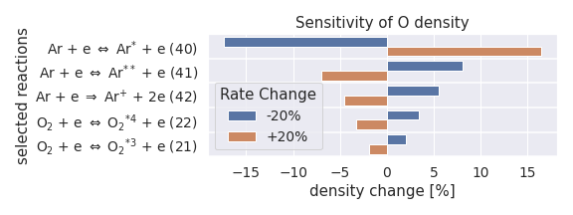
3. Results: nanosecond pulse discharge in O₂ – Ar (Winters [5])
O₂ – Ar nanosecond pulse discharge case
1%O₂ – Ar gas mixture
31 species and 74 reactions
global (0D) model
deposited energy: 4.2mJ/pulse
constant pressure: p = 300 Torr,
initial gas temperature: T_{g} = 500 K
volume: 10cm³, 6.5 x 1.5 x 1cm (L x W x H)
EEDF: Maxwellian
Running parameters (SA):
rate uncertainties: ±20%
number of runs: 149 (= 1 + 2 x 74)
# time steps: 95091
t_{end} = 0.5ms (10 pulses)
Results:
species of interest: O
run time: ~180s/run → ~4h 30min
In parallel on 10 cores → ~45min
Sensitivity to 20% uncertainty in reaction rate coefficients (K)
Combined effect on O density | Minimum |  | Maximum
R40: Ar + e ↔ Ar* + e | +20% | -26.1% | -20% | +30.5%
R41: Ar + e ↔ Ar** + e | -20% |  | +20%
R42: Ar + e → Ar⁺ + e + e | +20% |  | -20%
R22: O₂ + e ↔ O₂^{*4} + e | +20% |  | -20%
R21: O₂ + e ↔ O₂^{*3} + e | +20% |  | -20%
[5] C. Winters et.al, J. Phys. D: Appl. Phys., 51, 015202 (2018).
Notes:
The results we present today are from simulating nanosecond pulse discharge in H2-Ar mixture. The case was taken from paper Winters (2018), pressure of 300 Torr, gas temperature 500K and rectangular reactor with volume 10cm3. We used Maxwellian EEDF.
With reaction set composed out of 31 species and 74 reactions, we simulated reaction rate coefficient uncertainties of +-20% for each of 74 reaction to see the system’s sensitivity. This resulted in 149 reactions. Each case is independent so cases were run in parallel and total run time was relatively short: 45 min. The plot on the right side shows the sensitivity of 5 selected reactions (top 5).
We took top 5 reaction that show the highest level of sensitivity and run simulations by changing individual rate coefficients on more than one reaction at the time. This resulted in 243 cases and the combination of rate coefficients showing the maximum sensitivity (in positive and negative direction) is presented in table on the bottom right.

Slide 5
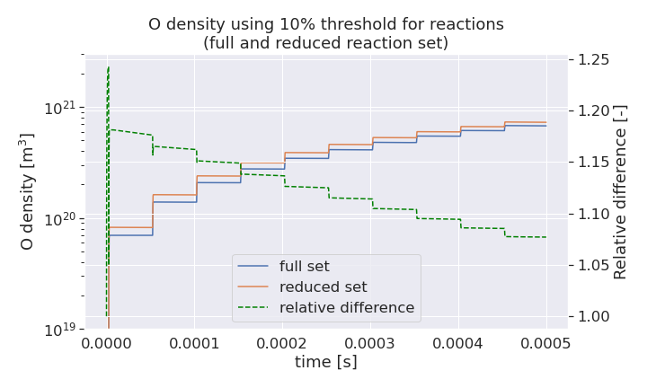
Nanosecond pulse discharge in O₂ – Ar (reduced reaction set)
Reduced reaction set for O density
The dominant reactions defined by PumpKin were used to in reduced reaction set and the time evolution of H density compared to full reaction set. Reduced set includes reactions that contribute at least 10% to the creation or destruction of individual species.
Reaction set: | full | reduced
# of species | 31 | 15
# of reactions | 74 | 26
Running time [s] | 180 | 64
Result:
The reduced set can capture the time evolution of O density and the difference between reaction sets is getting smaller with increasing time.
Notes:
Here we are showing the attempt to reduce the reaction set by taking only the reactions that contribute more than 10% to the selected density – in this case this was oxygen density.
The table on the left shows reactions that have more than 10% contribution on O density. By using this reactions, extracting species and using reactions contributing more than 10% to those species’ density, and going back until all species and reactions were checked, we created reduced reaction set.
The table on upper right shows the number of species and reactions in full and reduced reaction set. Reduced set has 50% less species, has 35% of reactions and takes around 65% less time to complete the simulation.
The plot on bottom right shows the time evolution of oxygen density simulated with full and reduced reaction set. The dashed green line shows the difference between both densities, where 1 means the densities are the same. The difference is getting smaller with advancing time and the system is not in steady state.

Slide 6
4. Conclusions and future work
Conclusions:
Performing a sensitivity analysis with the KGMf is simple, defining dominant reactions is mainly a manual work (preparation of a reduced reaction set simulation case).
The accuracy of the reduced reaction set highly depend on individual case; in some cases (H₂-Ar) it can capture the trend of time evolution of target species’ density, but the difference compared to the full reaction set is huge.
PumpKin is an efficient tool to extract contributions of reaction pathways to species densities (production/consumption of species), but additional check is necessary before using dominant reactions in reduced reaction sets.
Future work:
Validation of dominant reaction pathway results with KGMf-PumpKin.
Automatization of processing of results from PumpKin.
Identify dominant reaction pathways in simulations with coupled BE solver.
Reducing the overall running time with coupled BE solver, coupling with BOLSIG+/MCIG.
Notes:
Conclusions:
- the sensitivity analysis is relatively easy to do with KGMf, defining dominant reactions requires quite some amount of manual work
- the accuracy of the reduced reaction set depends heavily on simulated case. Presented O2-Ar case shows good agreement between full and reduced reaction set, but, for example, H2-Ar set under similar conditions shows huge difference in time evolution of H density (factor of 2.8 and getting bigger with advancing time)
Future work:
As the results are preliminary ones, extensive verification and validation of the code is necessary; especially validation is important to establish the fidelity of results produced by the code
With large number of reactions, specially taking case of forward and reverse reactions, preparing the system with reduced reaction set can be tedious and prone to introduce errors (adding or leaving out reactions or species). Some sort of automation is needed.
Tests with coupled BE solver needs to be conducted
Including BE solver to compute the EEDF increases the overall run time – the reduction of run time is needed; maybe one direction would be coupling with BOLSIG+/MCIG

