Slide 1
MODELING SHEATH DYNAMICS AROUND WATER DROPLETS IN LOW TEMPERATURE PLASMAS*
Mackenzie Meyer¹, Gaurav Nayak², Peter Bruggeman², and Mark J. Kushner¹
¹University of Michigan, Ann Arbor, MI 48109-2122 USA ²University of Minnesota, Minneapolis, MN 55455 USA
maemeyer@umich.edu, mjkush@umich.edu
11th Annual MIPSE Graduate Student Symposium
17 November 2020
* Work supported by the National Science Foundation (PHY-1902878) and the Department of Energy Fusion Energy Sciences (DE-SC000319, DE-SC0020232).

Slide 2
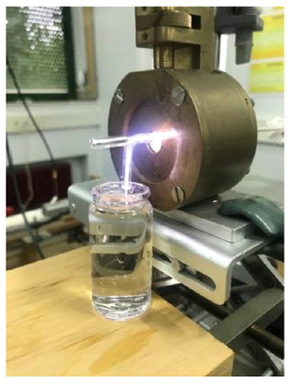
PLASMA-LIQUID INTERACTIONS
Plasma medicine and water treatment often rely on plasma-liquid interactions.
Reactive oxygen species produced in the plasma, transported into the liquid, oxidize complex organic molecules.
Reactive nitrogen species can acidify the liquid and produce biologically active compounds.
Limiting factor of chemical activation of the liquid is transport.
High surface to volume ratio of liquid enables rapid activation.
Argon plasma jet interacting with liquid water (E. Casado et al, Plasma Process Polym. E2000030 (2020)).
University of Michigan
Institute for Plasma Science & Engr.
MIPSE_2020
Notes:
Plasma-liquid interaction is important in water treatment and plasma medicine (biological tissue covered by layer of water)
Two categories of reactive species produced in plasma
ROS transported to liquid, oxidize organics
RNS acidify liquid, produce biologically active compounds
Limiting factor of chem activation is transport (RONS -> surface -> bulk liquid) – high SVR enables transport to bulk liquid

Slide 3
PLASMA-LIQUID INTERACTIONS
Interactions at the surface of the liquid are not well understood.
Concentrated water vapor near the surface due to evaporation
Short-lived species dynamics
Charging of the surface
Sheath dynamics and electrical properties of a water droplet are investigated by the 2D model nonPDPSIM.
Processes occurring in the plasma, interface, and bulk liquid.
University of Michigan
Institute for Plasma Science & Engr.
MIPSE_2020
Notes:
Interactions near surface not well understood, and we aim to understand them – some processes shown in graphic to right
Evaporation (concentrated layer of water vapor above surface), short-lived species react, charging complicates surface
Use 2 models: 2D for electrical properties and sheath dynamics, 0D for chem modeling

Slide 4
GEOMETRY, CONDITIONS
Reactor is a radio frequency (RF) glow discharge at atmospheric pressure.
A dielectric droplet with ε/ε₀=80 was used.
Dielectric droplet has same electrical properties as liquid water droplet, but liquid phase chemistry is not tracked.
Species: e, He, He(2³S), He(2¹S), He(2³P), He(2¹P), He(3P), He(3S), He*₂, He⁺, He⁺₂
RF frequency: 10 MHz
Geometry
Numerical mesh.
University of Michigan
Institute for Plasma Science & Engr.
MIPSE_2020
Notes:
Reactor near plasma is modeled – liquid in center, grounded electrode on left and powered on right, 2 mm gap – dielectric top and bottom
Model droplet with relative permittivity of 80 to reduce computational time (not tracking liquid chemistry) – electrically, behaves like water droplet
Don’t need to track too many species to see electrical properties – just including electrons and helium species (ground state, various excited states, ions, dimer and dimer ion)
RF frequency is 10 MHz (cycle is 100 ns)
Atmospheric pressure
Rxns with include: electronic excitation/de-excitation, elastic collisions, dimer formation, recombination, dissociative recombination (of He2^), Penning ionization

Slide 5
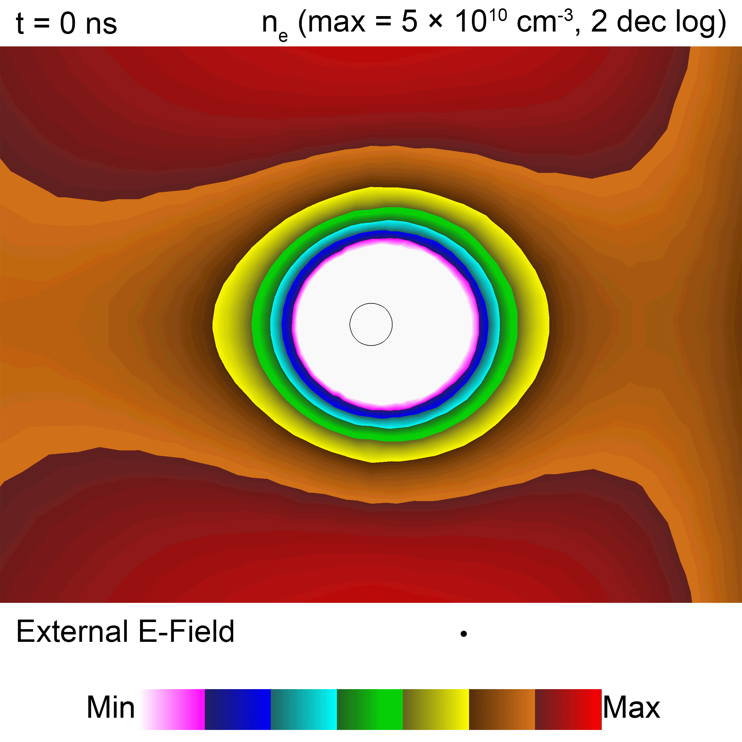
ELECTRON DENSITY AROUND “DROPLET”
40 µm diameter nonconductive dielectric droplet
RF amplitude = 200 V (0.5 W)
The sheath oscillates throughout the RF cycle.
Sheath is distorted asymmetrically, elongated in opposite direction of external E-field.
Polarization of droplet in vacuum field enhances E-field at poles parallel to external field, minimizes at equator.
Electron density during 40th RF cycle.
Animation Slide
University of Michigan
Institute for Plasma Science & Engr.
MIPSE_2020
Notes:
Base case: 40 micron diameter droplet, RF voltage 10 MHz and 200 V, no conductivity (not steady state, over 40th RF cycle)
bulk density 4e10 cm-3, 0.5 W
Slides show properties over 40th RF cycle, time from beginning of RF cycle
Explain plot – voltage from powered electrode changes
Sheath oscillates – asymmetric as its in the opposite direction of the external E
Polarization: in horizontal E, max in E/N on horizontal axis and min on vertical axis
He23s density: 1e9 cm^-3, He2+ density: 4e10 cm^-3, He2* density: 2.5e8 cm^-3

Slide 6
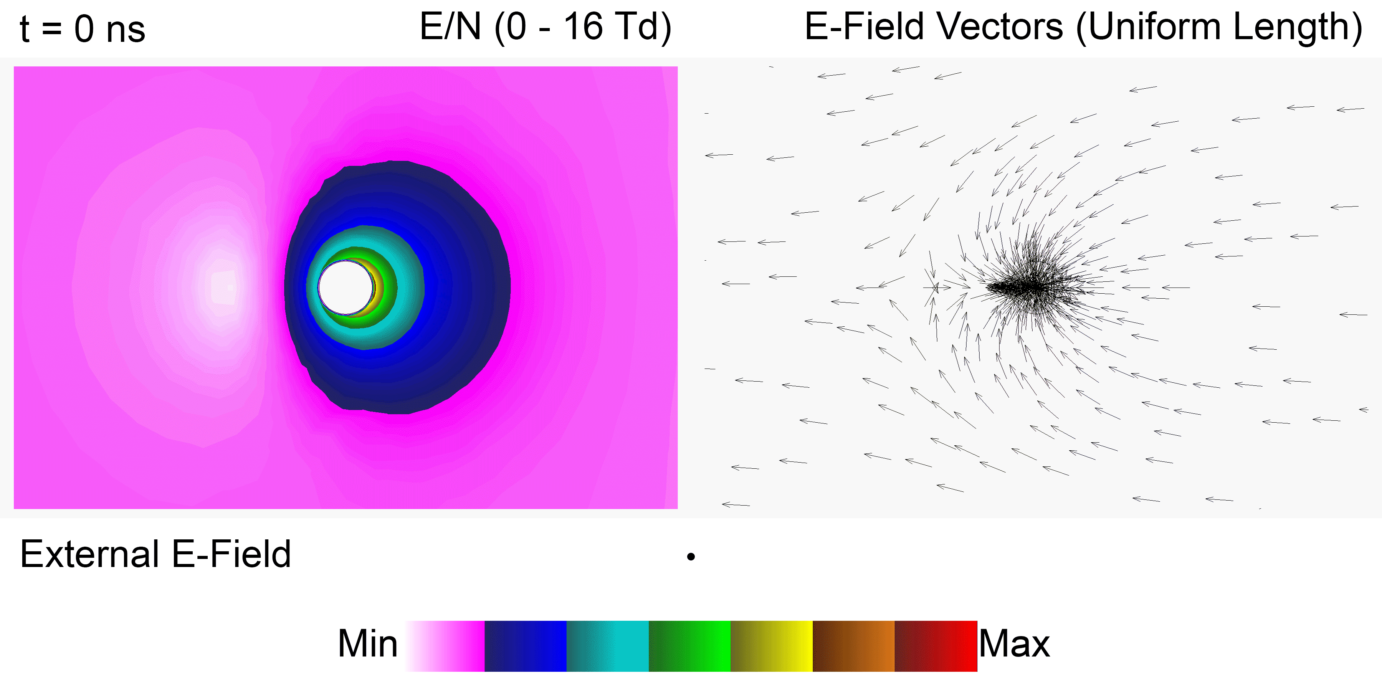
ELECTRIC FIELD AROUND “DROPLET”
E/N and electric field during 40th RF cycle.
Polarization of dielectric droplet oscillates with change in direction of external E-field.
Sum of external E-field and sheath E-field produce enhancement and decrease on opposite sides.
E/N is “zero” when external and sheath fields cancel.
Animation Slide
University of Michigan
Institute for Plasma Science & Engr.
MIPSE_2020
Notes:
Shows E/N on left and E vectors on right
Polarization distorted by charging and sheath dynamics, oscillates with external E
Two fields: sheath field always points towards droplet, and external field flips – enhancement of E on one side and decrease (to 0) on other side during RF cycle)
The spot where E/N is zero shows where fields cancel

Slide 7
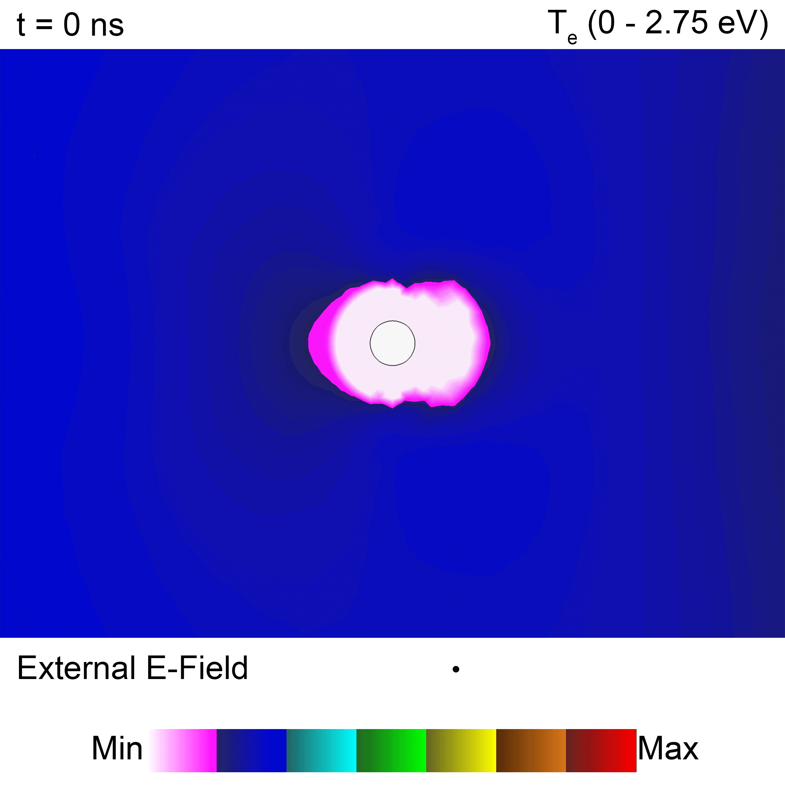
ELECTRON TEMPERATURE AROUND “DROPLET”
Electron temperature equilibration time at 1 atm is << RF cycle (100 ns).
T_{e} largely reflects local E/N, varying from 0.8 to 2.75 eV over RF cycle near droplet.
Min and max T_{e} occur in alignment with external E-field (constructive, destructive interference with sheath).
Electron temperature during 40th RF cycle.
Animation Slide
University of Michigan
Institute for Plasma Science & Engr.
MIPSE_2020
Notes:
Te responds much quicker compared to RF cycle
Te follows local E/N trends, varies 0.8-2.75 eV near droplet
Min/max occur along external E – because of the two E’s adding/subtracting
0.9-3.7 eV is the max electron temperature overall

Slide 8
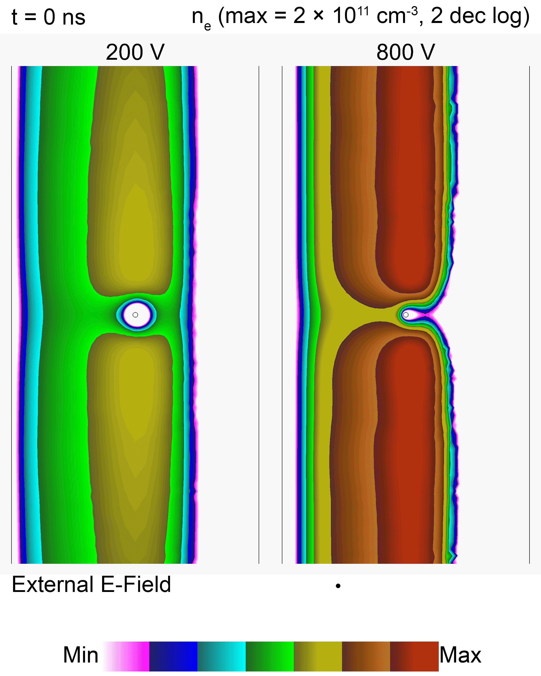
ELECTRON DENSITY WITH VARYING RF AMPLITUDE
200 V: plasma occupies most of the gap between the electrodes.
800 V: plasma occupies half the gap between the electrodes.
Since potential drop occurs near the cathode, the large voltage confines the plasma.
Electron density during 40th RF cycle for different RF voltage amplitudes.
Animation Slide
University of Michigan
Institute for Plasma Science & Engr.
MIPSE_2020
Notes:
Varied parameter: RF voltage – base case has 200 V
200 V: plasma occupies most of gap between electrodes (Te is 0.8-3.7 eV, not steady state, 0.5 W in plasma)
800 V: plasma occupies half of gap between electrodes (Te is 4.5-5.8 eV, not steady state, 6.3 W in plasma)
Most of potential is dropped near negative electrode (cathode), and 800 V has more of a potential to drop, confining plasma more

Slide 9
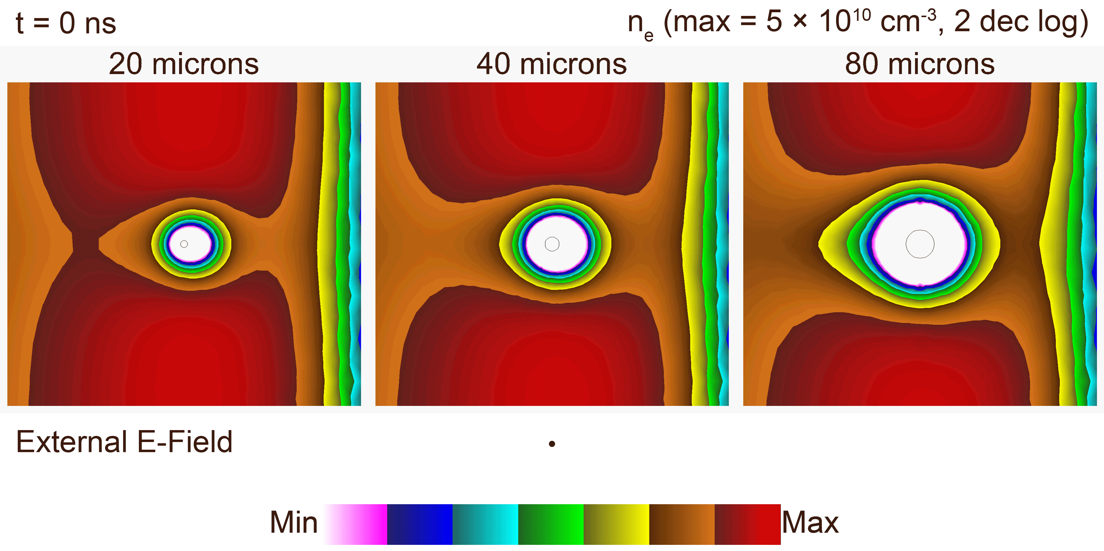
ELECTRON DENSITY WITH VARYING DROPLET DIAMETER
Electron density during RF cycle for various droplet diameters.
Increasing droplet diameter increases size of sheath.
Larger sheath decreases plasma density aligned with external E-field.
Animation Slide
University of Michigan
Institute for Plasma Science & Engr.
MIPSE_2020
Notes:
Will show parameter sweeps – first is diameter – base case has 40
Increasing diameter increase sheath size
Larger sheath area/diameter decreases/deforms plasma density aligned with external E in sheaths near electrodes
Larger sheath area increases effect droplet has on plasma

Slide 10
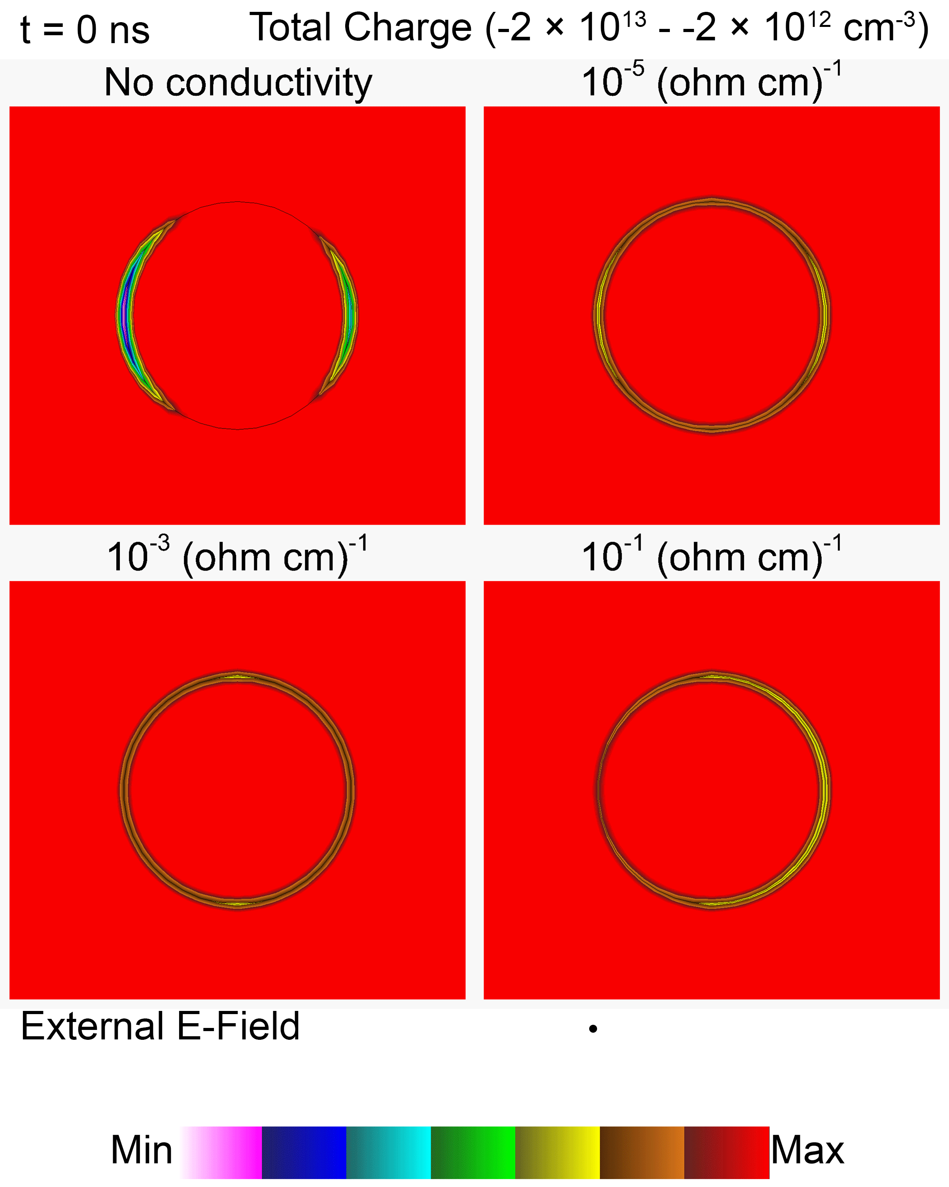
TOTAL CHARGE WITH VARYING DROPLET CONDUCTIVITY
Charge does not oscillate on non-conductive droplet, instead accumulating over time.
The charge is spread out more on higher conductivity droplets.
Increasing conductivity increases oscillation of charge in opposite direction of external E-field.
Animation Slide
Total charge during 40th RF cycle for different droplet conductivities.
University of Michigan
Institute for Plasma Science & Engr.
MIPSE_2020
Notes:
Varied parameter: conductivity (0 to 1e-1) – base case has 0
No conductivity: charge on droplet does not move, accumulates over time
Increasing conductivity, charge spread out more on surface
Increasing conductivity, charge oscillates more during RF cycle – electric field pushes charges on droplet
Not symmetric in nonconductive case as not in steady state, and ne decreases – leads to one side experiencing more charge each RF cycle than the other

Slide 11
CONCLUDING REMARKS
Electrical properties and sheath dynamics of a small water droplet immersed in a humid helium plasma are investigated by 2D modeling.
The polarization of the droplet is distorted by charging of the droplet and sheath forming around the droplet.
Increasing RF amplitude decreases the width of the plasma.
Increasing droplet diameter increases the size of the sheath surrounding the droplet.
Increasing droplet conductivity increases charge oscillation during the RF cycle.
Current work involves including air impurities in the He plasma.
University of Michigan
Institute for Plasma Science & Engr.
MIPSE_2020

