Slide 1
A GLOBAL MODEL FOR THE ATMOSPHERIC PRESSURE PLASMA SURFACE FUNCTIONALIZATION OF POLYSTYRENE*
Jordyn Polito and Mark J. Kushner
University of Michigan, Ann Arbor, MI 48109-2122 USA
jopolito@umich.edu, mjkush@umich.edu
Mark Denning, David Frost, and Richard Stewart
Agilent Technologies
11th Annual MIPSE Symposium
November 17th, 2020
* This work was supported by Agilent Technologies and the Department of Energy Office of Fusion Energy Science.
Notes:
1
1

Slide 2
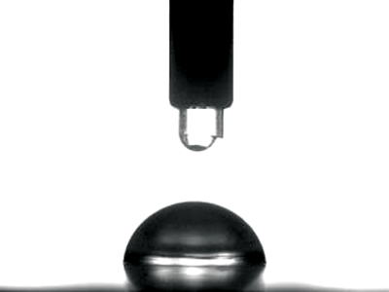
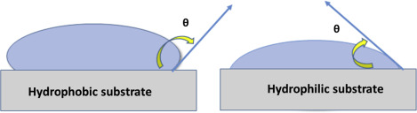
PLASMA TREATMENT OF POLYMERS
Synthetic organic polymers have many desirable characteristics that make them more useful than traditional engineering materials.
Polymers suffer from low surface energy (low adhesion, wettability).
Surface energy can be increased by adding O containing functional groups to the polymer surface.
LTP treatment of polymers
Efficient surface functionalization
Good alternative to traditional methods for treating heat sensitive materials
1. Henniker Plasma
2. R.S.Hebbar et. al. Membrane Characterization. 219-225 (2017).
University of Michigan
Institute for Plasma Science & Engr.
MIPSE_2020
Notes:
2
2
Paints, biomaterials, biomedical devices

Slide 3


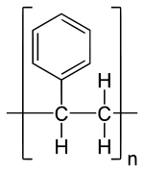
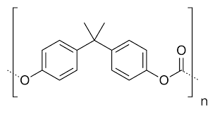

PREVIOUS MODELS AND CHALLENGES
Several models have predicted surface functionalization of polypropylene (e.g., surface site balance model, regressive model)
Focus on polypropylene likely due to large presence in industry and simple monomer unit.
Gas-phase plasmas-surface reaction data unavailable for most polymers, mechanisms for functionalization unclear
Approximations can be made by using rate data from analogous gas-phase reactions of LTPs with similar short-chain alkanes.
n
n
Polypropylene
Polystyrene
Polycarbonate
University of Michigan
Institute for Plasma Science & Engr.
MIPSE_2020
Notes:
3
3

Slide 4
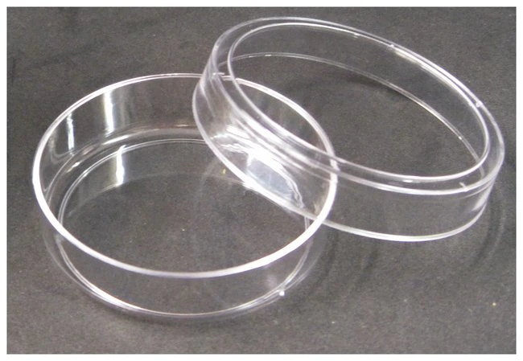
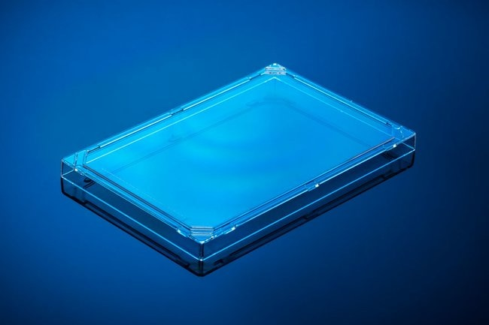
PLASMA TREATMENT OF POLYSTYRENE (PS)
PS is a versatile polymer widely used in the biological and biomedical fields
We propose a reaction mechanism for APPJ treatment of PS
A global model was used to predict fractional occupancy of oxygen on the PS surface after plasma treatment and exposure to air
Trends from model are compared to contact angle measurements.
fisherscientific.com
University of Michigan
Institute for Plasma Science & Engr.
MIPSE_2020

Slide 5
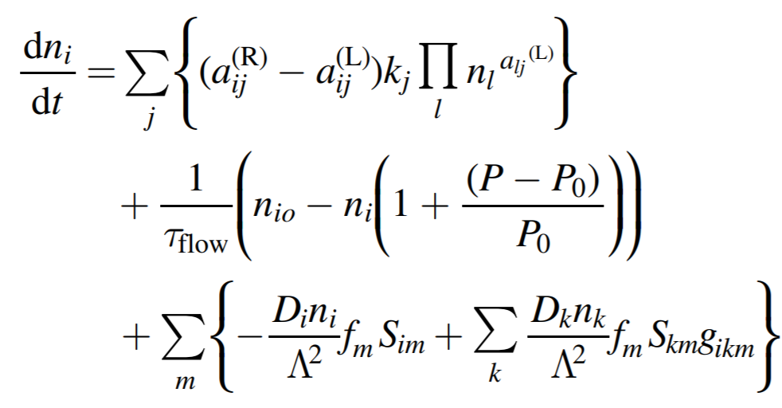
MODEL DESCRIPTION: GLOBALKIN
GlobalKin is a 0-dimensional global plasma chemistry module
Species densities are solved using a continuity equation. Sources and losses due to reactions, flow, and losses to wall are accounted for
The electron energy equation is solved to provide average electron temperature
Plug flow, circuit module, volume averages based on user input
University of Michigan
Institute for Plasma Science & Engr.
MIPSE_2020
Notes:
5
5
Boltzmann solved for range of E/N to produce a table of rate coefficient as a function of average electron energy. Lookup table is interpolated over using the mean electron energy provided by electron energy equation
Energy: power gained by deposition, inelastic colls., elastic colls.

Slide 6
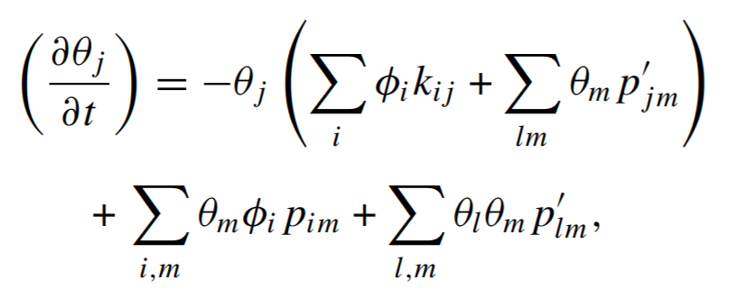
GLOBALKIN: SURFACE KINETICS MODULE
The Surface Kinetics Module (SKM) can be used in conjunction with GlobalKin
Fluxes to surface are calculated based on bulk densities and diffusion length.
Surface sites are characterized by fractional occupation of site by functional groups.
A site balance is solved that accounts for rates of desorption, abstraction, and adsorption per unit area of surface.
θ_{j} = surface site coverage of j
ϕ_{i} = flux of gas species i
k_{ij}= rate of reaction of species i with j
p_{im} = reaction probability between species i and m
p’_{jm} = reaction probability between surface site species j and m
University of Michigan
Institute for Plasma Science & Engr.
MIPSE_2020
Notes:
6
6
First two terms, depletion of

Slide 7
REACTOR CONFIGURATION
Based on Surfx plasma head
Inlet 1:
He/O₂ =0.976/0.024, 0.98/0.20, 0.986/0.013
Head distance from surface: 2 mm, 8.9 mm, 14.7 mm
T_{gas} = 323 K, T_{air} = 298 K
Power = 180 W, 210 W, 270 W
Treatment area = 5 cm x 5 cm
Inlet 2:
N₂/O₂/H₂O = 0.78/0.20/0.02
1% flow rate of Inlet 1 to approximate diffusion of air into plume.
Inlet 1: He/O₂
~
Electrode
10 cm
0.2 cm
Plasma
0.2 cm
Inlet 2: Air
5 cm
University of Michigan
Institute for Plasma Science & Engr.
MIPSE_2020
Notes:
7
7

Slide 8

POLYSTYRENE CHEMISTRY
Table 1. Base surface reaction mechanism for PS
Reactionª | Probabilities or reaction rates^{b,c}
Initiation
O_{g} + PS-H → PS● + OH_{g} | 10⁻³, 10⁻⁴
O_{g} + PS-RH → PS-R● + OH_{g} | 10⁻⁵
OH_{g} + PS-H → PS-H● + H₂O_{g} | 0.25, 0.05
OH_{g} + PS-RH → PS-R● + H₂O_{g} | 10⁻⁵
Propagation
PS● + O­_{g} → PS-O● | 10⁻¹, 10⁻²
PS● + O­_{2g} → PS-O₂● | 1.0 x 10⁻³, 2.3 x 10⁻⁴
PS● + O­_{3g} → PS-O● + O_{2g} | 1.0, 0.5
PS-R● + O­_{g} → PS-RO● | 9.4 x 10⁻³
PS-R● + O­_{2g} → PS-RO₂● | 5.4 x 10⁻³
PS-R● + O­_{3g} → PS-RO● + O_{2g} | 1.0
Termination
H_{g} + PS● → PS-H | 0.2, 0.2
OH_{g} + PS● → PS-OH | 0.2
H_{g} + PS-R● → PS-R | 1.0
ª Subscript g denotes gas phase species, PS-H refers to C contained in the alkane chain of polystyrene monomer, PS-R refers to C contained in the benzene ring of polystyrene monomer ^{b} Coefficients are given as unitless reaction probabilities ^{c} Comma delimited reaction probabilities correspond to 3°, 2° sites respectively
Reaction mechanism based on polypropylene.
Reaction probabilities estimated as analog gas-phase reactions with small chain alkanes.
Cross-linking reactions included for PS to terminate instead of chain scission reactions.
R
3°
2°
University of Michigan
Institute for Plasma Science & Engr.
MIPSE_2020
Notes:
8
8

Slide 9
PLASMA PROPERTIES
T_{e} = 2- 2.5 eV
n_{e} = 10¹⁰ cm⁻³
Power = 270 W
Species needed for surface functionalization: O₂ , O₂* , O , O*, O₃ , OH, HO₂
• He/O₂ = 0.976/0.024 , Power = 270 W, Gap = 2.0 mm
University of Michigan
Institute for Plasma Science & Engr.
GEC_2020

Slide 10
PLASMA PROPERTIES: REACTOR OUTLET
Ambient (humid) air diffuses into plasma plume at 10 cm
Species responsible for H abstraction from the surface: O , OH
Species responsible for formation of alkoxy (R-O*) radicals: O , O₃
Species responsible for formation of peroxy (R-OO*) radicals: O₂, O*₂
Reactor Outlet
• He/O₂ = 0.976/0.024 , Power = 270 W, Gap = 2.0 mm
University of Michigan
Institute for Plasma Science & Engr.
MIPSE_2020
Notes:
Sharp increase in H2O due to humidity + H abstraction by OH and OH*
H2O2 due to h abstraction by HO2

Slide 11
CONTACT ANGLE COMPARISONS
Gap between plasma head and surface = 2.0 mm.
Polymer web speed (mm/min) varies in model as treatment time
Model gives good agreement with trends of contact angle measurements.
Smaller contact angle corresponds to more O on surface.
 | 400 mm/min | 800 mm/min | 1200 mm/min
2.0 mm | 15 deg | 29 deg | 24 deg
8.9 mm | 30 deg | 38 deg | 59 deg
14.7 mm | 42 deg | 68 deg | 81 deg
• He/O₂ = 0.976/0.024 , Power = 270 W, Gap = 2.0 mm
University of Michigan
Institute for Plasma Science & Engr.
MIPSE_2020
Notes:
11
11

Slide 12
SURFACE FRACTIONAL OCCUPANCY: OXYGEN
Plasma treatment 3 s, followed by exposure to ambient air.
O containing groups responsible for changes in contact angle.
“Other”: any other oxygen containing groups (dominated by radicals).
Initial decrease in fractional occupancy of oxygen due to cross linking of radical sites.
• He/O₂ = 0.976/0.024 , Power = 270 W, Gap = 2.0 mm
University of Michigan
Institute for Plasma Science & Engr.
MIPSE_2020

Slide 13
%O OCCUPANCY vs. INLET MOLE FRACTION O₂
Plasma treatment 3 s, followed by exposure to ambient air.
Lower mole fraction of O₂ in plasma leads to higher surface O-occupancy – with optimum at 1%.
Higher mole fraction yields more O₃ and fewer species responsible for creation of alcohol groups.
• Power = 270 W, Gap = 2.0 mm
University of Michigan
Institute for Plasma Science & Engr.
MIPSE_2020

Slide 14
CONTACT ANGLE vs POWER, OXYGEN
Gap distance between plasma head and surface = 2.0 mm.
Commercial plasma applicator recipes require specified O₂ fraction in He for a given power.
End result is non-monotonic O-occupancy with power.
• Web speed = 800 mm/min = 1.5 s treatment time, Gap = 2.0 mm
University of Michigan
Institute for Plasma Science & Engr.
MIPSE_2020
Notes:
14
14

Slide 15
%O OCCUPANCY vs. %H₂O IN AIR
An H₂O fraction of 1% corresponds to relative humidity of 40%.
As H₂O content increases, O occupancy decreases.
Competing reactions of O with H₂O could cause less H abstraction from the surface.
• He/O₂ = 0.976/0.024 , Power = 270 W, Gap = 2.0 mm
University of Michigan
Institute for Plasma Science & Engr.
GEC_2020

Slide 16
CONCLUDING REMARKS
A mechanism for plasma functionalization of PS was developed including post-plasma treatment exposure to ambient air.
Trends in oxygen fractional occupancy agree with contact angle measurements.
The model predicts that changes in contact angle of the PS are mainly due to formation of alcohol groups and cross linking products on the surface.
Cross linking is generally responsible for stabilizing the surface.
Future work includes creation of a mechanism plasma functionalization of polyethylene terephthalate (PET).
Comparison of results from treatment of different polymers will be used to better understanding of plasma functionalization of polymers containing various functional groups
University of Michigan
Institute for Plasma Science & Engr.
GEC_2020
Notes:
16
16

