Slide 1
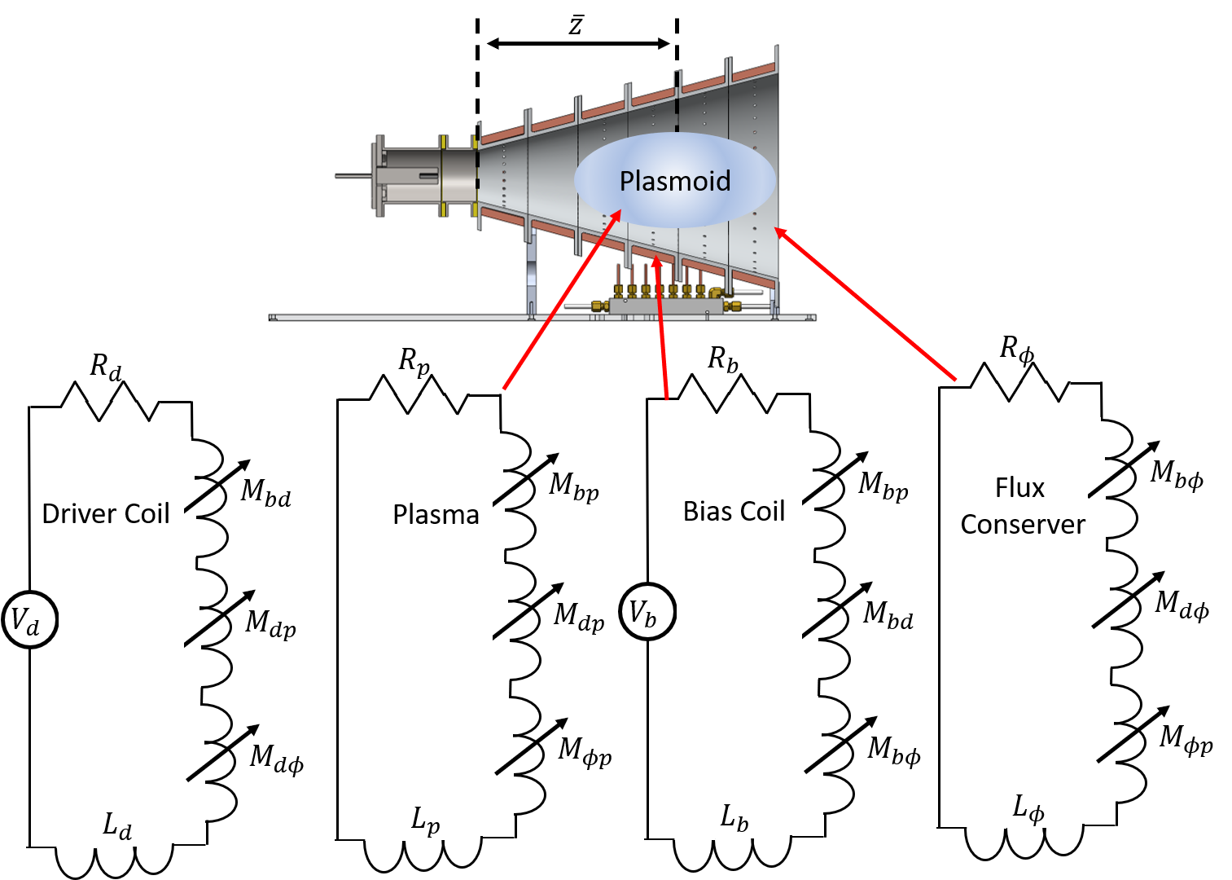
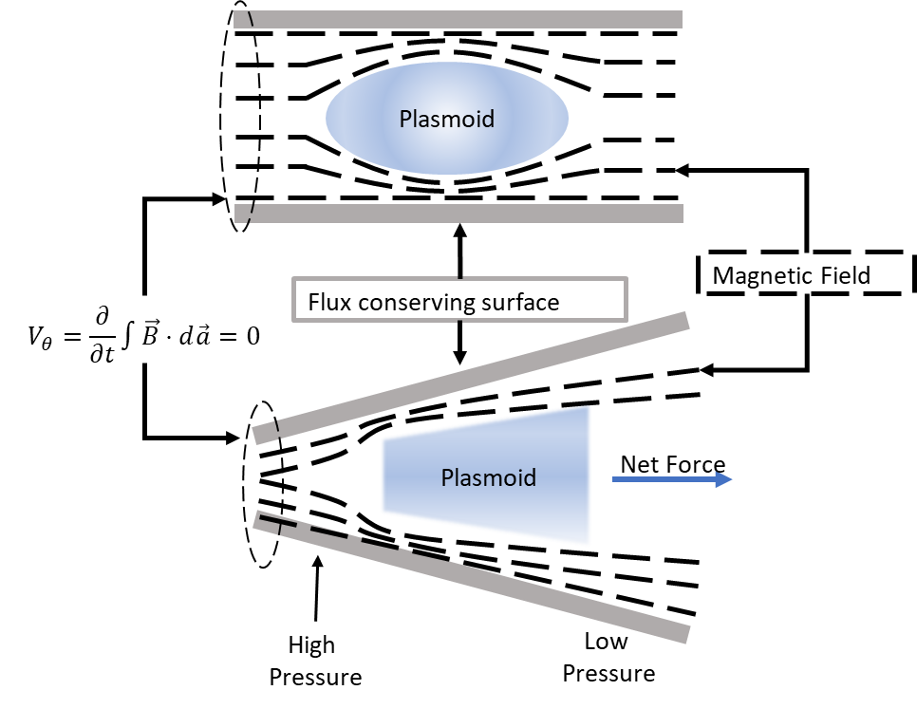
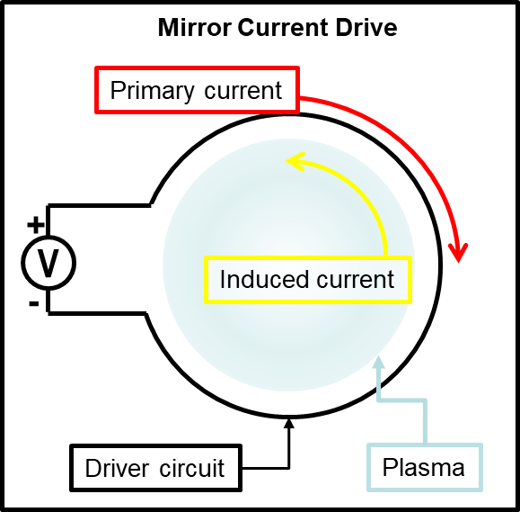
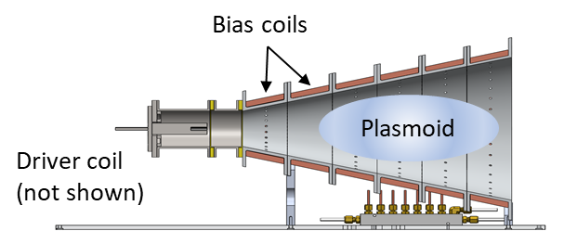
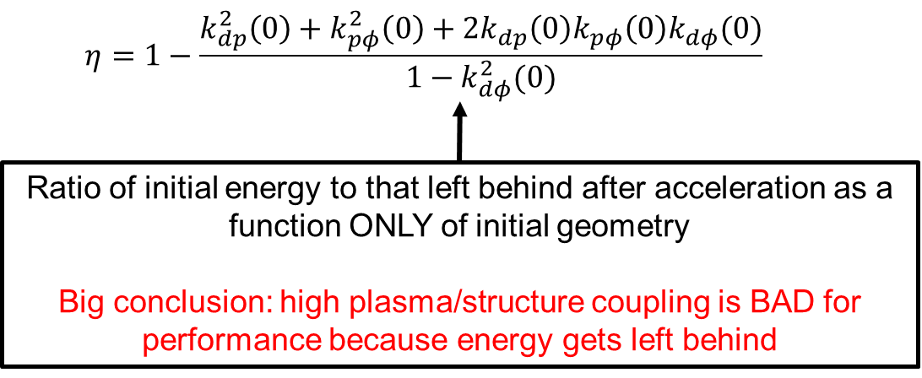
Effect of Flux Conservers on Inductive Pulsed Plasmoid Thrusters
Christopher Sercel, Joshua Woods, Tate Gill, and Benjamin Jorns
University of Michigan, Department of Aerospace Engineering, Ann Arbor, MI 48109
Motivation
Circuit Analysis
The Role of Flux Conservers
Field-Reversed Configuration (FRC) thrusters could fill the role of high-power (>100 kW), propellant-agnostic thruster
However, physical mechanisms behind plasmoid acceleration are poorly understood, and some design features seem due to heritage from the fusion community rather than rigorous physical motivation
To address uncertainties in their applicability to thrusters, rather than confinement devices, there is a need for a quantitative understanding of how flux conservers impact FRC thruster performance
Current Drive Mechanism
Circuit analysis: device forms current loops which couple to each other via mutual inductance.
Major assumption made in this study: energy coupled from driver to rest of system instantly at time 0
A flux conserving surface outside the plasma, created using conductive rings or a shell, increases magnetic pressure outside the plasma by preventing field lines from straying beyond the volume.
Flux conservers are often included in FRC thrusters with the qualitative argument that the increased magnetic pressure in the cone will help force the plasma out, akin to squeezing a toothpaste tube
Results
$k(0)$: Mutual coupling coefficient at time 0
Subscripts: $d$ driver coil; $p$ plasma; $φ$ flux conserver
References
[1] Polzin, Kurt, et al. "State-of-the-Art and Advancement Paths for Inductive Pulsed Plasma Thrusters." Aerospace 7.8 (2020): 105.
[2] Jahn, Robert G. Physics of electric propulsion. Courier Corporation, 2006.
[3] Weber, Thomas. The electrodeless Lorentz force thruster experiment. Diss. 2010.
Current is inductively driven by a primary ‘driver’ coil, situated azimuthally around the plasma. When current is rapidly discharged through this coil, the plasma experiences the opposite current
Contact: csercel@umich.edu
This work was partially supported by the NASA Space Technology Research Fellowship under Grant 80NSSC18K1190

