Slide 1
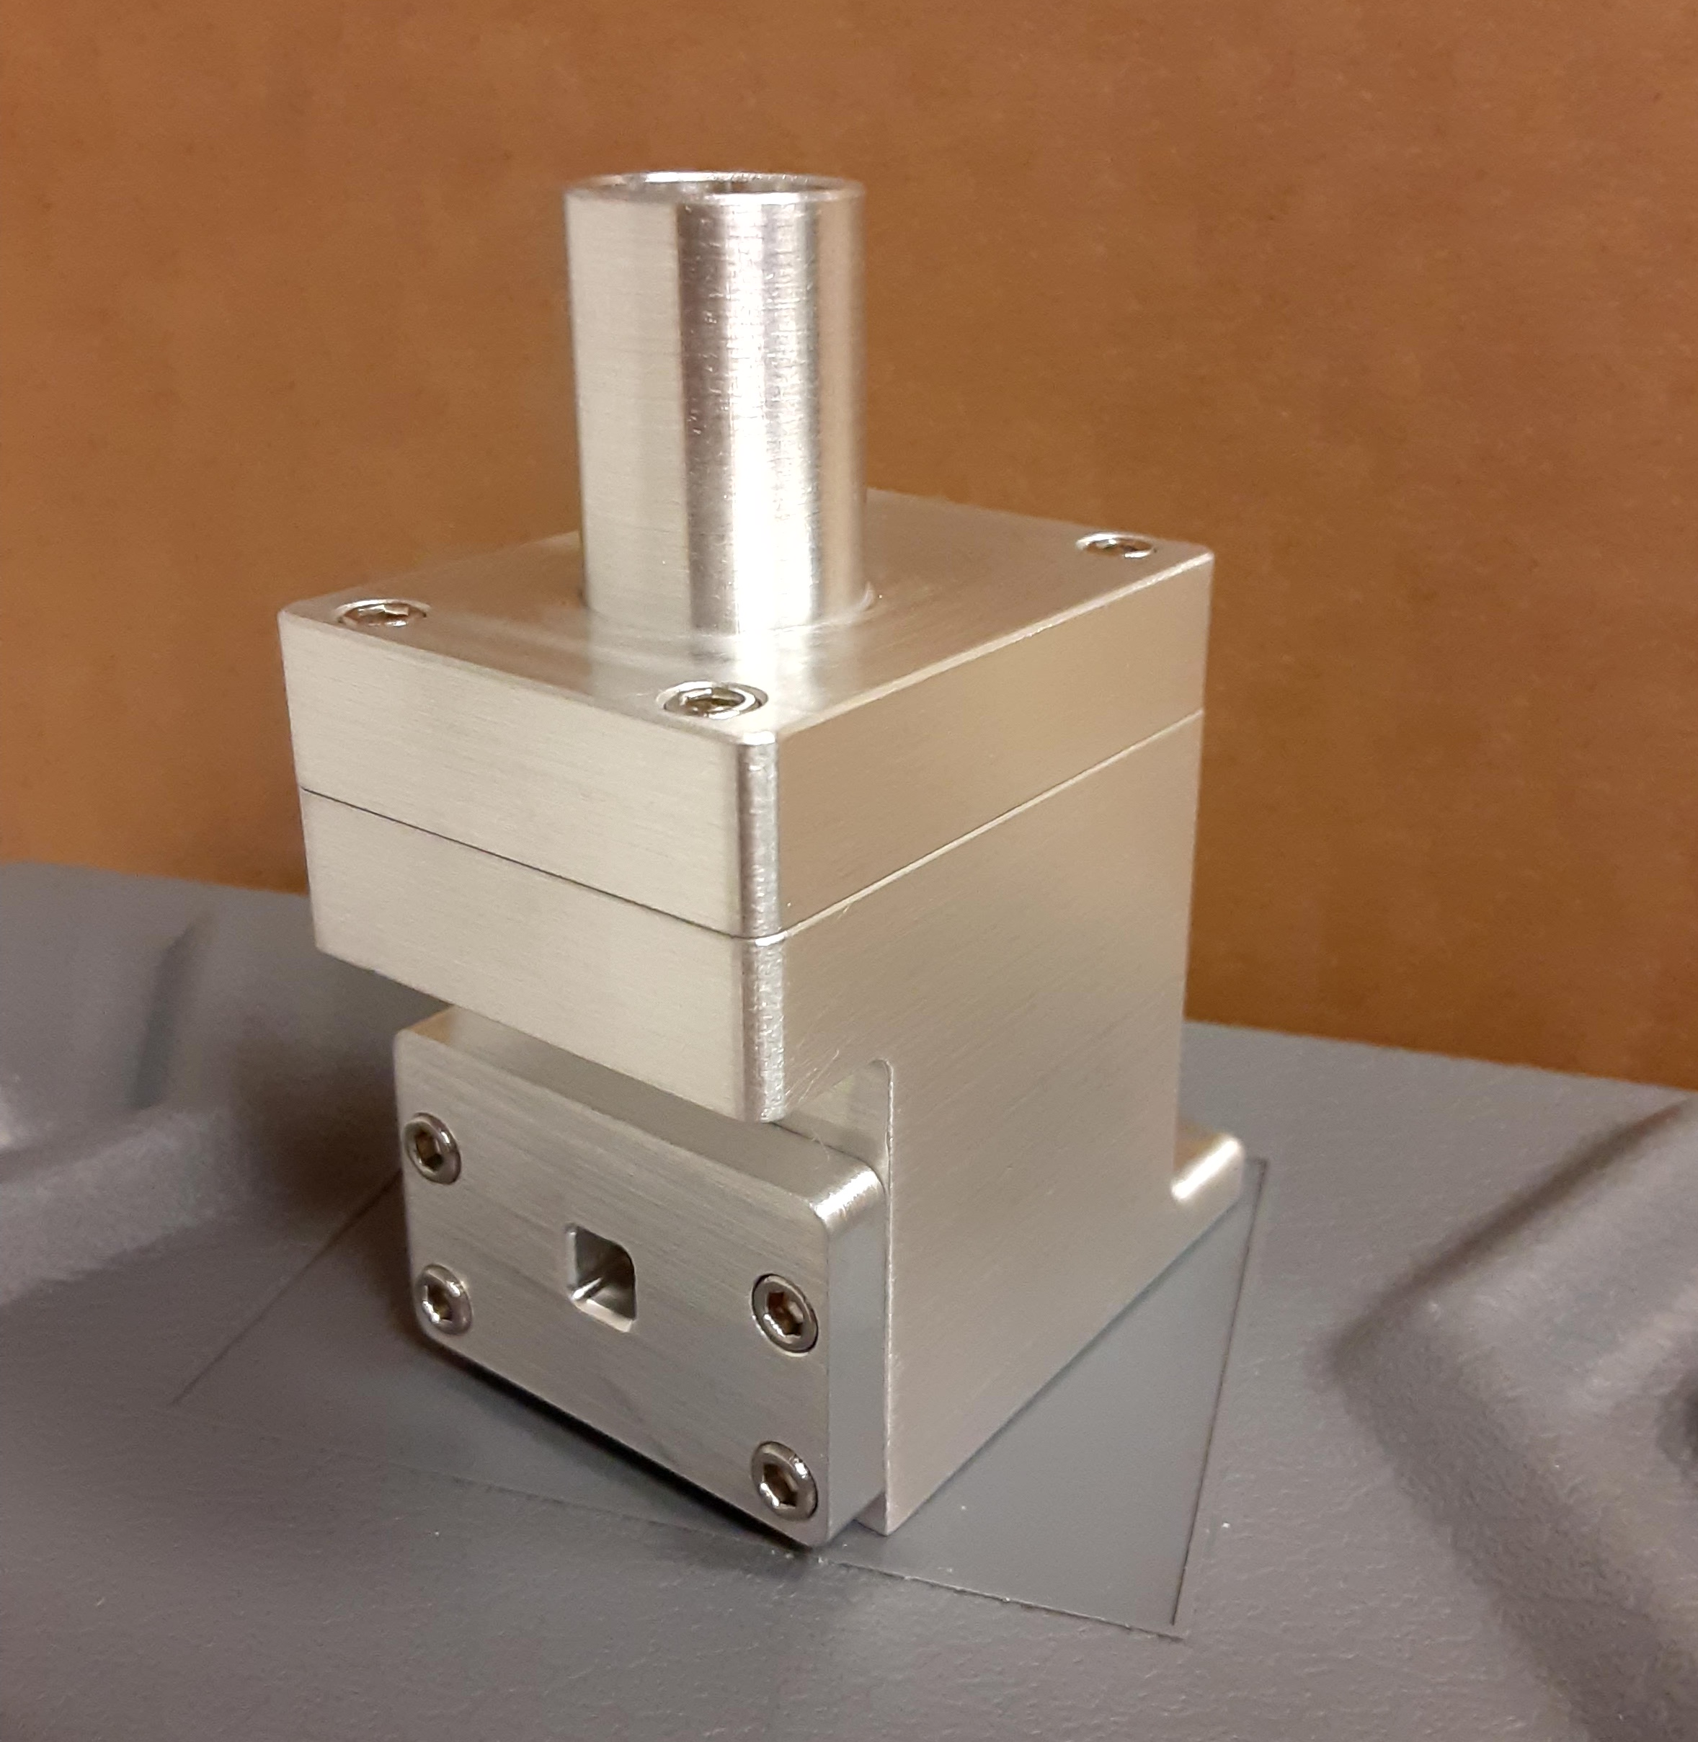
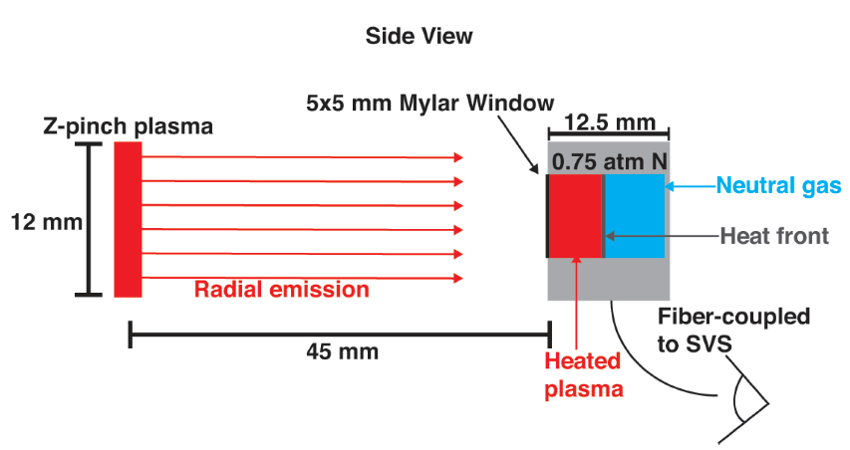
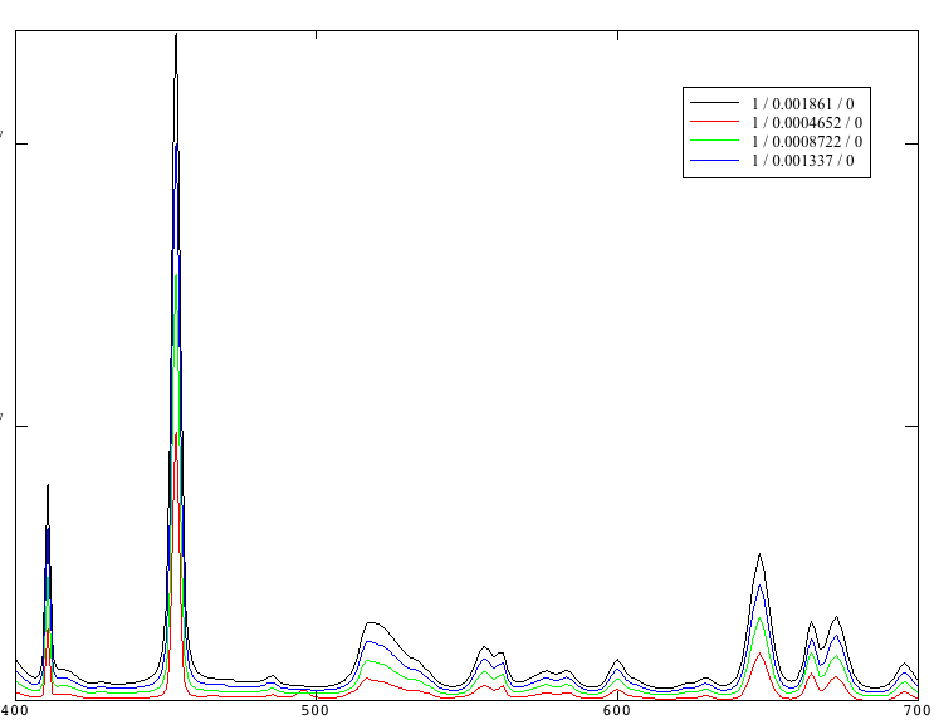
Laboratory Generated Photoionization Fronts Relevant to Cosmology
M. P. Springstead,¹ H. J. LeFevre,¹ T. N. Nagayama,² G. P. Loisel,² J. E. Bailey,² S. R. Klein,¹ R. C. Mancini,³ K. J. Swanson,³ D. E. Winget,⁴ B. H. Dunlap,⁴ J. S. Davis,¹ W.J.Gray¹, C.C. Kuranz,¹ R. P. Drake¹
¹University of Michigan, Center for Laboratory Astrophysics, Ann Arbor, Michigan, 48105, USA
² Sandia National Laboratory, Albuquerque, New Mexico, 87122, USA
³University of Nevada, Department of Physics, Reno, Nevada, 89557, USA
⁴University of Texas and McDonald Observatory, Austin, Texas, 78712, USA
Abstract
Experimental Design
Photon Doppler Velocimetry (PDV)
Photoionization Fronts (commonly referred to as Ionization Fronts or PI fronts) are a type of radiation-driven heat front that dictate important physics in the reionization era of the early universe. The first galaxies of the reionization era merged to form minihalos. Subsequently, these minihalos emitted ionizing radiation to the surrounding gas clouds, which generated PI fronts. The asymmetric propagation and attenuation of a PI front within a gas cloud is an active area of study in the early universe cosmology. In the laboratory setting, the Z Astrophysical Plasma Properties (ZAPP) platform on Sandia’s Z-Machine facility is capable of generating an intense radiation source to drive a PI front through a 0.75 atm nitrogen gas cell. To better understand upcoming ZAPP experiments on Sandia’s Z-Machine, this work presents an initial experimental design, accompanied by HELIOS radiation-hydrodynamic simulations, and PrismSPECT atomic kinetics calculations.
Will use perpendicularly-mounted PDV as a shock arrival measurement
$v_{PI front}≅ 2,131\frac{m}{s} ; v_{e−front }≅291\frac{m}{s}$
Future goal of using 2 PDV to front velocity measurement
Primary
Secondary
Streaked Visible Spectrometer (SVS)
Gas Cell
Primary diagnostic to determine the temperature and density
Will utilize spectral line ratios to characterize plasma and determine ionization state distribution
Figure 2. Gas Cell CAD
Figure 3. Gas Cell as Built
Simulated Line Emission
Simulated SVS Signal
Astrophysics Motivation
Intensity [a.u.]
Time [ns]
Wavelength [nm]
Energy [eV]
Figure 4. ZAPP Experimental Setup
Figure 5. Simulated Line Emission
of Nitrogen
Figure 6. Simulated SVS Signal
Figure 1. History of Universe¹
Photoionization Fundamentals
Wavelength [nm] | Intensity | Probe
410.8 | Standard | Density
454.3 | Strong | Density / Temperature
522.1 | Standard | Temperature
647.4 | Weak | Temperature
Reionizaiton Era
Dark matter Mini-halo’s emit ionizing photons into the surrounding intergalactic medium during the Reionization Era
$$\frac{dn_{ion}}{dt}=f_{esc}ζ_{Q}ρ_{SFR}$$
¹The production rate density of ionizing photons ${(n}_{ion}),$ is proportional to the the escape fraction ($f_{esc}$), number of photons emitted per star($ζ_{Q})$, and star formation rate${ (ρ}_{SFR})$
The escape fraction of photons moving through a PI front help determine when the Reionization Era occurred
Detection of High Redshift Galaxies
²Shifts in the Lyman and Balmer spectral lines from high redshift (~z = 6) galaxies can be used to determine age
Metals in the interstellar medium can greatly effect the measurement of the Lyman and Balmer shifts and the resulting galaxy age (~$z±3)$
Euler Equation: Flux conservation across the PI Front
Mass: $ρ_{1}u_{1}=ρ_{2}u_{2}$
Momentum: $ρ_{1}u_{1}^{2}+p_{1}=ρ_{2}u_{2}^{2}+p_{2}$
Energy: $\left(\frac{ρ_{1}u_{1}^{2}}{2} +\frac{γp_{1}}{γ−1 }\right)u_{1}−F_{R}=\left(\frac{ρ_{2}u_{2}^{2}}{2} +\frac{γp_{2}}{γ−1 }\right)u_{2}$
Future Work
Establish PI front experimental platform on Sandia Z-Machine
Field ZAPP experiments in July of 2021
Use nitrogen filled gas cell to collect SVS and PDV signal
Make a PI front velocity measurement
Key Predictions
Radiation flux from Sandia Z-Machine will drive a PI front within the nitrogen gas cell
The PI front velocity will be ~2,100 [km/s] and traverse the 12.5mm gas cell in ~ 6.5ns
The PI front will be a supersonic heat front and cause a spike in electron temperature. There will be no shock (hydrodynamic motion) so the density will remain unchanged
The nitrogen gas will reach approximately the third ionization state (NIV)
Acknowledgments/References
This work is funded by the U.S. Department of Energy NNSA Center of Excellence under cooperative agreement number DE-NA0003869.
¹B. E. Robertson, R. S. Ellis, J. S. Dunlop, R. J. McLure, and D. P. Stark, “Early star-forming galaxies and the reionization of the universe,” Nature 468, 49–55 (2010).
²Schaerer, D. and de Barros, S., “The impact of nebular emission on the ages of zfns f napproxg 6 galaxies,” A&A 502, 423–426 (2009).
Measurement of the downstream line emission spectra from metal enriched PI fronts can reduce the uncertainty in galactic age
Notes:
To change this poster, replace our sample content with your own. Or, if you'd rather start from a clean slate, press the New Slide button on the Home tab to insert a new page. Now enter your text and pictures in the empty placeholders. If you need more placeholders for titles, subtitles or body text, copy any of the existing placeholders, then drag the new one into place.

