Slide 1


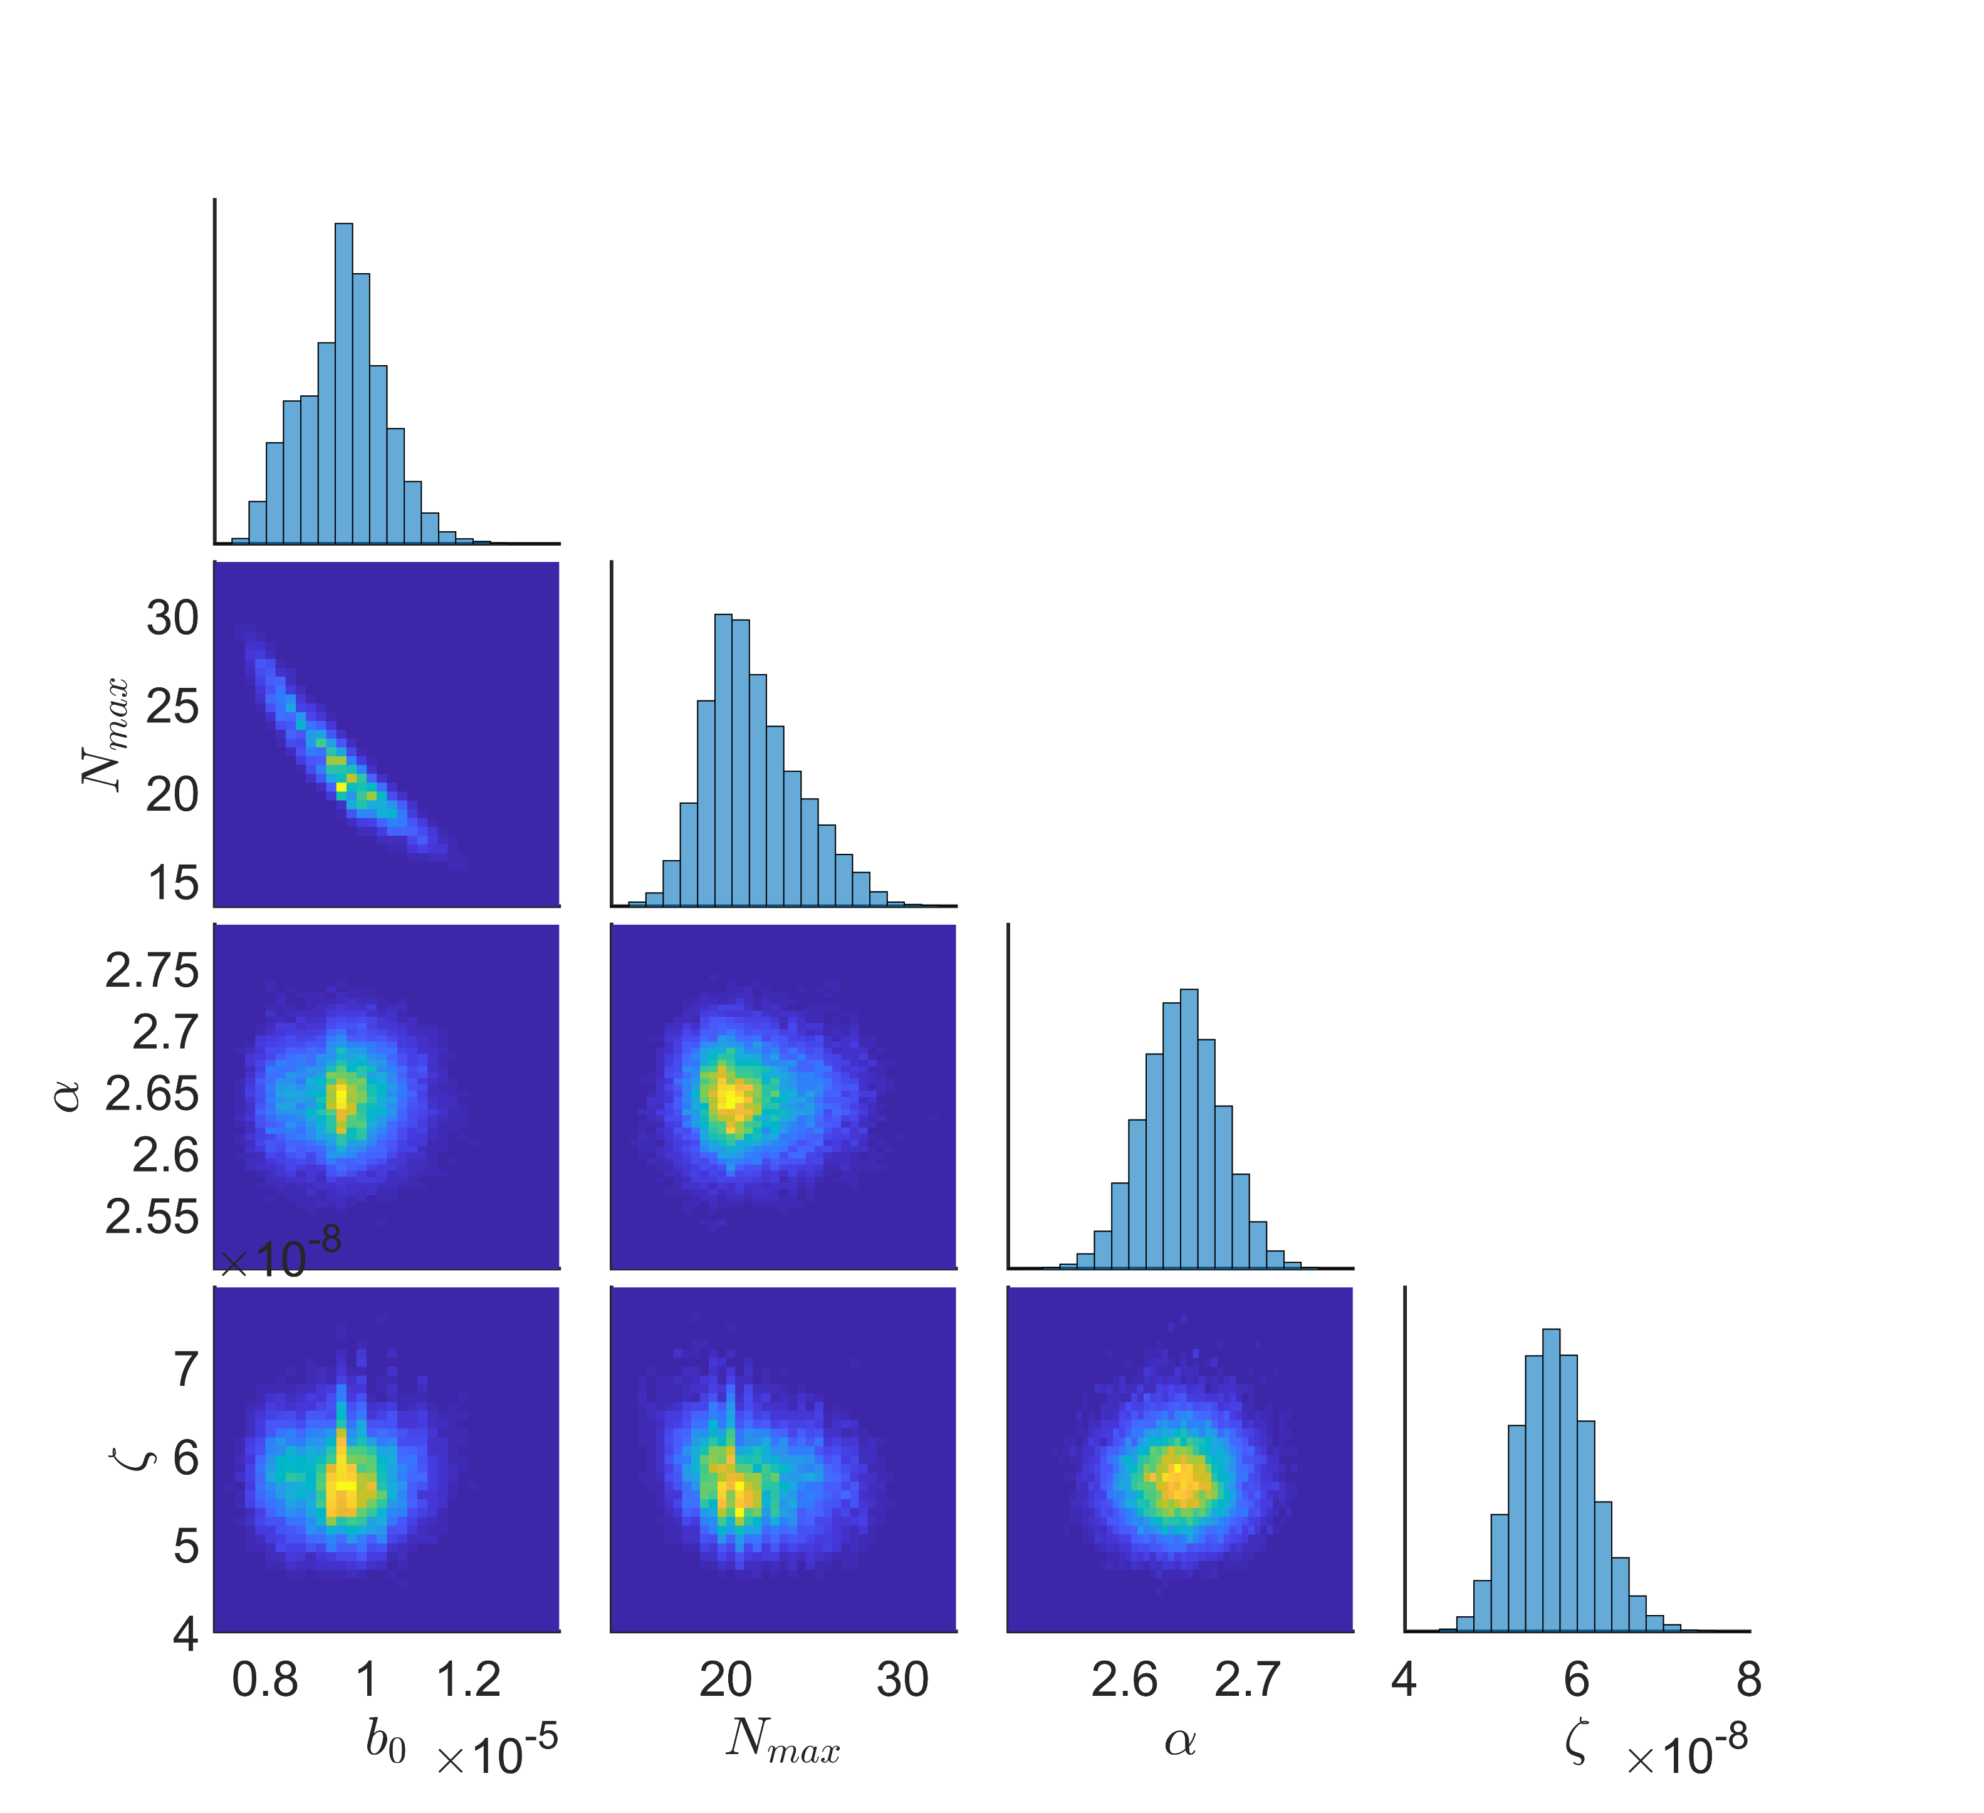
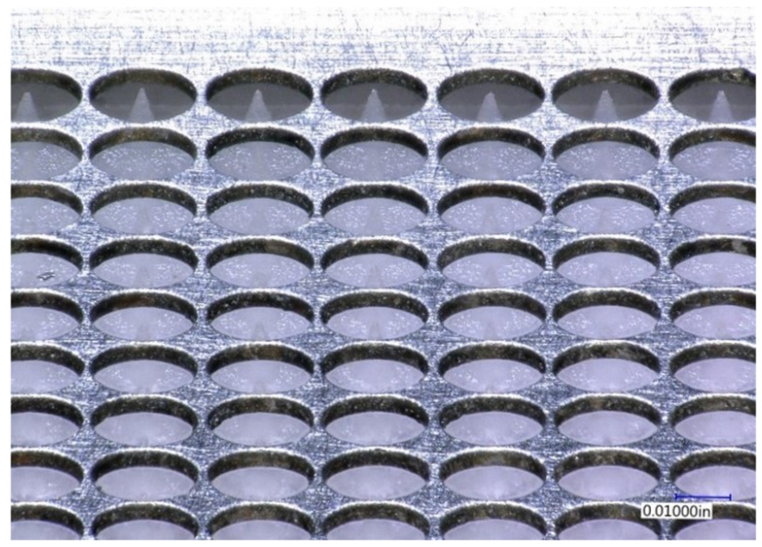
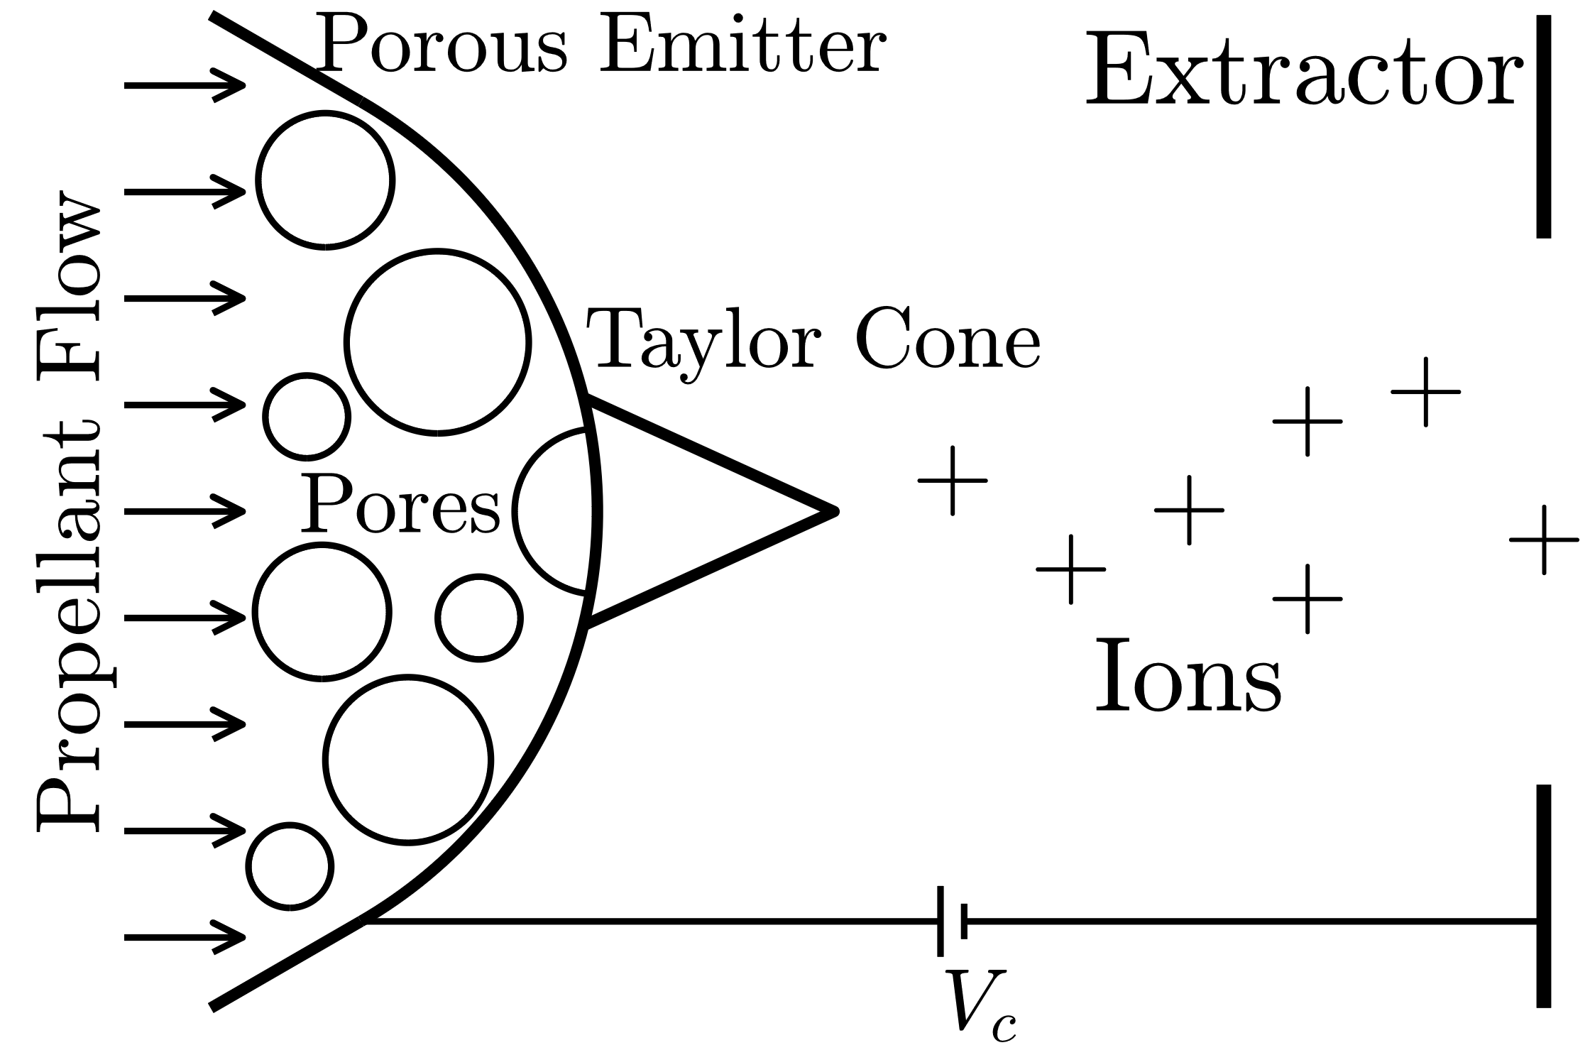
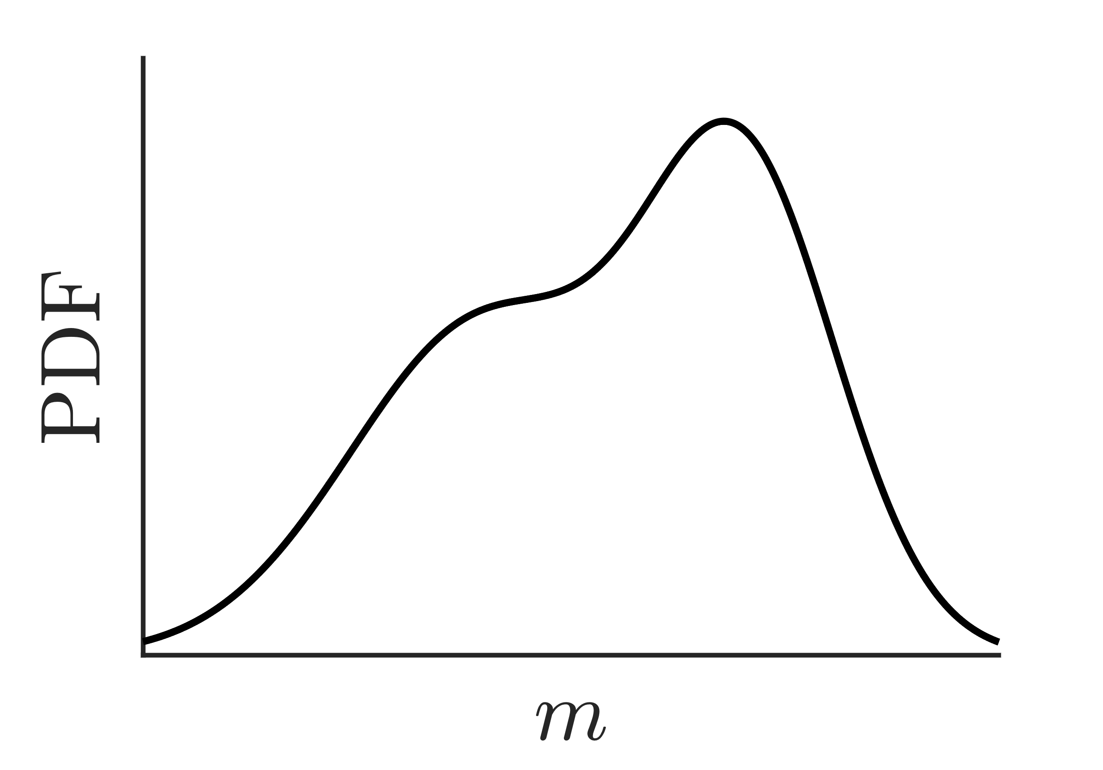
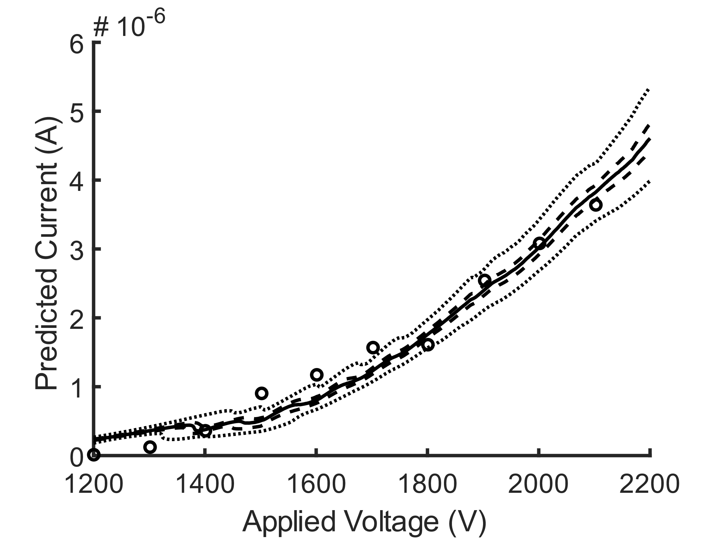
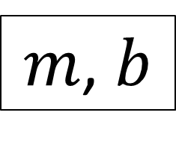
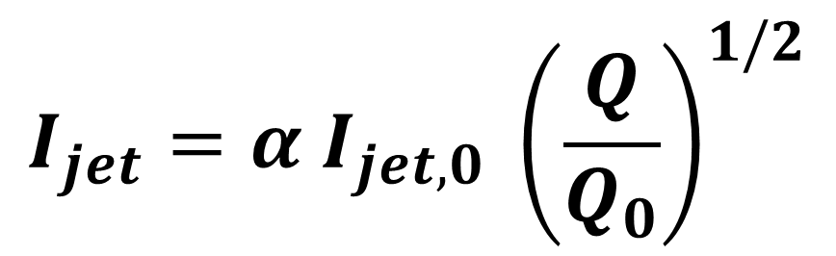
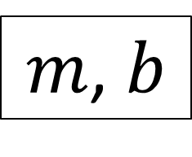
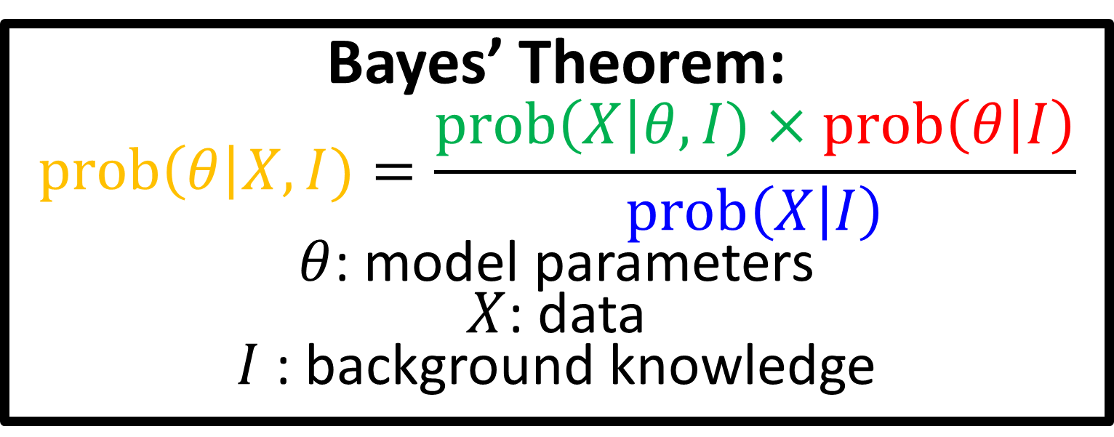

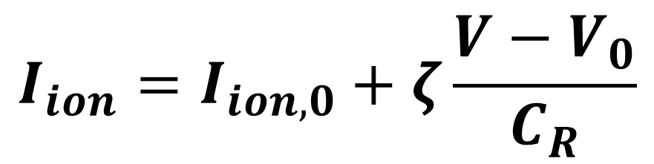
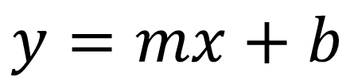
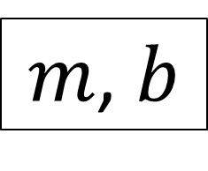
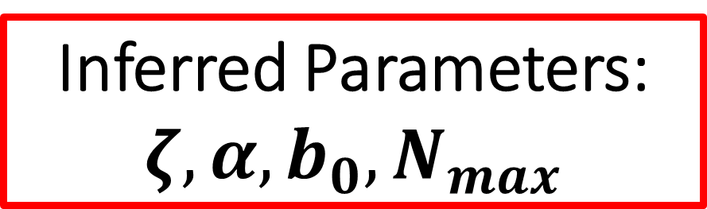
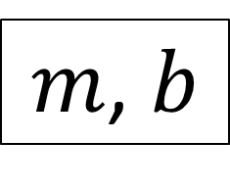
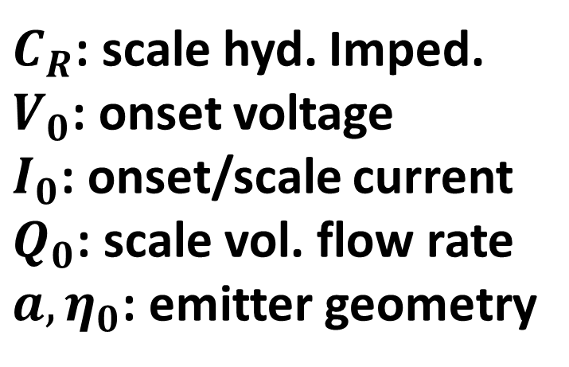
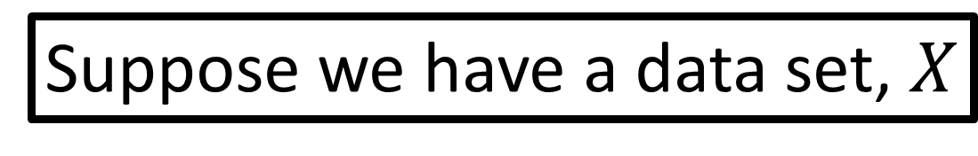
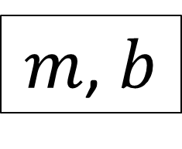
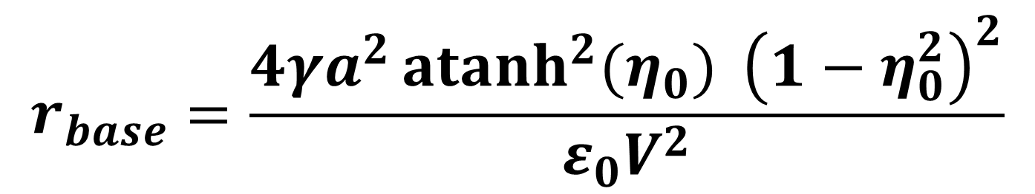
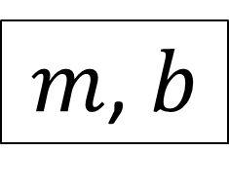
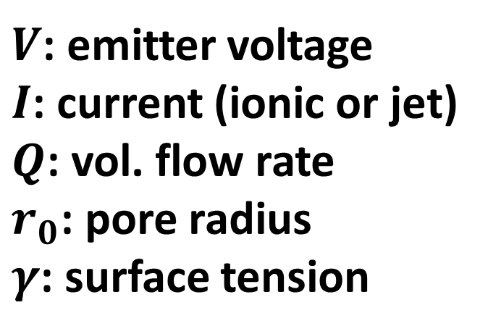
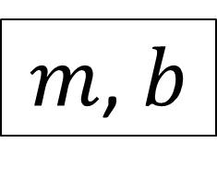
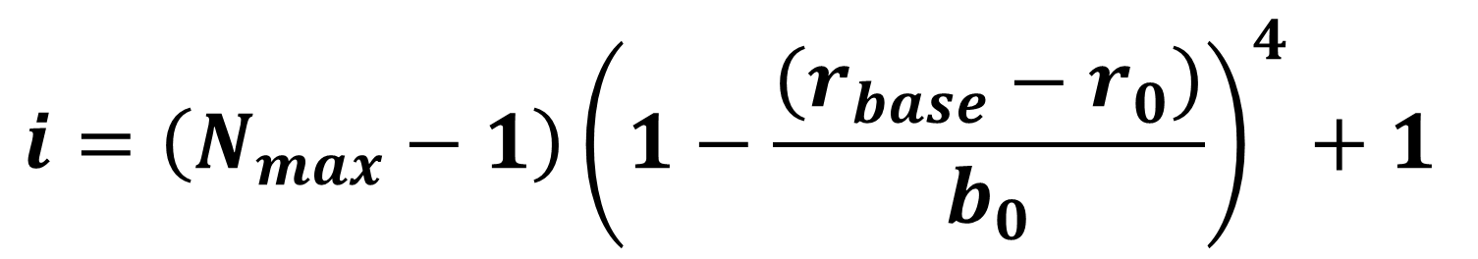
Uncertainty Quantification and Credible Predictions for Reduced-Fidelity Modeling of Porous Electrospray
Collin B. Whittaker, Alex A. Gorodetsky, and Benjamin A. Jorns
University of Michigan, Department of Aerospace Engineering, Ann Arbor, MI 48109
Motivation
Methodology
Results
Electrospray thrusters are electrohydrodynamic devices that extract charged particles from a conductive liquid to produce thrust in space. In principle, this process is more efficient and scalable than other electric propulsion devices.
But electrosprays are small, requiring arrays of 10²-10⁴ individual emitters. At this scale, lifetime and performance can be limited by physical and manufacturing uncertainty. We aim to address this problem with a robust design optimization and testing loop.
We focus here on updating reduced-fidelity models given new data.
Bayes’ Theorem:
$$prob\left(θ\right|X,I)=\frac{prob\left(X\right|θ,I)×prob\left(θ | I\right)}{prob\left(X | I\right)}$$
$θ$: model parameters
$X$: data
$I$ : background knowledge
Posterior distributions inferred from published data underpredicted experimental emitter current. When updated with the new experimental data, predictions improved.
Training data indicated that the ionic current scaling is highly sensitive to device geometry, which was considered certain.
Suppose we have a data set, $X$
$$m=1±0.5$$
$$b=0.5±0.1$$
The analysis was adjusted to exclude the ionic training data.
See posteriors on left.
Propose a simplified model:
$$y=mx+b$$
Model uncertain from experimental error and simplification
Posterior distributions over parameters
Sampling from the revised posterior distributions more closely matched empirical data (see left). Considering these uncertainties creates a prediction envelope that encodes our knowledge. Extending this framework to additional models and uncertain parameters could enable robust design.
95% CI (dotted)
Use existing modeling framework
Median (solid)
Sample Many Times to Make Predictions
Exp. Data
ESPET
$m$, $b$
$m$, $b$
ElectroSpray Propulsion Engineering Toolkit
$m$, $b$
$m$, $b$
$m$, $b$
$m$, $b$
$m$, $b$
Objectives
Models
Conclusions
Reduced-fidelity modeling engenders physical uncertainty by simplifying physics.
How do we rigorously account for this uncertainty?
Can we use data to update our state of knowledge?
How can we use our knowledge to credibly predict device performance?
$$I_{ion}=I_{ion,0}+ζ\frac{V−V_{0}}{C_{R}}$$
Model Inputs:
Bayesian inference can be used to describe the physical uncertainty of reduced-fidelity models.
Performance is highly sensitive to uncertain device geometry, motivating a probabilistic problem.
Additional model development may be necessary to capture other phenomena.
$V$: emitter voltage
$I$: current (ionic or jet)
$Q$: vol. flow rate
$r_{0}$: pore radius
$γ$: surface tension
$C_{R}$: scale hyd. Imped.
$V_{0}$: onset voltage
$I_{0}$: onset/scale current
$Q_{0}$: scale vol. flow rate
$a,η_{0}$: emitter geometry
$$I_{jet}=α I_{jet,0} {\left(\frac{Q}{Q_{0}}\right)}^{1/2}$$
$$i=\left(N_{max}−1\right){\left(1−\frac{\left(r_{base}−r_{0}\right)}{b_{0}}\right)}^{4}+1$$
Inferred Parameters:
$$ζ, α, b_{0}, N_{max}$$
References
$$r_{base}=\frac{4γa^{2}{atanh}^{2}{{(η}_{0}) }{\left(1−η_{0}^{2}\right)}^{2}}{ε_{0}V^{2}}$$
[1] B. St. Peter et al., Aerospace. 7, 91 (2020).
[2] C. Coffman et al., Appl. Phys. Lett. 109, 23 (2016).
[3] Gañan-Calvo et al., J. Aer. Sci. 125 (2018).
[4] C. Whittaker et al., AIAA P&E 2020 Forum, 3615 (2020).
[5] Natisin et al. 37th IEPC, 522 (2019).
This work was supported by an Early Stage Innovations grant from NASA’s Space Technology Research Grants Program.
11th Annual MIPSE Graduate Student Symposium

